Slide 1
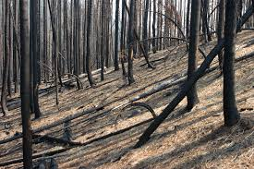
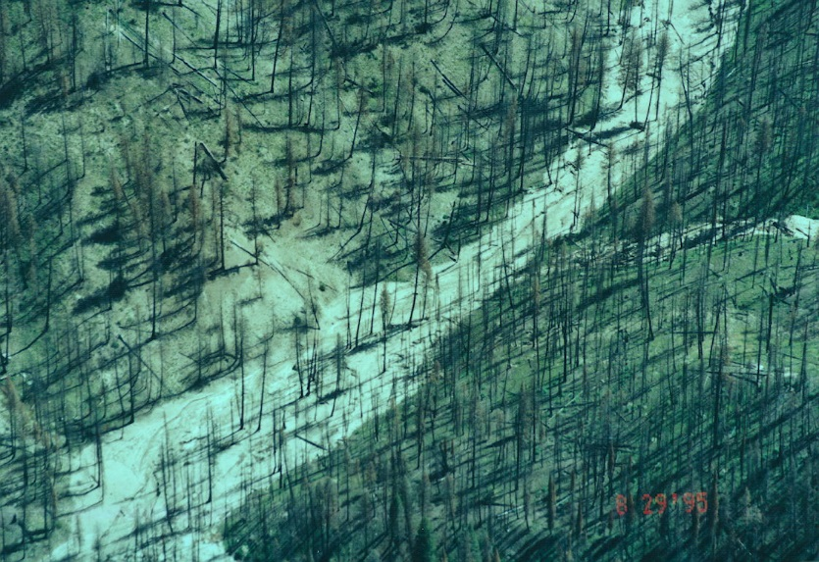
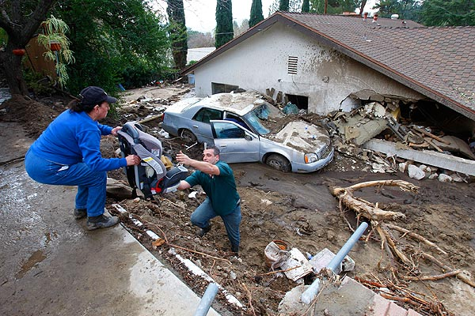
Post Fire Decision Support
Identifying At-Risk Infrastructure and Aquatic/Riparian Habitats to Inform
Post Fire Restoration
(Pilot Project, Canyon Creek Complex Wildfire, 2015, Malheur National Forest, Eastern Oregon)
At-Risk Aquatic/Riparian Habitats
Post-Fire Planning
(BAER, Restoration)
At-Risk Infrastructure
TerrainWorks (NetMap), in Collaboration with US Forest Service, PNW Corvallis and Malheur National Forest
Summer, 2015
Notes:
This Powerpoint presentation summarizes the use of NetMap for a Fire and Fish Decision Support System. Created on July 24, 2015 by Dr. Lee Benda and Kevin Andras (TerrainWorks).

Slide 2
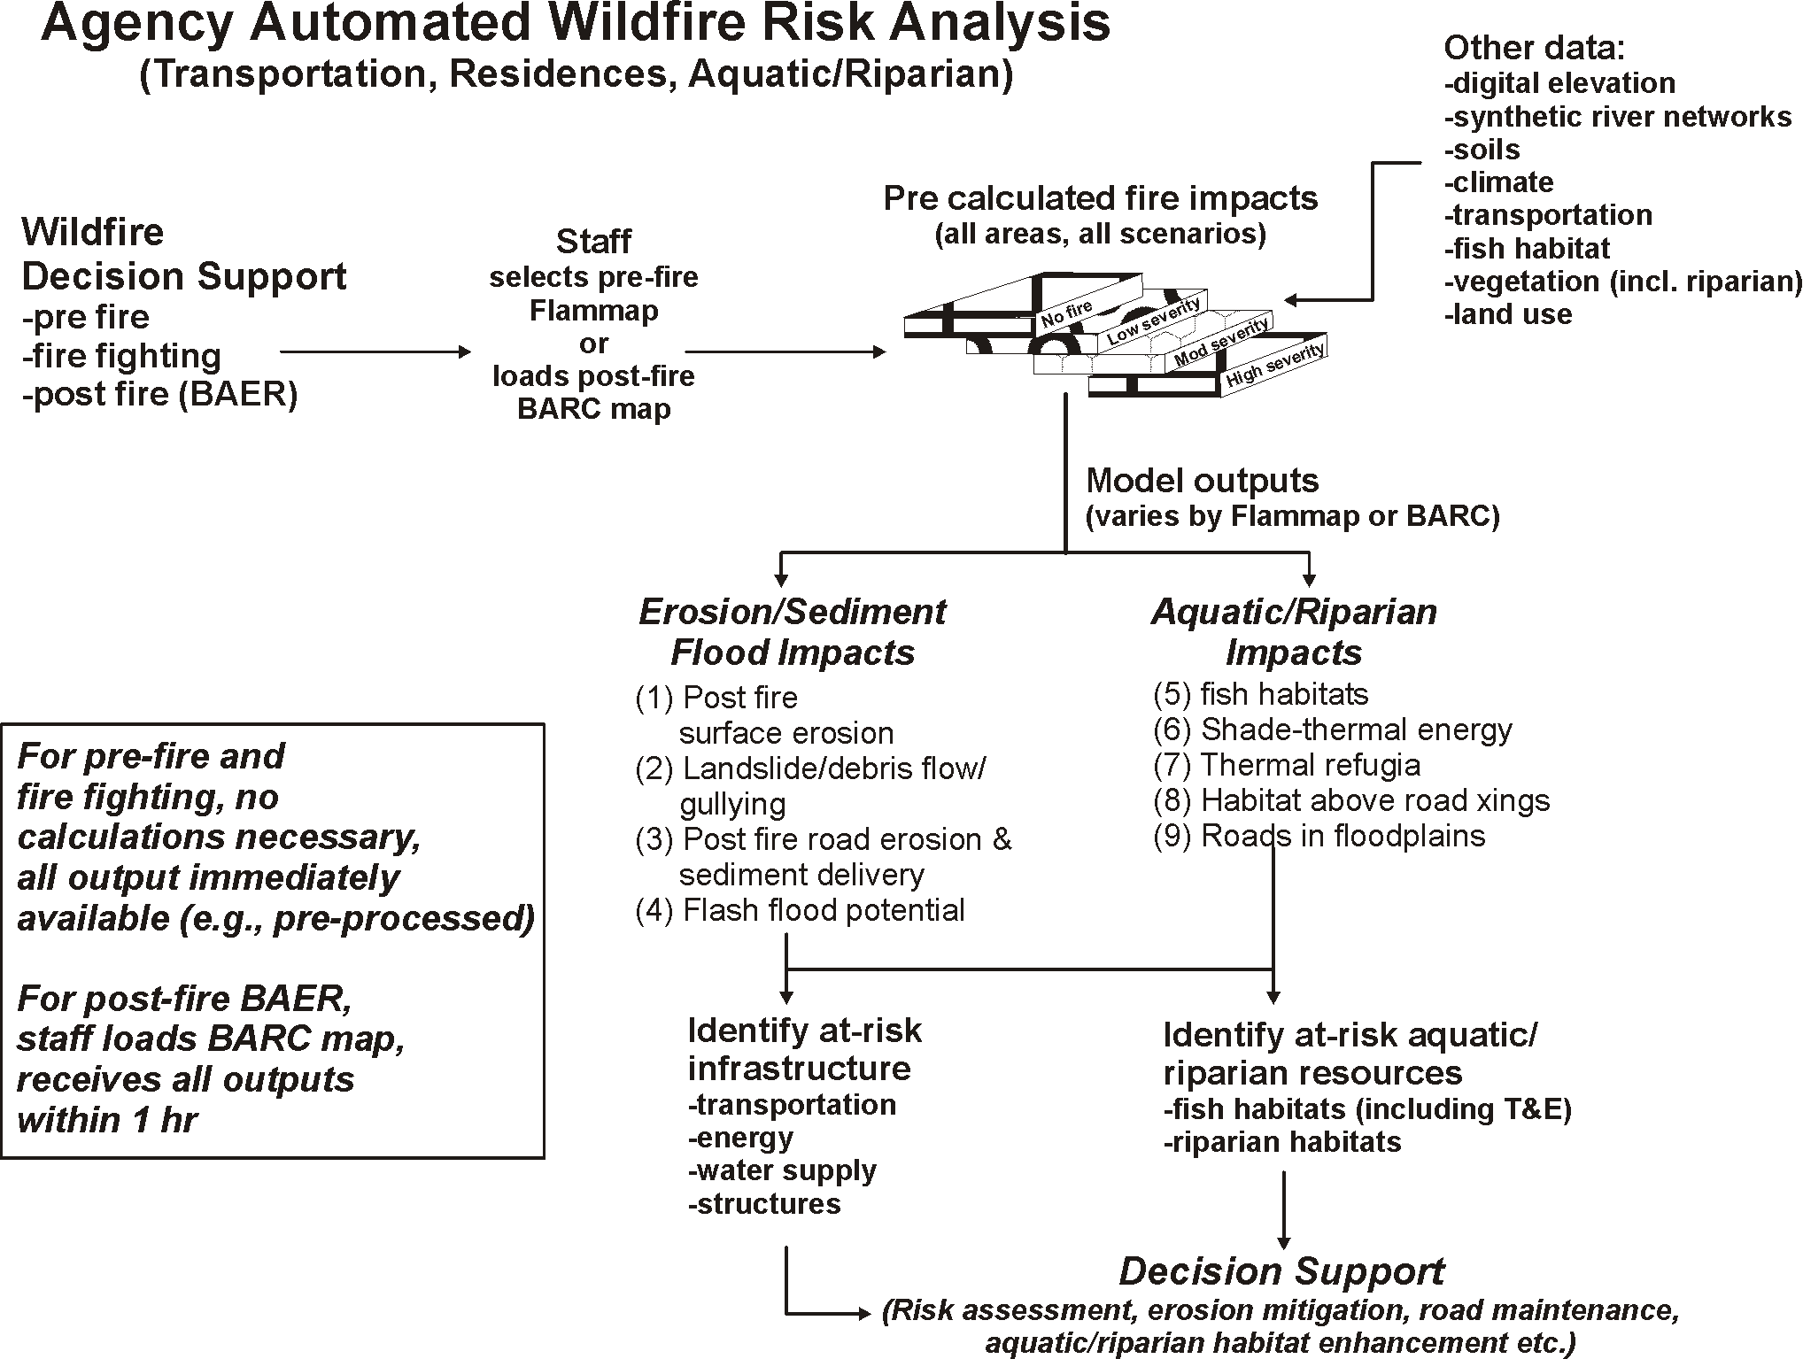
Analysis
Framework

Slide 3
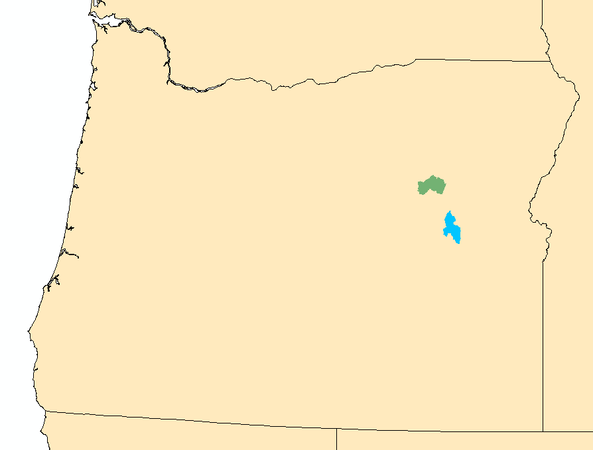
For the Pre-fire analysis in two pilot areas in the Malheur National Forest, go to:
http://www.netmaptools.org/Pages/FireFish/NetMap_Fire&Fish.pdf and for video, go to:
www.netmaptools.org/Pages/FireFish/NetMap_Fire&Fish2.pptx
Camp Creek watershed
(1 m LiDAR DEM)
Upper North Fork Malheur
(10 m DEM)
Continue with post fire (BAER) analysis, next slide…..

Slide 4
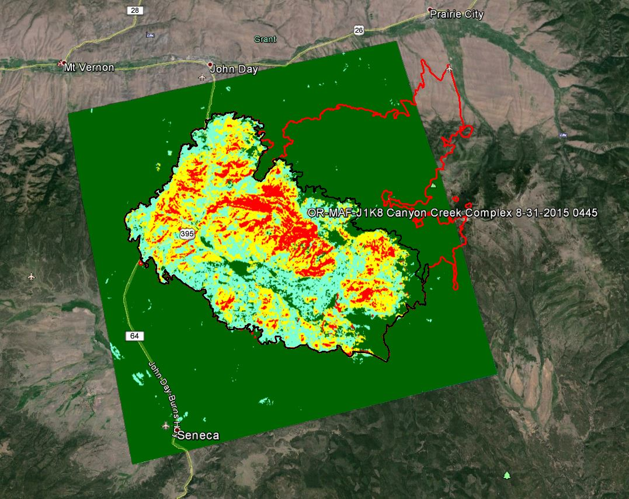
Post fire BAER
Analysis
Canyon Creek
Complex Wildfire,
as of August 31, 2015
Canyon Creek
BAER-NetMap
analysis area
(colored)

Slide 5
Models and Sources
(1) DEMs – 10 m
(2) Synthetic River Networks (stream layers) NetMap (www.terrainworks.com)
(3) Fire severity (BARC map, Canyon Creek Complex)
(4) Post fire surface erosion (WEPP – Disturbed)
(5) Post fire gully potential (Parker et al. 2010)
(6) Post fire landsliding/gullying (Miller and Burnett 2007, 2008, NetMap)
(7) Post fire road surface erosion and sediment delivery (GRAIP-Lite w/ modified sediment delivery)
(8) Flash Flood Index (Smith 2010, NOAA-NWS)
(9) Salmon habitat (FS habitat distribution/Intrinsic Potential Model, Burnett et al. 2007)
(10) Shade/thermal loading/thermal refugia (NetMap and Groom et al. 2011)
(11) Road – stability (NetMap)
(12) Cumulative habitat length above roads (NetMap)
Refer to NetMap’s online technical help manuals for additional information
Notes:
Here is a list of the various models and data sources there were used in the BAER analysis.

Slide 6
Data Deliverables
Data Type | Raster | Road | Polygon | Reach Segment | Reach, routed | Aggregated HUC 6th Polygon
1) Burned Area Reflectance Classification (BARC) | X |  |  | X | X | X
2) Salmon intrinsic potential (variable, e.g., steelhead, coho, Chinook) |  |  |  | X | X | X
3) Post fire surface erosion (WEPP-Disturbed) | X |  |  | X | X | X
4) Landslide potential | X |  |  | X | X | X
5) Gully potential
6) Flash Flood Index, Fire Impacted | X |  |  | X | X | X
7) Current shade-thermal energy/thermal refugia (LEMMA) |  |  |  | X | X | X
8) Post fire shade-thermal energy/thermal refugia (LEMMA reduced) |  |  |  | X | X | X
9) Thermal difference (sensitivity) map |  |  |  | X | X | X
10) Road Sediment production |  | X |  | X | X | X
11) Road sediment delivery (no fire) |  | X |  | X | X | X
12) Post fire road sediment delivery (e.g., reduced soil infiltration capacity)
13) Road sediment delivery difference (no fire-fire) |  | X |  | X | X | X
14) Cumulative habitat length above road crossings |  |  |  | X
15) Road – landslide/gully potential |  | X
Notes:
These are the general data deliverables and their formats within ArcMap shapefiles.

Slide 7
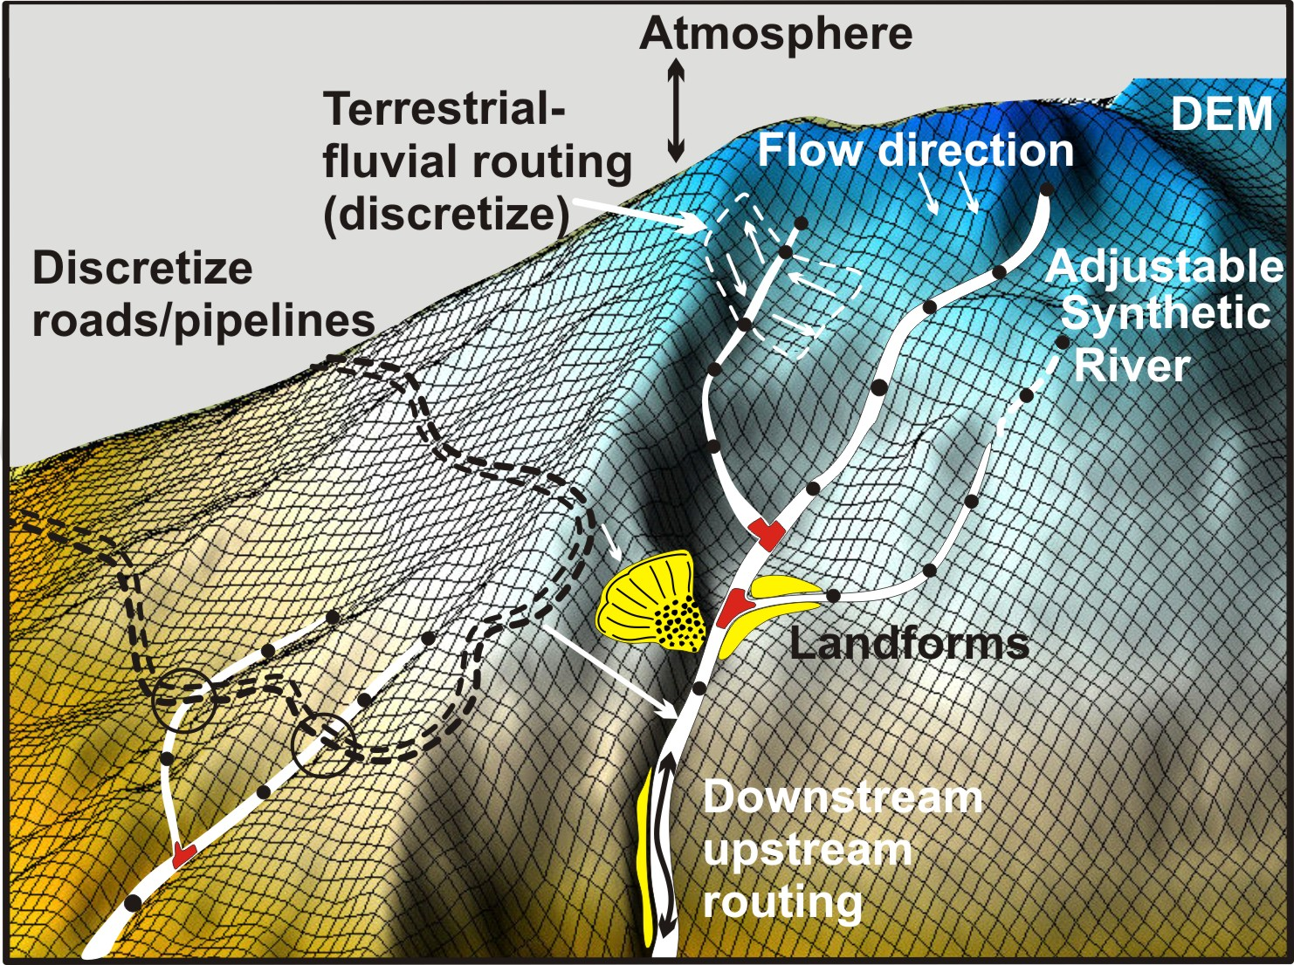
The analysis uses NetMap’s synthetic river network and virtual watersheds
Go to www.terrainworks.com
to learn about how synthetic
river networks and virtual
watersheds are built, and
their capabilities
For additional details see
slides towards the end of this
presentation
Notes:
The analytical foundation for the Fire Analysis is NetMap’s synthetic stream network and virtual watersheds. For brevity, this important topic is left for the viewers to explore as they need to; see www.terrainworks.com for additional background information or NetMap’s online Technical Help materials.

Slide 8
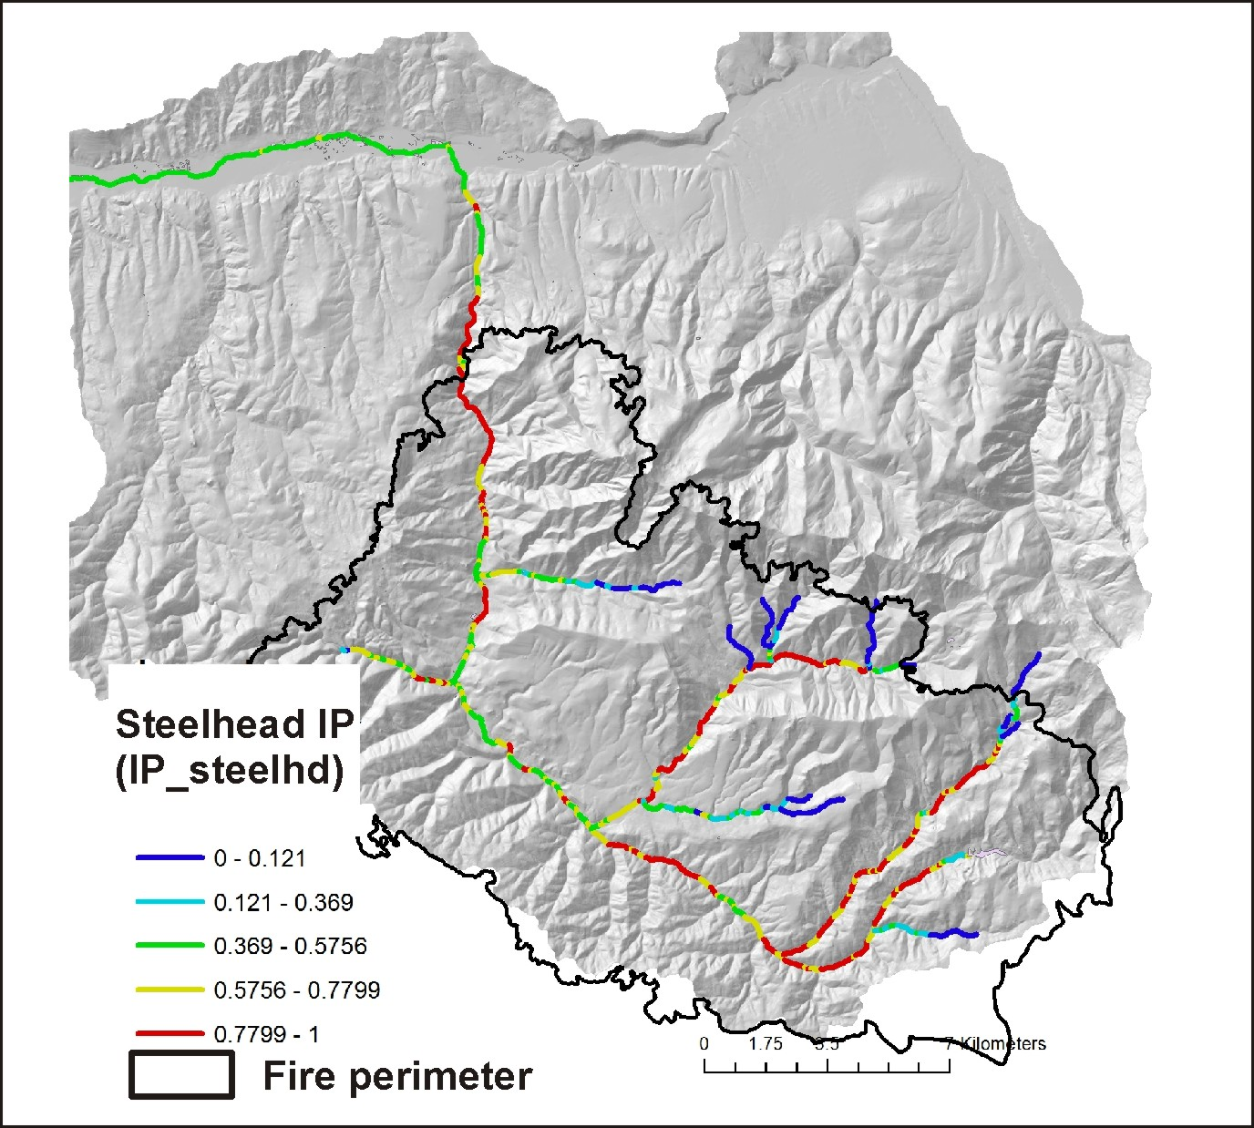
Data Deliverables:
Fish Habitat: steelhead Trout (Oncorhynchus mykiss)

Slide 9
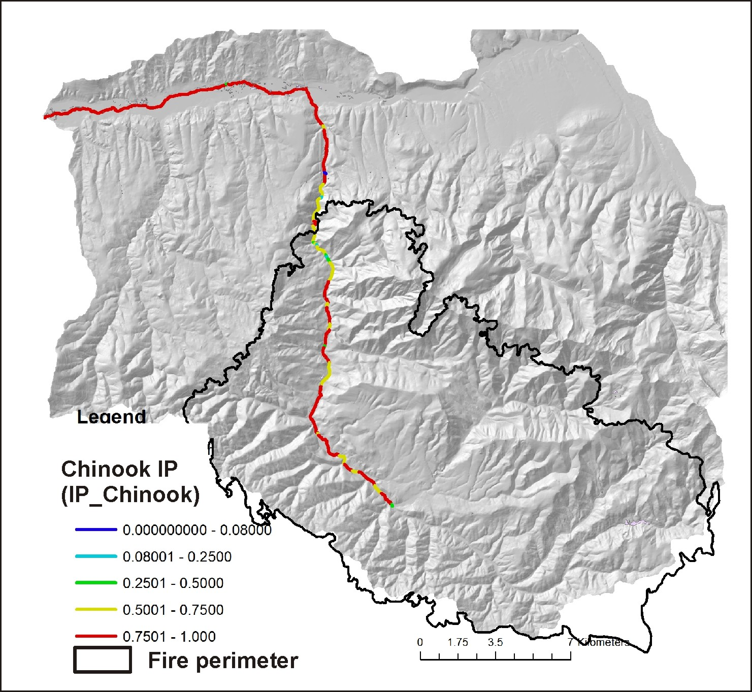
Fish Habitat: Chinook salmon (Oncorhynchus tshawytscha)

Slide 10
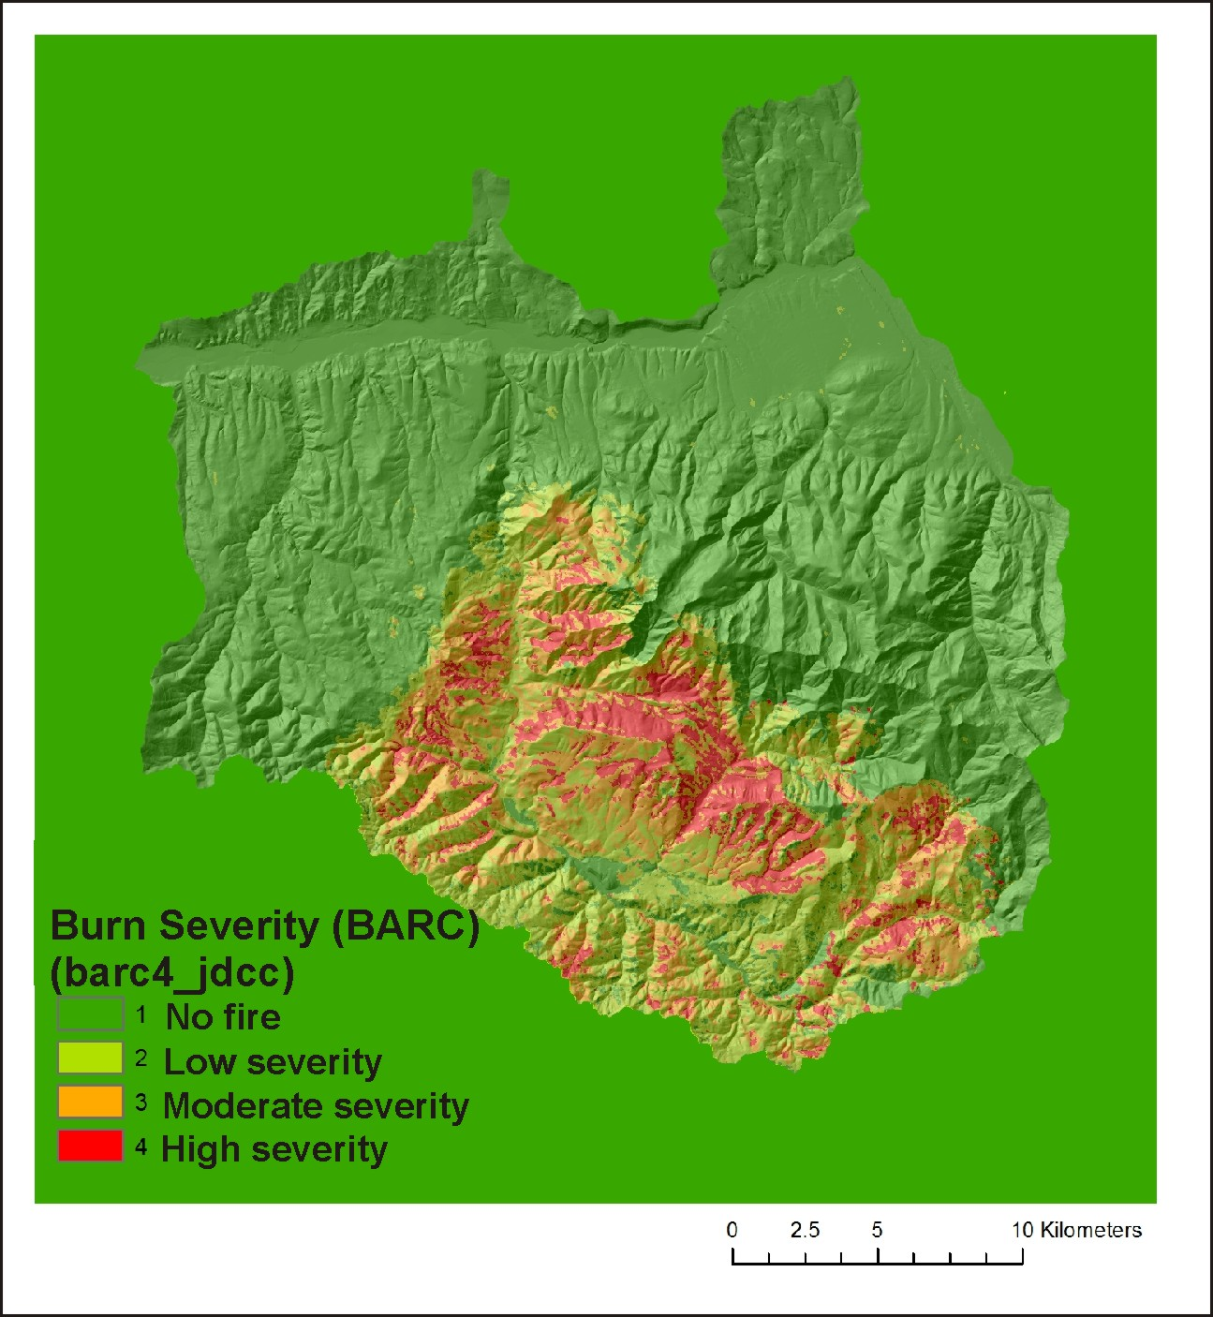
Fire Severity (hillside, Burned Area
Reflectance Classification [BARC] Map)
Notes:
Fire severity as reported in the Burned Area Reflectance Classification [BARC] map.

Slide 11
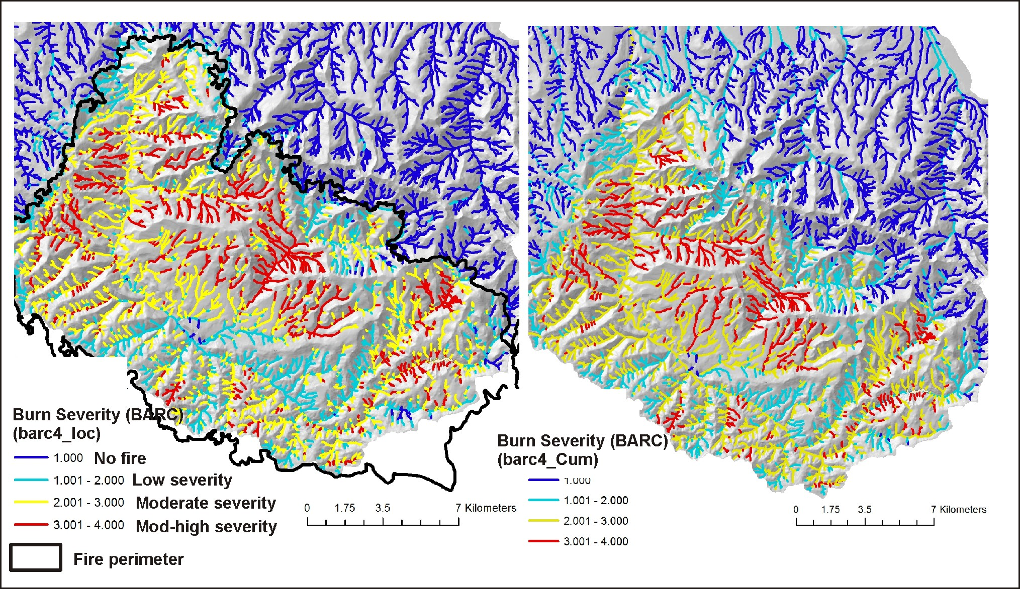
Fire severity mapped to channels
Why are hillslope
attributes
reported to channels, via
drainage wings?
This facilitates comparing
hillslope related stressors
(fire severity, erosion,
roads etc.) to fish habitats,
a channel attribute.
Fire Severity
(channel, fish eye)
Fire Severity, Aggregated Downstream
(tributary scale patterns)
Notes:
Fire severity is reported to individual channel segments (left), via drainage wings, and aggregated downstream.

Slide 12
Notes:
Post fire erosion and channel sedimentation are predicted for surface erosion, gullying and shallow landsliding.

Slide 13
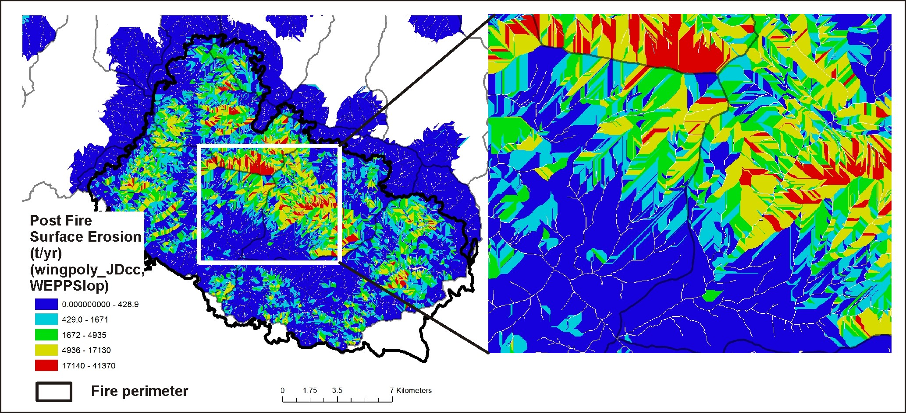
Post Fire Surface Erosion (WEPP, disturbed)
Notes:
Post fire surface erosion was predicted using the WEPP-disturbed model. The color patterns indicating variable surface erosion illustrate the variable sizes and shapes of local contributing areas or drainage wings. See NetMap’s online technical help materials for additional information: http://www.netmaptools.org/Pages/NetMapHelp/5_5_surface_erosion_veg_fire.htm

Slide 14
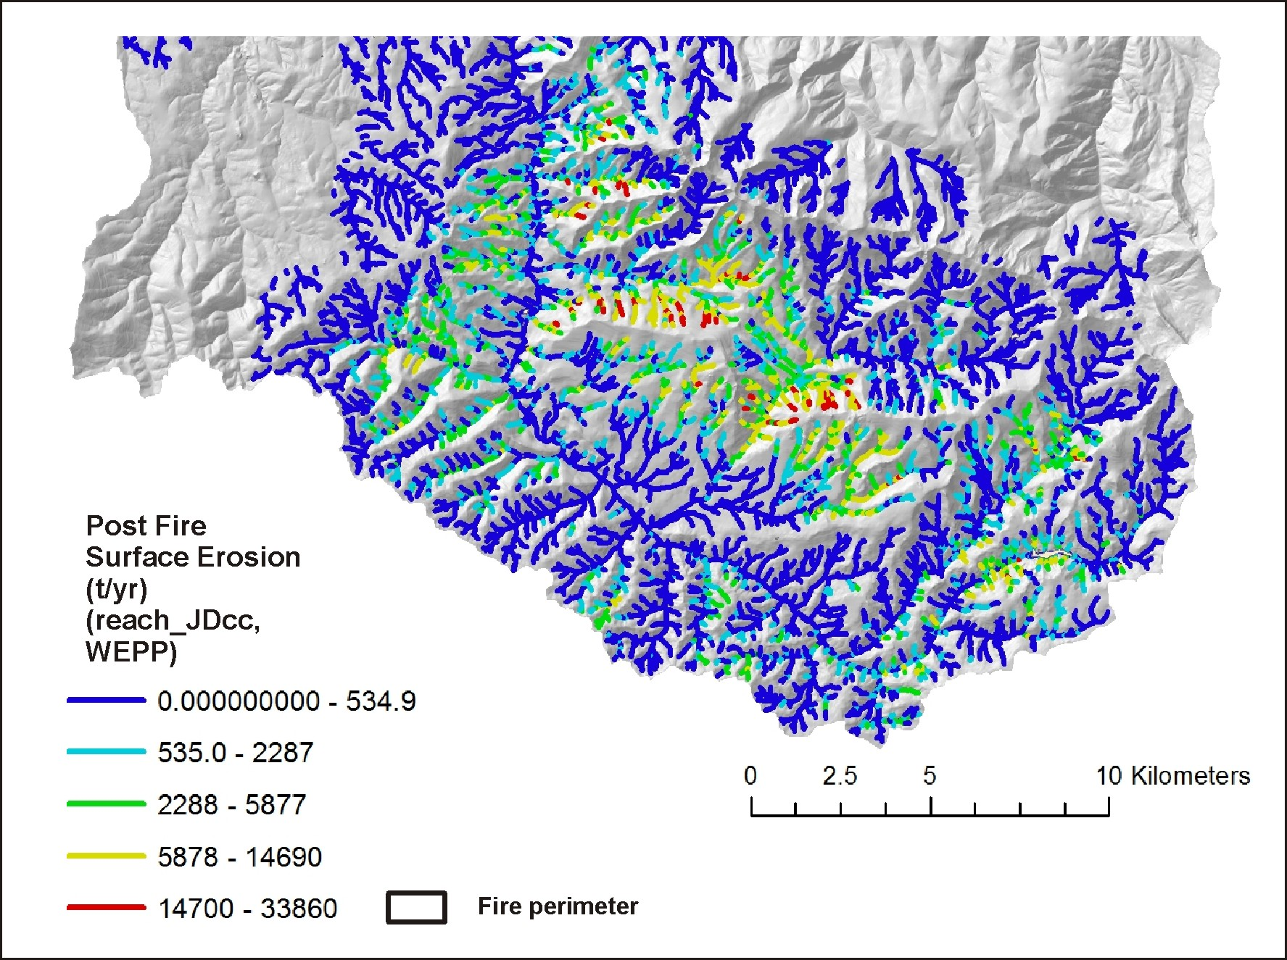
Post Fire Surface
Erosion (WEPP,
disturbed, e.g., function
of fire severity)
reported to stream
channels
(aggregated downstream
also available)
Notes:
Predicted surface erosion is transferred to individual stream segments (left) and aggregated downstream (right), the latter revealing erosion patterns at the tributary and subbasin scale.

Slide 15
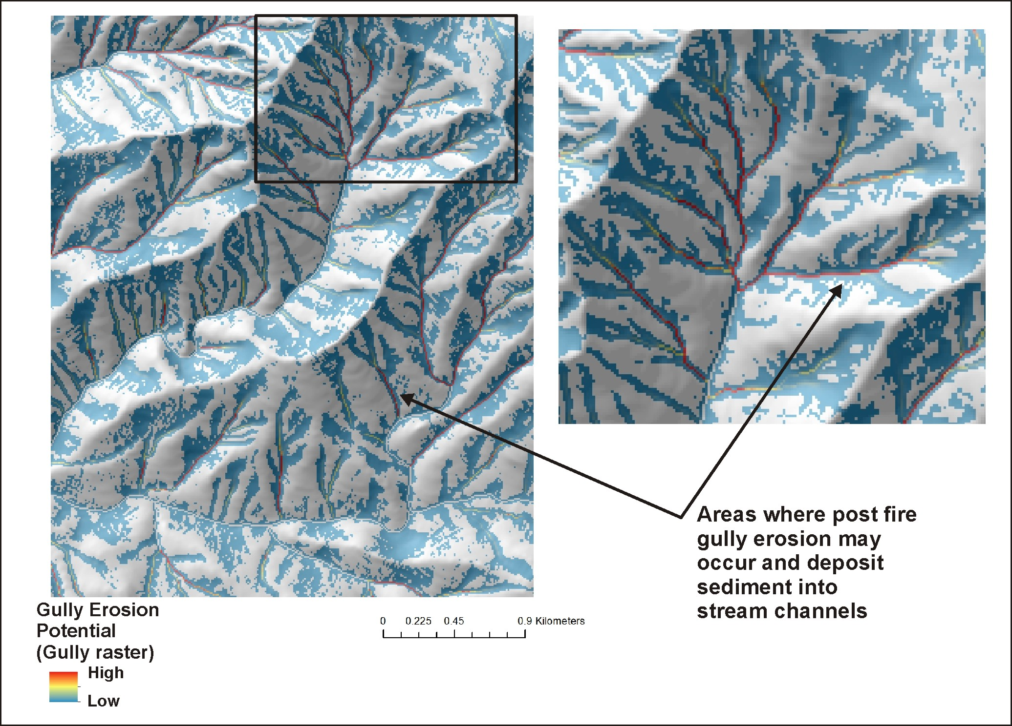
Post Fire
Gully Potential
Notes:
An gully erosion model was used in the analysis (Parker et al. 2010). See NetMap’s online technical help materials for additional information.
http://www.netmaptools.org/Pages/NetMapHelp/gullying.htm

Slide 16
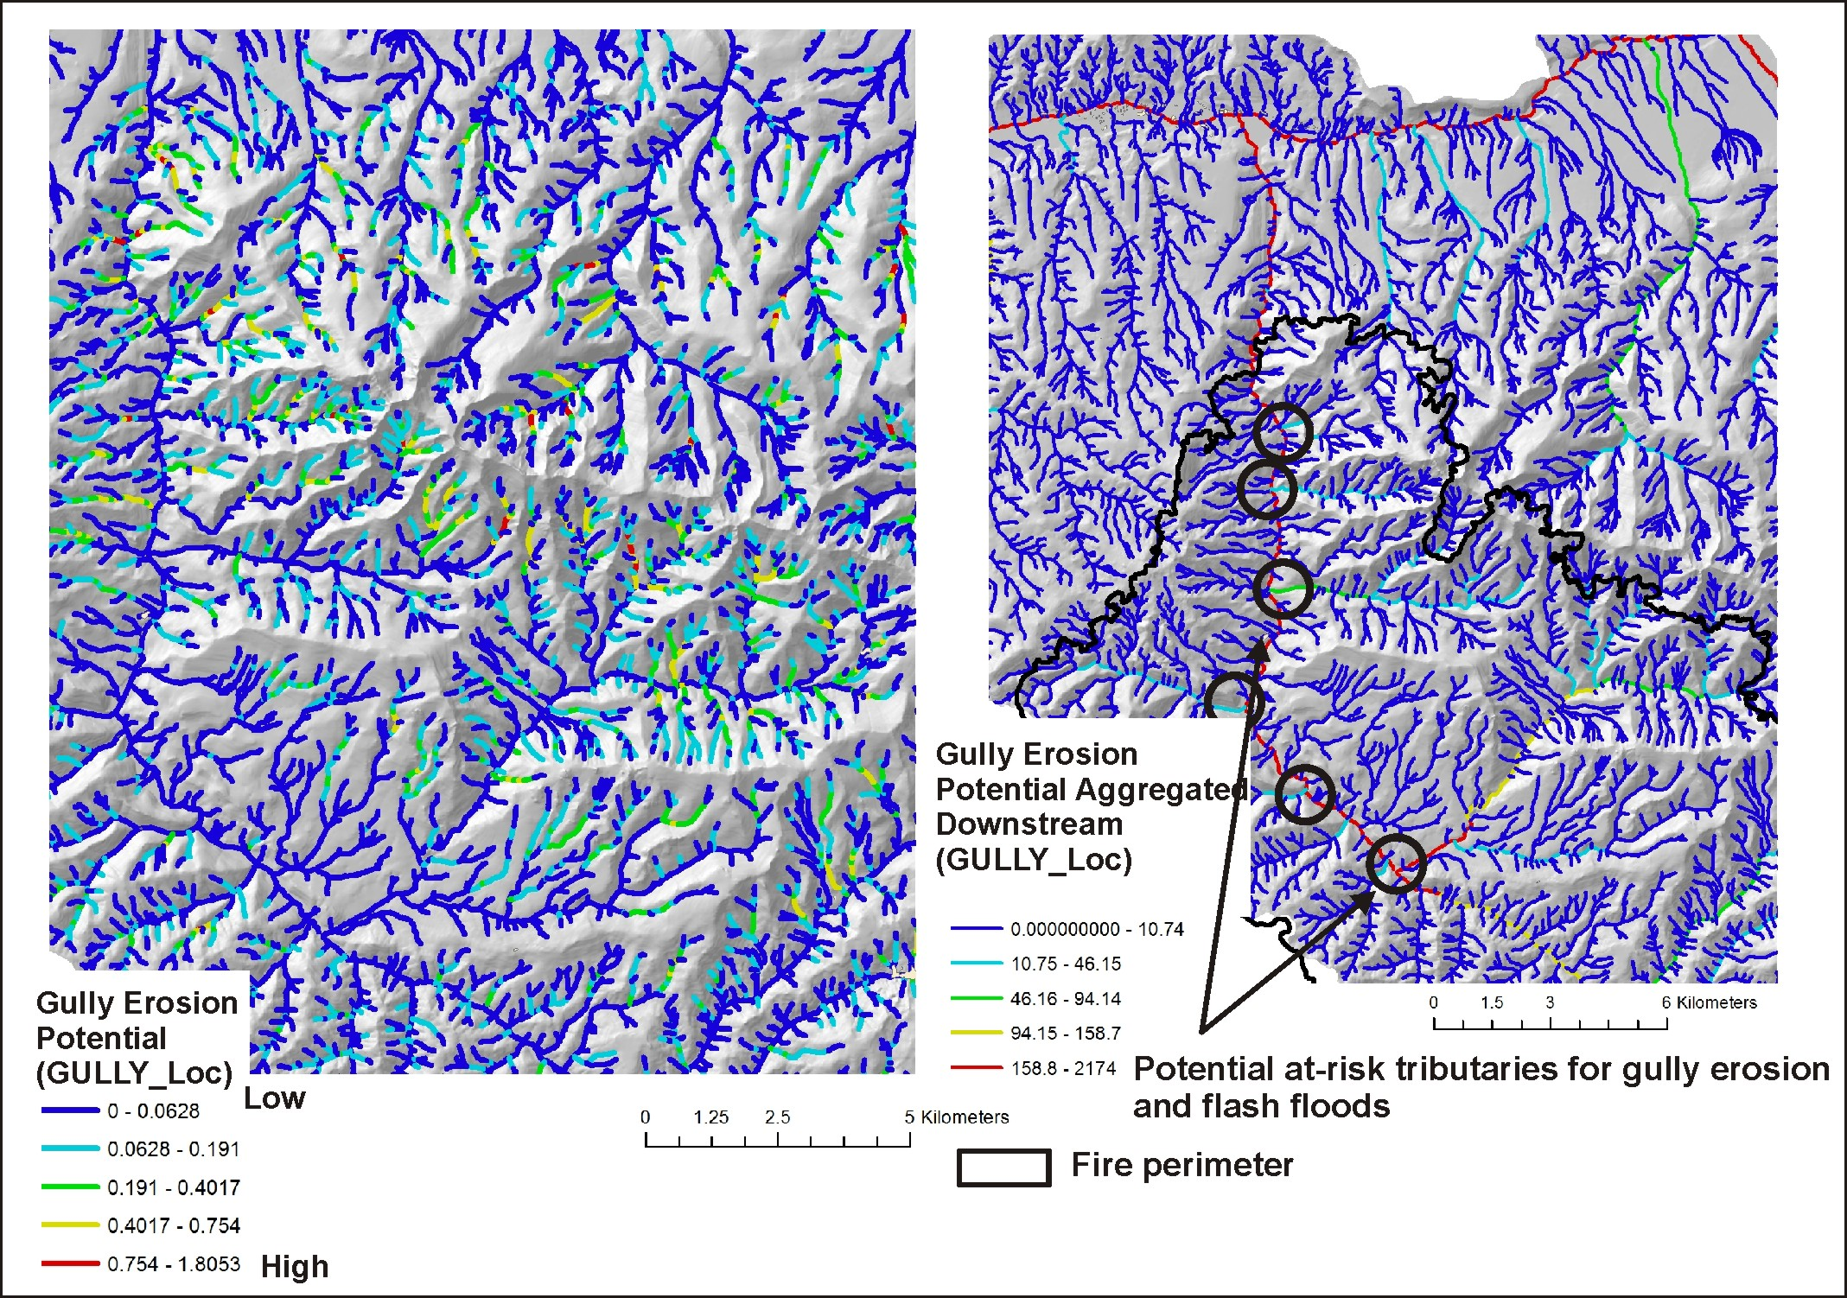
Post Fire
Gully
Potential
(fish
eye view)
Notes:
Gully erosion results reported to stream channels, via drainage wings or local contributing areas.

Slide 17
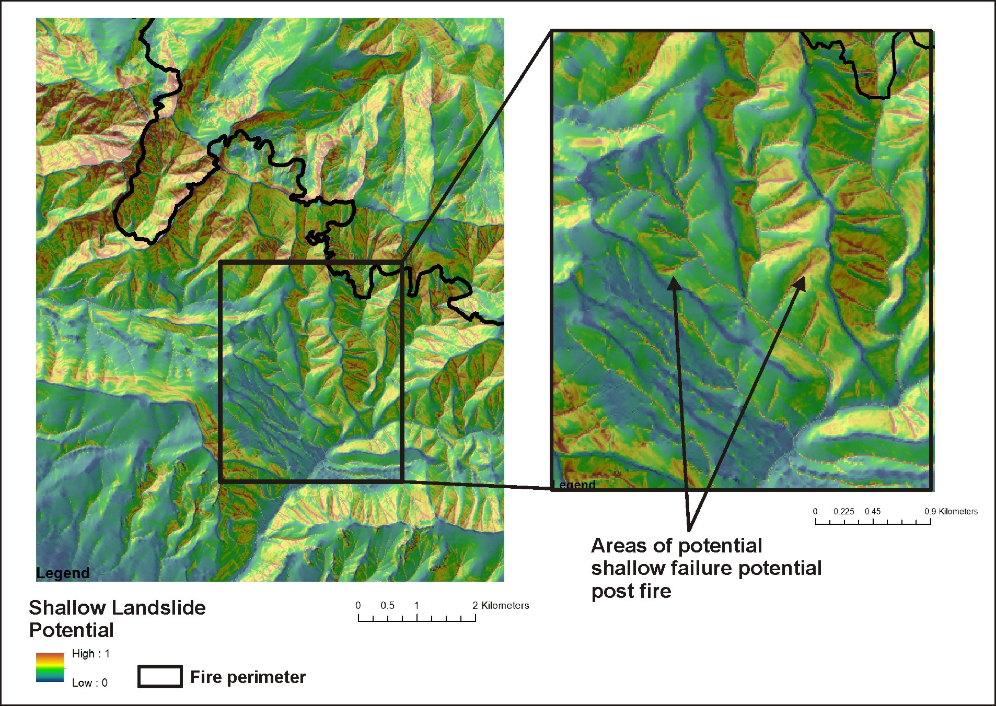
Shallow Landslide
Potential, Debris
Flow Source Areas
Notes:
A shallow landslide model (Miller and Burnett 2007) based on hillslope gradient and curvature was used in the analysis. See NetMap’s online technical help materials for additional information: http://www.netmaptools.org/Pages/NetMapHelp/hillside_1.htm

Slide 18
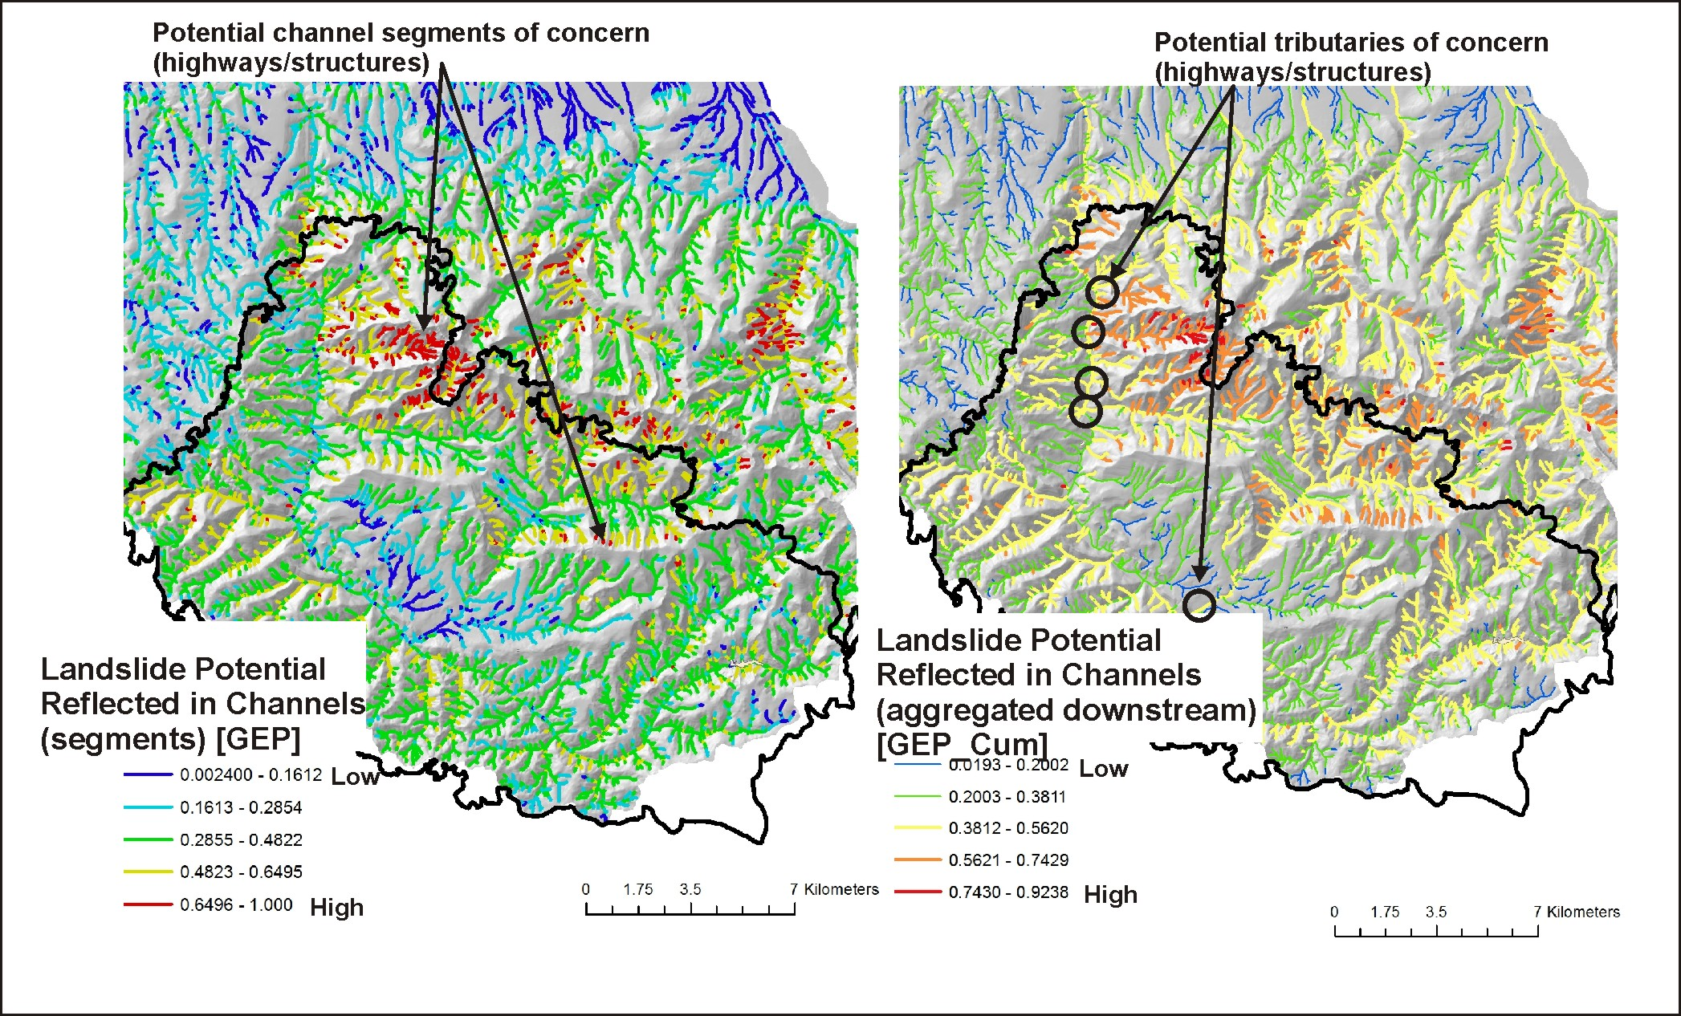
Notes:
Shallow failure potential as represented in individual channel segments and aggregated downstream.

Slide 19
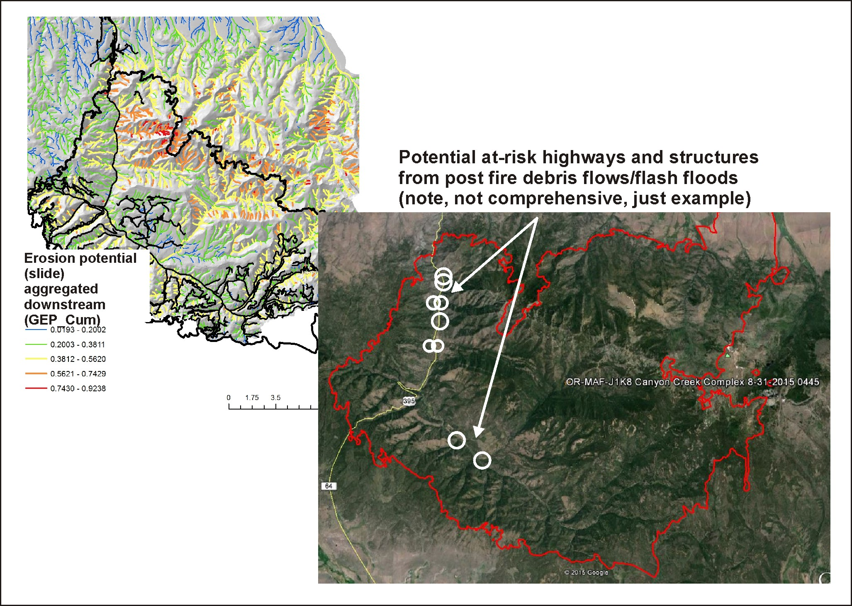
Example of a
risk assessment
you can combine
post fire surface
erosion with
gullying and
shallow failure
Notes:
Here is an example of a risk assessment that overlays predicted erosion potential (aggregated downstream, and thus tributary scale) and the locations of vulnerable highways and residences.

Slide 20
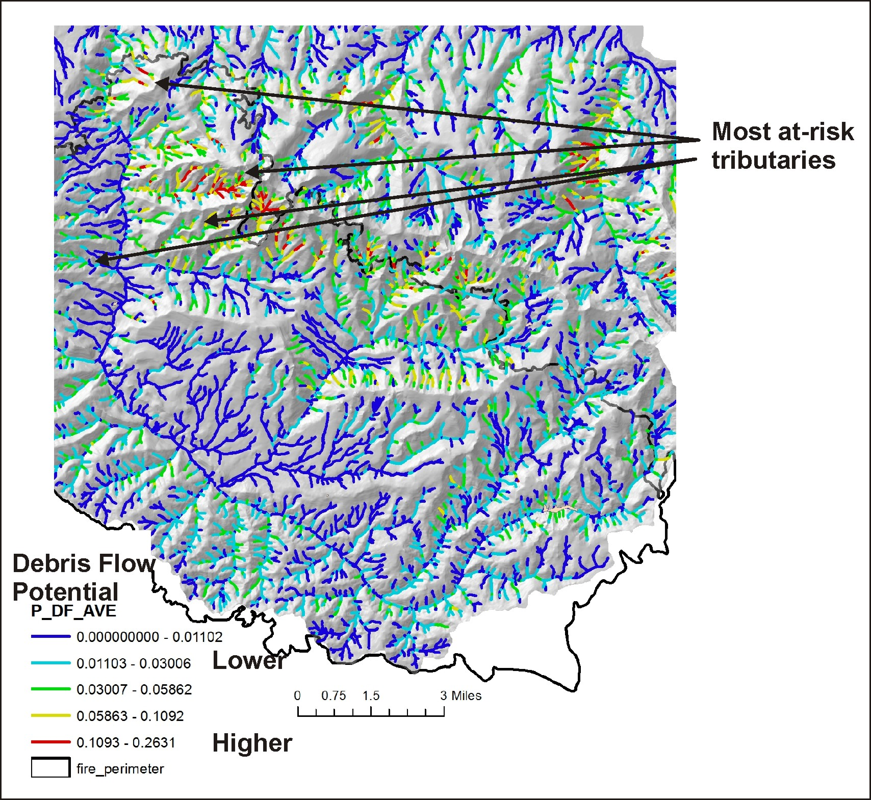
Consider tributary debris flow
risk

Slide 21
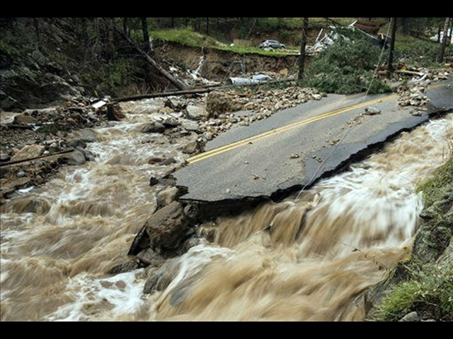
FLASH FLOOD Potential
A dimensionless index developed by the
National Weather Service. The Flash Flood Potential
Index (FFPI) consists of four factors:
hillslope gradient
soils (percent silt, clay and sand)
vegetation density (forest, shrubs, grasses)
fire impacts on soils and vegetation.
See NetMap’s online technical help manual for
additional details.
Notes:
A flash flood potential index will be applied to the study area (second week of Sept).

Slide 22
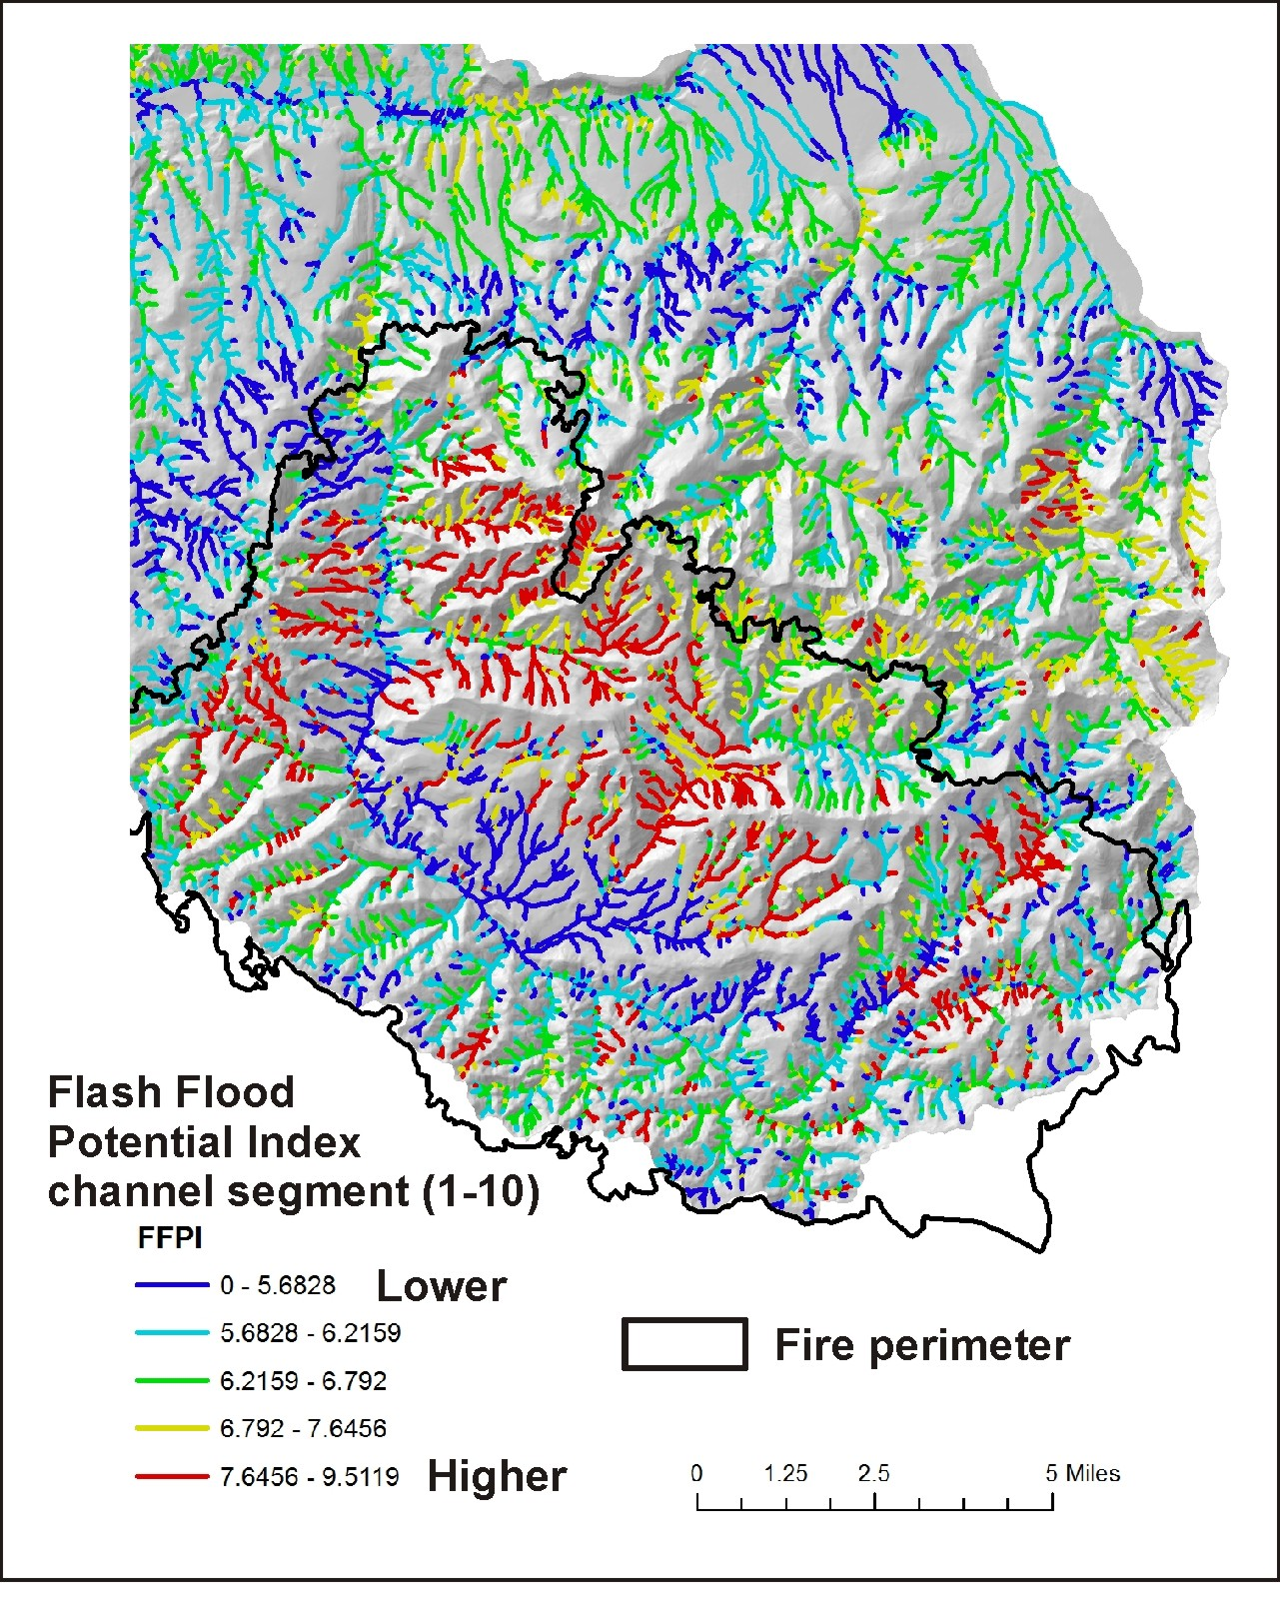
Flash Flood Potential Index
(individual channel segment
scale)

Slide 23
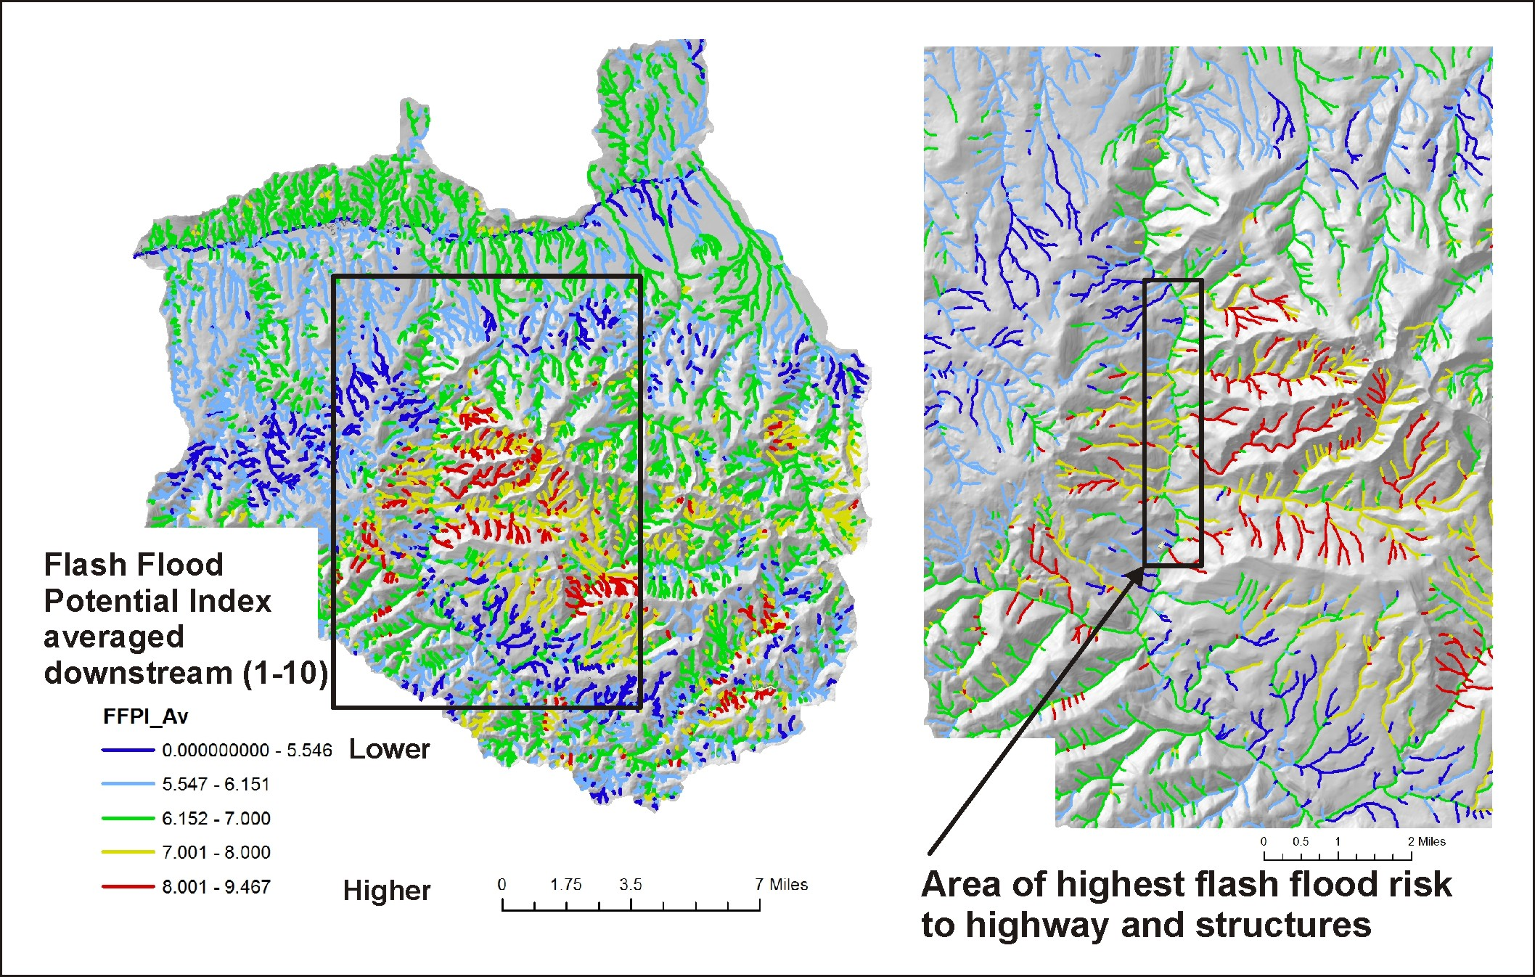
Flash Flood Potential Index (tributary scale, most relevant from risk assessment)

Slide 24
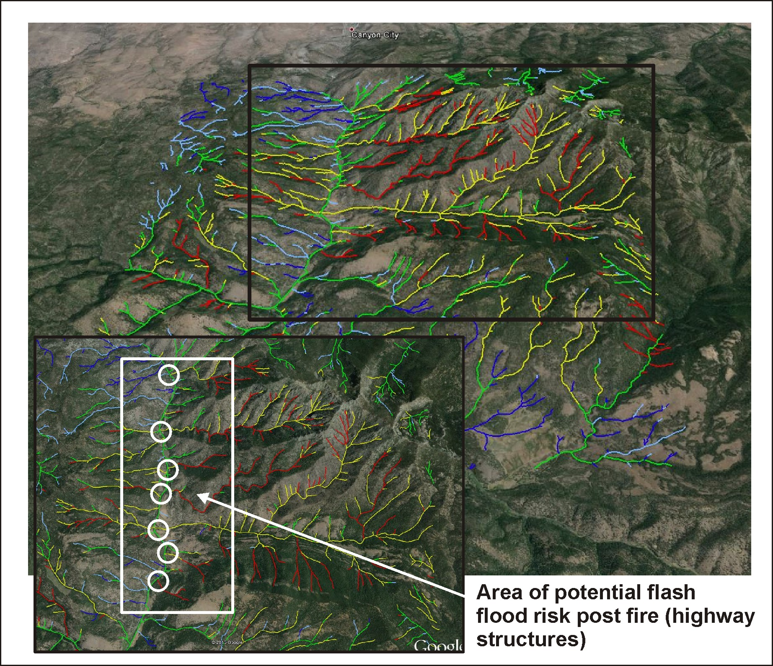
Flash Flood Potential
Index (tributary scale,
most relevant from risk
assessment)
mapped to Google Earth

Slide 25
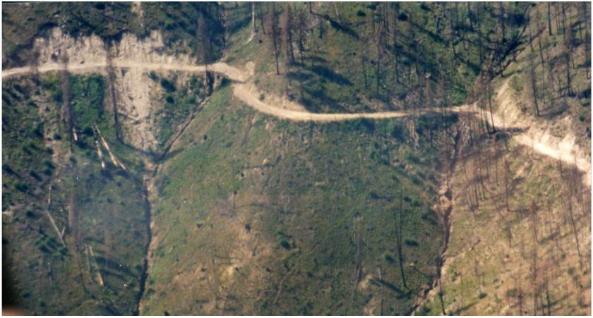
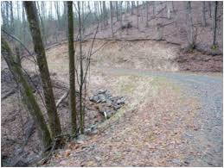
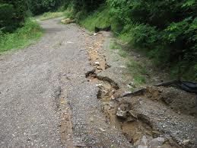
Road Surface Erosion and Sediment Delivery to Streams, Post Fire
Notes:
Roads can be significant sources of flooding, erosion and sediment delivery to streams, post fire.

Slide 26
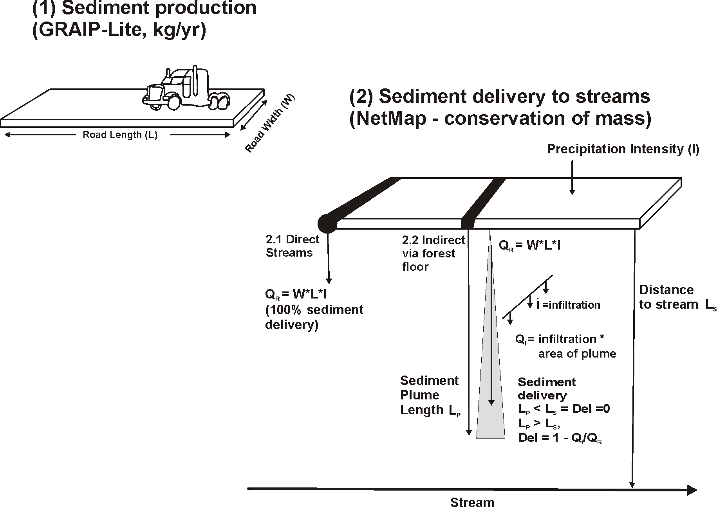
Road erosion and
sediment
delivery
model,
see additional
details at
end of ppt
Notes:
The model GRAIP-Lite for sediment production was coupled to NetMap’s conservation of mass sediment delivery model (see end of pptx for additional details).

Slide 27
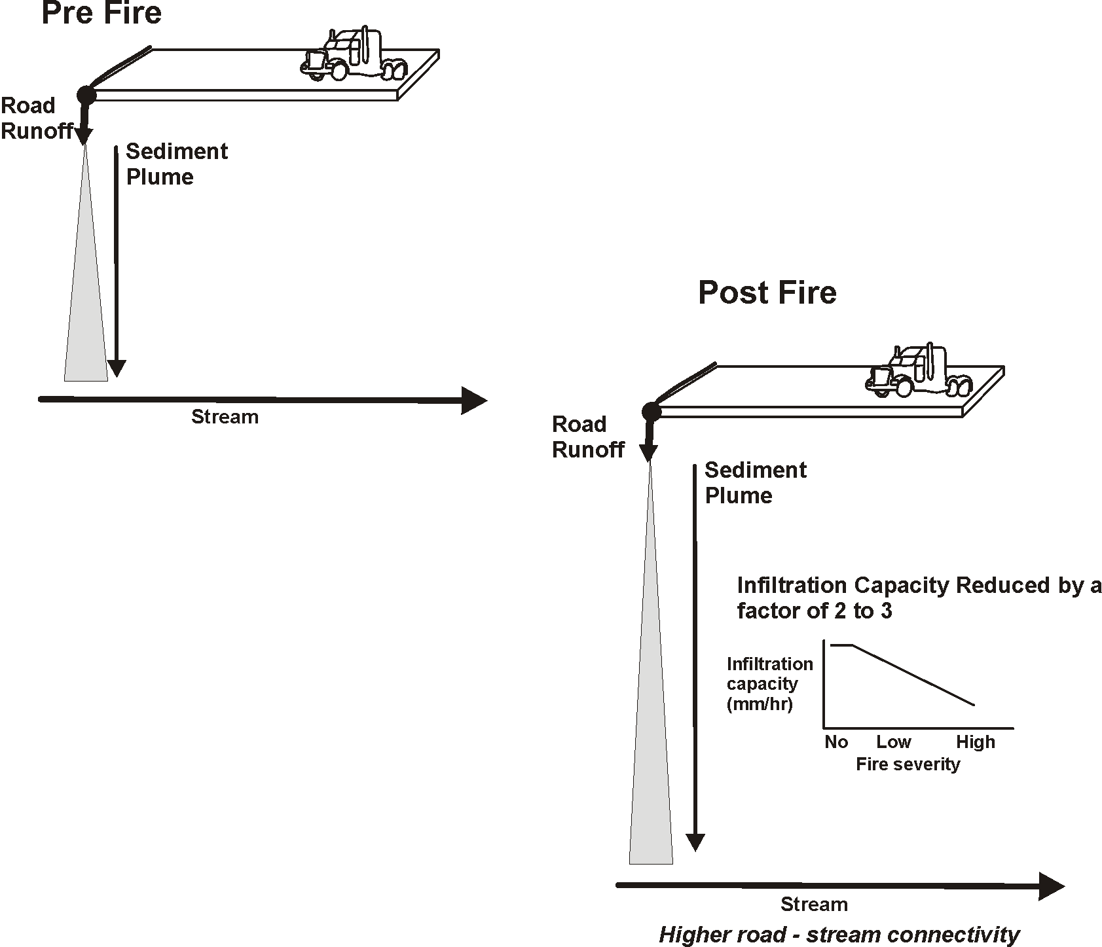
Fire Effects on Road Erosion
and Sediment Delivery
to Streams
Fire that reduces infiltration capacity will result in
a larger proportion of forest roads delivering sediment
to stream channels (these could be targeted for
restoration)
Notes:
Fire reduces infiltration capacity and thus allows greater sediment travel distances from roads to streams and hence greater road-stream connectivity.

Slide 28
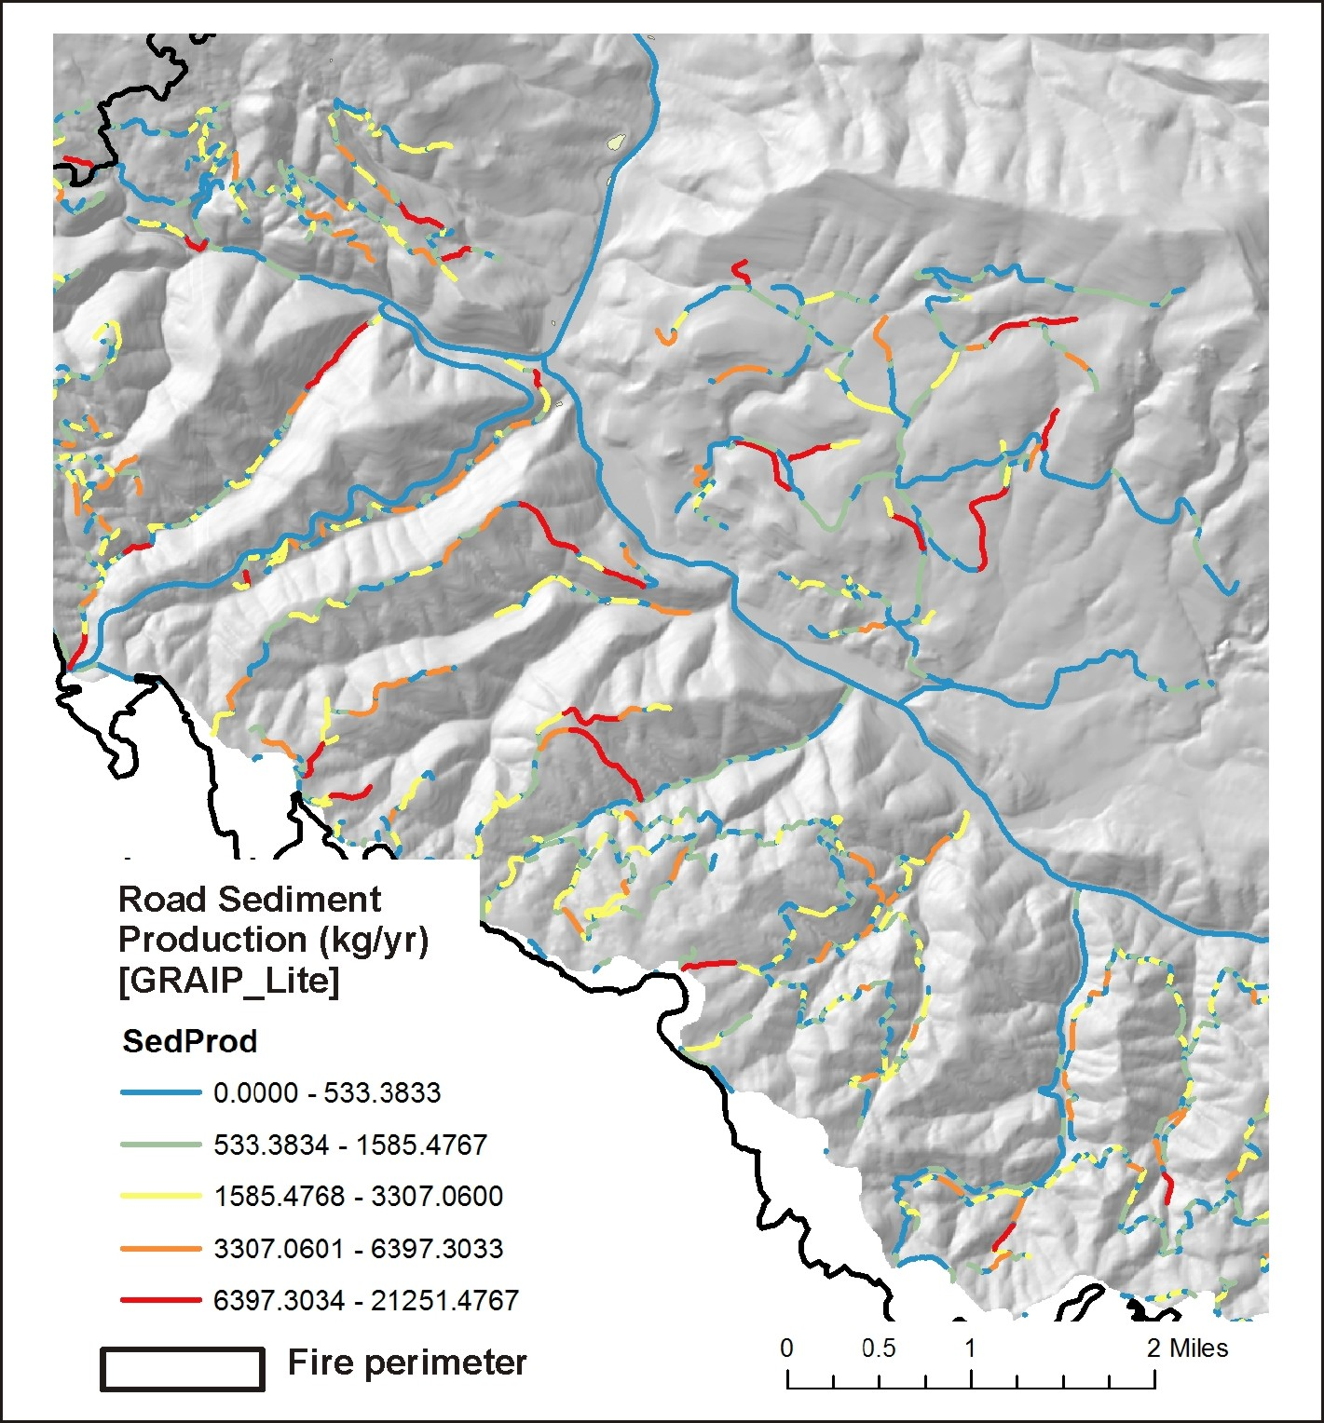
First, start with road sediment
production
Notes:
Sediment production as predicted by GRAIP-Lite; a base erosion rate of 1.5 kg/yr was used.

Slide 29
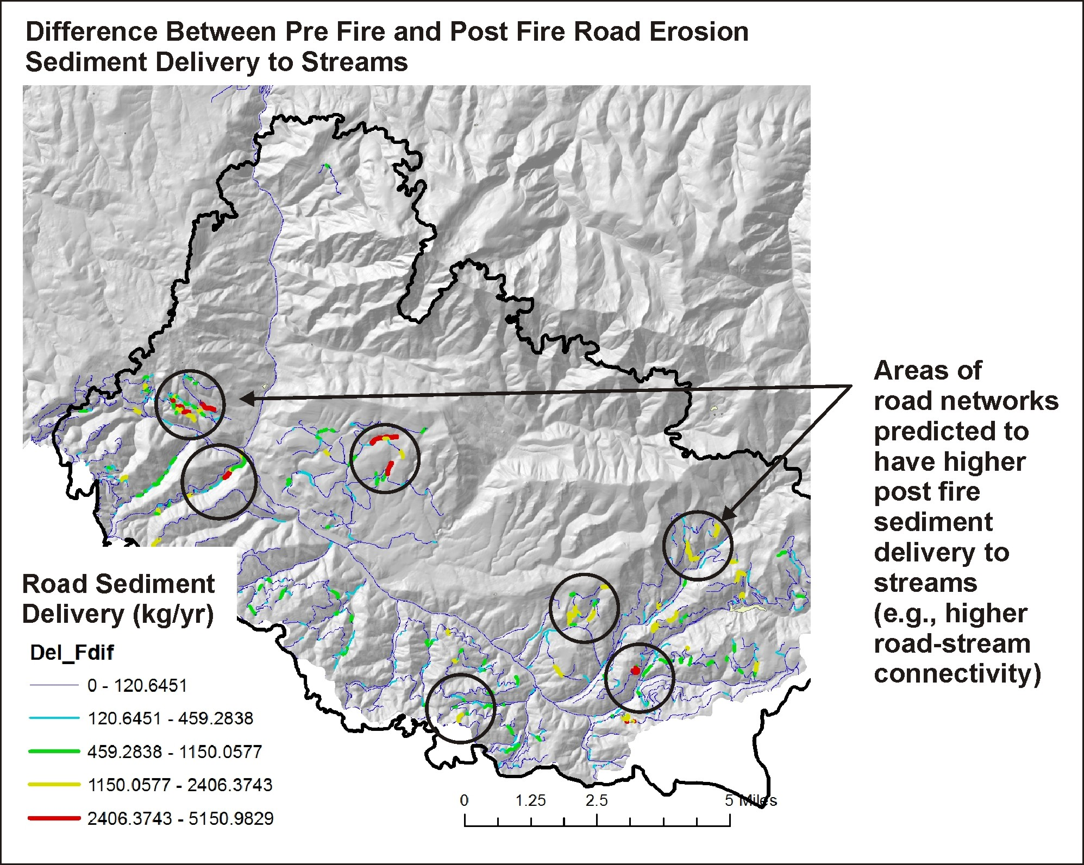
Next, calculate sediment
delivery pre fire and
compare that to
sediment delivery post
fire, and identify areas
of predicted increases
Notes:
A difference map of road sediment delivery reveals that some road segments are more sensitive to fire reductions in infiltration capacity compared to others.

Slide 30
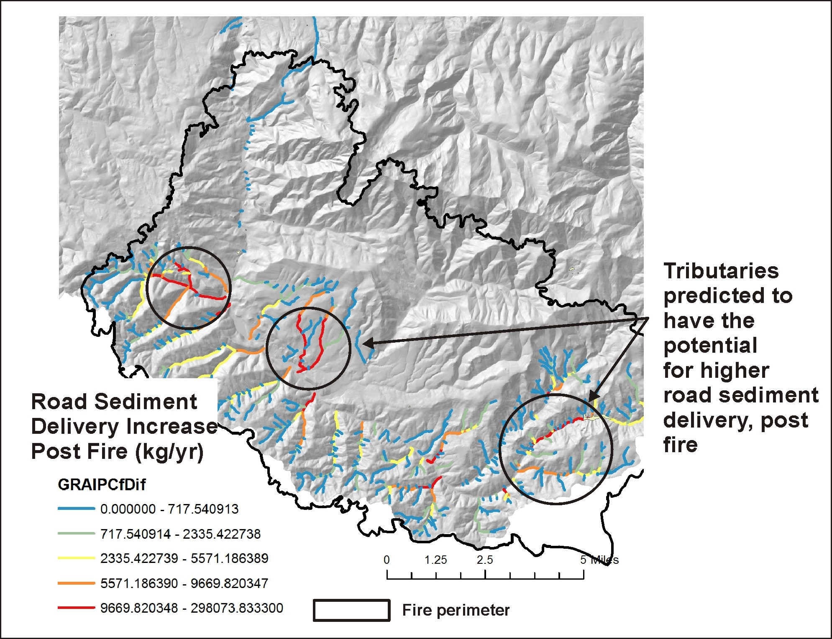
Identify tributary
scale increases
in delivery of
road sediment

Slide 31
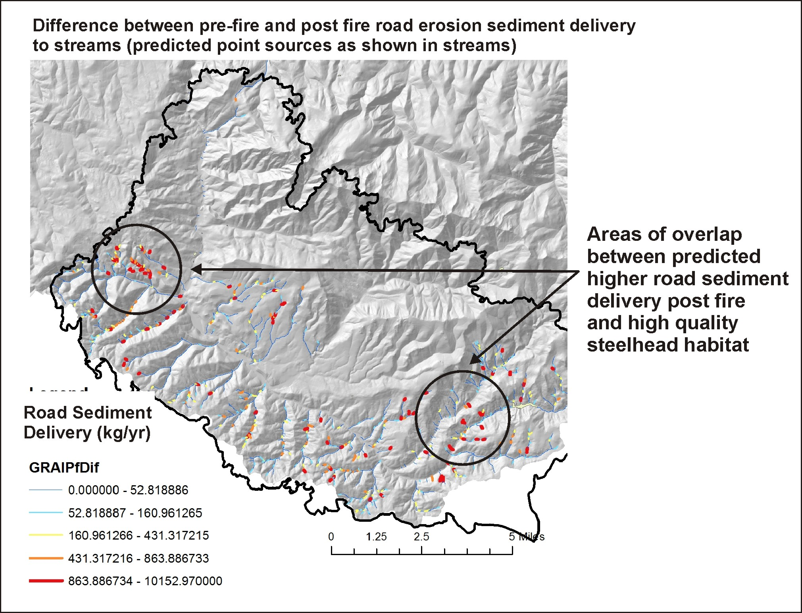
Then compare it to
locations of high
quality and sensitive
aquatic habitats
Notes:
Stream reaches where post fire road sediment delivery is predicted to increase; some of these reaches overlap sensitive fish habitats.

Slide 32
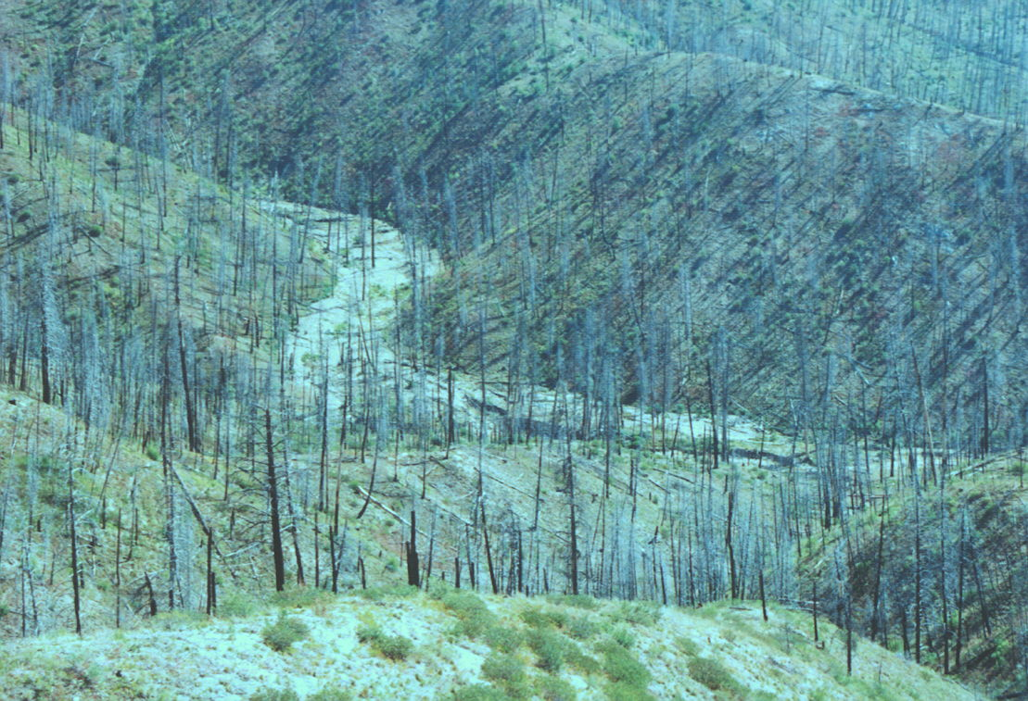
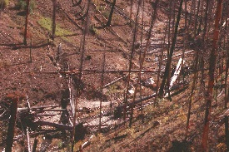
Riparian Zones: Impacts from Fire, Loss of Shade, Increases in Thermal Loading and
Loss of Cool Water Refugia

Slide 33
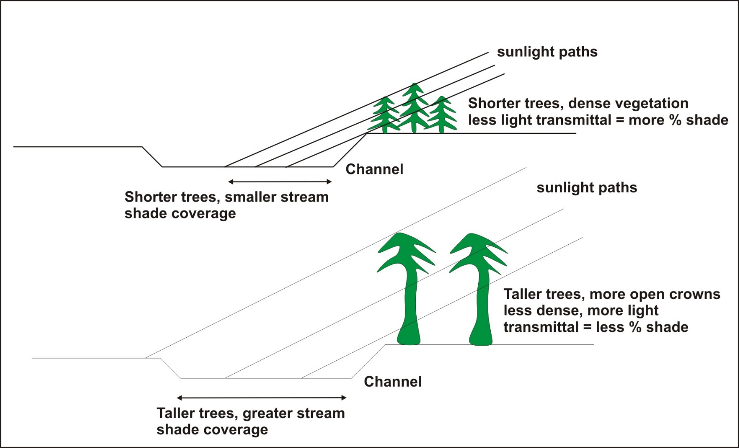
Riparian – Current Shade/Thermal Energy
Fire effects on shade & thermal
loading
Shade model, Groom et al. 2011
Tree height, basal area
(LEMMA)
(where fire would have the largest impacts on the thermal regime,
including loss of thermal refugia)
Notes:
A shade model was used to estimate the effects of vegetation on reducing thermal energy to streams. Shorter, denser vegetation provides more shade, but the shadow length is smaller. Taller older trees have less dense vegetation mid crown that can reduce the shade, but they have a longer shadow length. We used a simple linear relationship between percent shade and predicted flame length. To learn more about this modeling approach, go to NetMap’s online technical help materials: http://www.netmaptools.org/Pages/NetMapHelp/current_shade_thermal_energy.htm

Slide 34
Notes:
The difference between thermal energy to streams under no fire shade conditions (using LEMMA vegetation data (http://lemma.forestry.oregonstate.edu/) and fire-reduced shade. Many channel segments receive higher thermal loading, post fire.

Slide 35
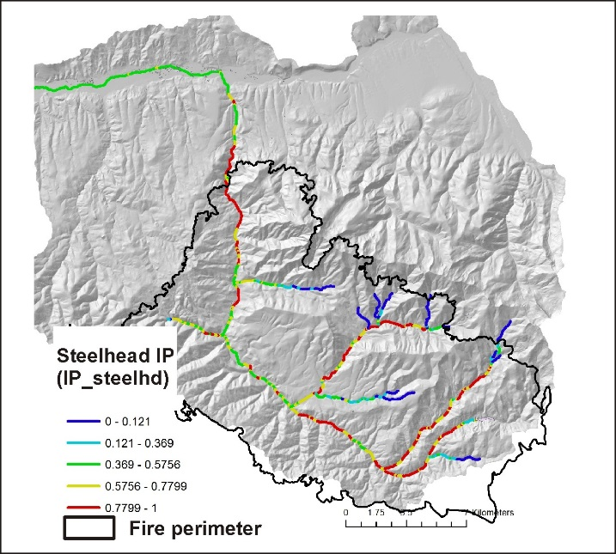
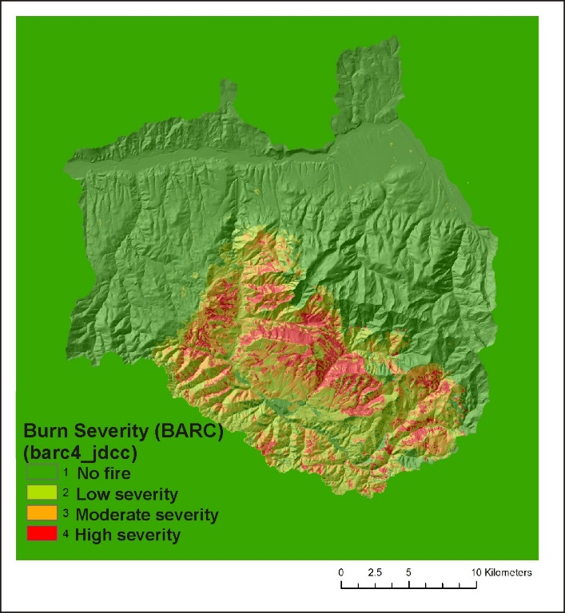
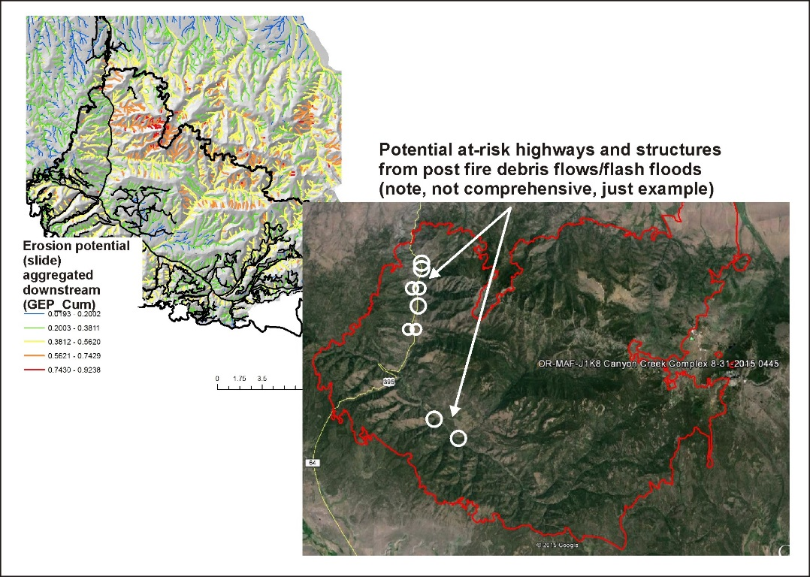
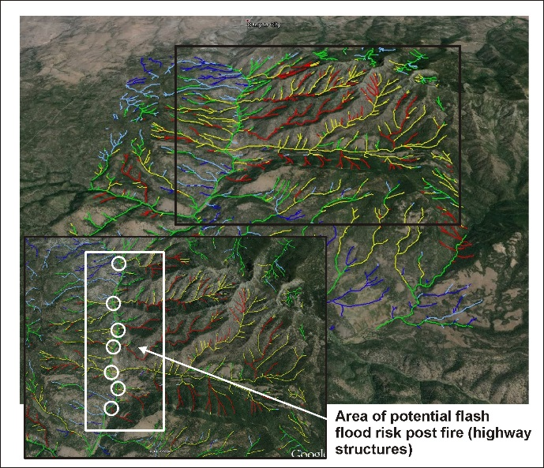
Decision Space: Spatially Explicit Maps (visual - qualitative)
+
+
Fish habitat
Burn Severity
Post Fire Surface Erosion
+
flash flood potential
= priority sites
for restoration
Notes:
Information provided in the BAER analysis (previous slides, among other data) can be used visually and qualitatively to search for intersections or overlaps between various fire related stressors (fire severity, post fire surface erosion, gully erosion) and sensitive aquatic habitats, as illustrated above. Or one of NetMap’s tools (Resource – Fire Stressor Overlap Tool) can be used quantitatively to locate overlaps and intersections (see next slide).

Slide 36
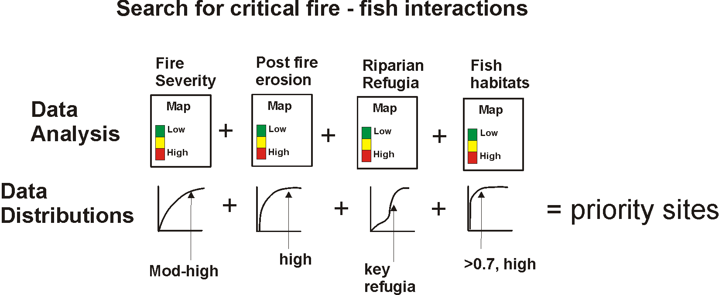
Decision Space: Spatially Explicit Quantitative (use NetMap’s Resource-Fire Stressor Overlap
Tool [Quick Tool])
Notes:
NetMap’s Quick Tool that contains the Resource – Fire Stressor overlap capability can be used to locate intersections between fire related impacts and sensitive fish habitats. The tool calculates, on the fly, the full frequency distribution of values (shown as the cumulative distribution of values in this slide), and the analyst, using the tool, selects from the distributions to search for overlaps. For example, an analyst can quickly search for intersections among the highest 10% of fire severity, highest 5% of post fire surface erosion (or landsliding or gullying), highest 10% of fire related increases in thermal loading, and fish habitats (either presence of habitat or some numeric value of habitat quality [used in IP]).
For additional information, see NetMap’s online technical help that describes the overlap tool: http://www.netmaptools.org/Pages/NetMapHelp/overlap_tool___reaches.htm
And the Quick Tool, which is provided as part of this analysis: http://www.netmaptools.org/Pages/NetMapHelp/netmap_quick_tool.htm

Slide 37
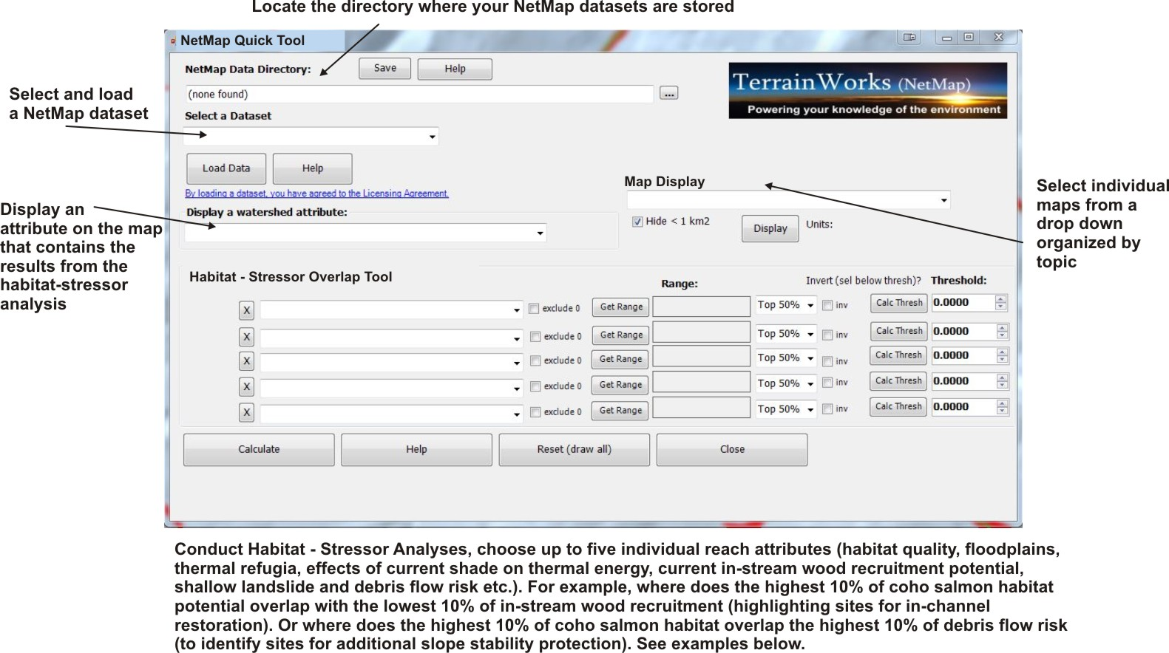
NetMap’s Resource-Fire Stressor Overlap Tool

Slide 38
Drop down attribute list in NetMap’s Fire and Fish Quick Tool
However, one can load all shapefiles
within ArcMap without using
the Quick Tool interface
ArcMap field name
NetMap name
Notes:
The drop down list of analysis results in the Quick Tool (previous slide) shows all of the analysis results.

Slide 39
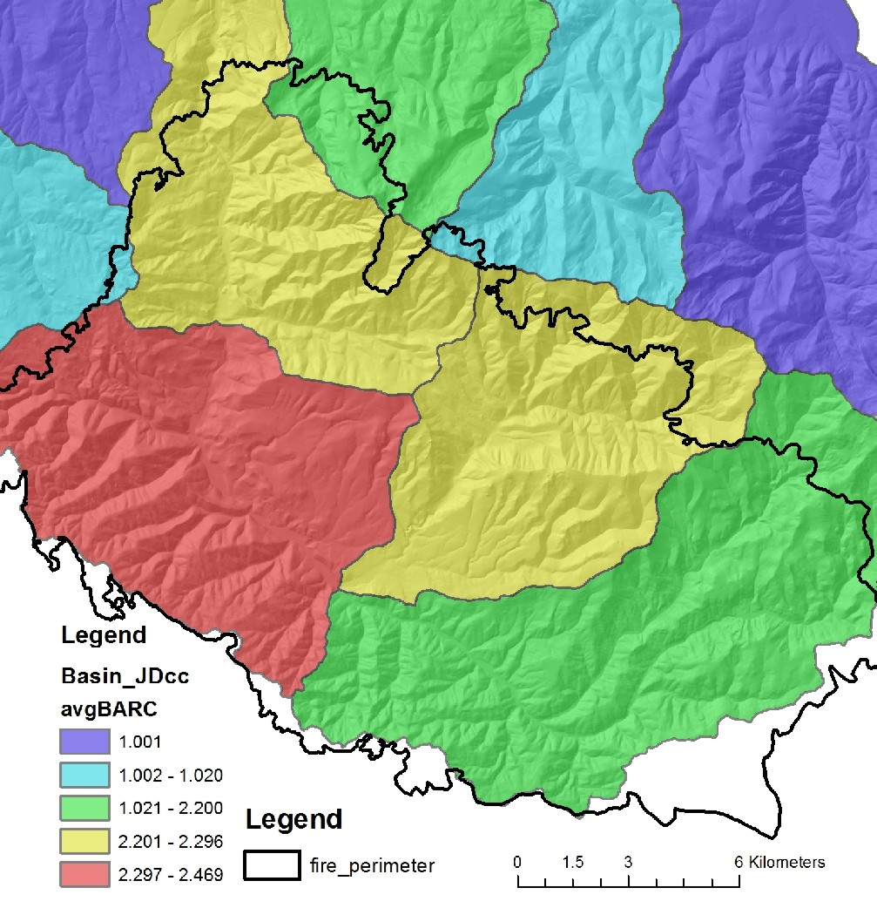
All analysis results are summarized at the scale of HUC 6th field
For example, burn severity (BARC)
per 6th field subbasin
Notes:
All analysis results are summarized to the HUC 6th subbasin scale. This can be used to examine subbasin scale patterns of fire related attributes and stressors and the locations of aquatic habitats. Subbasin scale data summaries may be most useful at the scale of larger watersheds or entire national forests.

Slide 40
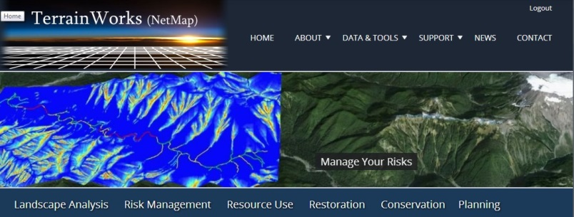
Presentation
Complete
TerrainWorks designs and builds the most advanced watershed and landscape analysis system
in the world. Learn more about NetMap virtual watersheds, watershed analysis tools,
online technical help and tools at: www.terrainworks.com. Contact us with questions,
we are here to help.

Slide 41
The next four slides contain additional details about NetMap capabilities as applied to the BAER analysis

Slide 42
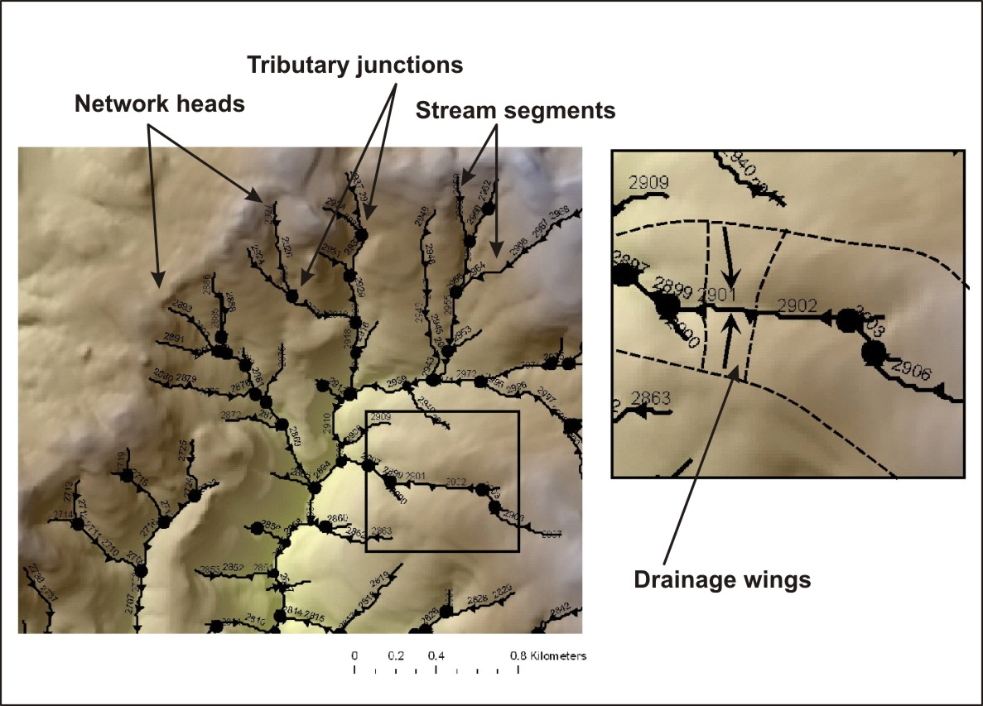
The BAER-NetMap analysis requires that terrestrial information (on hillsides)
be transferred to channel
networks, so that fire
related stressors (erosion,
roads) can be directly
linked to structures and
fish habitats, at the scale
of individual channel
segments.
Notes:
The data structure of the virtual watershed includes a synthetic river network (derived from DEMs and the NHD) and drainage wings, local contributing areas located on both sides of 100 m channel segments. Each channel segment has a corresponding set of local contributing areas or drainage wings.

Slide 43
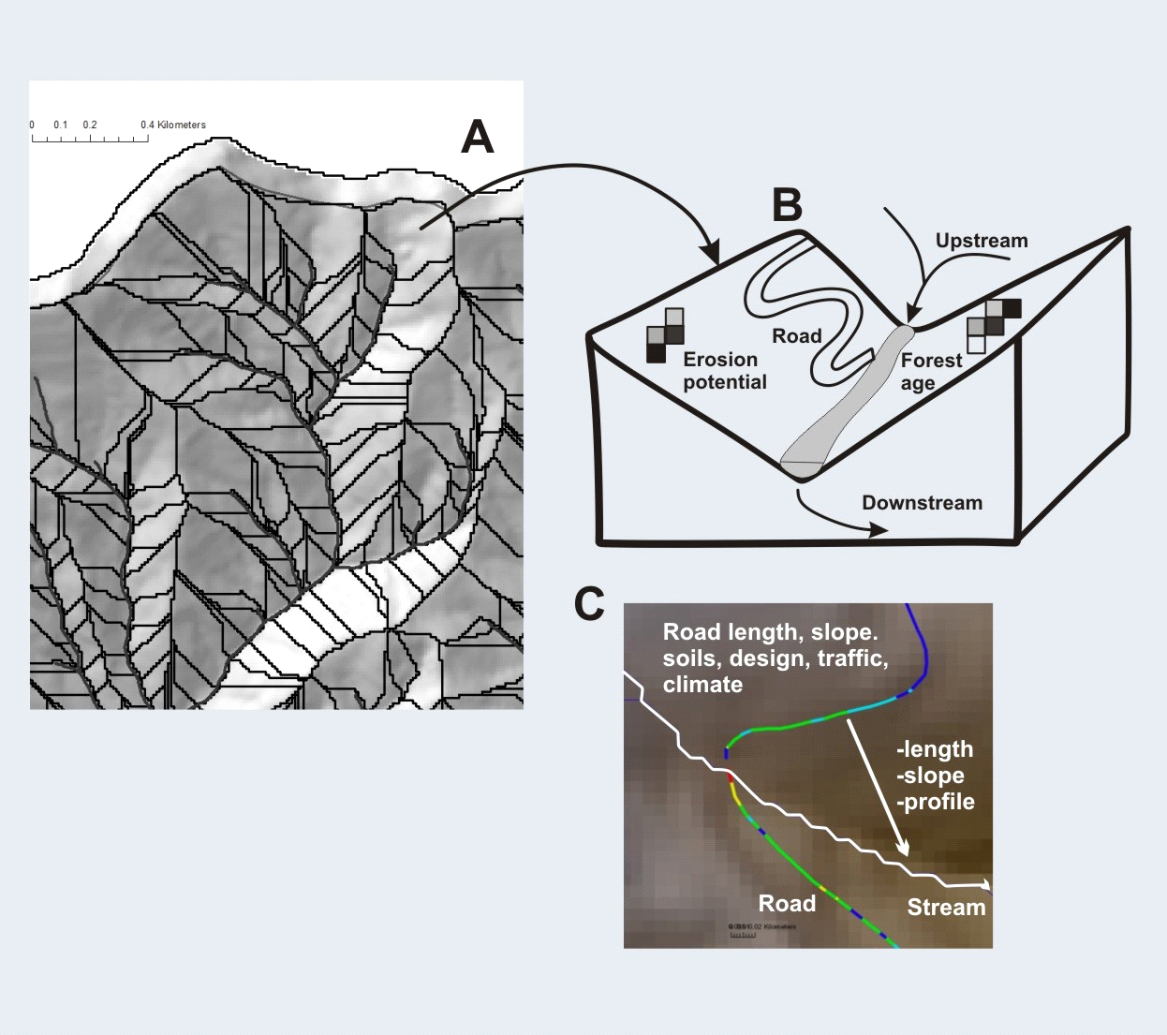
Drainage wings (discretize landscapes and land uses)
Notes:
The drainage wings discretize the watershed terrestrial environment into small areas (approx. 0.1 km² in area) and all information on hillsides is then summarized to channels. This supports analysis of aquatic habitat-terrestrial stressor intersections.

Slide 44
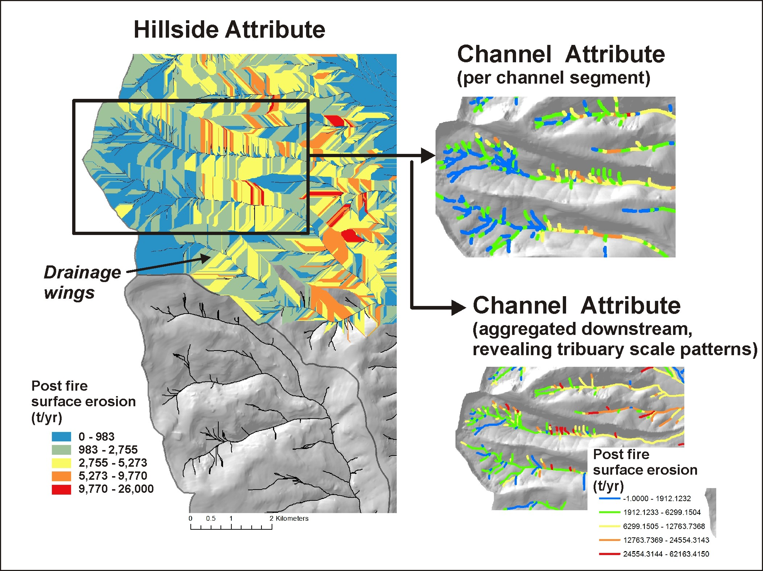
An example about
how a hillside attribute
(post fire erosion)
is transferred to individual
channel segments, and
aggregated downstream
Notes:
Here is an example of how a terrestrial (hillside) attribute is transferred to the channel network and aggregated downstream. These types of channel attributes can then be compared to other channel attributes such as fish habitat or other watershed characteristics, like thermal refugia.

Slide 45
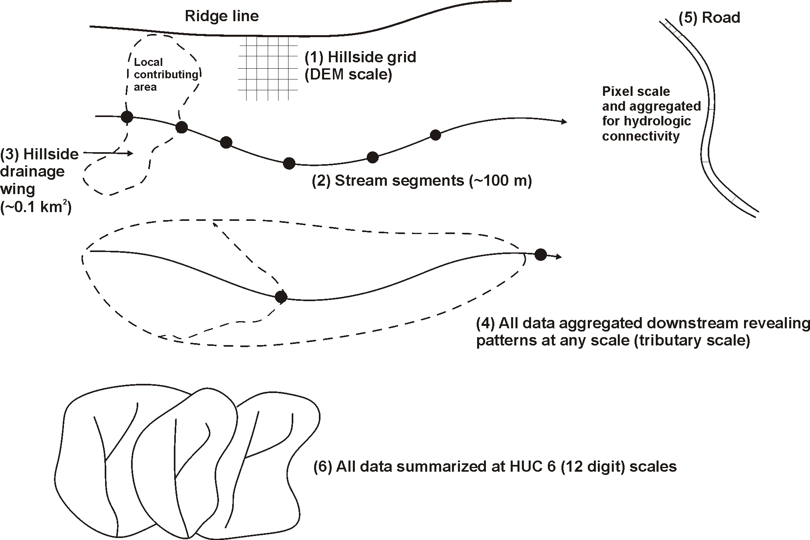
Data spatial scales
Notes:
The data deliverables come at a range of scales including (1) hillside raters or grids (at the scale of the DEM), (2) individual stream segments (~100 m), (3) hillside drainage wings (local contributing areas, ~ 0.1 km2), (4) stream segment data aggregated downstream, (5) road segments broken a pixel boundaries and re-aggregated for various purposes, including hydrologic connectivity and (6) data summarized at the scale of HUC 6 subbasins.

Slide 46
The next seven slides contain additional details about the road analysis

Slide 47
Road Model Details (7 slides)
GRAIP-Lite model of road surface erosion (in NetMap)
(USFS, Rocky Mountain Research Station, Boise ID)
E = B * R * S * V
where E is road sediment production to streams (kg/yr), B is the “base”
surface erosion rate (empirical), R is the elevation difference between the road segment
end points (length), S is the road surface factor and V is the vegetation factor.
V = 1 – 0.86x, where x is the fraction of the road length where flow path vegetation
(ditch) is greater than 25%; R (elev. diff) is slope x road segment (hydrologic) length.
Example base rates:
Oregon Coast Range = 79 kg/yr
Idaho Batholith = 33 kg/yr
Montana (Belt sedimentary) = 7 kg/yr
Eastern Oregon (Umatilla, Basalt) = 1.5 kg/kg
Eastern Sierra (SPI) = 11 kg/yr
Notes:
The GRAIP-Lite model (RMRS, Luce, Black and Nelson) was used in the analysis. See NetMap’s online technical help materials for additional information: http://www.netmaptools.org/Pages/NetMapHelp/graip_lite.htm

Slide 48
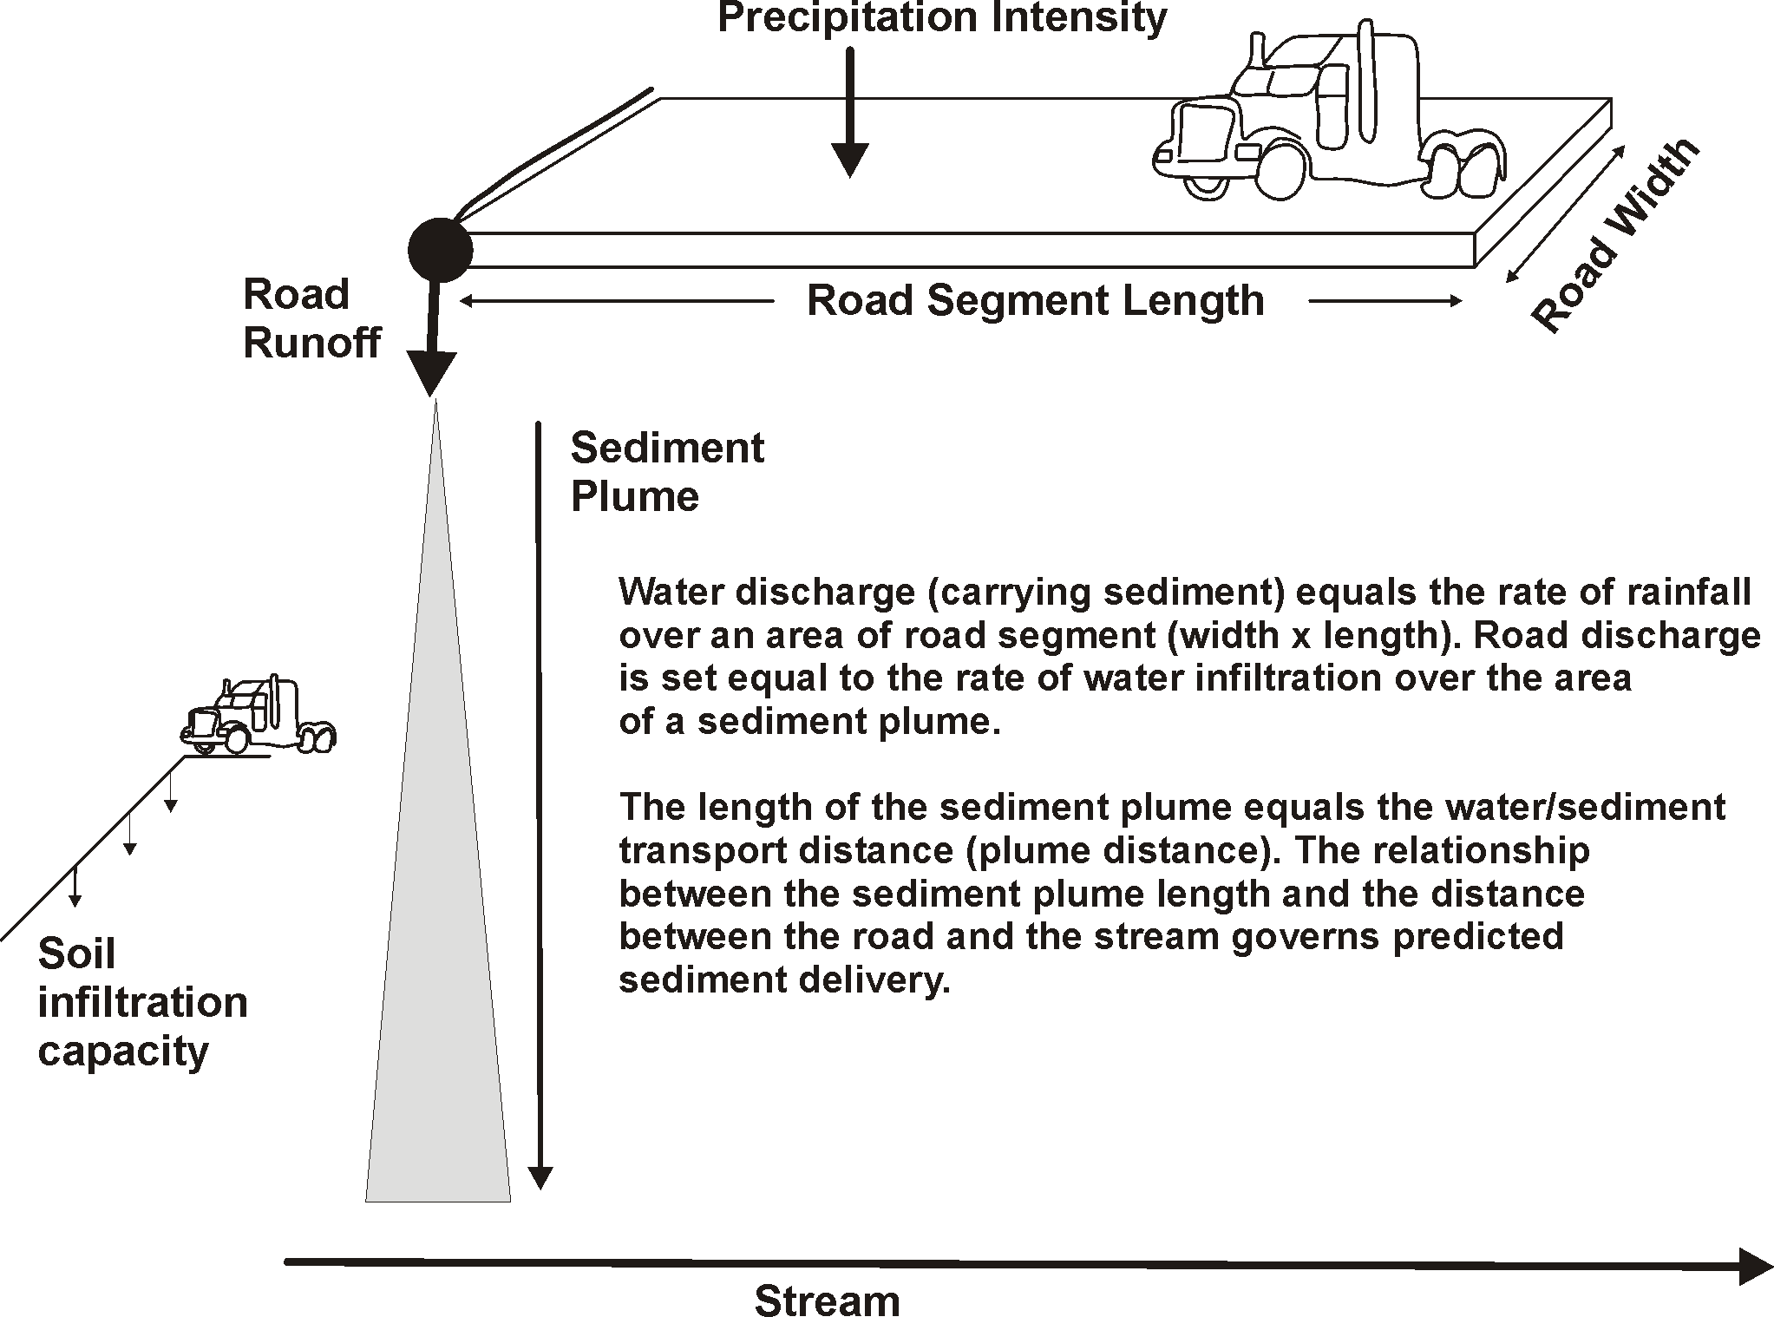
Road sediment delivery to streams (conservation of mass)
Notes:
The GRAIP-Lite sediment delivery component was modified in NetMap, using a steady state, conservation of mass approach. For additional information, see NetMap’s online technical help: http://www.netmaptools.org/Pages/NetMapHelp/netmap_sediment_delivery_2.htm

Slide 49
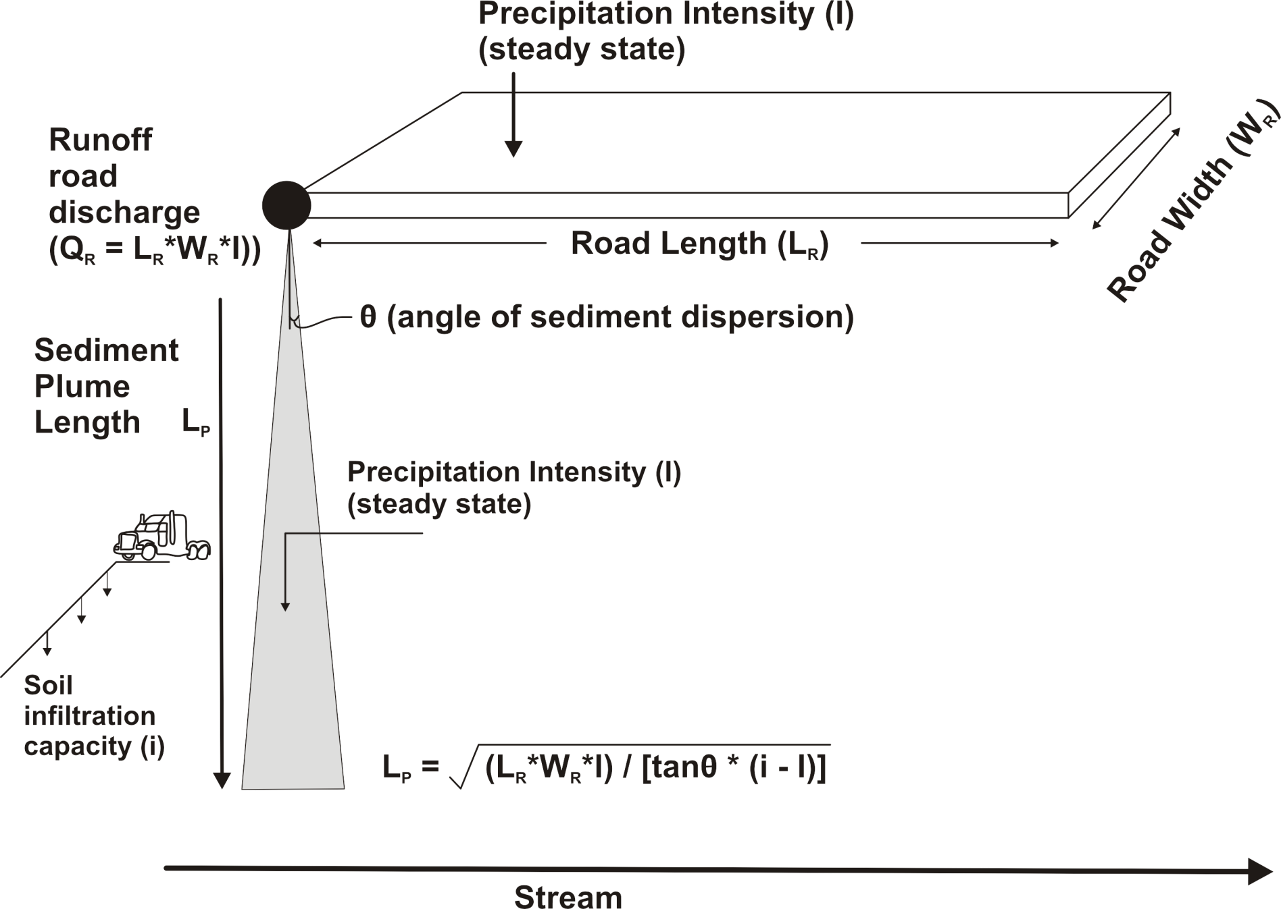
Road sediment delivery to streams

Slide 50
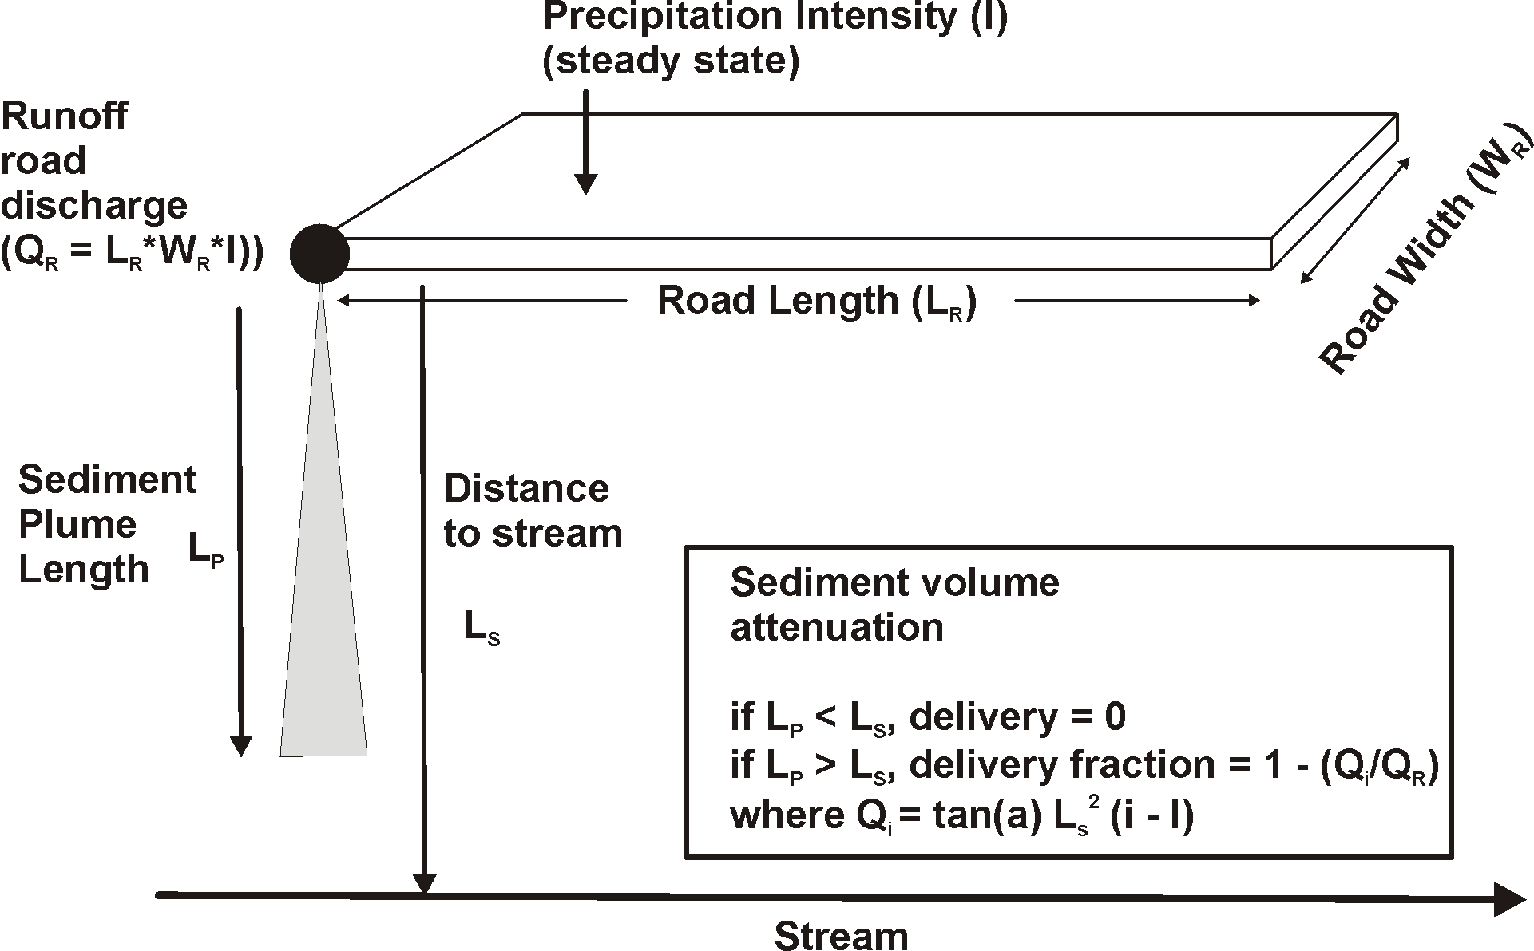
Road sediment delivery to streams

Slide 51
Fire Effects on Road Erosion
Sediment Delivery to Streams
Fire that reduces infiltration capacity will result in
a larger proportion of forest roads delivering sediment
to stream channels (these could be targeted for
restoration)
Notes:
Fire can impact road erosion sediment delivery by reducing the infiltration capacity of the forest floor (if burned). Lower infiltration capacity can lead to longer sediment plume lengths and greater connectivity between forest roads and stream channels.

Slide 52
Fire reduction in infiltration:
Low severity =
50 mm/hr
Moderate severity = 40 mm/hr
High severity = 20 mm/hr
Notes:
We selected a non fire forest floor infiltration rate of 60 mm/hr; this was reduced based on predicted fire severity as indicated above.

Slide 53
Design storm (short duration, high intensity)
0.92 in/hr (23 mm/hr)
ftp://ftp.odot.state.or.us/techserv/Geo-Environmental/Hydraulics/Hydraulics%20Manual/Chapter_07/Chapter_07_appendix_A/CHAPTER_07_APPENDIX_A.pdf
Notes:
A design storm is needed in NetMap’s sediment delivery model. We choose a short duration 10-year storm to mimic thunderstorm activity, post fire.

