Slide 1
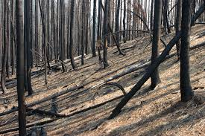
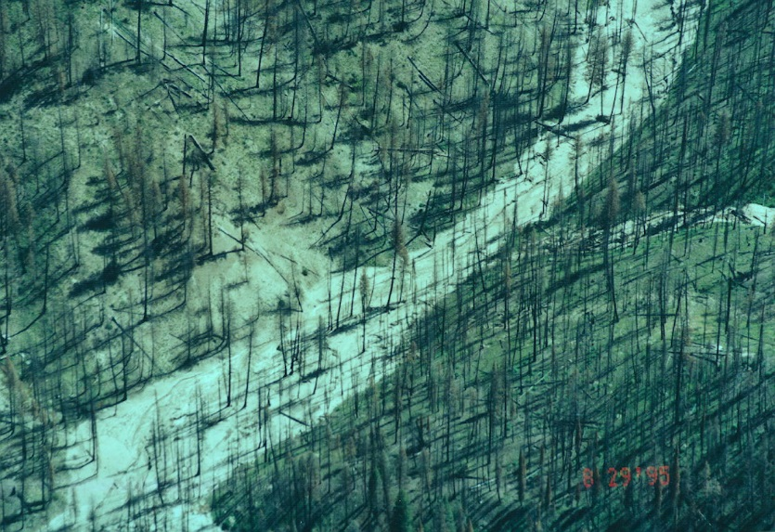
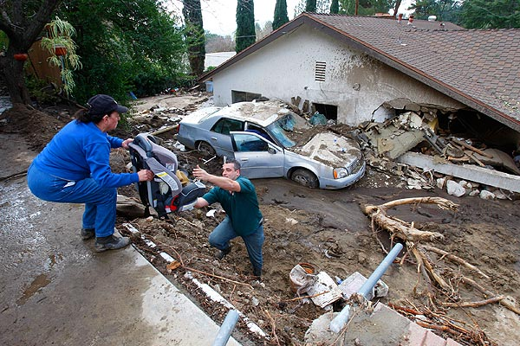
Post Fire Decision Support
Informing Post Fire Restoration
(Canyon Creek Complex Wildfire, 2015, Malheur National Forest, Eastern Oregon)
At-Risk Aquatic/Riparian Habitats
Post-Fire Planning
(BAER, Restoration)
At-Risk Infrastructure
TerrainWorks (NetMap), in Collaboration with US Forest Service, PNW Corvallis and Malheur National Forest
Summer, 2015
Notes:
This Powerpoint presentation summarizes the use of NetMap for a Fire and Fish Decision Support System. Created on July 24, 2015 by Dr. Lee Benda and Kevin Andras (TerrainWorks).

Slide 2
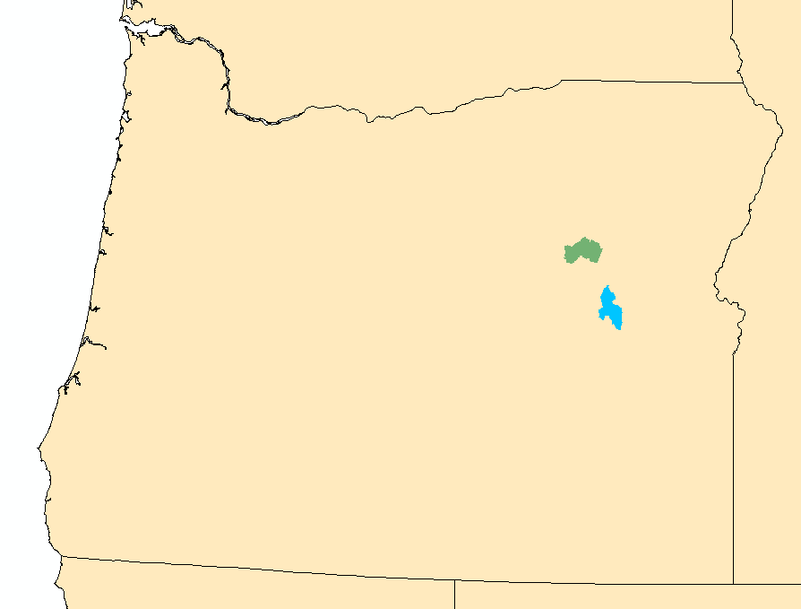
For the Pre-fire analysis in two areas in the Malheur National Forest, go to:
http://www.netmaptools.org/Pages/NetMap_Fire&Fish_Malheur1a.pdf and for video, go to:
www.netmaptools.org/Pages/FireFish/NetMap_Fire&Fish2.pptx
Camp Creek watershed
(1 m LiDAR DEM)
Upper North Fork Malheur
(10 m DEM)
Continue with post fire (BAER) analysis, next slide…..

Slide 3
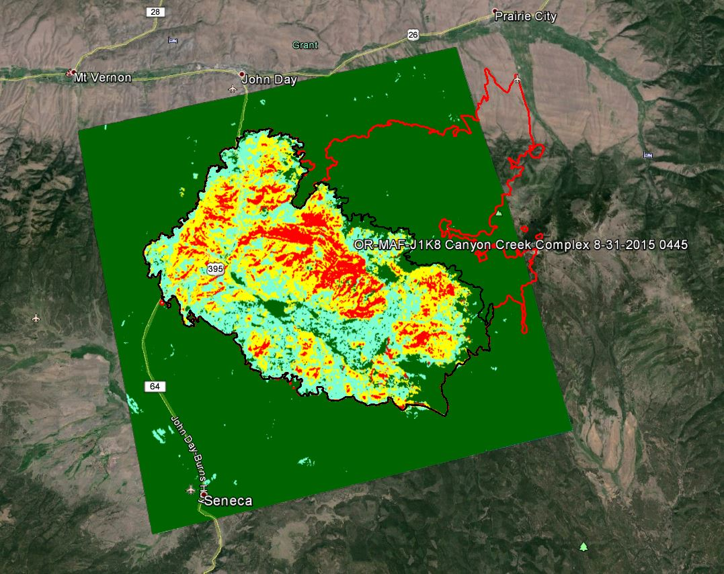
Post fire BAER
Analysis
Canyon Creek
Complex Wildfire,
as of August 31, 2015
Canyon Creek
BAER-NetMap
analysis area
(colored)

Slide 4
Models and Sources
(1) DEMs – 10 m
(2) Synthetic River Networks (stream layers) NetMap (www.terrainworks.com)
(3) Fire severity (BARC map, Canyon Creek Complex)
(4) Post fire surface erosion (WEPP – Disturbed)
(5) Post fire gully potential (Parker et al. 2010)
(6) Post fire landsliding/gullying (Miller and Burnett 2007, 2008, NetMap)
(7) Post fire road surface erosion and sediment delivery (GRAIP-Lite w/ modified sediment delivery)
(8) Flash Flood Index (Smith 2010, NOAA-NWS)
(9) Salmon habitat (FS habitat distribution/Intrinsic Potential Model, Burnett et al. 2007)
(10) Shade/thermal loading/thermal refugia (NetMap and Groom et al. 2011)
(11) Road – stability (NetMap)
(12) Cumulative habitat length above roads (NetMap)
Refer to NetMap’s online technical help manuals for additional information
Notes:
Here is a list of the various models and data sources there were used in the BAER analysis.

Slide 5
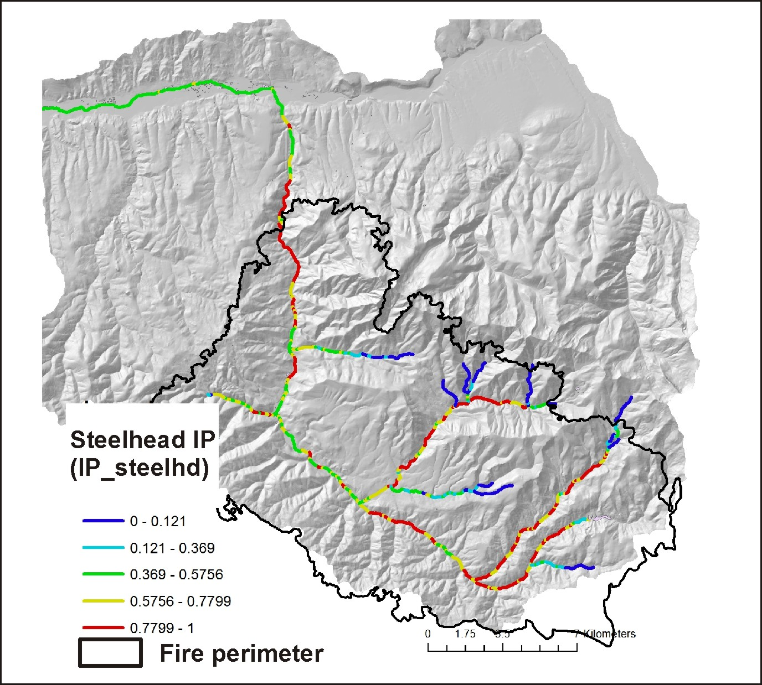
Fish Habitat: steelhead Trout (Oncorhynchus mykiss)
Notes:
Based on intrinsic potential habitat modeling (Burnett et al. 2007).

Slide 6
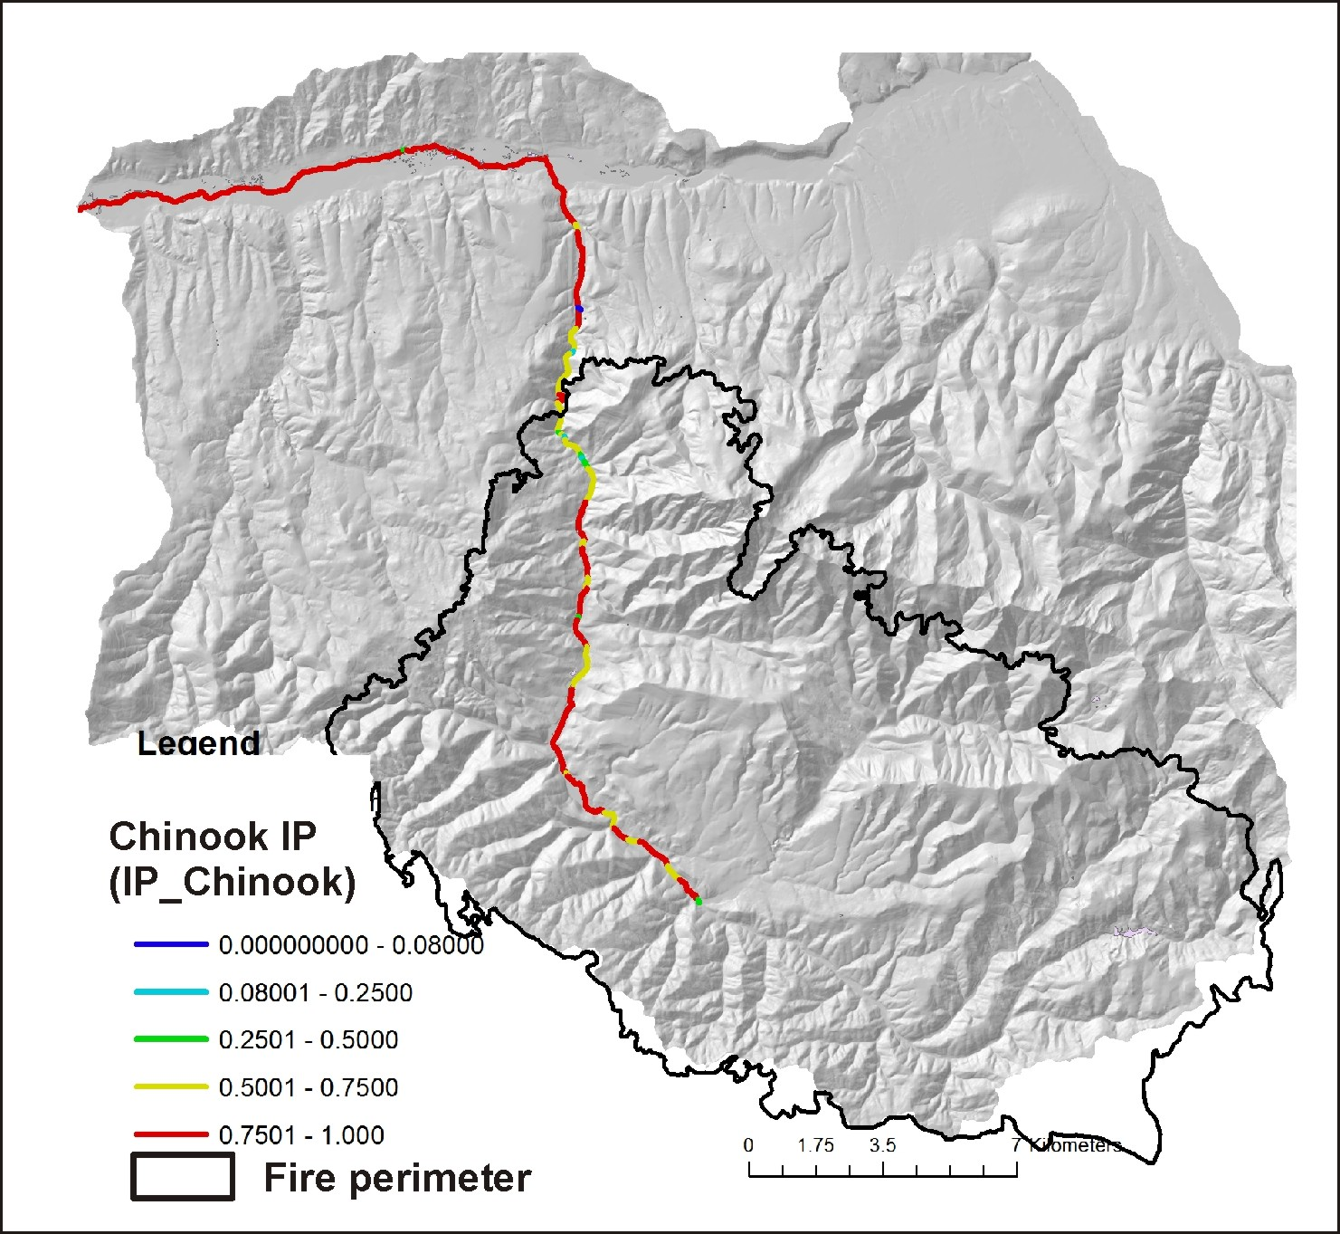
Fish Habitat: Chinook salmon (Oncorhynchus tshawytscha)
Notes:
Based on intrinsic potential habitat modeling (Burnett et al. 2007).

Slide 7
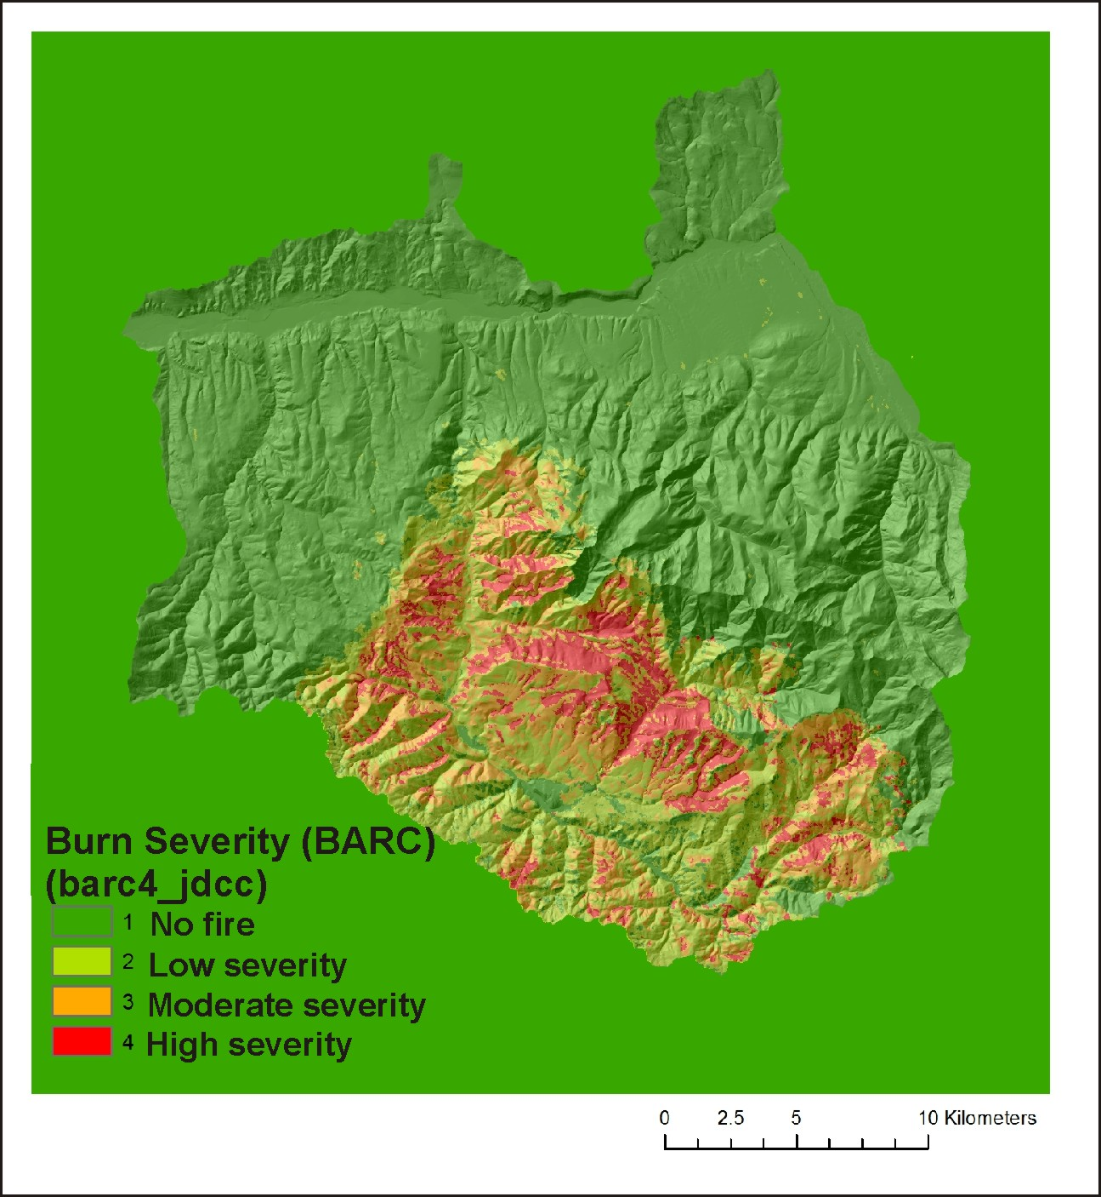
Fire Severity (hillside, Burned Area
Reflectance Classification [BARC] Map)
Notes:
Fire severity as reported in the Burned Area Reflectance Classification [BARC] map.

Slide 8
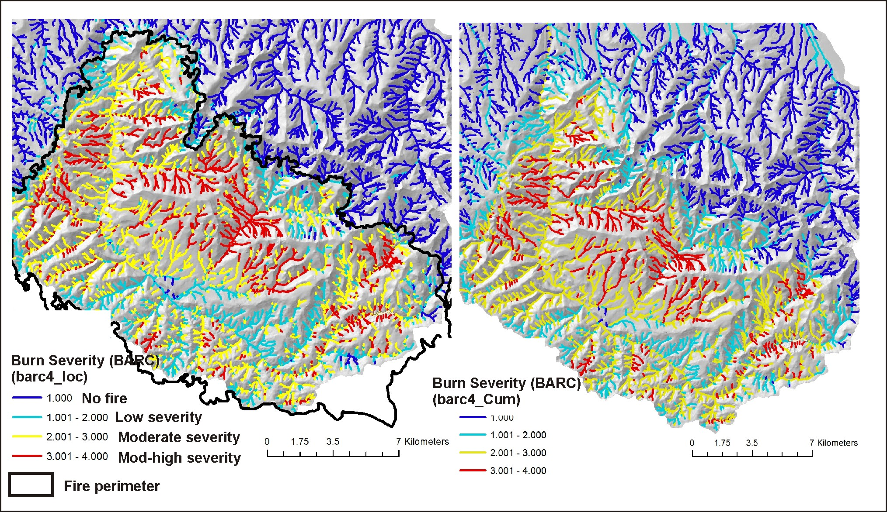
Fire severity mapped to channels
Why are hillslope
attributes
reported to channels, via
drainage wings?
This facilitates comparing
hillslope related stressors
(fire severity, erosion,
roads etc.) to fish habitats,
a channel attribute.
Fire Severity
(channel, fish eye)
Fire Severity, Aggregated Downstream
(tributary scale patterns)
Notes:
Fire severity is reported to individual channel segments (left), via drainage wings, and aggregated downstream.

Slide 9
Notes:
Post fire erosion and channel sedimentation are predicted for surface erosion, gullying and shallow landsliding.

Slide 10
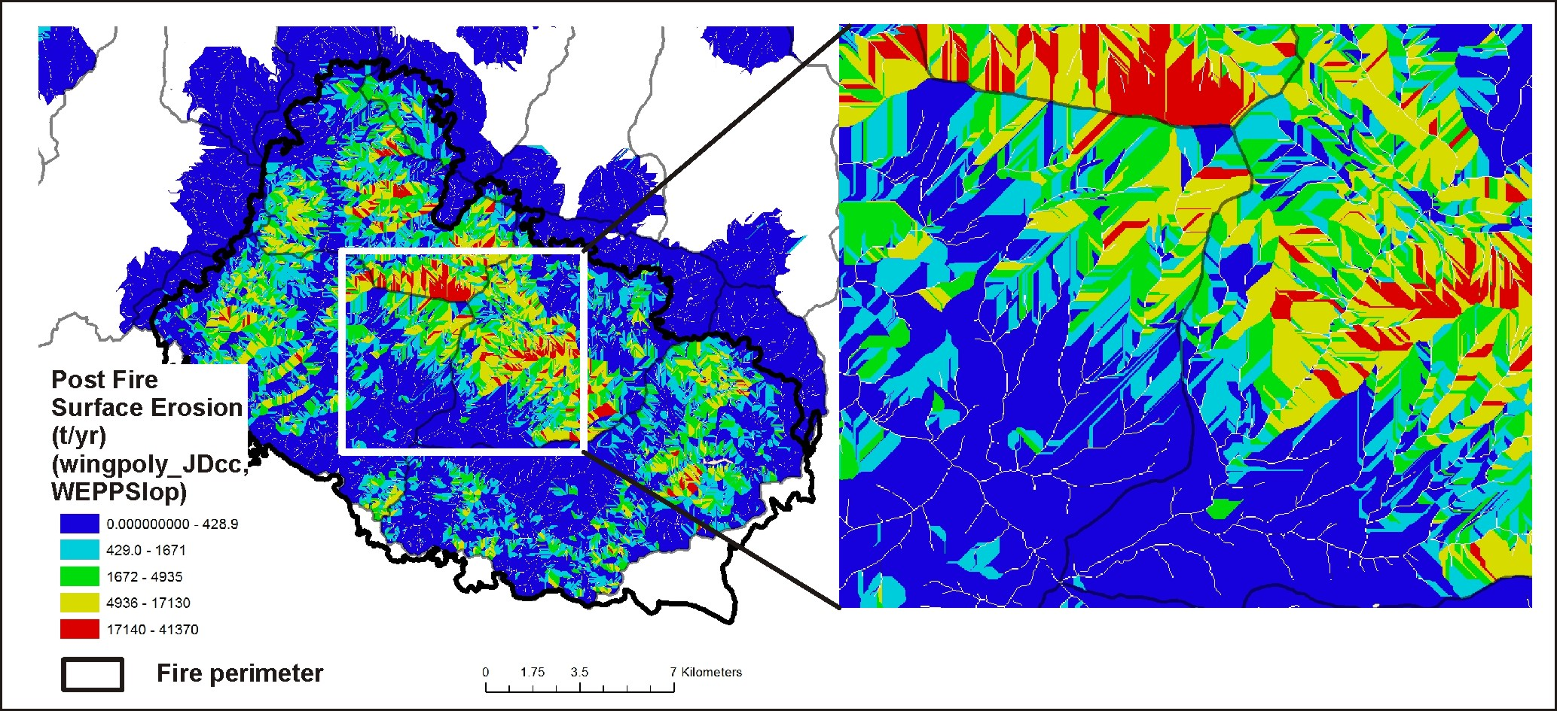
Post Fire Surface Erosion (USFS WEPP model)
Notes:
Post fire surface erosion was predicted using the WEPP-disturbed model. The color patterns indicating variable surface erosion illustrate the variable sizes and shapes of local contributing areas or drainage wings. See NetMap’s online technical help materials for additional information: http://www.netmaptools.org/Pages/NetMapHelp/5_5_surface_erosion_veg_fire.htm

Slide 11
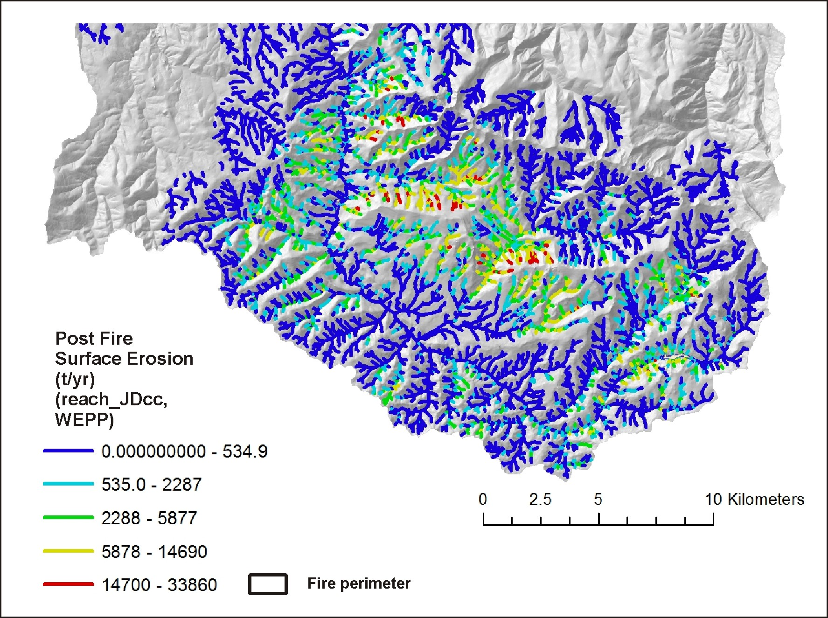
Post Fire Surface
Erosion (WEPP,
disturbed, e.g., function
of fire severity)
reported to stream
channels
(aggregated downstream
also available)
Notes:
Predicted surface erosion is transferred to individual stream segments (left) and aggregated downstream (right), the latter revealing erosion patterns at the tributary and subbasin scale.

Slide 12
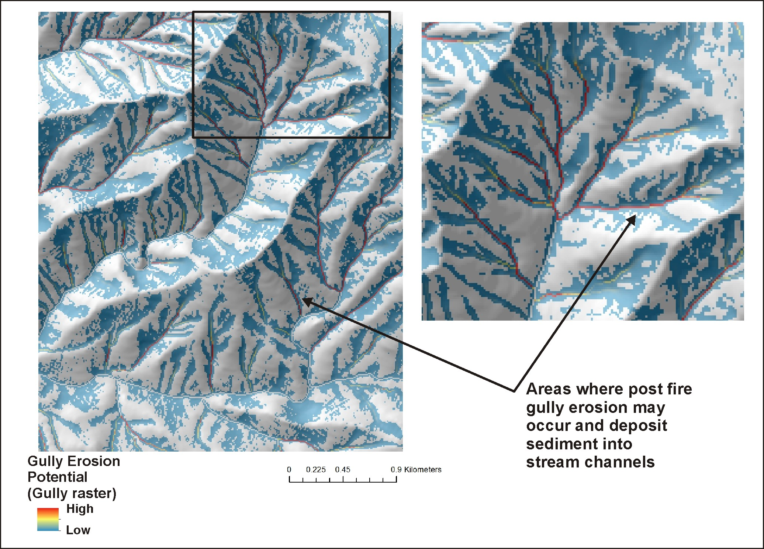
Post Fire
Gully Potential
Notes:
An gully erosion model was used in the analysis (Parker et al. 2010). See NetMap’s online technical help materials for additional information.
http://www.netmaptools.org/Pages/NetMapHelp/gullying.htm

Slide 13
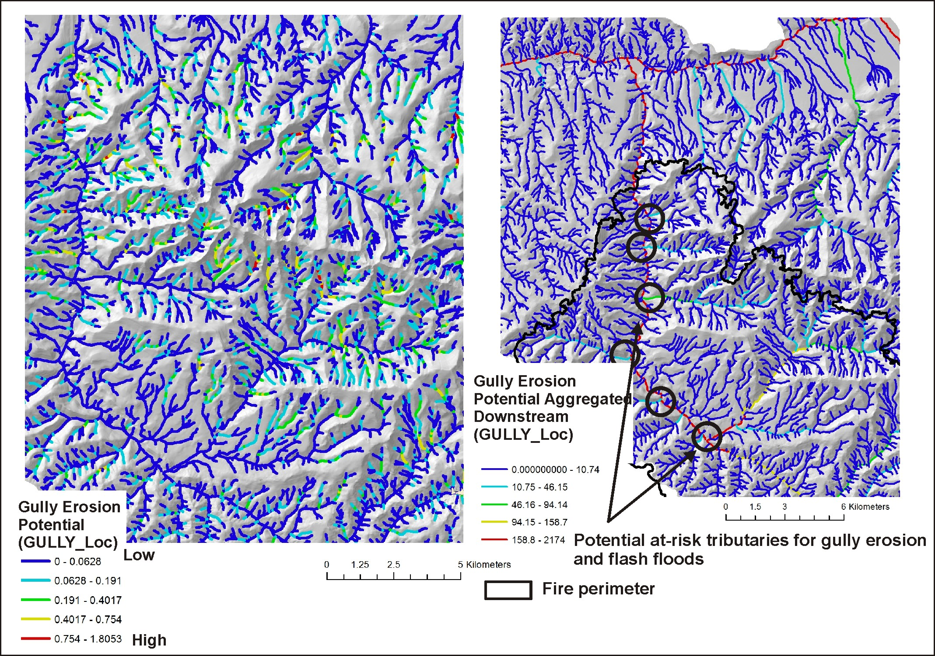
Post Fire
Gully
Potential
(fish
eye view)
Notes:
Gully erosion results reported to stream channels, via drainage wings or local contributing areas.

Slide 14
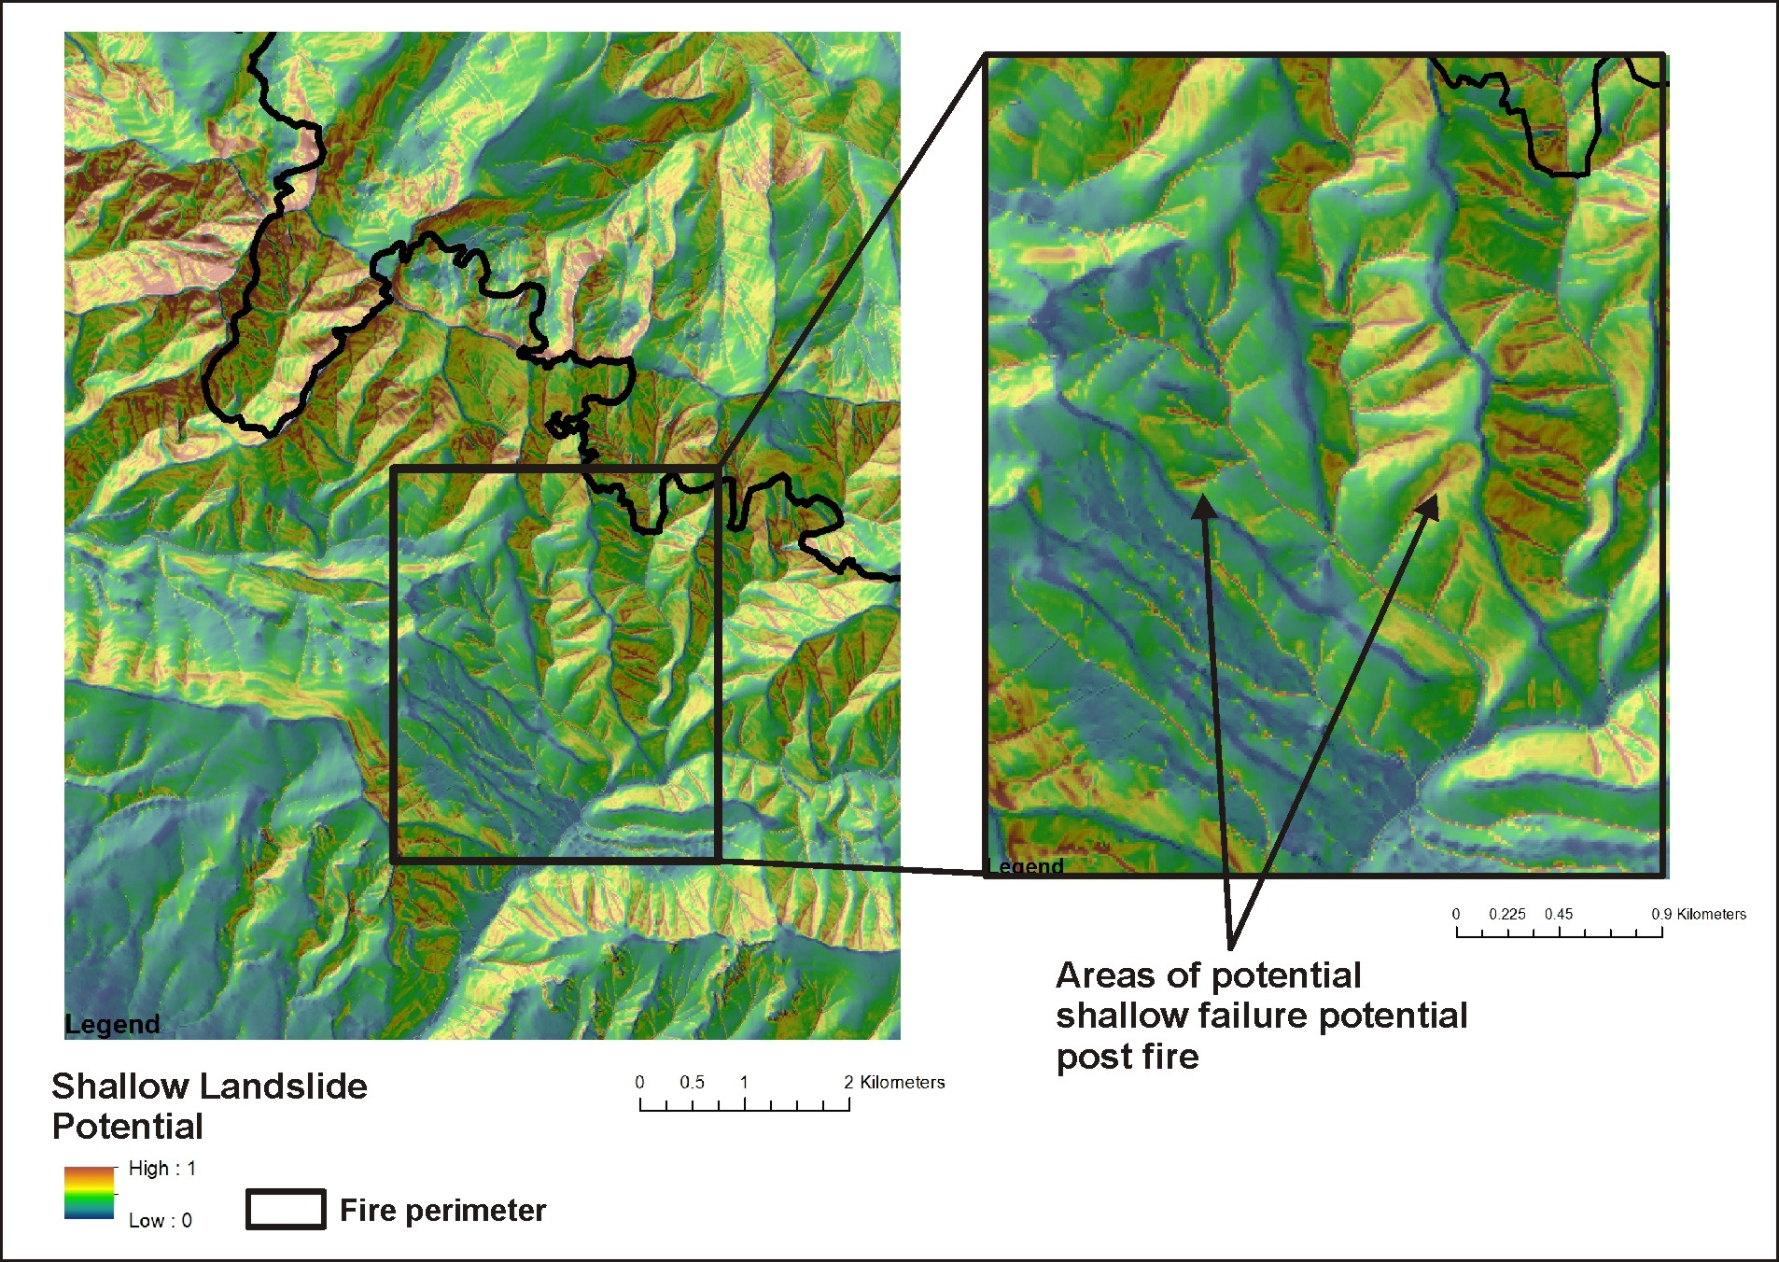
Shallow Landslide
Potential, Debris
Flow Source Areas
Notes:
A shallow landslide model (Miller and Burnett 2007) based on hillslope gradient and curvature was used in the analysis. See NetMap’s online technical help materials for additional information: http://www.netmaptools.org/Pages/NetMapHelp/hillside_1.htm

Slide 15
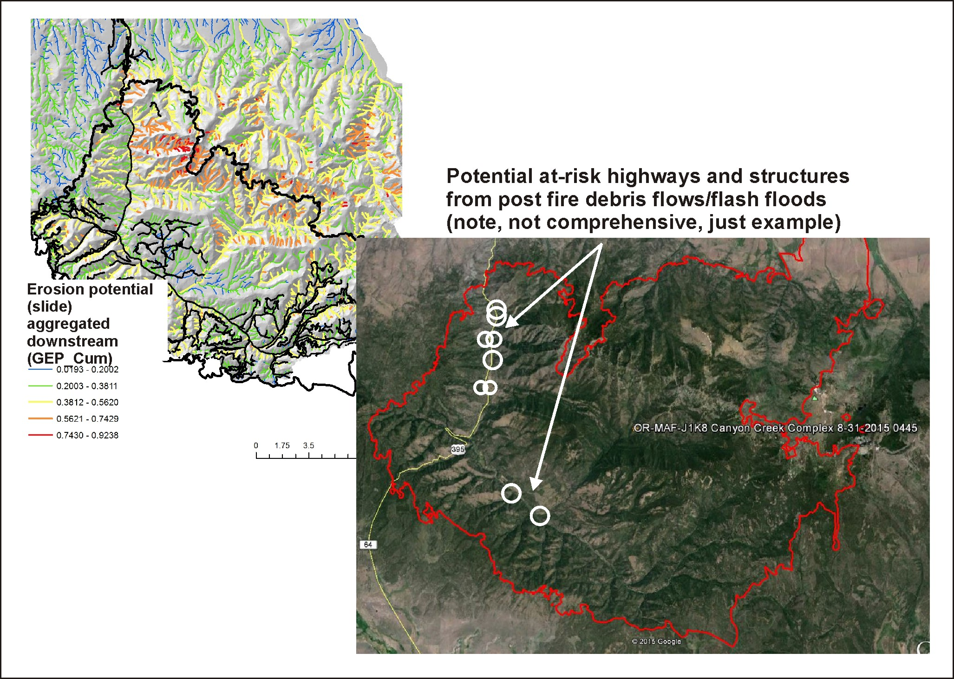
Example of a
risk assessment
you can combine
post fire surface
erosion with
gullying and
shallow failure
Notes:
Here is an example of a risk assessment that overlays predicted erosion potential (aggregated downstream, and thus tributary scale) and the locations of vulnerable highways and residences.

Slide 16
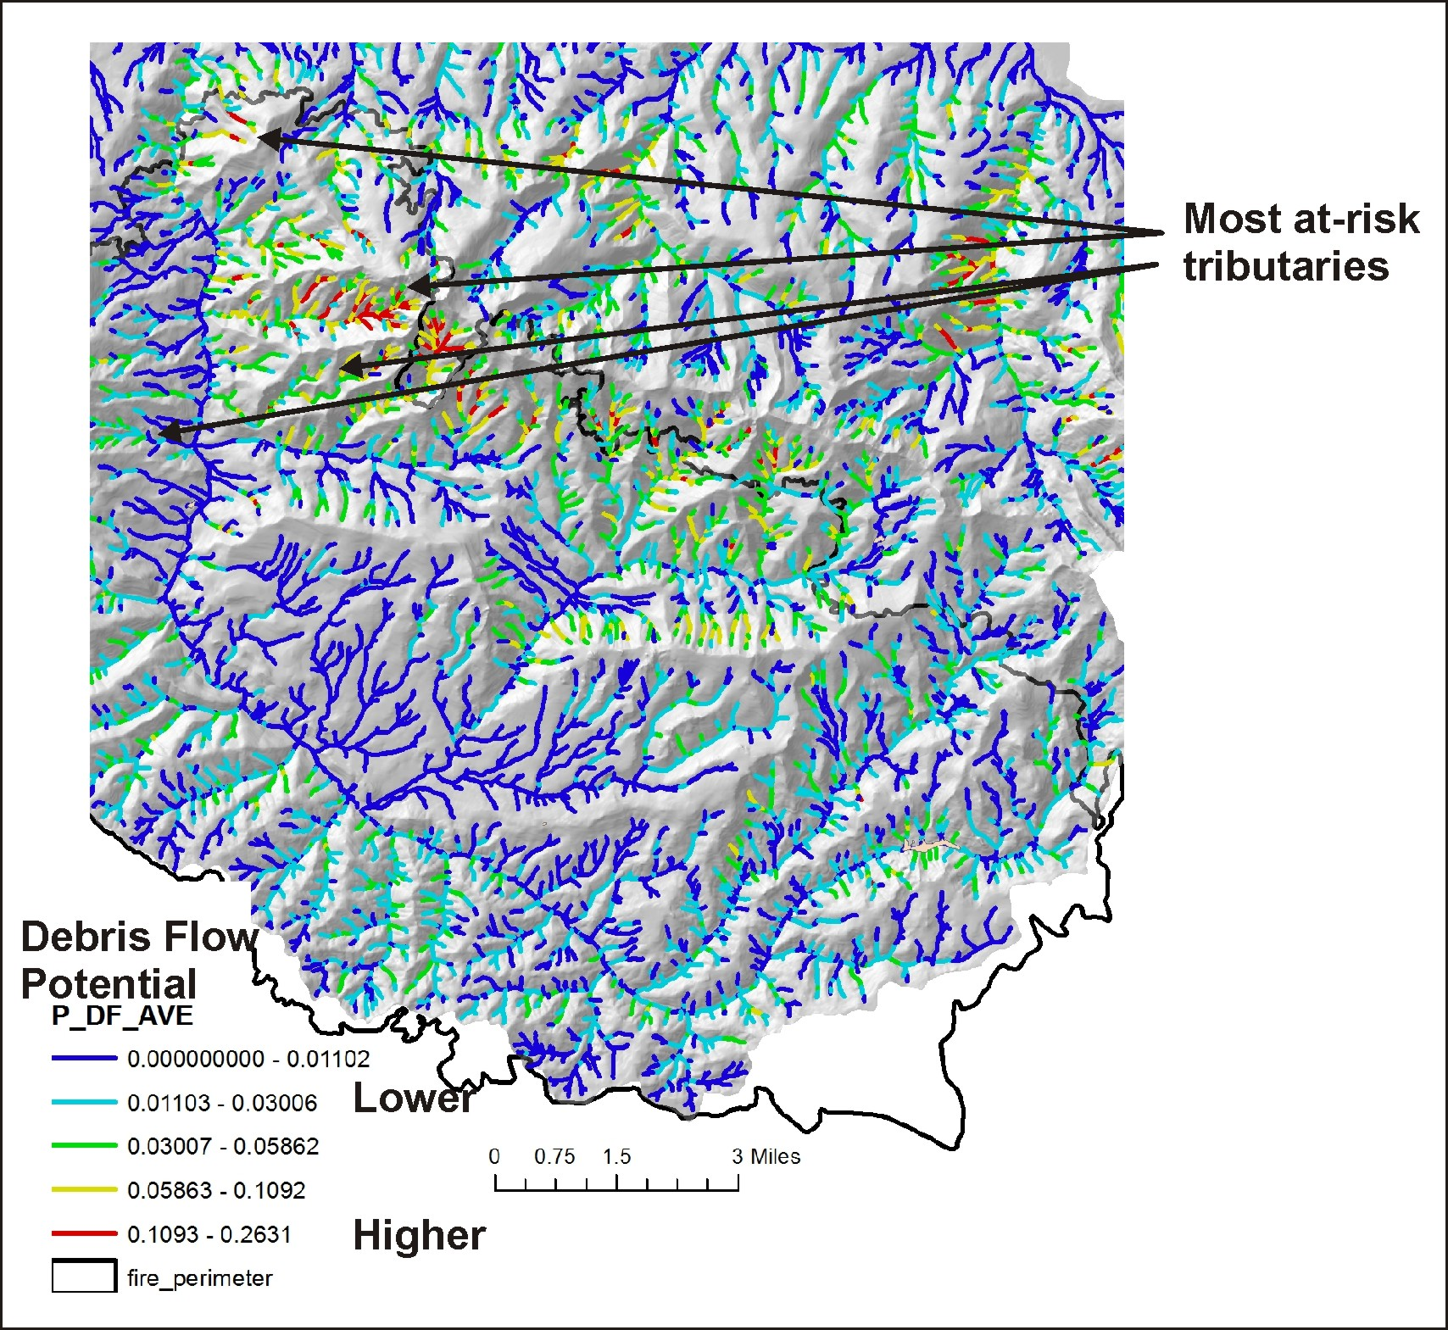
Consider tributary debris flow
risk
Notes:
Although the model employed (Miller and Burnett 2007) is based on data from another mountainous landscape, it provides an approximation of at-risk tributaries using universal attributes related to debris flows including number of source areas, tributary channel gradients, valley confinement and tributary junctions. Also predicted is gully erosion, shallow failure potential and flash flood potential.

Slide 17
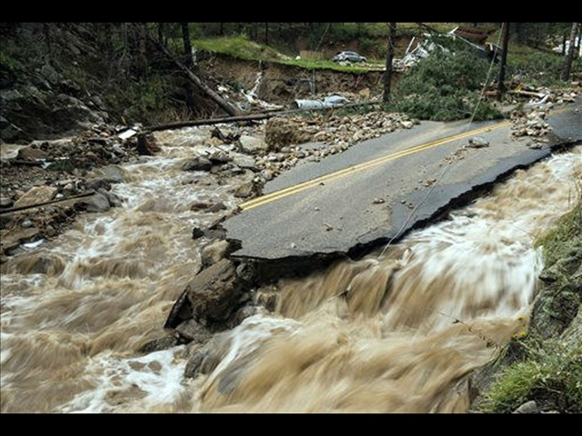
FLASH FLOOD Potential
A dimensionless index developed by the
National Weather Service. The Flash Flood Potential
Index (FFPI) consists of four factors:
hillslope gradient
soils (percent silt, clay and sand)
vegetation density (forest, shrubs, grasses)
fire impacts on soils and vegetation.
See NetMap’s online technical help manual for
additional details.
Notes:
A flash flood potential index will be applied to the study area (second week of Sept).

Slide 18
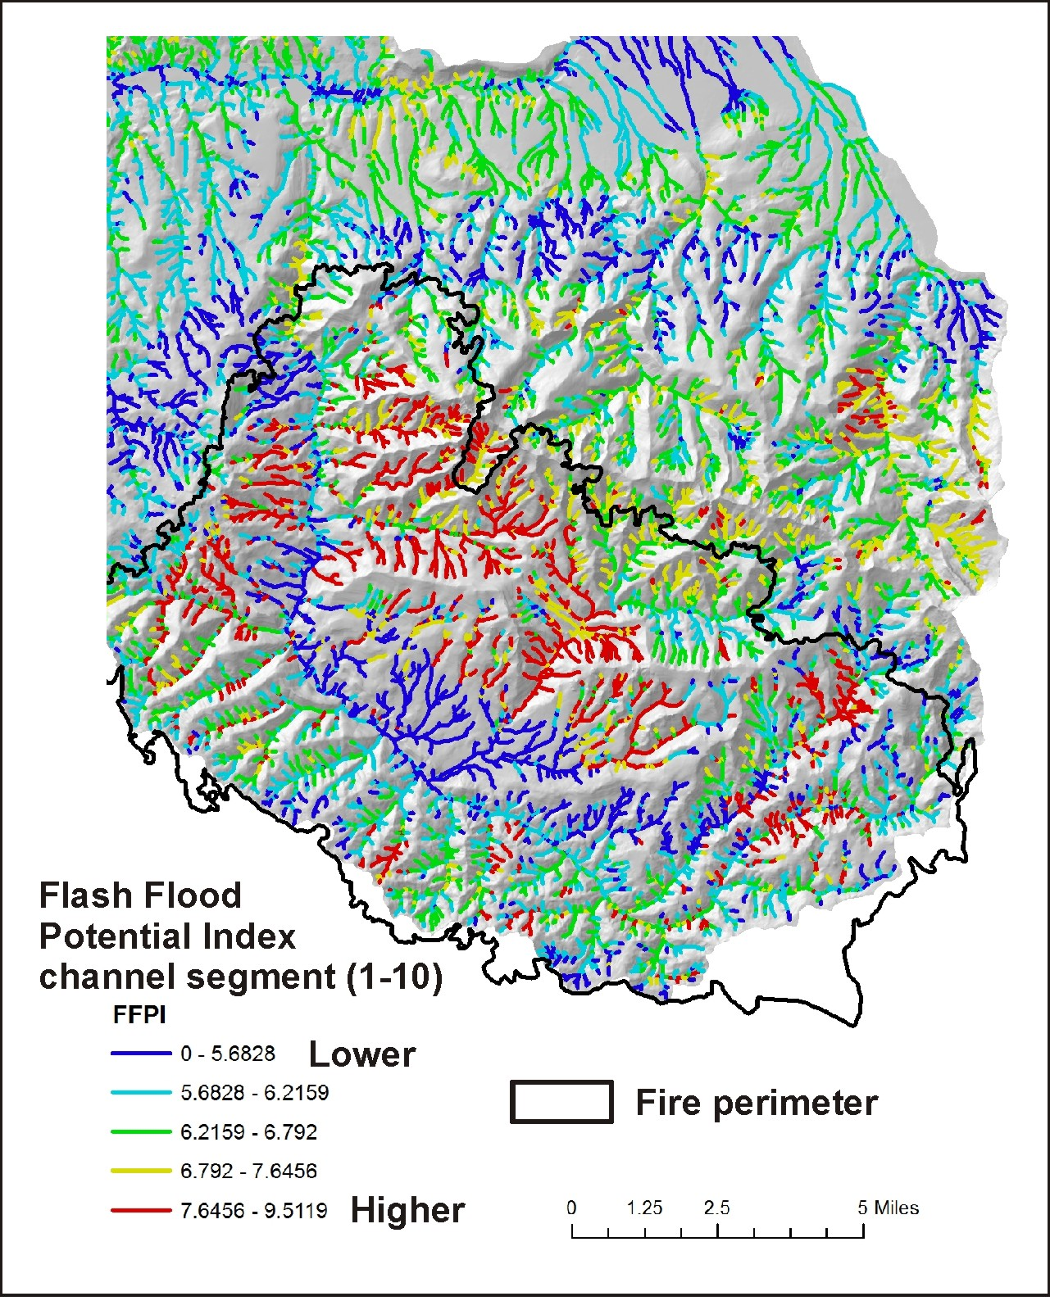
Flash Flood Potential Index
(individual channel segment
scale)

Slide 19
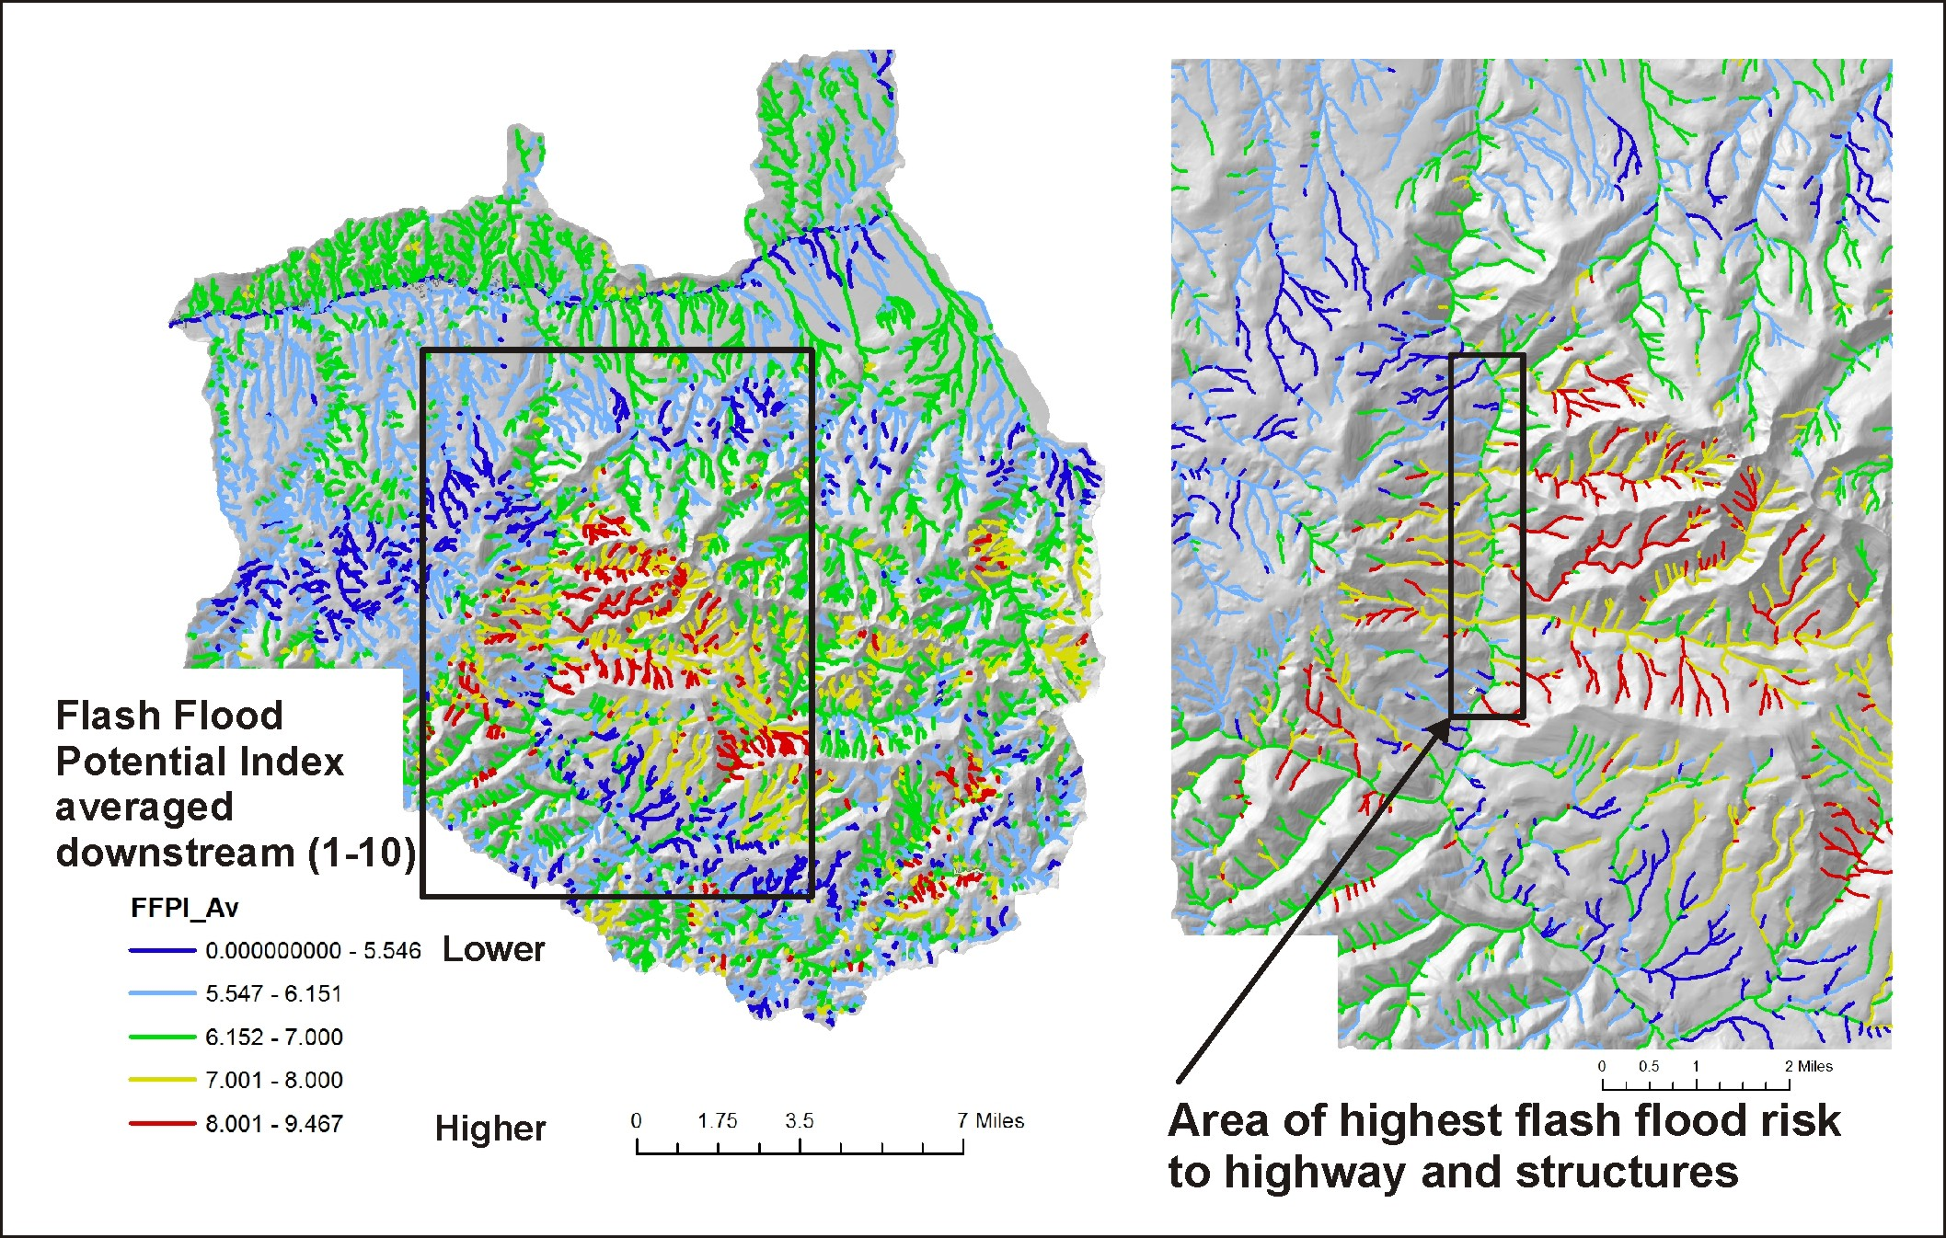
Flash Flood Potential Index (tributary scale, most relevant from risk assessment)

Slide 20
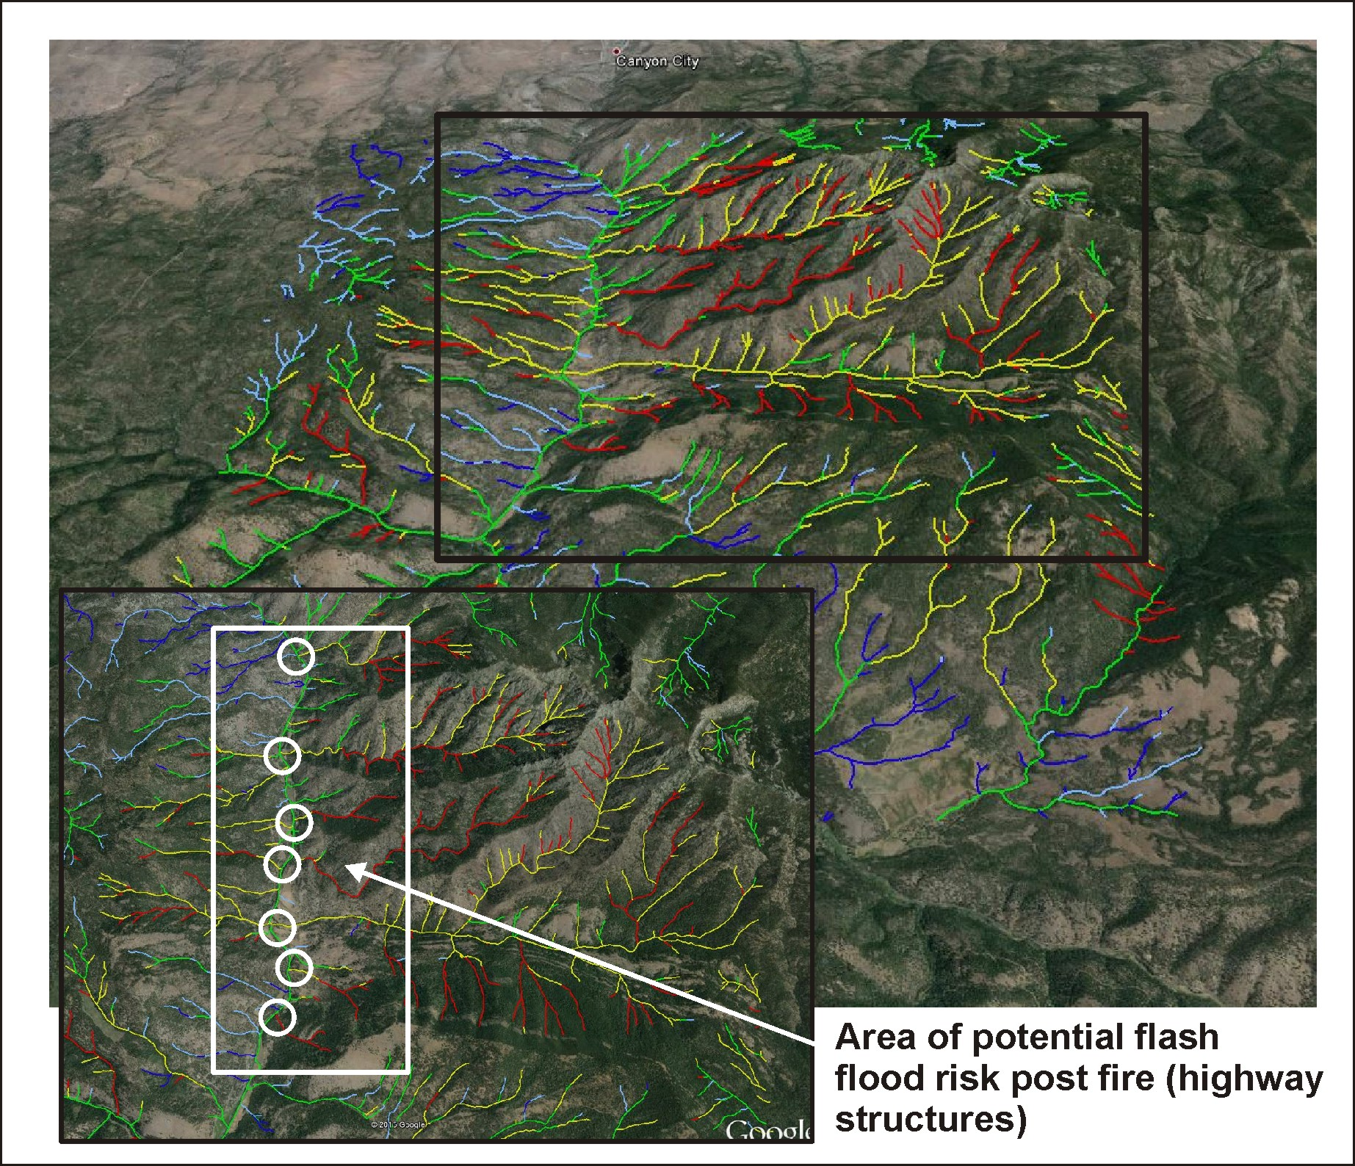
Flash Flood Potential
Index (tributary scale,
most relevant from risk
assessment)
mapped to Google Earth

Slide 21
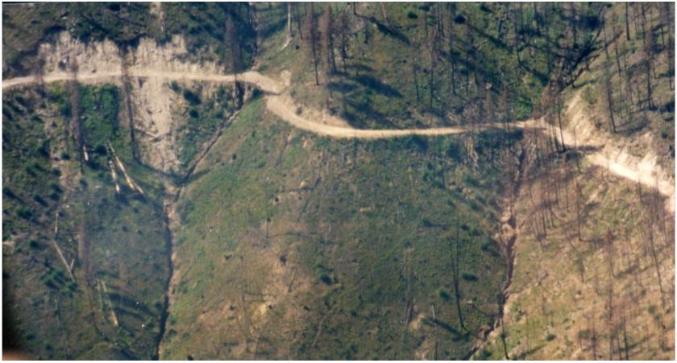
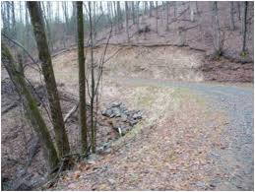
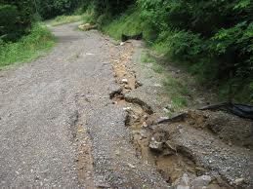
Road Surface Erosion and Sediment Delivery to Streams, Post Fire
Notes:
Roads can be significant sources of flooding, erosion and sediment delivery to streams, post fire.

Slide 22
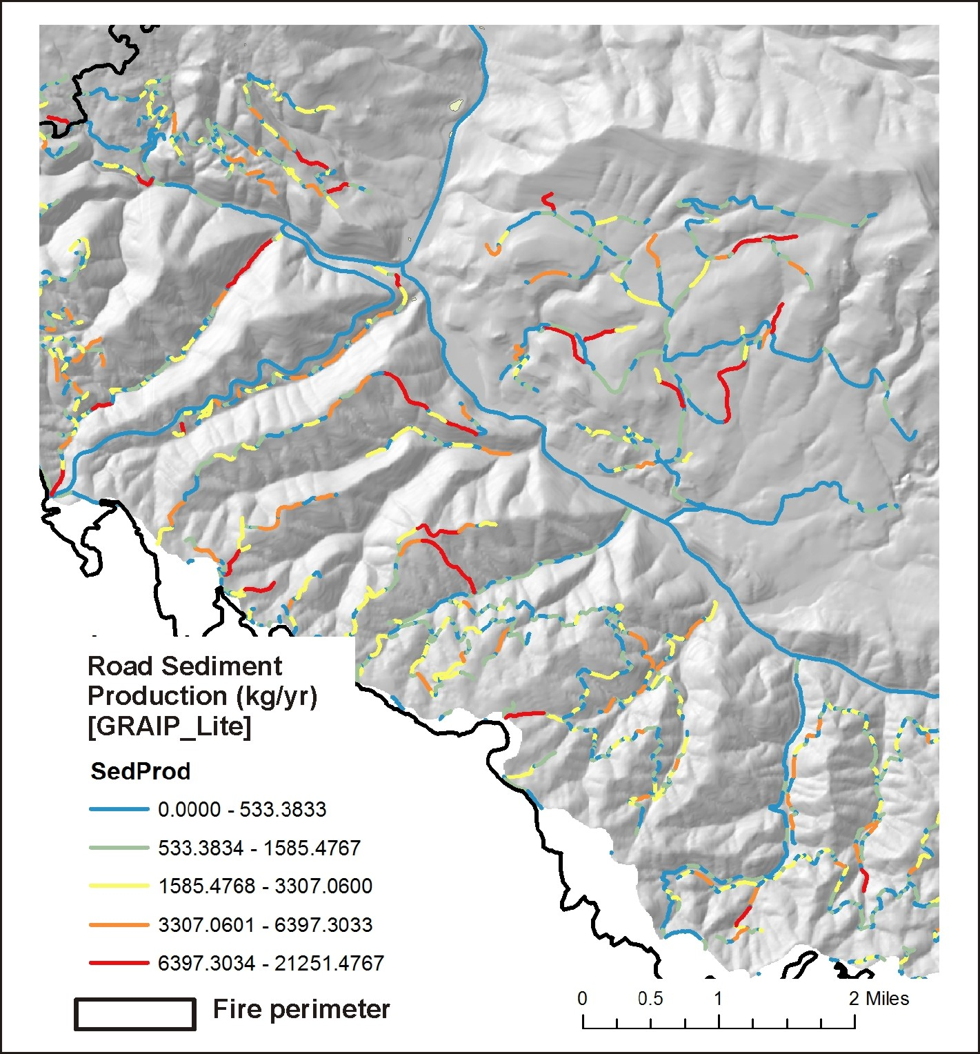
First, start with road sediment
production
Notes:
Sediment production as predicted by GRAIP-Lite; a base erosion rate of 1.5 kg/yr was used.

Slide 23
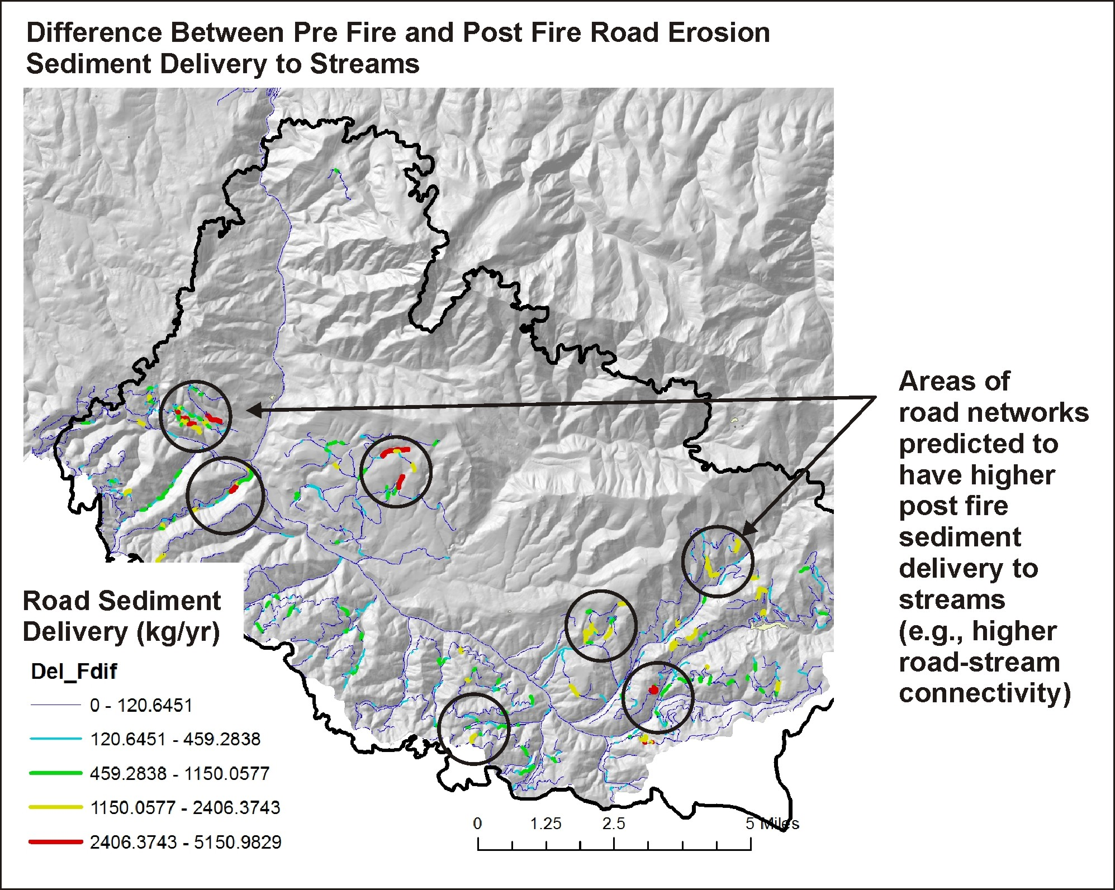
Next, calculate sediment
delivery pre fire and
compare that to
sediment delivery post
fire, and identify areas
of predicted increases
higher connectivity can
occur because high to
moderate severity fires
can reduce soil
infiltration rates, leading
to longer road runoff
sediment plumes
Prioritize remediation
Notes:
A difference map of road sediment delivery reveals that some road segments are more sensitive to fire reductions in infiltration capacity compared to others.

Slide 24
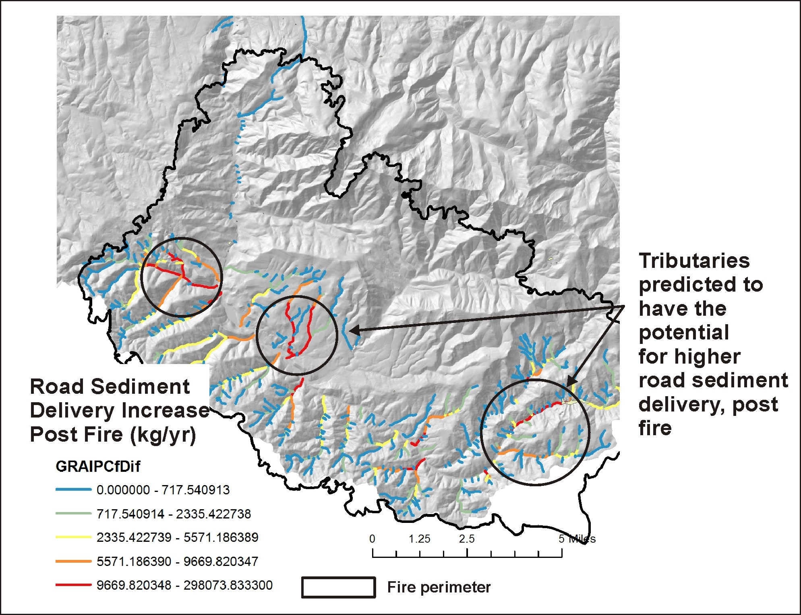
Identify tributary
scale increases
in delivery of
road sediment

Slide 25
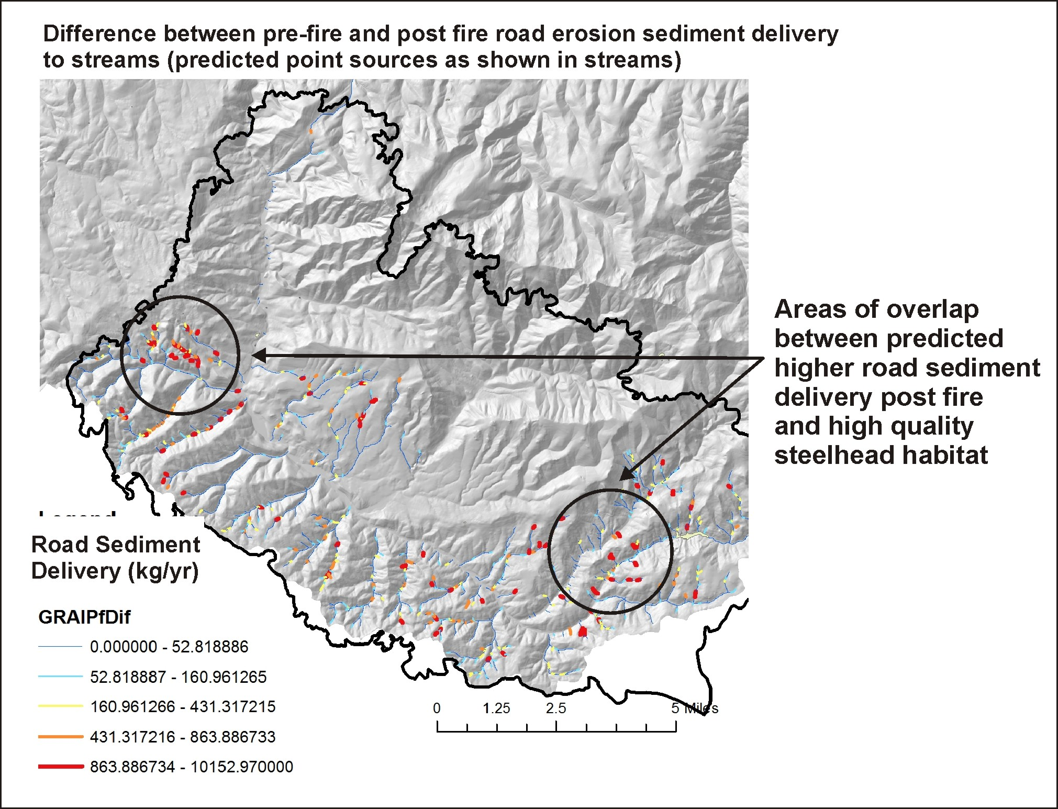
Then compare it to
locations of high
quality and sensitive
aquatic habitats
Notes:
Stream reaches where post fire road sediment delivery is predicted to increase; some of these reaches overlap sensitive fish habitats.

Slide 26
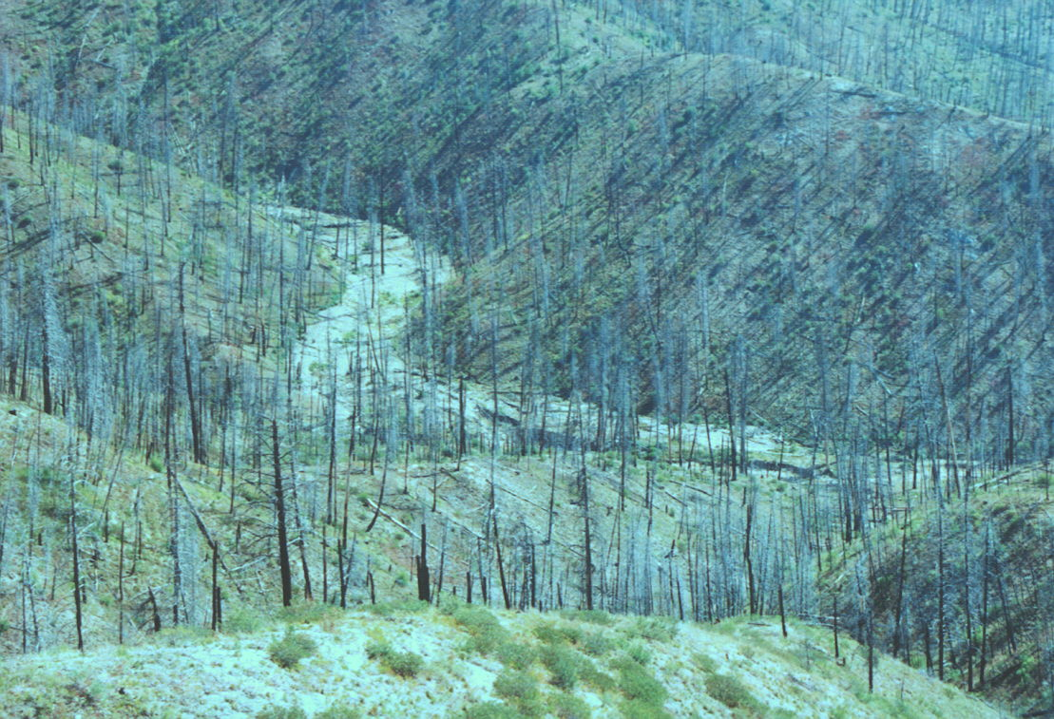
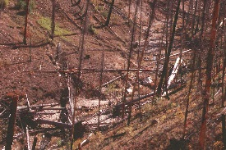
Riparian Zones: Impacts from Fire, Loss of Shade, Increases in Thermal Loading and
Loss of Cool Water Refugia

Slide 27
Notes:
The difference between thermal energy to streams under no fire shade conditions (using LEMMA vegetation data (http://lemma.forestry.oregonstate.edu/) and fire-reduced shade. Many channel segments receive higher thermal loading, post fire.

Slide 28
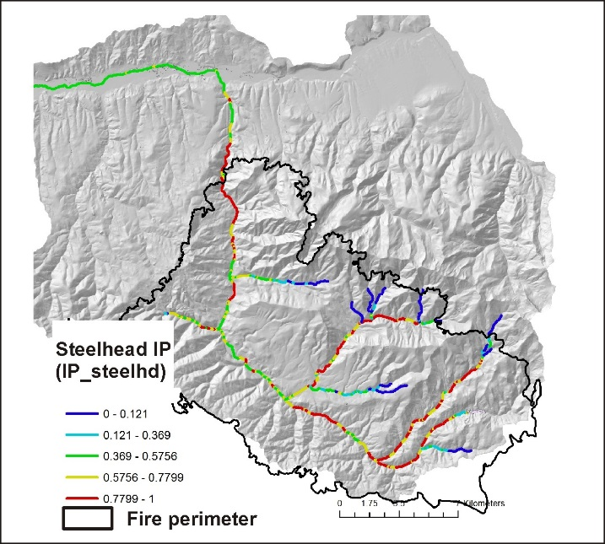
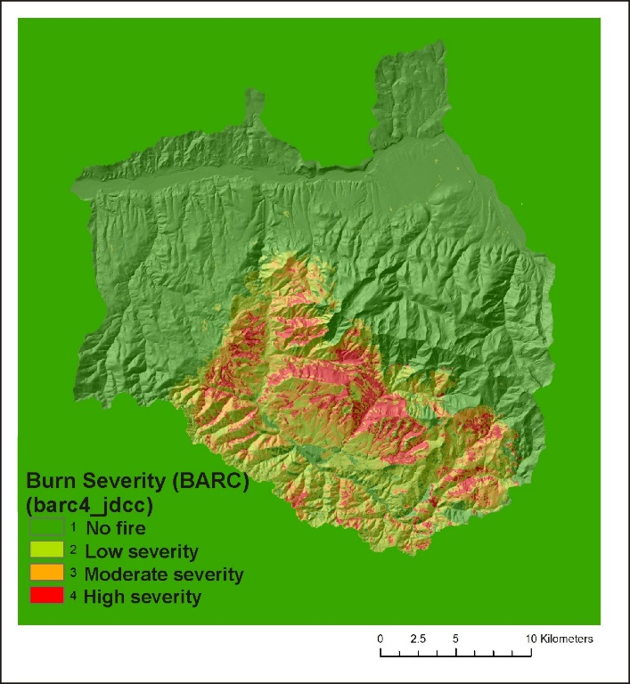
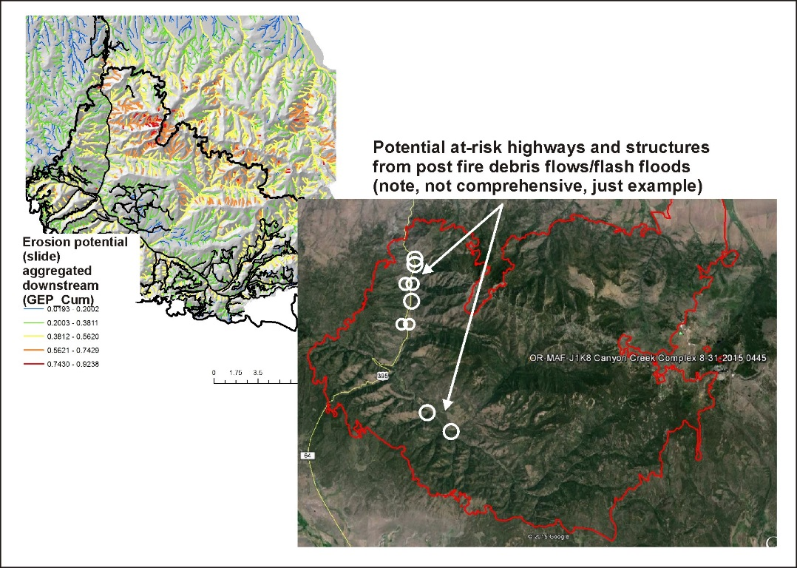
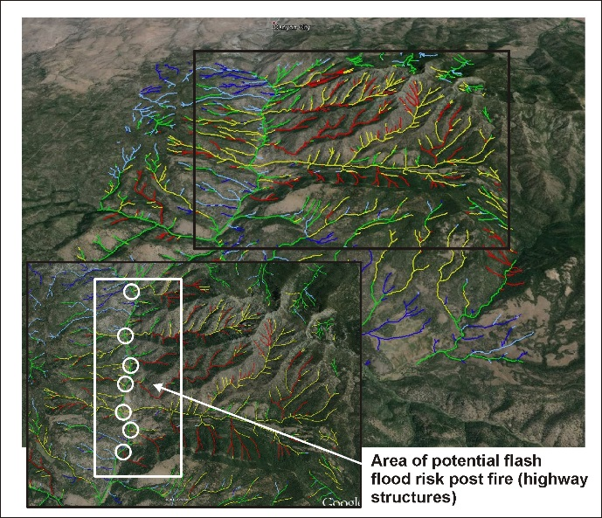
Decision Space: Spatially Explicit Maps (visual - qualitative)
+
+
Fish habitat
Burn Severity
Post Fire Surface Erosion
+
flash flood potential
= priority sites
for restoration
Notes:
Information provided in the BAER analysis (previous slides, among other data) can be used visually and qualitatively to search for intersections or overlaps between various fire related stressors (fire severity, post fire surface erosion, gully erosion) and sensitive aquatic habitats, as illustrated above. Or one of NetMap’s tools (Resource – Fire Stressor Overlap Tool) can be used quantitatively to locate overlaps and intersections (see next slide).

Slide 29
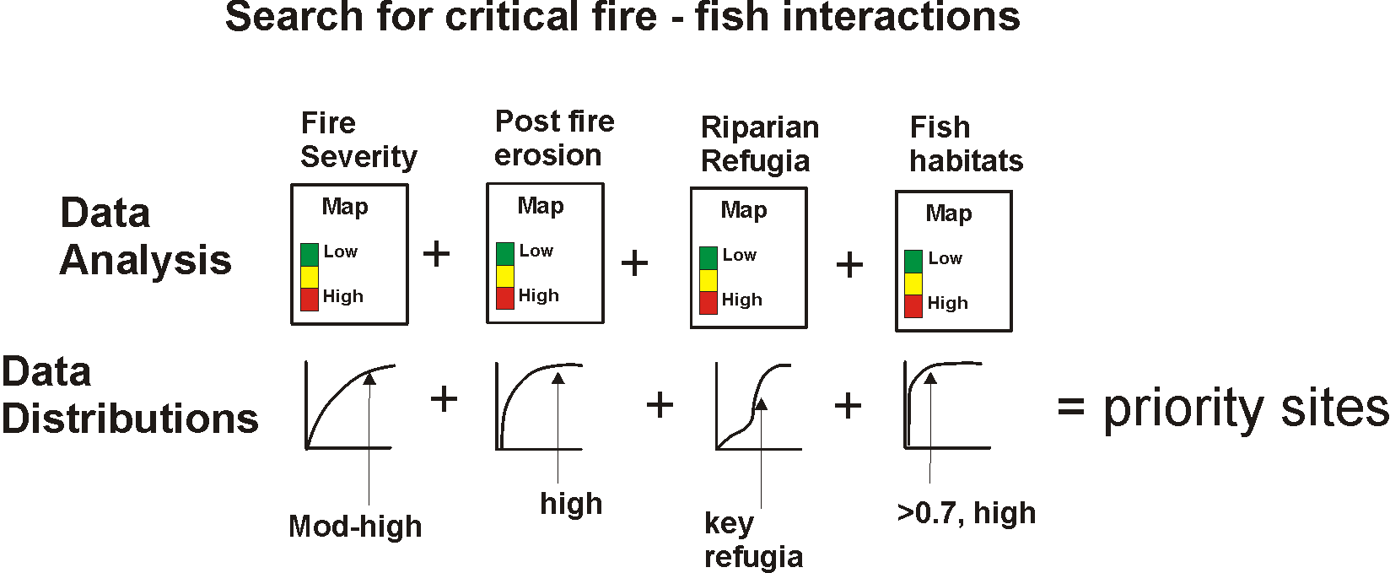
Decision Space: Spatially Explicit Quantitative (use NetMap’s Resource-Fire Stressor Overlap
Tool [Quick Tool])
Notes:
NetMap’s Quick Tool that contains the Resource – Fire Stressor overlap capability can be used to locate intersections between fire related impacts and sensitive fish habitats. The tool calculates, on the fly, the full frequency distribution of values (shown as the cumulative distribution of values in this slide), and the analyst, using the tool, selects from the distributions to search for overlaps. For example, an analyst can quickly search for intersections among the highest 10% of fire severity, highest 5% of post fire surface erosion (or landsliding or gullying), highest 10% of fire related increases in thermal loading, and fish habitats (either presence of habitat or some numeric value of habitat quality [used in IP]).
For additional information, see NetMap’s online technical help that describes the overlap tool: http://www.netmaptools.org/Pages/NetMapHelp/overlap_tool___reaches.htm
And the Quick Tool, which is provided as part of this analysis: http://www.netmaptools.org/Pages/NetMapHelp/netmap_quick_tool.htm

Slide 30
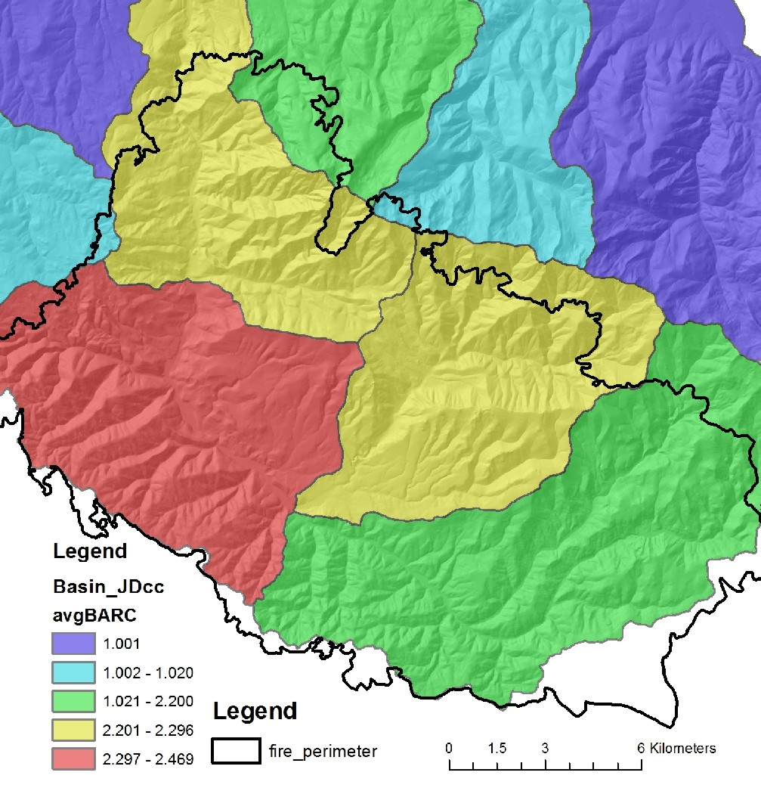
All analysis results are summarized at the scale of HUC 6th field
For example, burn severity (BARC)
per 6th field subbasin
Notes:
All analysis results are summarized to the HUC 6th subbasin scale. This can be used to examine subbasin scale patterns of fire related attributes and stressors and the locations of aquatic habitats. Subbasin scale data summaries may be most useful at the scale of larger watersheds or entire national forests.

Slide 31
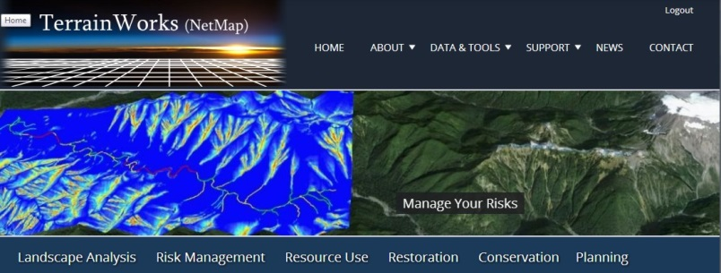
Presentation
Complete
TerrainWorks designs and builds the most advanced watershed and landscape analysis system
in the world. Learn more about NetMap virtual watersheds, watershed analysis tools,
online technical help and tools at: www.terrainworks.com. Contact us with questions,
we are here to help.

