Slide 1
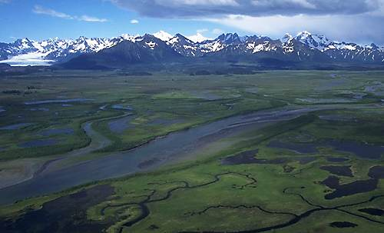
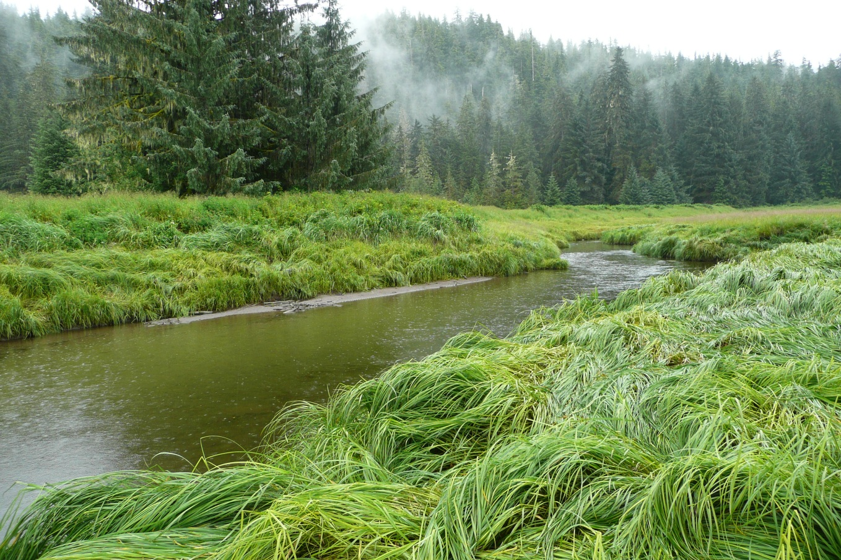





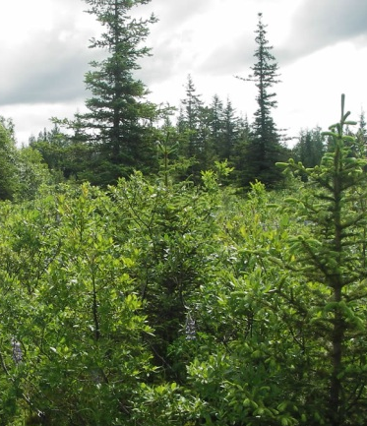
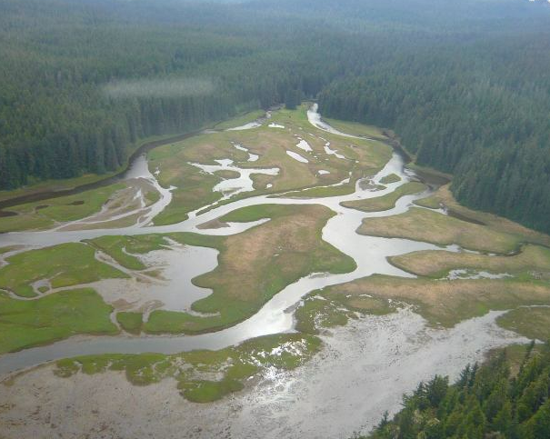
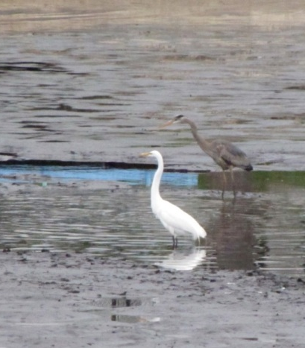
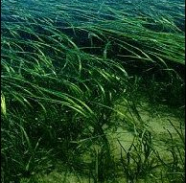
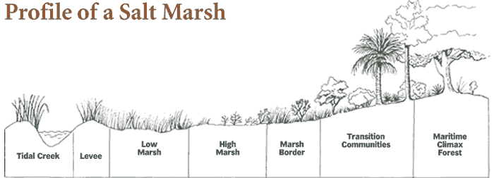
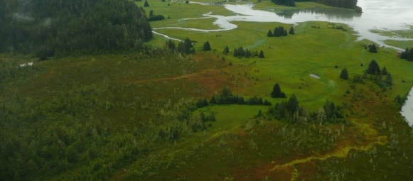
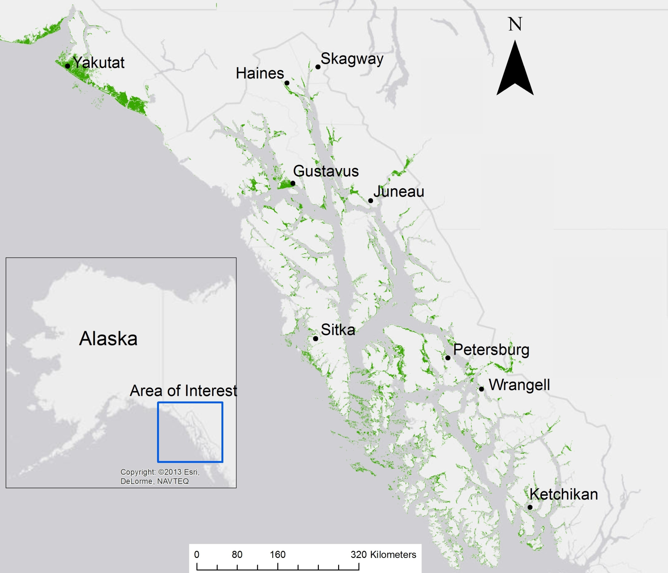
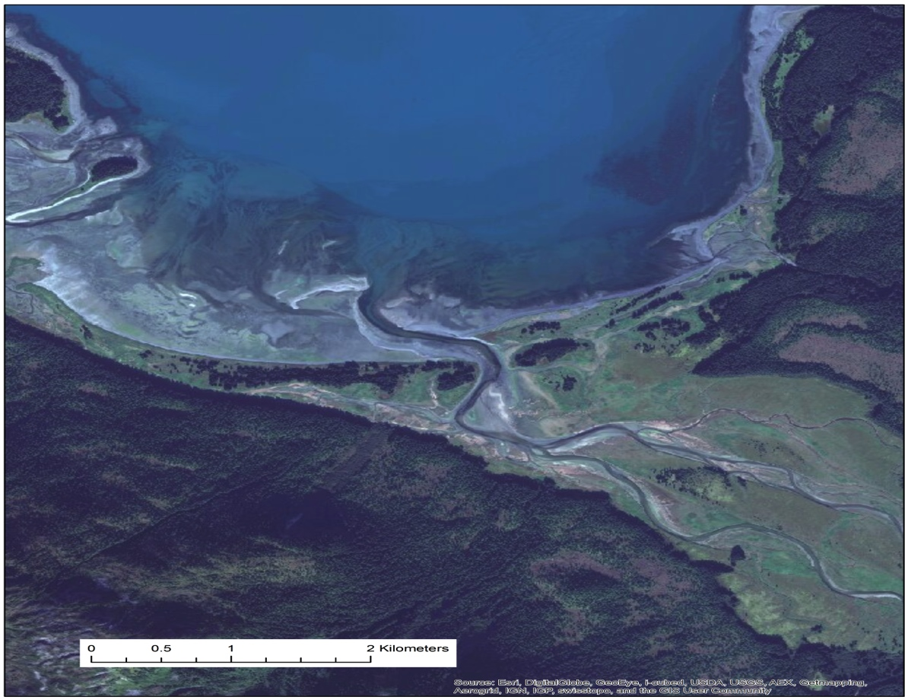
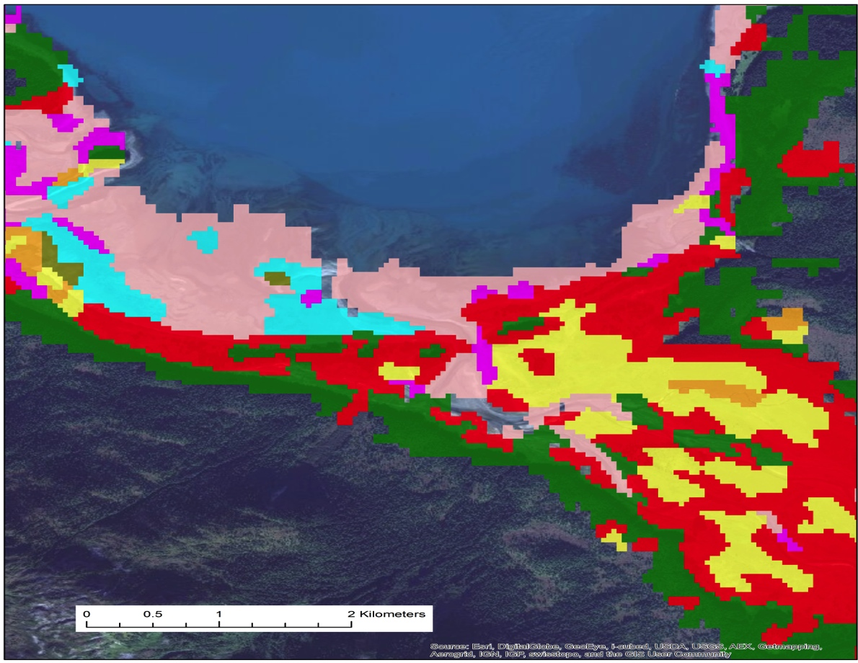
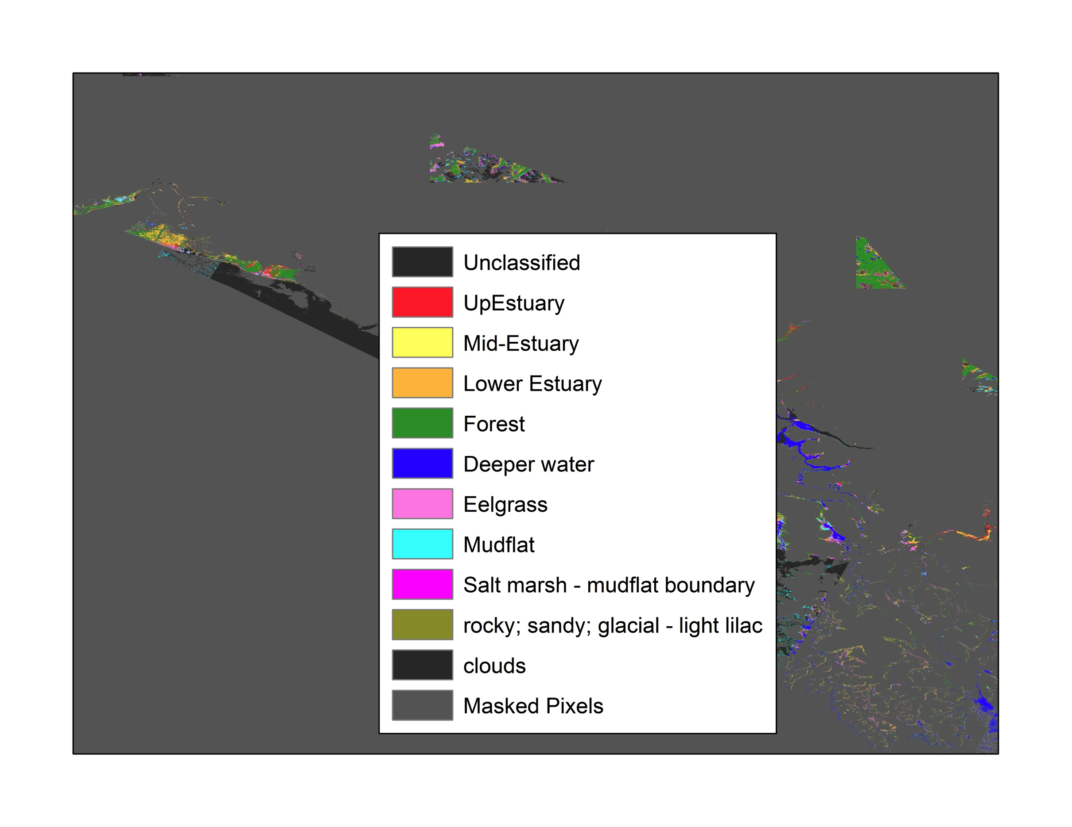
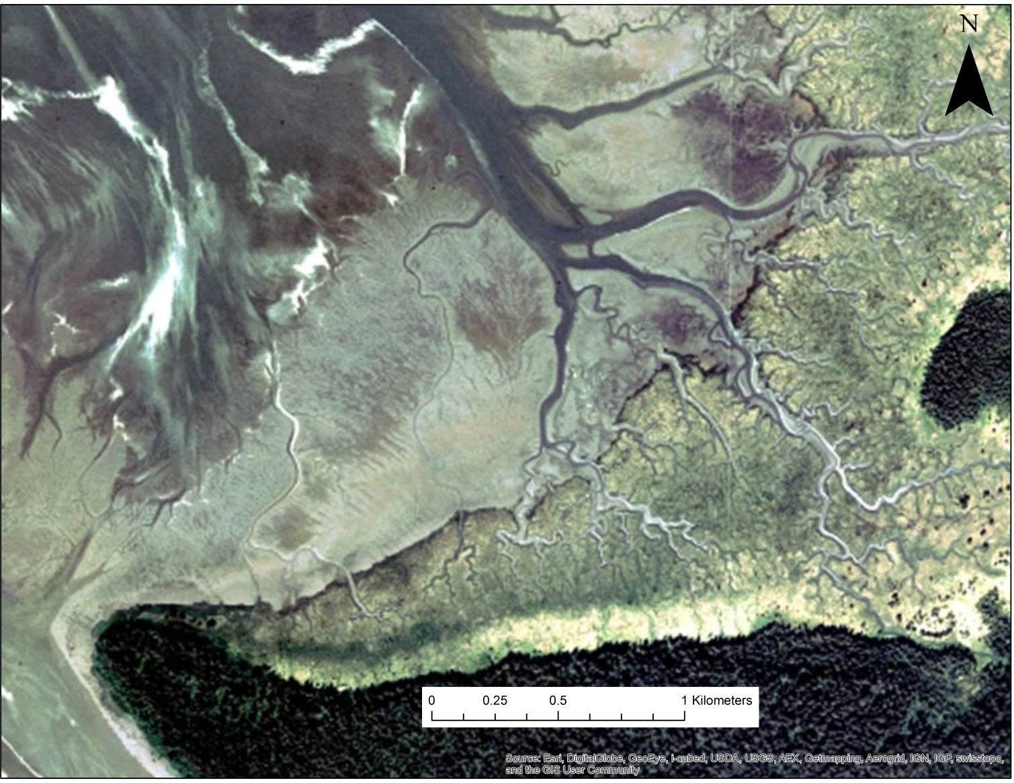
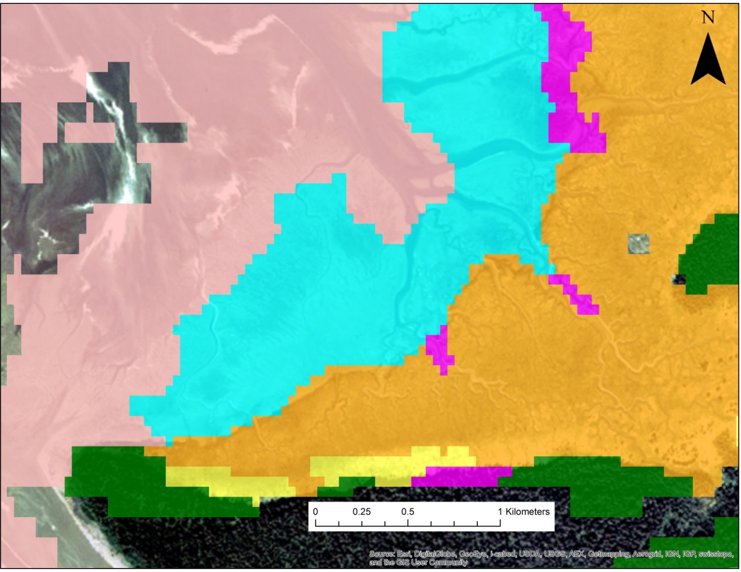
Estuarine habitat modeling in Southeast Alaska
Jamie D. Fuller¹ Sam Lischert², Carolyn Ownby³, Wei Gao³, and Lee Benda²
Graduate Degree Program in Ecology, Colorado State University and (2) Earth Systems Institute
(3) USDA UV-B Monitoring Program and ColoradoView
Background
Research Objectives
Classification
To identify estuarine habitat using geomorphic variables and Landsat 8 imagery for Southeast Alaska.
Identify the extent of salt marsh and mud flat area per estuarine area.
Calculate total estuarine habitat for Southeast Alaska.
Estuarine habitats in Southeast Alaska include an extensive network of intertidal mudflats and salt marshes.
Estuarine habitats are ecologically and economically important. They provide critical habitat for diverse flora and fauna, protect shorelines from erosion and flooding, support recreation and commercial fisheries, and sequester large amounts of carbon (Albert, 2010).
Delineating the variable spatial extent of estuarine habitats in Southeast Alaska will provide a better understanding of critical habitats and will lead to improved ecological mapping and classification.
Since the Little Ice Age (1700’s) rapid and widespread glacial retreat has resulted in isostatic adjustment in SE Alaska (Larsen et al, 2005). There is a strong N-S gradient in rate of uplift varying between 1 to 32 mm/yr. (Sun et al. 2010). Uplift is causing estuarine areas to enlarge over time.
Knowledge of the spatial distribution of estuaries, in combination with other watershed characteristics such as fish habitats, floodplains and network geometry, will be used to develop a watershed ecological classification scheme.
Land-cover Classes:
Salt marsh
Upper Estuary –no inundation and densely vegetated
Middle Estuary – occasionally inundated and vegetated
Lower Estuary – frequently inundated; sparsely vegetated with salt
tolerant vegetation
Salt marsh-mudflat transition zone – areas not definitively salt marsh or mudflat
Mud flats
Mudflats – estuarine mud and silt tidal deposits; not vegetated
Eelgrass – submerged/partially submerged grass-like vegetation
Rocky, sandy, & glacial flow – brightly reflective deposits
Transitional Forest – forest cover intermingled within the estuary or near 20 m
in elevation.
Data Processing
Multispectral imagery: Landsat 8
Radiometric correction
15 scenes cover the entire extent
were captured in 2013 between 6/10 – 8/25
Scenes are, on average, within 2 hours of low tide
Restacked bands to mimic Landsat 7 format for ENVI processing
Mask probable estuary areas:
Reclassify and multiply the DEM, Cirrus clouds, and NDVI:
1 – region of interest (ROI)
0 – No Data
Water mask: NDVI (values: -0.2 to 1)
Cloud Mask: Landsat 8 Cirrus band
Elevation Mask: ASTER Digital Elevation Model (DEM): -5 to 20 meters
Add the Estuary ROI to spectral data as a band layer and apply ROI
High Tide
Tasseled Cap analysis
Low Tide
Mud flats
Transition zone
Low
Estuary
Middle
Estuary
Upper
Estuary
Forest transitional zone
Image Classification
Supervised classification: 35+ training polygons per class
Method: maximum likelihood classifier
Sea water
Eelgrass
Increasing frequency of tidal inundation and increasing salt tolerance
Results
Fig. 1. The various ecotones that can be found in an estuary.
Accuracy assessment using 55 randomly generated points per class to calculate overall accuracy and the Kappa statistic.
Results
Results
Across the extent of this study (~1,000,000 km²) where 0.7% is estuarine habitat, the mudflat class occupies 60% or 4200 km² and the estuary occupies 40% or 2800 km² (Fig 3).
The differences among estuary habitats can be identified using
multispectral imagery captured proximal to low tide (Fig 3).
An accuracy assessment of 55 random points per class resulted in a good overall accuracy of 91% and Kappa statistic of 87% (Table 1).
Estuary
Land
Ocean
Breakdown
Class | Commission accuracy | Omission accuracy
Forest | 95% | 93%
Mudflat | 91% | 92%
Estuary | 89% | 89%
60%
40%
Fig. 3. Percentage of each estuarine land-cover class. The total mudflat areas total 4200 km² and the estuary areas total 2800 km².
Fig. 4. Estuary near Gustavus showing fine resolution imagery from ESRI (left) and land-cover classification (right).
Table 1. Accuracy assessment for the estuary, mudflat, and forest classifications.
Discussion and Future Work
The estuary habitats land-cover classification for SE Alaska provides detailed information of estuary characteristics and supports continued ecological and economical research.
In other studies, isostatic rebound was shown to result in the regional uplift (Larsen et al., 2005). Next, we will pair each estuary classification, slope, and area to estimate the extent of accretion per estuary.
Estuarine classes and area data will be integrated with NetMap stream reach attributes to determine spatial relationships between estuaries and the watersheds upstream. The classification can be joined to a number of physical and biological variables (land cover, topography, watershed area, and stream geomorphology) to further inform estuarine mapping and models.
Fig. 2. Southeastern Alaska spanning from Yakutat to the southern tip of Alaska. The inlay pie char shows the percentage of land-cover that is estuary.
References
Albert, D., C. Shanley, and L. Baker (2010) A preliminary classification of bays and estuaries in Southeast Alaska: A hierarchical Framework and Exploratory analysis. Coastal ecological systems in Southeast Alaska, June, Nature Conservancy Report.
Larsen, C. F., R. J. Motyka, J. T. Freymueller, K. A. Echelmeyer, E. R. Ivins (2005) Rapid viscoelastic uplift in southeast Alaska caused by post-Little Ice Age glacial retreat. Earth and Planetary Science Let., 237, 547-560 doi:10.1016/j.epsl.2005.06.032.
Sun, W., S. Miura, T. Sato, T. Sugano, J. Freymueller, M. Kaufman, C. F. Larsen, R. Cross, and D. Inazu (2010), Gravity measurements in southeastern Alaska reveal negative gravity rate of change caused by glacial isostatic adjustment, J. Geophys. Res., 115, B12406, doi:10.1029/2009JB007194.
Fig. 5. Estuary between Wrangle and Petersburg showing fine resolution imagery from ESRI (left) and land-cover classification (right).

