Slide 1
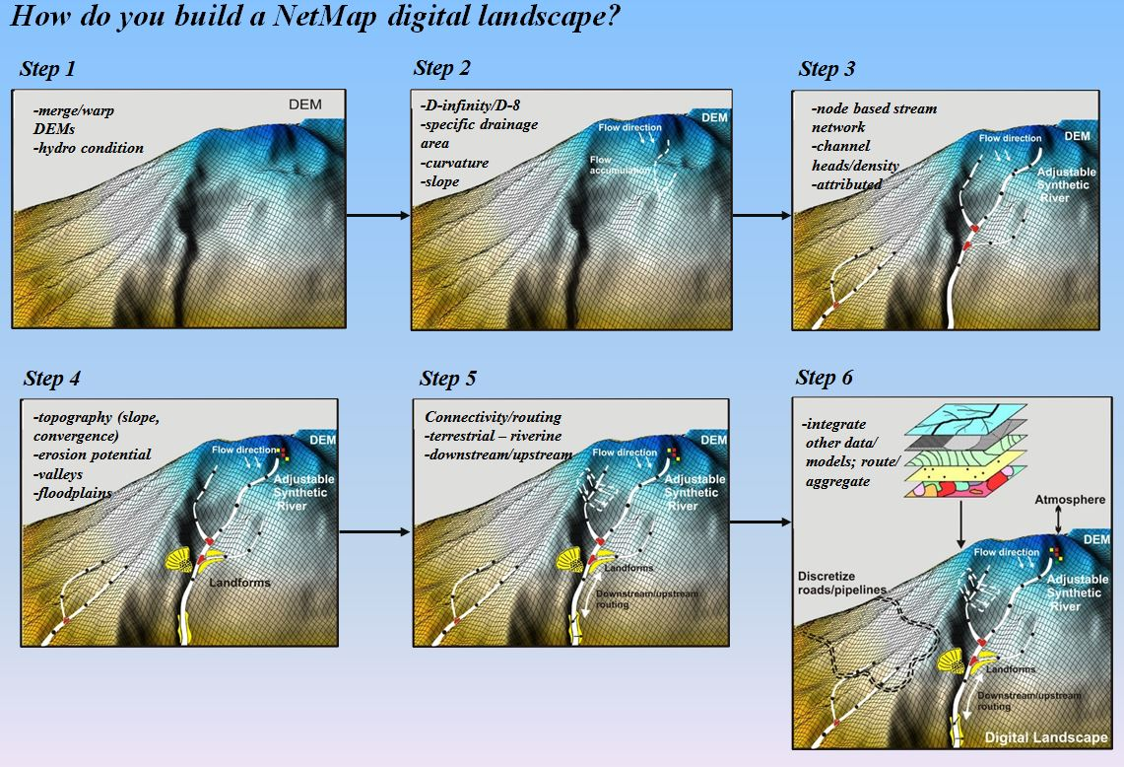
TerrainWorks (NetMap)
Seattle. Mt Shasta.
www.terrainworks.com
Notes:
Our new website. TerrainWorks is the next step in our business evolution. We’ve worked since 1997 as a 501(c)3 nonprofit research organization (Earth Systems Institute), and a large part of our efforts over the last 7 years has been development of software tools for spatial data analysis from a landscape perspective via a platform called NetMap. We’ve been successful in funding development of NetMap, but not so much in funding implementation, maintenance, updates, and user support. This is where TerrainWorks comes in. TerrainWorks is a for-profit company whose role is to implement, maintain, and update the software and data sets, and provide user support, funded via data sales, software subscriptions, and implementation services.

Slide 2
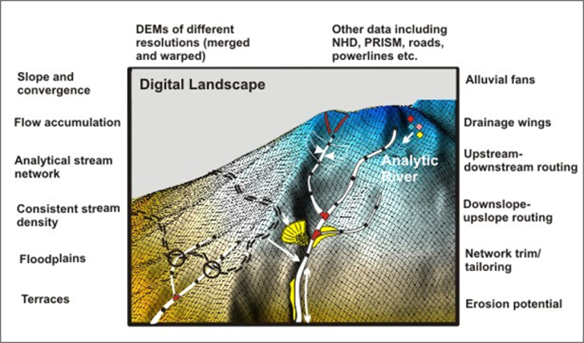
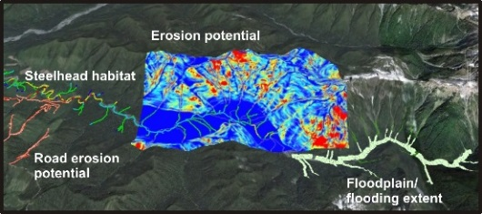
A stream layer (synthetic)
Versus a Digital Landscape
Many differences,
see next slides
Notes:
A key component of NetMap is a software platform we refer to as a “Digital Landscape”. The digital landscape provides a computer implementation of our conceptual models of how landscape processes interact over space and time. It provides a convenient way to look at linkages and interactions between disparate data and disparate processes.
Integral to the digital landscape is a synthetic channel network. This is a network derived from flow directions inferred from digital elevation data. Within the digital landscape, every point is explicitly linked to the channel network via surface flow paths. In the digital landscape, the synthetic channel network provides the spatial framework for linking different processes.

Slide 3
Goal: Understand how the landscape works.
Learn as much as we can from the data we have.
Quantitative Framework: a digital landscape
Spatially Explicit
Visualize relationships
See patterns
Identify linkages
Computer based
Simulate interactions
Try different scenarios
Consistent
Linked to GIS
Share data
Common methodology
Test conceptual models
Quantitative predictions
Numerical experiments
Notes:
A quantitative model allows us to make predictions, to test and improve conceptual models.

Slide 4
Design of a Digital Landscape
Updatable, modifiable. Incorporate new data, new algorithms, corrections. Object-oriented design, data abstraction.
Maintain data at finest spatial grain feasible. (Hardware constraints)
Ability to efficiently query, summarize, and output to GIS or other files. Fortran numerical code.
Provide input to and incorporate output from diverse models.
Flexible data structures, data abstraction.
Notes:
The design, in terms of data structures, computer languages, software, and user interfaces must anticipate how a digital landscape will and could be used.

Slide 5
Components of a Digital Landscape (data + software)
Digital Elevation Model DEM
Spatial reference, topography
Flow routing; all locations are dynamically linked via flow paths
Linked channel-node database
Routed, attributed channel network; linked to, and at the same spatial grain as, the DEM
Explicit Linkages
Other data: Land cover, roads, soils, geology, climate, field surveys, ...
Models: mass wasting, surface erosion, habitat intrinsic potential, wood recruitment, hydrology, ....
Notes:
The digital landscape consists of interlinked data and software. A digital channel network is an integral component of a digital landscape.

Slide 6
Steps in building a channel-network dataset.
Build a contiguous DEM over entire watershed (IfSAR, LiDAR, NED). Decisions: resolution, coordinate system.
Calibrate synthetic channel-network extent. Decisions: length scale for topographic attributes, channel density.
Hydrologic conditioning.
Build a water mask.
Identify road crossings (LiDAR).
Existing line work for hydrologic enforcement.
Drain or fill closed depressions.
Define flow directions.
Build linked channel-node dataset.
Build GIS output files.
Routed channel network. Decisions: reach length, upslope extent.
Attributes (contributing area, gradient, flow length, etc.)
Flood-plain polygons.
Drainage wings.
Run other needed analyses (road erosion, etc.)
Verify (field surveys, other data sets), Quality Control. Iterate. Ensure all subsequent analyses properly functional.
All processing on separate DEM; original data unaltered.
Notes:
We’ll go through all these steps in subsequent slides.

Slide 7
Matanuska-Susitna Basin
Build a contiguous DEM.
Merge IfSAR 5-m DEM
and LiDAR 1-m DEM.
Pilot
basins
Pilot Area
Merged, sampled to 5-m
5-m IfSAR
1-m LiDAR
Mosaic tiles.
Project to common coordinate system (Albers).
Vertically warp DEMs so elevations match at edge of overlap (3000-m transition).
Subsample to 5-m cell size.
Notes:
Mosaic prior to any coordinate-system projections. Be sure to use bilinear interpolation when projecting. Warping and subsampling done with Fortran code.

Slide 8
Merged, sampled to 5 m
5-m IfSAR
1-m LiDAR
Notes:
Warping over 3000-m transition zone. Warping matches mean elevations over a specified radius (150 m) from each DEM. High-resolution detail maintained throughout overlap, except for a 100-m transition zone. Subsampling of warped DEMs using bilinear interpolation.

Slide 9
Steps in building a channel-network dataset.
Build a contiguous DEM over entire watershed (IfSAR, LiDAR, NED). Decisions: resolution, coordinate system.
Calibrate synthetic channel-network extent. Decisions: length scale for topographic attributes, channel density.
Hydrologic conditioning.
Build a water mask.
Identify road crossings (LiDAR).
Existing line work for hydrologic enforcement.
Drain or fill closed depressions.
Define flow directions for flat ground.
Build linked channel-node dataset.
Build GIS output files.
Routed channel network. Decisions: reach length, upslope extent.
Attributes (contributing area, gradient, flow length, etc.)
Flood-plain polygons.
Drainage wings.
Run other needed analyses (road erosion, etc.)
Verify (field surveys, other data sets), Quality Control. Iterate. Ensure all subsequent analyses properly functional.

Slide 10
Calibrate channel-network extent. Channel-initiation threshold calibrated to DEM.
Three thresholds:
Specific contributing area * slope squared (AS²); measure of erosive potential.
Plan curvature; measure of topographic convergence.
Minimum flow length over which above two threshold musts be met.
Merged, sampled to 5-m
Calibration
Area
Thresholds use overlay of four data sets derived from the DEM:
Contributing area.
Contour length crossed by flow exiting DEM cell.
Plan curvature.
Gradient.
High
Low

Slide 11
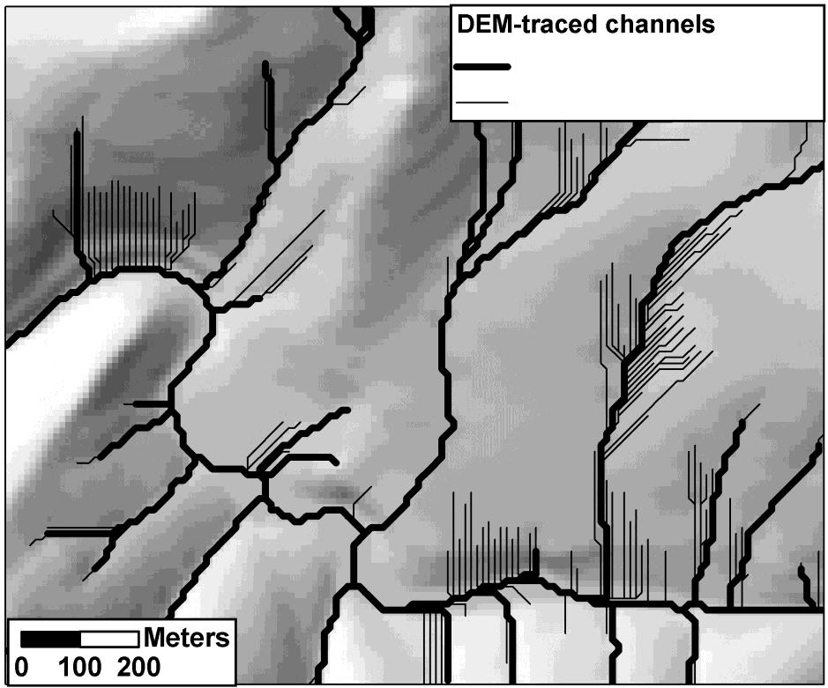
Calibrate channel-initiation threshold to DEM.
Goal: Extend channels as far upslope as resolved by the DEM without feathering.
“Feathering” is extension of traced channels onto areas seen on the DEM as planar hillslopes.
Primary channels
Feathering

Slide 12
Specific contributing area * slope squared. Find the value at which traced channels start to extend onto planar hillslopes, identified by a change in slope in the curve of modeled channel density verses threshold value (log-log plot).
Channel Density (km/km²)
Caibration
Area
Channel Density (km/km²)
Specific area = contributing area / unit contour width.
Contributing area for a DEM cell and contour length crossed by flow exiting a cell calculated with D-∞.
Slope for each DEM cell calculated by fitting a surface over a specified radius centered at each cell.
We examine low-gradient and high-gradient areas separately, because channel-forming processes and associated topography may differ (e.g., seepage erosion versus debris flow).
Notes:
As we progress with this project, we are finding a lot of spatial variability in channel extent. We are expanding the initiation criteria to accommodate greater spatial variability based on landform mapping, which primarily delineates areas with differing soil and subsurface characteristics.

Slide 13
Specific contributing area * slope² (AS²) channel-initiation threshold
Channel Density (km/km²)
Channel Density (km/km²)
250 < AS² < 400m²
AS² > 400m²
Notes:
Red and blue zones show areas meeting different area-slope thresholds.

Slide 14
Plan curvature: identifies convergent topography indicative of channels.
Value varies with the length scale over which it is measured.
10-m length scale
50-m length scale
If we use too short a length scale, we include tree-throw wells and DEM artifacts; if we use too long a length scale, we miss streams.

Slide 15
Contributing area * slope²
Candidate Channel Initiation Sites
Plan Curvature
Candidate sites identify topography, as resolved by the DEM, indicative of presence of channels. One can “turn the knobs” on these thresholds to push initiation sites further upslope, resulting in higher channel density.

Slide 16
Candidate Channel Initiation Sites
We seek the upslope-most points that meet all criteria.
We further require that “channel-indicative” topography persist along a flow path for some specified distance (e.g., at least 30m).
Too short
OK
Notes:
We’re finding that we cannot resolve all channel initiation sites, even with 1-m LiDAR. For example, channels that appear within wetlands don’t have much topographic signature. So we added the ability to specify specific channel initiation points using a point shapefile.

Slide 17
Channel initiation: upslope-most points that meet all criteria.
Flow-direction algorithm:
Upslope of initiation: D-∞, allows downslope dispersion.
Downslope of initiation: D-8, no dispersion.
Notes:
We seek the highest channel density resolved by the DEM. Then we find other data sources to classify channels. For example, if there are topographic thresholds that distinguish ephemeral from seasonal from perennial channels, the network can be divided into these separate classes and further analyses focused on the channel types of interest. It is always possible to remove channels from the synthetic network; not so easy to add them (because that can require re-directing flow directions).

Slide 18
Steps in building a channel-network dataset.
Build a contiguous DEM over entire watershed (IfSAR, LiDAR, NED). Decisions: resolution, coordinate system.
Calibrate synthetic channel-network extent. Decisions: length scale for topographic attributes, channel density.
Hydrologic conditioning.
Build a water mask.
Identify road crossings (LiDAR).
Existing line work for hydrologic enforcement.
Drain or fill closed depressions.
Define flow directions for flat ground.
Build linked channel-node dataset.
Build GIS output files.
Routed channel network. Decisions: reach length, upslope extent.
Attributes (contributing area, gradient, flow length, etc.)
Flood-plain polygons.
Drainage wings.
Run other needed analyses (road erosion, etc.)
Verify (field surveys, other data sets), Quality Control. Iterate. Ensure all subsequent analyses properly functional.

Slide 19
Water mask. A raster or vector layer delineating areas with surface water.
Derived from remotely sensed imagery.
Advantages:
Hydrologic enforcement – guides flow lines in low-relief areas poorly resolved in DEM.
Provides measures of wetted channel area, off-channel habitat, confluence nodes, channel edge length, etc.
Radar Intensity
Notes:
We will take advantage of whatever data sources we can.

Slide 20
Channel mask provides a snapshot in time.
Channel locations can change.
LiDAR
IfSAR

Slide 21
Channel mask provides a snapshot in time.
Channel locations can change.
LiDAR double-line hydrography
LiDAR
IfSAR

Slide 22
Steps in building a channel-network dataset.
Build a contiguous DEM over entire watershed (IfSAR, LiDAR, NED). Decisions: resolution, coordinate system.
Calibrate synthetic channel-network extent. Decisions: length scale for topographic attributes, channel density.
Hydrologic conditioning.
Build a water mask.
Identify road crossings (LiDAR).
Existing line work for hydrologic enforcement.
Drain or fill closed depressions.
Define flow directions for flat ground.
Build linked channel-node dataset.
Build GIS output files.
Routed channel network. Decisions: reach length, upslope extent.
Attributes (contributing area, gradient, flow length, etc.)
Flood-plain polygons.
Drainage wings.
Run other needed analyses (road erosion, etc.)
Verify (field surveys, other data sets), Quality Control. Iterate. Ensure all subsequent analyses properly functional.

Slide 23
Road crossings.
Current options.
Point file of crossing locations. Bomb-crater.
Line file with short line segments from oned side of road to the other. Excavate.
Create stream layer with coarse DEM (10m) that does not resolve road prisms, intersect with road vector layer to identify crossing locations.
Meters
0
100
200
Notes:
For the MatSu, we will probably use option 2 above, digitized short line segments.
Someday we’ll figure out how to get the computer to map road prisms and identify road crossings automatically. Not quite there yet.

Slide 24
Road Crossings: Bomb-crater strategy.
Road Prism
Requires accurately located digitized points for road crossings.
Typically takes several iterations:
Create a stream layer.
Manually check that all road diversions are resolved. If any are missed, add or move points, generate new stream layer.
Repeat until all diversions are dealt with.
Digitized
Point
Stream Channel
Outer
Radius
Inner
Radius
5-m DEM
Road Crossings
Original topography
Craters over road prism.
Notes:
The “bomb-crater” strategy allows us to use a point file of culverts, for example, that has some spatial error. The culvert points don’t have to be perfectly located over the road prism.

Slide 25
Steps in building a channel-network dataset.
Build a contiguous DEM over entire watershed (IfSAR, LiDAR, NED). Decisions: resolution, coordinate system.
Calibrate synthetic channel-network extent. Decisions: length scale for topographic attributes, channel density.
Hydrologic conditioning.
Build a water mask.
Identify road crossings (LiDAR).
Existing line work for hydrologic enforcement.
Drain or fill closed depressions.
Define flow directions for flat ground.
Build linked channel-node dataset.
Build GIS output files.
Routed channel network. Decisions: reach length, upslope extent.
Attributes (contributing area, gradient, flow length, etc.)
Flood-plain polygons.
Drainage wings.
Run other needed analyses (road erosion, etc.)
Verify (field surveys, other data sets), Quality Control. Iterate. Ensure all subsequent analyses properly functional.

Slide 26
Drainage enforcement using existing single-line hydrography.
Originally intended to guide flow paths through areas of low relief where channel courses were not resolved or were ambiguous on DEM.
Subsequently used to force flow to follow existing hydrography (can lead to inconsistent channel gradients).
Strategy:
On a duplicate DEM, incise a “swale” of specified width and depth where drainage is to be enforced.
Depth and width of swale are user specified; provides for more or less enforcement.
Swale excavation can be limited to a user-specified range of channel gradients. This prevents drainage enforcement on steep slopes, where errors in location create anomalous channel gradients.
Flow directions are calculated using the modified DEM.
All subsequent calculations are made on the original DEM.
Channel initiation may be allowed along enforced channels, even if all criteria are not met.
width
Original topography
swale
depth

Slide 27
Original DEM
Excavated swale
1-m deep, 100-m wide
Excavated swale
2-m deep, 100-m wide
Drainage enforcement:
Encourage flow toward preferred courses.
Degree of encouragement determined by depth and width of excavated swale.
Once flow directions set, swale is removed and all analyses done on original DEM.

Slide 28
Steps in building a channel-network dataset.
Build a contiguous DEM over entire watershed (IfSAR, LiDAR, NED). Decisions: resolution, coordinate system.
Calibrate synthetic channel-network extent. Decisions: length scale for topographic attributes, channel density.
Hydrologic conditioning.
Build a water mask.
Identify road crossings (LiDAR).
Existing line work for hydrologic enforcement.
Drain or fill closed depressions.
Define flow directions for flat ground.
Build linked channel-node dataset.
Build GIS output files.
Routed channel network. Decisions: reach length, upslope extent.
Attributes (contributing area, gradient, flow length, etc.)
Flood-plain polygons.
Drainage wings.
Run other needed analyses (road erosion, etc.)
Verify (field surveys, other data sets), Quality Control. Iterate. Ensure all subsequent analyses properly functional.

Slide 29
Drain or fill closed depressions.
Variety of algorithms: filling, excavating, carving, minimum impact, ...
Current strategy:
Attempt to “carve”; cut a channel along probable flow path to drain closed depressions.
If a good “probable flow path” cannot be found, fill to level of pour point. This obliterates any topography within the depression – bad.
Currently experimenting with alternatives.

Slide 30
Steps in building a channel-network dataset.
Build a contiguous DEM over entire watershed (IfSAR, LiDAR, NED). Decisions: resolution, coordinate system.
Calibrate synthetic channel-network extent. Decisions: length scale for topographic attributes, channel density.
Hydrologic conditioning.
Build a water mask.
Identify road crossings (LiDAR).
Existing line work for hydrologic enforcement.
Drain or fill closed depressions.
Define flow directions.
Build linked channel-node dataset.
Build GIS output files.
Routed channel network. Decisions: reach length, upslope extent.
Attributes (contributing area, gradient, flow length, etc.)
Flood-plain polygons.
Drainage wings.
Run other needed analyses (road erosion, etc.)
Verify (field surveys, other data sets), Quality Control. Iterate. Ensure all subsequent analyses properly functional.

Slide 31
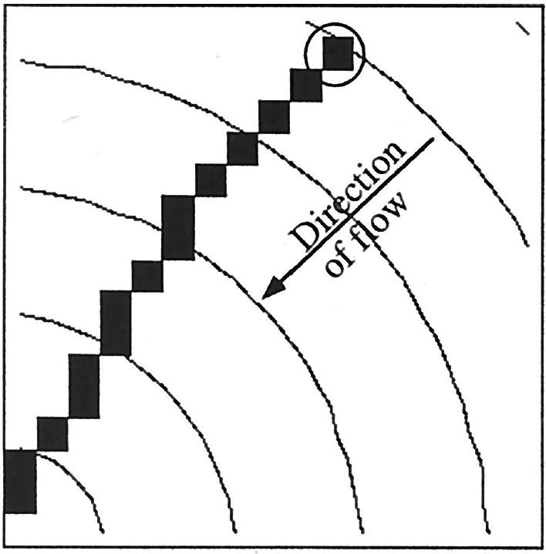
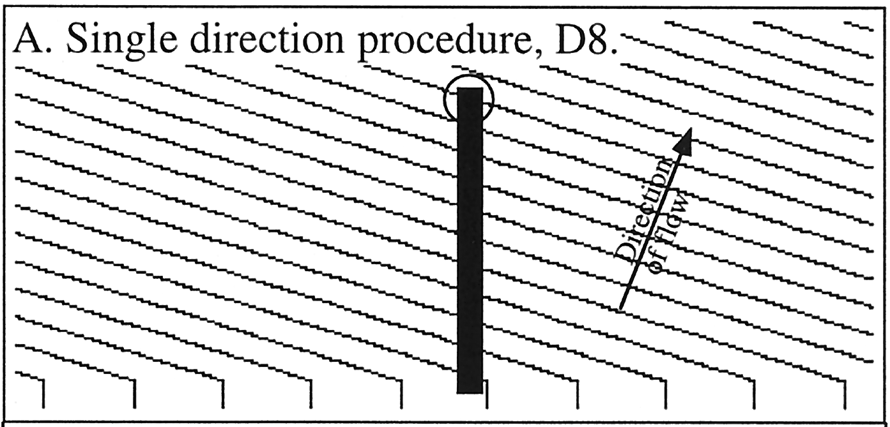
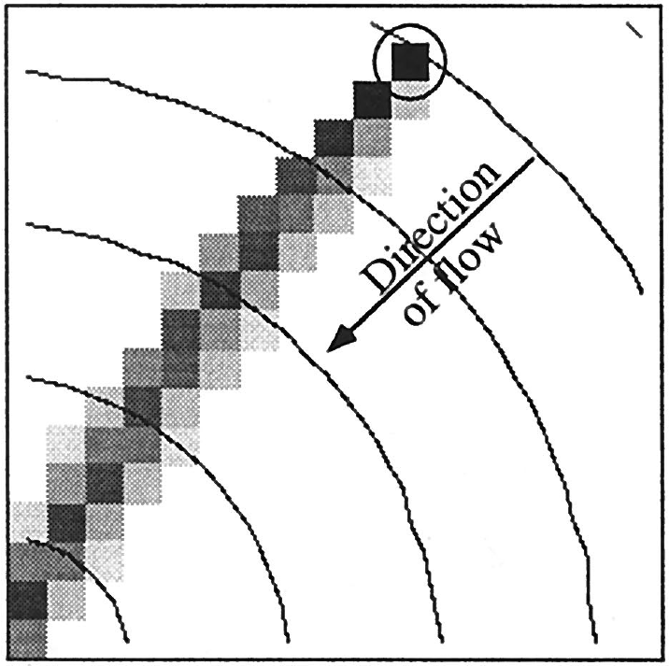
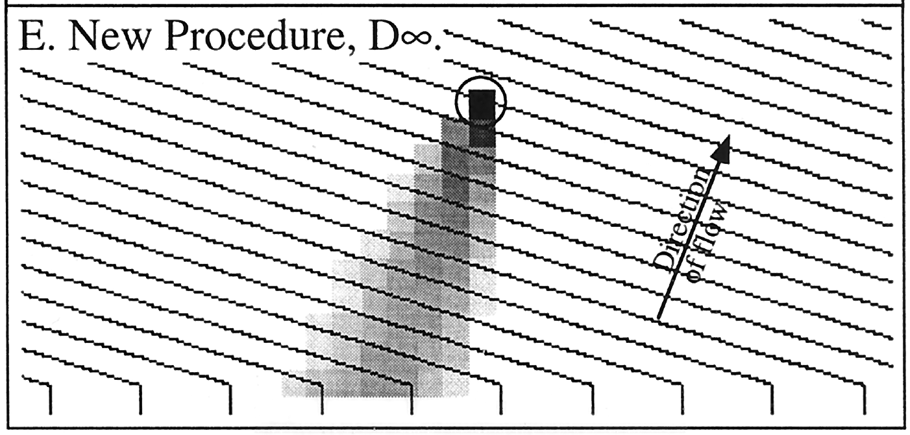
Flow directions. Variety of algorithms; must chose those that best balance physical understanding, quality of data, and computational efficiency.
D-infinity, until channel-initiation criteria is met, then D-8.
For channels, follow greatest downslope plan curvature.
For flat areas: flow toward outlets, away from edges.
On a cone
Flow Downslope
On a plane
D-8
D-∞
From Tarboton, 1997, Water Resources Research, 33:309-319
Notes:
Note that the direction of flow in the right panels is actually downward, not upward as the arrow indicates.

Slide 32
Flow Direction
Directional
bias
Channelized vs unchannelized flow
We use D-∞ for unchanneled areas, because it allows downslope dispersion.
Once flow is channelized, we want to preclude dispersions, so use D-8.
To address directional bias, we direct flow to the downslope cell with greatest plan curvature, rather than steepest descent. Traced channels then follow contour crenulations.
On a plane
Downslope
dispersion

Slide 33
Steps in building a channel-network dataset.
Build a contiguous DEM over entire watershed (IfSAR, LiDAR, NED). Decisions: resolution, coordinate system.
Calibrate synthetic channel-network extent. Decisions: length scale for topographic attributes, channel density.
Hydrologic conditioning.
Build a water mask.
Identify road crossings (LiDAR).
Existing line work for hydrologic enforcement.
Drain or fill closed depressions.
Define flow directions.
Build linked channel-node dataset.
Build GIS output files.
Routed channel network. Decisions: reach length, upslope extent.
Attributes (contributing area, gradient, flow length, lake, etc.)
Flood-plain polygons.
Drainage wings.
Other needed analyses (road erosion, etc.)
Verify (field surveys, other data sets), Quality Control. Iterate. Ensure all subsequent analyses properly functional.

Slide 34
Channel
node
DEM grid point
DEM cells
D-8 flow path
Smoothed flow path
Channel nodes are defined from smoothed flow paths fit through the D-8 flow directions.
Nodes are linked to the adjacent upstream and downstream nodes in the channel network.
Each node has a flow length and an associated set of attributes that apply either to the node location or over the node flow length.

Slide 35
Why use linked nodes (instead of, say, a routed vector network)?
Data stored at the spatial grain of the DEM.
Each node is associated with a single DEM cell; we can thus initiate flow routing from any point in the channel network. This helps enable coupling the “digital landscape” to hydrologic, erosion, and routing models.
Each DEM cell can also be associated to a single (or multiple) channel node, so that areas within a water mask, on the flood plain, and on hillslopes can be associated with specific locations along the center-line flow path defined by the nodes.
Node-based information can be summarized at any larger spatial scale to generate GIS vector files.
Channel
node
DEM grid point
DEM cells
D-8 flow path
Smoothed flow path

Slide 36
Steps in building a channel-network dataset.
Build a contiguous DEM over entire watershed (IfSAR, LiDAR, NED). Decisions: resolution, coordinate system.
Calibrate synthetic channel-network extent. Decisions: length scale for topographic attributes, channel density.
Hydrologic conditioning.
Build a water mask.
Identify road crossings (LiDAR).
Existing line work for hydrologic enforcement.
Drain or fill closed depressions.
Define flow directions.
Build linked channel-node dataset.
Build GIS output files.
Routed channel network. Decisions: reach length, upslope extent.
Attributes (contributing area, gradient, flow length, lake, etc.)
Flood-plain polygons.
Drainage wings.
Other needed analyses (road erosion, etc.)
Verify (field surveys, other data sets), Quality Control. Iterate. Ensure all subsequent analyses properly functional.

Slide 37
GIS output files
Vector GIS files can be generated with fixed or variable reach lengths.
A variety of data attributes can be assigned to each reach, depending on available data (shown here are some attributes derived solely from the DEM).
Notes:
A variety of options exist for summarizing other raster and vector data, e.g., field surveys, land cover, fish presence.

Slide 38
Channel segments can be nominally coded; for example, to delineate flow paths within mapped lakes.
Lakes
Channel
Lake flow path

Slide 39
Steps in building a channel-network dataset.
Build a contiguous DEM over entire watershed (IfSAR, LiDAR, NED). Decisions: resolution, coordinate system.
Calibrate synthetic channel-network extent. Decisions: length scale for topographic attributes, channel density.
Hydrologic conditioning.
Build a water mask.
Identify road crossings (LiDAR).
Existing line work for hydrologic enforcement.
Drain or fill closed depressions.
Define flow directions.
Build linked channel-node dataset.
Build GIS output files.
Routed channel network. Decisions: reach length, upslope extent.
Attributes (contributing area, gradient, flow length, lake, etc.)
Flood-plain polygons.
Drainage wings.
Other needed analyses (road erosion, etc.)
Verify (field surveys, other data sets), Quality Control. Iterate. Ensure all subsequent analyses properly functional.

Slide 40
Little
Susitna
Flood Plain Extent

Slide 41
Flood plain extent
Mapping algorithm uses mean elevation of all channel cells within a specified distance (e.g., 250 bank-full depths) of the channel, weighted by distance from the channel and elevation difference encountered between the cell and the channel.
This algorithm is sensitive to errors in channel elevation.
Normalization by bank-full depth requires accurate estimates of mean depth.

Slide 42
Steps in building a channel-network dataset.
Build a contiguous DEM over entire watershed (IfSAR, LiDAR, NED). Decisions: resolution, coordinate system.
Calibrate synthetic channel-network extent. Decisions: length scale for topographic attributes, channel density.
Hydrologic conditioning.
Build a water mask.
Identify road crossings (LiDAR).
Existing line work for hydrologic enforcement.
Drain or fill closed depressions.
Define flow directions.
Build linked channel-node dataset.
Build GIS output files.
Routed channel network. Decisions: reach length, upslope extent.
Attributes (contributing area, gradient, flow length, lake, etc.)
Flood-plain polygons.
Drainage wings.
Other needed analyses (road erosion, etc.)
Verify (field surveys, other data sets), Quality Control. Iterate. Ensure all subsequent analyses properly functional.

Slide 43
Drainage “wings”.
Delineate local contributing area to each channel reach.
Based on D-8 flow directions.
Delineated at the scale of “reaches” in the vector channel network, which may extend from a single channel node to hundreds of meters.
Tributary to Little Susitna
Tributary to Little Susitna

