Slide 1
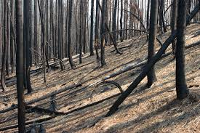
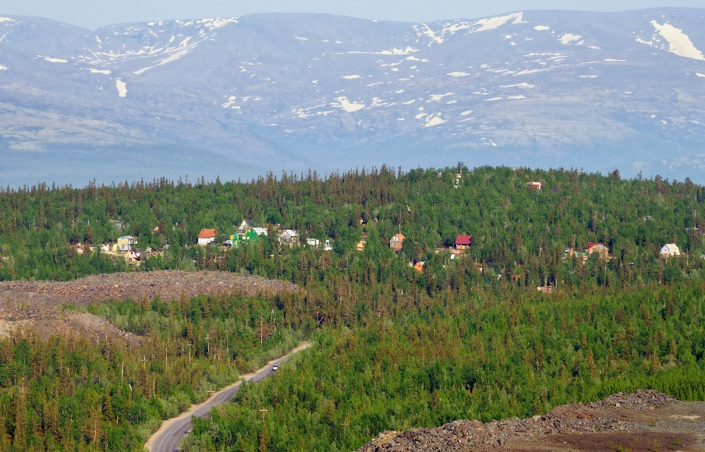
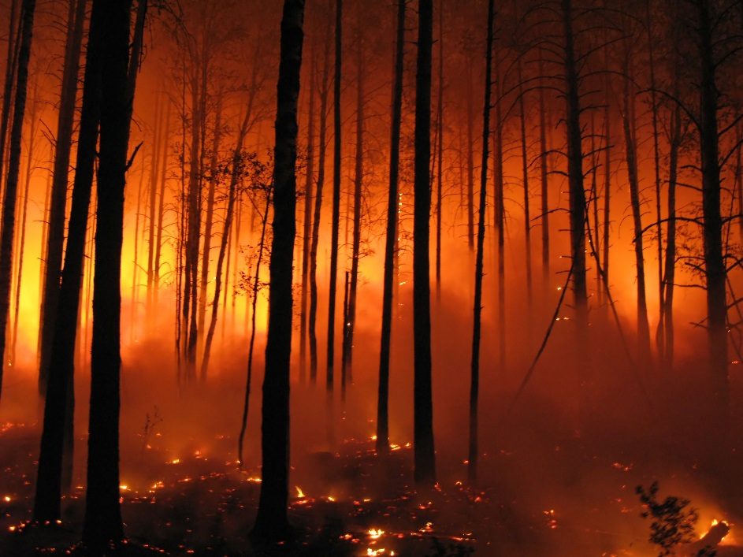
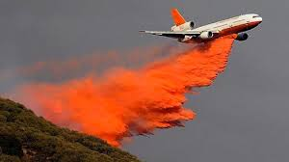
Fire & Fish
Decision Support for Pre Fire, Fire Fighting and Post Fire
(Pilot Project, Malheur National Forest, Eastern Oregon)
Post-Fire Planning
(BAER, Restoration)
Real Time Fire Fighting
(Retardant Go/No Go)
Pre-Fire Planning
(Veg/Road Mgmt)
TerrainWorks (NetMap), in Collaboration with US Forest Service, PNW Corvallis and Malheur National Forest
Summer, 2015
Notes:
This Powerpoint presentation summarizes the use of NetMap for a Fire and Fish Decision Support System. Created on July 24, 2015 by Dr. Lee Benda and Kevin Andras (TerrainWorks).

Slide 2
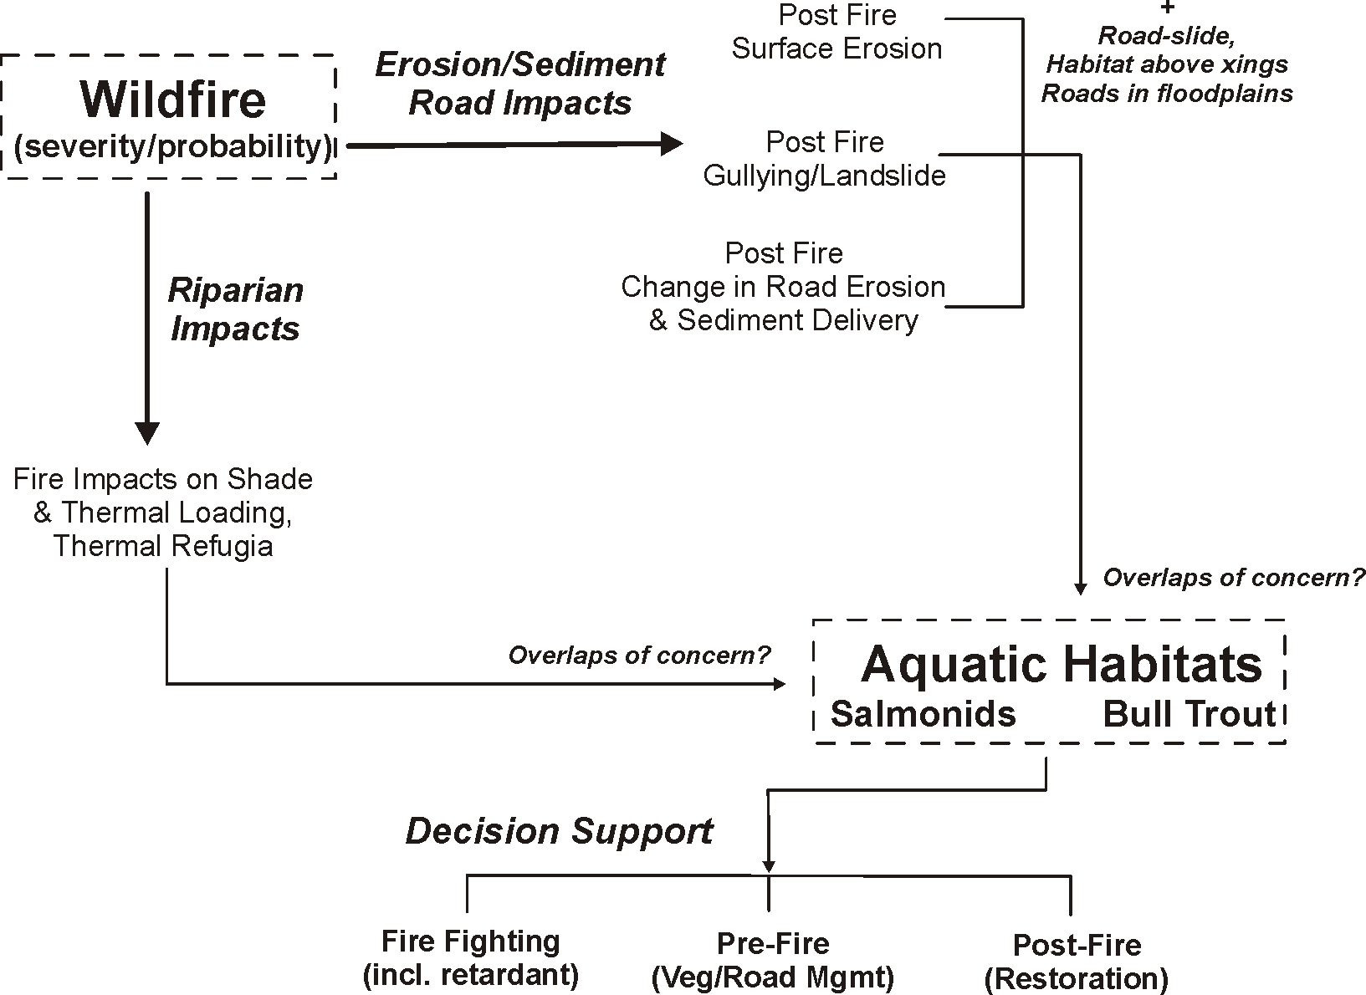
Approach
Notes:
The general approach strategy. Wildfire (severity) is linked to aquatic habitats (primarily fish) via (1) erosion processes and sediment delivery to streams (surface erosion, gullying, shallow landsliding and post fire road erosion) and (2) riparian processes, specifically impacts on shade, thermal loading and on thermal refugia. The approach is designed to provide decision support for (i) firefighting (including retardant drops), (ii) pre fire management (vegetation and roads) and (lll) post fire restoration (in the BAER process or otherwise).

Slide 3
Pre Fire Management Activities | Data layers | Purpose
Forest Restoration (fuels reduction, thinning including in riparian zones, prescribed burns) | -Fire severity and fire probability -Post fire surface erosion -Post fire landslide/gully erosion -Fish habitats -Thermal refugia (impacts to) | -Reduce potential for post fire erosion and sediment delivery to streams (impacts on sensitive fish habitats) -Protect critical fish-riparian habitats (key habitats, refuges)
Road Restoration (upgrade surfacing, increase drains, improve stream crossings, storage, decommissioning) | -Road surface erosion & sediment delivery potential (fire impacts on increased sediment delivery potential) -Road instability potential/fire increased -Roads in floodplains -Cumulative habitat above roads crossings | -Reduce potential for post fire erosion and sediment delivery (also in non-fire conditions) -Reduce potential for road related landsliding/gullying -Remove fish barriers
Firefighting | Data layers | Purpose
Firefighting, including retardant use | -All stream buffered (300’) - avoidance -Perennial stream buffered only - avoidance -Identify high value aquatic/riparian – non avoidance | -Avoid retardant pollution in surface waters -Protect critical aquatic/riparian habitats
Post Fire Management Activities (BAER) | Data layers | Purpose
Land surface restoration (mulching, surface disturbance, planting) | Same data layers as above for Forest Restoration, except in a post fire environment (using BARC maps) | Similar purpose to Forest Restoration except in a post fire environment
Road restoration (upgrade surfacing, increase drains, improve stream crossings, storage, decommissioning) | Same data layers as above for Road Restoration, except in a post fire environment (using BARC maps) | Similar purpose to Road Restoration except in a post fire environment
Notes:
A listing of decision support activities (left panel), the NetMap data layers to support it (middle panel) and the purpose of the data layers.

Slide 4
Models and Sources
DEMs – LiDAR and 10 m
Synthetic River Networks (stream layers) NetMap (www.terrainworks.com)
Fire severity and probability (Flammap)
Post fire surface erosion (WEPP – Disturbed)
Post fire gully potential (Parker et al. 2010)
Post fire landsliding/gullying (Miller and Burnett 2007, 2008, NetMap)
Post fire road surface erosion and sediment delivery (GRAIP-Lite w/ modified sediment delivery)
Bull Trout Habitat (NorWest and US Forest Service stream layer)
Salmon habitat (Intrinsic Potential Chinook and steelhead, Burnett et al. 2007)
Shade/thermal loading/thermal refugia (NetMap and Groom et al. 2011)
Road – stability (NetMap)
Cumulative habitat length above roads (NetMap)
Refer to NetMap’s online technical help manuals for additional information
Notes:
Here is a list of the various models and data sources there were used in the Fire and Fish analysis.

Slide 5
Data Deliverables
Data Type | Raster | Road | Polygon | Reach Segment | Reach, routed | Aggregated HUC 6th Polygon
1) Fire severity | X |  |  | X | X | X
2) Fire probability | X |  |  | X | X | X
3) Bull trout/Redband presence |  |  |  | X |  | X
4) Salmon intrinsic potential (chinook, steelhead, coho) |  |  |  | X | X | X
5) Post fire surface erosion (WEPP-Disturbed) | X |  |  | X | X | X
6) Post fire landslide potential | X |  |  | X | X | X
7) Post fire gully potential
8) Current shade-thermal energy/thermal refugia (LEMMA) |  |  |  | X | X | X
9) Post fire shade-thermal energy/thermal refugia (LEMMA reduced) |  |  |  | X | X | X
10) Thermal difference (sensitivity) map (#5 –# 6) |  |  |  | X | X | X
11) Road Sediment production |  | X |  | X | X | X
12) Road sediment delivery (no fire) |  | X |  | X | X | X
13) Road sediment delivery difference (no fire-fire) |  | X |  | X | X | X
14) Cumulative habitat length above road crossings |  |  |  | X
15) Road – landslide/gully potential |  | X
16) Retardant no go – all channels buffererd |  |  | X
17) Retardant no go – ephemeral channels removed |  |  | X
Notes:
These are the general data deliverables and their formats within ArcMap shapefiles.

Slide 6
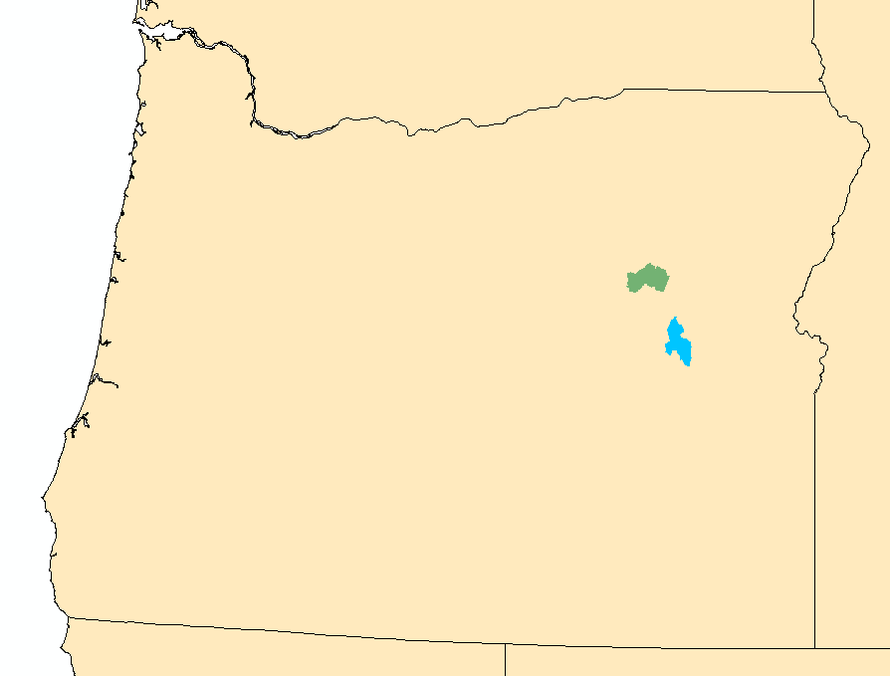
Pilot Areas
Camp Creek watershed
(1 m LiDAR DEM)
Upper North Fork Malheur
(10 m DEM)
Notes:
Pilot area study locations showing Camp Creek (covered by 1 m LiDAR DEM) and the Upper North Fork Malheur (covered by 10 m DEM); both watersheds are located in the Malheur National Forest.

Slide 7
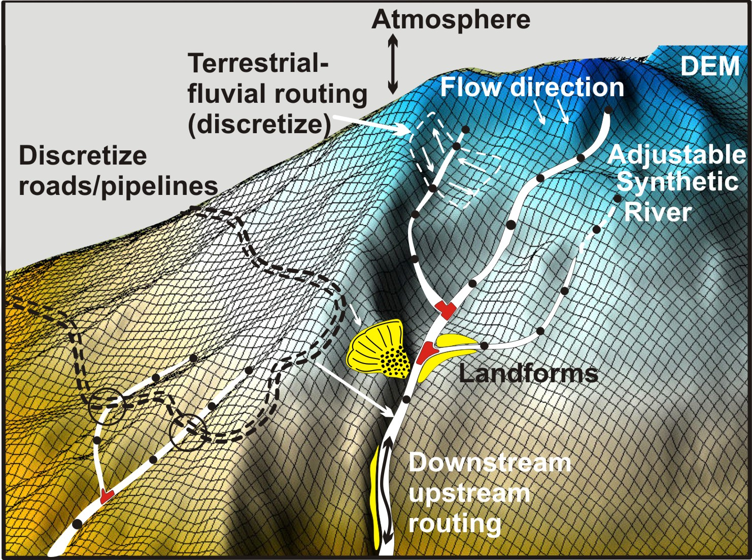
The analysis depends on NetMap’s synthetic river network and virtual watersheds
Go to www.terrainworks.com
to learn about how synthetic
river networks and virtual
watersheds are built, and
their capabilities
Notes:
The analytical foundation for the Fire and Fish Analysis is NetMap’s synthetic stream network and virtual watersheds. For brevity, this important topic is left for the viewers to explore as they need to; see www.terrainworks.com for additional background information or NetMap’s online Technical Help materials.

Slide 8
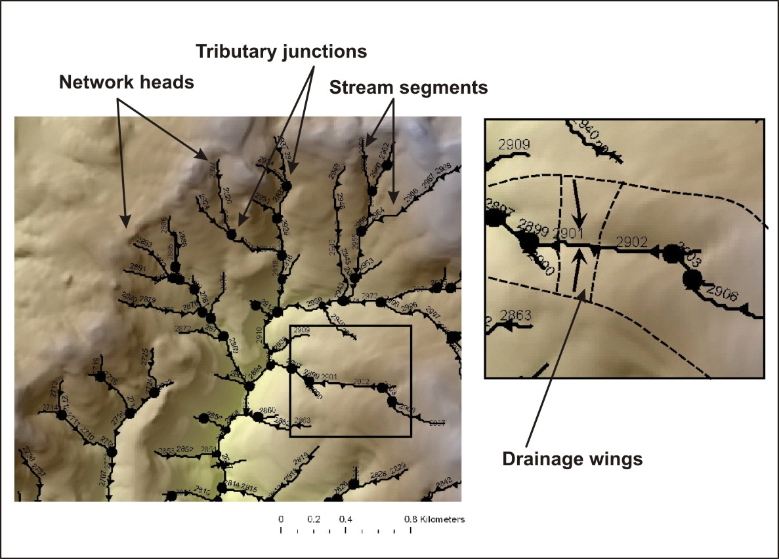
The fire and fish analysis requires that terrestrial information (on hillsides)
be transferred to channel
networks, so that fire
related stressors (erosion,
roads) can be directly
linked to fish habitats, at
the scale of individual
channel segments.
Notes:
The data structure of the virtual watershed includes a synthetic river network (derived from DEMs and the NHD) and drainage wings, local contributing areas located on both sides of 100 m channel segments. Each channel segment has a corresponding set of local contributing areas or drainage wings.

Slide 9
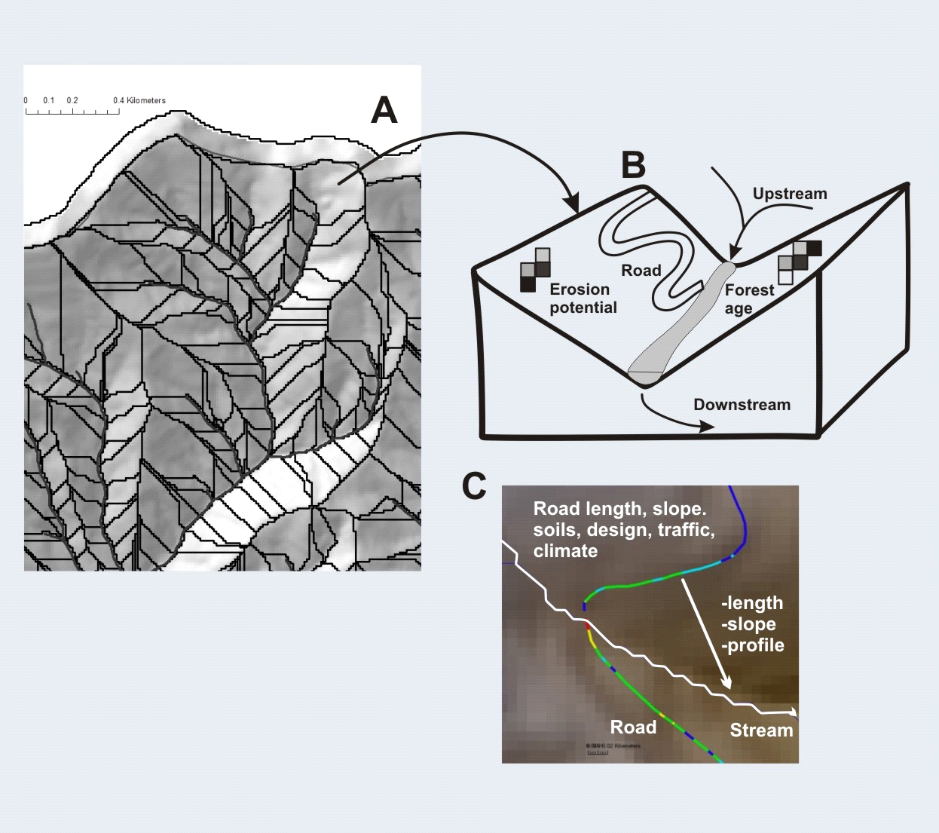
Drainage wings (discretize landscapes and land uses)
Notes:
The drainage wings discretize the watershed terrestrial environment into small areas (approx. 0.1 km² in area) and all information on hillsides is then summarized to channels. This supports analysis of aquatic habitat-terrestrial stressor intersections.

Slide 10
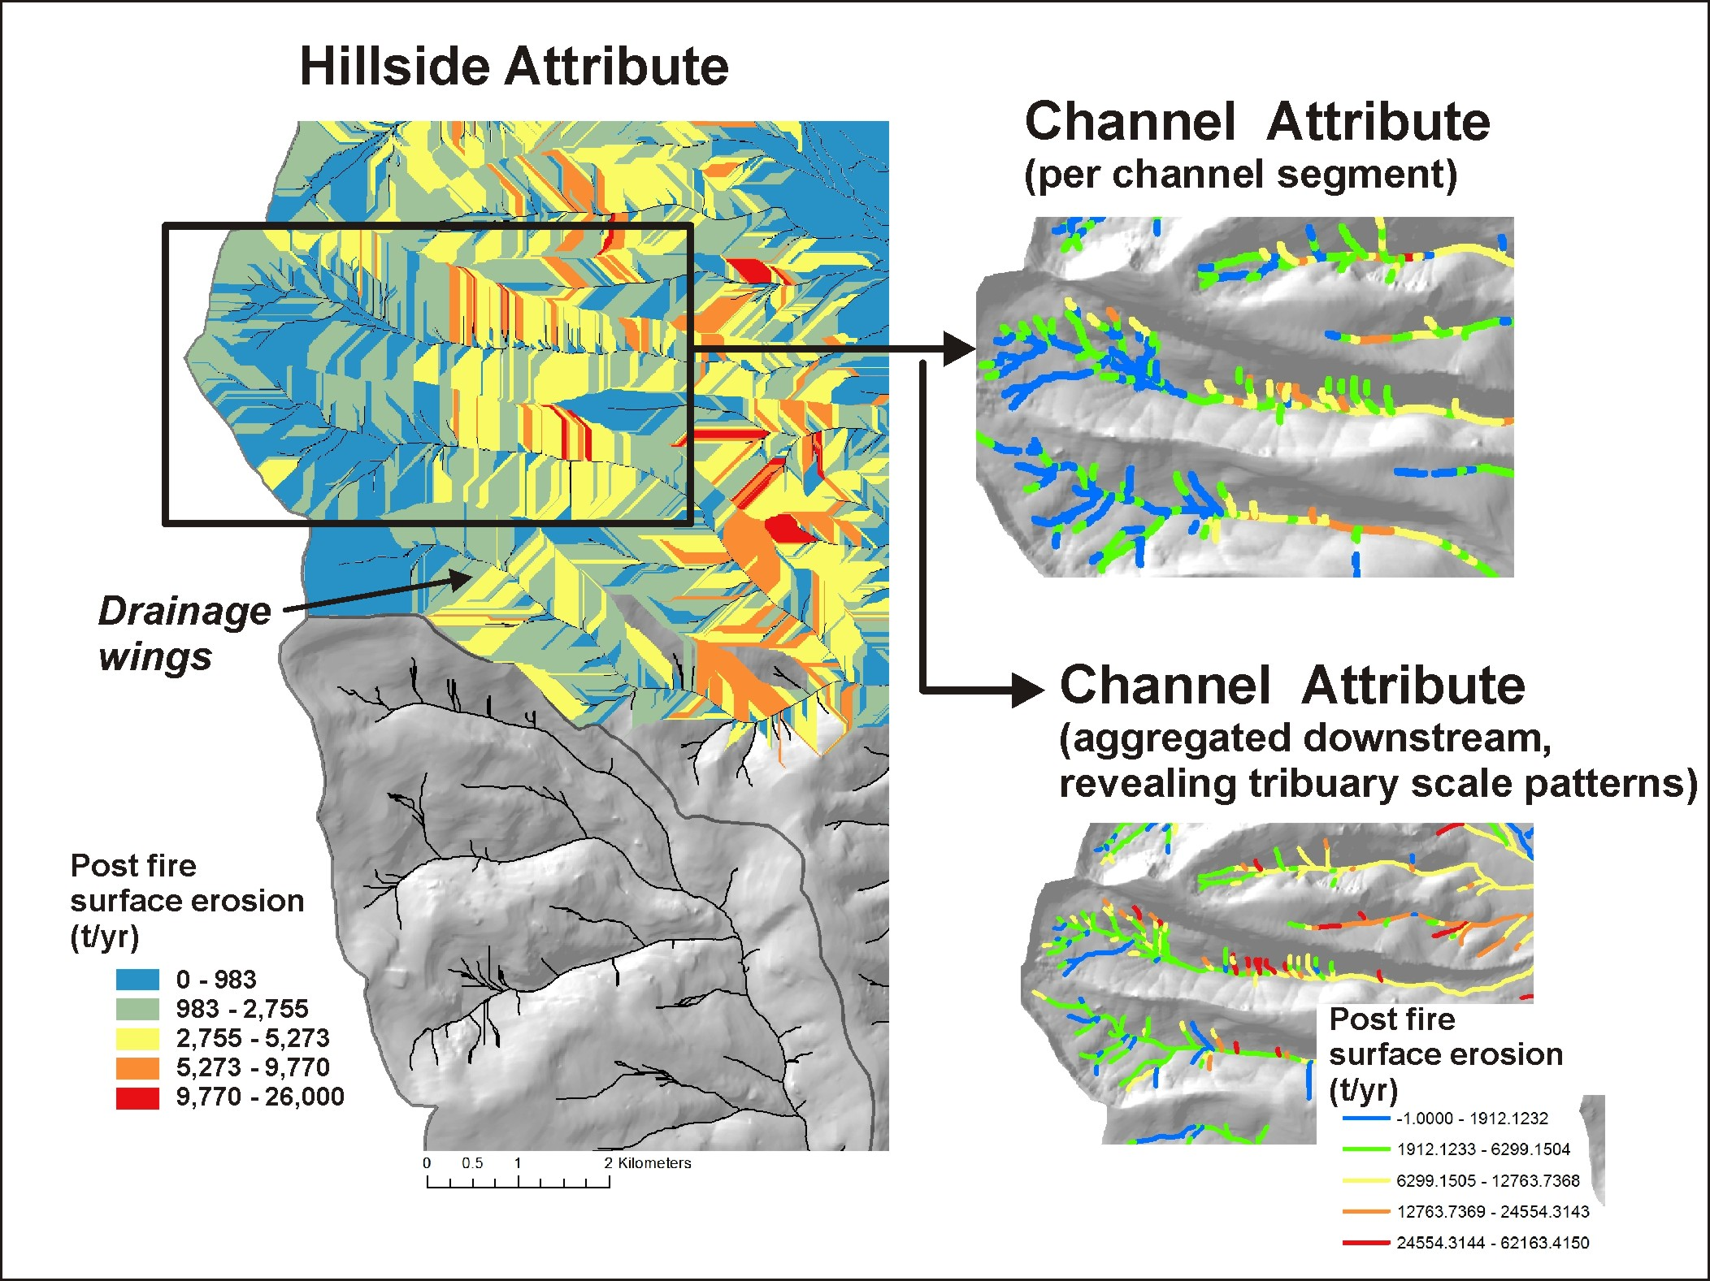
An example about
how a hillside attribute
(post fire erosion)
is transferred to individual
channel segments, and
aggregated downstream
Notes:
Here is an example of how a terrestrial (hillside) attribute is transferred to the channel network and aggregated downstream. These types of channel attributes can then be compared to other channel attributes such as fish habitat or other watershed characteristics, like thermal refugia.

Slide 11
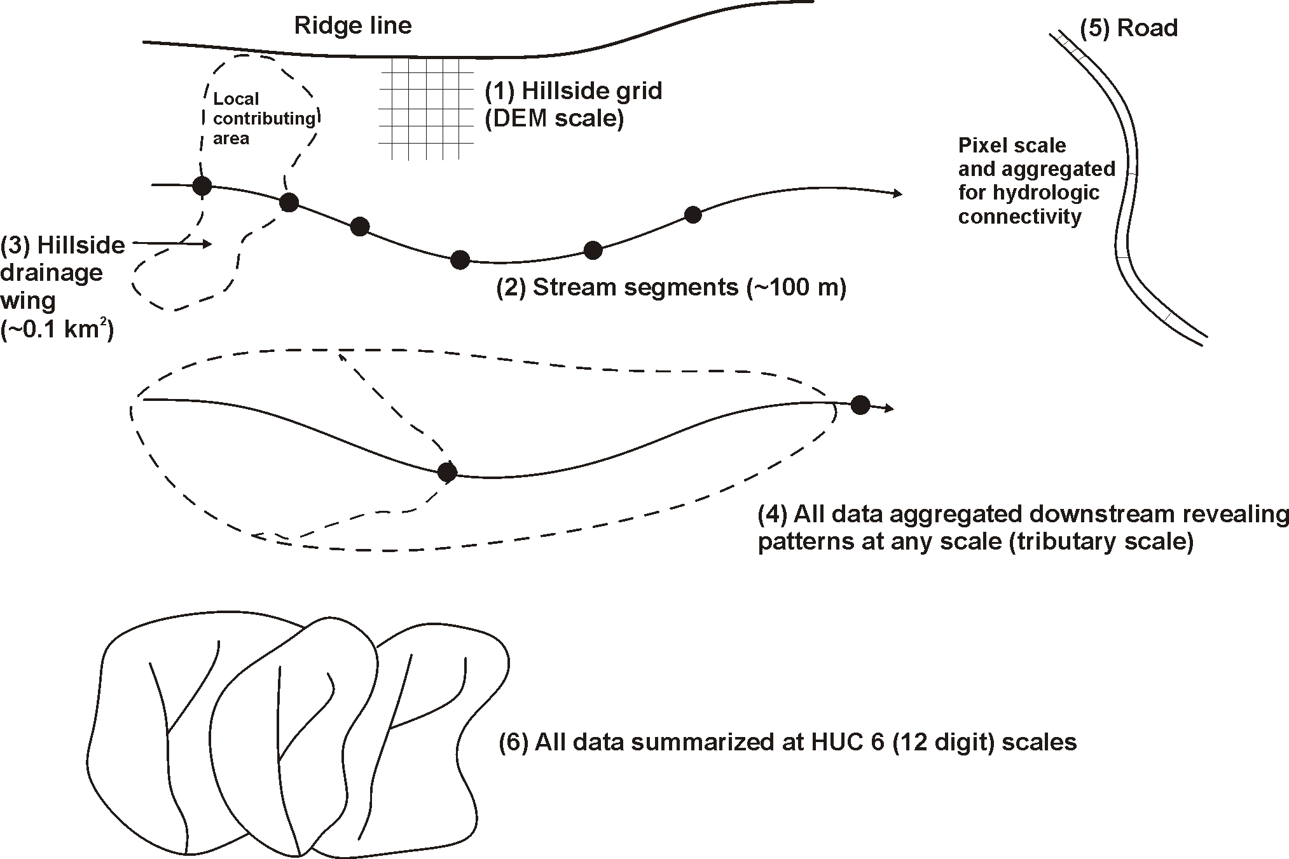
Data spatial scales
Notes:
The data deliverables come at a range of scales including (1) hillside raters or grids (at the scale of the DEM), (2) individual stream segments (~100 m), (3) hillside drainage wings (local contributing areas, ~ 0.1 km2), (4) stream segment data aggregated downstream, (5) road segments broken a pixel boundaries and re-aggregated for various purposes, including hydrologic connectivity and (6) data summarized at the scale of HUC 6 subbasins.

Slide 12
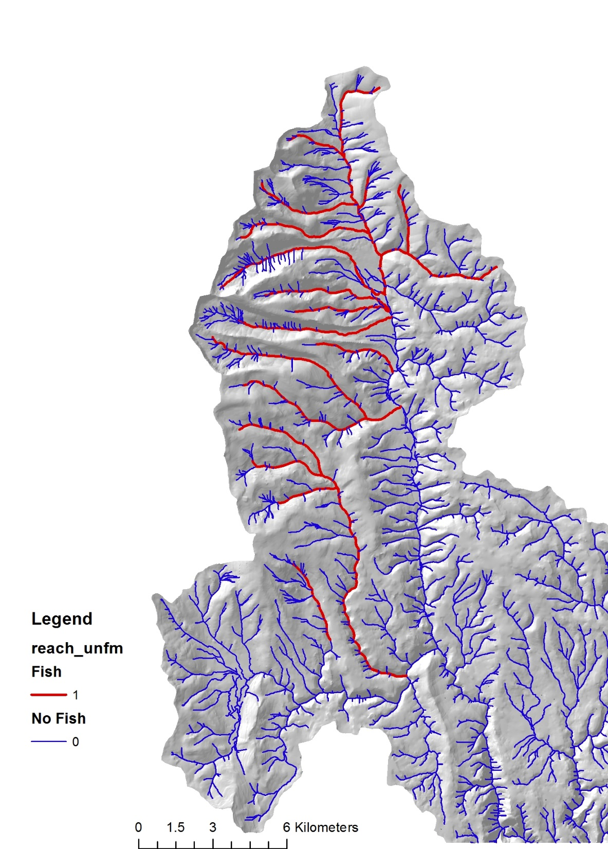
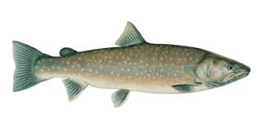
Data Deliverable: Fish Habitat
Bull Trout (Salvelinus confluentus)
Notes:
US Forest Service information on distribution of Bull Trout and Redband Trout were used in the analysis. Habitat intrinsic potential (HIP) models (Burnett et al. 2007) were applied for steelhead and Chinook.

Slide 13
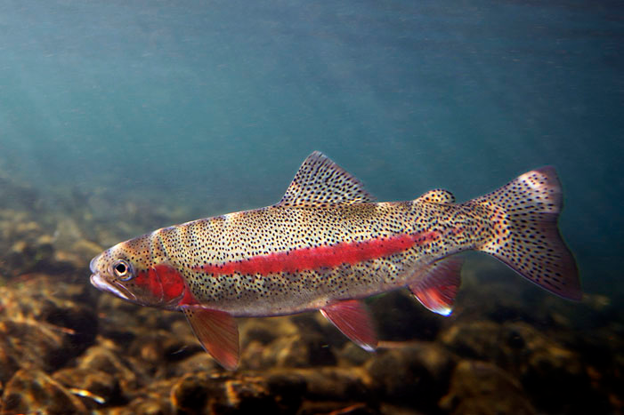
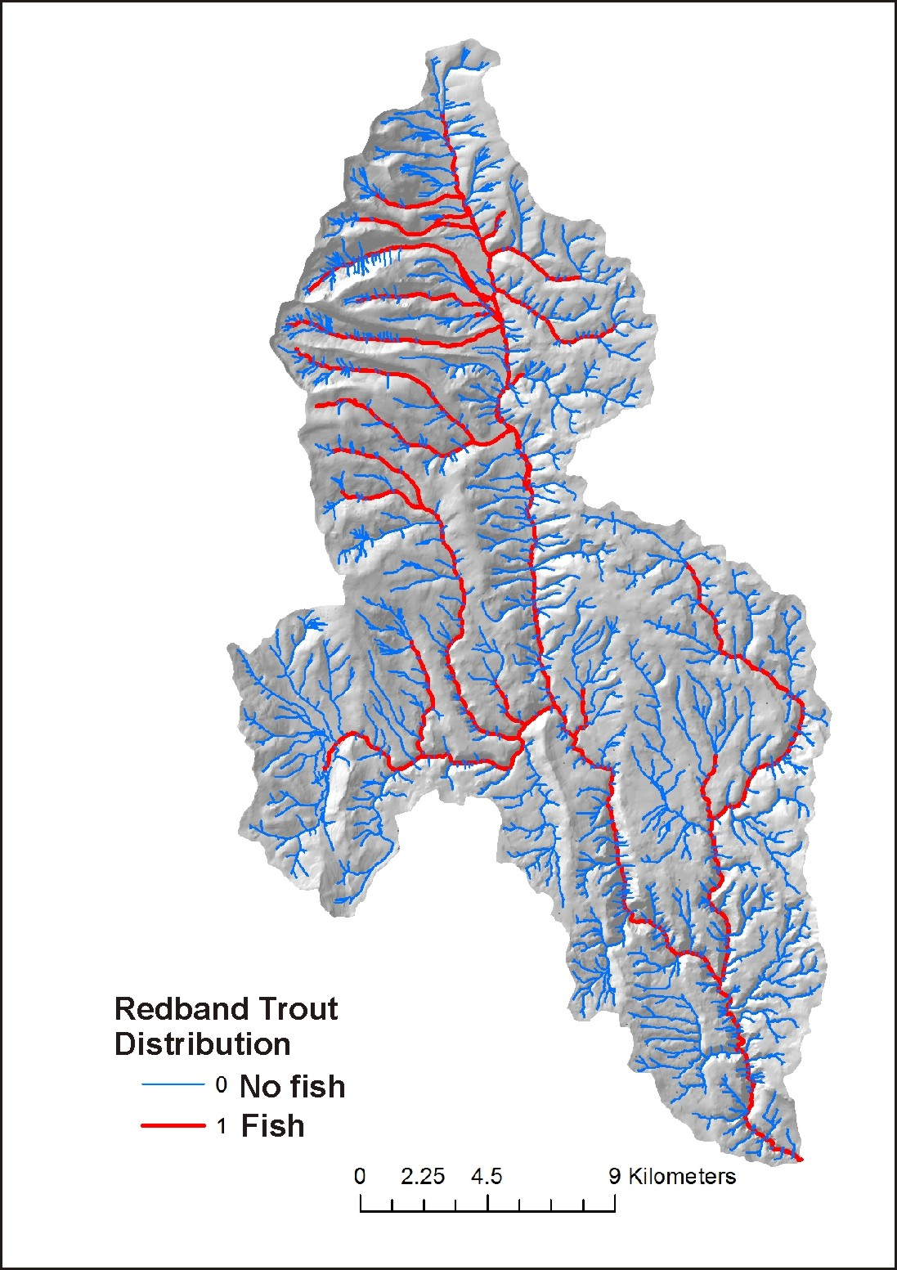
Fish Habitat: Redband Trout (subspecies of Oncorhynchus mykiss)

Slide 14
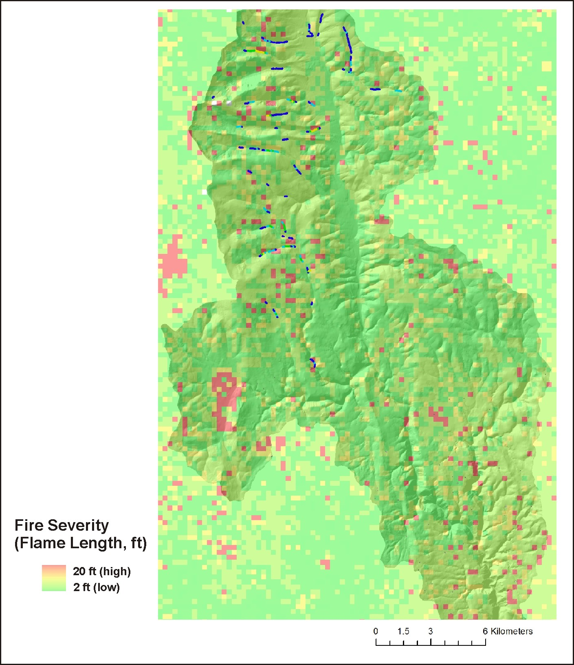
Data Deliverables
Fire Severity (hillside, Flammap)
Notes:
Fire severity in terms of flame length was obtained from agency Flammap predictions (WWETAC).

Slide 15
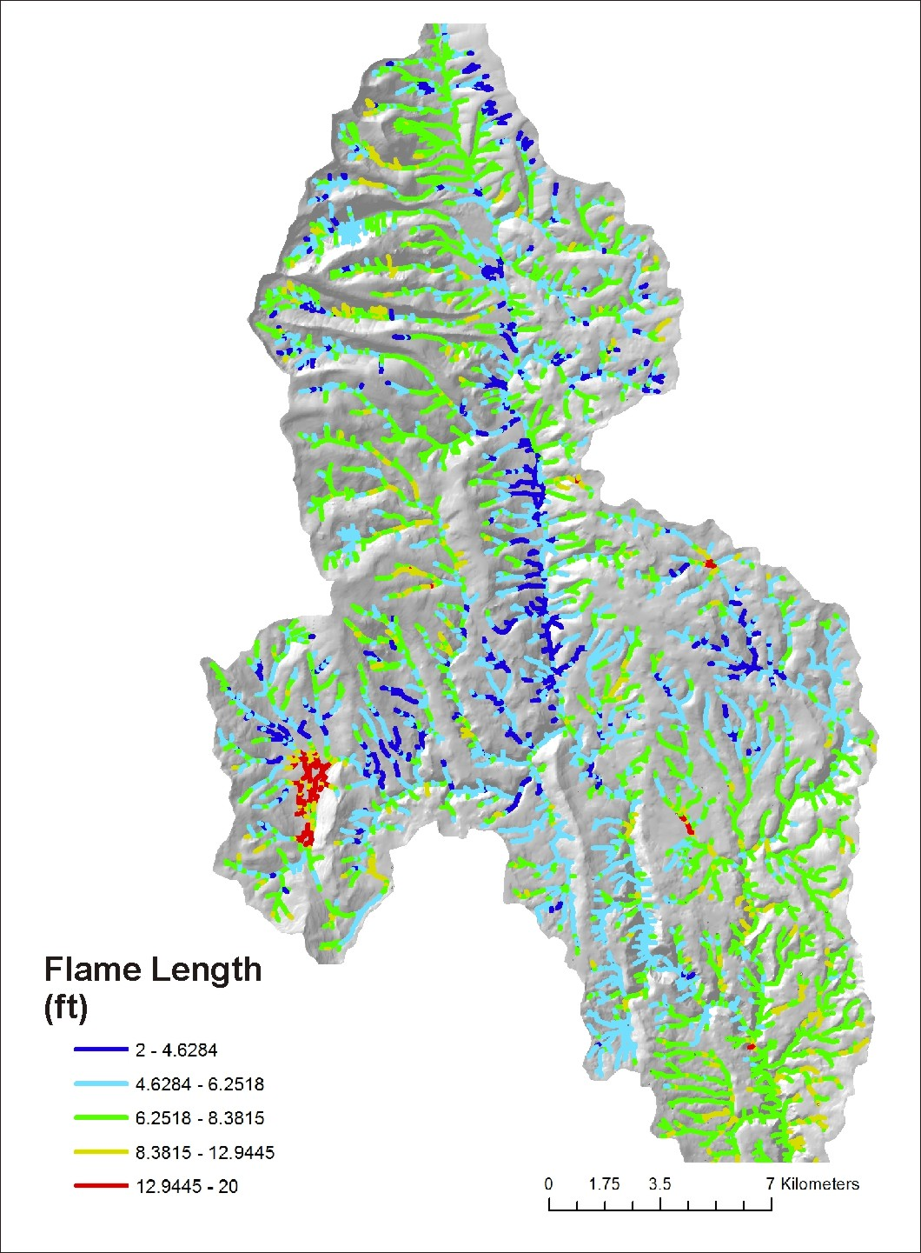
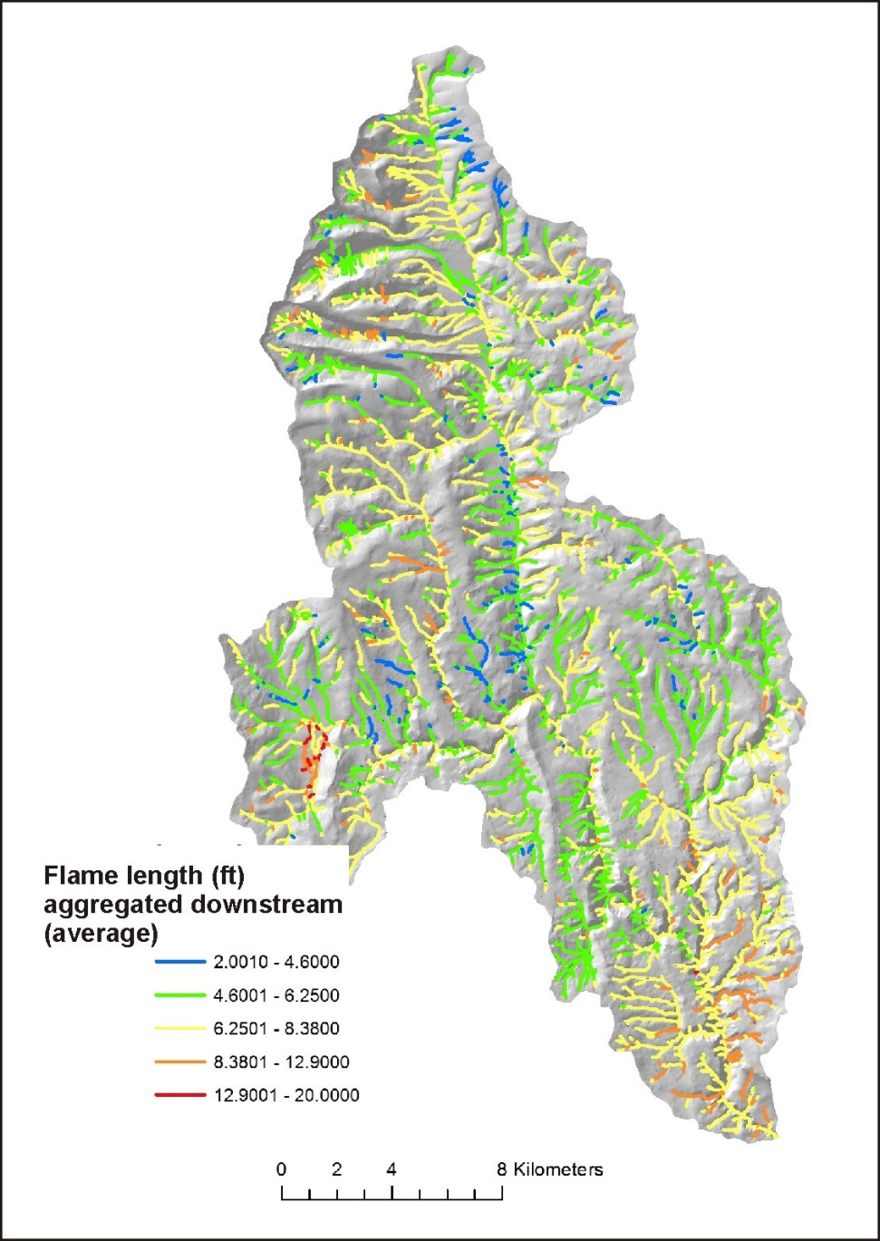
Fire Severity
(channel, fish eye)
Fire Severity, Aggregated Downstream
(tributary scale patterns)
Why are hillslope attributes
reported to channels, via
drainage wings?
This facilitates comparing
hillslope related stressors
(fire severity, erosion,
roads etc.) to fish habitats,
a channel attribute.
Notes:
Fire severity is reported to individual channel segments (left), via drainage wings, and aggregated downstream.

Slide 16
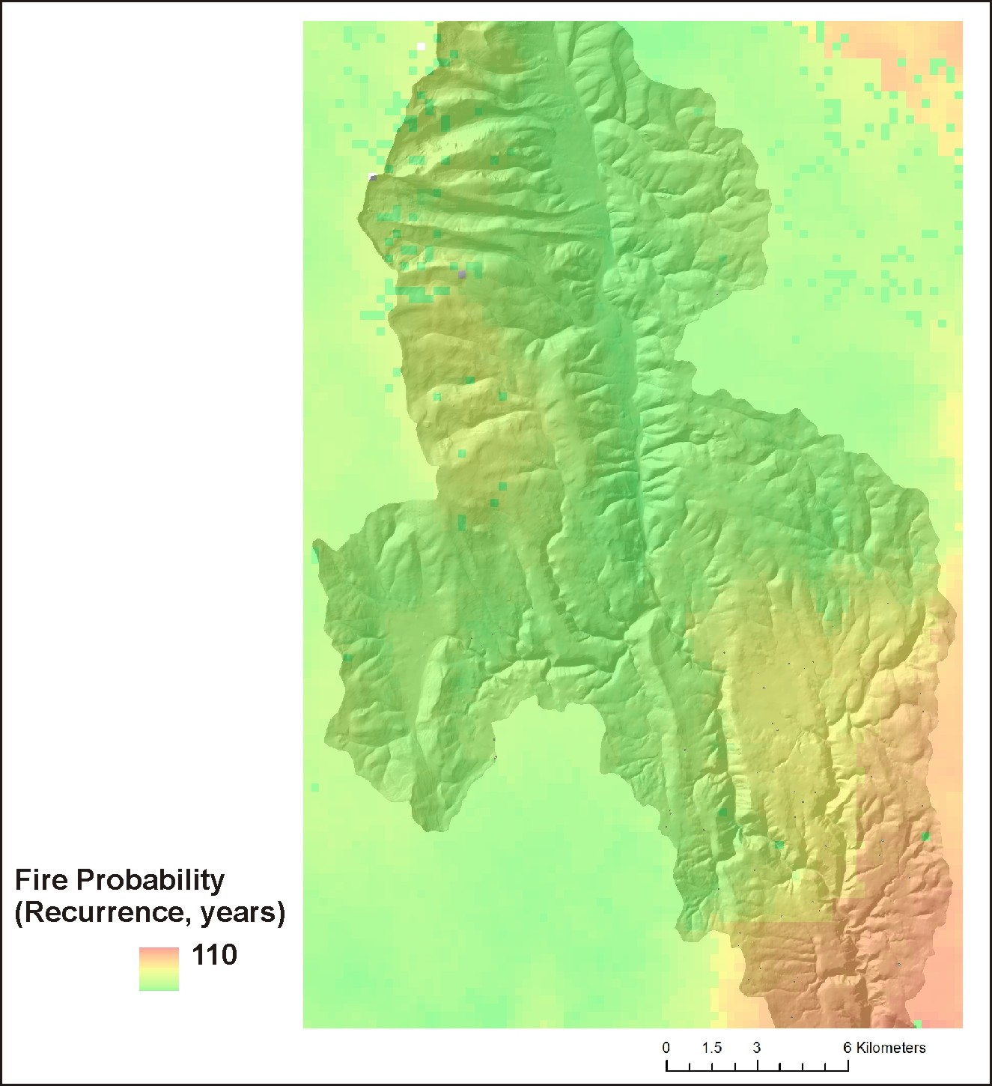
Fire Probability
Notes:
Fire probability was obtained from agency Flammap predictions (WWETAC). 1/probability = fire recurrence interval.

Slide 17
Notes:
Post fire erosion and channel sedimentation are predicted for surface erosion, gullying and shallow landsliding.

Slide 18
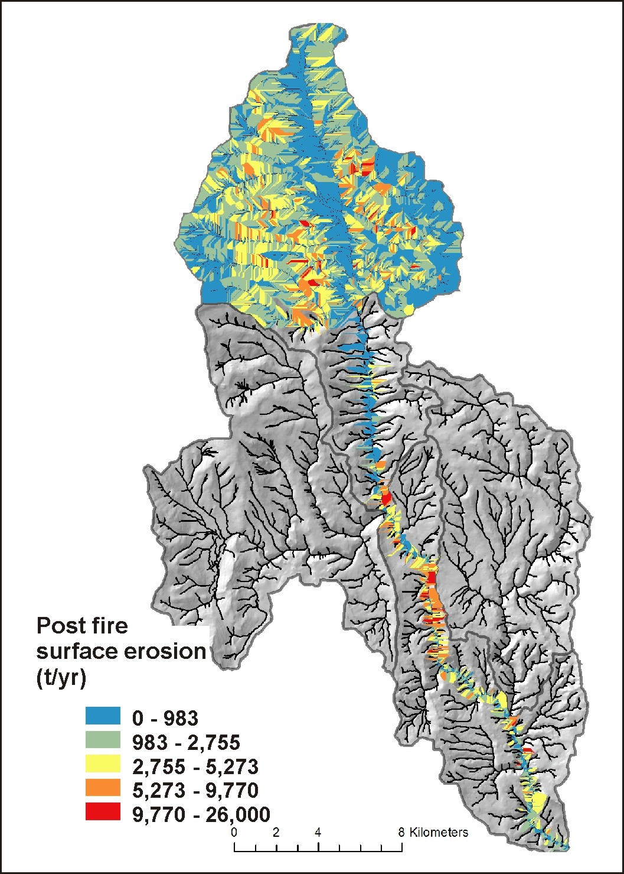
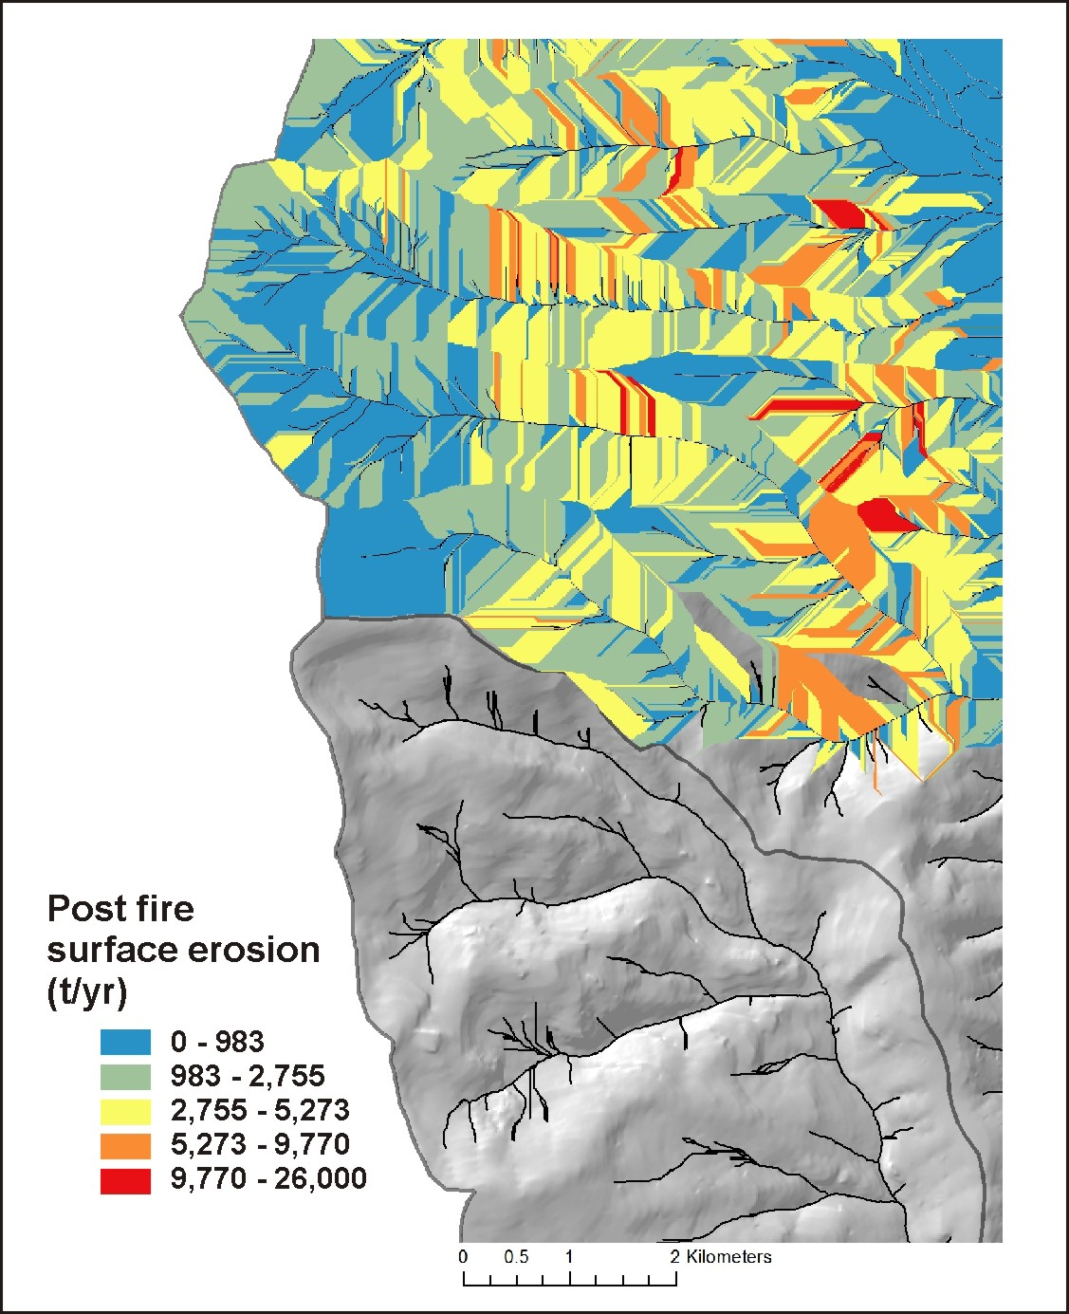
Post Fire Surface Erosion (WEPP, disturbed)
Notes:
Post fire surface erosion was predicted using the WEPP-disturbed model. The color patterns (right panel) indicating variable surface erosion illustrates the variable sizes and shapes of local contributing areas or drainage wings. See NetMap’s online technical help materials for additional information: http://www.netmaptools.org/Pages/NetMapHelp/5_5_surface_erosion_veg_fire.htm

Slide 19
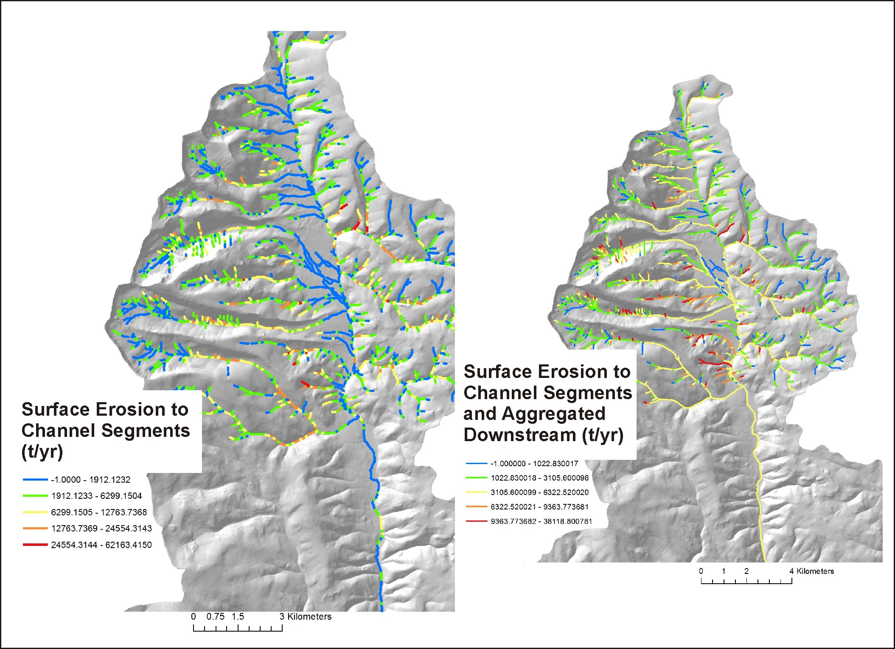
Post Fire Surface
Erosion (WEPP,
disturbed, e.g., function
of fire severity)
reported to stream
channels
and aggregated
downstream
Notes:
Predicted surface erosion is transferred to individual stream segments (left) and aggregated downstream (right), the latter revealing erosion patterns at the tributary and subbasin scale.

Slide 20
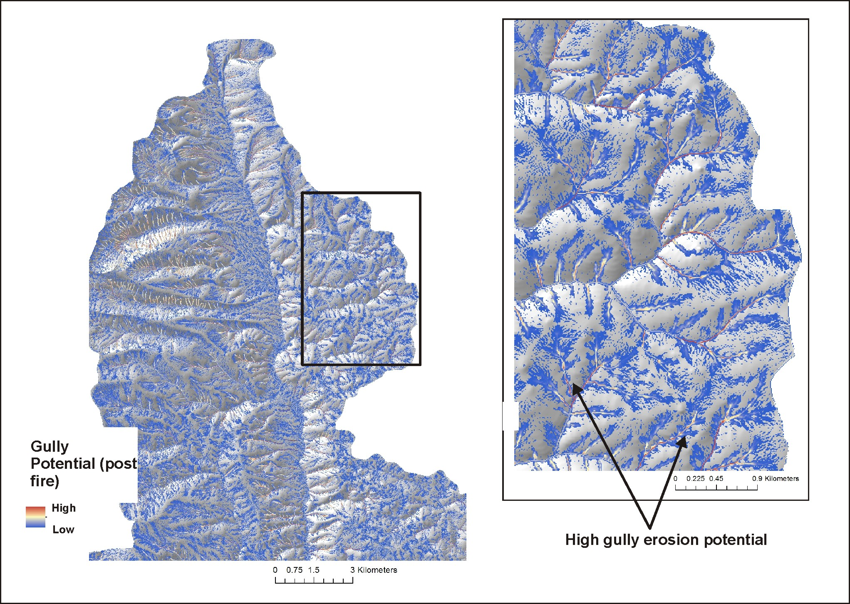
Post Fire
Gully Potential
Notes:
An gully erosion model was used in the analysis (Parker et al. 2010). See NetMap’s online technical help materials for additional information.
http://www.netmaptools.org/Pages/NetMapHelp/gullying.htm

Slide 21
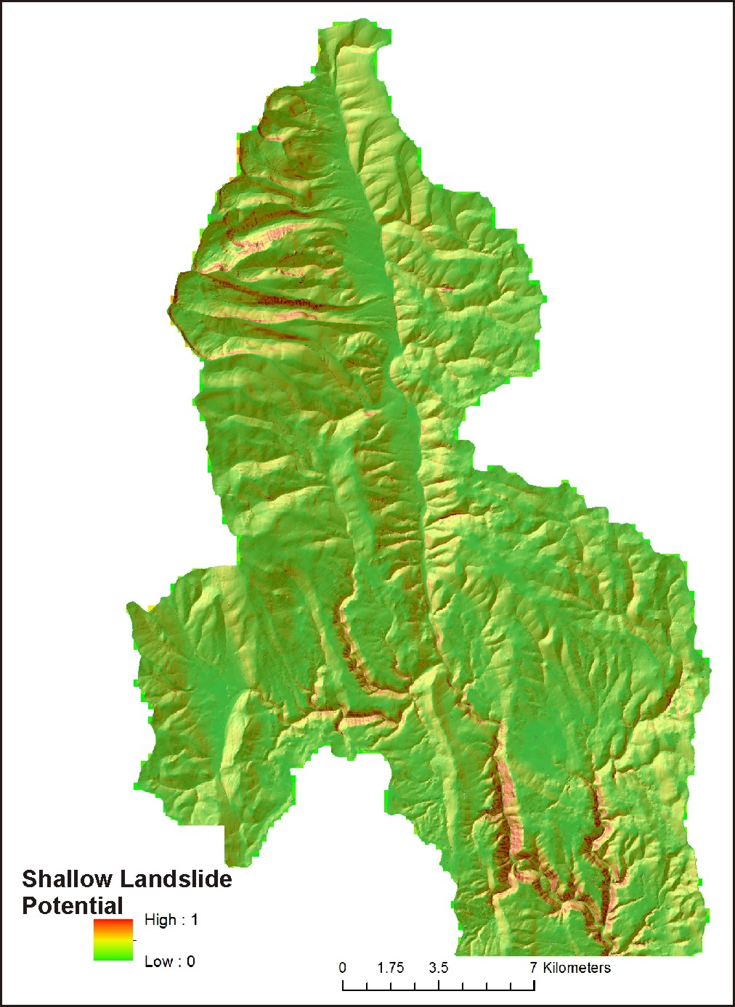
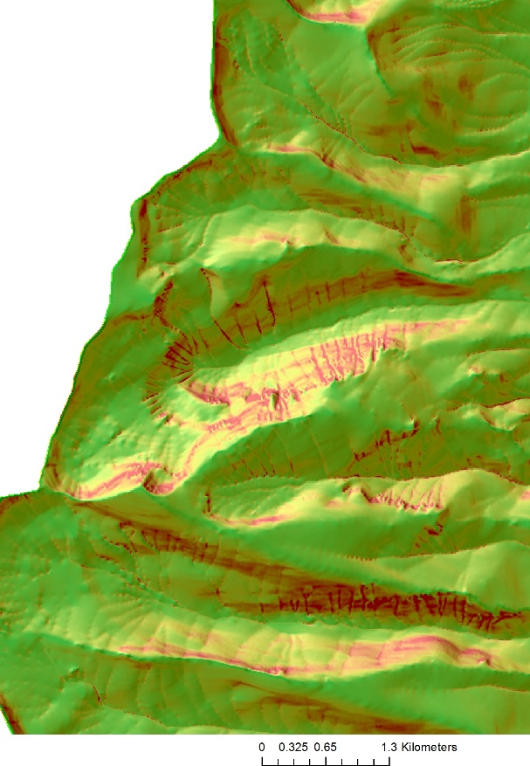
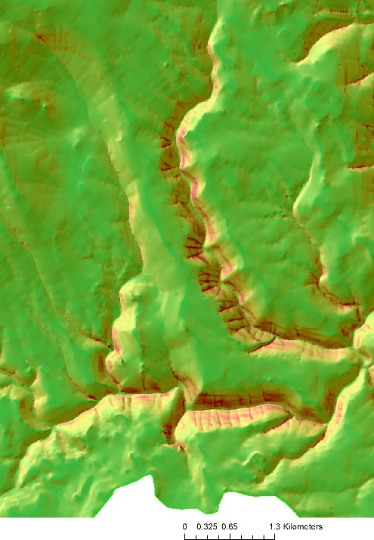
Shallow Landslide-
Debris Flow Potential
Notes:
A shallow landslide model (Miller and Burnett 2007) based on hillslope gradient and curvature was used in the analysis. See NetMap’s online technical help materials for additional information: http://www.netmaptools.org/Pages/NetMapHelp/hillside_1.htm

Slide 22
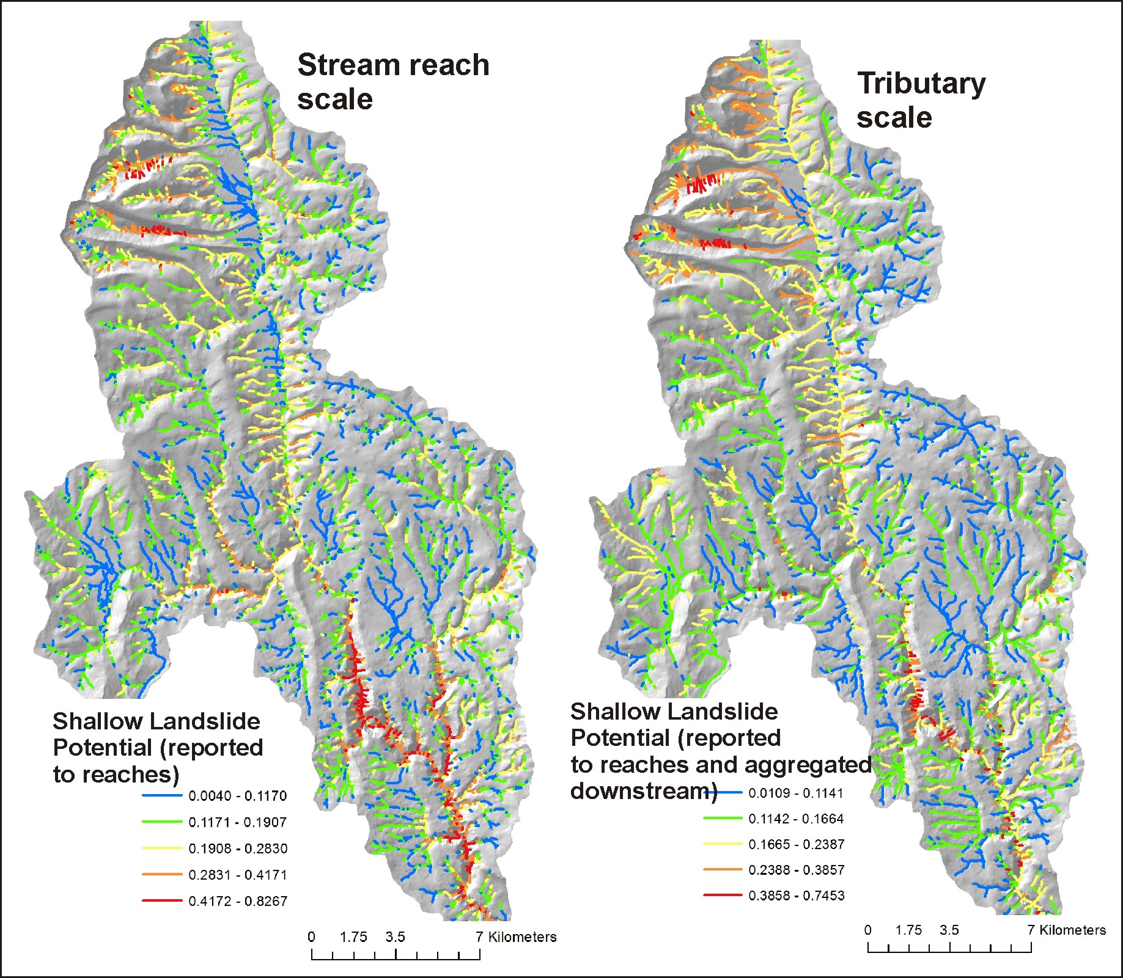
Shallow landslide
potential reported to
channel segments and
aggregated downstream

Slide 23
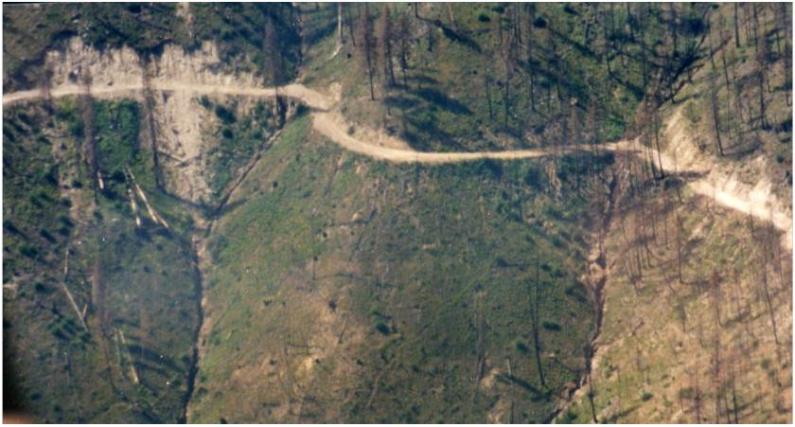
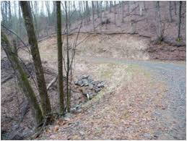
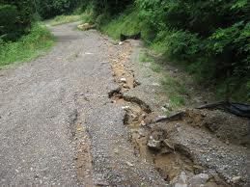
Road Surface Erosion and Sediment Delivery to Streams, Post Fire
Notes:
Roads can be significant sources of flooding, erosion and sediment delivery to streams, post fire.

Slide 24
Post Fire Road Surface Erosion (Sediment Production)
GRAIP-Lite model of road surface erosion (in NetMap)
(USFS, Rocky Mountain Research Station, Boise ID)
E = B * R * S * V
where E is road sediment production to streams (kg/yr), B is the “base”
surface erosion rate (empirical), R is the elevation difference between the road segment
end points (length), S is the road surface factor and V is the vegetation factor.
V = 1 – 0.86x, where x is the fraction of the road length where flow path vegetation
(ditch) is greater than 25%; R (elev. diff) is slope x road segment (hydrologic) length.
Example base rates:
Oregon Coast Range = 79 kg/yr
Idaho Batholith = 33 kg/yr
Montana (Belt sedimentary) = 7 kg/yr
Eastern Oregon (Umatilla, Basalt) = 1.5 kg/kg
Eastern Sierra (SPI) = 11 kg/yr
Notes:
The GRAIP-Lite model (RMRS, Luce, Black and Nelson) was used in the analysis. See NetMap’s online technical help materials for additional information: http://www.netmaptools.org/Pages/NetMapHelp/graip_lite.htm

Slide 25
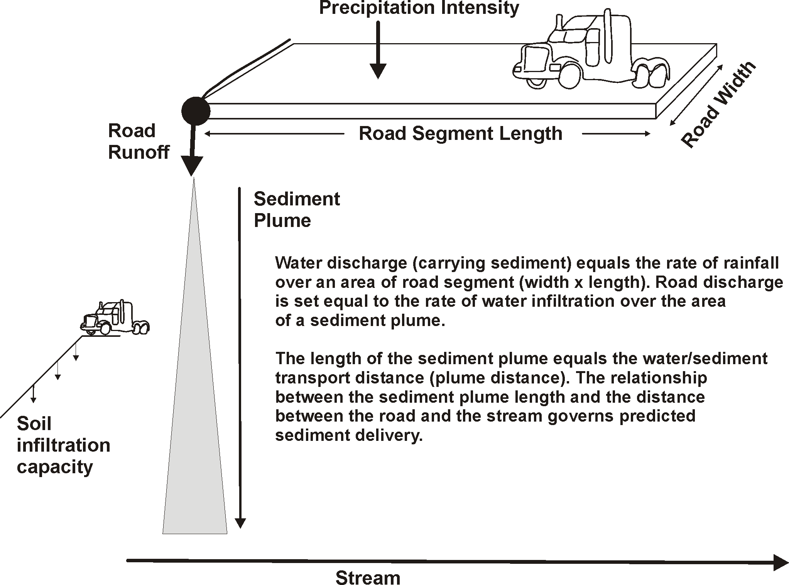
Road sediment delivery to streams (NetMap - conservation of mass)
Notes:
The GRAIP-Lite sediment delivery component was modified in NetMap, using a steady state, conservation of mass approach. For additional information, see NetMap’s online technical help: http://www.netmaptools.org/Pages/NetMapHelp/netmap_sediment_delivery_2.htm

Slide 26
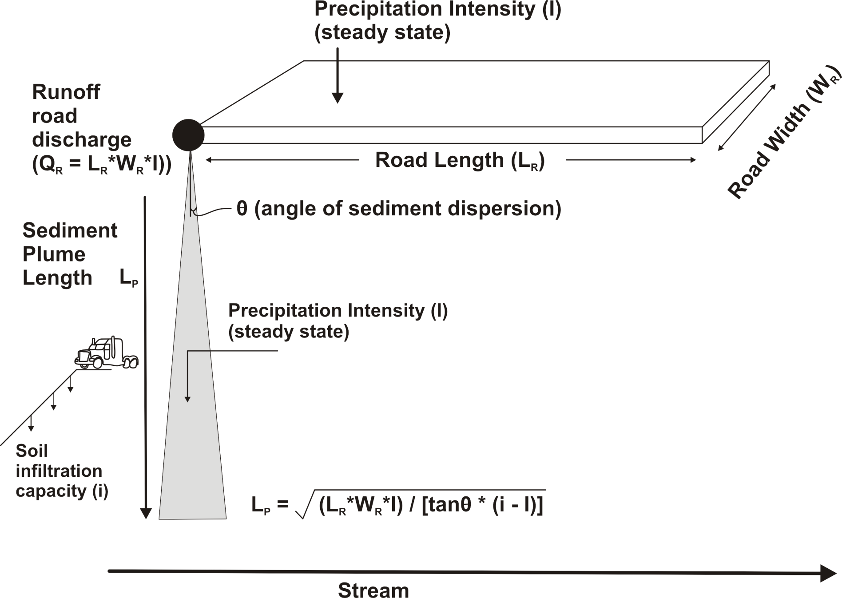
Road sediment delivery to streams (NetMap model)

Slide 27
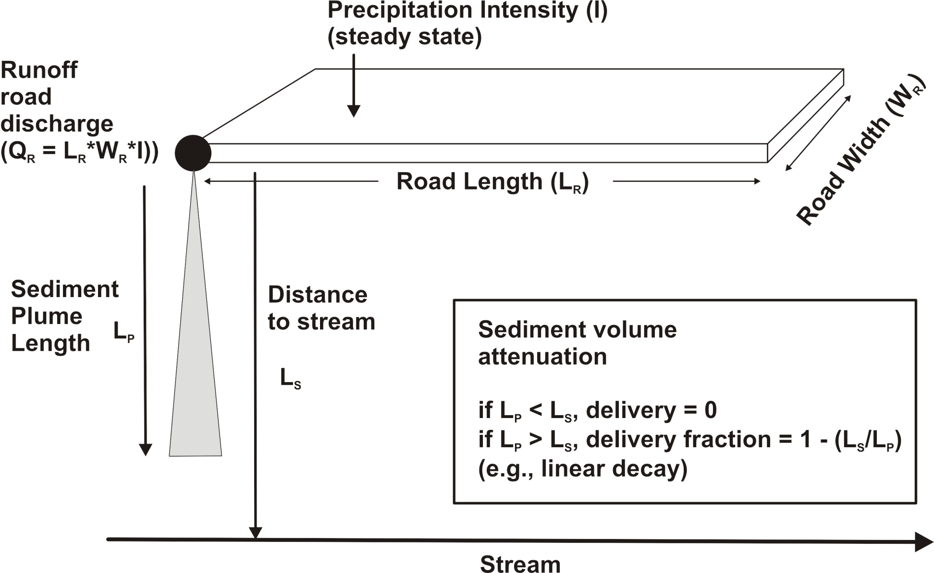
Road sediment delivery to streams (NetMap model)

Slide 28
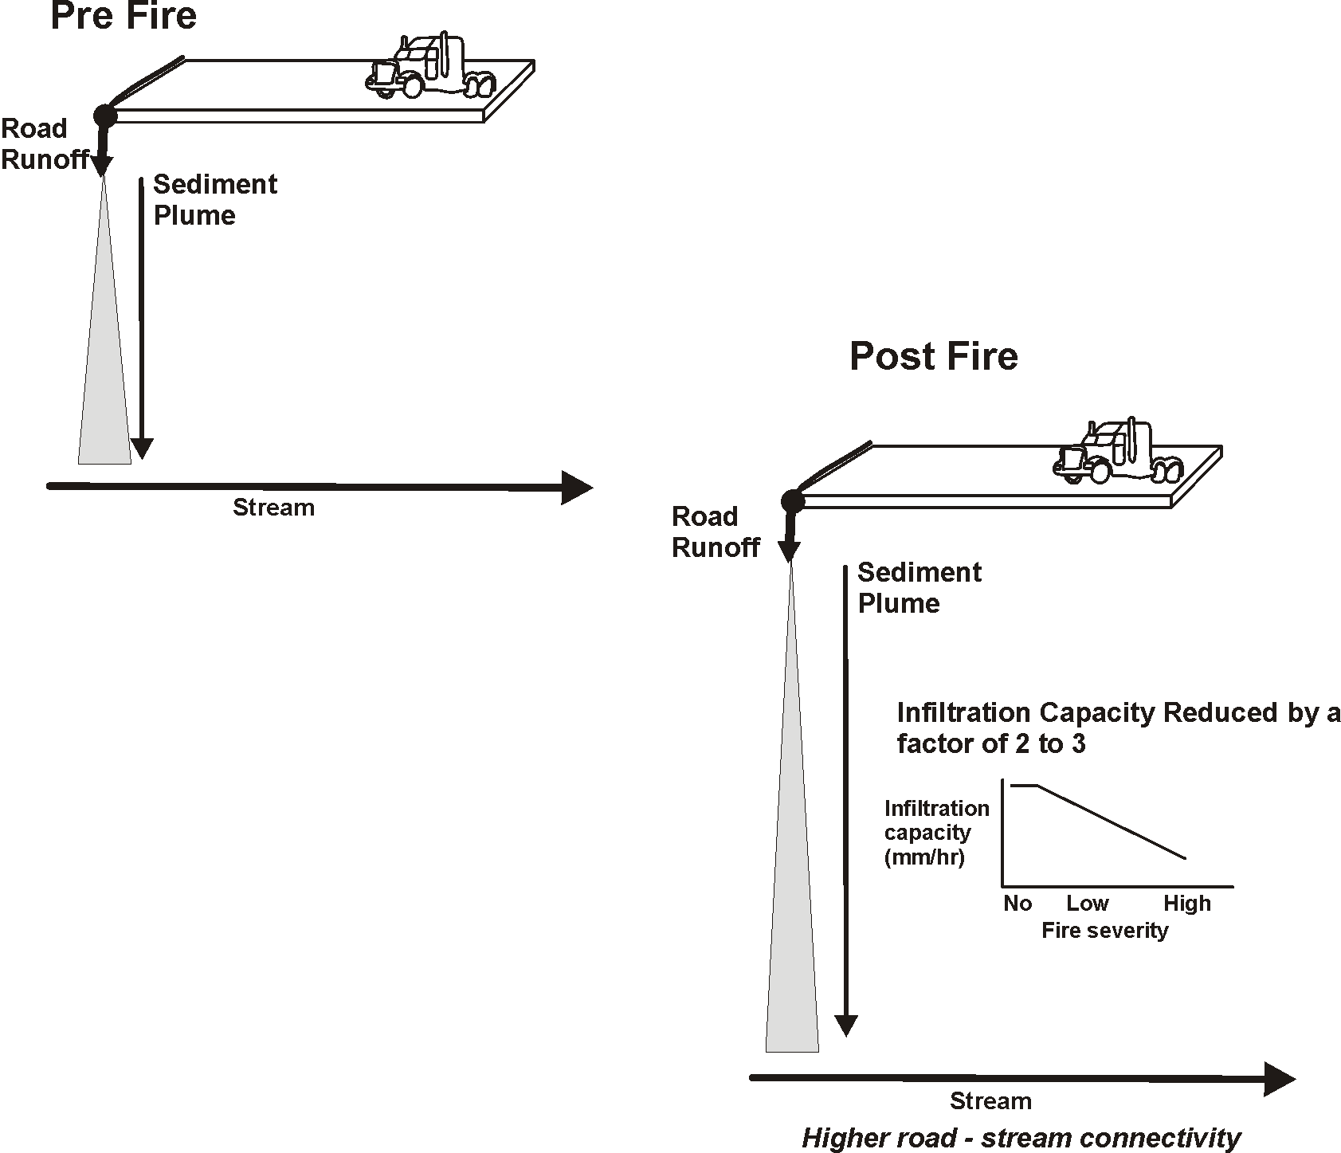
Fire Effects on Road Erosion
Sediment Delivery to Streams
Fire that reduces infiltration capacity will result in
a larger proportion of forest roads delivering sediment
to stream channels (these could be targeted for
restoration)
Notes:
Fire can impact road erosion sediment delivery by reducing the infiltration capacity of the forest floor (if burned). Lower infiltration capacity can lead to longer sediment plume lengths and greater connectivity between forest roads and stream channels.

Slide 29
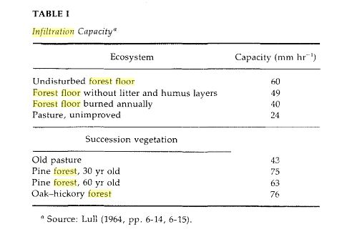
Low severity =
50 mm/hr
Moderate severity = 40 mm/hr
High severity = 20 mm/hr
Notes:
We selected a non fire forest floor infiltration rate of 60 mm/hr; this was reduced based on predicted fire severity as indicated above.

Slide 30
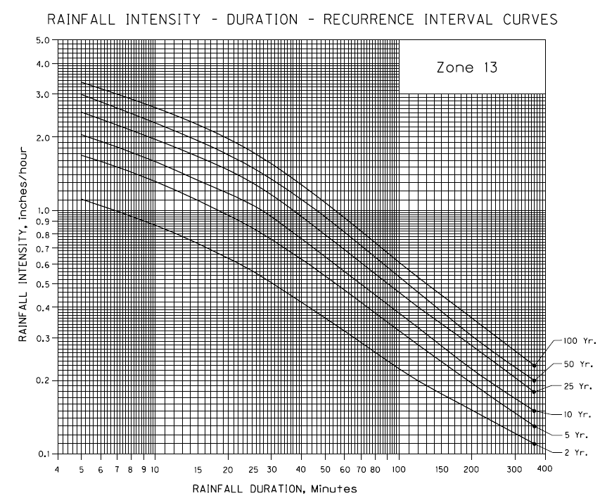
Design storm (short duration, high intensity)
0.92 in/hr (23 mm/hr)
ftp://ftp.odot.state.or.us/techserv/Geo-Environmental/Hydraulics/Hydraulics%20Manual/Chapter_07/Chapter_07_appendix_A/CHAPTER_07_APPENDIX_A.pdf
Notes:
A design storm is needed in NetMap’s sediment delivery model. We choose a short duration 10-year storm to mimic thunderstorm activity, post fire.

Slide 31
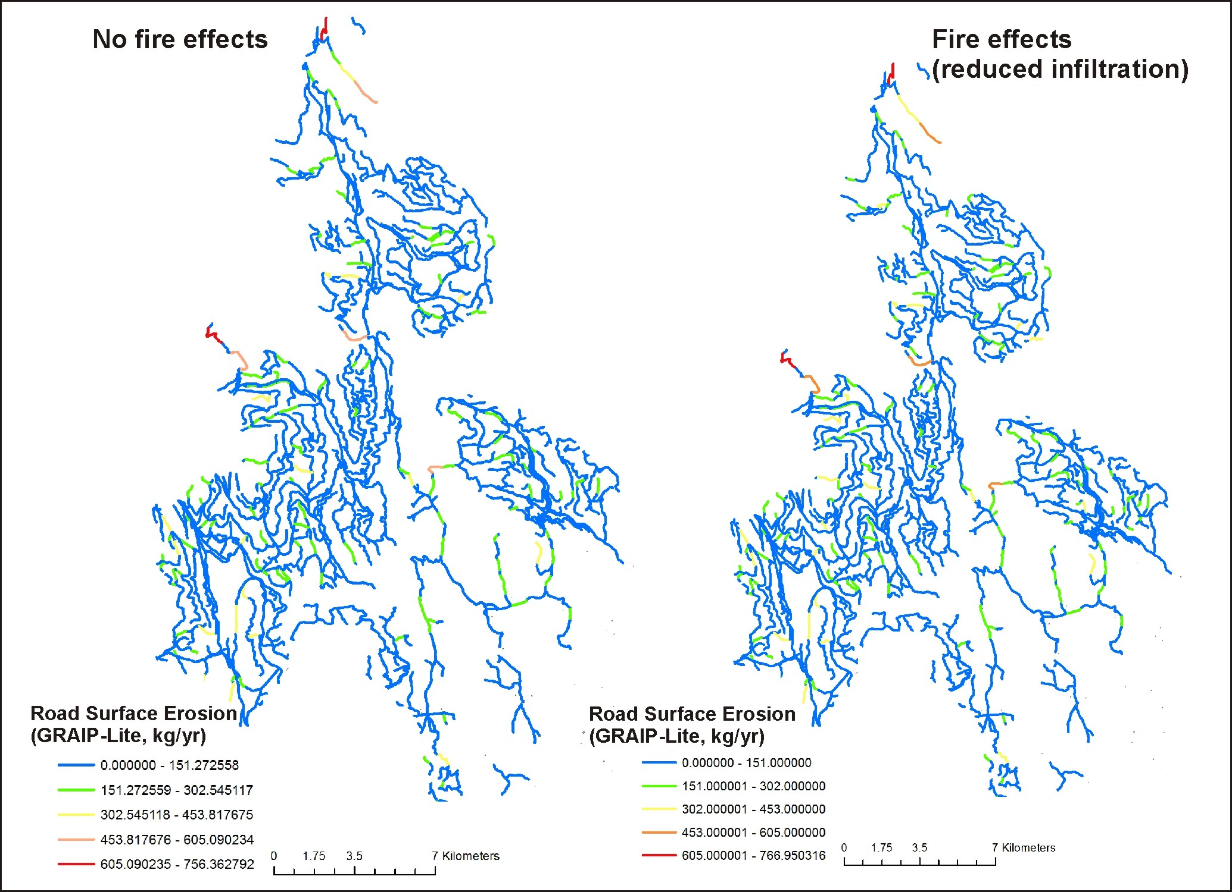
Road erosion results, pre and post fire
It is difficult to see the changes
in these maps because of the
broad legend categories.
See following slide for
the difference between
no fire and fire.
Notes:
Predicted sediment delivery is mapped to the road network for pre and post fire conditions; little change can be see because of the board legend classes, but see next slide.

Slide 32
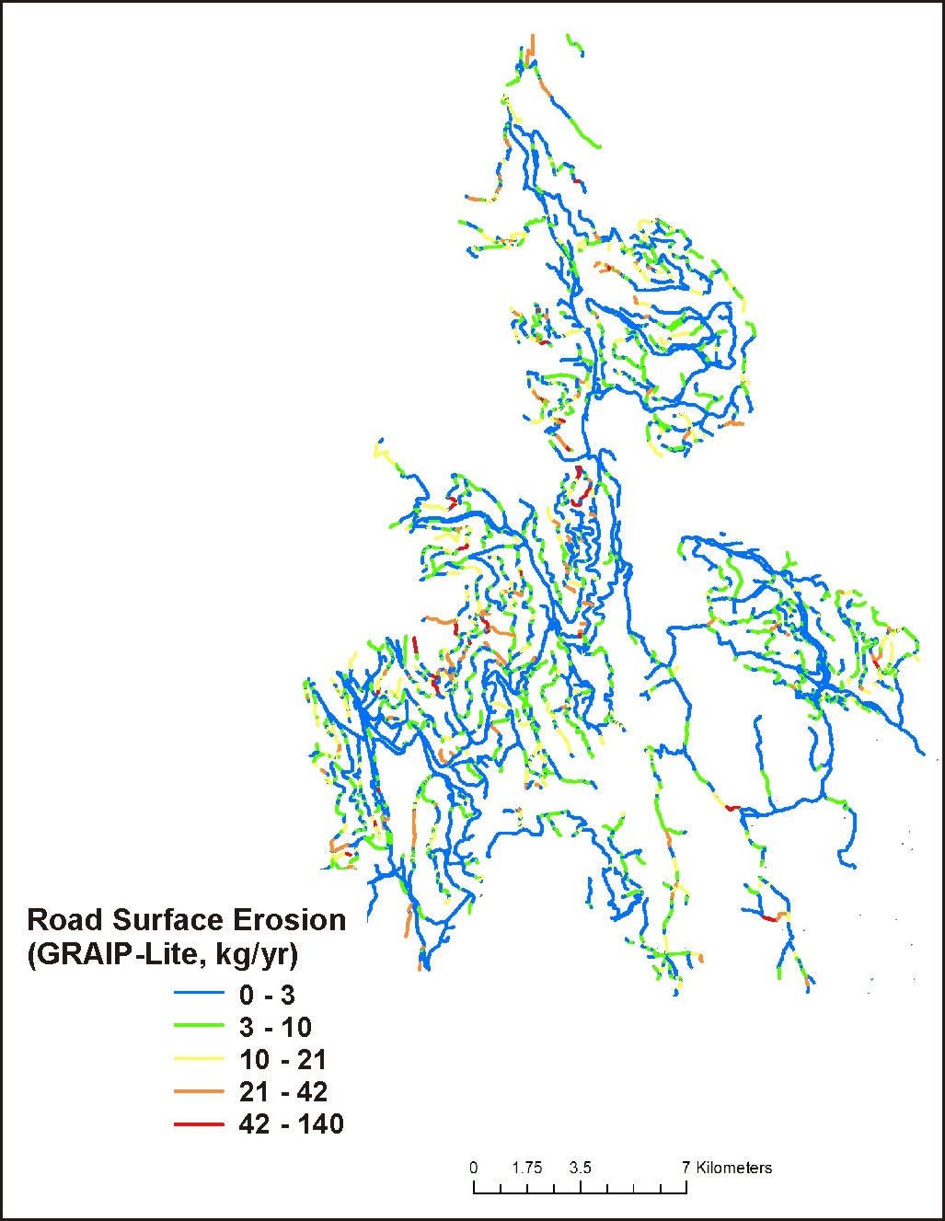
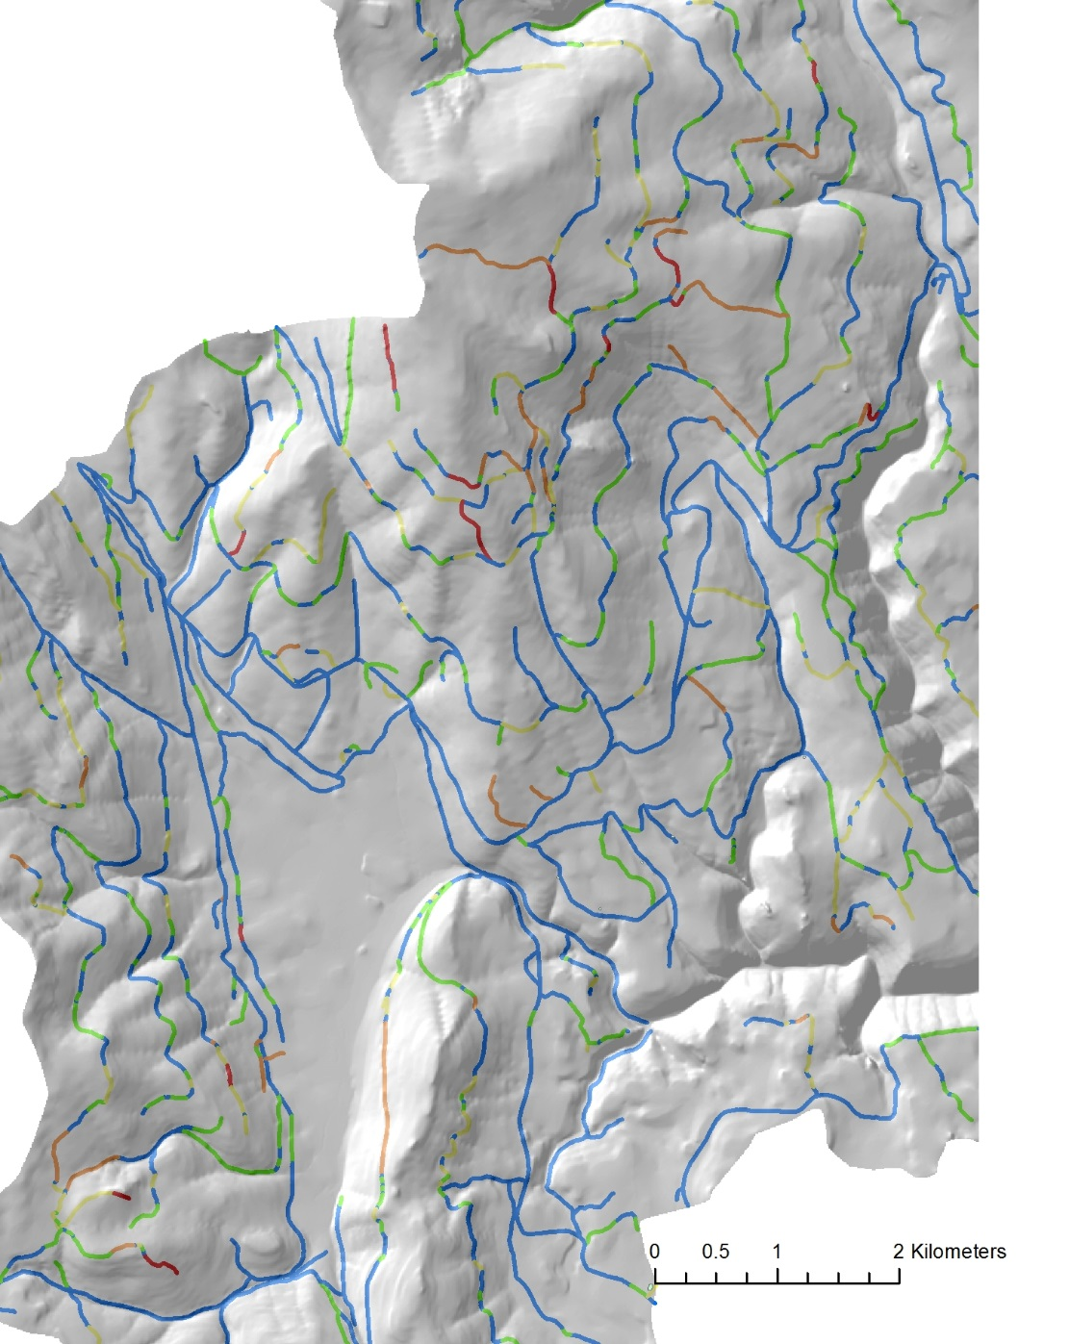
Road erosion
difference map,
where fire should
have the largest effect
of increasing sediment
delivery
Notes:
A difference map of road sediment delivery reveals that some road segments are more sensitive to fire reductions in infiltration capacity compared to others.

Slide 33
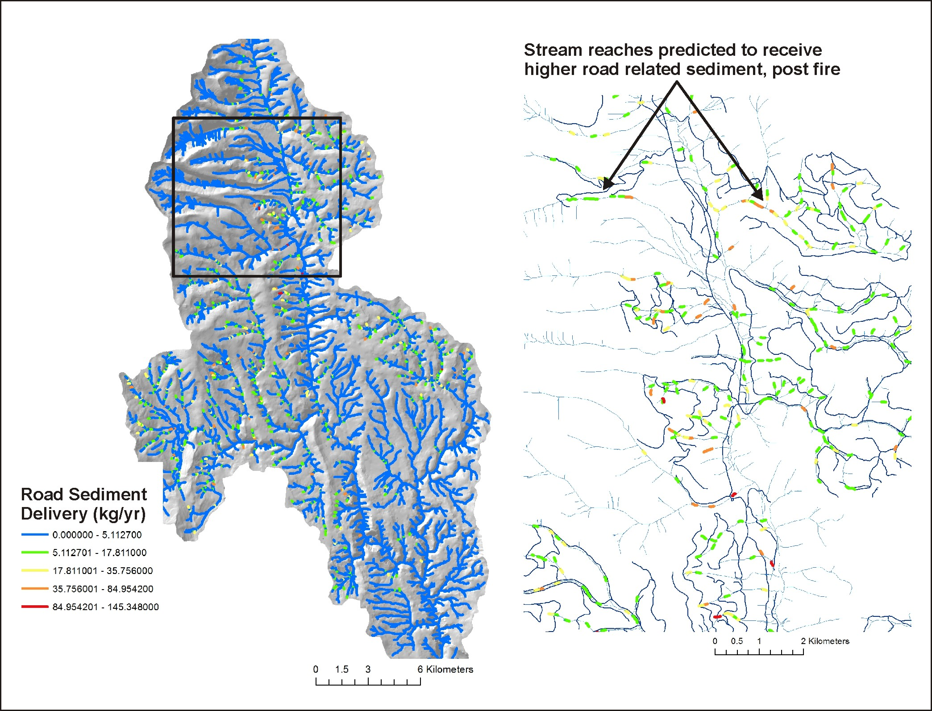
Notes:
Stream reaches where post fire road sediment delivery is predicted to increase; some of these reaches overlap sensitive fish habitats.

Slide 34
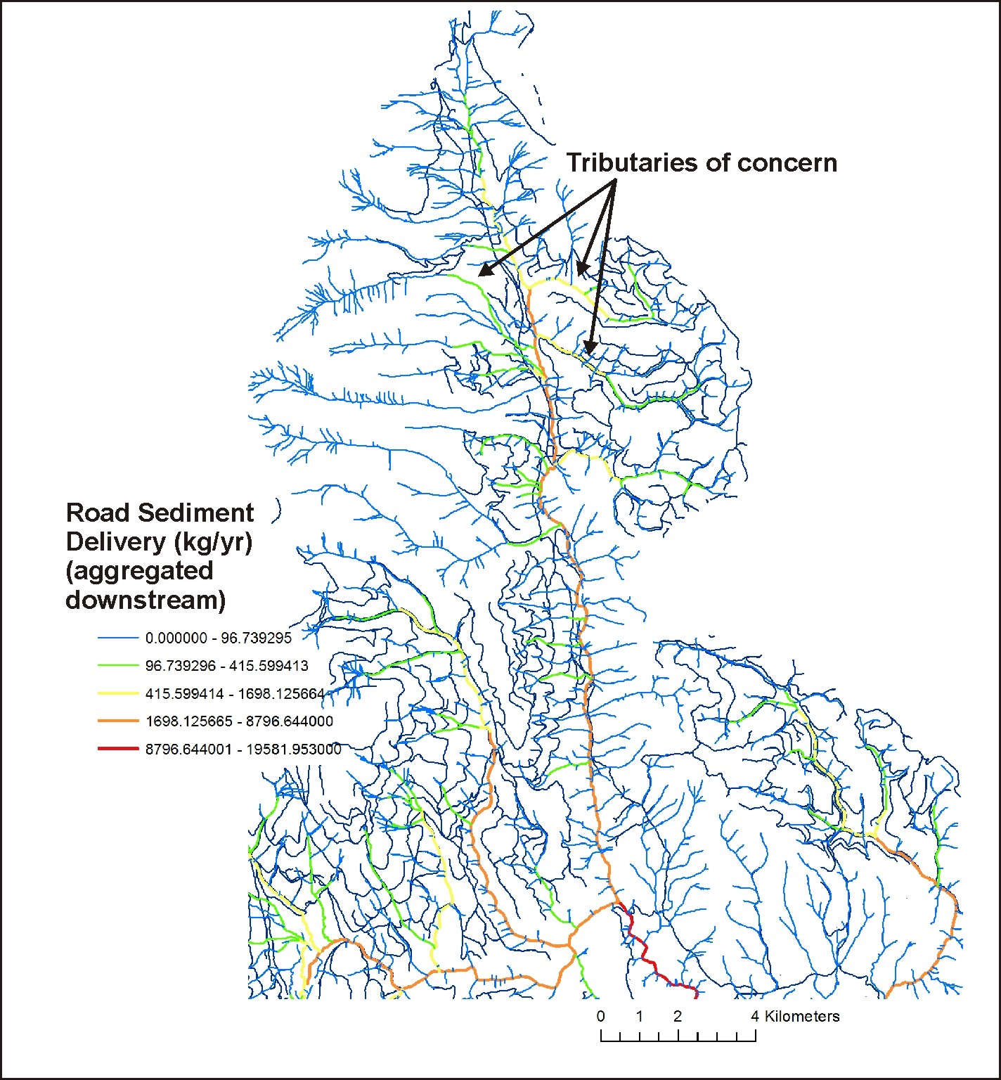
Notes:
Differences in pre and post fire road erosion sediment delivery is routed or aggregated downstream, revealing tributary and subbasin patterns. This information was also aggregated to the HUC 6th subbasin.

Slide 35
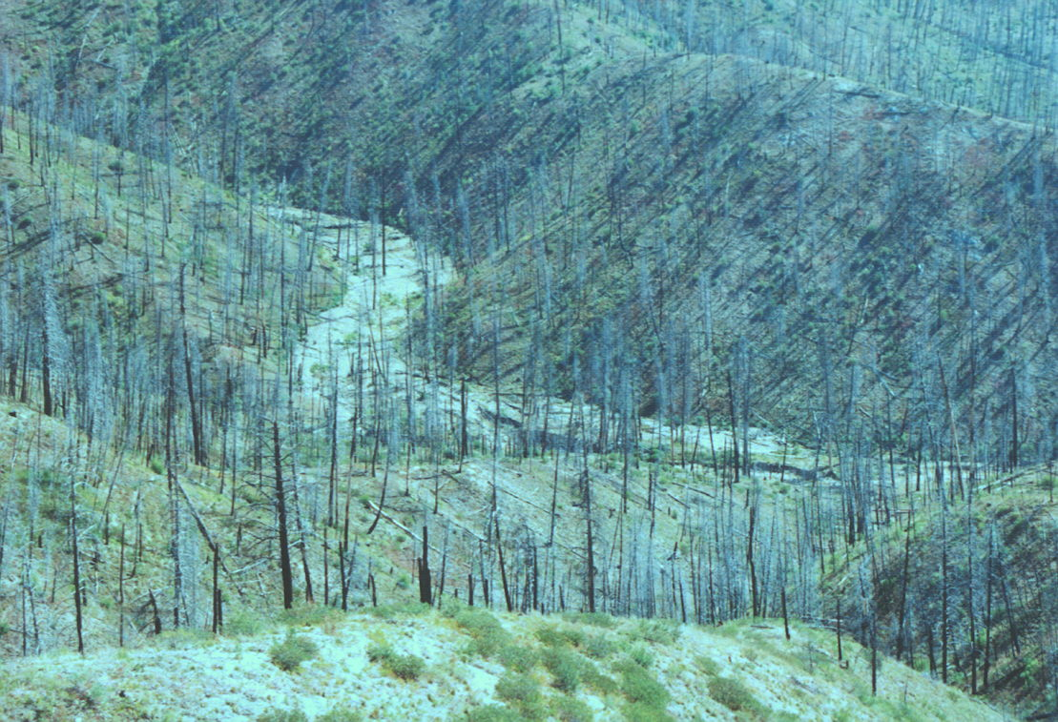
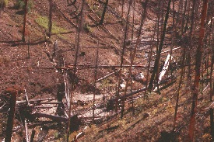
Riparian Zones: Impacts from Fire, Loss of Shade, Increases in Thermal Loading and
Loss of Cool Water Refugia

Slide 36
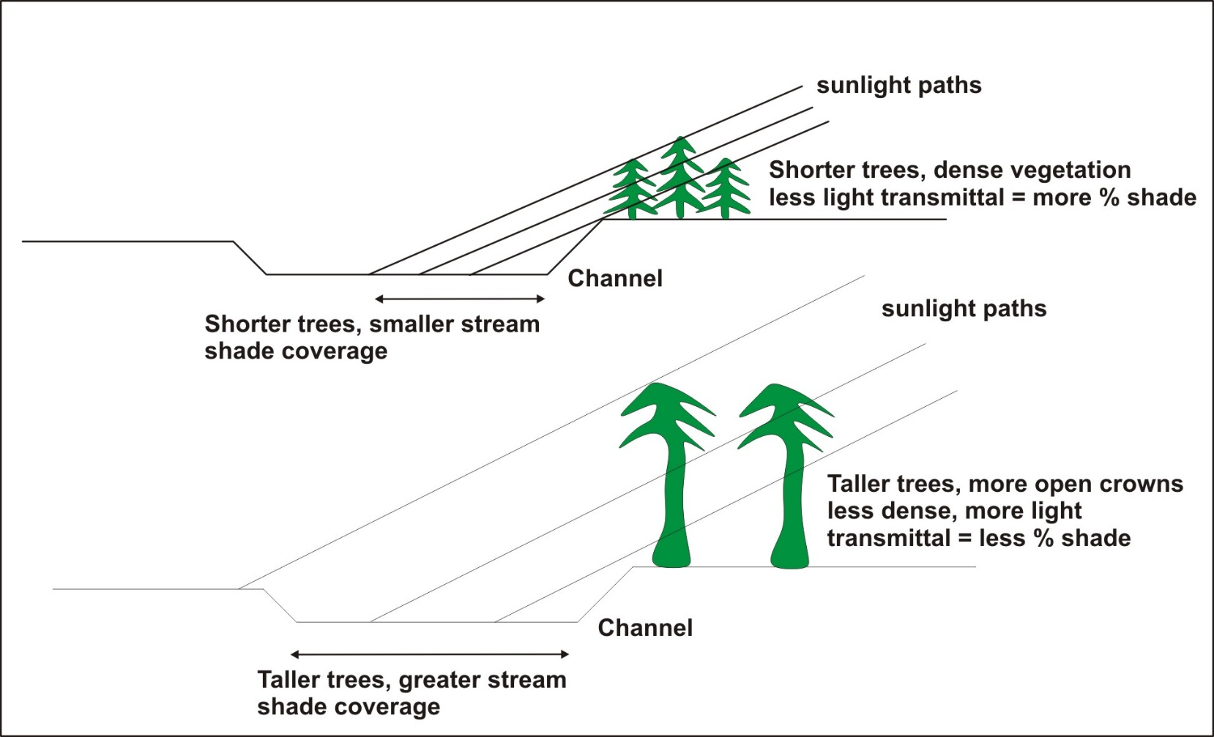
Riparian – Current Shade/Thermal Energy
Fire effects on shade & thermal
loading
Shade model, Groom et al. 2011
Tree height, basal area
(LEMMA)
(where fire would have the largest impacts on the thermal regime,
including loss of thermal refugia)
Notes:
A shade model was used to estimate the effects of vegetation on reducing thermal energy to streams. Shorter, denser vegetation provides more shade, but the shadow length is smaller. Taller older trees have less dense vegetation mid crown that can reduce the shade, but they have a longer shadow length. We used a simple linear relationship between percent shade and predicted flame length. To learn more about this modeling approach, go to NetMap’s online technical help materials: http://www.netmaptools.org/Pages/NetMapHelp/current_shade_thermal_energy.htm

Slide 37
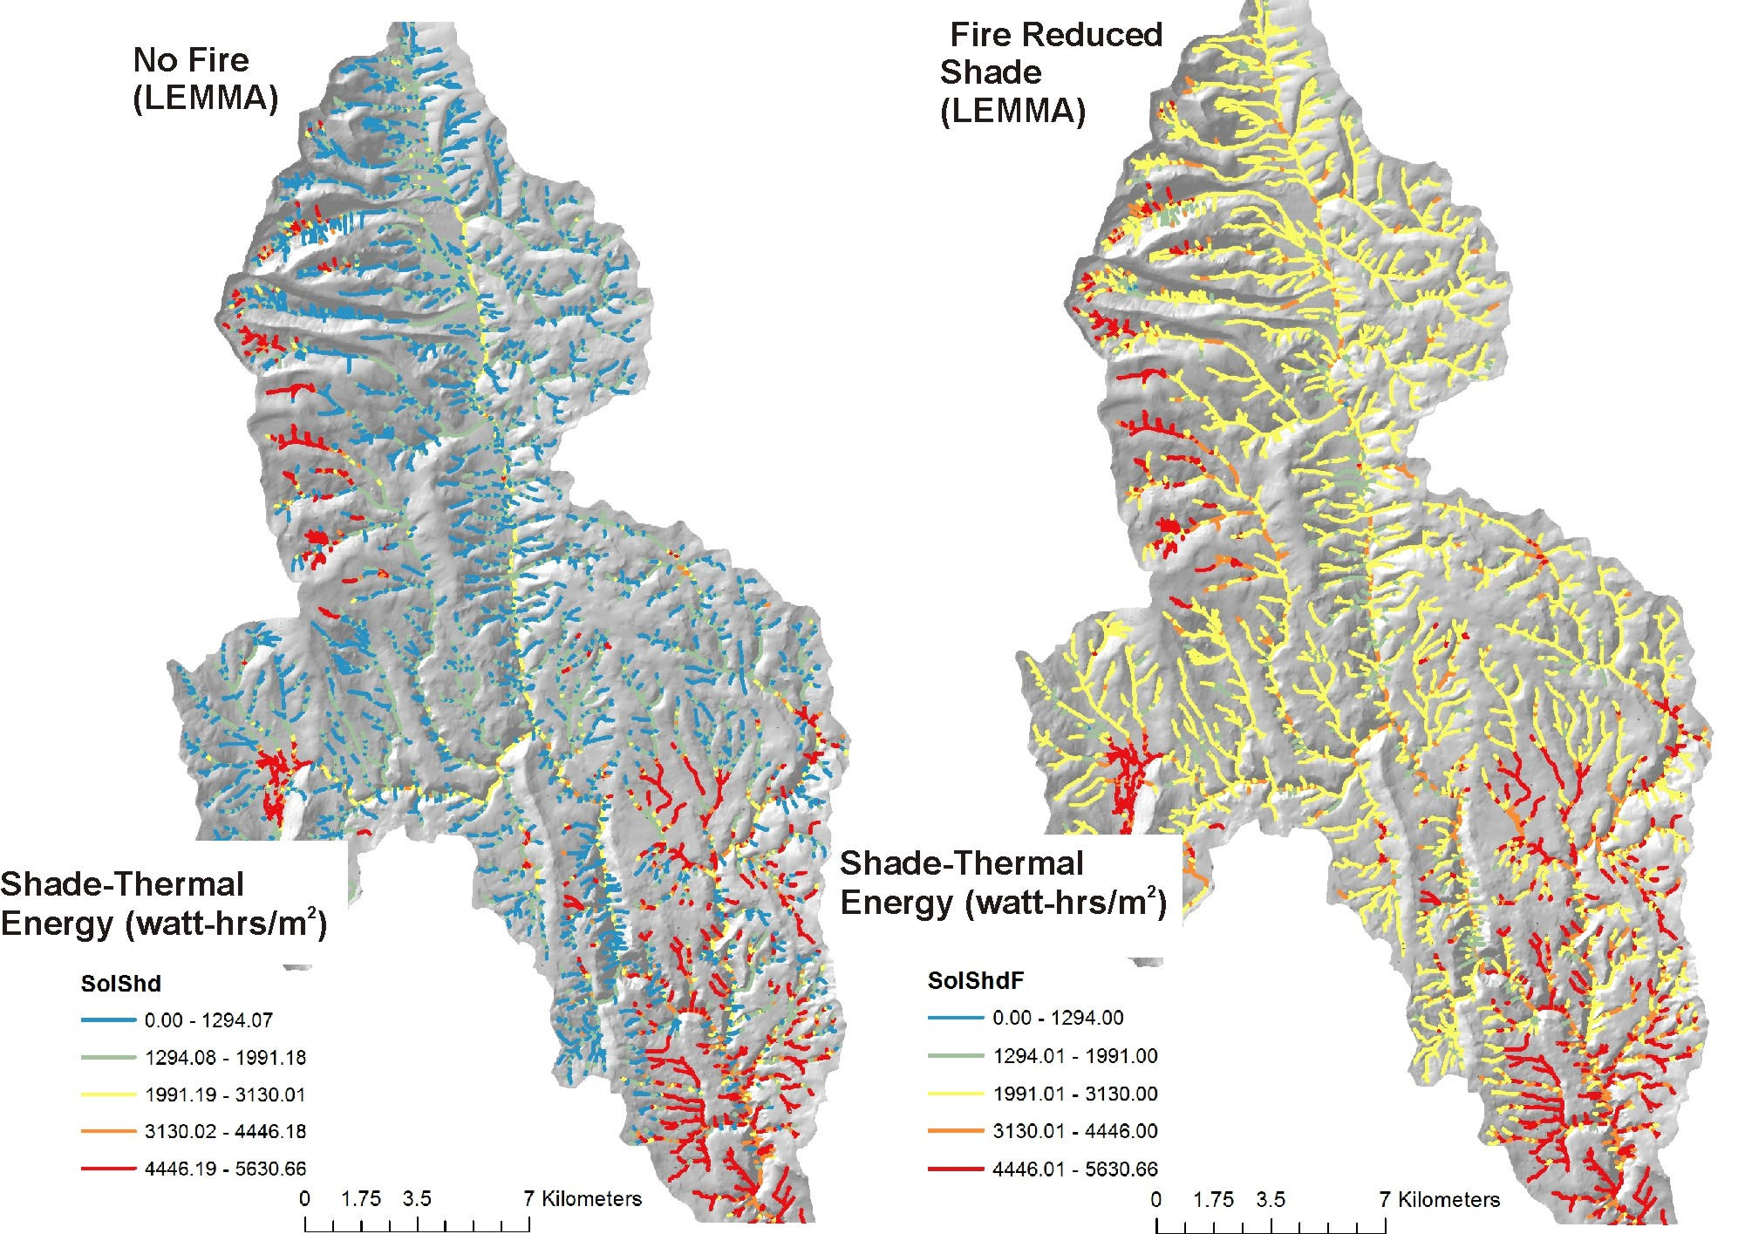
Riparian –
Current Shade/
Thermal Energy
Notes:
Predicted thermal energy to streams under current (no fire) shade conditions (using LEMMA vegetation data (http://lemma.forestry.oregonstate.edu/) and fire-reduced shade. Many channel segments receive higher thermal loading, post fire. Some areas like the lower right hand corner are south facing with little topographic shading, and thus do not exhibit much change.

Slide 38
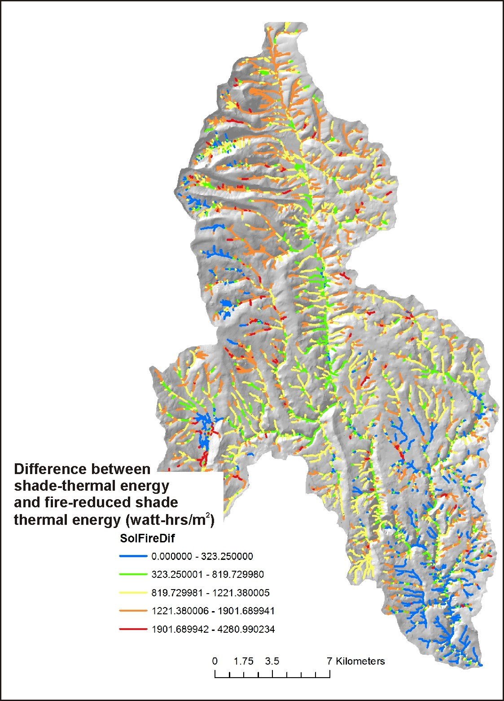
Difference between current shade-
thermal energy and fire reduced shade
thermal energy.
Shows reaches where the greatest impacts to
shade and increases in thermal energy are
predicted to occur
Notes:
A difference map is produced from the previous slide’s data, revealing which channel segments would be most sensitive to fire-induced reductions in shade, according to the predicted fire severity (flame length).

Slide 39
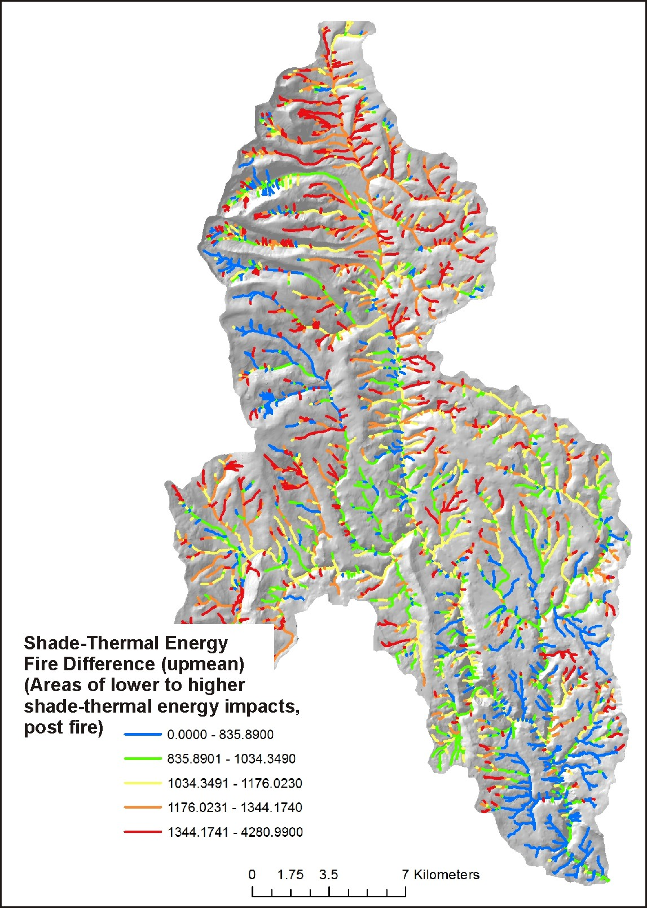
Difference between current shade-
thermal energy and fire reduced shade
thermal energy, but aggregated downstream
(running average).
Shows multi-reach or tributary scale impacts to
shade and increases in thermal energy, e.g.,
stream segments and tributaries where thermal
refugia will be reduced.
Notes:
The information from the previous slide is aggregated downstream, revealing tributary and subbasin scale patterns of increasing thermal conditions due to fire and its variable intensity.

Slide 40
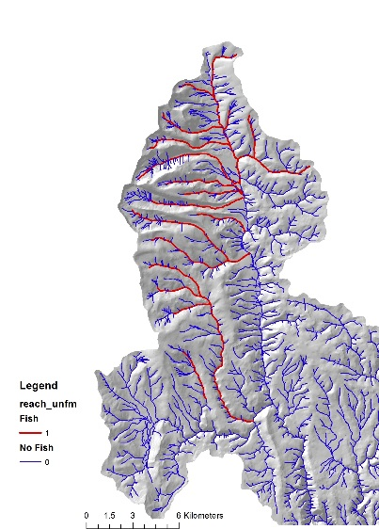
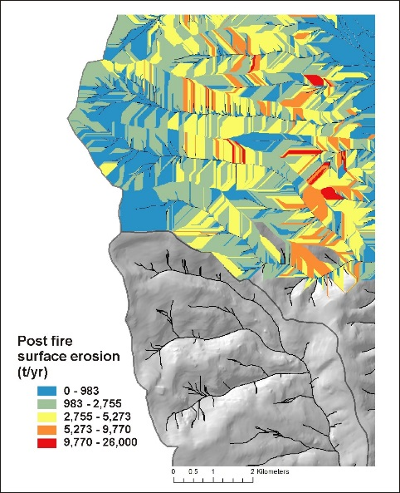
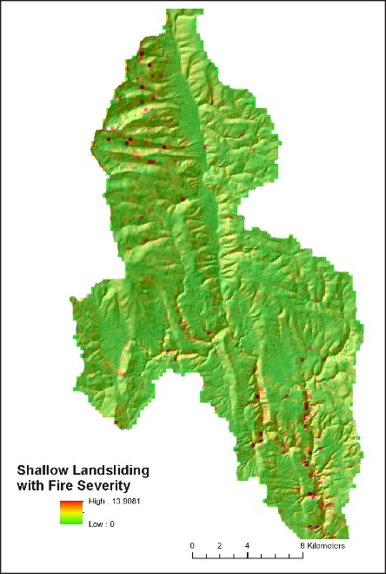
Decision Space: Spatially Explicit Maps (visual - qualitative)
+
+
Fish habitat
Surface Erosion Potential
Landslide Potential
+
Impacts on thermal refugia
= priority sites for protection (pre fire management, firefighting)
Notes:
Information provided in the Fire and Fish analysis (previous slides, among other data) can be used visually and qualitatively to search for intersections or overlaps between various fire related stressors (erosion, roads, thermal) and sensitive aquatic habitats, as illustrated above. Or one of NetMap’s tools (Habitat-Stressor Overlap Tool) can be used quantitatively to locate overlaps and intersections (see next slide).

Slide 41
Decision Space: Spatially Explicit Quantitative
Notes:
NetMap’s Quick Tool that contains the Habitat-Stressor overlap capability can be used to locate intersections between fire related impacts and sensitive fish habitats. The tool calculates, on the fly, the full frequency distribution of values (shown as the cumulative distribution of values in this slide), and the analyst, using the tool, selects from the distributions to search for overlaps. For example, an analyst can quickly search for intersections among the highest 10% of fire severity, highest 5% of post fire surface erosion (or landsliding or gullying), highest 10% of fire related increases in thermal loading, and fish habitats (either presence of habitat or some numeric value of habitat quality [used in IP]).
For additional information, see NetMap’s online technical help that describes the overlap tool: http://www.netmaptools.org/Pages/NetMapHelp/overlap_tool___reaches.htm
And the Quick Tool, which is provided as part of this analysis: http://www.netmaptools.org/Pages/NetMapHelp/netmap_quick_tool.htm

Slide 42
Notes:
All analysis results are summarized to the HUC 6th subbasin scale. This can be used to examine subbasin scale patterns of fire related attributes and stressors and the locations of aquatic habitats. Subbasin scale data summaries may be most useful at the scale of larger watersheds or entire national forests.

Slide 43
Fire Fighting
(Retardant Avoidance/Yes Areas)
Notes:
NetMap’s Fire and Fish analysis could be used to inform firefighting, including retardant drops. For example, critical riparian-fish habitat zones, using the shade-thermal results and fish distributions (or IP mapping) could be used to direct on the ground firefighting to protect important riparian forests. The analysis can also be used to inform locations where retardant drops should be avoided or allowed. For example, a relevant question is whether long term loss of critical riparian habitats (and resultant long term increases in thermal loading and a loss of thermal refugia) outweights short term retardant in water impacts.

Slide 44
Retardant YES Line Mapping
A GIS Based Approach
Willamette National Forest
Modeled on the Deception Fire - Middle Fork Ranger District
February, 2015
Nikki Swanson, Willamette +
Step 1. NHD flow lines,
buffering 300 ft each side.
Step 4. Map ridgetops.
Step 3. Map
retardant avoidance
areas
Step 2. Add SHABs/wet meadows
/lakes & National Retardant Avoidance
Layer
Step 5. Retardant YES areas
Notes:
This is the approach for identifying retardant avoidance and retardant Yes areas, used by the Willamette National Forest. We modified this approach in the following slides.

Slide 45
Fire & Fish: Retardant Avoidance/Yes areas (modified)
Step 1: NetMap stream layer (more comprehensive, more consistent) – delineate a 300 ft buffer both sides of all streams –
Retardant Avoidance Areas.
Step 2. Remove headwater channels likely to be dry during fire season (first-order streams, likely ephemeral, dry in
fire season).
Step 3. Identify critical fish – riparian environments (thermal refugia, floodplains) and REMOVE these from avoidance
areas (they become optionally a retardant YES area). Reasoning: Short term vs longer term impacts.

Slide 46
Fire retardant
avoidance areas
Notes:
300 foot buffers on both sides of NetMap’s synthetic stream layer (left) compared to first-order channels (likely ephemeral channels, dry in fire season) removed from the retardant avoidance areas (right) (all fish bearing channels are included in the avoidance areas in both maps). This is only an illustration, and it used the NorWest data (NHD-based) on Bull Trout, not the US Forest Service more extensive Bull Trout habitat distribution. Agency analysts will need to conduct their own GIS buffering, although TerrainWorks uses a customized program that employs drainage wings for accurate buffering (contact TerrainWorks for additional details).

Slide 47
Notes:
(Left) Avoidance areas that do not include first-order channels. (Right) Areas of critical riparian-aquatic habitats (defined as the highest 30% of thermally impacted reaches due to shade loss from fire, overlapped with Bull Trout habitat) have been removed from the left panel avoidance areas. Agency analysts can use the Habitat-Stressor Overlap function in NetMap’s Quick Tool (provided as an add-in ArcMap) to identify other combinations of critical habitats to protect. This is only an illustration, and it used the NorWest data (NHD-based) on Bull Trout, not the US Forest Service more extensive Bull Trout habitat distribution. Agency analysts will need to conduct their own GIS buffering and the selection of what constitutes critical riparian and aquatic habitats. However,TerrainWorks uses a customized program that employs drainage wings for accurate buffering (contact TerrainWorks for additional details).

Slide 48
Notes:
The analysis results are provided as a set of shapefiles that can be loaded into ArcMap (a table in a provided document lists the attribute field names and shapefile locations). In addition, the results can be accessed from NetMap’s Quick Tool (provided) where selecting an attribute from a drop down list and displaying it is made easy. In addition, the Quick Tool contains the stressor-habitat overlap tool for making quick searches for up to 5 attribute combinations of data, such as the highest 10% of thermal impacts by fire overlapped with Bull Trout habitat.
To learn more about the Quick Tool, go to: http://www.netmaptools.org/Pages/NetMapHelp/netmap_quick_tool.htm
To learn more about its overlap tool, go here: http://www.netmaptools.org/Pages/NetMapHelp/overlap_tool___reaches.htm

Slide 49
Drop down attribute list in NetMap’s Fire and Fish Quick Tool
Fire
[flamelen_unfm] Fire Severity-Hillside [flam_loc ] Fire Severity-Channel [flam_cum ] Fire Severity-Aggregated [AvgaFlame] HUC6-summarized Fire Severity
Aquatics
[fish_bull] Bull Trout (presence/absence) [SumLBull] HUC6-summarized Bull Trout Length
[fish_redb] Redband Trout (presence/absence) [SumLRedb] HUC6-summarized Red Band Length
[IP_Steelhd] Steelhead IP [AvgIPStlnd] HUC6-summarized Steelhead IP
[IP_Chinook] Chinook IP [AvgIPChinook] HUC6-summarized Chinook IP
Erosion
[WEPPSlop] Surface Erosion(Fire)-Hillside [SumWepp] HUC6-summarized Surface Erosion [WEPP} Surface Erosion(Fire)-Channel [WEPP_Cum] Surface Erosion(Fire)-Aggregated
[Gully] Gully Potential-Hillside [AvgGully] HUC6-summarized Gully Erosion [Gully_Loc] Gully Potential-Segment [Gully_Cum] Gully Potential-Aggregated
[GEP] Shallow Landslide Potential-Hillside [AvgGEP] HUC6-summarized Landslide Potential [GEP] Shallow Landslide-Channel [GEP_Cum] Shallow Landslide-Aggregated
Notes:
The drop down list of analysis results in the Quick Tool (previous slide) is organized by main

Slide 50
Roads
[SedProd] Sediment Production-Road [SedDel] Sediment Delivery-Road [SedDelF] Fire Sediment Delivery-Road [Del_Fdif] Difference-Road [Length_M] Road Drainage Length [ToStream_M] Distance to Stream
[Graip] Sediment Delivery-Channel [SumGDel] HUC6-summarized Sediment Delivery [Graip_Cum] Sediment Delivery-Aggregated [GraipF] Fire Sediment Delivery-Channel [SumGFDel] HUC6-summarized Sediment Delivery Fire GraipCumF] Fire Sediment Delivery-Aggregated [GraipDif] Difference-Channel [SumGDif] HUC6-summarized Sediment Delivery Difference [GraipCfdif] Difference-Aggregated
Riparian
[SolShd] CurrentShade-Thermal-Channel [SumSolShd] HUC6-summarized Shade-Thermal Energy
[SolShdF] FireShade-Channel [SumSolShdF] HUC6-summarized Shade-Thermal Energy Fire [SolFireDif] Difference-Channel [SumSolShdF] HUC6-summarized Shade-Thermal Energy Difference [solardif_r] Difference-Aggregated
Thermal Refugia [SolMean] Aggregated Shade-Thermal Energy (SolShd) [TrbThrm] Thermal Refugia-Confluences [TrbThrmSc] Thermal Refugia-Confluences, scaled by tributary-mainstem drainage area (flow) [FPchg] Thermal Refugia-Floodplains
[vw_2] Floodplain-Polygon [FP_WIDTH] Floodplain-Segment

Slide 51
Presentation
Complete
TerrainWorks designs and builds the most advanced watershed and landscape analysis system
in the world. Learn more about NetMap virtual watersheds, watershed analysis tools,
online technical help and tools at: www.terrainworks.com. Contact us with questions,
we are here to help.

