Slide 1
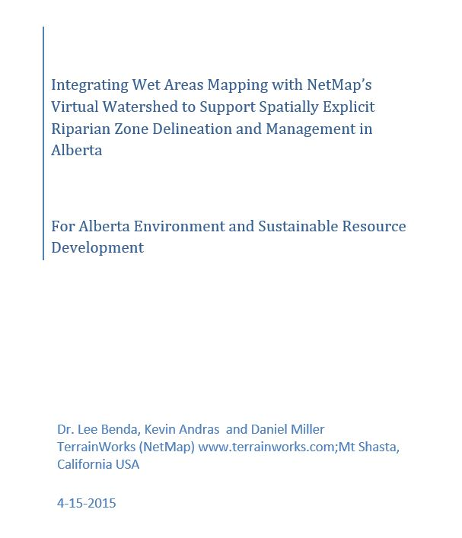

Slide 2
To main objectives:
Build a seamless, routed stream network across WAM tiles
Apply a process based, riparian zone delineation tool
Riparian Processes
Depth to water (WAM)
Floodplains
In-stream wood recruitment
Current vegetation shade effects on thermal energy to streams
Add Environmental Settings (not included)
Channel types
Habitat (fish) potential
Hillslope erosion potential
Channel migration
Thermal refugia
Tributary confluence zones
Wildfire risk
Climate change

Slide 3
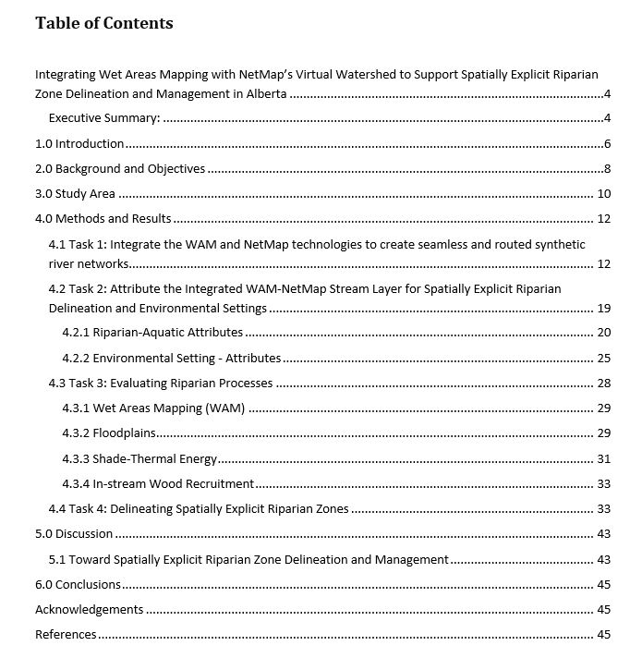

Slide 4
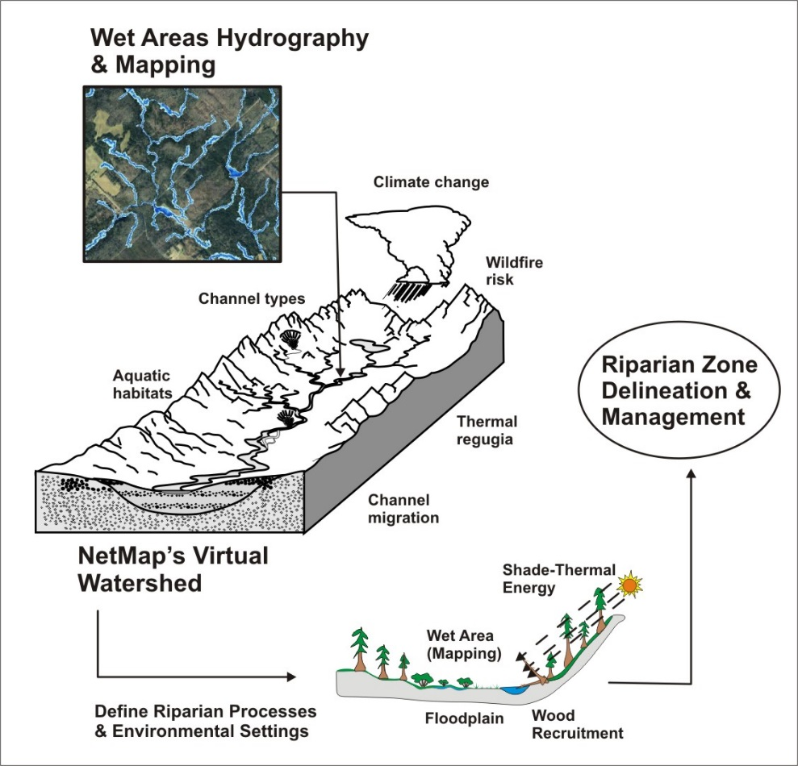
Conceptual Framework

Slide 5
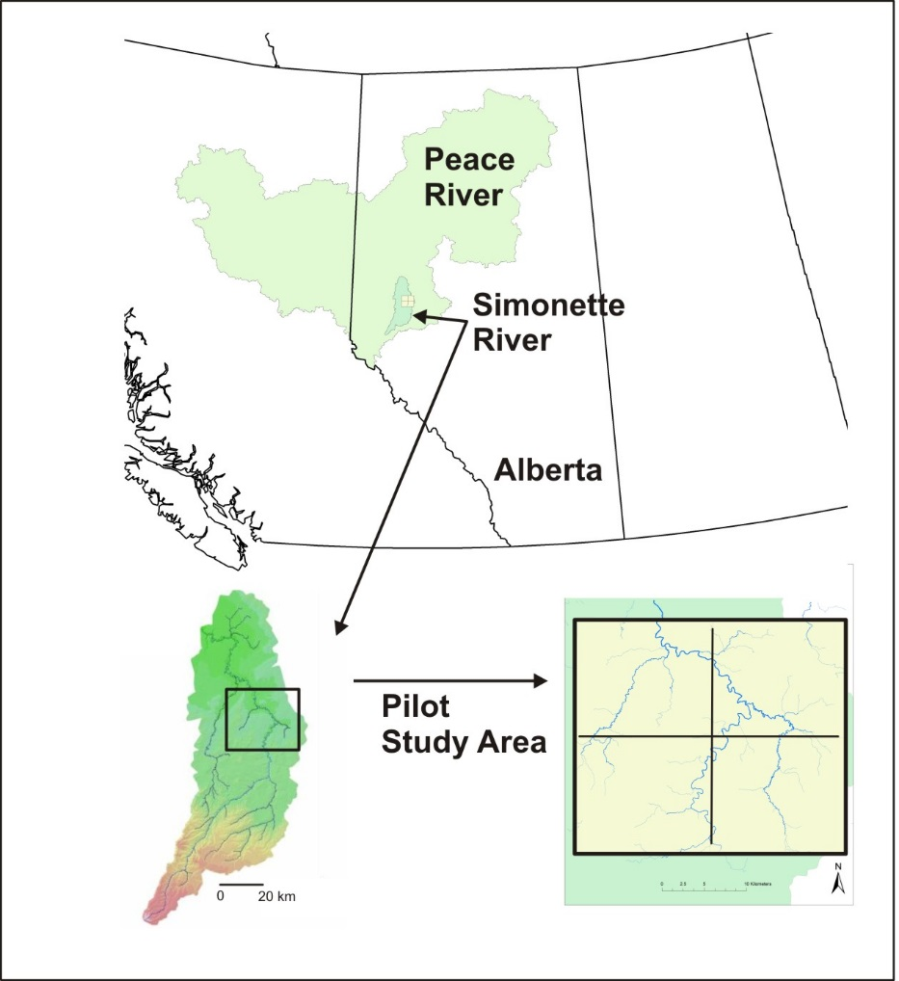
Project Area

Slide 6
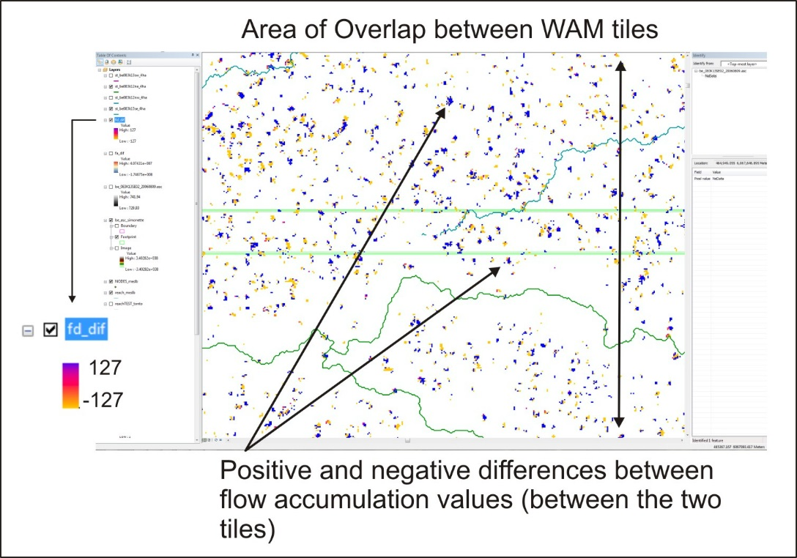
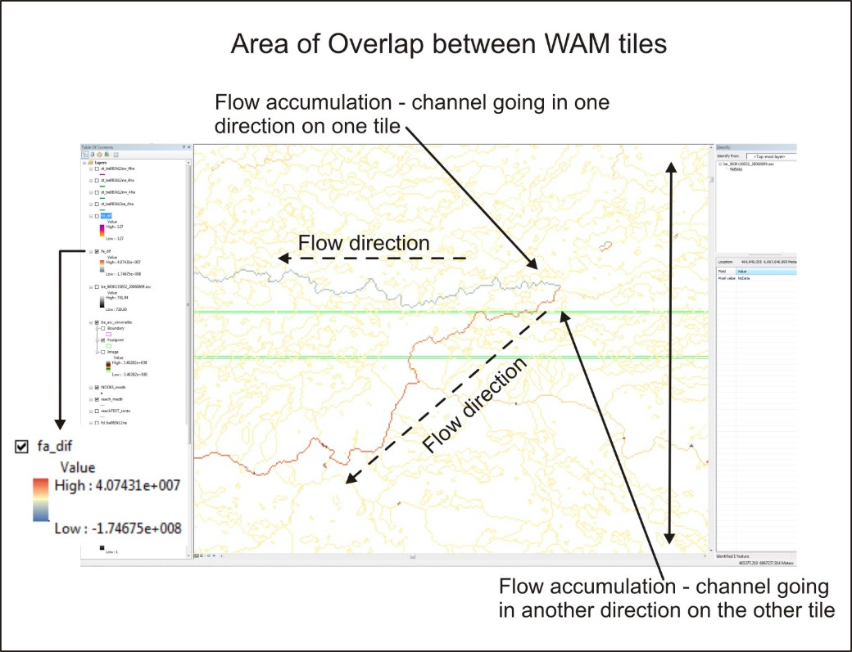

Slide 7
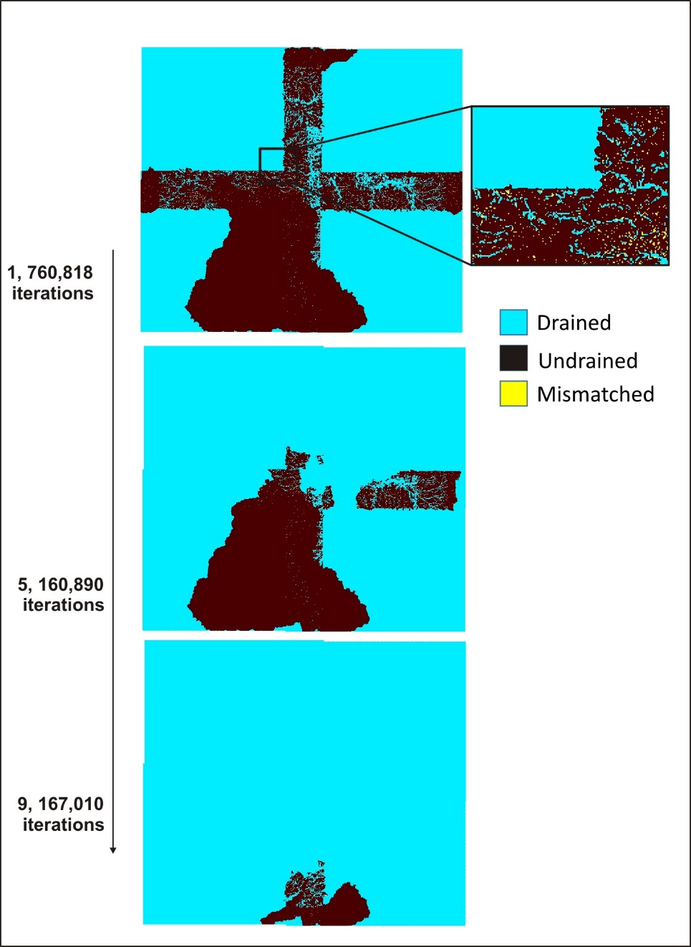
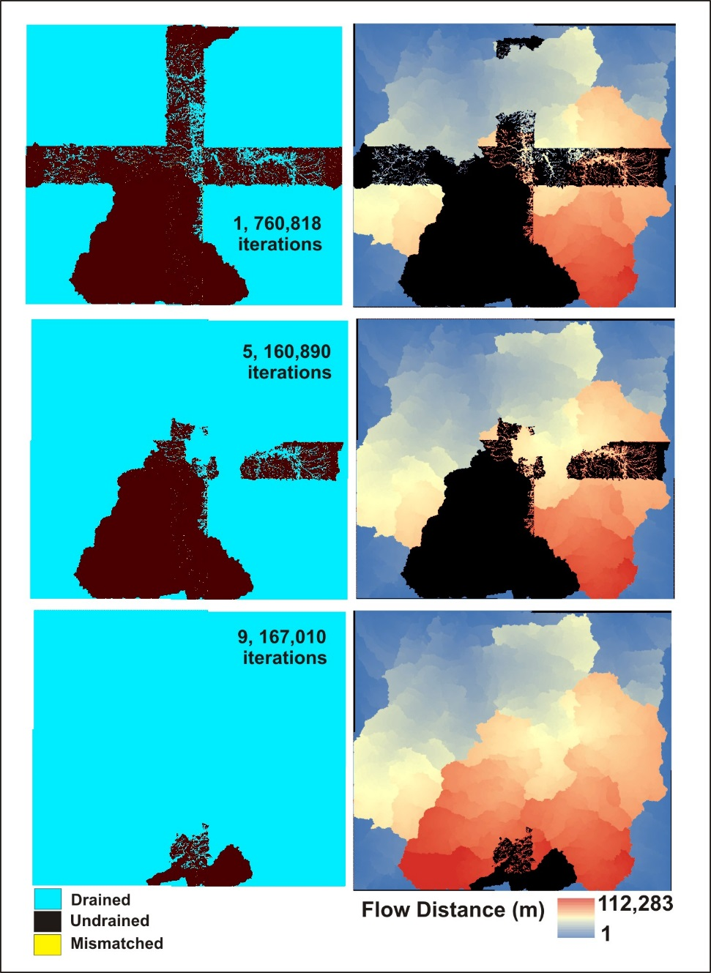

Slide 8
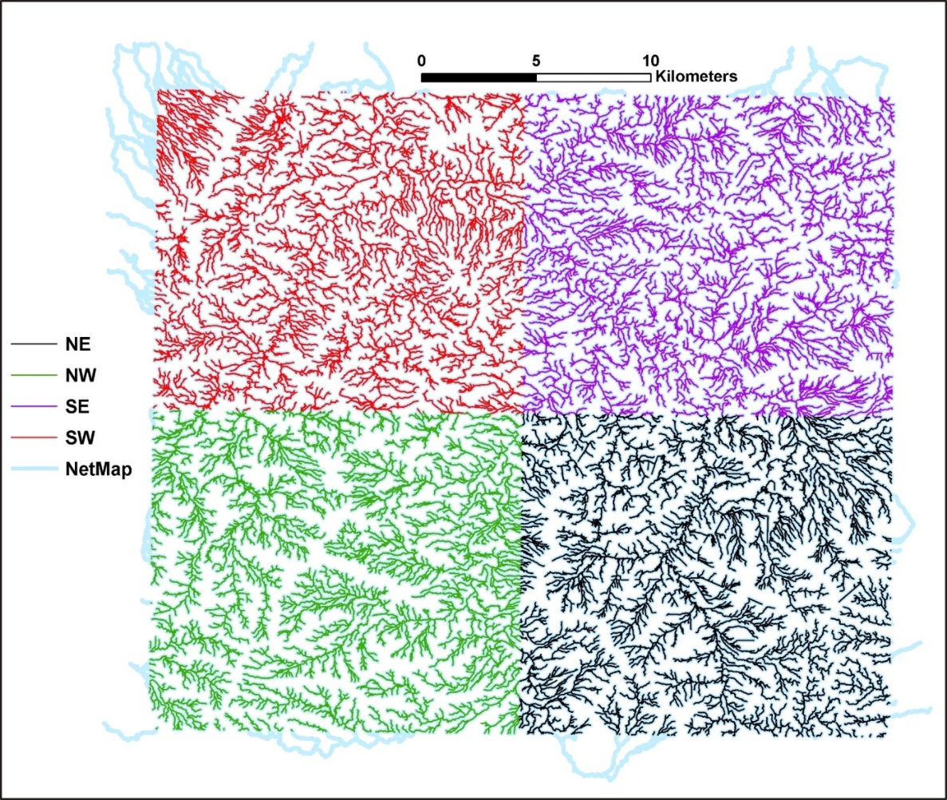
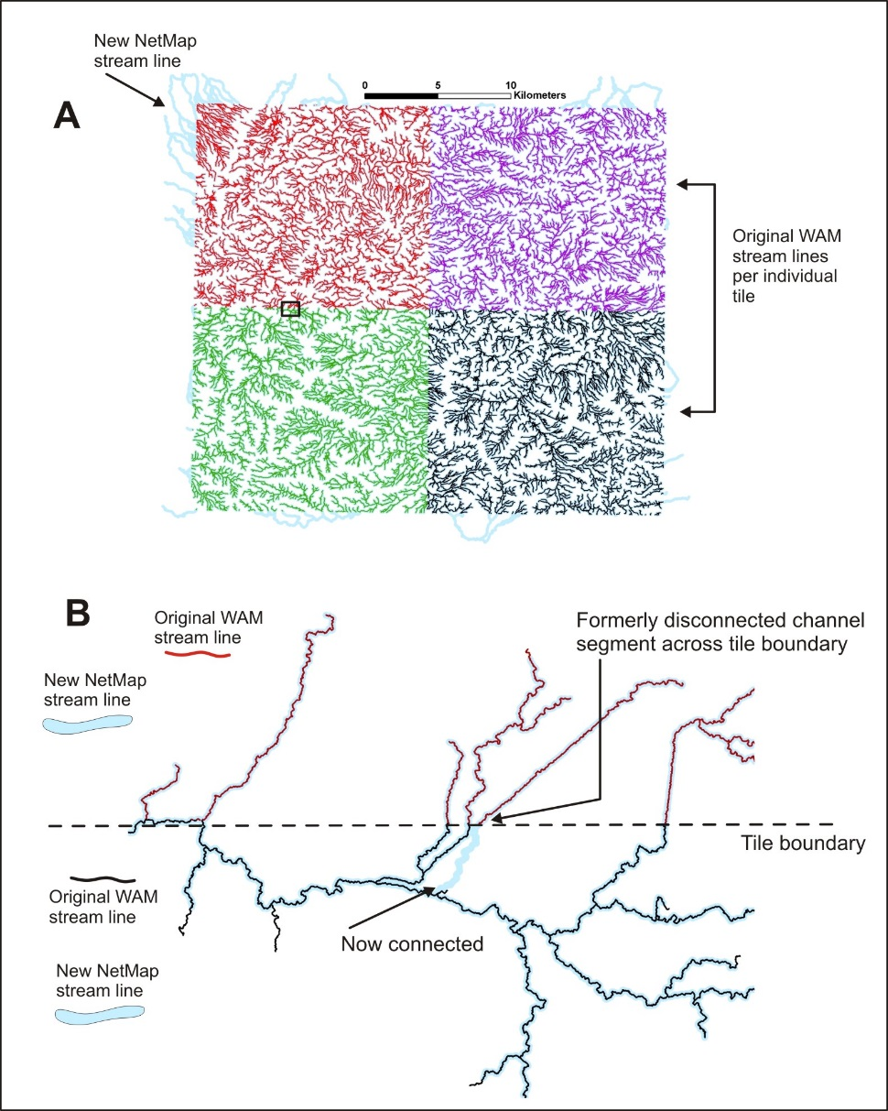

Slide 9
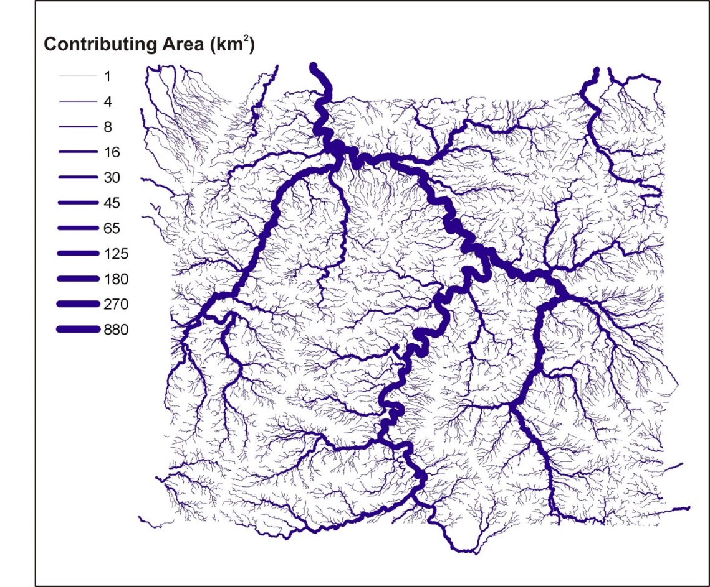

Slide 10
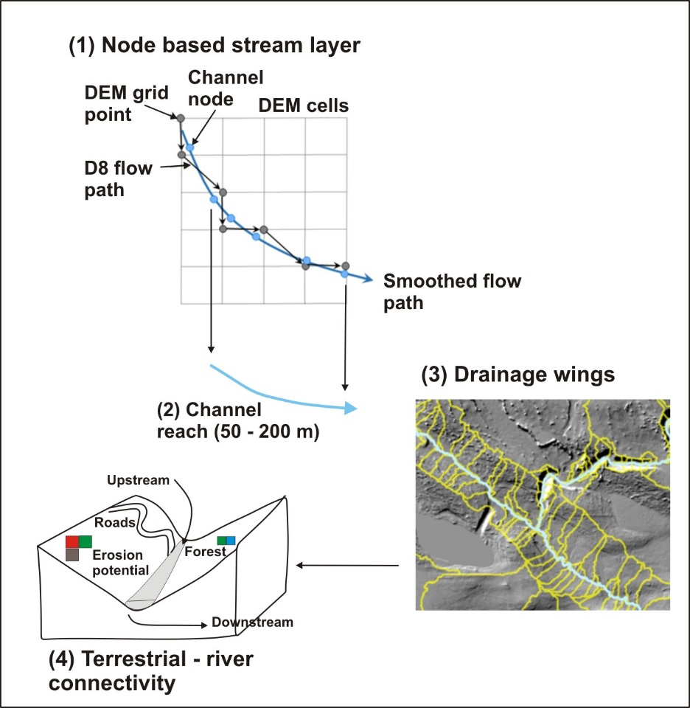
Figure 12. The Integrated WAM-NetMap node based synthetic stream layer with drainage wings.

Slide 11
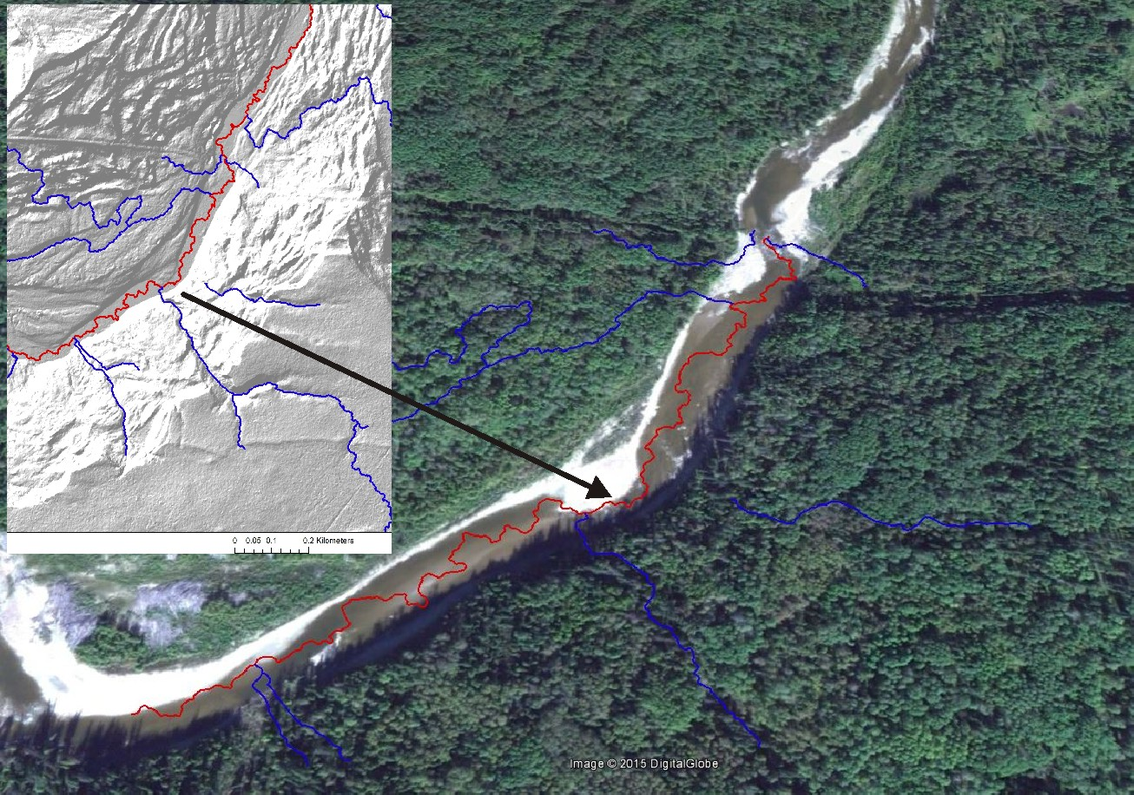
Figure 15. Sinuosity of the stream lines in the Integrated WAM-NetMap is significantly greater than natural river channels in the study area.

Slide 12
Table 1. List of attributes contained within the Integrated WAM-NetMap to support spatially explicit riparian zone delineation and environmental settings.
Riparian Process/Delineation Parameters (units) | Environmental Settings Parameters (units)
Synthetic Stream Layer (Integrated WAM-NetMap) | Channel Classification (types)*
Depth to Water (WAM, in meters) | Stream order (Strahler 1952)
Drainage area (km²) | Channel confinement (LL⁻¹)
Elevation (m) | Entrenchment ratio (LL⁻¹)*
Gradient (LL⁻¹) | Hillslope erosion potential (GEP)
Azimuth (0 – 360º) | Sinuosity (LL⁻¹)
Bankfull width (m) | Tributary confluence effects (P)
Bankfull depth (m) | Thermal refugia (watt-hours/m² or indexed by contributing area)
Valley Elevations/Floodplain width (n=5, m) | Channel Migration Zone (m)*
Topography (slope, curvature, distance to stream) | Maximum downstream gradient (LL⁻¹)
Mean annual flow (m³s⁻¹) | Aquatic (Fish) Habitats*
Mean annual precipitation (m) | Mean annual flow (m³s⁻¹)
Thermal Energy to Channels (Bare Earth, watt-hours /m²) | Summer habitat volume (m³)*
Current Shade (tree height and basal area) | Wildfire risk**
In-stream wood recruitment (tree height, stand density, diameter classes) | Climate change forecasts**
Riparian vegetation (basal area, average tree height, average stand density, quadratic mean diameter)

Slide 13
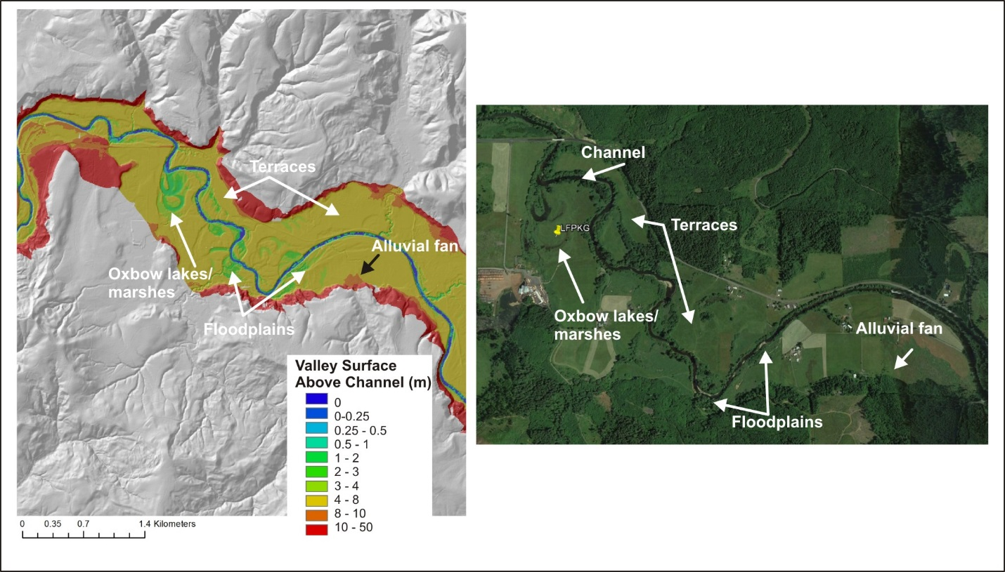
Figure 13. An illustration of valley floor mapping in the Integrated WAM-NetMap.

Slide 14
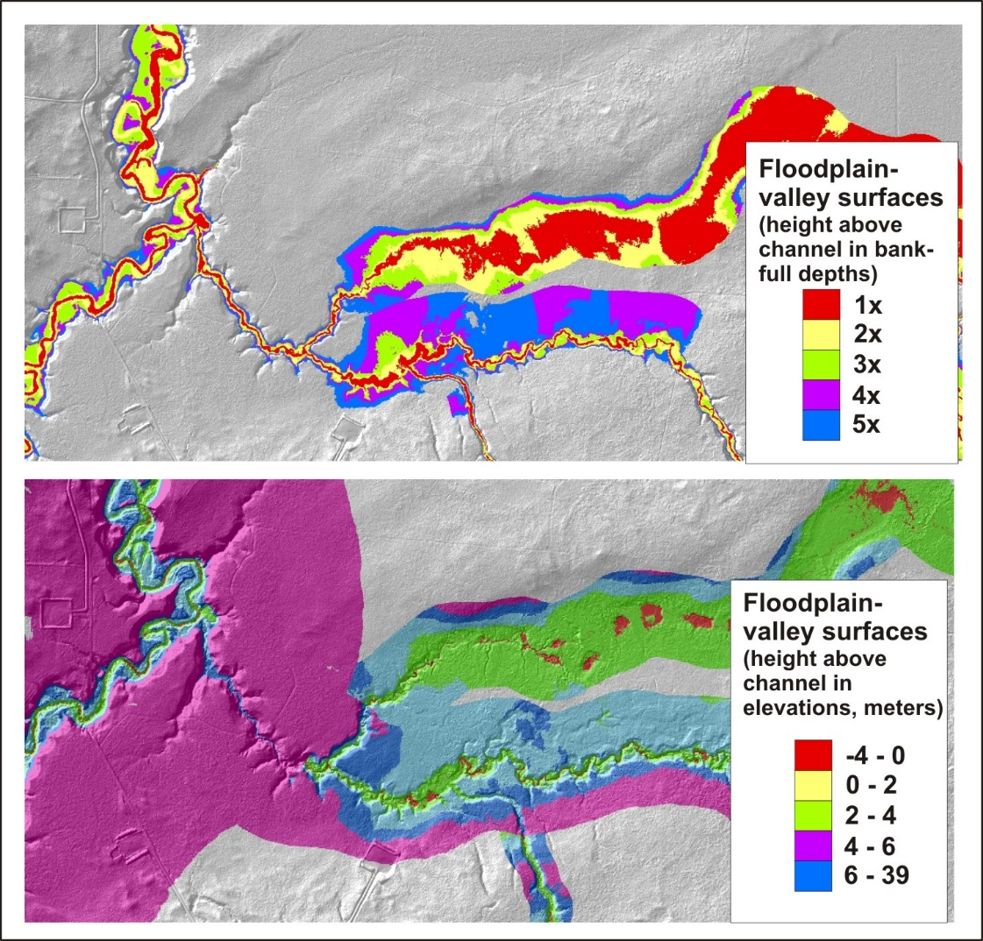
Figure 17. An example of two different types of valley floor and floodplain mapping in the Simonette River basin.

Slide 15
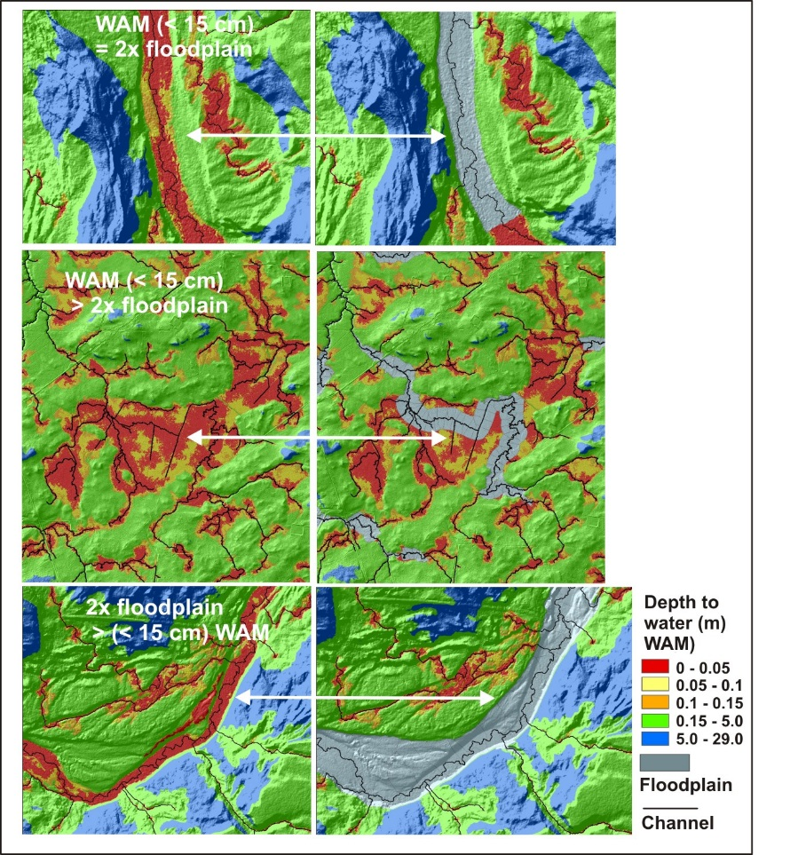
Figure 16. The WAM depth to water in the Simonette River pilot project area compared to floodplain mapping.

Slide 16
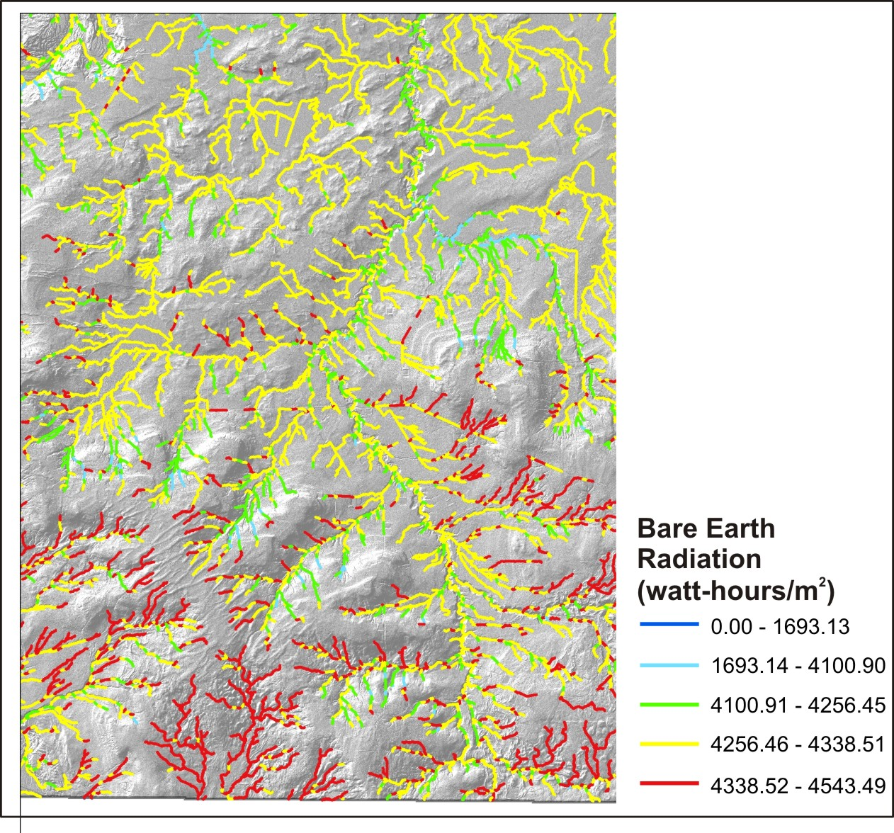
Figure 19. Bare earth radiation loading to streams in the Simonette River
-latitude -solar angle -topographic shading -stream width -stream azimuth -vegetation height -vegetation width -vegetation density

Slide 17
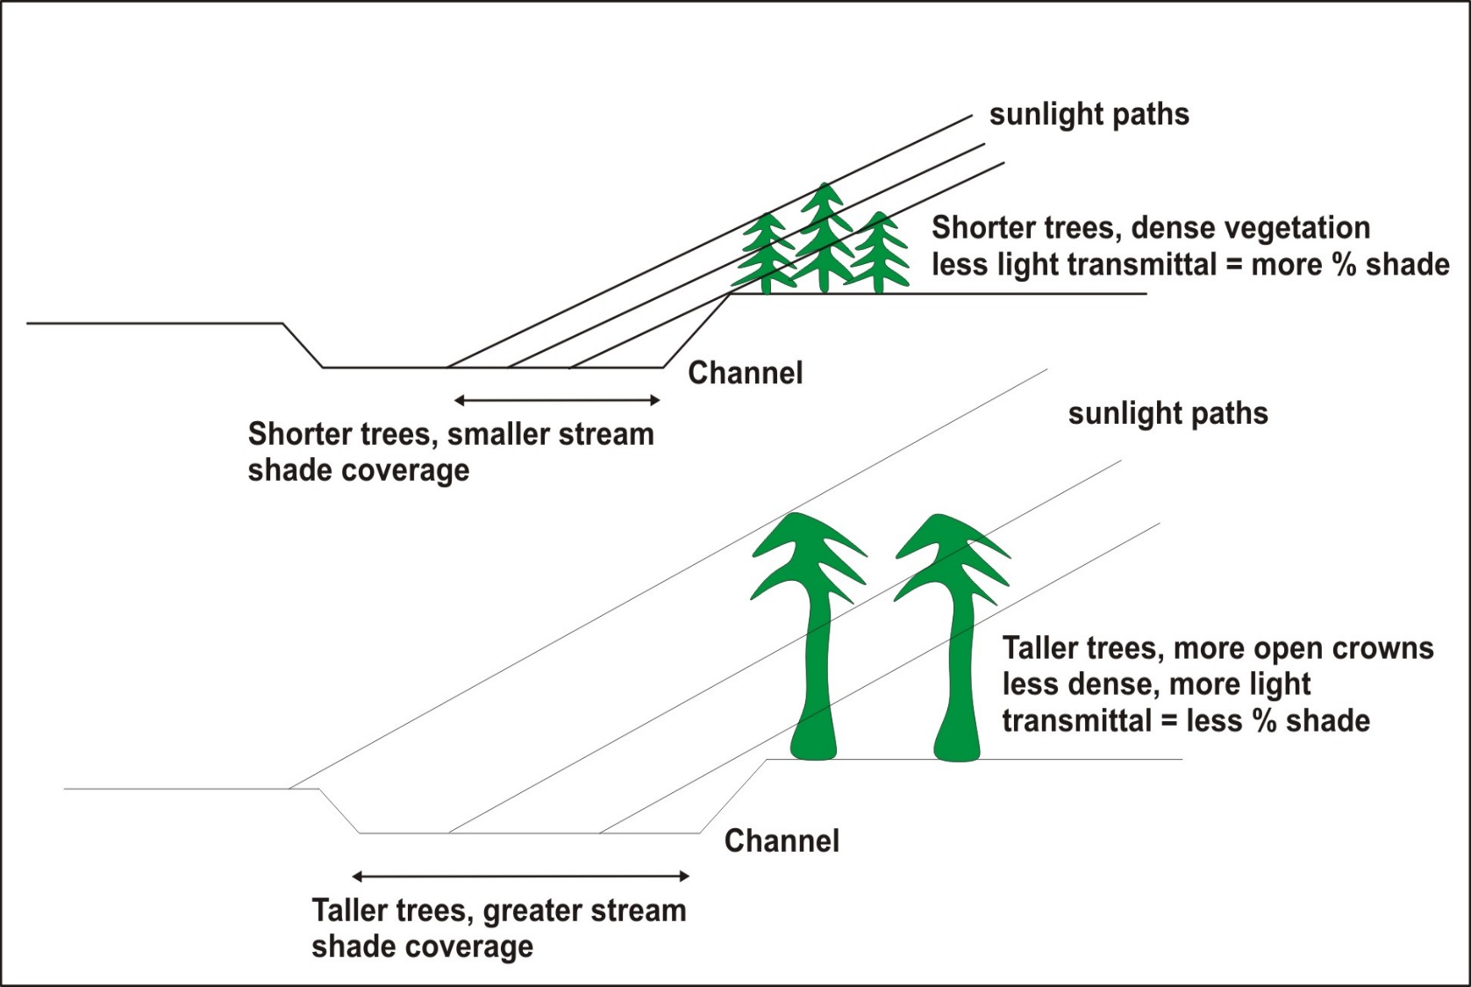
Shade model (Groom et al. 2011)
uses basal area and tree height

Slide 18
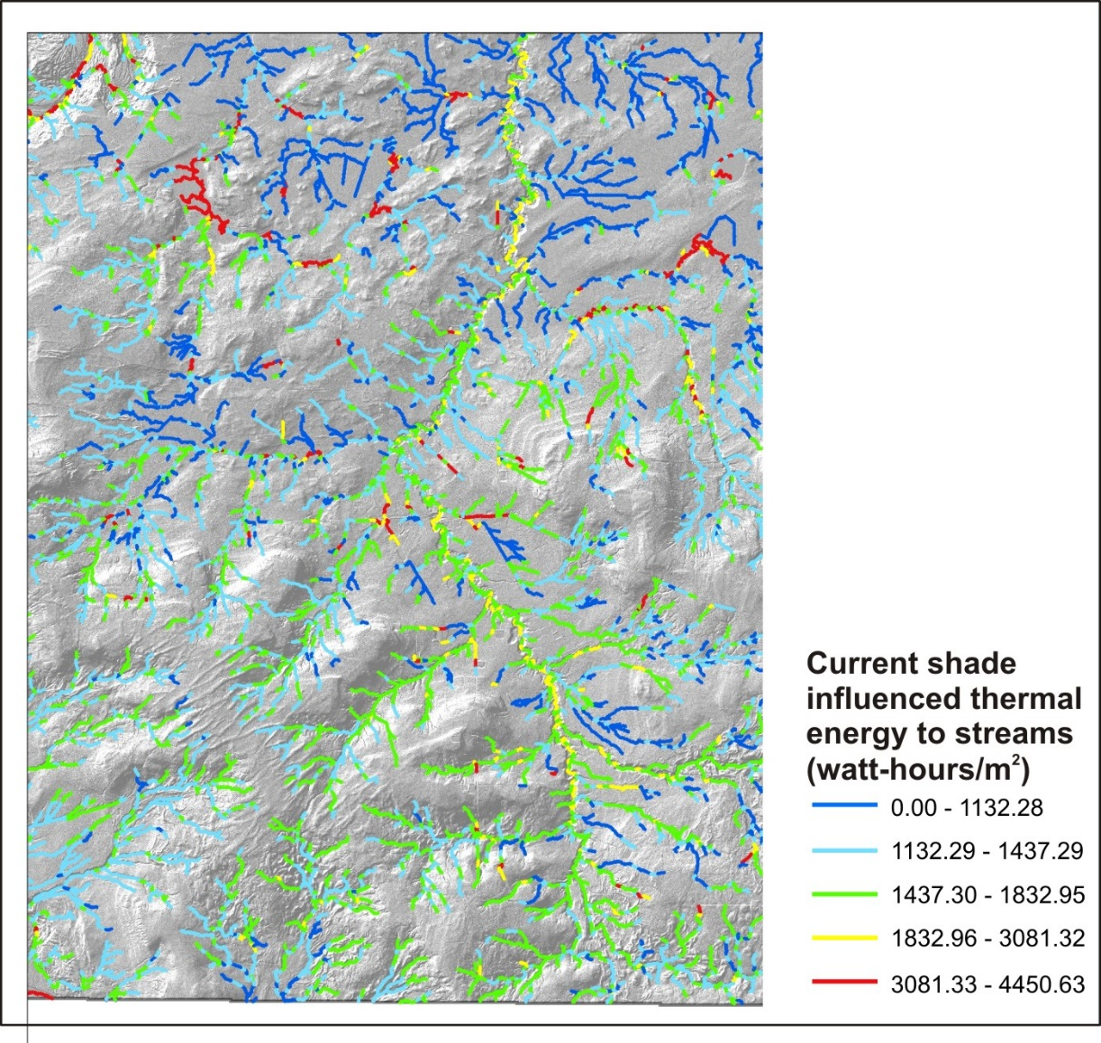
Figure 20. Current streamside shade influenced thermal energy to streams using basal area and tree height.

Slide 19
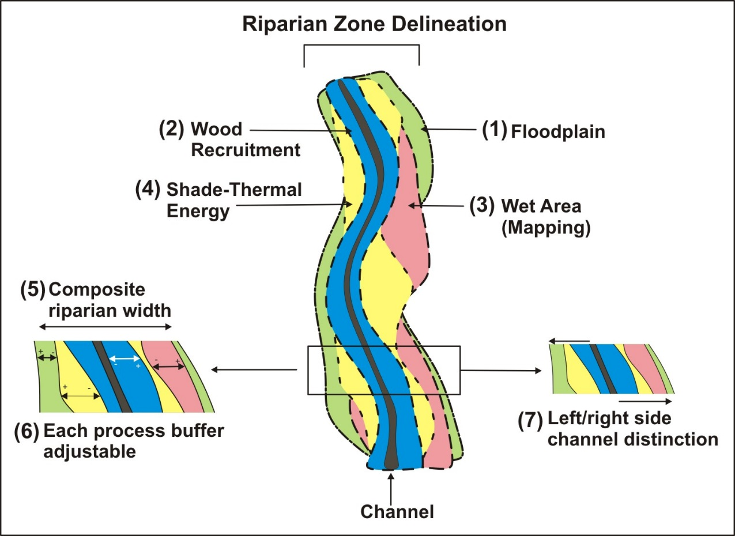
Spatially explicit, variable width
riparian zone delineation model

Slide 20
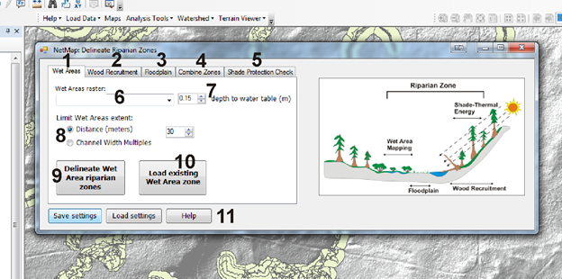

Slide 21
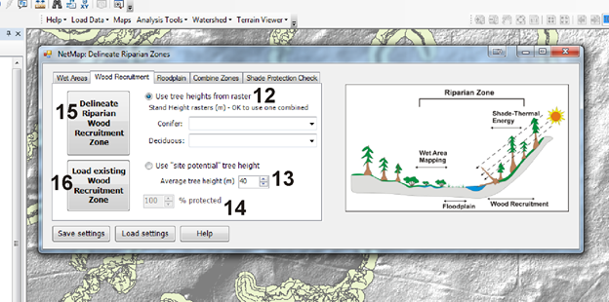

Slide 22
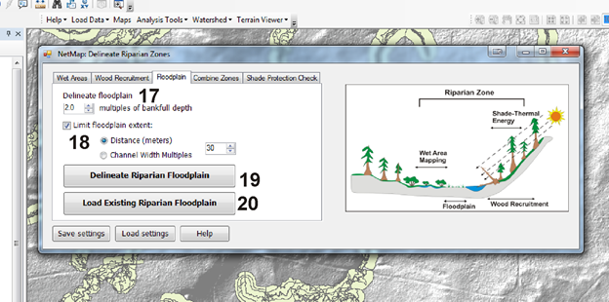

Slide 23
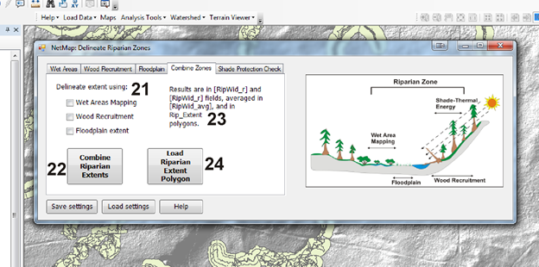

Slide 24
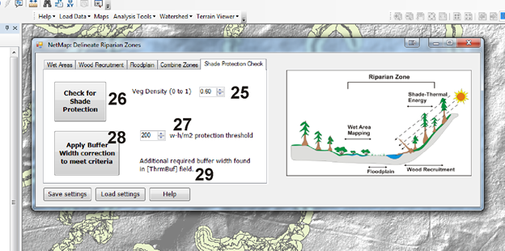

Slide 25
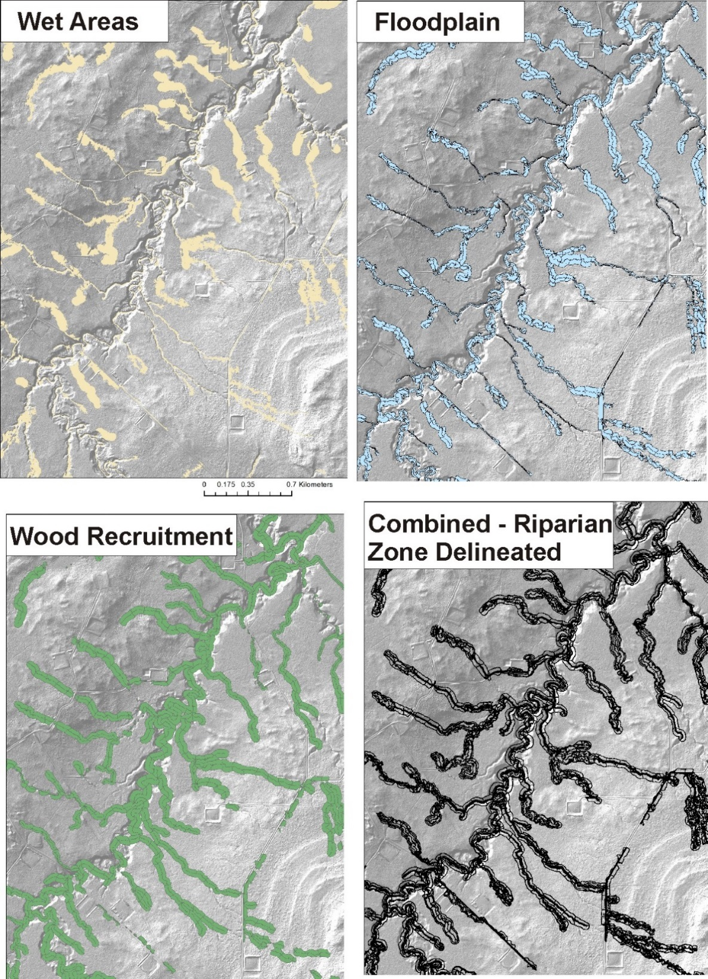
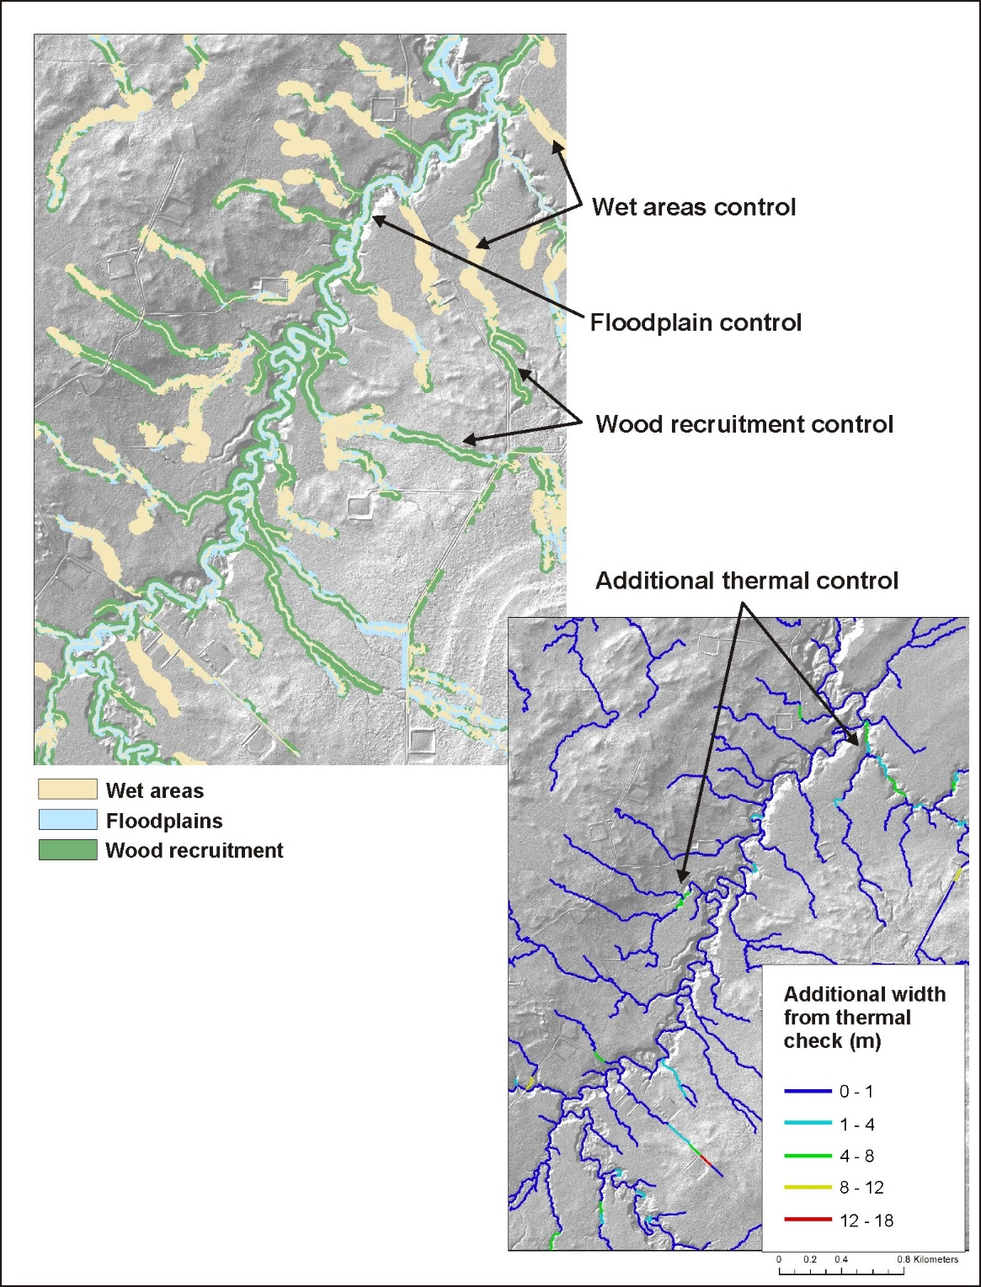

Slide 26
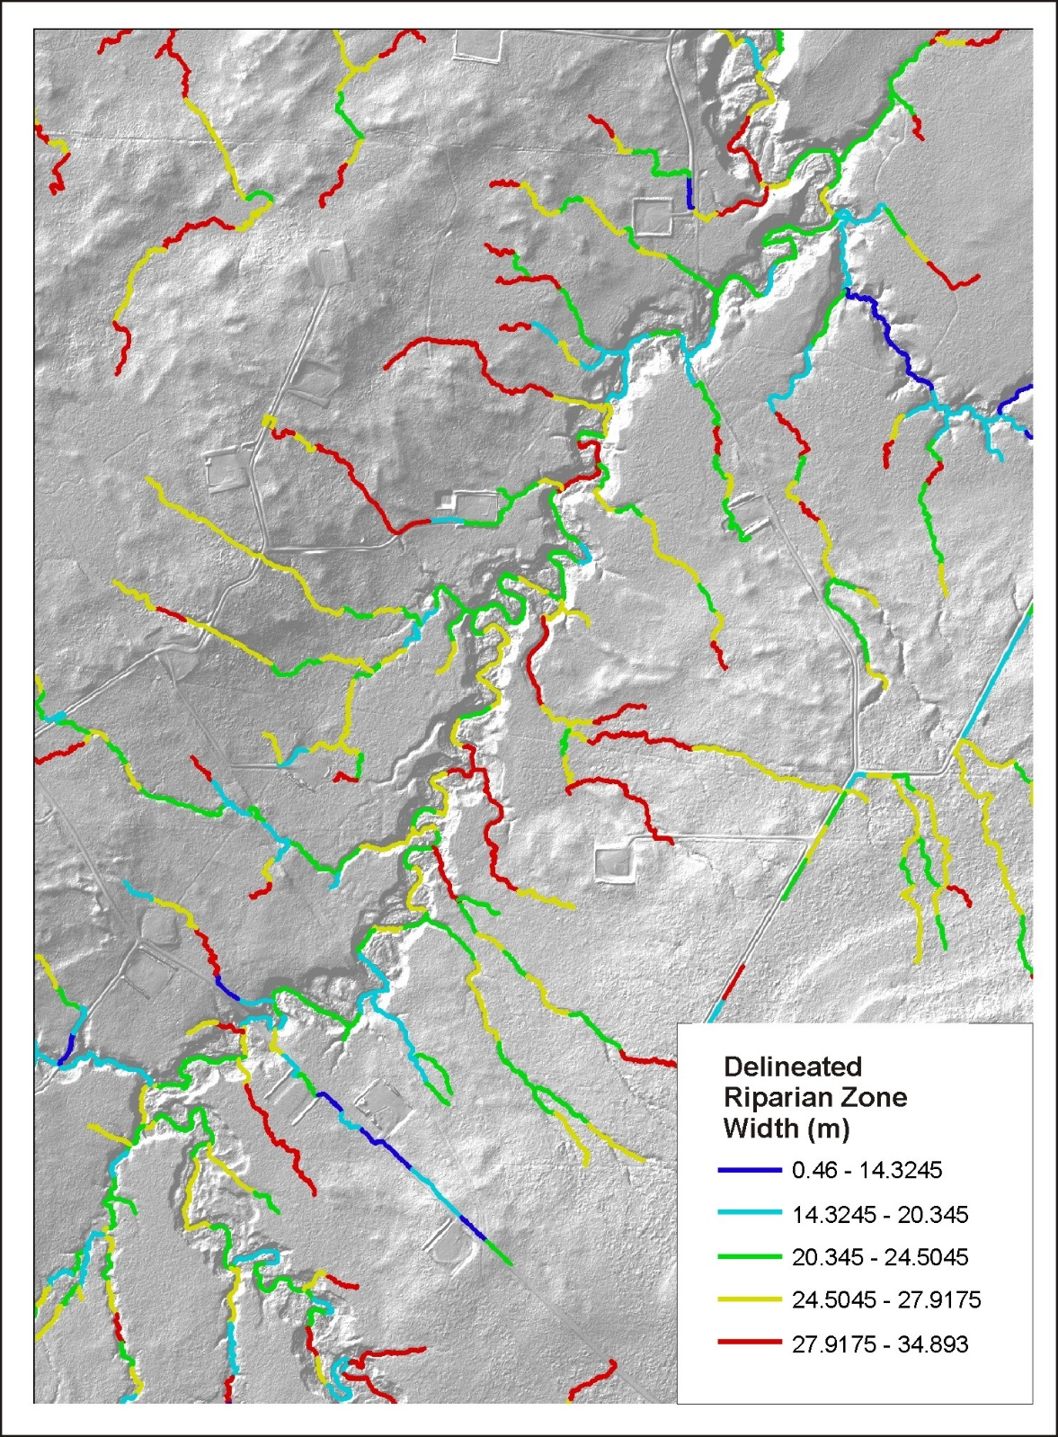
Predicted Spatial Variability in
Delineated Riparian Zone in the
Simonette basin

