Slide 1
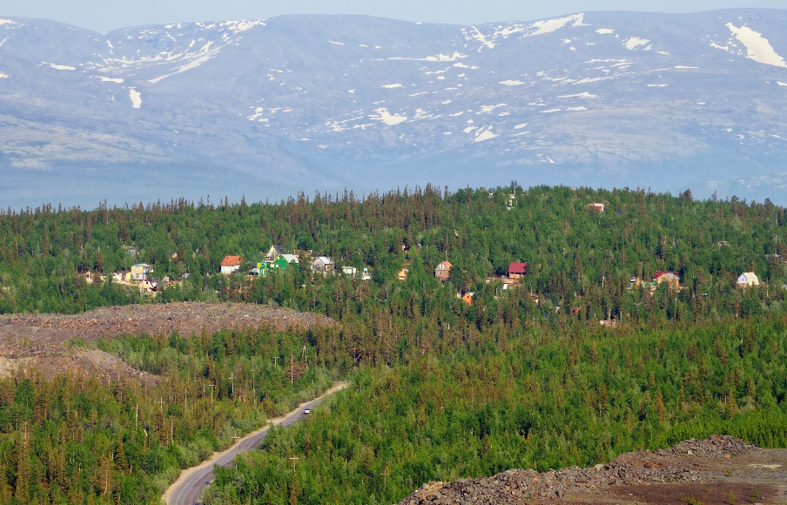
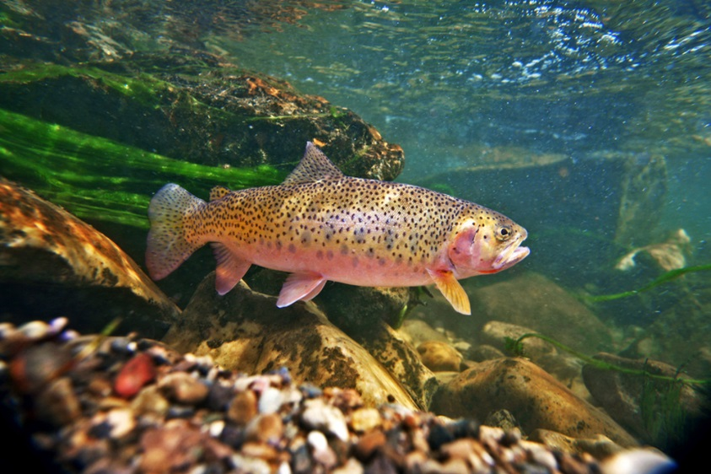
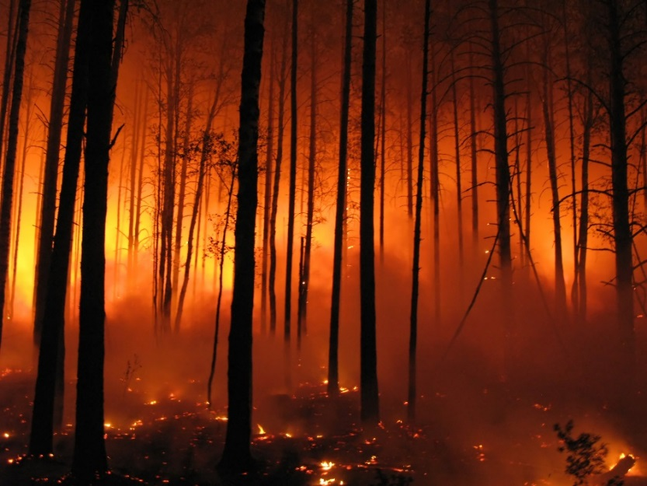
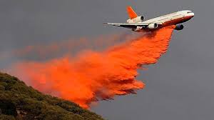
Pre Wildfire Decision Support
Identifying At-Risk Infrastructure & Aquatic/Riparian Habitats
(Malheur National Forest, Eastern Oregon)
Pre-Fire Planning
(Aquatic/Riparian Habitats)
Real Time Fire Fighting
(Retardant Go/No Go)
Pre-Fire Planning
(Infrastructure)
TerrainWorks (NetMap), in Collaboration with US Forest Service, PNW Corvallis and Malheur National Forest
Summer, 2015
Notes:
This Powerpoint presentation summarizes the use of NetMap for a Fire Decision Support System. Created on Sept 25, 2015 by Dr. Lee Benda and Kevin Andras (TerrainWorks).

Slide 2
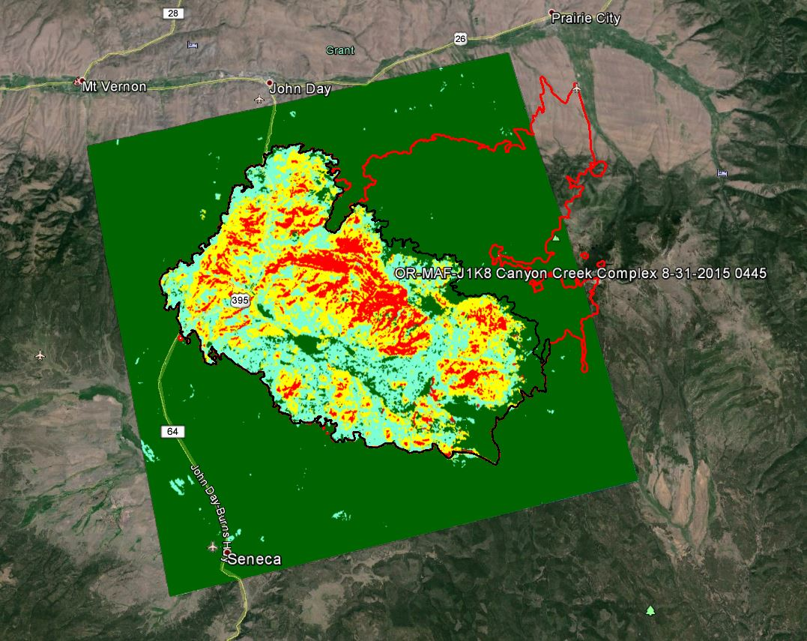
For the Post fire (BAER) analysis in the Canyon Creek Complex Fire, Eastern Oregon (9/2015), go to: http://http://www.netmaptools.org/Pages/Canyonlakecreekfire_Netmap.pdf
Canyon Creek
BAER-NetMap
analysis area
(colored)
Continue with pre fire analysis, next slide…..

Slide 3
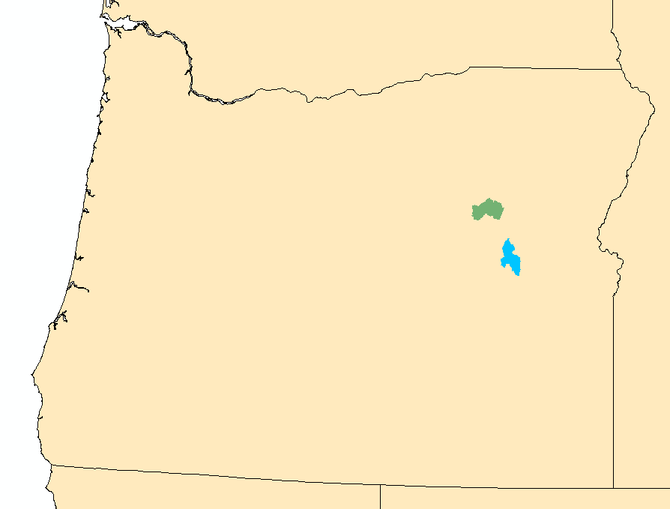
Pre fire analysis, pilot areas (preliminary)
Camp Creek watershed
(1 m LiDAR DEM)
Upper North Fork Malheur
(10 m DEM)
Notes:
This presentation contains some preliminary analyses, final analyses will be available by mid October.

Slide 4
Decision Support, Data Uses
Pre Fire Management Activities | Data layers | Purpose
Forest Restoration (fuels reduction, thinning including in riparian zones, prescribed burns) | -Fire severity and fire probability -Post fire surface erosion -Post fire landslide/gully erosion -Flash floods -Fish habitats -Thermal refugia (impacts to) | -Reduce potential for post fire erosion/floods and sediment delivery to streams (impacts on infrastructure and sensitive aquatic habitats) -Protect critical fish-riparian habitats (key habitats, refuges)
Road Restoration (upgrade surfacing, increase drains, improve stream crossings, storage, decommissioning) | -Road surface erosion & sediment delivery potential (fire impacts on increased sediment delivery potential) -Road instability potential/fire increased -Roads in floodplains -Cumulative habitat above roads crossings | -Reduce potential for post fire erosion and sediment delivery (also in non-fire conditions) -Reduce potential for road related landsliding/gullying -Remove fish barriers
Firefighting | Data layers | Purpose
Firefighting, including retardant use | -All stream buffered (300’) - avoidance -Perennial stream buffered only - avoidance -Identify high value aquatic/riparian – non avoidance | -Avoid retardant pollution in surface waters -Protect critical aquatic/riparian habitats
Notes:
A listing of decision support activities (left panel), the NetMap data layers to support it (middle panel) and the purpose of the data layers.

Slide 5
Models and Sources
DEMs – LiDAR and 10 m
Synthetic River Networks (stream layers) NetMap (www.terrainworks.com)
Fire severity and probability (Flammap)
Post fire surface erosion (WEPP – Disturbed)
Post fire gully potential (Parker et al. 2010)
Post fire landsliding/gullying (Miller and Burnett 2007, 2008, NetMap)
Post fire road surface erosion and sediment delivery (GRAIP-Lite w/ modified sediment delivery)
Flash floods (NWS model)
Bull Trout Habitat (NorWest and US Forest Service stream layer)
Salmon habitat (Intrinsic Potential Chinook and steelhead, Burnett et al. 2007)
Shade/thermal loading/thermal refugia (NetMap and Groom et al. 2011)
Road – stability (NetMap)
Cumulative habitat length above roads (NetMap)
Refer to NetMap’s online technical help manuals for additional information
Notes:
Here is a list of the various models and data sources there were used in the Fire and Fish analysis.

Slide 6
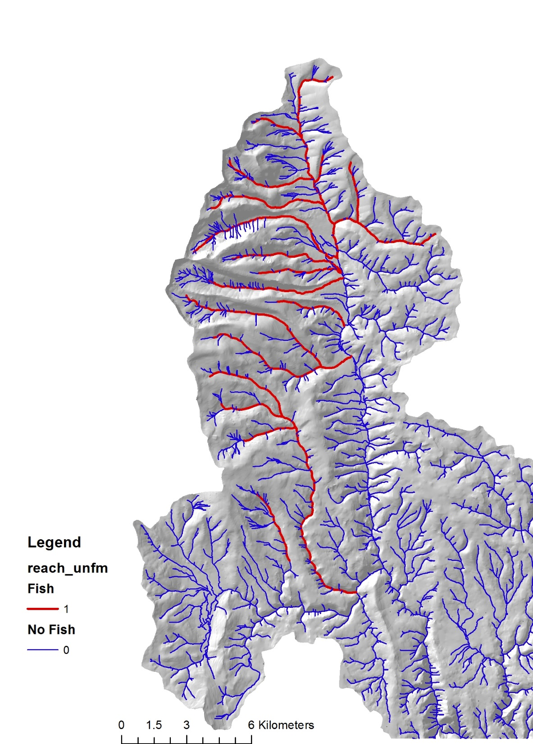
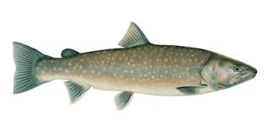
Data Deliverable: Fish Habitat
Bull Trout (Salvelinus confluentus)
Use habitat intrinsic potential models
in NetMap
Notes:
US Forest Service data on distribution of Bull Trout and Redband Trout were used in the analysis. Habitat intrinsic potential (HIP) models (Burnett et al. 2007) were applied for steelhead and Chinook.

Slide 7
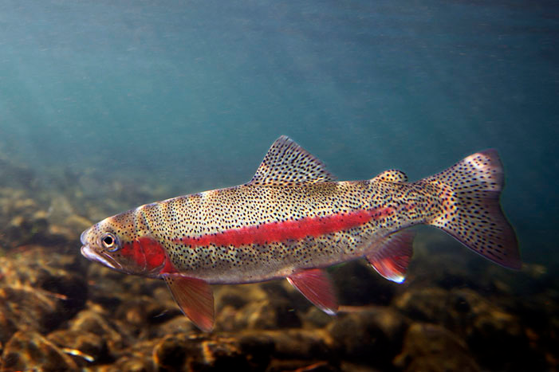
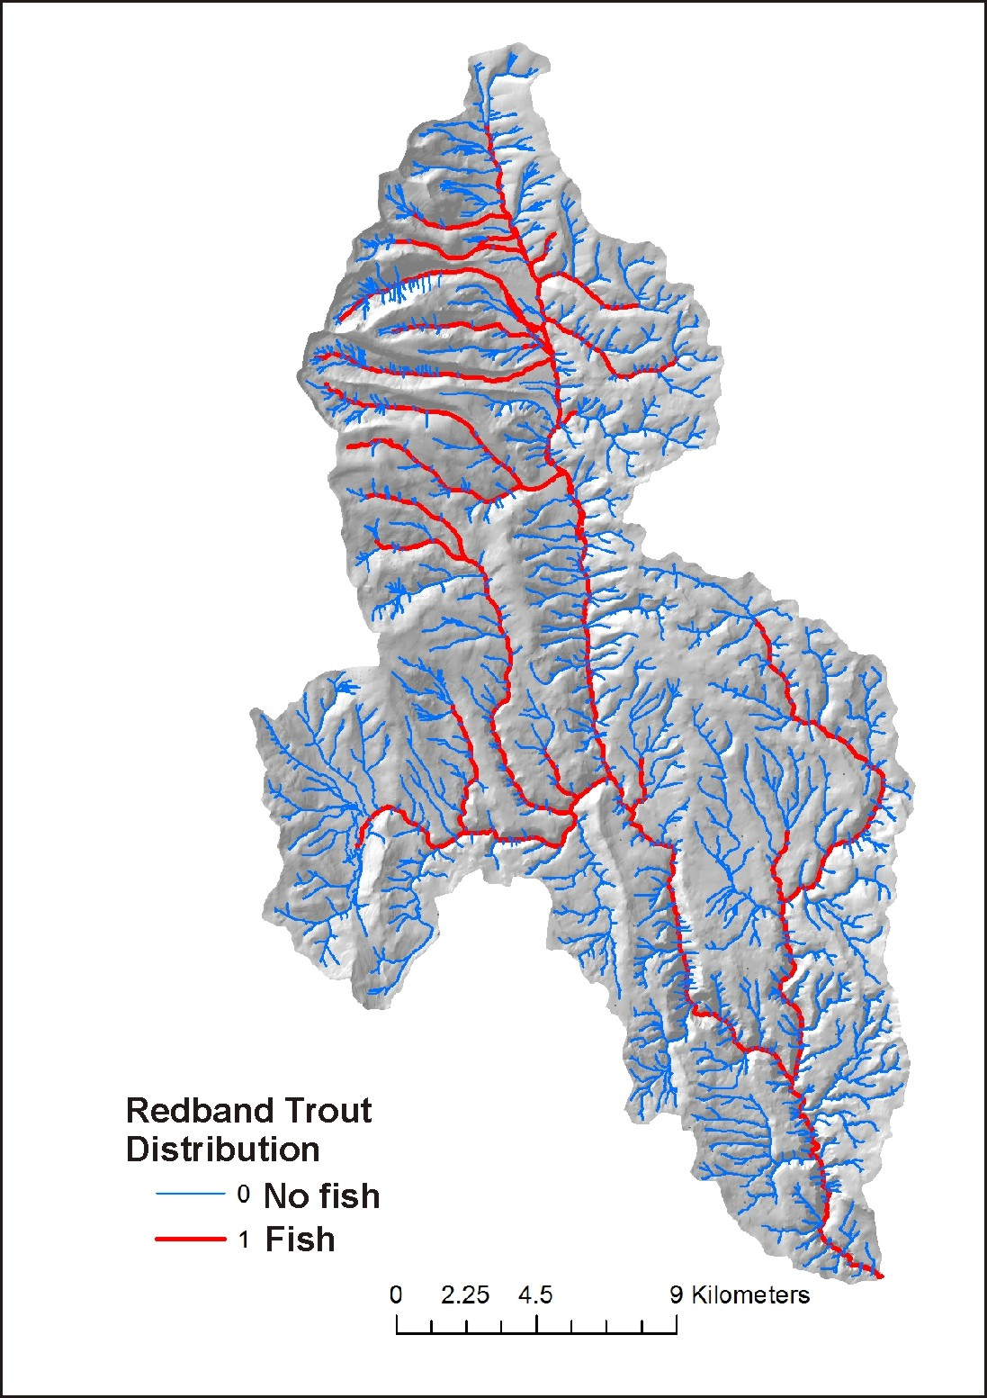
Fish Habitat: Redband Trout (subspecies of Oncorhynchus mykiss)
Use habitat intrinsic potential models
in NetMap

Slide 8
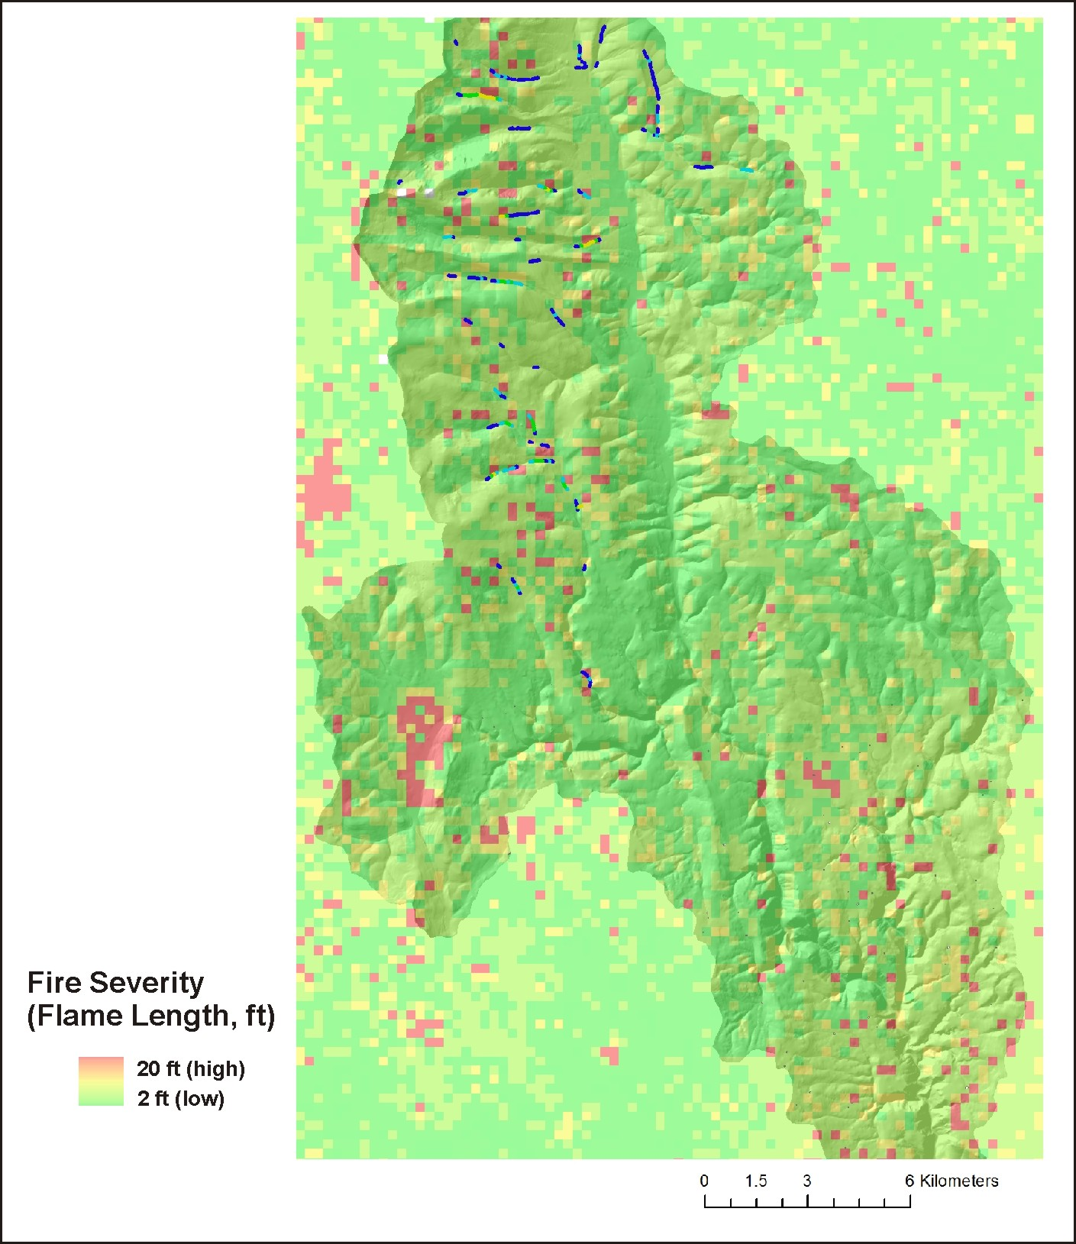
Data Deliverables
Fire Severity (hillside, Flammap)
Notes:
Fire severity in terms of flame length was obtained from agency Flammap predictions (WWETAC).

Slide 9
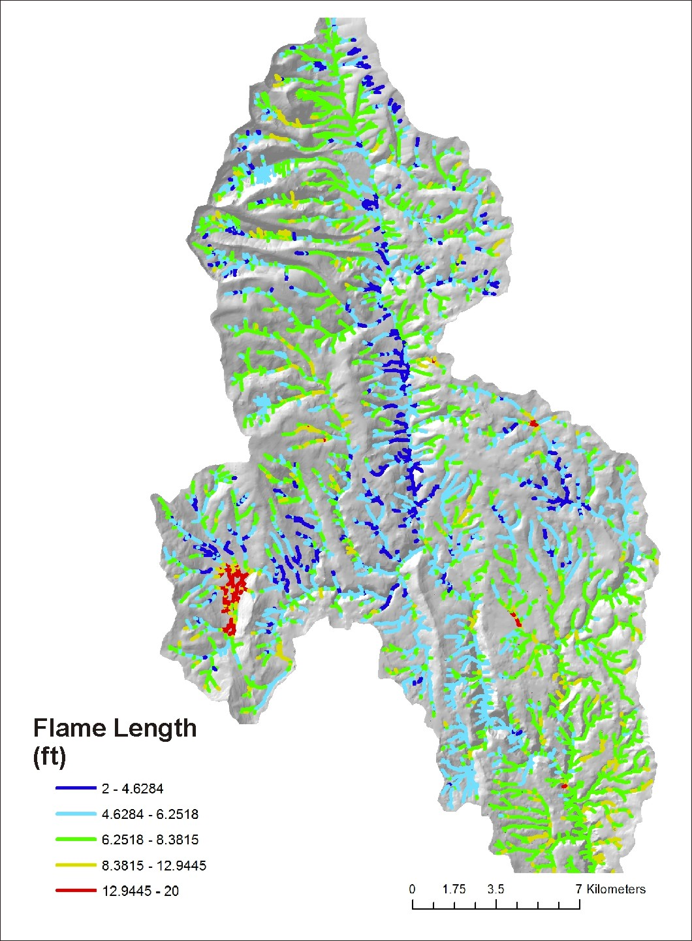
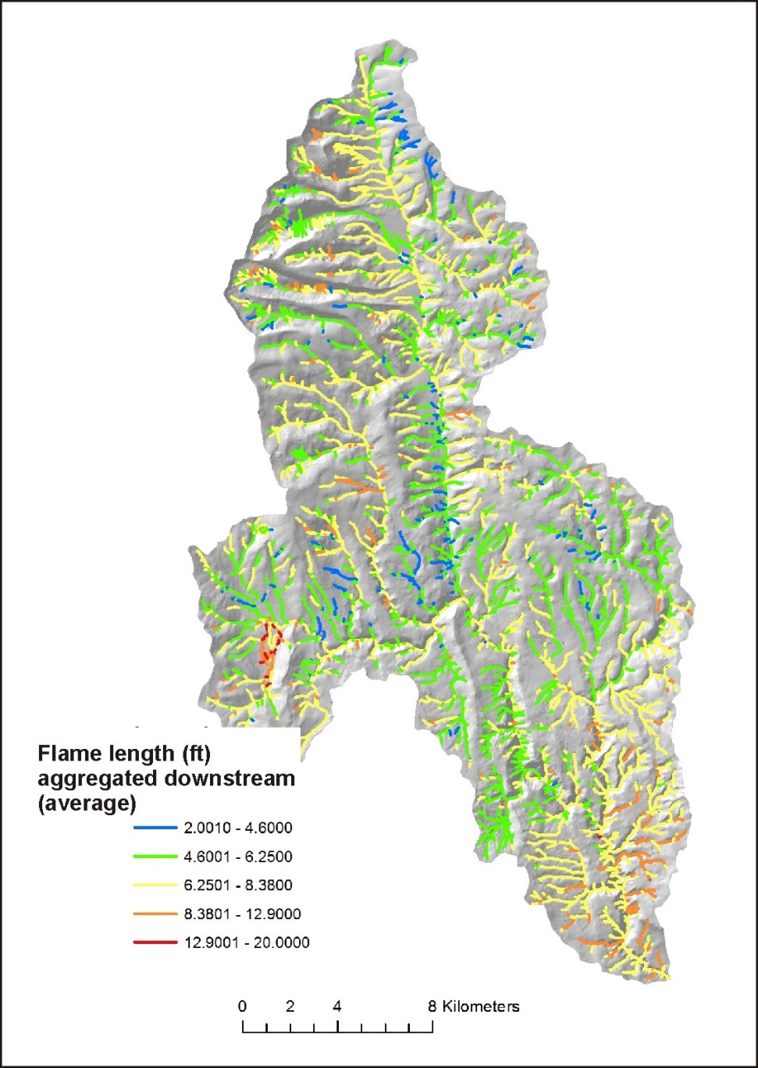
Fire Severity
(channel, fish eye)
Fire Severity, Aggregated Downstream
(tributary scale patterns)
Why are hillslope attributes
reported to channels, via
drainage wings?
This facilitates comparing
hillslope related stressors
(fire severity, erosion,
roads etc.) to fish habitats,
a channel attribute.
Notes:
Fire severity is reported to individual channel segments (left), via drainage wings, and aggregated downstream.

Slide 10
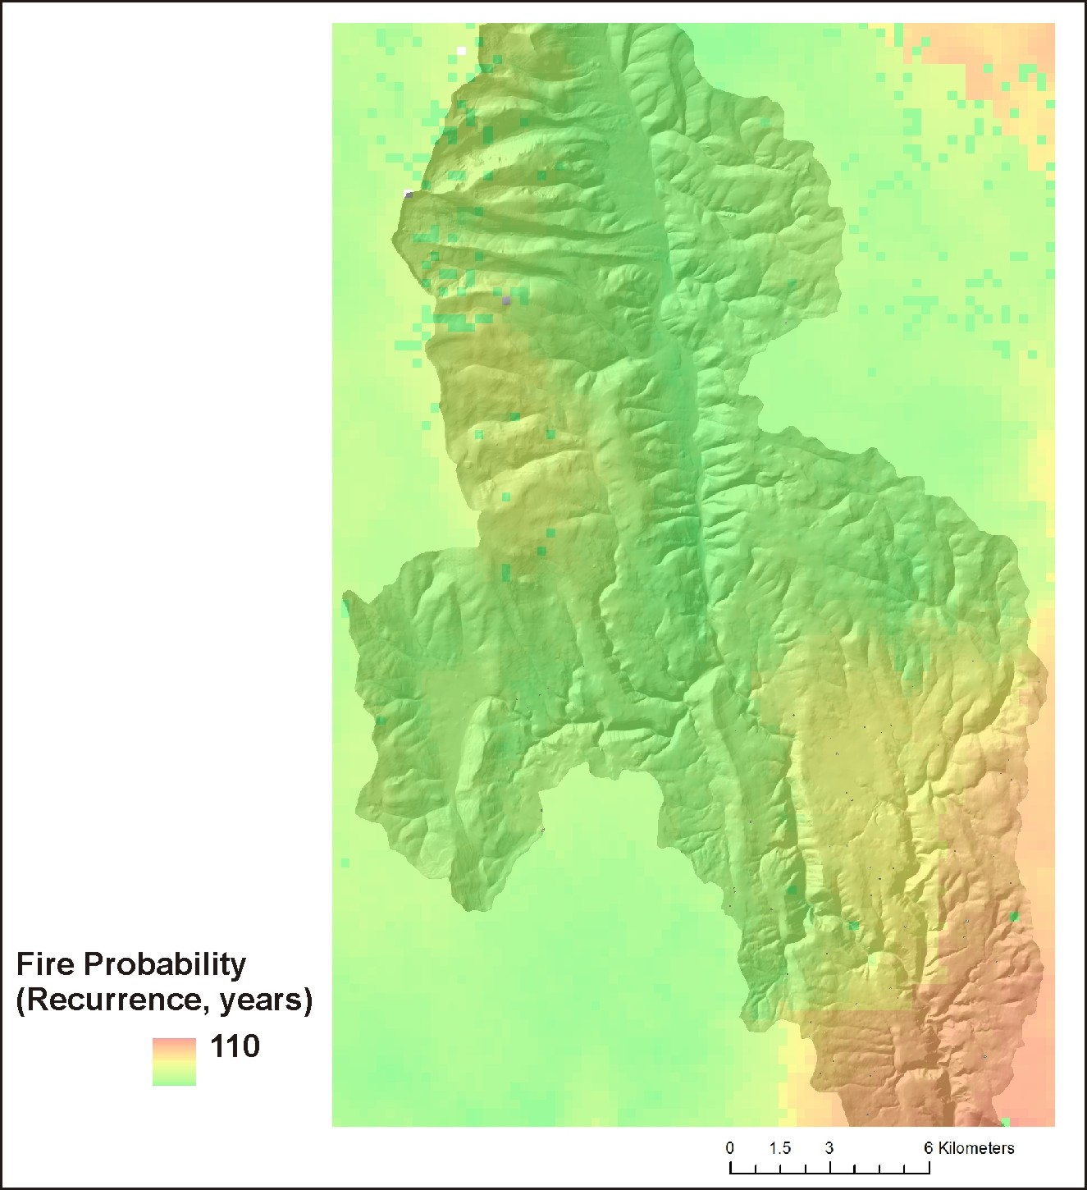
Fire Probability
Notes:
Fire probability was obtained from agency Flammap predictions (WWETAC). 1/probability = fire recurrence interval.

Slide 11
Notes:
Post fire erosion and channel sedimentation are predicted for surface erosion, gullying and shallow landsliding.

Slide 12
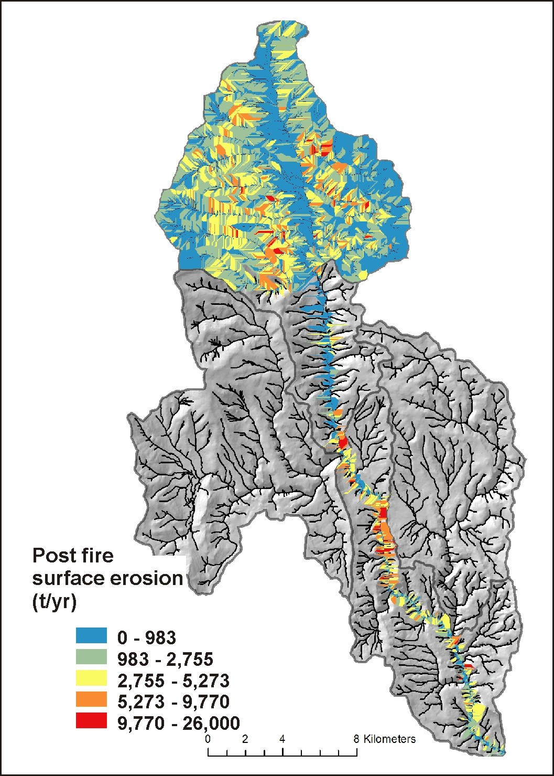
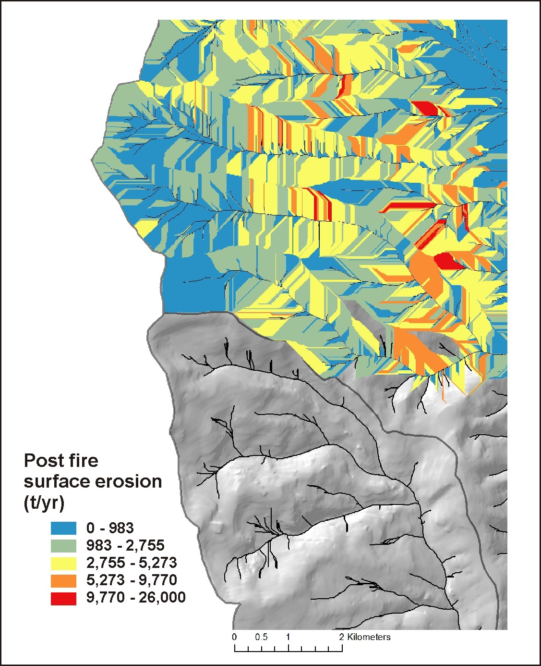
Post Fire Surface Erosion (WEPP, disturbed)
Notes:
Post fire surface erosion was predicted using the WEPP-disturbed model. The color patterns (right panel) indicating variable surface erosion illustrates the variable sizes and shapes of local contributing areas or drainage wings. See NetMap’s online technical help materials for additional information: http://www.netmaptools.org/Pages/NetMapHelp/5_5_surface_erosion_veg_fire.htm

Slide 13
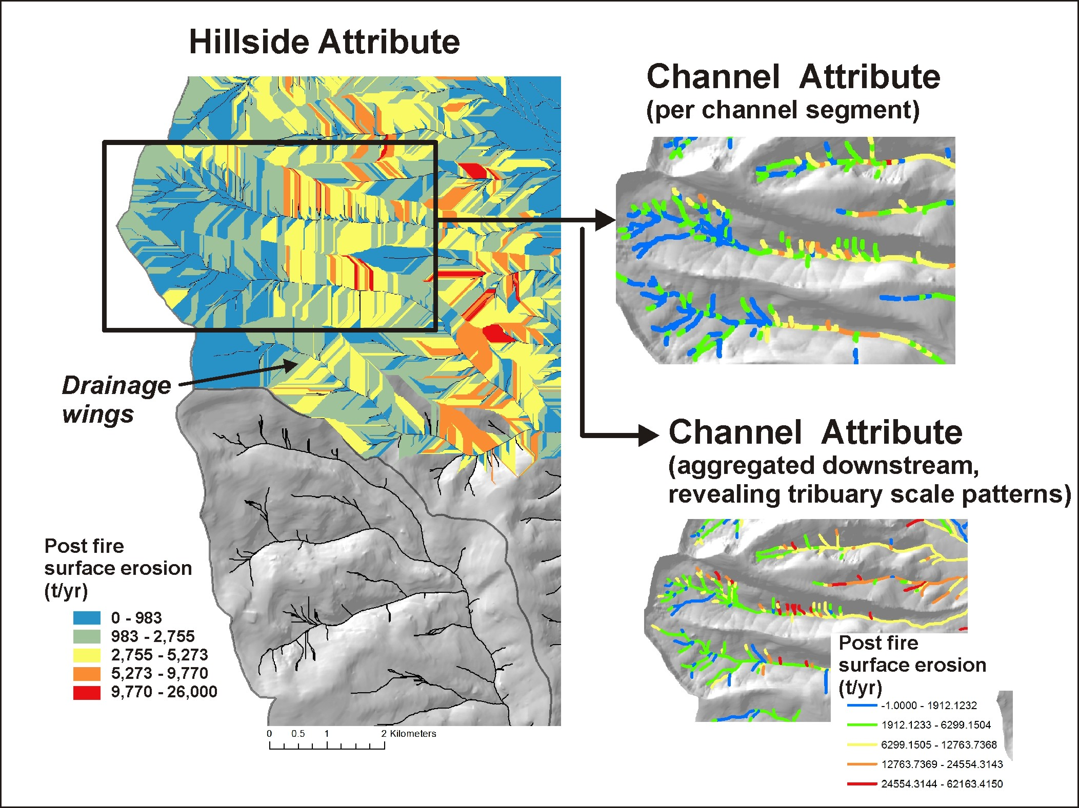
An example about
how a hillside attribute
(post fire erosion)
is transferred to individual
channel segments, and
aggregated downstream

Slide 14
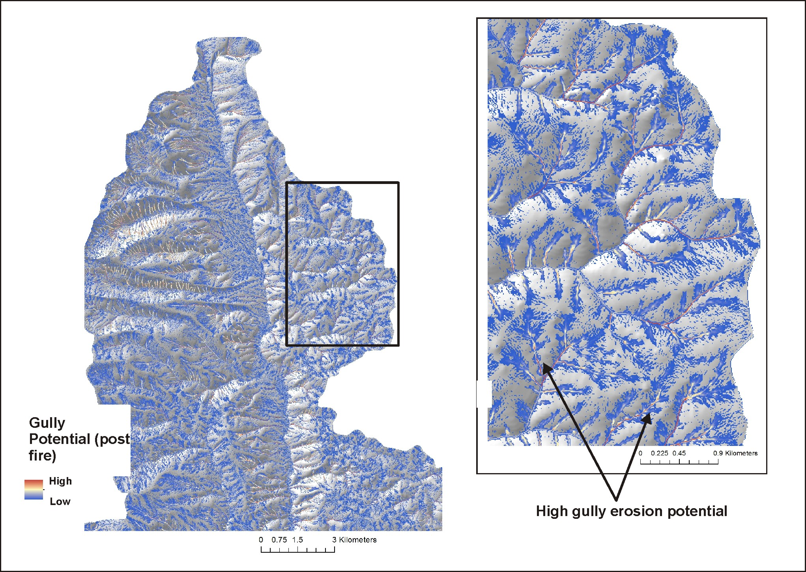
Post Fire
Gully Potential
Notes:
An gully erosion model was used in the analysis (Parker et al. 2010). See NetMap’s online technical help materials for additional information.
http://www.netmaptools.org/Pages/NetMapHelp/gullying.htm

Slide 15
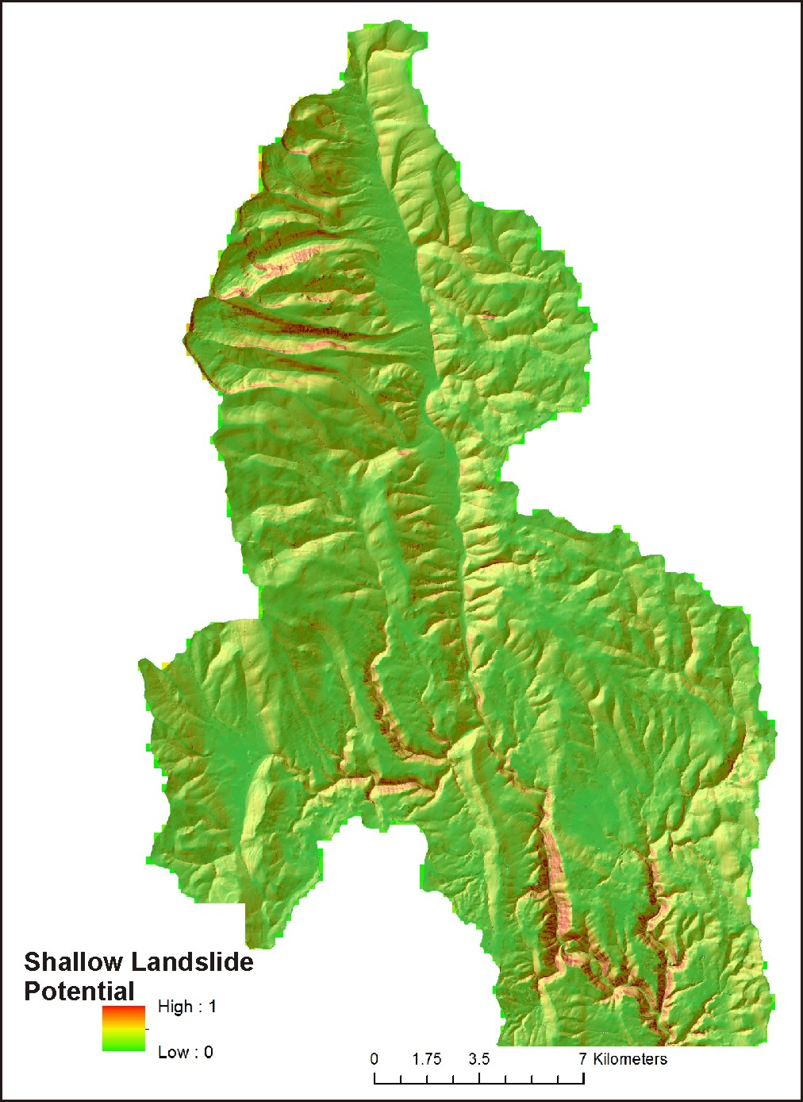
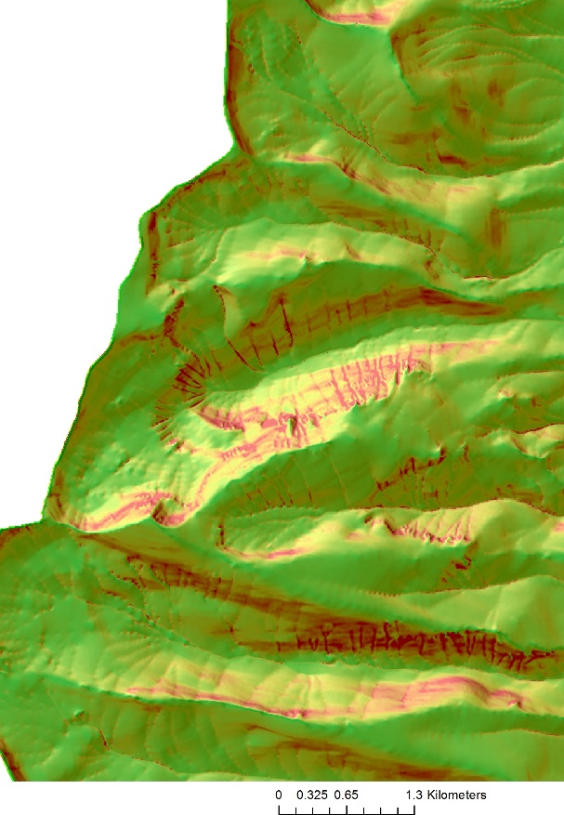
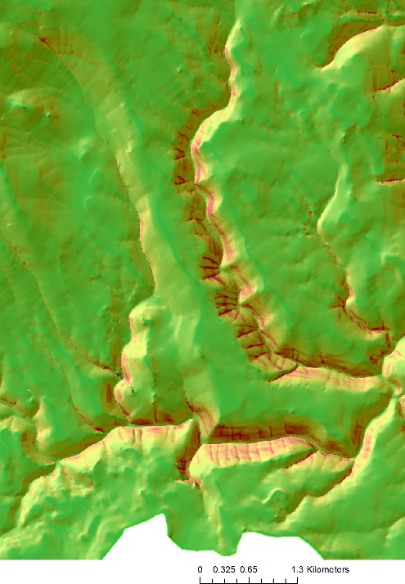
Shallow Landslide-
Debris Flow Potential
Notes:
A shallow landslide model (Miller and Burnett 2007) based on hillslope gradient and curvature was used in the analysis. See NetMap’s online technical help materials for additional information: http://www.netmaptools.org/Pages/NetMapHelp/hillside_1.htm

Slide 16
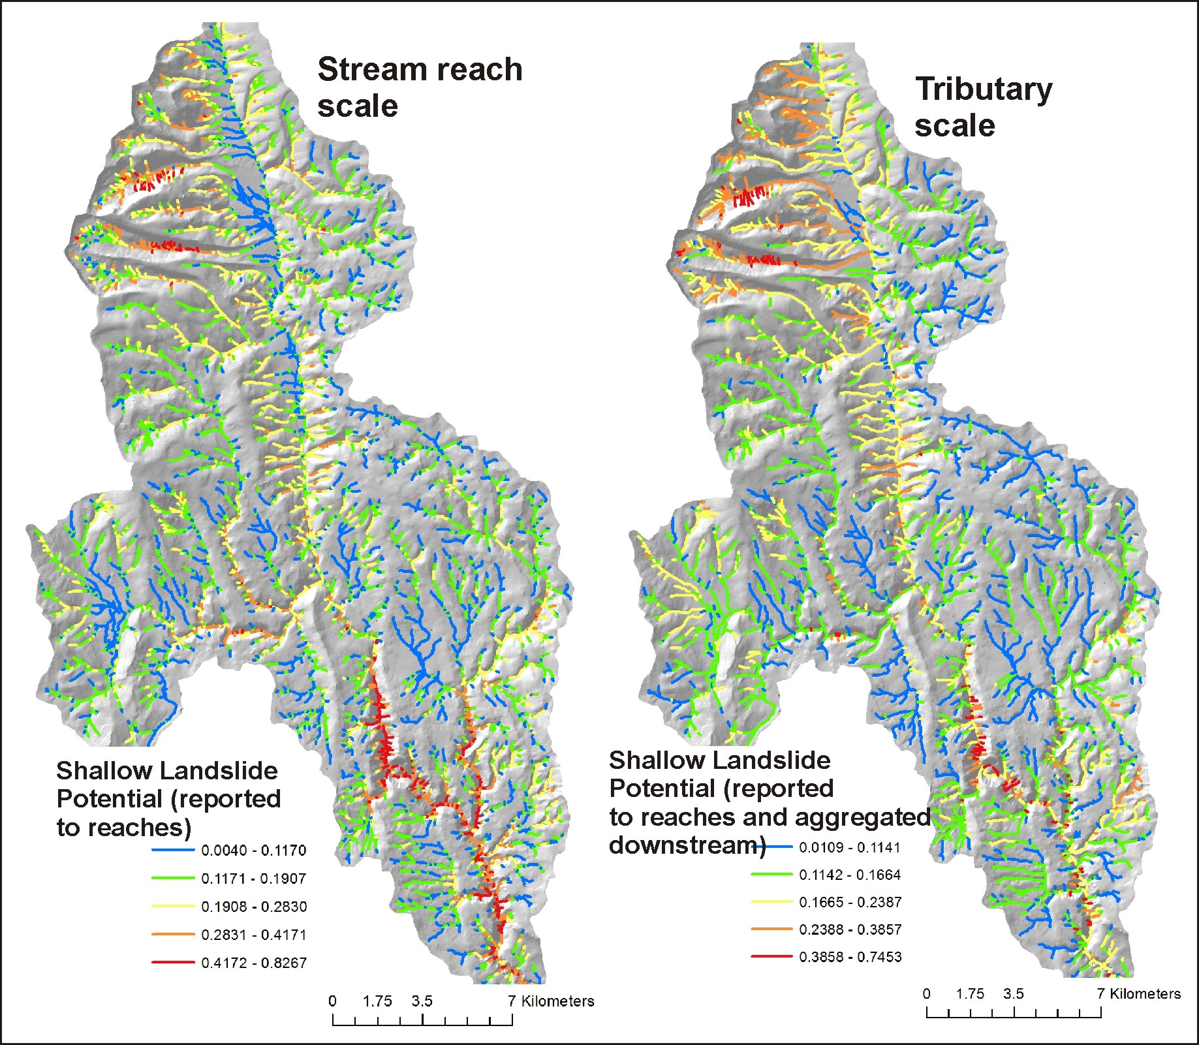
Shallow landslide
potential reported to
channel segments and
aggregated downstream

Slide 17
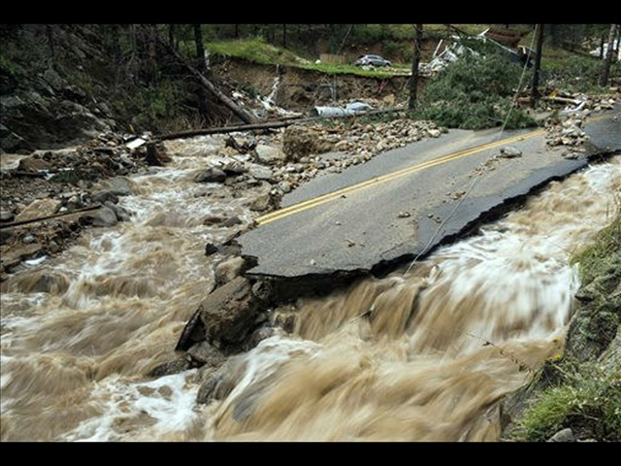
FLASH FLOOD Potential
A dimensionless index developed by the
National Weather Service. The Flash Flood Potential
Index (FFPI) consists of four factors:
hillslope gradient
soils (percent silt, clay and sand)
vegetation density (forest, shrubs, grasses)
fire impacts on soils and vegetation.
See NetMap’s online technical help manual for
additional details.

Slide 18
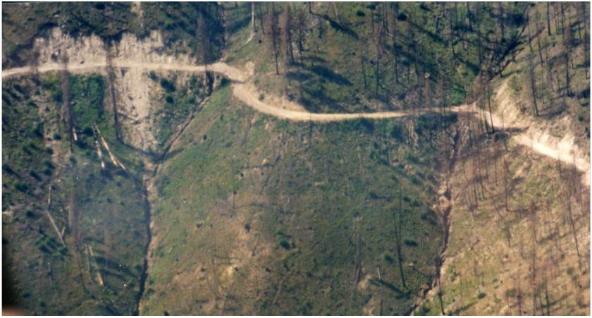
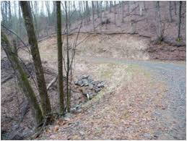
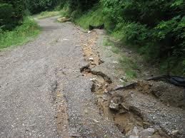
Road Surface Erosion and Sediment Delivery to Streams, Post Fire
Notes:
Roads can be significant sources of flooding, erosion and sediment delivery to streams, post fire.

Slide 19
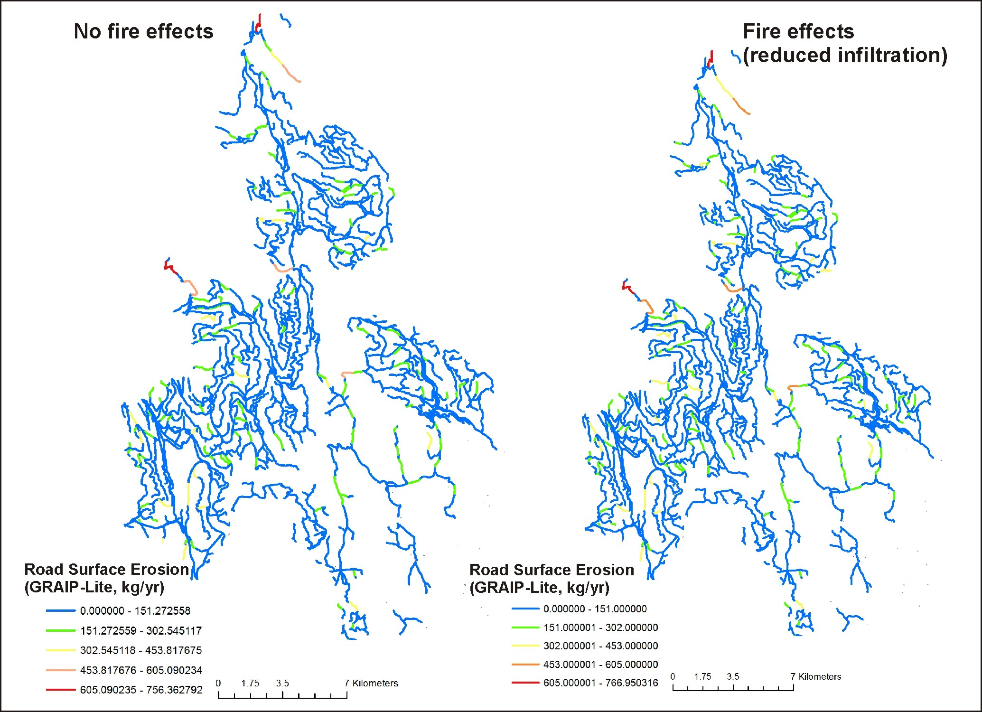
Road erosion results, pre and post fire
It is difficult to see the changes
in these maps because of the
broad legend categories.
See following slide for
the difference between
no fire and fire.
Notes:
Predicted sediment delivery is mapped to the road network for pre and post fire conditions; little change can be see because of the board legend classes, but see next slide.

Slide 20
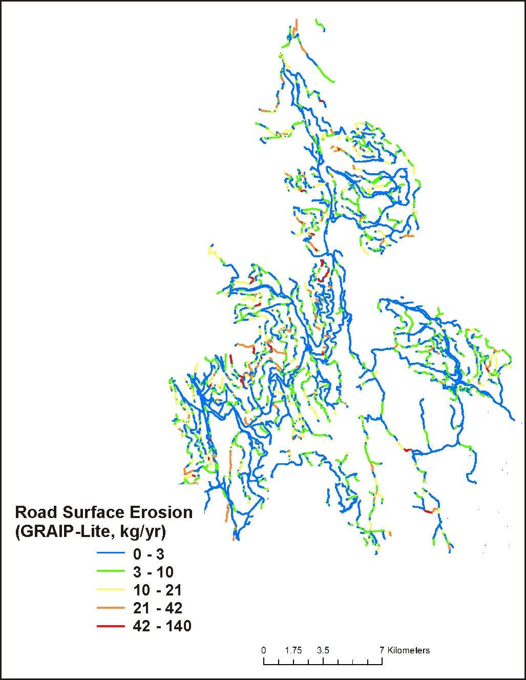
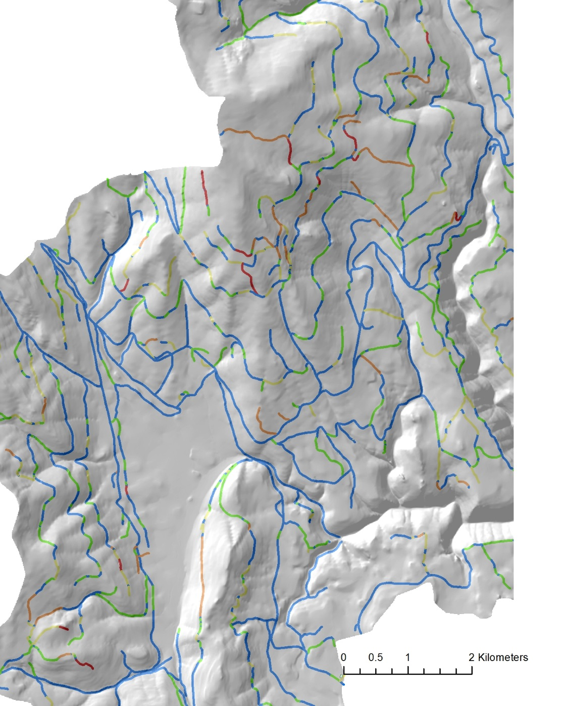
Road erosion
difference map,
where fire should
have the largest effect
of increasing sediment
delivery
Notes:
A difference map of road sediment delivery reveals that some road segments are more sensitive to fire reductions in infiltration capacity compared to others.

Slide 21
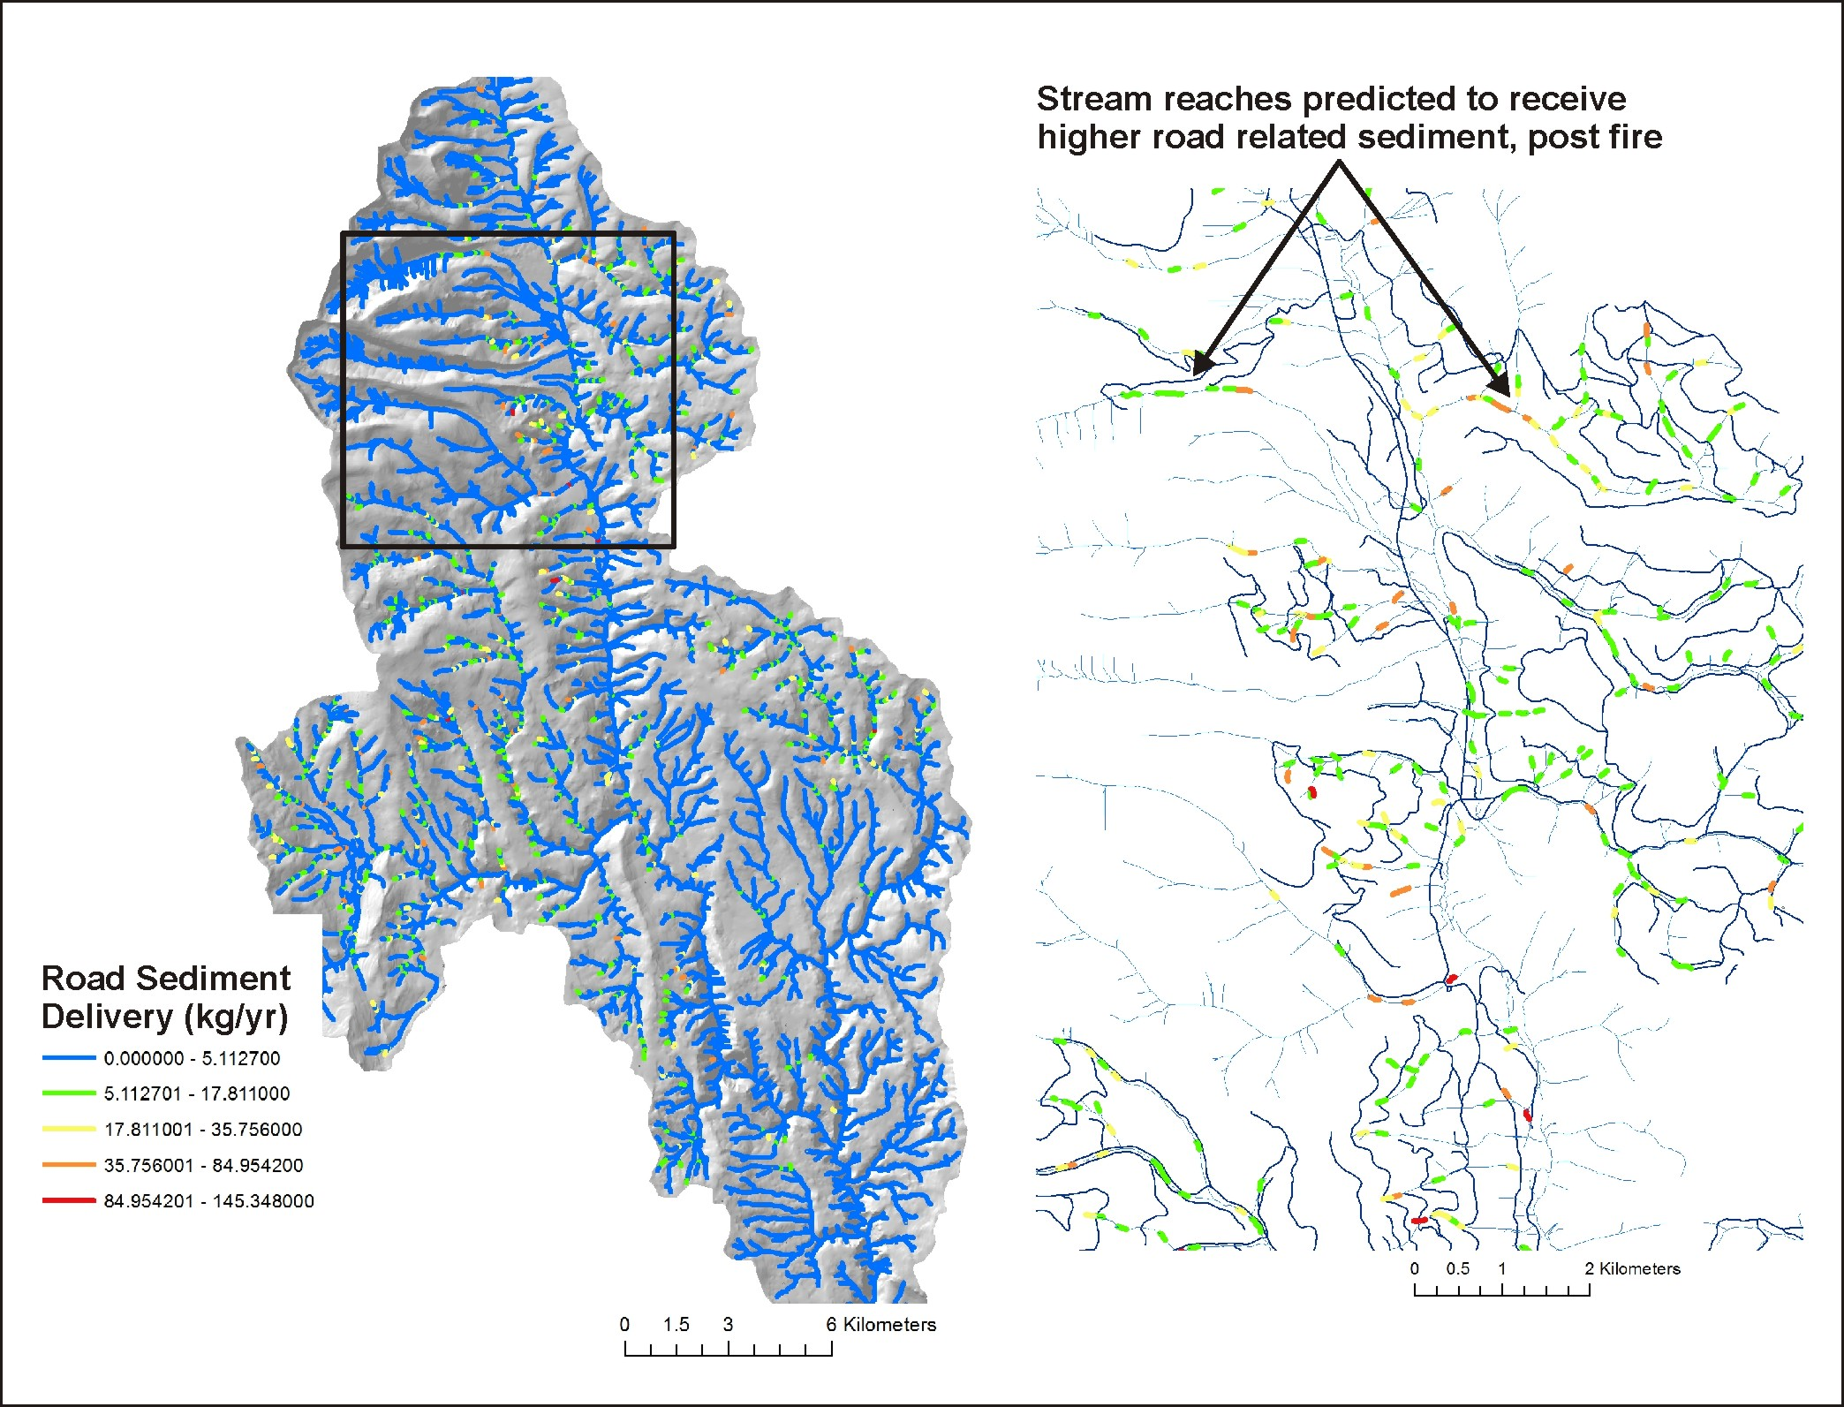
Notes:
Stream reaches where post fire road sediment delivery is predicted to increase; some of these reaches overlap sensitive fish habitats.

Slide 22
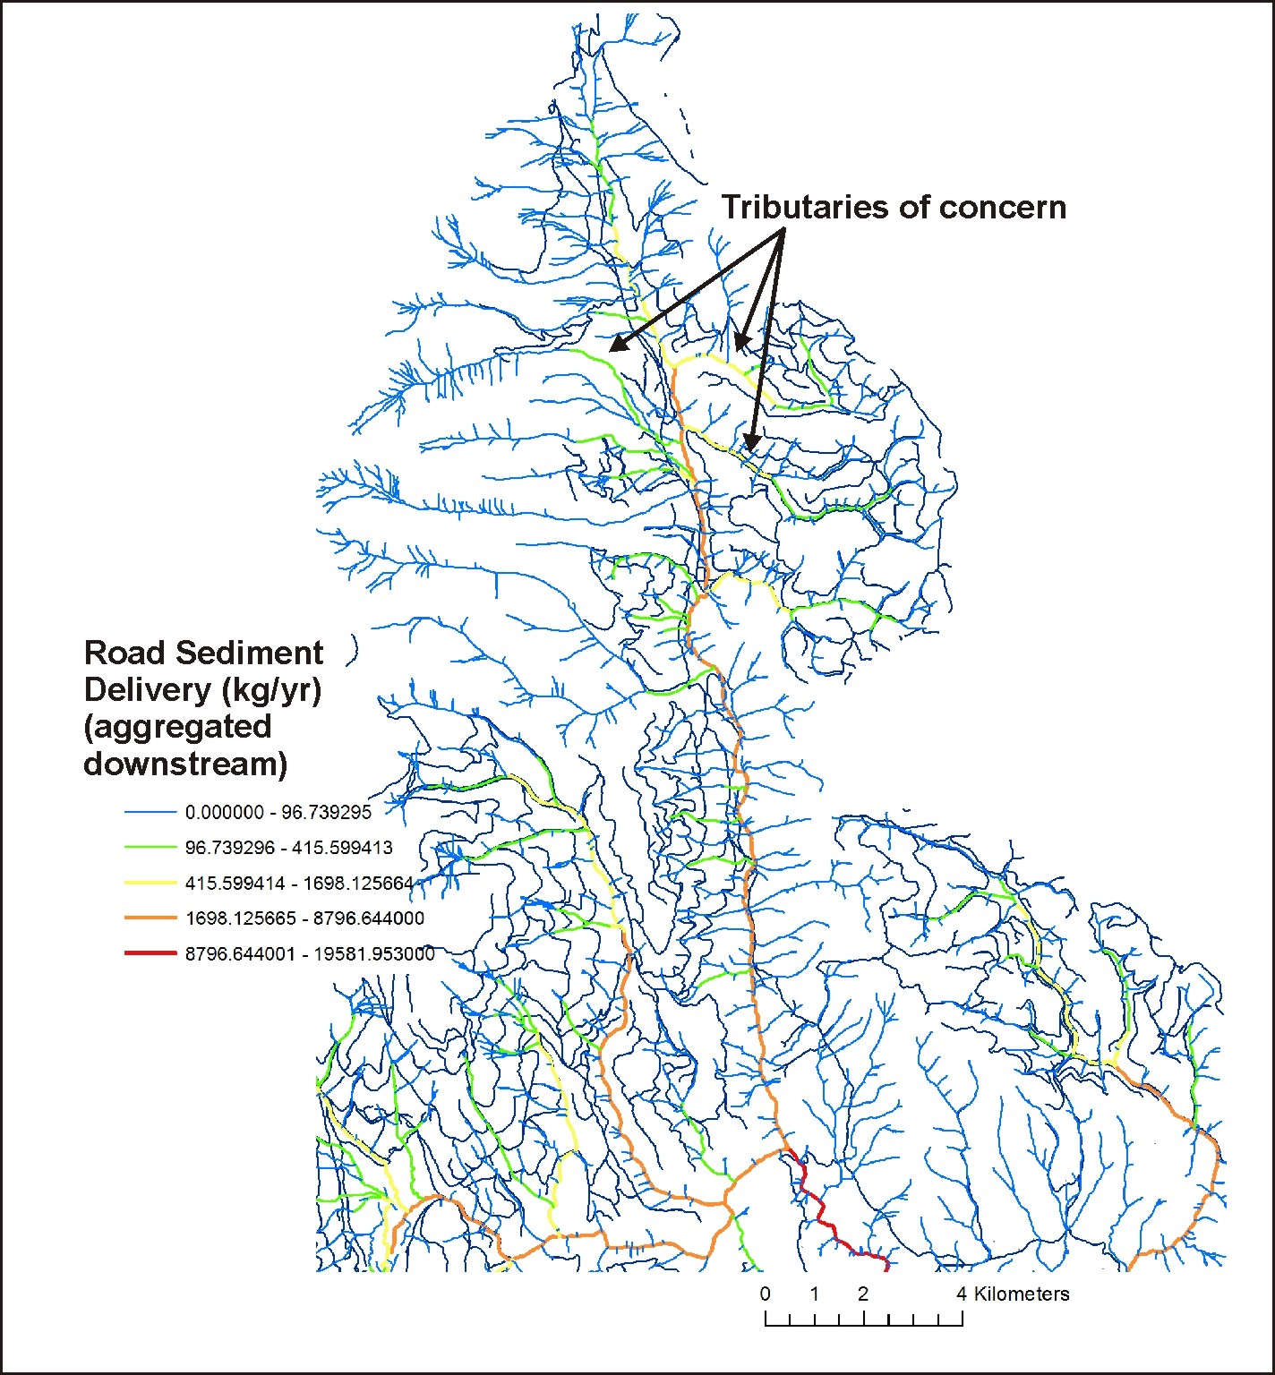
Notes:
Differences in pre and post fire road erosion sediment delivery is routed or aggregated downstream, revealing tributary and subbasin patterns. This information was also aggregated to the HUC 6th subbasin.

Slide 23
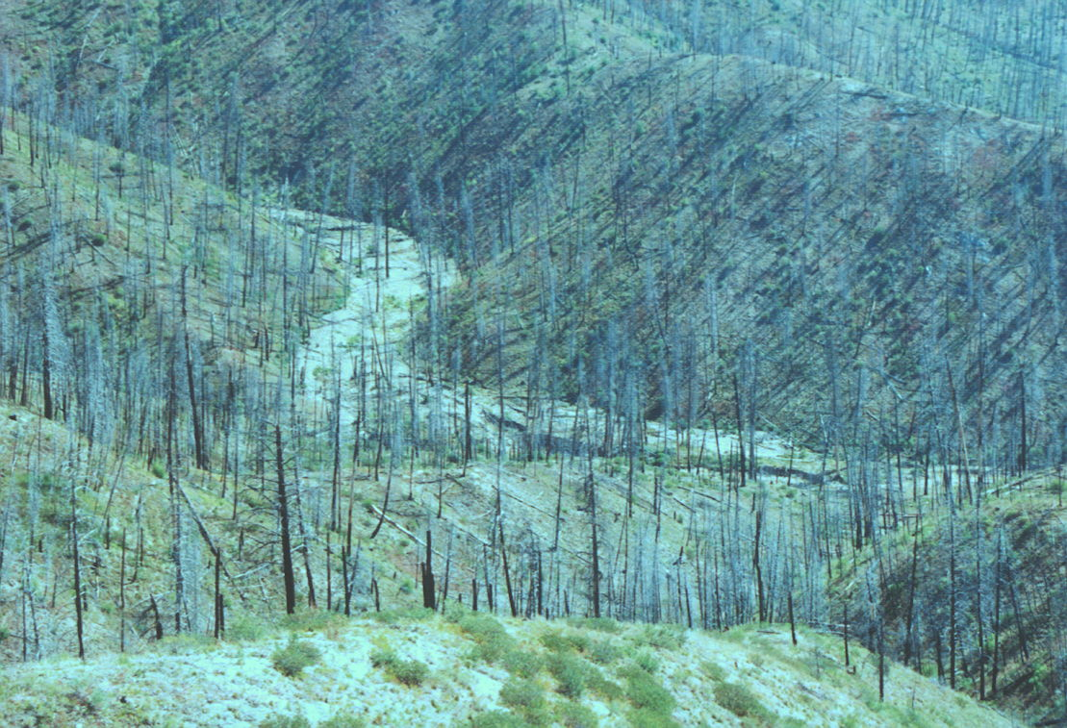
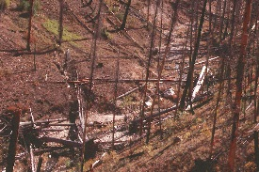
Riparian Zones: Impacts from Fire, Loss of Shade, Increases in Thermal Loading and
Loss of Cool Water Refugia

Slide 24
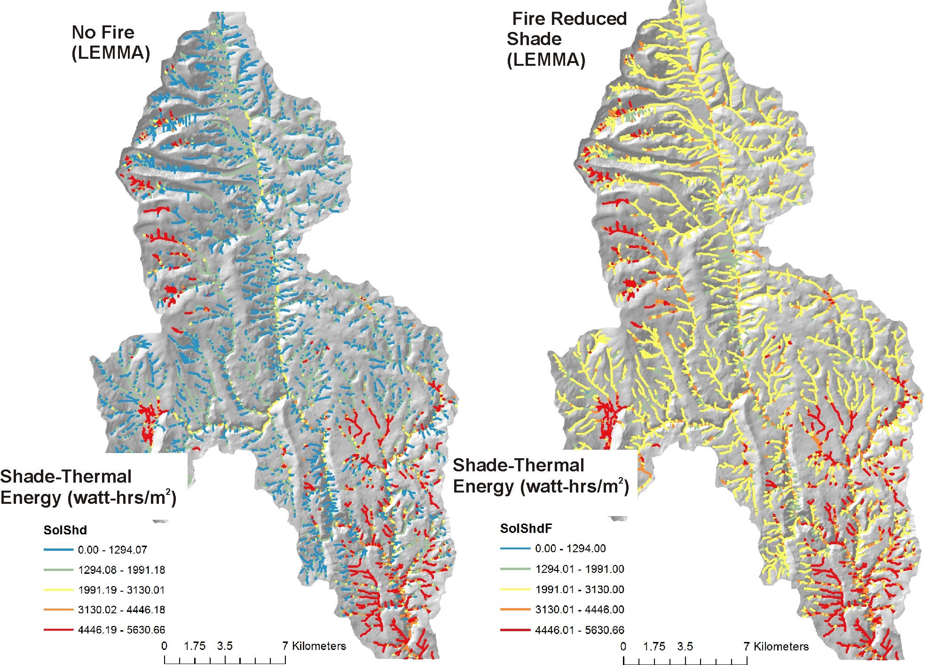
Riparian –
Current Shade/
Thermal Energy
Notes:
Predicted thermal energy to streams under current (no fire) shade conditions (using LEMMA vegetation data (http://lemma.forestry.oregonstate.edu/) and fire-reduced shade. Many channel segments receive higher thermal loading, post fire. Some areas like the lower right hand corner are south facing with little topographic shading, and thus do not exhibit much change.

Slide 25
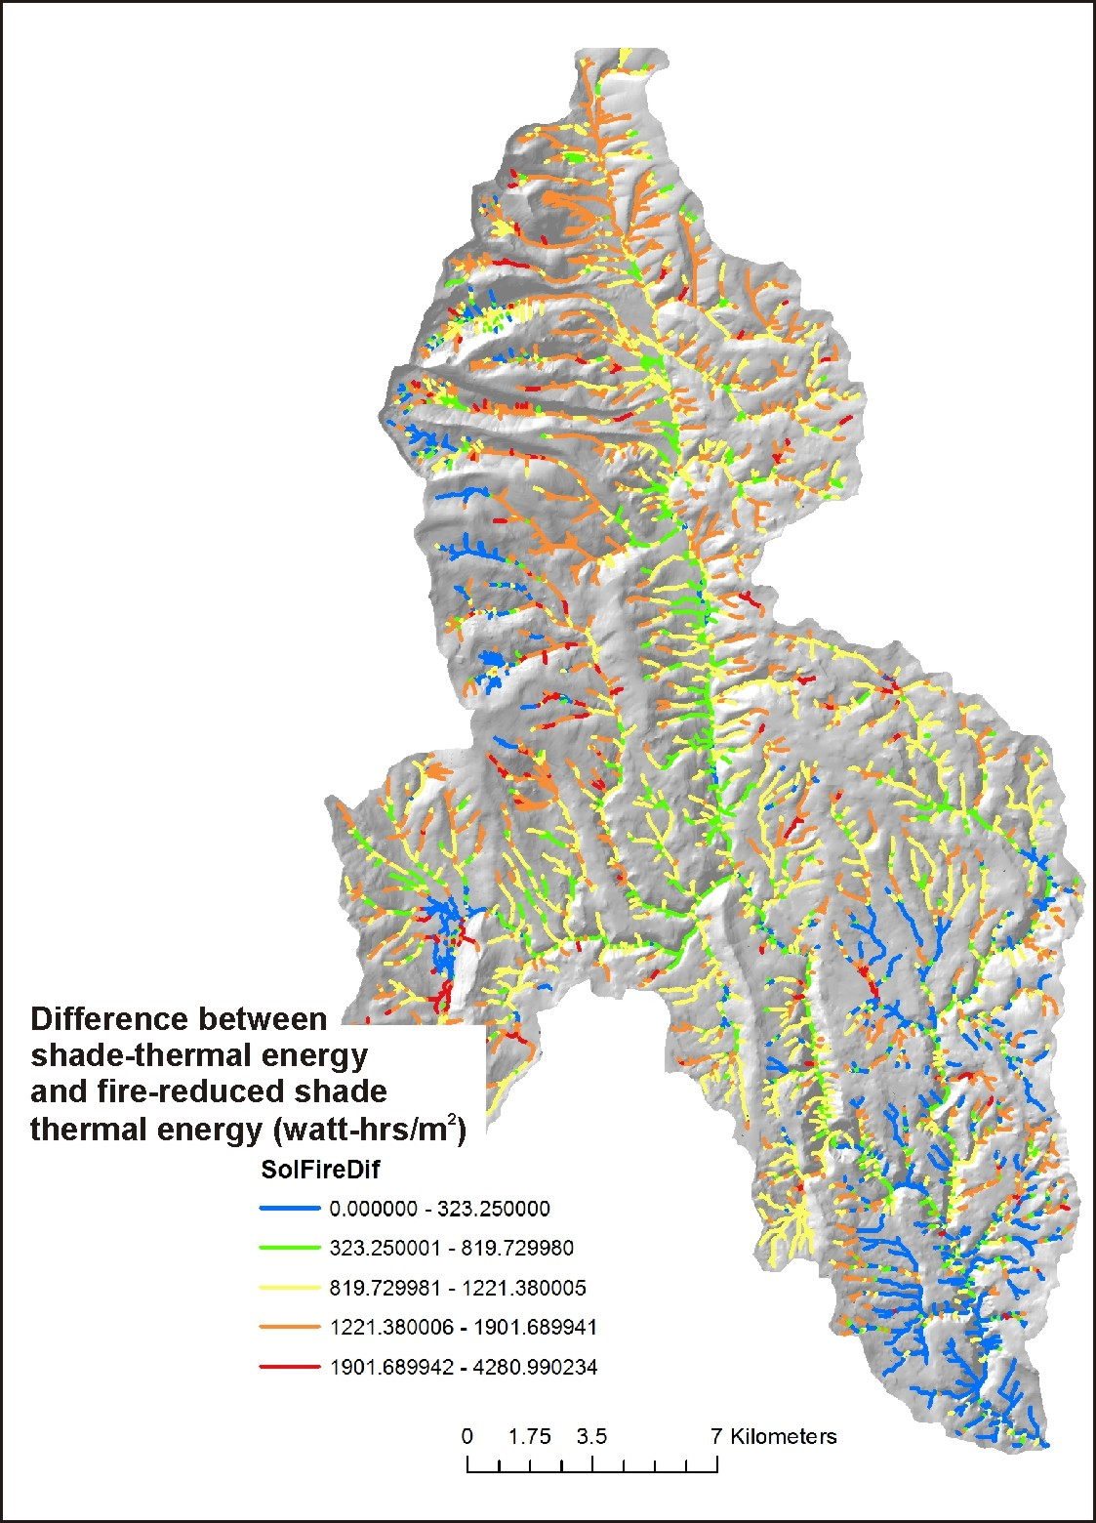
Difference between current shade-
thermal energy and fire reduced shade
thermal energy.
Shows reaches where the greatest impacts to
shade and increases in thermal energy are
predicted to occur
Notes:
A difference map is produced from the previous slide’s data, revealing which channel segments would be most sensitive to fire-induced reductions in shade, according to the predicted fire severity (flame length).

Slide 26
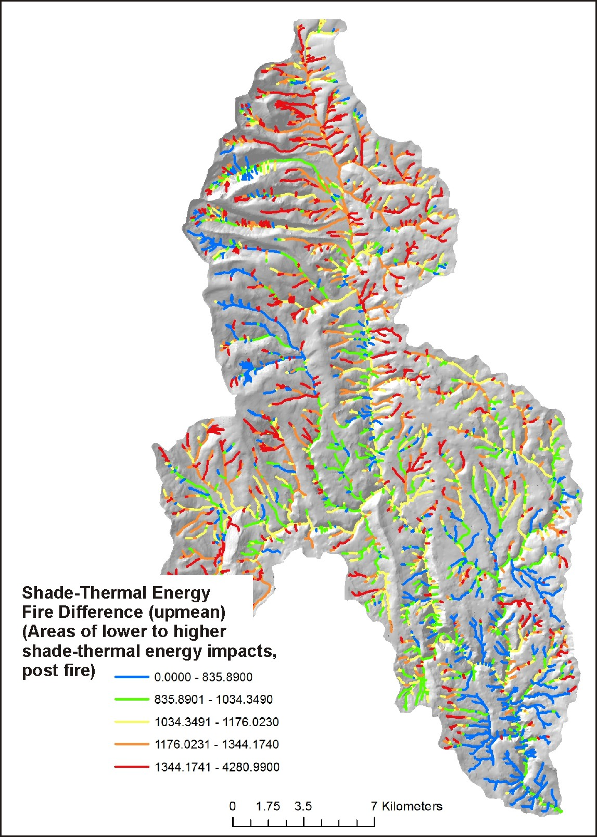
Difference between current shade-
thermal energy and fire reduced shade
thermal energy, but aggregated downstream
(running average).
Shows multi-reach or tributary scale impacts to
shade and increases in thermal energy, e.g.,
stream segments and tributaries where thermal
refugia will be reduced.
Notes:
The information from the previous slide is aggregated downstream, revealing tributary and subbasin scale patterns of increasing thermal conditions due to fire and its variable intensity.

Slide 27
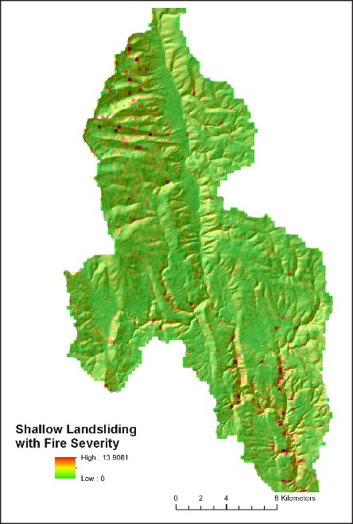
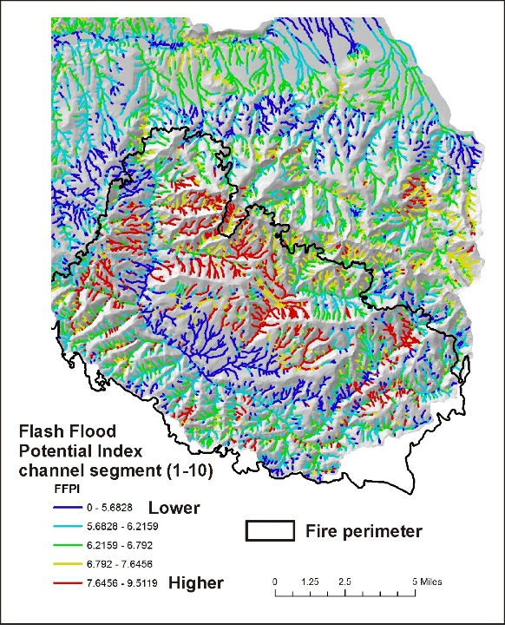
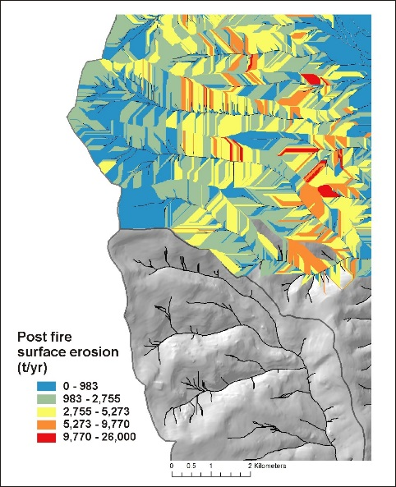
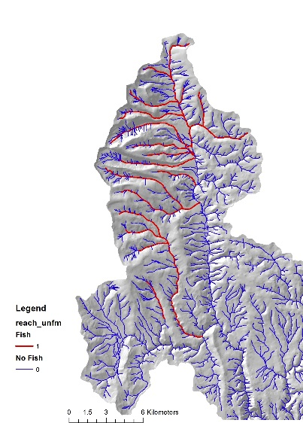
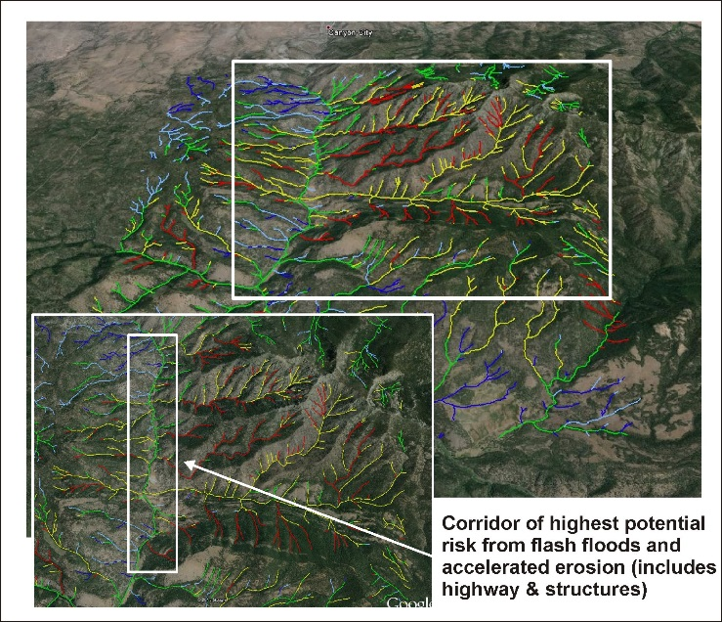
Decision Space: Spatially Explicit Maps (visual - qualitative)
+
+
Flash flood potential
Surface erosion potential
Landslide potential
+
locations of aquatic habitats, or infrastructure (homes, highways, energy)
Fish
habitat
= priority sites for
protection (pre fire management,
firefighting)
Notes:
Information provided in the Fire and Fish analysis (previous slides, among other data) can be used visually and qualitatively to search for intersections or overlaps between various fire related stressors (erosion, roads, thermal) and sensitive aquatic habitats, as illustrated above. Or one of NetMap’s tools (Habitat-Stressor Overlap Tool) can be used quantitatively to locate overlaps and intersections (see next slide).

Slide 28
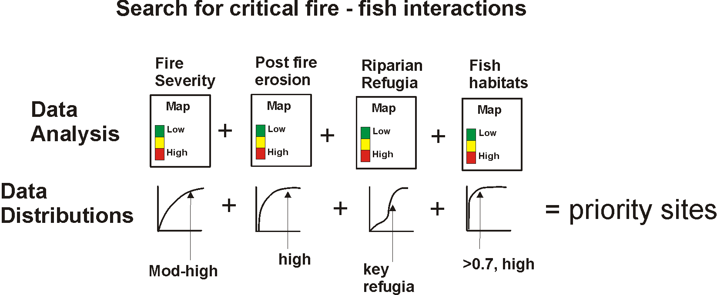
Decision Space: Spatially Explicit Quantitative (using Quick Fire Tool)
Notes:
NetMap’s Quick Tool that contains the Habitat-Stressor overlap capability can be used to locate intersections between fire related impacts and sensitive fish habitats. The tool calculates, on the fly, the full frequency distribution of values (shown as the cumulative distribution of values in this slide), and the analyst, using the tool, selects from the distributions to search for overlaps. For example, an analyst can quickly search for intersections among the highest 10% of fire severity, highest 5% of post fire surface erosion (or landsliding or gullying), highest 10% of fire related increases in thermal loading, and fish habitats (either presence of habitat or some numeric value of habitat quality [used in IP]).
For additional information, see NetMap’s online technical help that describes the overlap tool: http://www.netmaptools.org/Pages/NetMapHelp/overlap_tool___reaches.htm
And the Quick Tool, which is provided as part of this analysis: http://www.netmaptools.org/Pages/NetMapHelp/netmap_quick_tool.htm

Slide 29
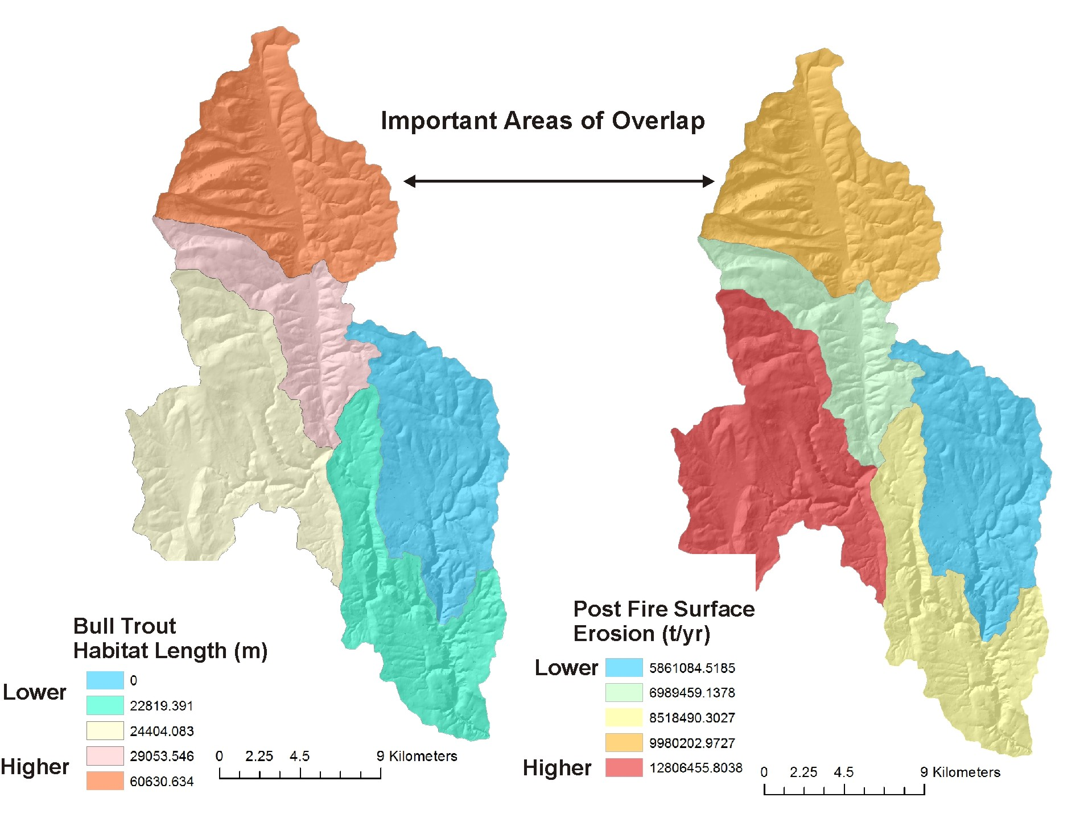
Notes:
All analysis results are summarized to the HUC 6th subbasin scale. This can be used to examine subbasin scale patterns of fire related attributes and stressors and the locations of aquatic habitats. Subbasin scale data summaries may be most useful at the scale of larger watersheds or entire national forests.

Slide 30
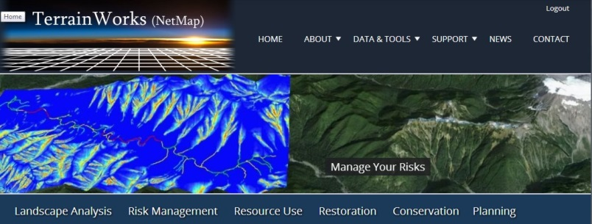
Presentation
Complete
TerrainWorks designs and builds the most advanced watershed and landscape analysis system
in the world. Learn more about NetMap virtual watersheds, watershed analysis tools,
online technical help and tools at: www.terrainworks.com. Contact us with questions,
we are here to help.

