Slide 1
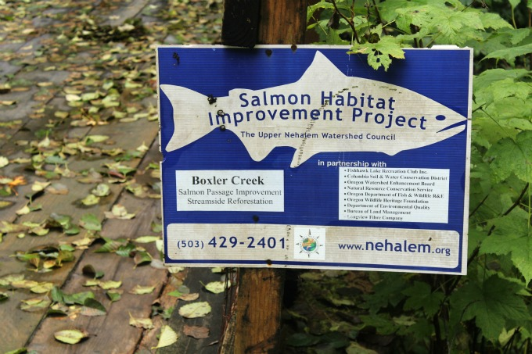
Watershed Restoration: Optimizing Site Selection with a Focus
on Agricultural Areas in the Nehalem Watershed, Western OR
Prepared for:
NOAA, ODFW & Nehalem Watershed Council
by:
TerrainWorks (NetMap)/www.terrainworks.com
February 2014
Notes:
The National Oceanographic and Atmospheric Administration (NOAA) along with Oregon Department of Fish and Wildlife (ODFW) and Watershed Councils, commissioned a pilot project in the Nehalem River watershed in northwestern Oregon to evaluate how the watershed analysis system, NetMap, could be used to support restoration planning, focusing on aquatic, riparian and road related issues pertaining to coho salmon. In part, the NetMap pilot project will be used to support the proposed NOAA coho delisting strategy for the Oregon Coast Range.
This powerpoint allows one to take a self guided tour of the analysis results. To see the movie of the full presentation, go to: https://vimeo.com/119868365

Slide 2
This short Powerpoint shows the part of the Nehalem-NetMap
analysis that applies to identifying restoration sites on agricultural
lands
Other aspects of the analysis not shown here cover forest lands
forest roads, and slope stability

Slide 3
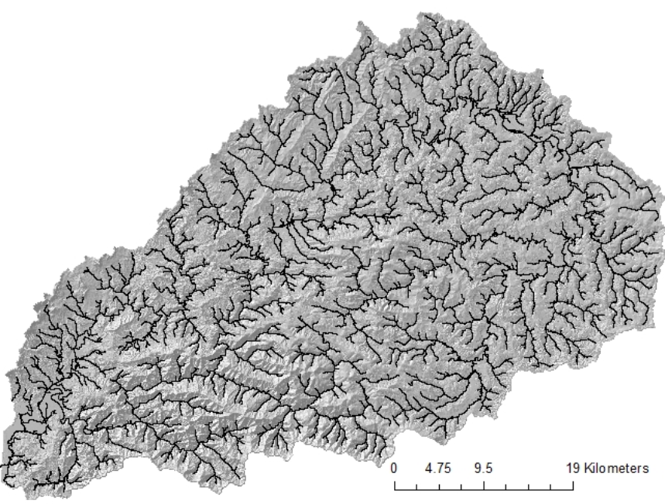
First, we build a synthetic river network (stream layer) directly from LiDAR DEMs
Nehalem
synthetic
river
High
Low
Notes:
NetMap’s synthetic river network is based on a comprehensive analysis of channel forming processes.

Slide 4
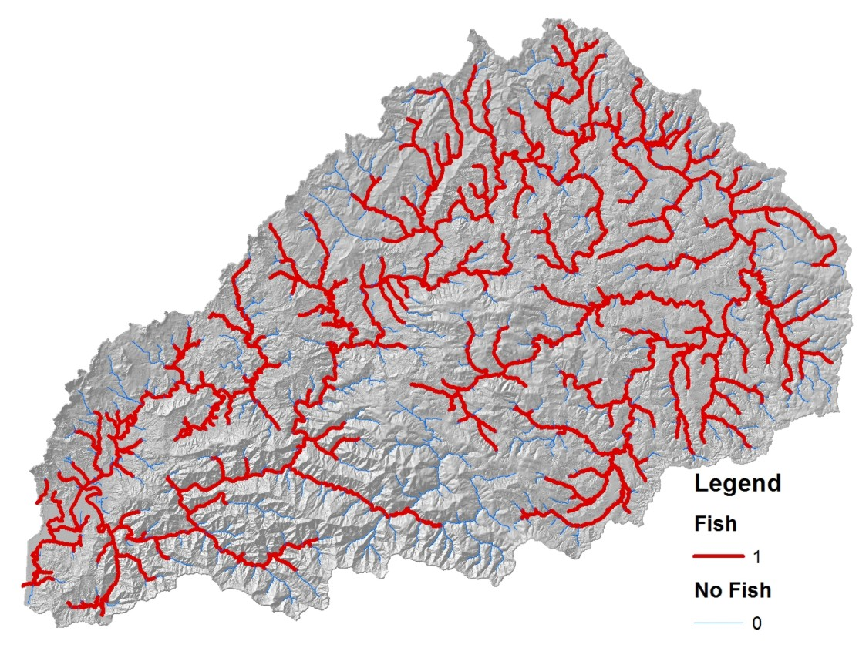
Next we predict abundance
and quality of fish habitat, in this
case for coho salmon
Notes:
First off, to map coho fish habitat quality we will use the distribution of coho salmon in the Nehalem watershed available from the Oregon Department of Fish and Wildlife, shown by the red network.

Slide 5
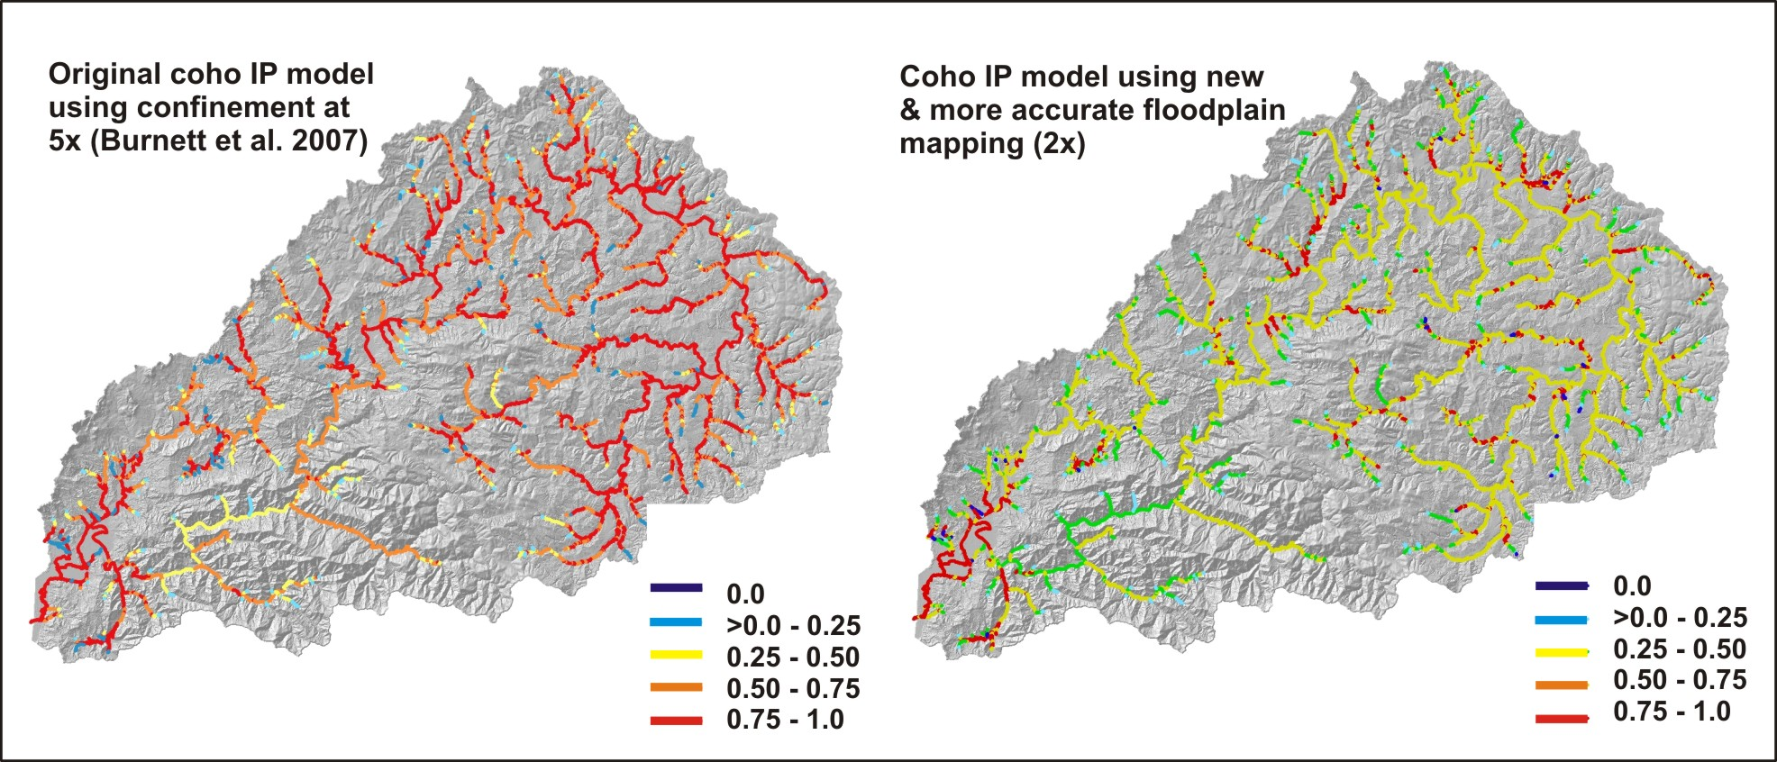
Coho Intrinsic Potential (e.g., intrinsic landscape position)
-gradient, confinement; mean annual flow; (Burnett et al. 2007)
Notes:
The first step is to map fish habitat according to intrinsic landscape position, known as “intrinsic habitat potential” or “IP”. Warmer colors equal better intrinsic habitat conditions
for coho (based on channel gradient, confinement and flow).

Slide 6
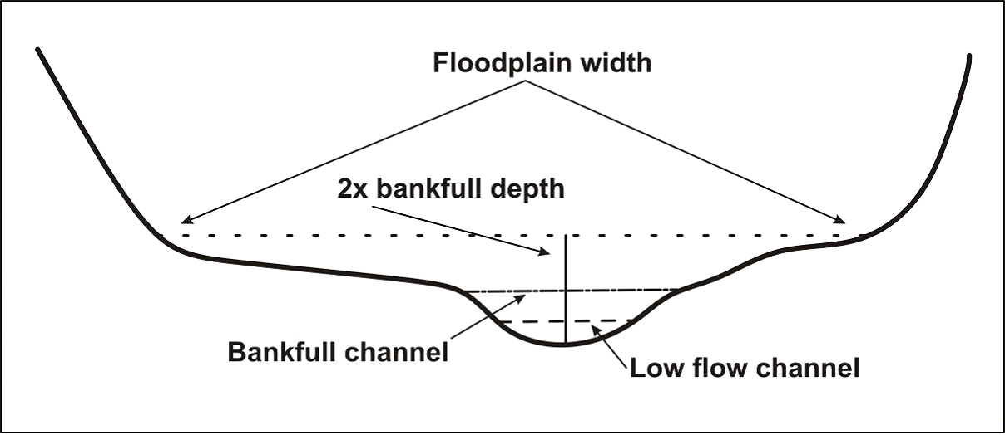
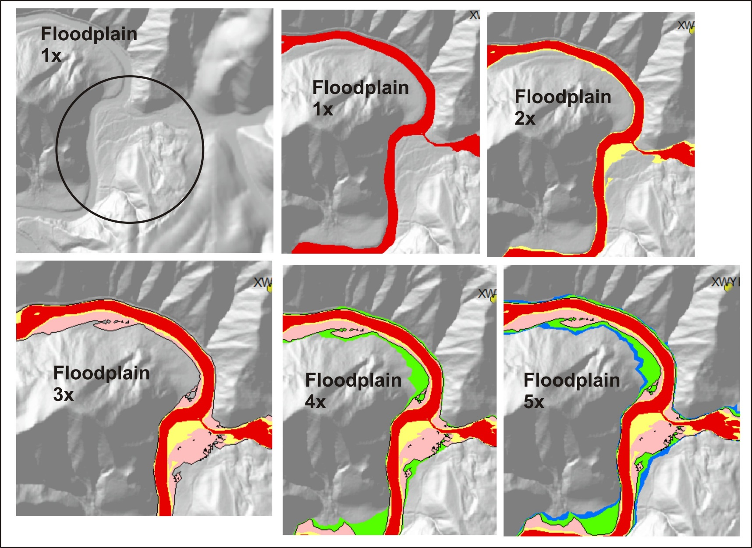
Next, we map floodplains of varying height and flood magnitude above the channel
NetMap’s floodplain mapping tool
Notes:
Floodplains are an important constituent of coho habitats and can be targeted for restoration. NetMap’s advanced floodplain mapping tool calculates floodplains based on multiples of bankfull depths above the channel. Floodplains at 1x bankfull depth defines the active channels; floodplain at 2x defines the current active floodplain; floodplain at 3x defines the higher current floodplain and or the historically active floodplain in channels that have incised; floodplains above 3x are likely terraces that do not get inundated.

Slide 7
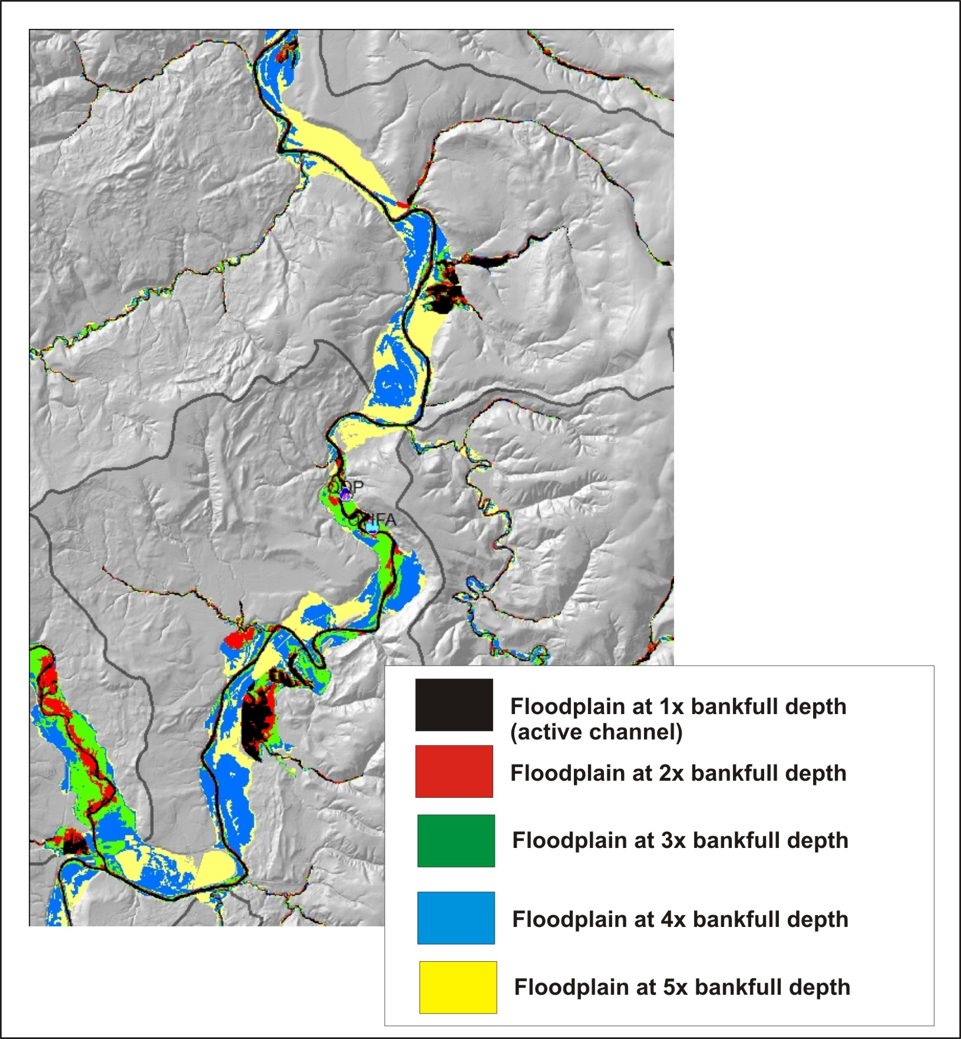
Potentially historical
active floodplains, channel
now incised
Notes:
NetMap’s floodplain mapping tool can be used to identify current floodplains and abandoned floodplains, those that were once active but currently are non functioning because of dikes and other land uses.

Slide 8
Notes:
The floodplain mapping tool can be used to detect the effects of dikes in isolating floodplains from their river systems, as illustrated above.

Slide 9
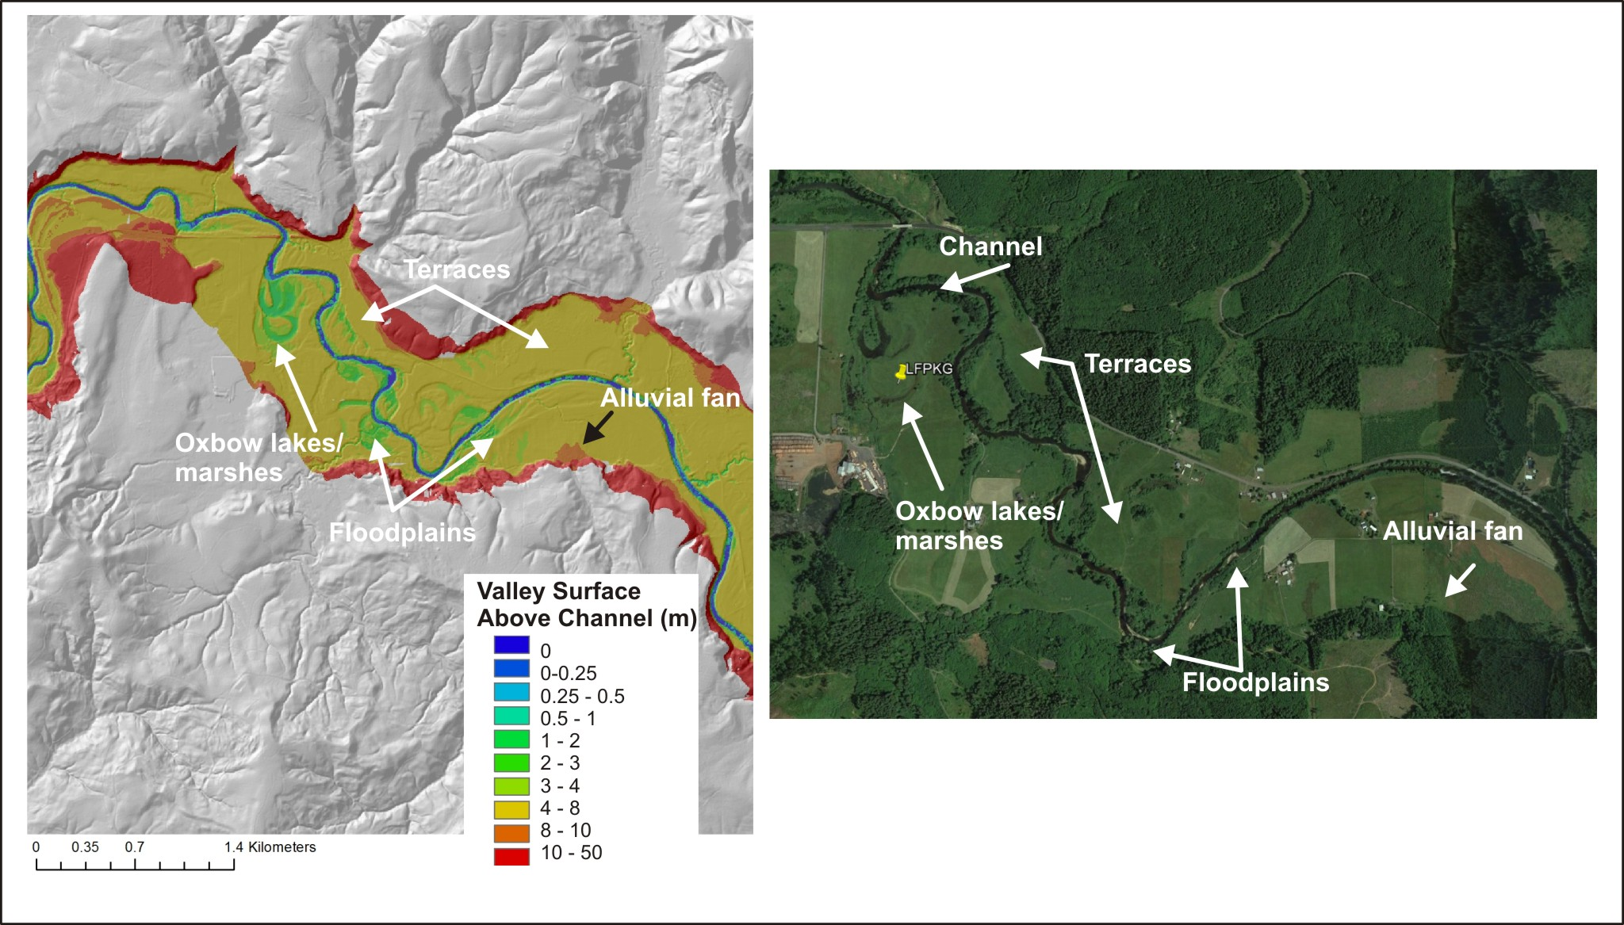
Notes:
NetMap’s valley floor mapping tool can identify landforms including channels, floodplains, oxbow lakes, marshes, terraces and alluvial fans. This information could be used to help prioritize restoration projects, particularly those designed to reconnect channels with their floodplains.

Slide 10
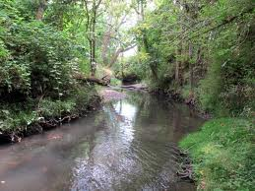
Then, we calculate current shade and thermal loading conditions along all
streams in the Nehalem watershed and determine where additional shade
is needed most, particularly in context with valuable fish habitats
Notes:
Shade and thermal loading can be important considerations when planning restoration activities. In particular, shade and thermal loading can be added to the other habitat forming factors to identify the best or optimized areas for targeting riparian and instream restoration.

Slide 11
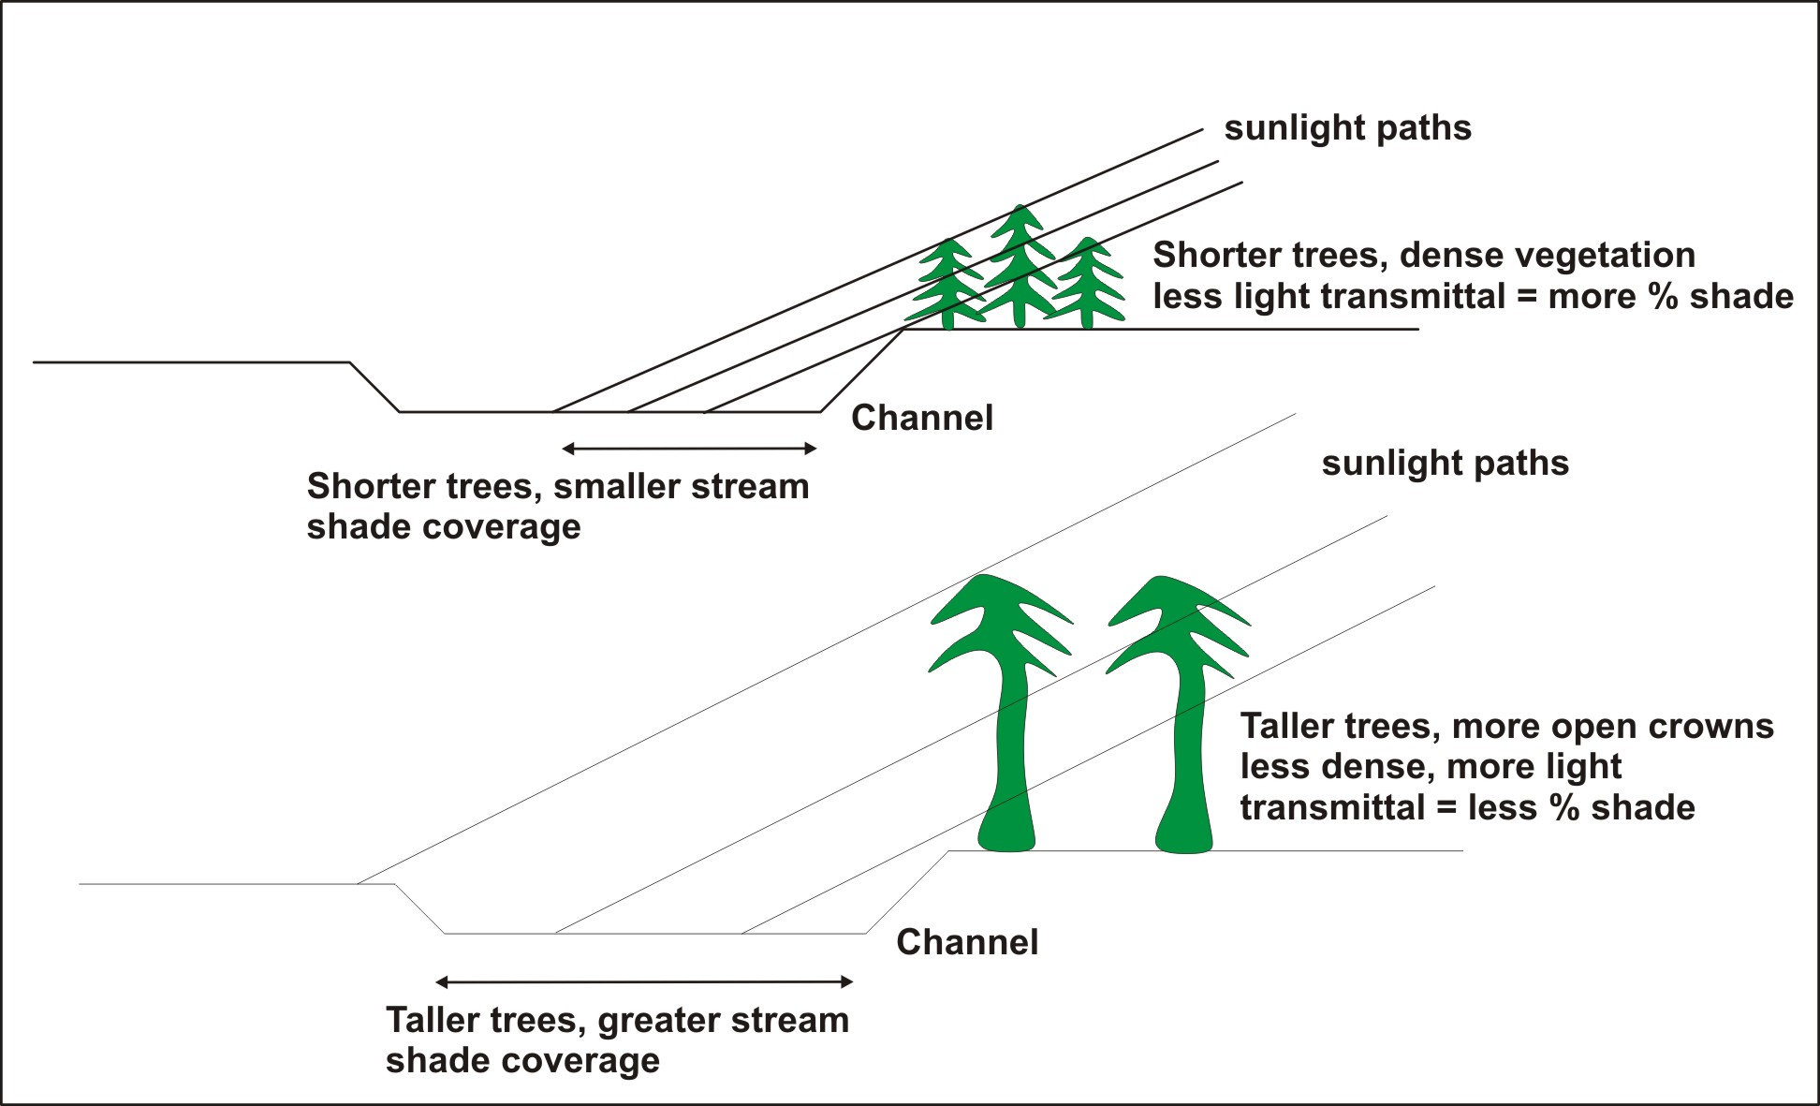
Notes:
We combined NetMap’s physically based thermal loading tool with a model to predict percent shade using basal area and tree height (shade model by Groom et al. 2014). Percent shade is positively correlated with basal area (think vegetation density) and negatively correlated with tree height (e.g., more light gets through taller trees that have less dense vegetation and more open canopies compared to shorter vegetation with dense vegetation). However, as trees get taller they shade an increasing proportion of the channel width, so taller vegetation equals greater shading also.

Slide 12
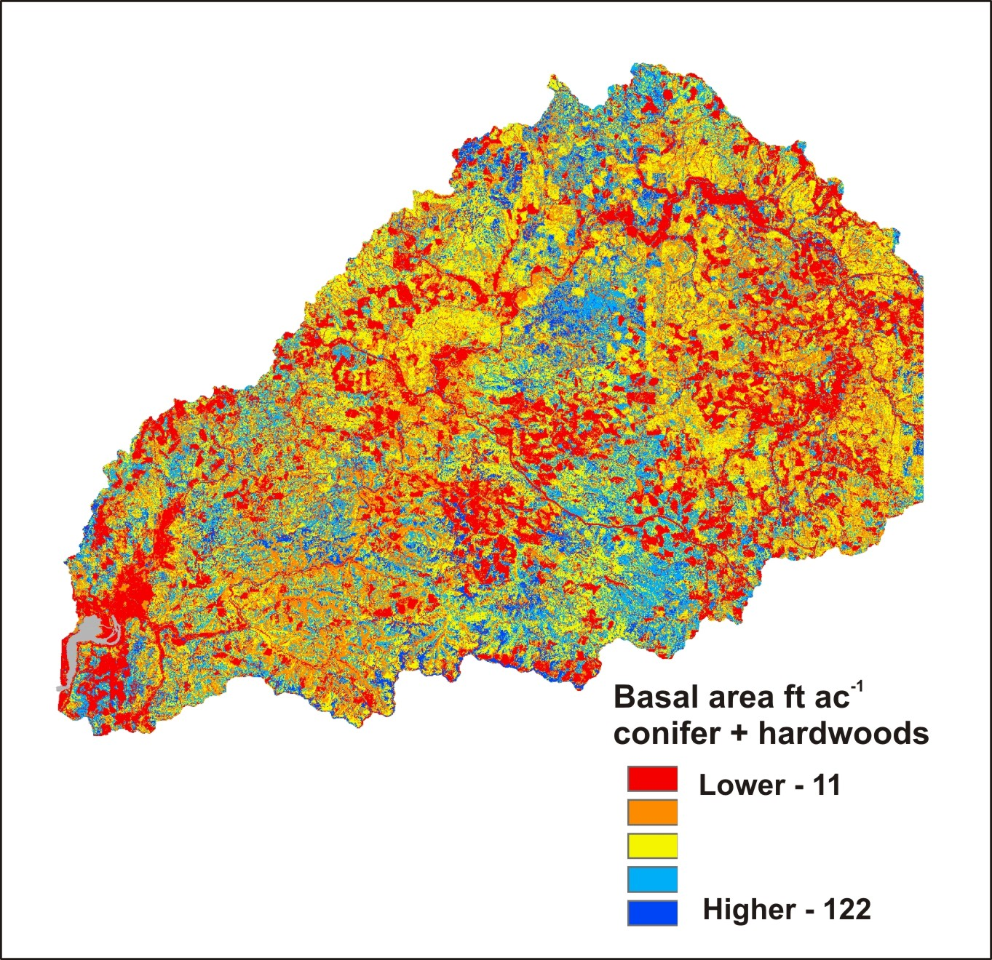
Basal Area (conifers & hardwoods), 30 m each side of channel – represented in stream channels
Smaller amounts of vegetation
commonly are found
along streams in valley floors,
in agricultural areas.
Notes:
Here is the LEMMA/GNN data on basal area, conifer and hardwoods combined for the Nehalem watershed.

Slide 13
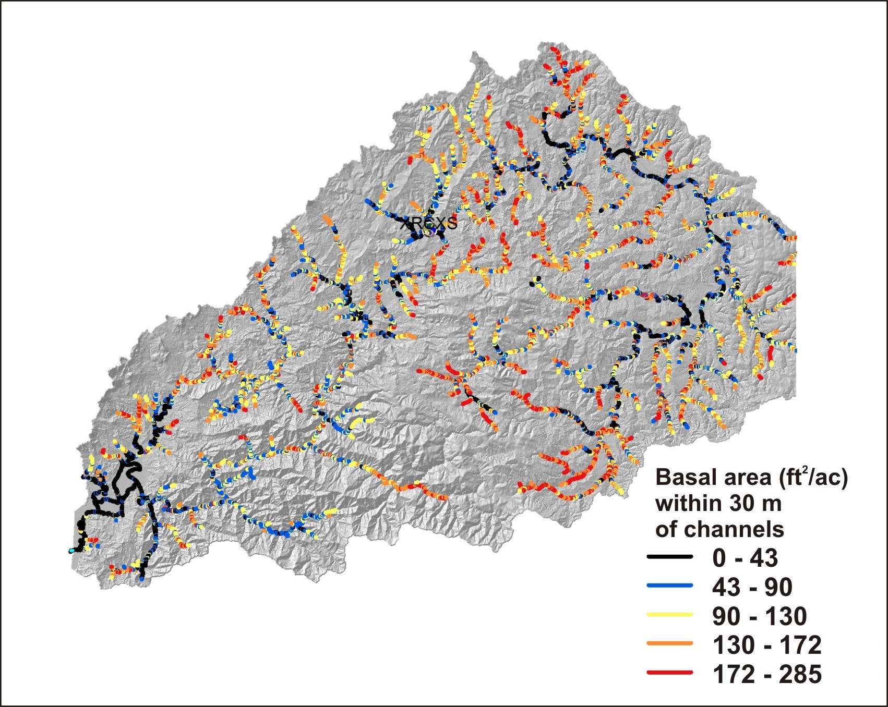
Many areas along mainstem
fish bearing reaches have low
shade.
Many small tributaries in
agricultural areas also have
low shade
Notes:
Here is a map of coho salmon bearing streams only revealing areas of high to low shade. Certain areas stand out as having low shade including the larger valley floors that are developed including for agriculture.

Slide 14
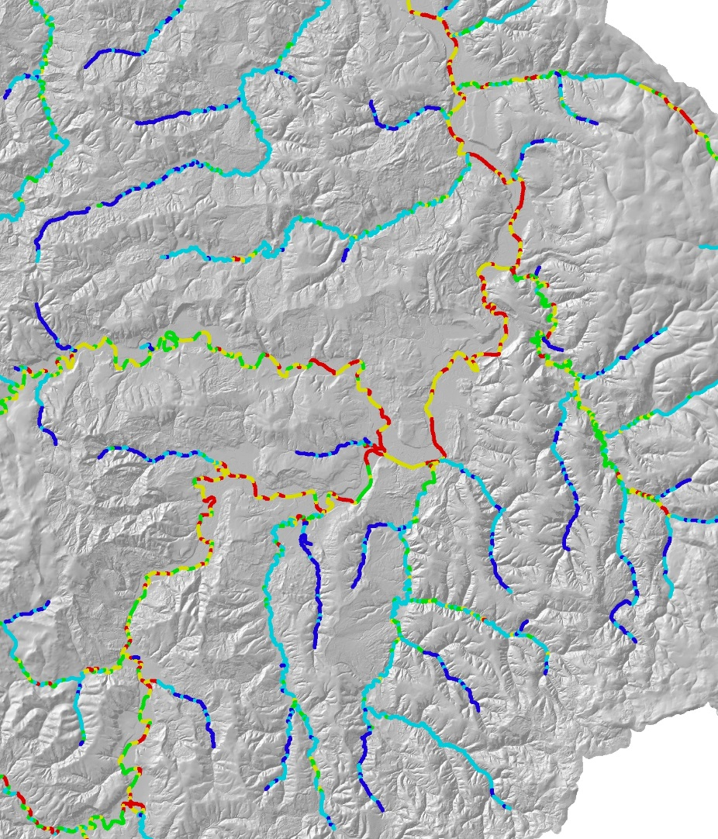
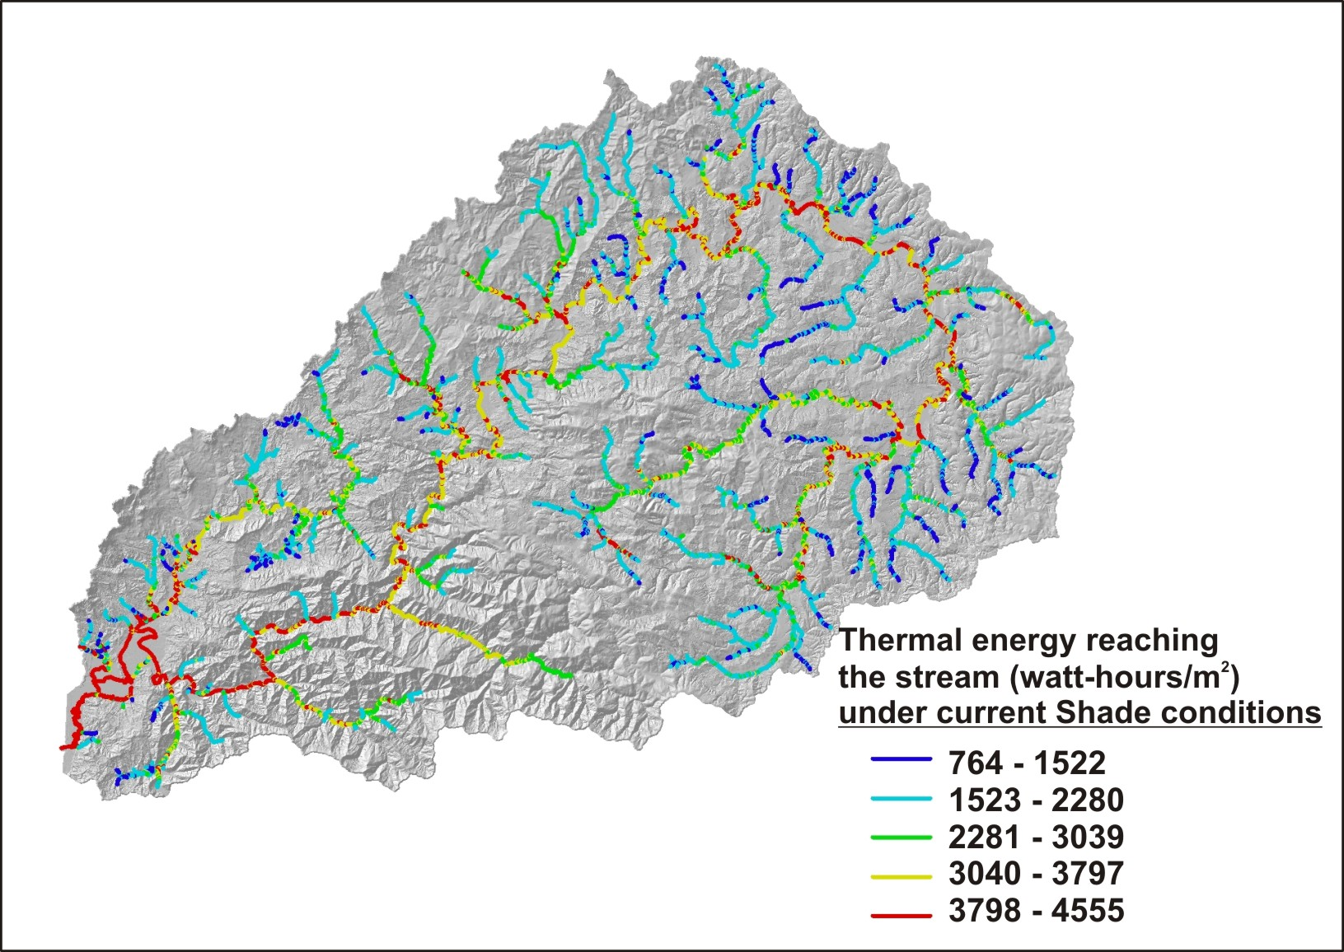
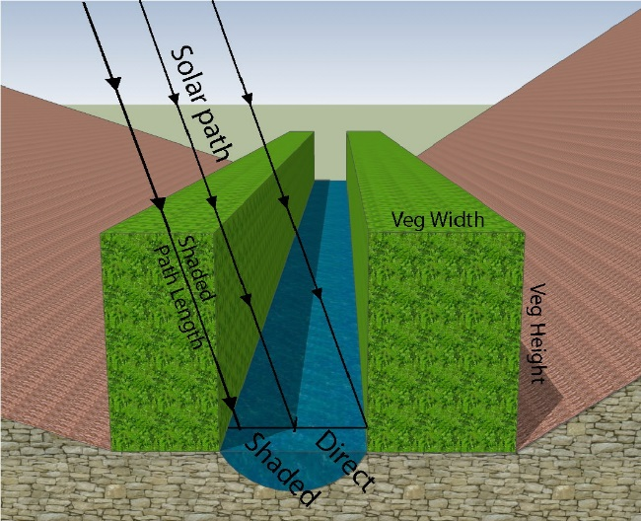
Higher thermal energy is
often associated with
small streams
in agricultural areas
Higher thermal along wide mainstem rivers is mostly
natural and hence additional shade would have
minimal effects
Notes:
We now evaluate how current shade conditions (basal area combined with tree height) affects thermal loading along streams in the Nehalem watershed. The warmer colors in the map indicate channels that have higher thermal loading due to present day shade, combined with natural patterns of thermal loading controlled by channel width, orientation, topography and solar angles.

Slide 15
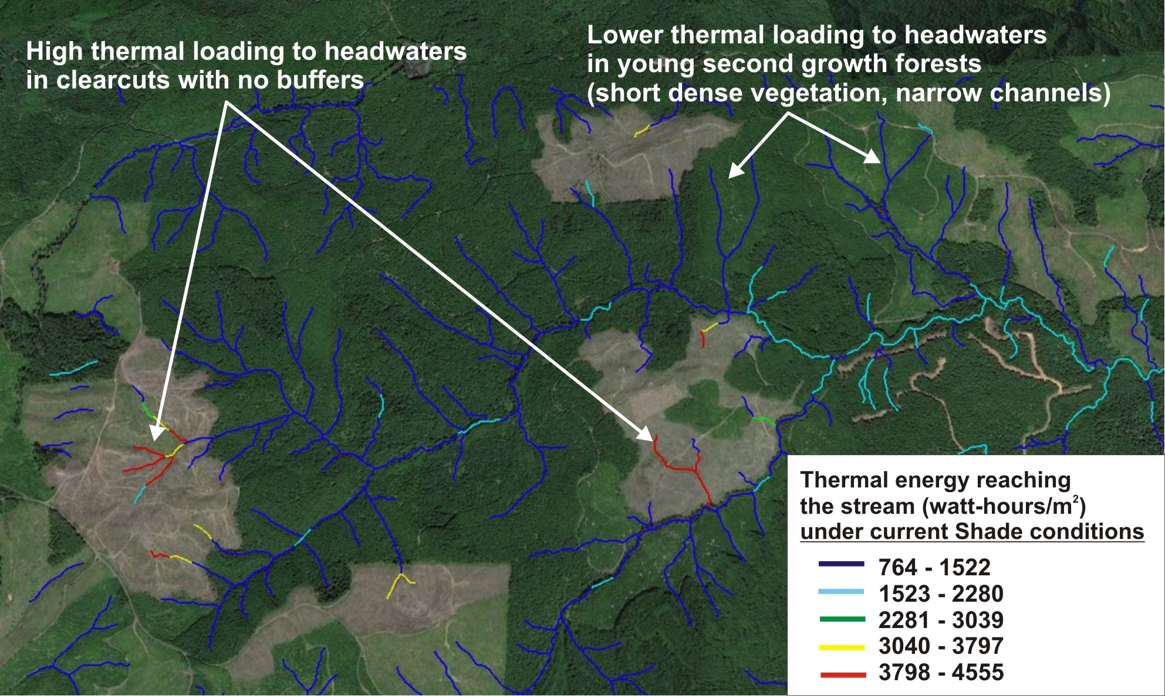
Notes:
NetMap’s predicted current shade-thermal loading conditions including for small headwater channels. Recent clearcuts have the highest thermal loading potential because of the absence of stream side vegetation and buffers. However, younger second growth forests do provide significant shade and thus lower thermal loading, including because of narrow (1-2 m wide) channels. Recall that shading is positively associated with basal area but negatively correlated with tree height.

Slide 16
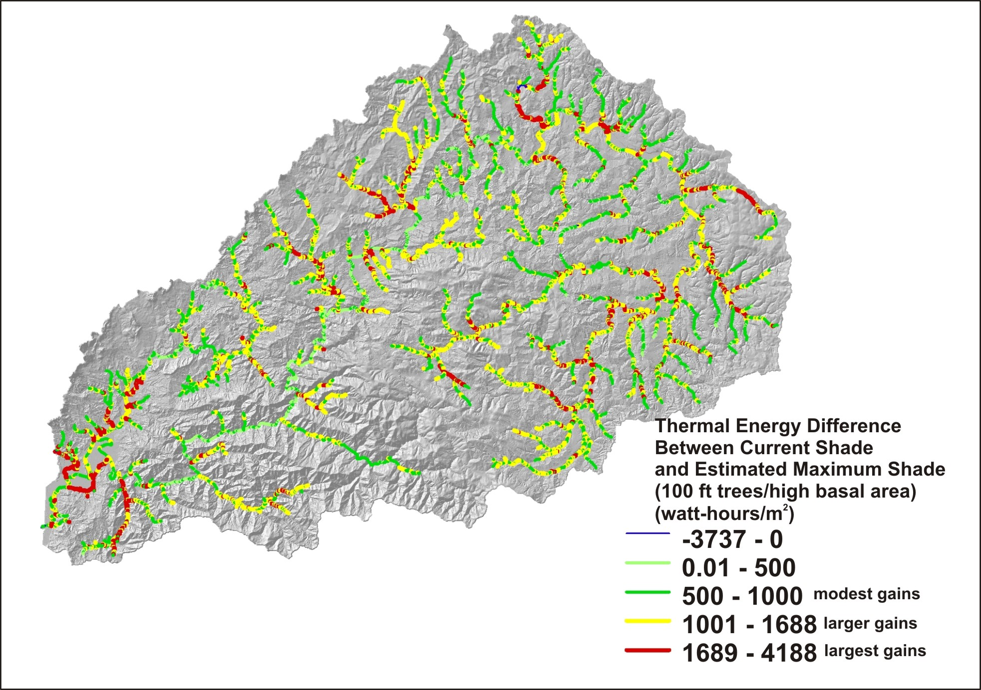
Where is increased shade needed most?
Notes:
We can estimate, based on Nehalem specific vegetation conditions, a likely maximum shade condition, combining basal area and tree height. A maximum shade condition is calculated using a high basal area (122) and a 100 ft tree height. The current shade condition (previous) slide is subtracted from that. The result is a map that shows where increasing shade by vegetation manipulation would have the largest potential benefit on water temperatures. The yellow and red areas in particular may be areas where increasing shade would be an improvement, including in many agricultural areas. See also next slide.

Slide 17
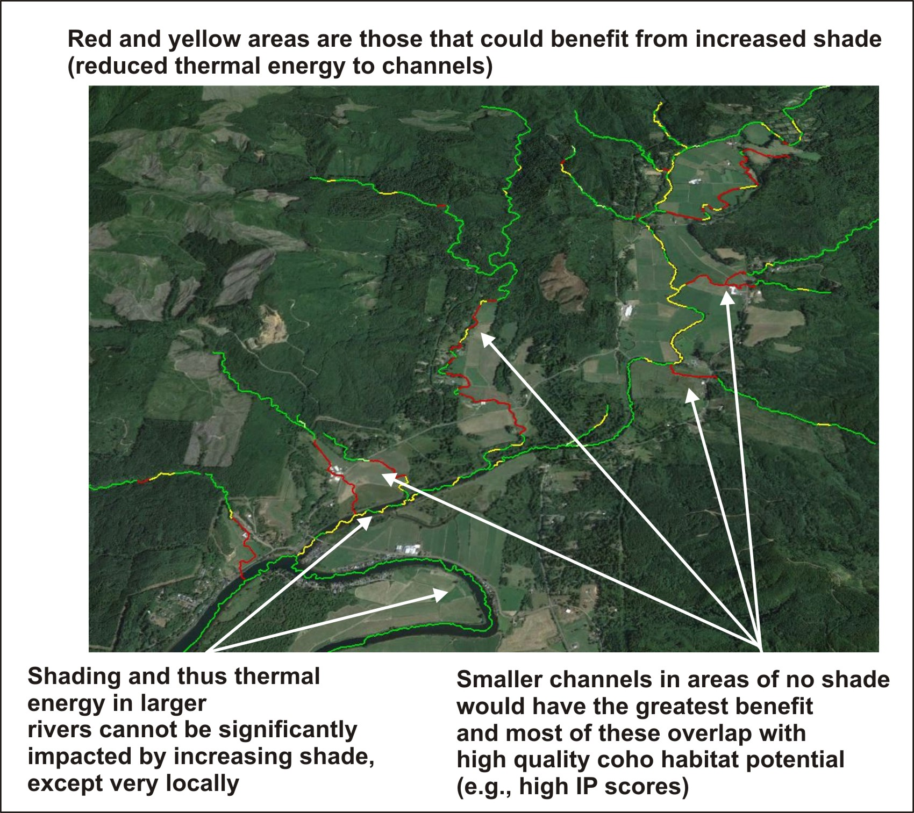
Notes:
As would be expected, small high value coho streams located on floodplains and terraces, but under current agriculture, are most sensitive to current low shade levels compared to larger rivers where shade is proportionally less important in reducing thermal loading.

Slide 18
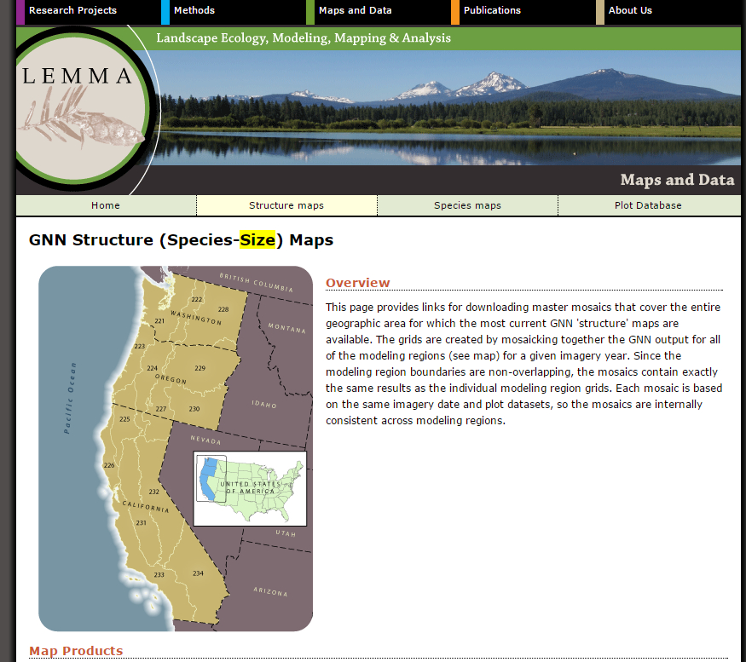
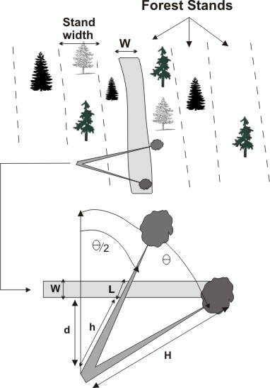
We also calculate in-stream wood recruitment
potential along all streams
Use digital data on vegetation characteristics
NetMap’s in-stream wood model
Notes:
Another important fish habitat component is in-stream wood recruitment that is dependent on a healthy riparian forest.

Slide 19
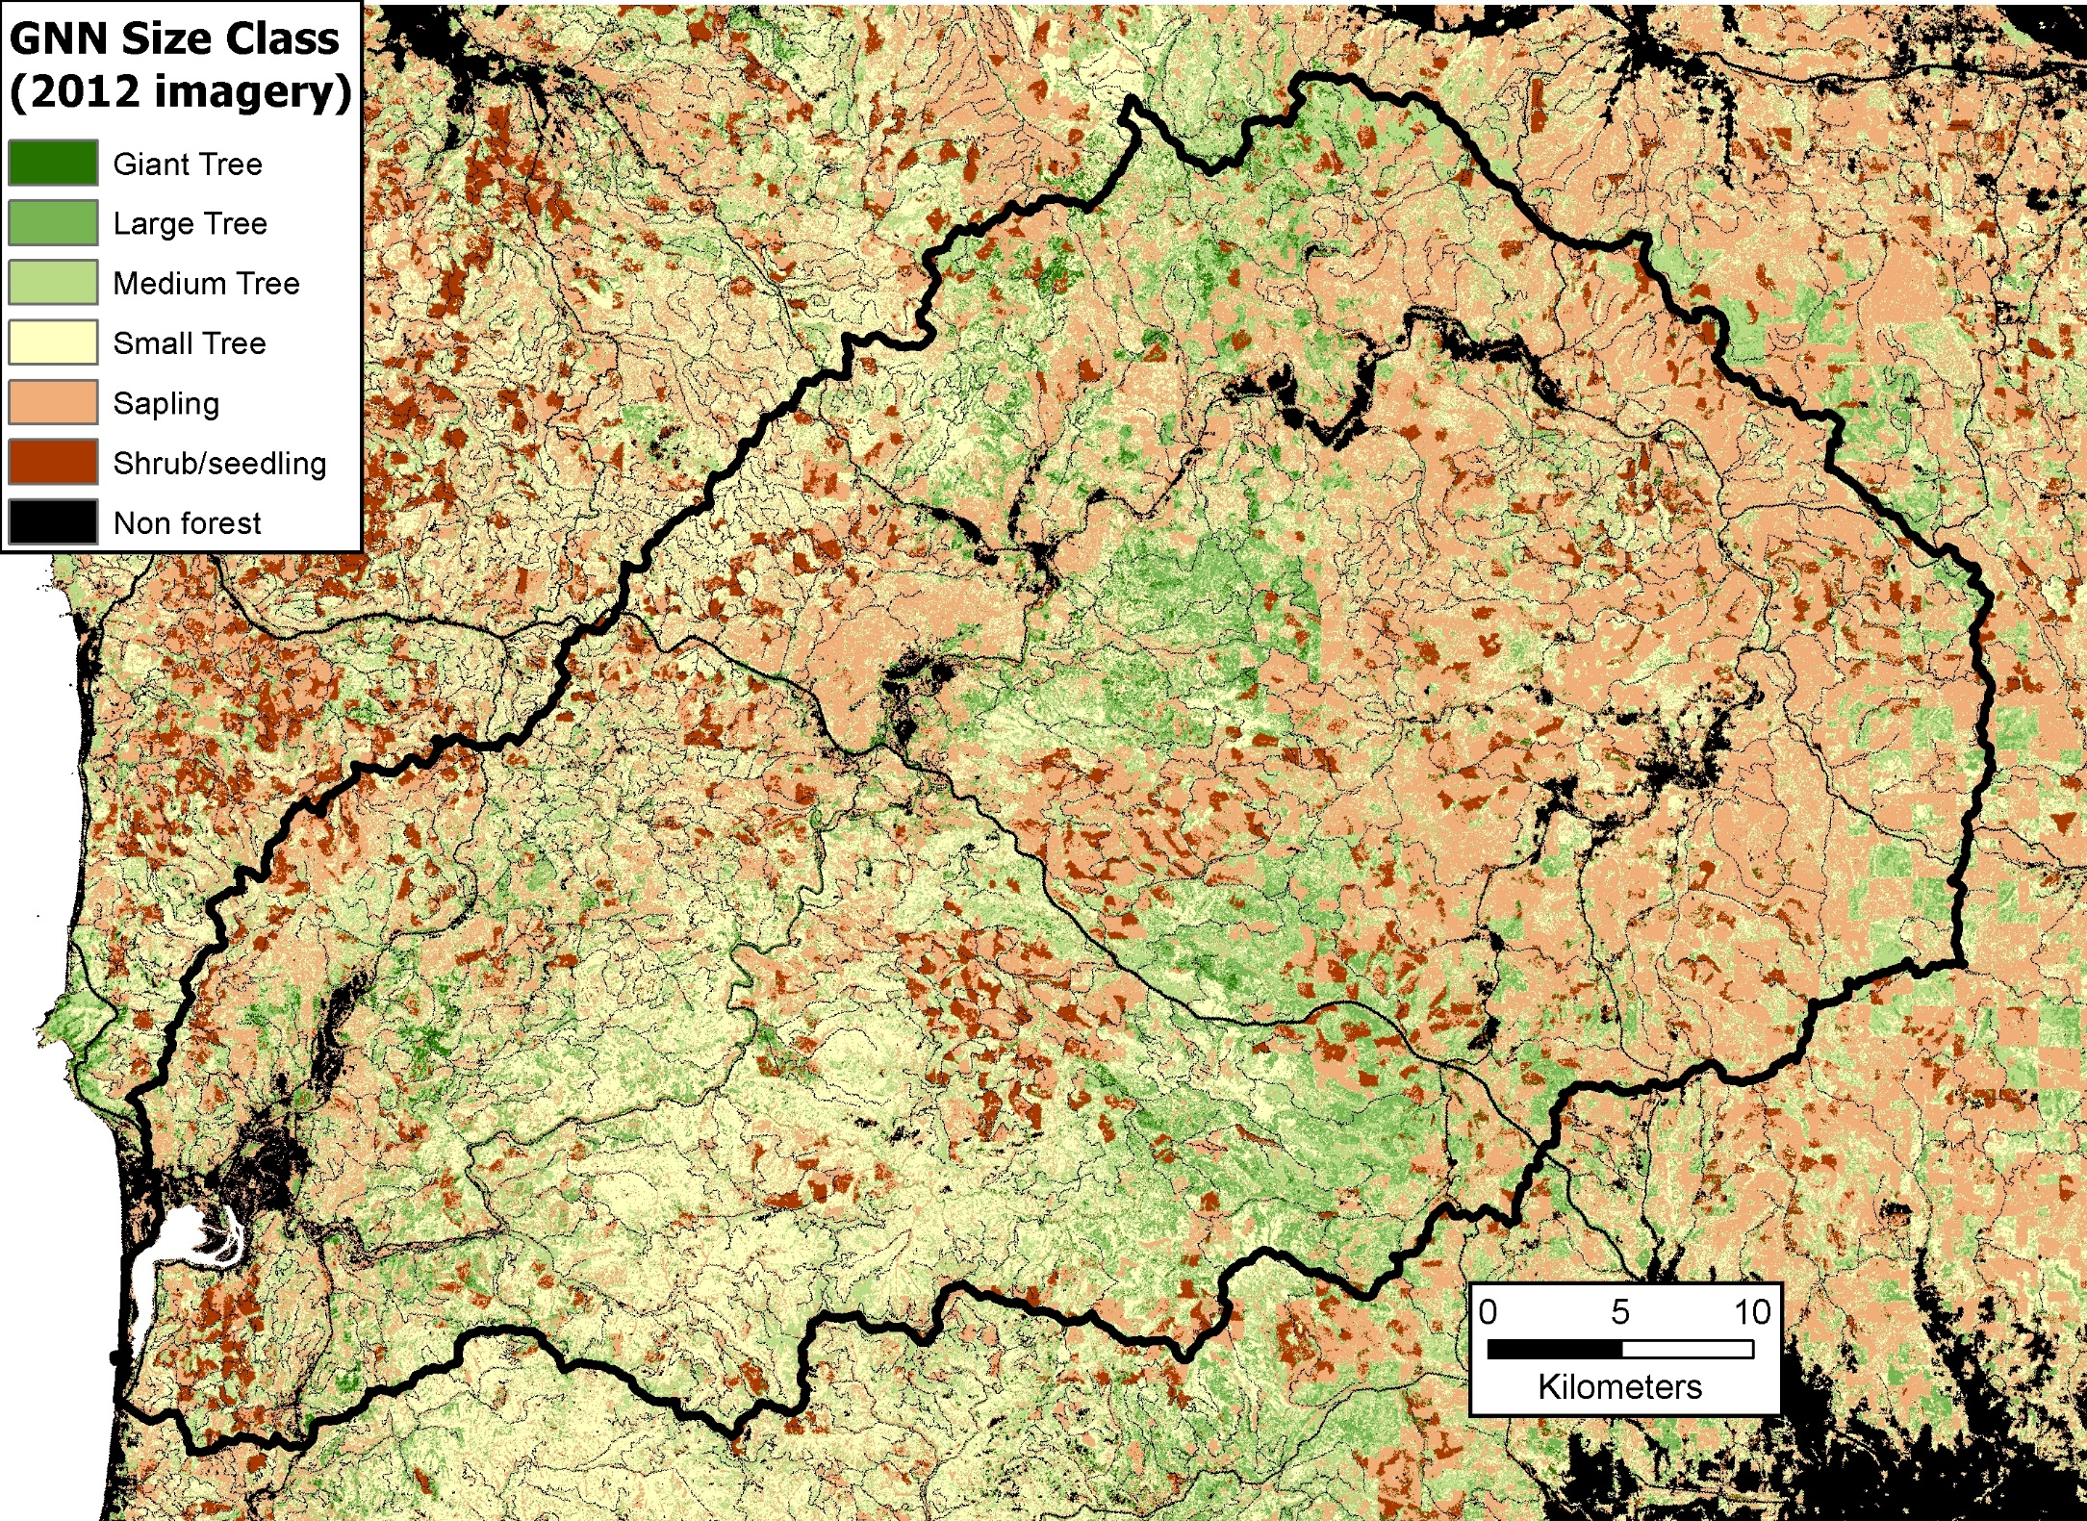
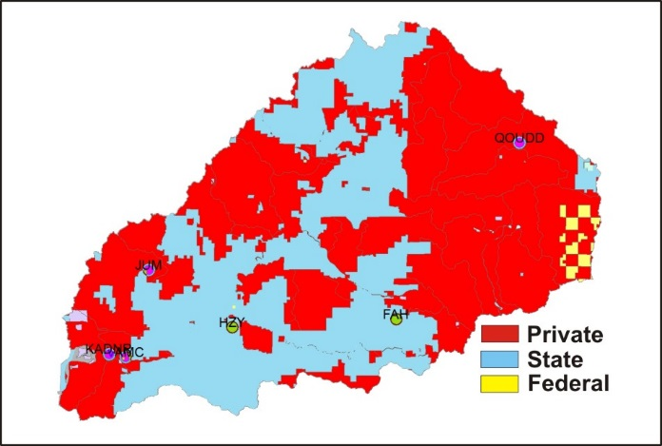
Notes:
Remote sensing data from LEMMA is used in NetMap’s watershed scale wood recruitment tool. Here we can see the distribution of vegetation/tree sizes across the Nehalem watershed. The dominance of small trees and saplings is concentrated in the private lands. However, many streams, particularly fish bearing, do have vegetation buffers that include larger trees (not easily seen in the watershed scale map).

Slide 20
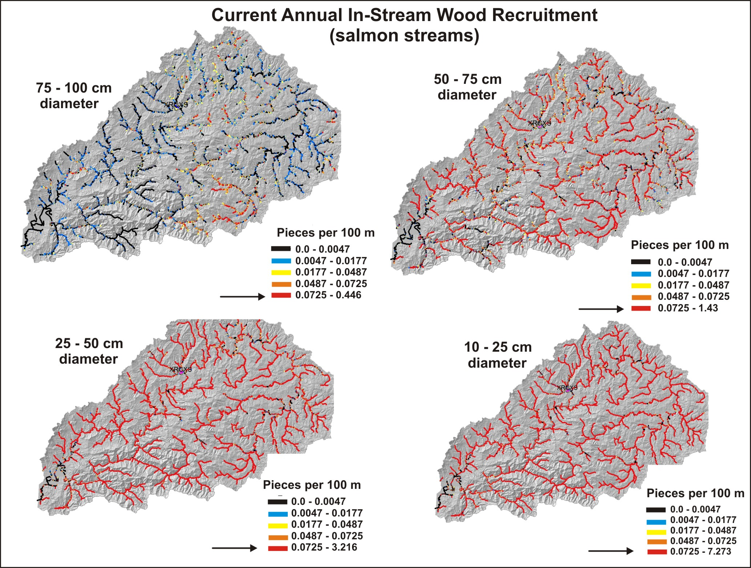
Notes:
NetMap’s watershed scale wood recruitment tool reveals patterns of potential in-stream wood loading for salmon streams. All legend classes are the same across all four diameter classes, with the exception of the highest values. Darker colors (black/blue) indicate low wood loading for size classes and the warmer colors (orange/red) indicate higher wood loading (pieces/100 m). There are patches of higher wood recruitment for the larger diameter classes (upper left). Many fish streams have higher levels of recruitment but of the smaller diameter classes. Areas of high to low recruitment of large to small wood could be matched up with higher intrinsic potential (IP) scores and used to help prioritize restoration site selection.

Slide 21
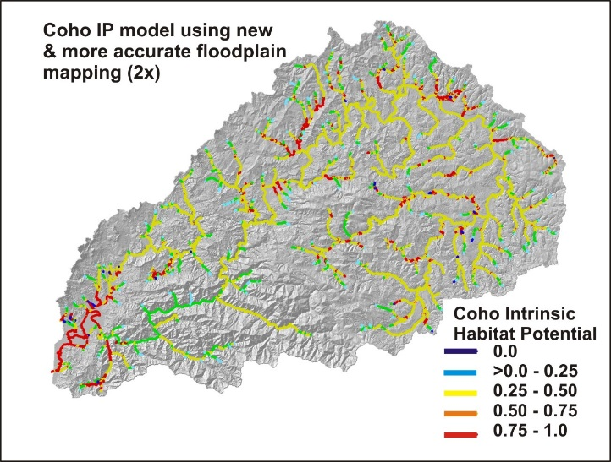
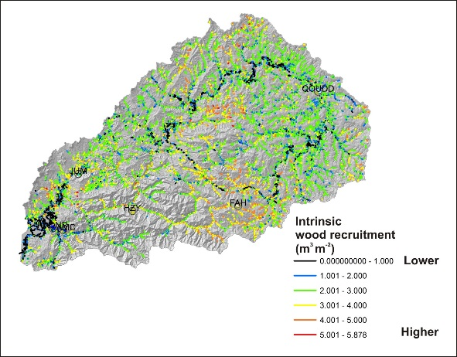
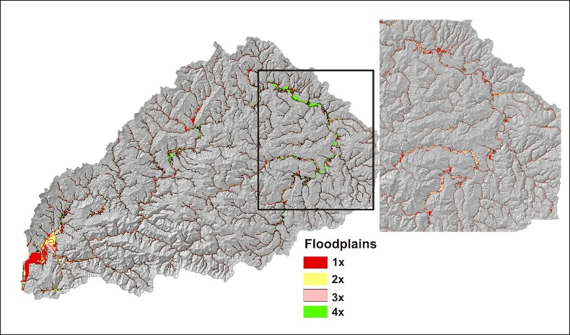
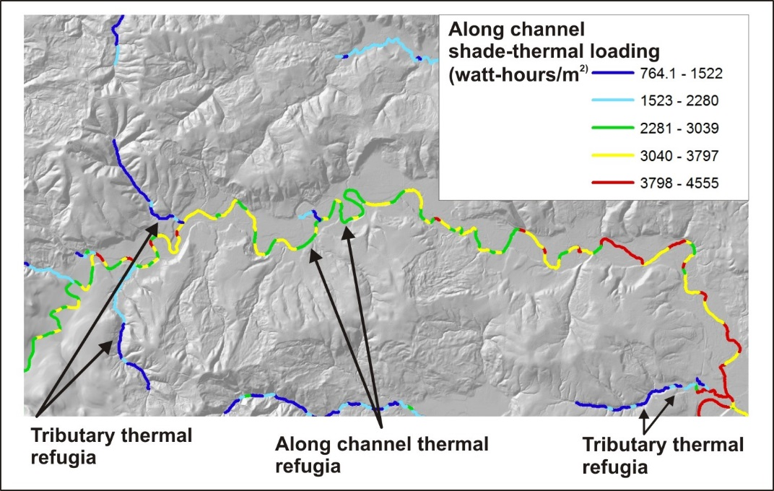
Decision Space: Spatially Explicit Maps
+
+
Coho fish habitat quality
Current wood recruitment
Floodplains
+
+
Thermal Refugia
Shade – basal area/thermal loading
Notes:
Relevant maps can be overlaid upon one another to locate hotspots in need of restoration (e.g., high value coho habitat with low shade, high thermal loading, and low to no in-stream wood recruitment). Or, one of NetMap’s tools can be used to quantitatively determine the best areas with a click of a mouse (see next slides).

Slide 22
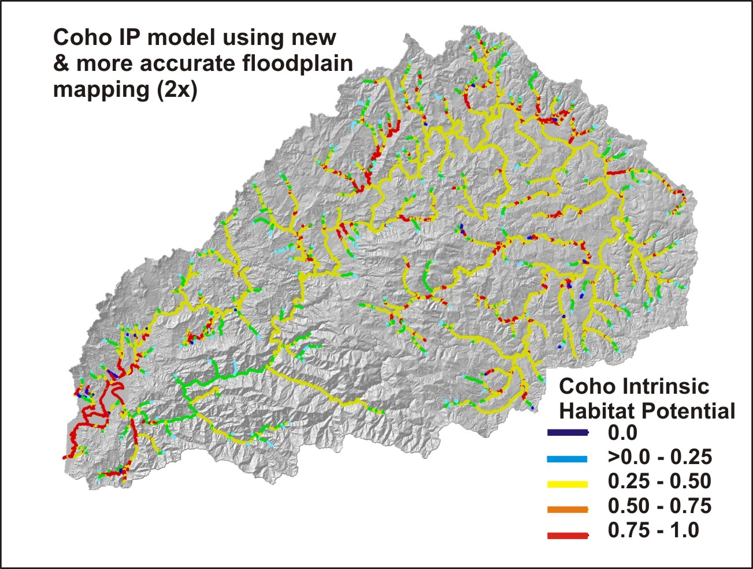
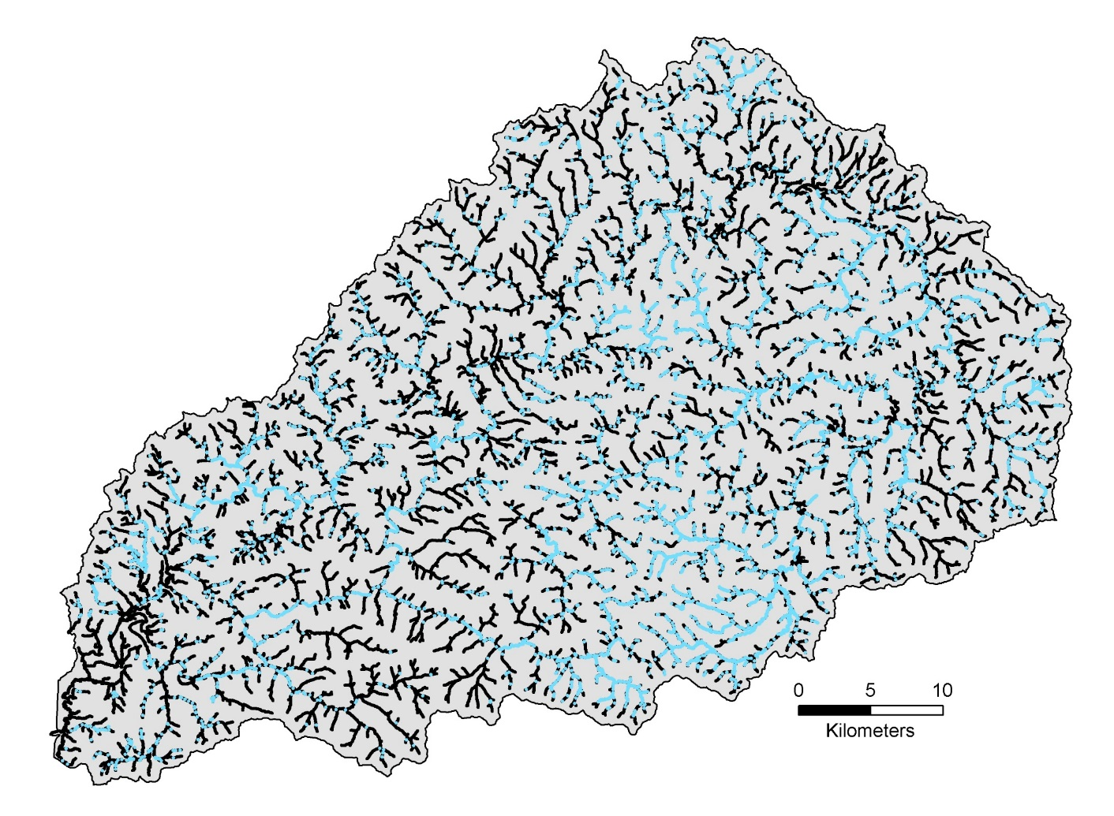
Combine coho intrinsic potential + wood recruitment (visual)
< 1 piece/yr/100m
> 1 piece/yr/100m
Where does the best coho habitat overlap with the best wood recruitment? – protect!
Where does the best coho habitat overlap with the worst wood recruitment? – restore!
Notes:
Decision Space: combine coho intrinsic potential scores with current, in-stream wood recruitment. Visually identify areas of overlap between the two. In areas of the highest IP scores and the highest wood recruitment, enhance protection. In areas of highest IP scores and lowest wood recruitment, prioritize for restoration activities (instream structures and or riparian restoration).

Slide 23
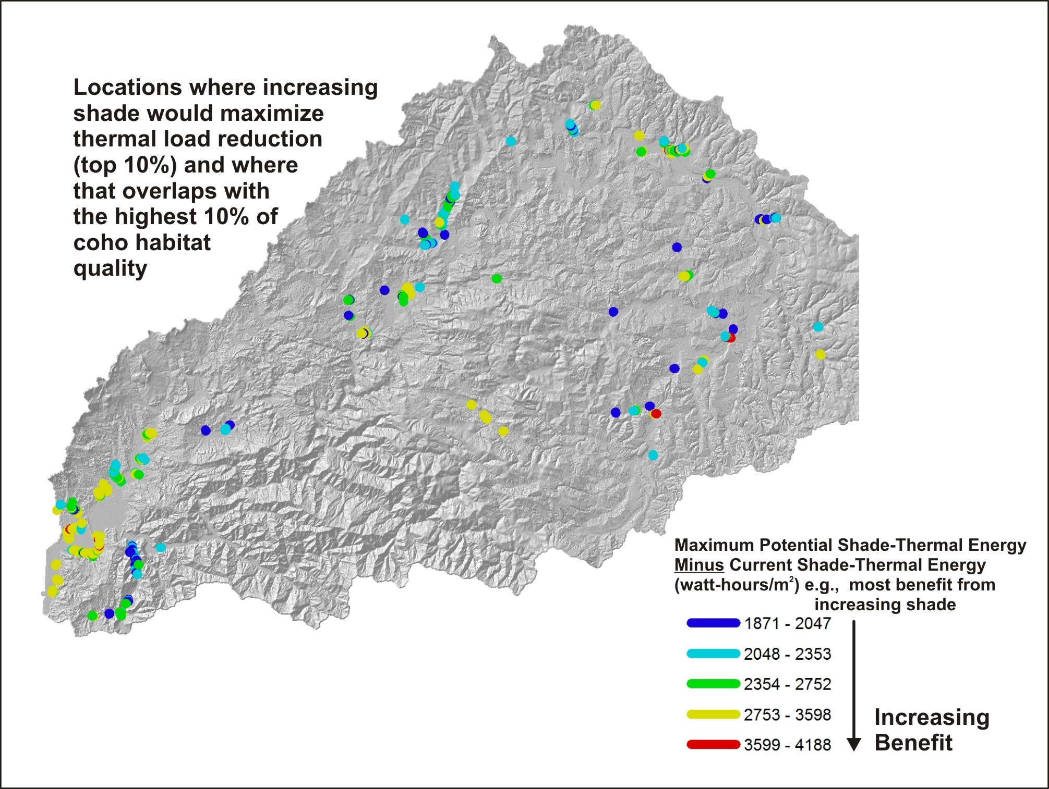
Identify strategic
locations where
increasing shade
would have the greatest
benefits
Agricultural areas
are highlighted where
high value coho
habitat overlaps with
shade and large wood
deficits – the highest
in the entire watershed
Notes:
Use NetMap’s quantitative overlap tool to quickly identify the locations where shade would have the greatest effect at reducing thermal energy to streams and where those locations overlap with the best fish habitat.

Slide 24
Notes:
Export results to Google Earth; agricultural lands are highlighted as the areas most in
need of shade and large wood (e.g., stream and riparian restoration).

Slide 25
Notes:
Small streams that have high coho habitat potential and low current shade would benefit most by shade enhancement and most of these are in agricultural areas, when compared to all other stream reaches in the watershed.

Slide 26
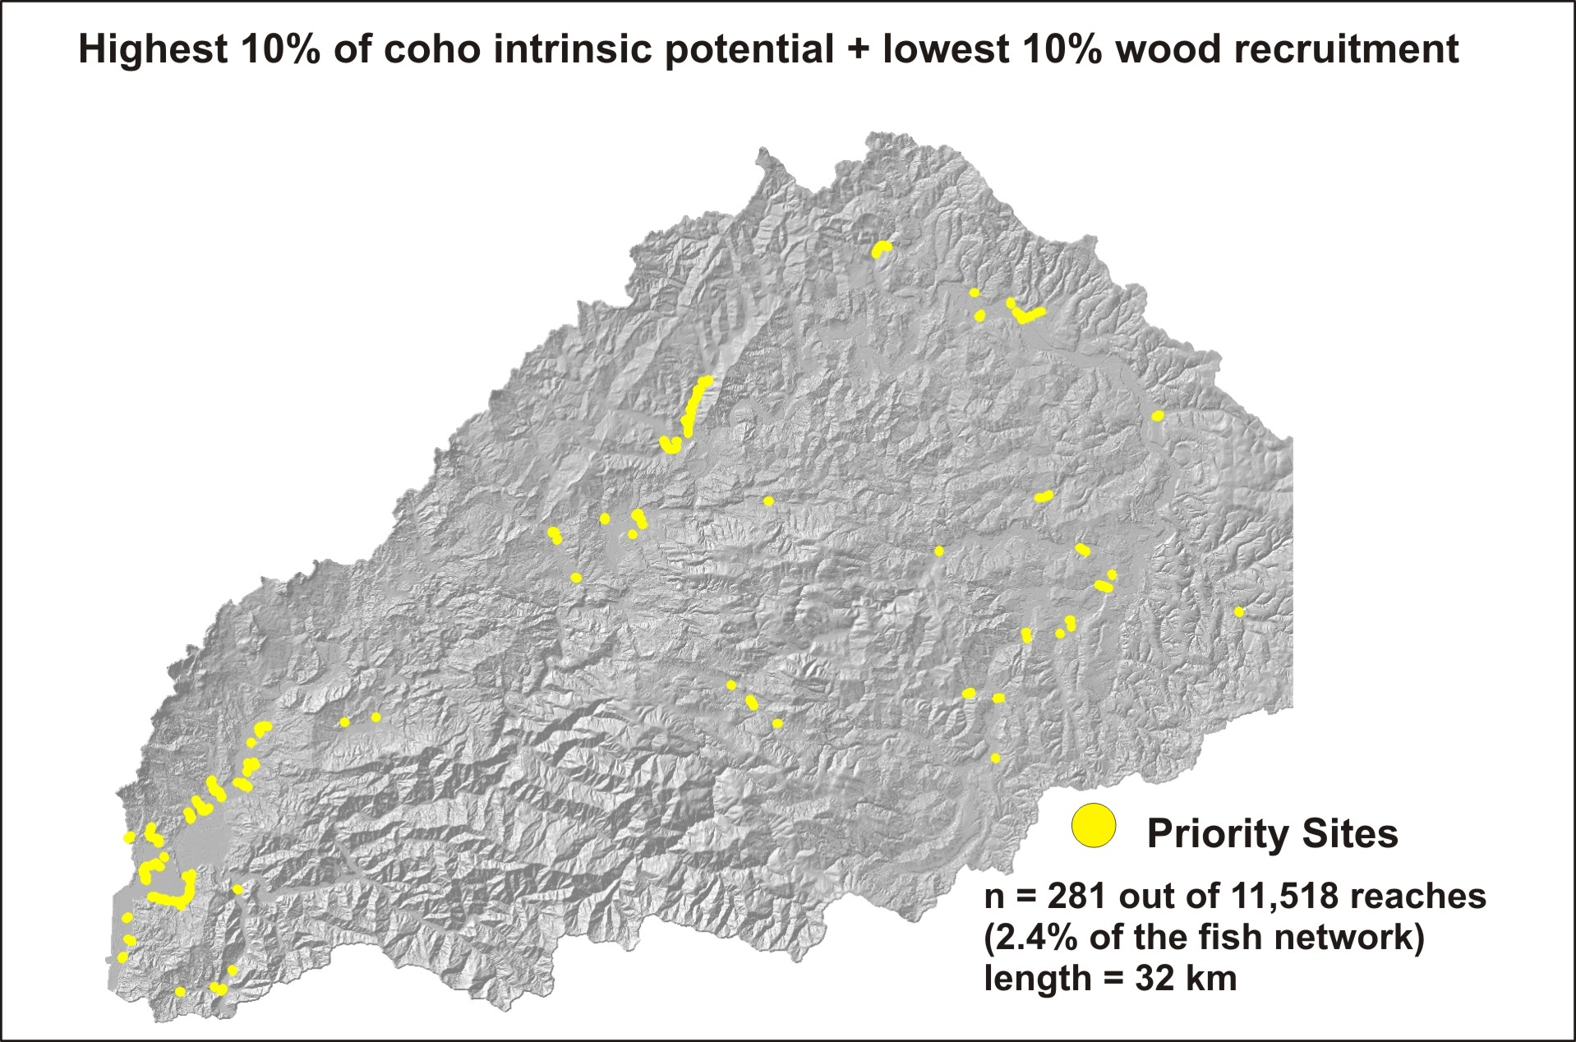
Application: Optimize Locations for Riparian Treatments or In-stream Structures
Agricultural areas
stand out
Notes:
Using NetMap’s tool, we quickly identified the locations where the highest 10% of coho habitat quality (IP) overlaps with the lowest 10% of wood recruitment. 281 sites were identified out of the total of 11,518 reaches in the virtual watershed (2.4% of the fish bearing network, with a total length of 32 km). Analysts, using the tool (previous slide), can change the threshold values (e.g., top 5%).

Slide 27
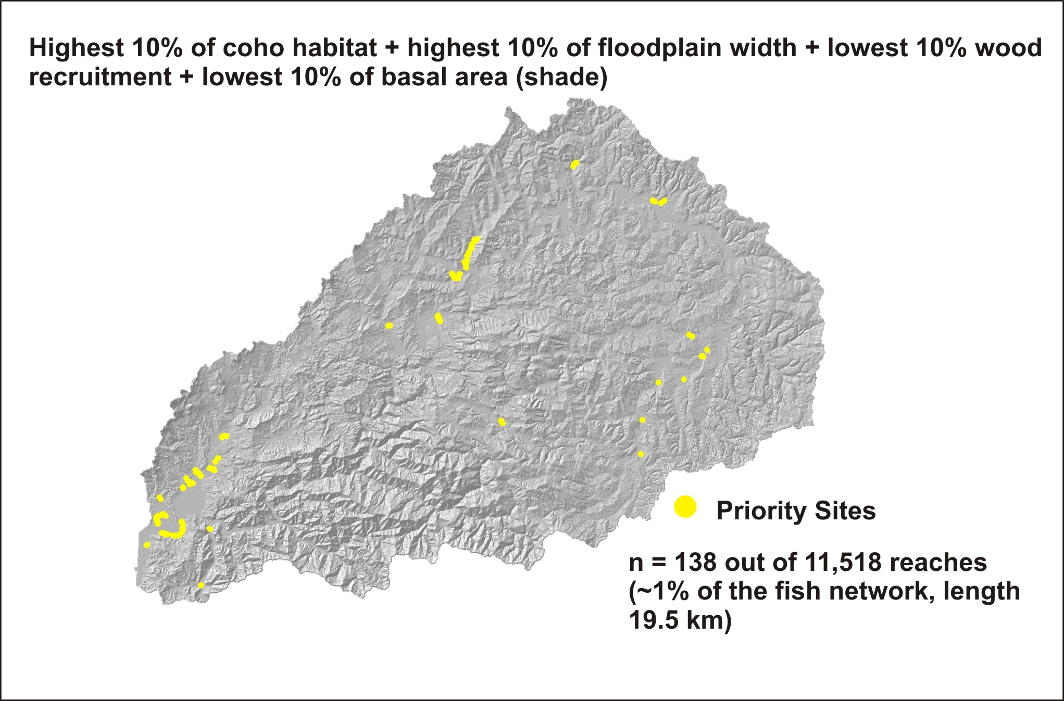
Application: Impaired habitat hotspots as restoration targets
Notes:
In NetMap, you can search for five levels of intersections or overlaps among habitat forming conditions (or lack thereof). This example shows how four factors were overlaid: highest 10% of coho habitat, highest 10% of floodplain width, lowest 10% of in-stream wood recruitment and the lowest 10% of shade, conditioned by thermal sensitivity. Only about 1% of the fish bearing network meets these criteria; use this type of information to inform restoration planning.

Slide 28
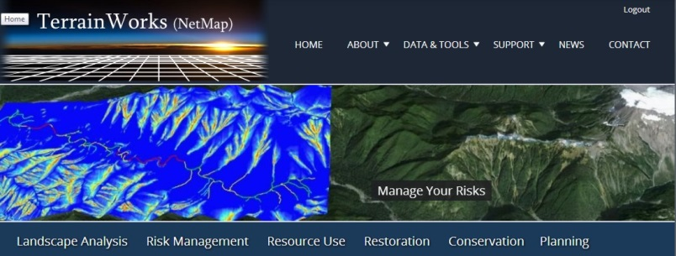
TerrainWorks designs and builds the most advanced watershed and landscape analysis system
in the world. Learn more about NetMap virtual watersheds, watershed analysis tools,
online technical help and tools at: www.terrainworks.com. Contact us with questions,
we are here to help.

