Slide 1
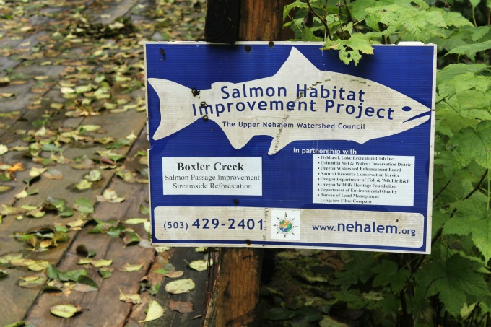
Watershed Restoration: Optimizing Site Selection
(Nehalem Prototype)
Prepared for:
NOAA, ODFW & Nehalem Watershed Council)
by:
TerrainWorks (NetMap)/www.terrainworks.com
February 2014
Notes:
The National Oceanographic and Atmospheric Administration (NOAA) along with Oregon Department of Fish and Wildlife (ODFW) and Watershed Councils, commissioned a pilot project in the Nehalem River watershed in northwestern Oregon to evaluate how the watershed analysis system, NetMap, could be used to support restoration planning, focusing on aquatic, riparian and road related issues pertaining to coho salmon. In part, the NetMap pilot project will be used to support the proposed NOAA coho delisting strategy for the Oregon Coast Range.
This powerpoint allows one to take a self guided tour of the analysis results. To see the movie of the full presentation, go to: https://vimeo.com/119868365

Slide 2
Table of Contents
xxxx, slides x - x

Slide 3
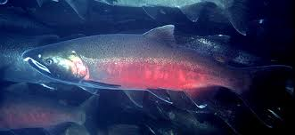
Objective:
Being Strategic and Effective with Limited Stream and Watershed Restoration Funds
Optimizing Restoration Outcomes
Notes:
The objective of using NetMap is to increase effectiveness in restoration given limited stream and watershed restoration funds, and for optimizing restoration outcomes.

Slide 4
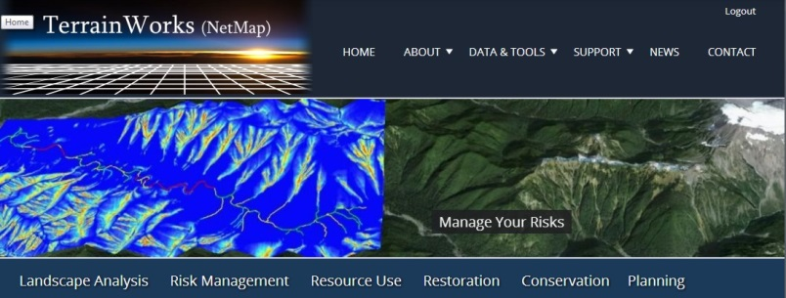
NetMap?
ArcMap
-standard GIS capabilities
-NHD stream layer
-or ArcHydro
-other data layers
ArcMap with NetMap
-virtual watershed (synthetic stream layer, landforms, everything connected)
-fish habitat mapping
-floodplains/terraces/fans (riparian areas
-instream wood recruitment
-landslides
-debris flows
-sediment delivery
-gravel supply
-thermal load/shade
-road analyses
road density (basin, reach scale)
road drainage diversion
road surface erosion/sed delivery
road stability
roads in floodplains
habitat length & quality above all crossings
-other resource management &
conservation capabilities
www.terrainworks.com
Notes:
What is the difference between standard ArcMap and the NetMap add-in in ArcMap? To learn more about NetMap, see: www.terrainworks.com

Slide 5
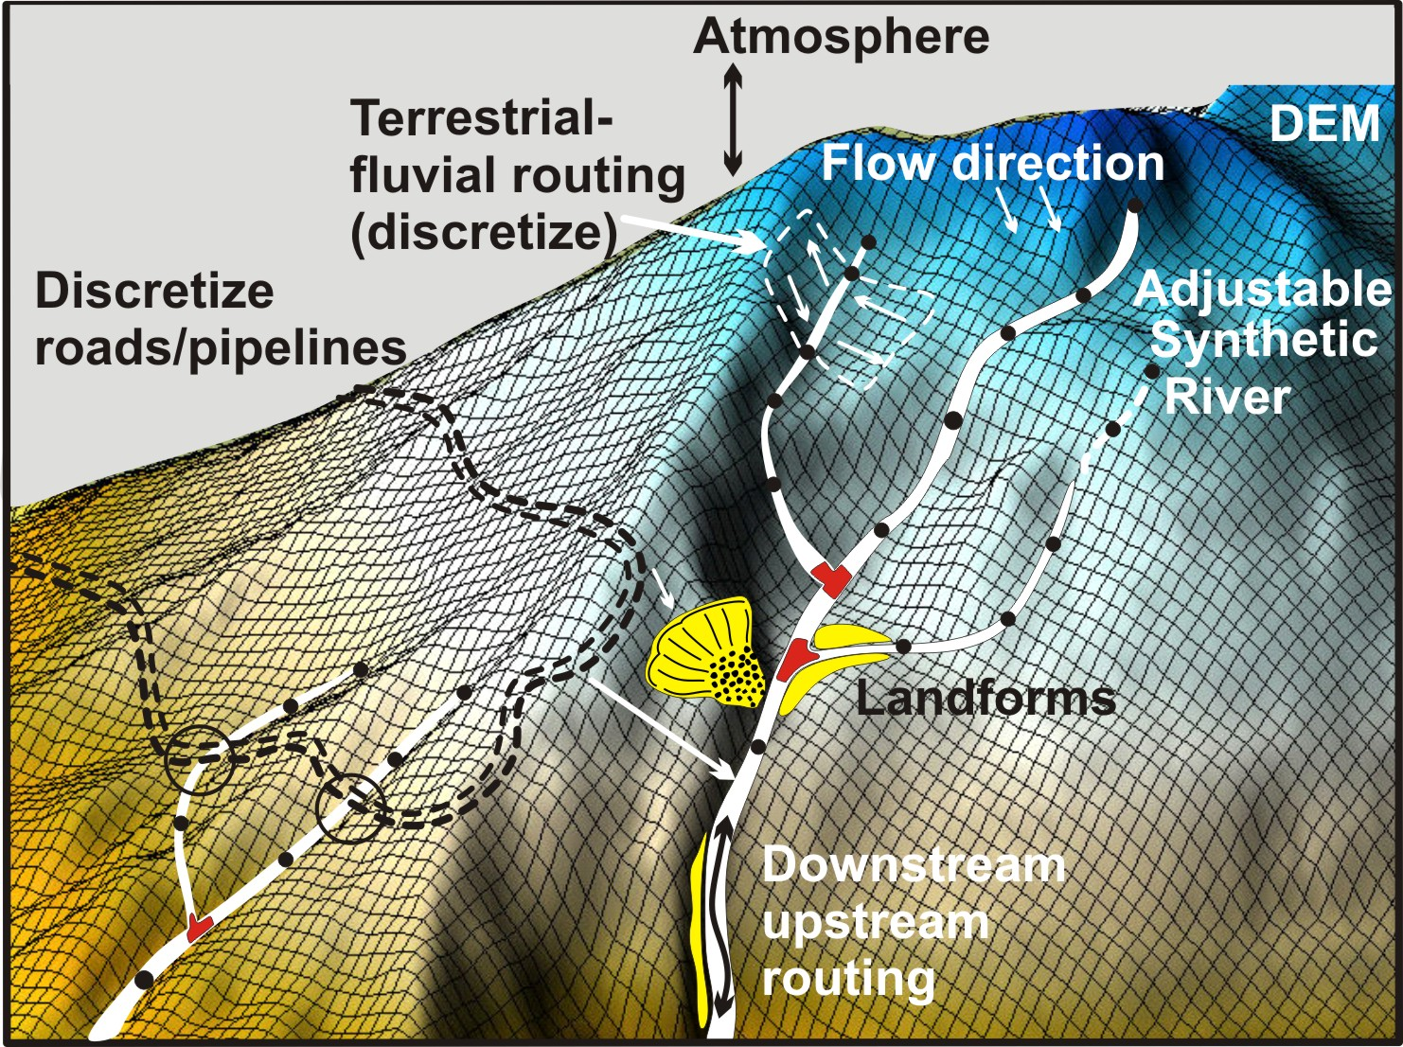
A virtual watershed uses the highest resolution DEMs, includes a routed & attributed synthetic
stream layer where stream and rivers are connected to terrestrial environments and land uses
Notes:
NetMap uses a “virtual watershed” in the watershed restoration analysis. To learn more about virtual watersheds, go here: http://www.terrainworks.com/digital-hydroscape-virtual-watershed

Slide 6
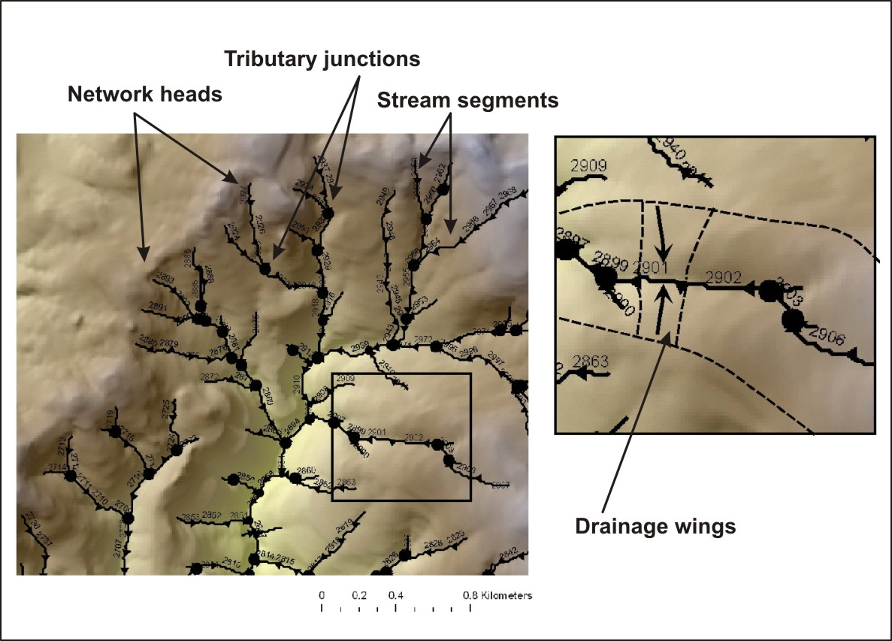
Topographic-channel data structure
-adjustable (remove, add streams,
custom segments)
Notes:
The data structure of the virtual watershed includes a synthetic river network (derived from DEMs and the NHD) and drainage wings, local contributing areas located on both sides of 100 m channel segments.

Slide 7
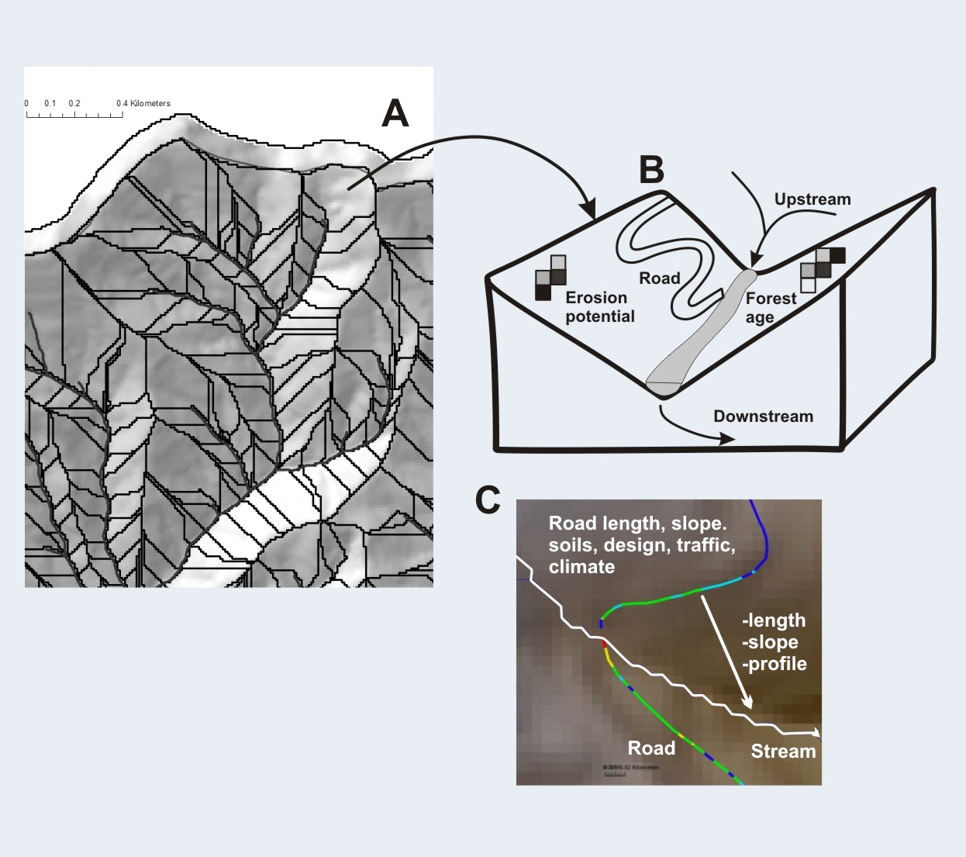
Drainage wings (discretize landscapes and land uses)
Notes:
The drainage wings discretize the watershed terrestrial environment into small areas (approx. 0.1 km² in area) and all information on hillsides is then summarized to channels. This supports analysis of aquatic habitat-terrestrial stressor intersections.

Slide 8
Stream layer and landscape attribution
Channel Attributes | Landforms and Process Characterizations
Gradient Elevation Distance to outlet Drainage area Mean annual flow Stream order Channel width and depth Bed substrate Channel sinuosity Channel classification Fish habitats Radiation loading Mean annual precipitation | Floodplains Terraces Alluvial fans Hillslope-gradient and convergence (mass wasting) Tributary confluences Erosion potential Hillslope–slope profile (surface erosion) Valley width and transitions Debris flows Earthflows
Notes:
The channel network is attributed with information useful for restoration planning. Landform and process characterization is another benchmark attribute of NetMap’s virtual watersheds.

Slide 9
NetMap: A collaborative enterprise since 2007
-National Forests (WA, OR, NCA, AK, ID, MT)
-Forest Service Research: PNW; PSW, RMRS
-USFWS
-NOAA
-BLM
-EPA
-Oregon Dept of Forestry
-OR/WA Fish and Wildlife
-NGOs (TNC, Ecotrust, Wild Salmon Center)
-Watershed Councils
-Universities
-Private
-International
Notes:
NetMap is a collaborative enterprise since 2007 and is designed to provide decision support in resource management, restoration and conservation across numerous agencies and NGOs.

Slide 10
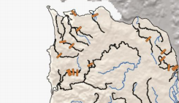
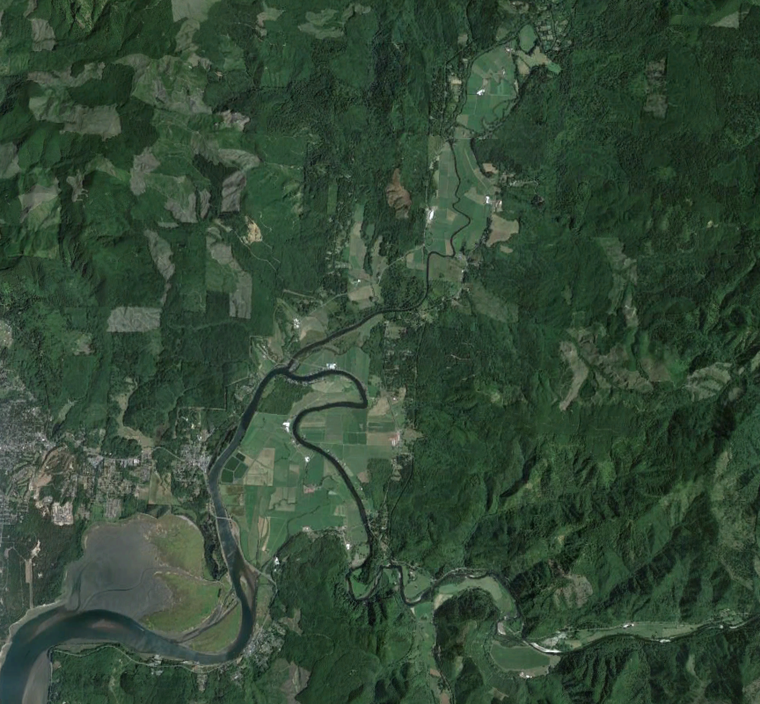
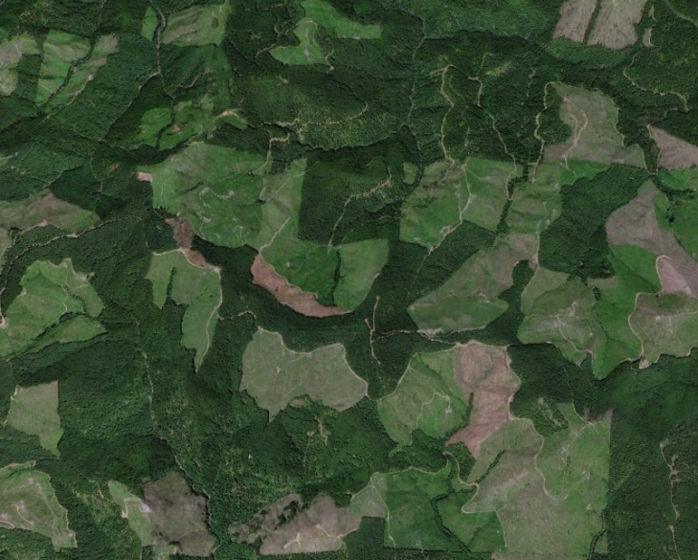
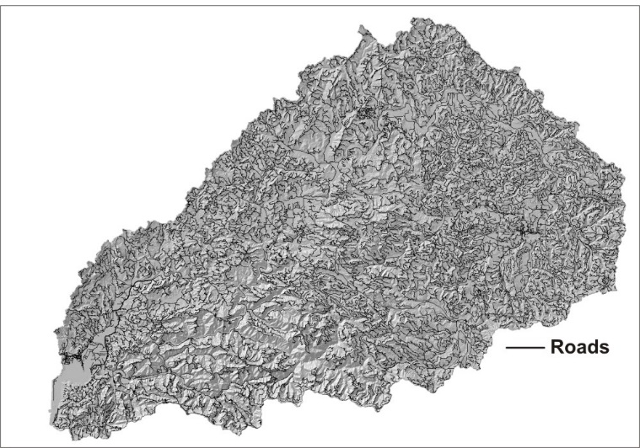
Nehalem Watershed Restoration Analysis - Potential Impacts
Historical splash dams
and log drives
Agriculture
Logging and road building/sediment
Roads, drainage, blockages, erosion
Notes:
Historical land uses have impacted fish habitats in the Nehalem basin.

Slide 11
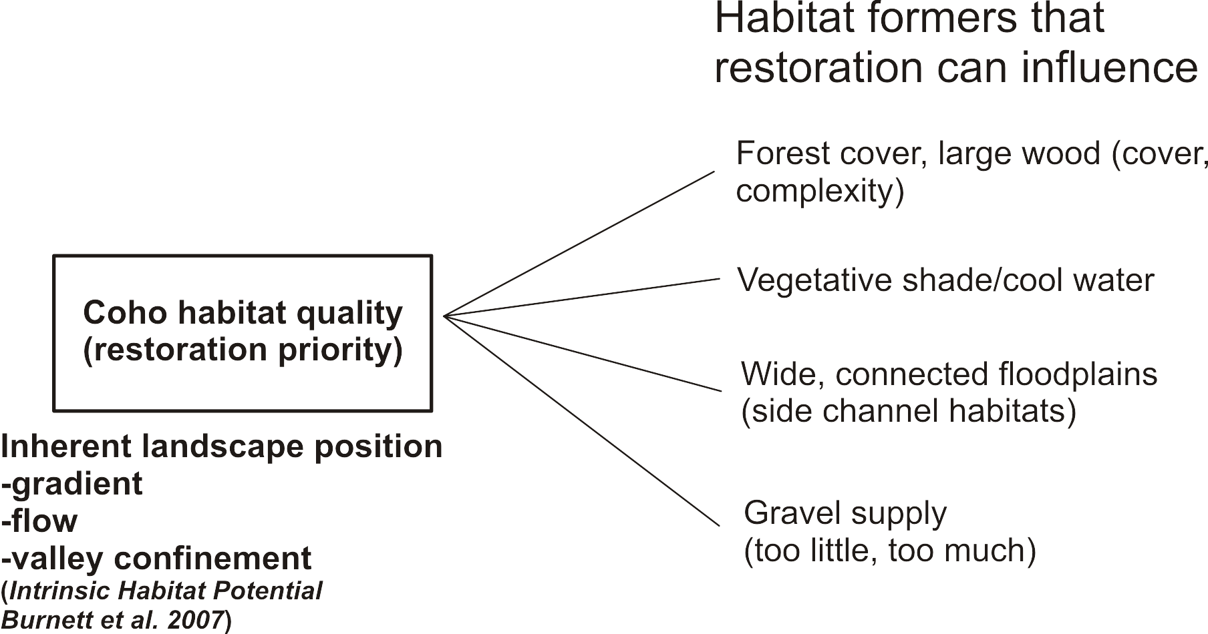
Approach
Notes:
The general technical approach is to evaluate fish habitat potential using information on inherent landscape properties, a modeling attribute referred to as habitat intrinsic potential (IP). Other habitat forming processes can be evaluated to inform restoration planning.

Slide 12
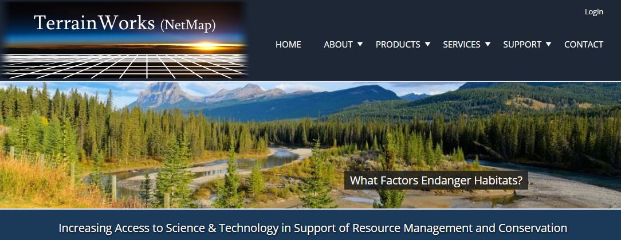
Project elements:
Using NetMap create prototype Watershed Restoration Analysis methodology
Create prototype work flow
Create new NetMap LiDAR based watershed datasets
Demonstrate the approach in the Nehalem watershed
Potential to extend to other areas (ESUs)
Notes:
Project elements.

Slide 13
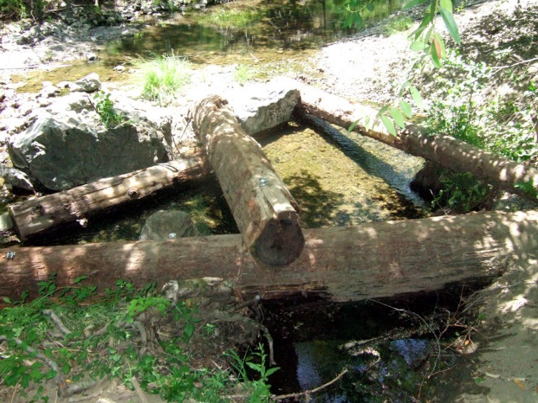
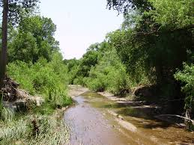
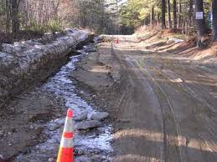
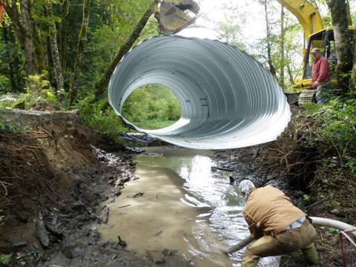
Restoration targets:
In-stream
Riparian
Roads
Notes:
Restoration targets in the Nehalem Watershed

Slide 14
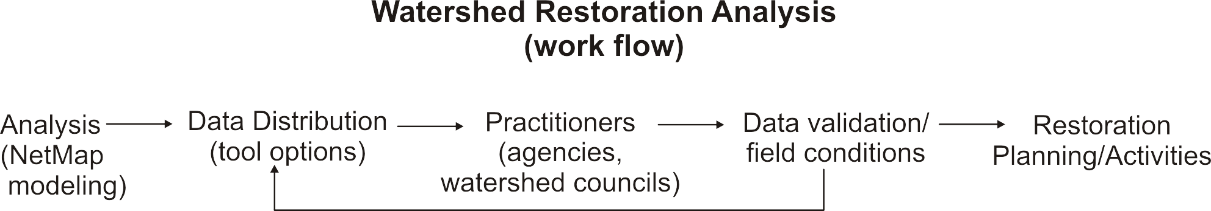
Iterative
Notes:
The analysis, data distribution, data validation and restoration planning workflow. During this presentation, we will concentrate on the first step in the workflow.
Map at right shows the coho watersheds in the Oregon Coast Range landscape.

Slide 15
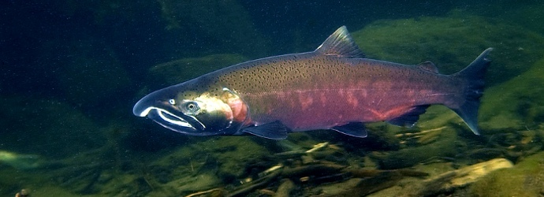
Target: Coho habitats and associated riparian areas
Notes:
First restoration target: coho in-stream and riparian environments.

Slide 16
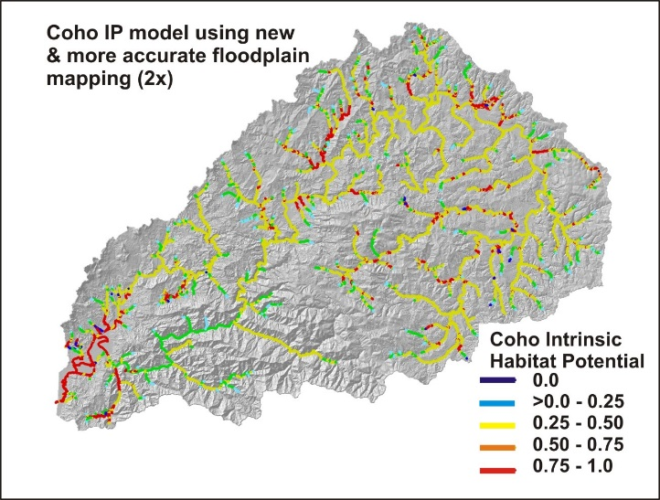
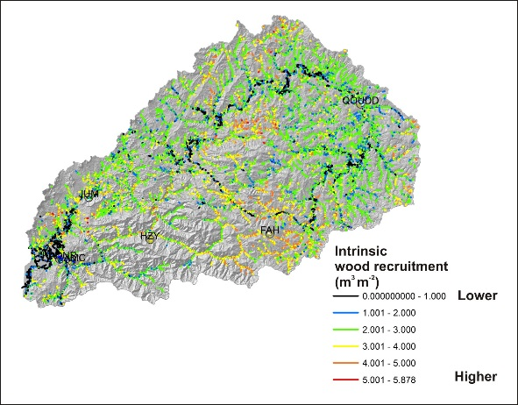
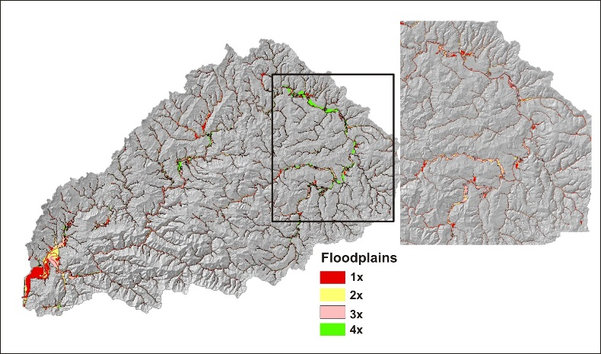
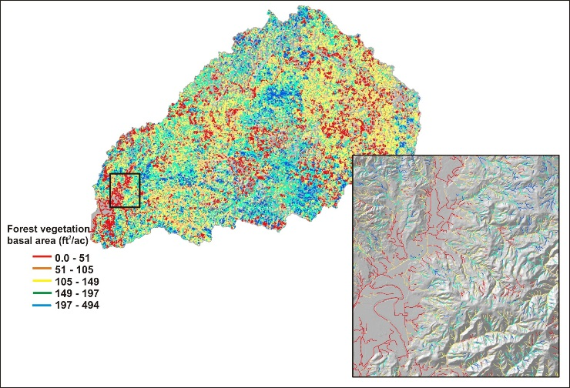
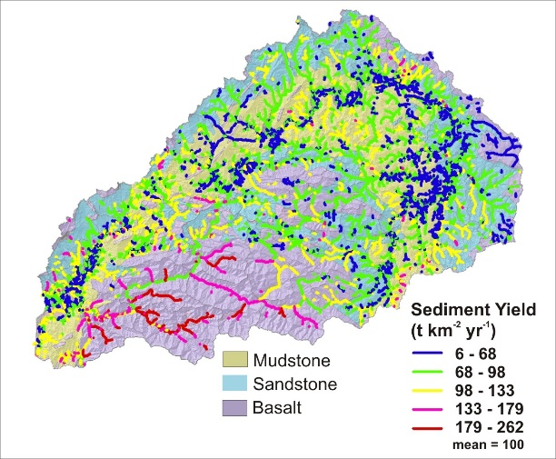
Decision Space: Spatially Explicit Maps
+
+
Coho fish habitat quality
Current wood recruitment
Floodplains
+
+
Gravel supply
Shade – basal area/thermal loading
Notes:
Decision Support Space 1: Spatially explicit maps of key watershed landforms and processes. In combination, including with other attributes, they can inform restoration planning. For example, where is the best potential coho habitat located and where does it overlap other important habitat forming processes such as wood recruitment, shade and gravel supply.

Slide 17
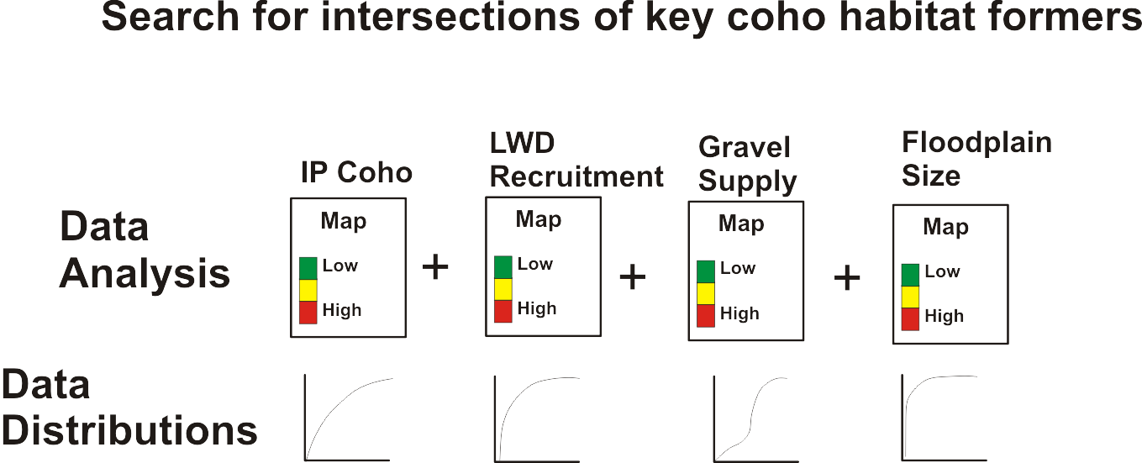
Decision Space: Automated Searches for Optimized Habitat Conditions
Notes:
Decision Support Space 2: Using data frequency distributions to identify attribute thresholds; see next slide.

Slide 18
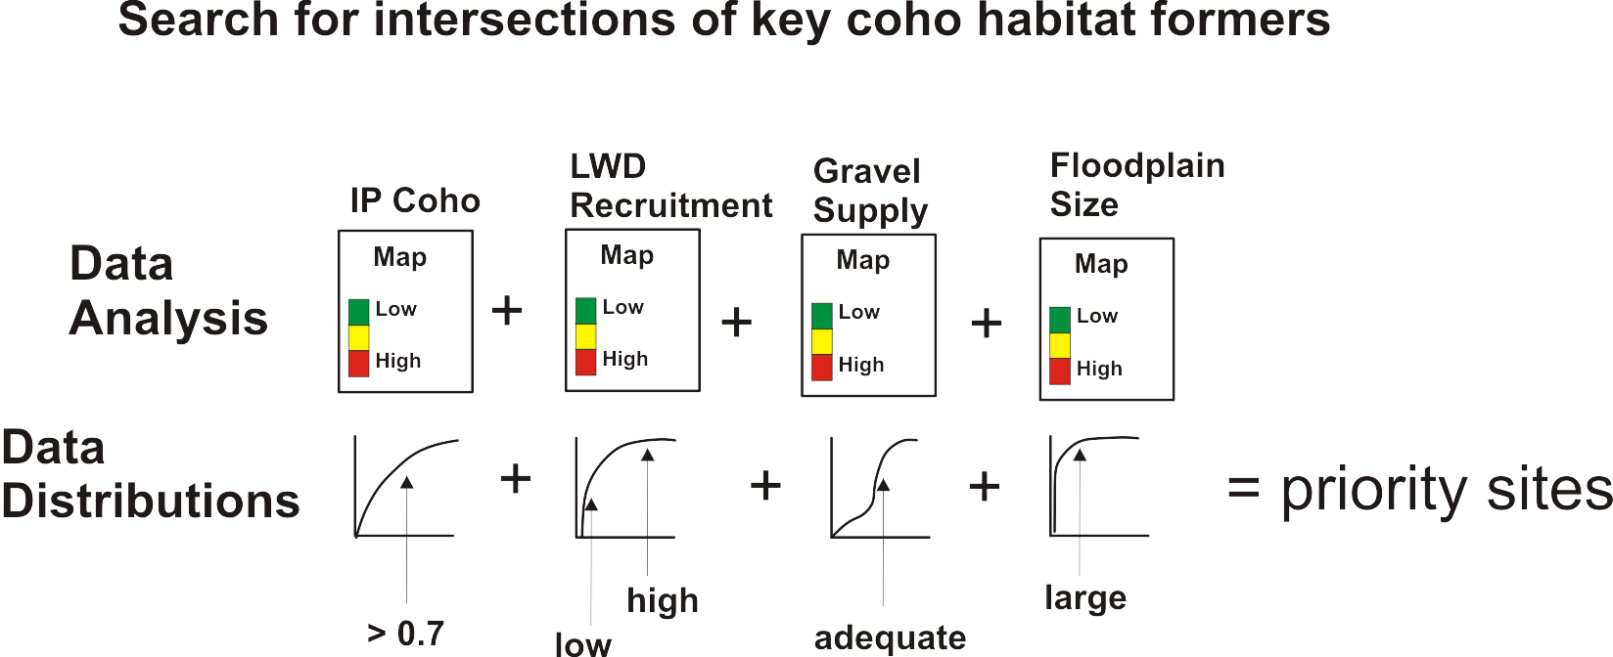
Decision Space: Automated Searches for Optimized Habitat Conditions
Notes:
Decision Support Space 2: Analysts select thresholds such as > 0.7 coho IP to identify locations where those habitat patches overlay with high to low wood recruitment and floodplain size; see examples later in the presentation.

Slide 19
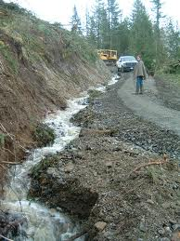
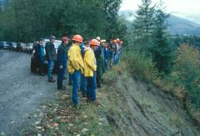
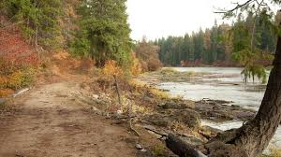
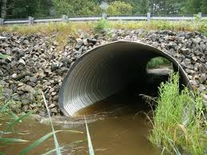

Road Restoration
Roads drainage diversion
Roads erosion/
sediment delivery
Road failure
Roads in
floodplains
Habitat length
above crossings
Notes:
Road restoration can encompass numerous aspects, all of which are included in NetMap’s analysis of the Nehalem watershed.

Slide 20
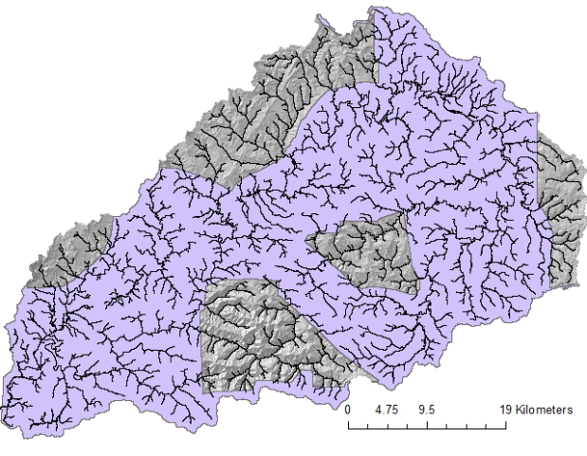
Building the Virtual Watershed: Available Data
2.5 m LiDAR and 10 m digital elevation models (DEMs)
Tasks:
LiDAR hydro-conditioned DEM
Channel head calibration – where do channels begin?
Synthetic stream derivation (21,400 individual segments, average 100 m length)
Network line check: remove flow diversions by roads
Attribution
Routed (downstream/upstream)
LiDAR coverage in purple
Notes:
Available data to build a virtual watershed include 10 m and 2.5 m LiDAR digital elevation models (DEM). Tasks involved are listed.

Slide 21
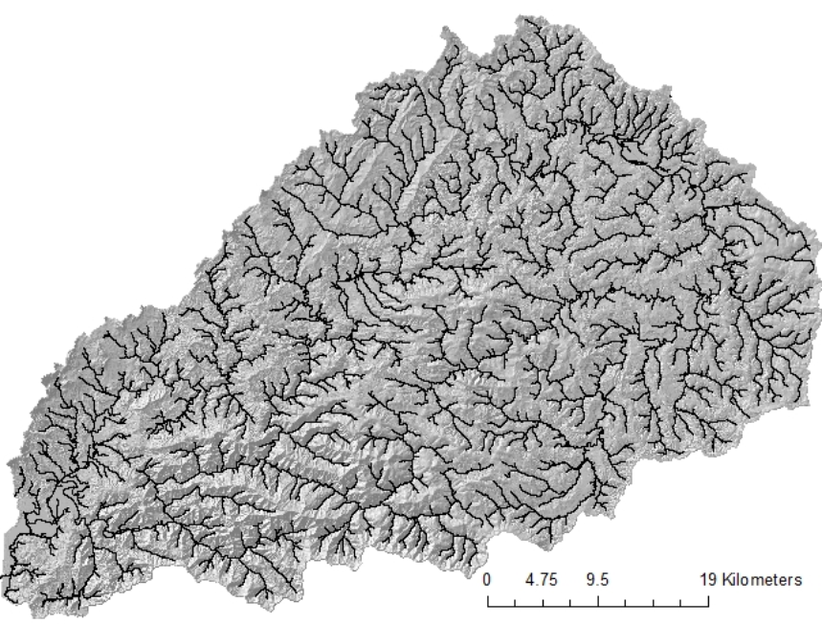
Synthetic river network
Channel-initiation threshold calibrated to DEM.
Four criteria:
Specific contributing area * slope squared (AS²); measure of erosive potential.
Plan curvature; measure of topographic (flow) convergence.
Minimum flow length over which above two threshold musts be met.
Gradient.
Nehalem
synthetic
river
High
Low
Notes:
NetMap’s synthetic river network is based on a comprehensive analysis of channel forming processes.

Slide 22
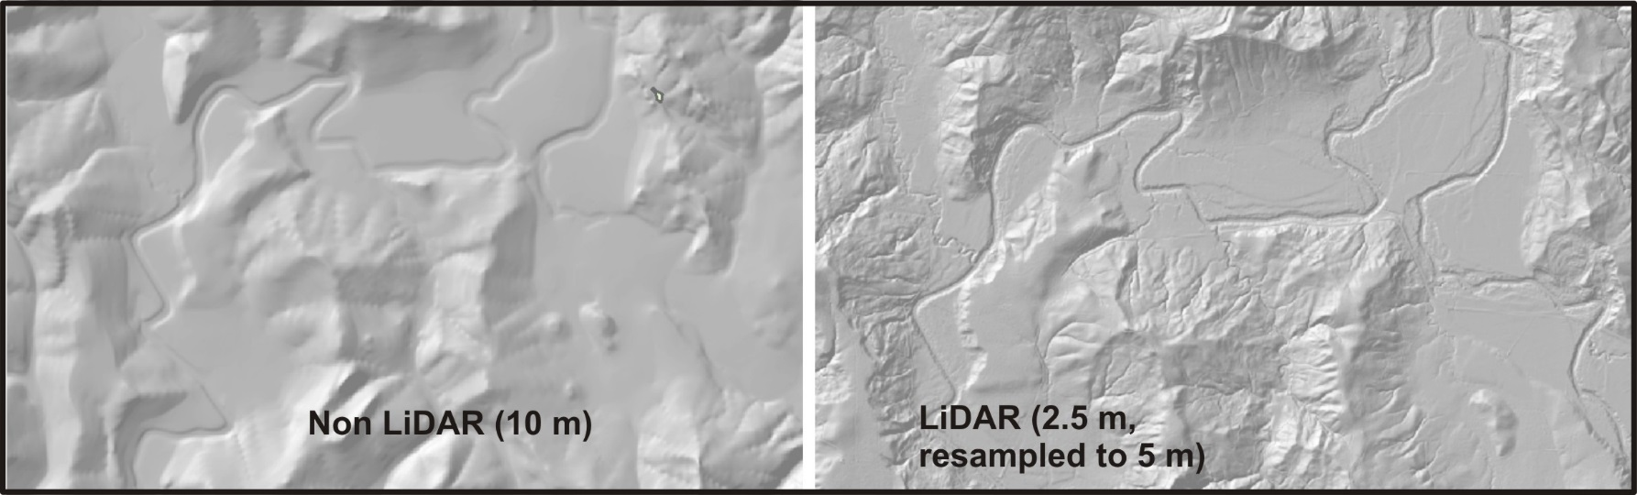
Floodplains and terraces
resolved
Tributaries resolved
Hillslope erosion
features resolved
LiDAR = 4 x higher resolution
16 x more data!
Notes:
LiDAR or mixed LiDAR-10 m DEMs can resolve numerous details in our virtual watershed.

Slide 23
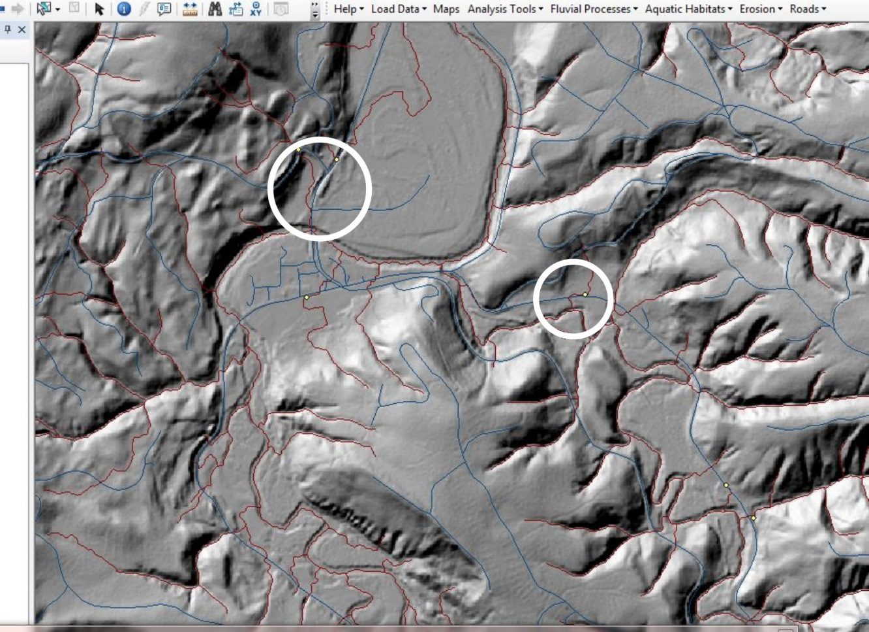
Roads in LiDAR DEMs
are often seen as
topographic features
and cause drainage
diversions that need to
be corrected
Notes:
Roads are seen as topographic features in LiDAR and the resulting drainage diversions need to be addressed when building the synthetic river network

Slide 24
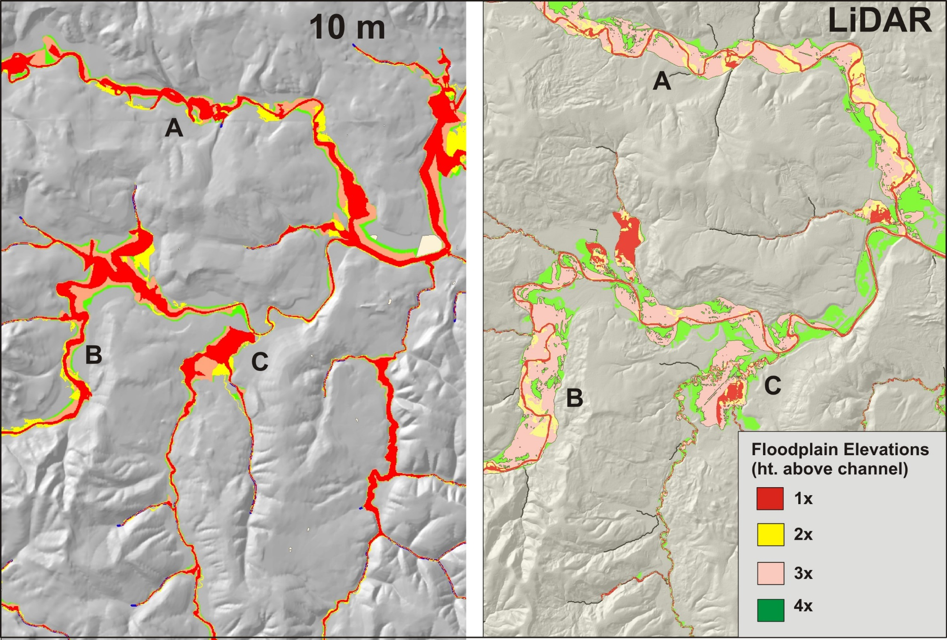
Notes:
NetMap’s floodplain mapping tool works with either 10 m or with LiDAR, although the LiDAR based floodplain maps provide considerably more detail (right panel).

Slide 25
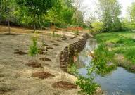
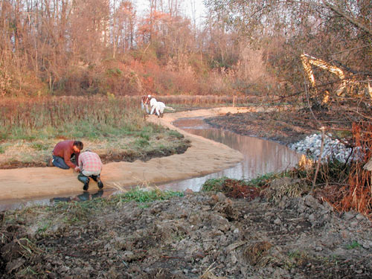
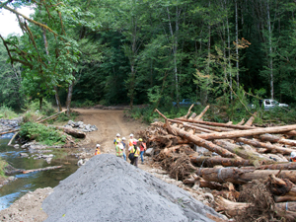
Stream/Riparian Restoration
Notes:
This section of the powerpoint presentation will cover the NetMap analysis pertaining to stream and riparian restoration; analysis of road restoration opportunities will come later.

Slide 26
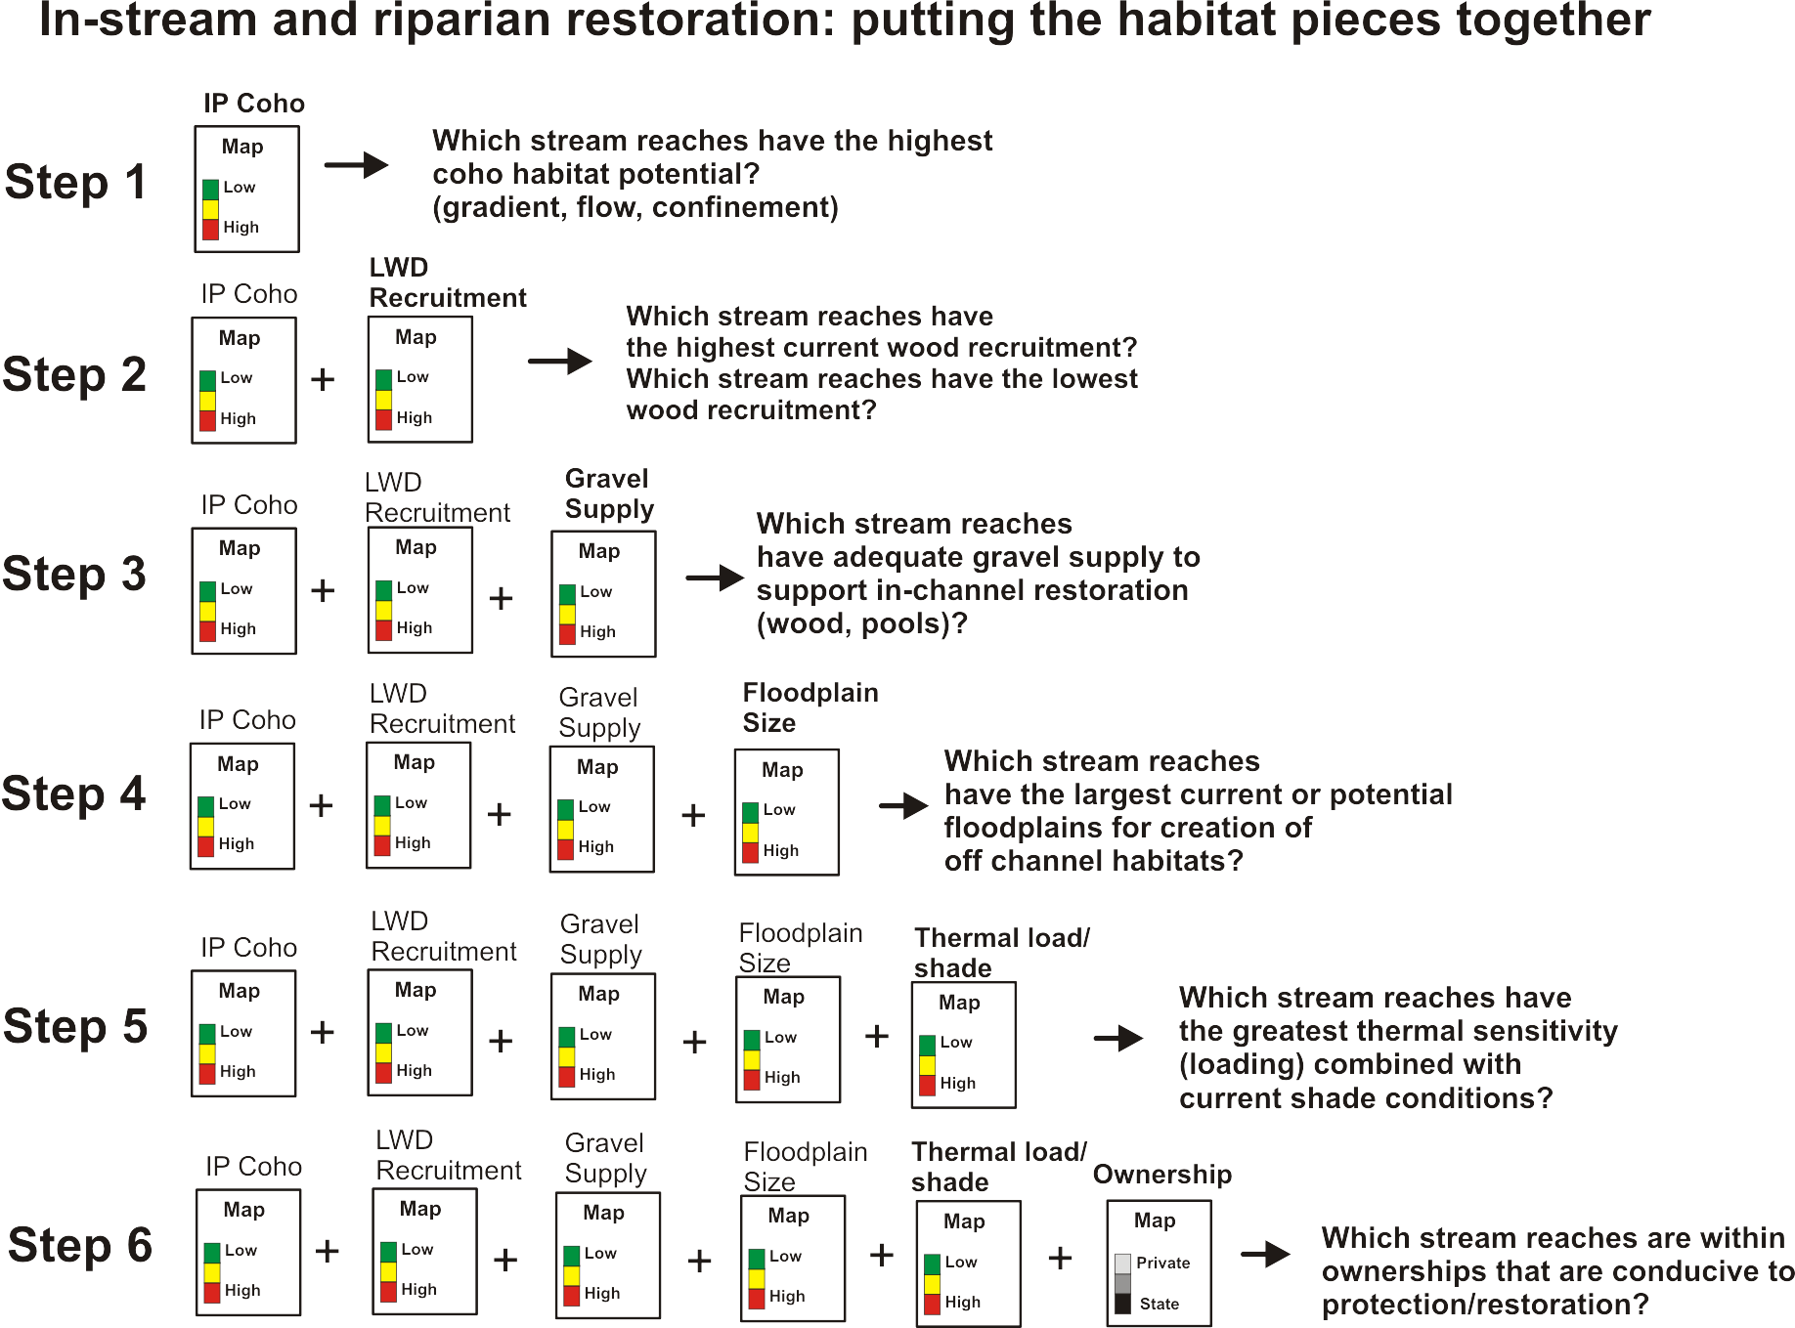
Notes:
The approach to the NetMap Watershed Restoration Analysis is to combine spatial information from five data sources (others could be added, including for roads, see later). Data sources include: 1) landscape position described by intrinsic habitat potential models, 2) in-stream wood recruitment, 3) gravel supply, 4) floodplain size, and 5) shade, conditioned by stream thermal sensitivity. Other factors could be added including tributary confluences (e.g., thermal refugia), erosion potential and land ownership.

Slide 27
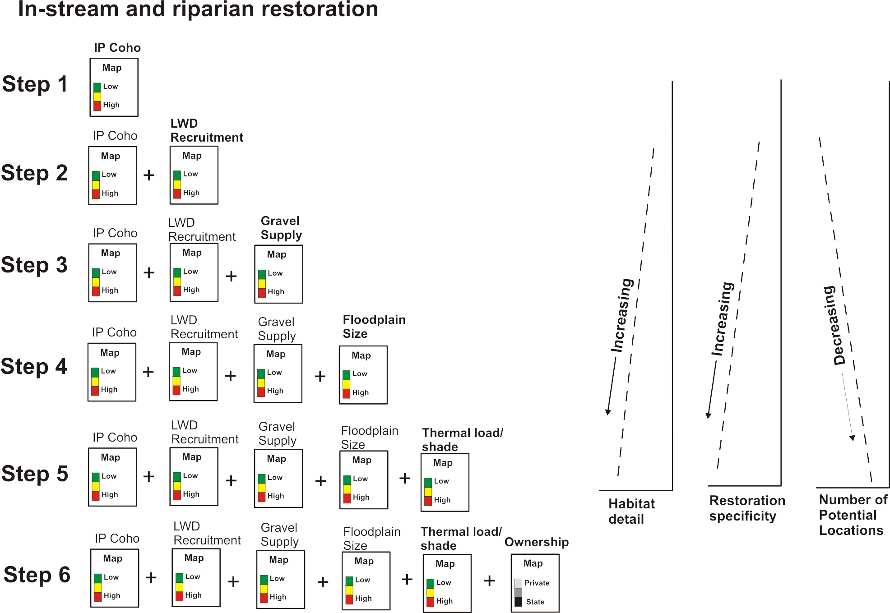
Notes:
Combining all of these habitat forming factors, with the objective of optimizing restoration, leads to several outcomes including 1: habitat detail increases, 2) restoration site specificity increases, and 3) the potential number of restoration sites decreases. In other words, the number of locations in a watersheds where all the factors are optimized is reduced.

Slide 28
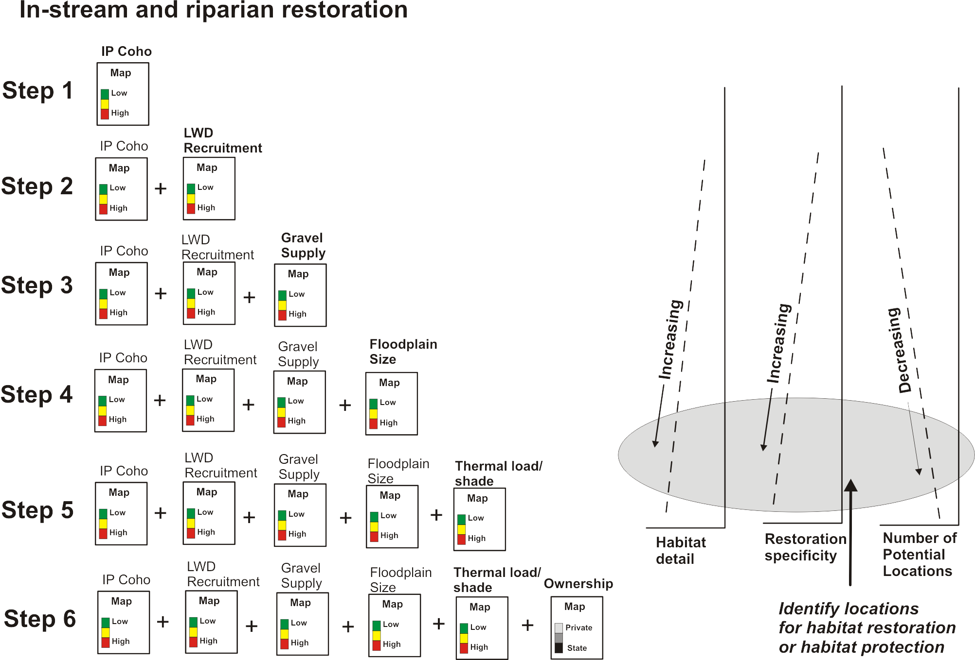
Notes:
Thus, restoration activities in the Nehalem watershed should focus on the domains (shaded area in slide) of increasing habitat information or detail, increasing site specificity for restoration (e.g., combining intrinsic landscape position, wood recruitment, floodplain size, and shade-thermal loading etc.). This will result in a smaller number of restoration hotspots.

Slide 29
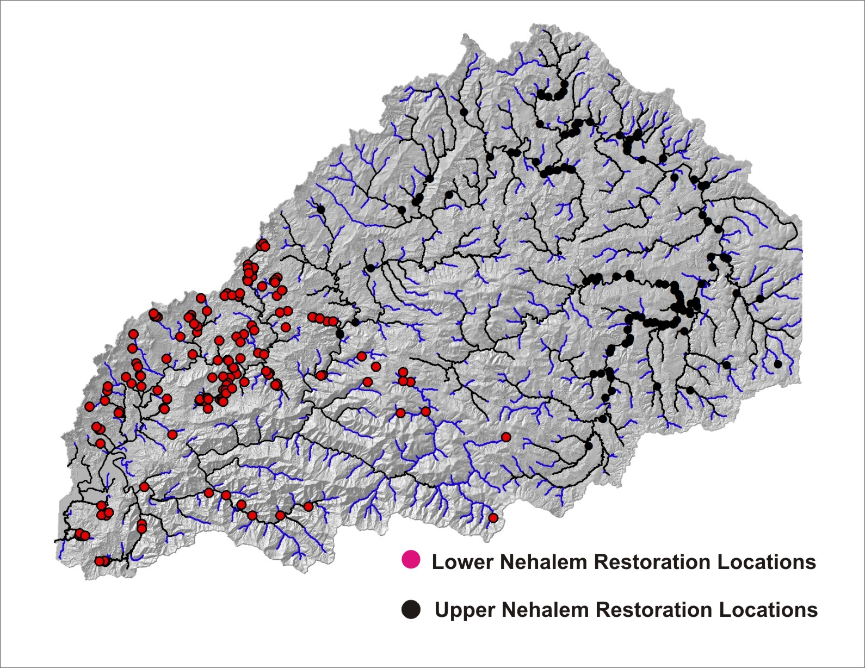
How do the sites compare to
predicted hotspots for coho
habitat?
Notes:
As part of the Nehalem analysis, we will compare the locations of existing restoration projects, primarily those related to in-stream and riparian areas, to predicted and mapped environmental characteristics related to fish habitat quality, floodplains, large wood recruitment and shade. In other words, are existing restoration projects located in areas that would optimize fish habitat restoration? See for yourself as we move on with the presentation.

Slide 30
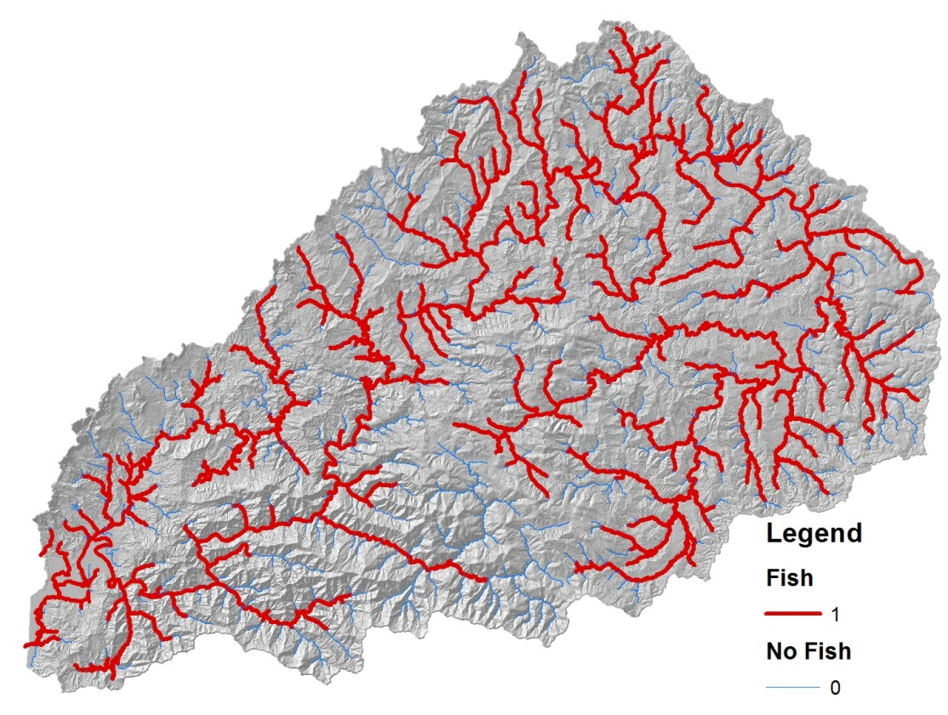
ODFW Coho
Fish Distribution
Notes:
First off, to map coho fish habitat quality we will use the distribution of coho salmon in the Nehalem watershed available from the Oregon Department of Fish and Wildlife, shown by the red network.

Slide 31
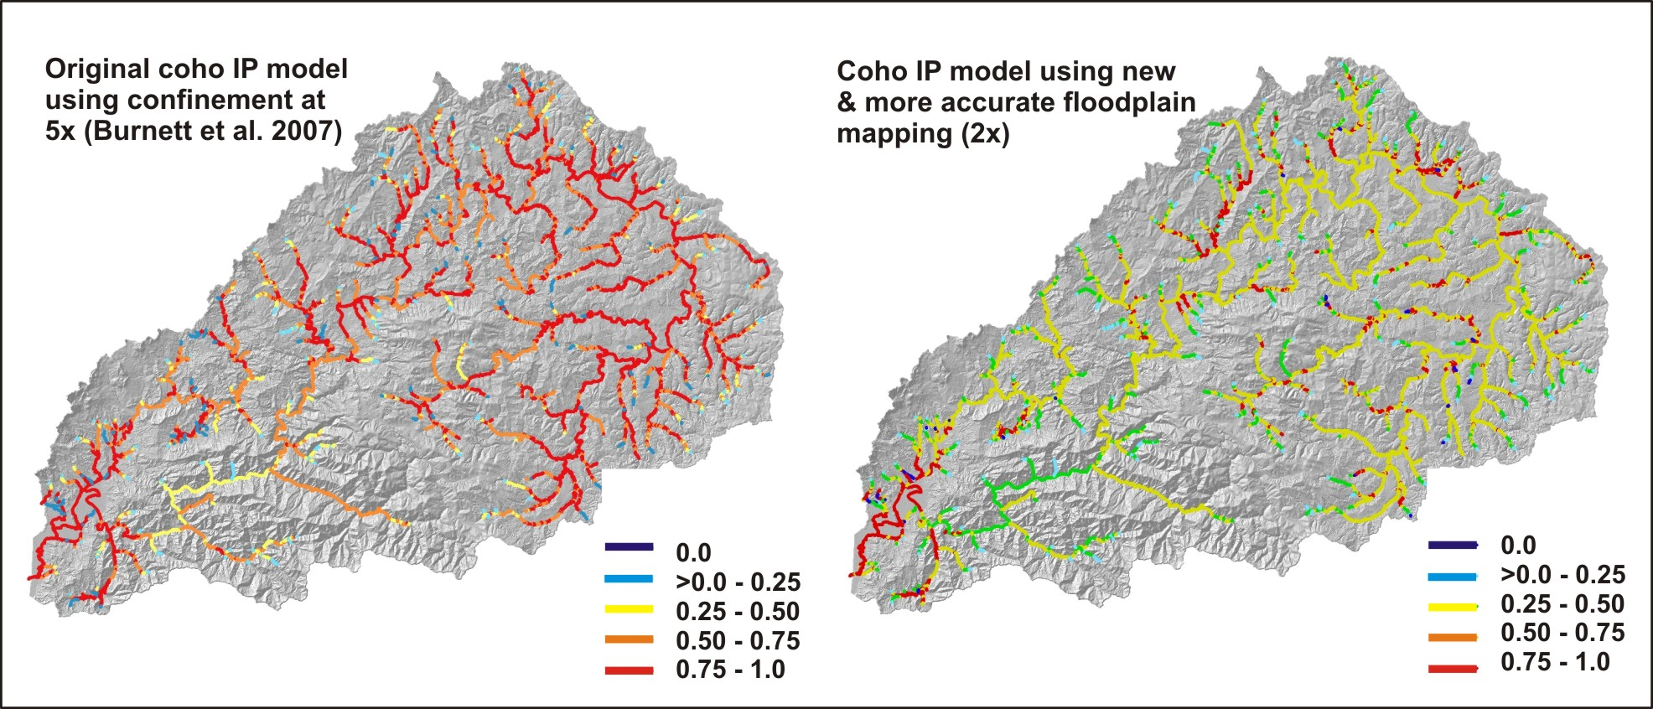
Coho Intrinsic Potential (e.g., intrinsic landscape position)
-gradient, confinement; mean annual flow; (Burnett et al. 2007)
Notes:
The first step is to map fish habitat according to intrinsic landscape position, known as “intrinsic habitat potential” or “IP”. The original coho IP model was developed more than a decade ago, including in the Oregon Coast Range, and was based on lower resolution DEMs and a limited ability to accurately map floodplains (left panel above). We now have the ability to more accurately map floodplain width and hence channel confinement, and this in combination with higher resolution DEMs, including LiDAR, allow for a much more accurate depiction of intrinsic habitat mapping (right panel above). Learn more about this issue here: http://www.terrainworks.com/intrinsic-potential-ip-fish-habitat-modeling-read. See next slide for additional information.

Slide 32
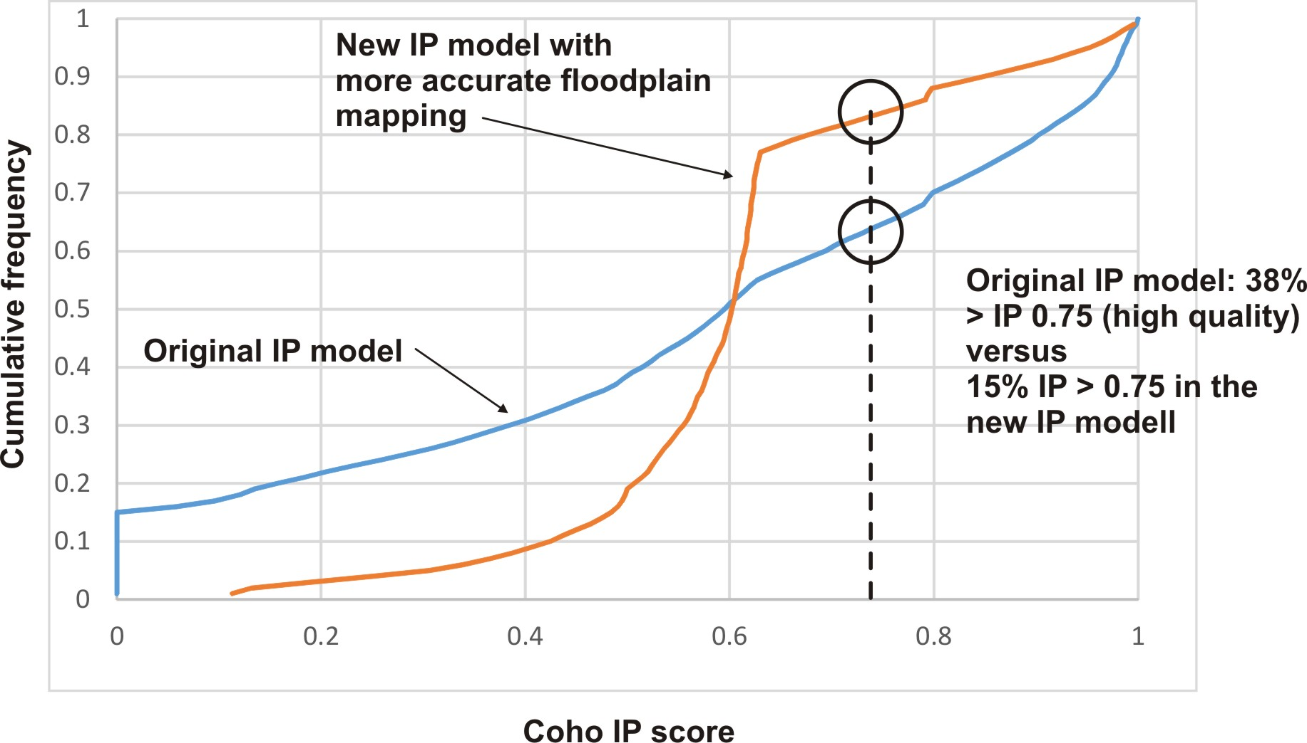
Notes:
These two cumulative frequency plots show the difference between the original (decade old) IP model scores for the Nehalem watershed compared to the newer (2015) IP scores using advanced floodplain mapping capabilities and the mixed 10 m – LiDAR DEMs. One of the largest differences is the reduction in the highest and lowest IP scores and a large increase in the moderate range of IP. Hence, very good coho habitat quality would be constrained to fewer areas.

Slide 33
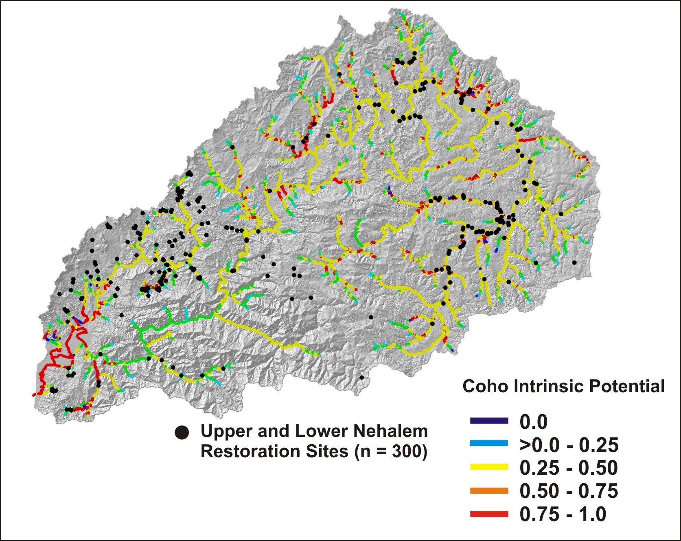
Notes:
This figure shows the locations of the upper and lower Nehalem restoration sites compared to the predicted coho intrinsic habitat potential. The next slide will show, quantitatively, how the restoration sites compare to the mapped IP scores.

Slide 34
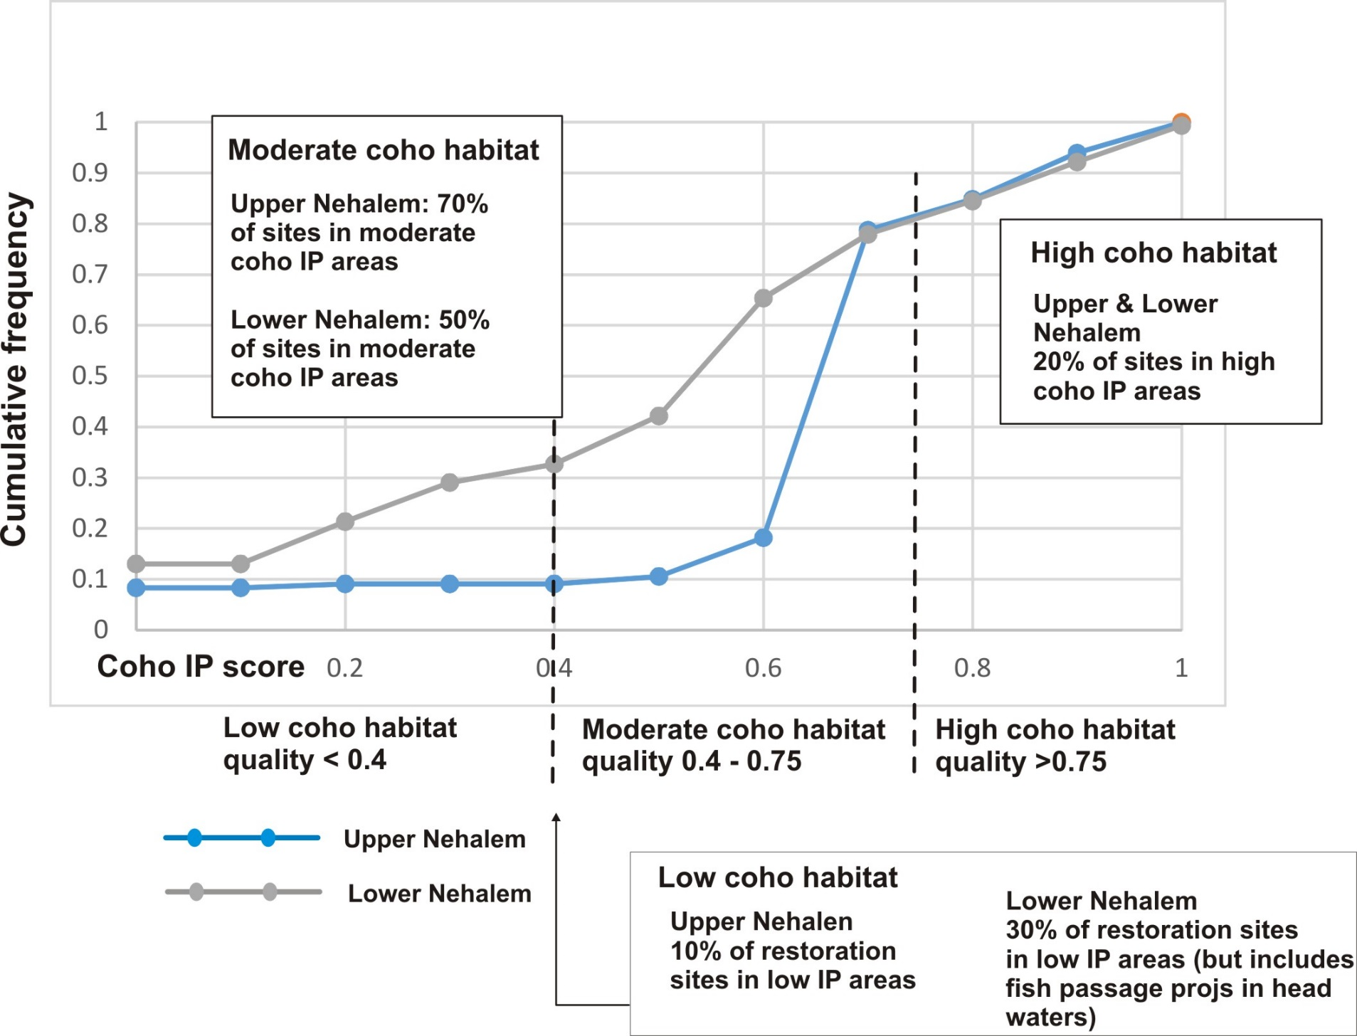
Compare Upper & Lower Nehalem Restoration Locations to Predicted Coho Habitat Quality (IP)
Notes:
The cumulative frequency plots above show the distribution of existing restoration sites in the lower and upper Nehalem watershed (e.g., associated with the lower and upper Nehalem Restoration Councils). This analysis shows that only about 20% of the restoration locations are located in predicted high coho IP areas. Between 10% and 30% of sites are located in areas of low IP. The majority of sites (50-70%) occurs within the moderate IP areas. This plot suggests that restoration sites may not be targeting the areas with the highest intrinsic site conditions for coho habitats. It may also indicate that restoration sites are targeting areas that currently have a lower IP score but that historically may have had a higher score, due to, for example, floodplain diking and channel downcutting. In either case, the use of modern IP maps could be used to help site future restoration locations. The removal of fish migration (barrier removal) projects in the lower Nehalem does not significantly change the outcome in the plots.

Slide 35
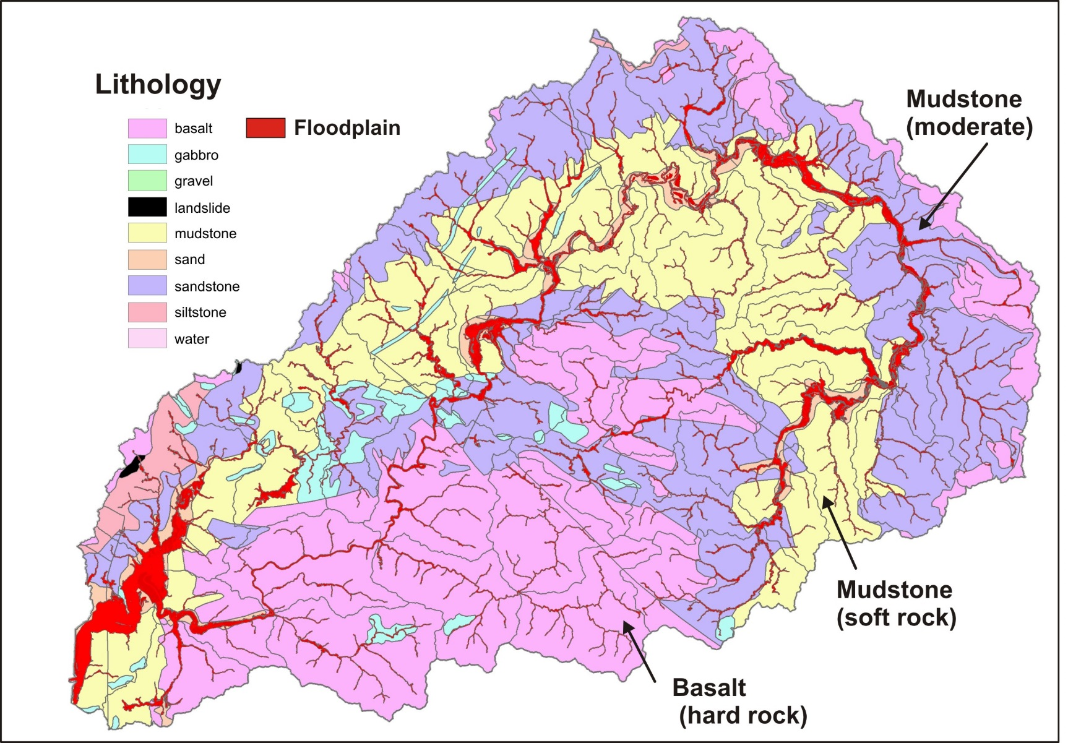
The best coho habitat
with the widest
floodplains follow
the zone of weakest
rock - mudstone
Notes:
The distribution of rock types, ranging from hard rock (basalt) to soft rock (mudstone) helps explain the distribution of certain types of habitats in the Nehalem watershed (e.g., geology is destiny).

Slide 36
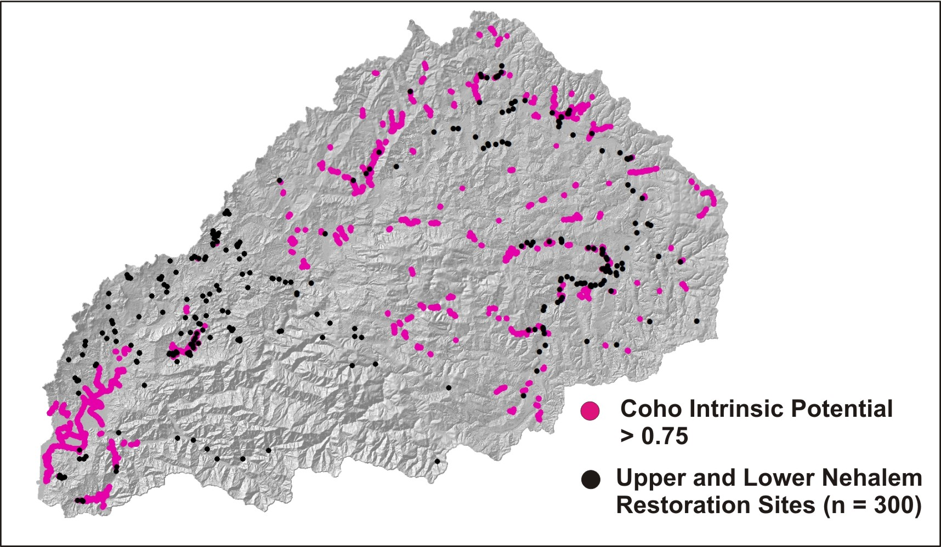
Notes:
Here is a graphic that illustrates the locations of upper and lower Nehalem restoration locations compared to the highest coho IP scores. In some areas they overlap while in many other areas they do not. Note how coho IP high quality habitats are concentrated in several areas, as well as being more distributed in other areas. There are concentrated hotspots for coho habitats such as the lower floodplains area, currently under agriculture.

Slide 37
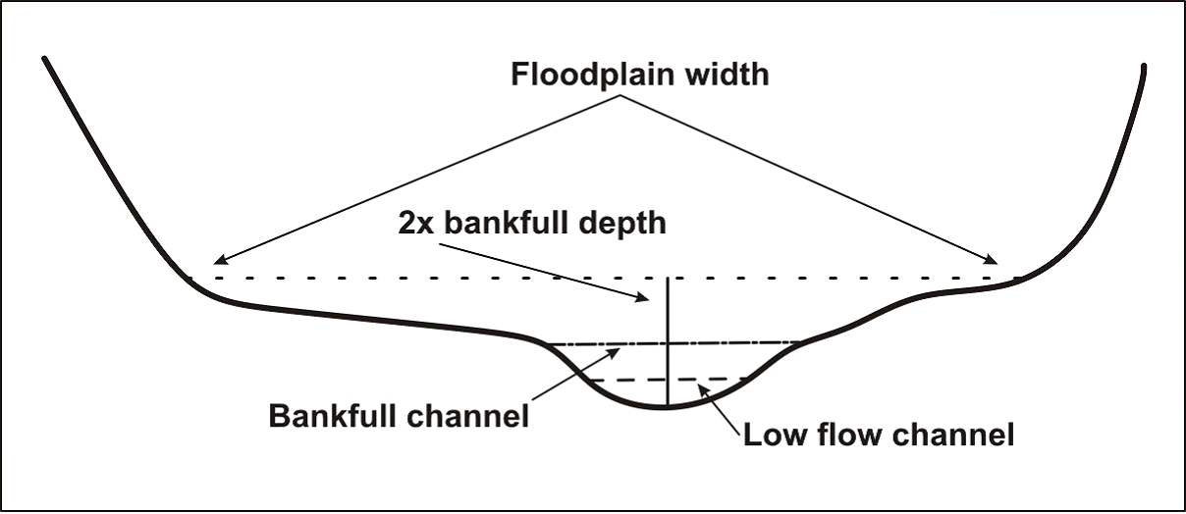
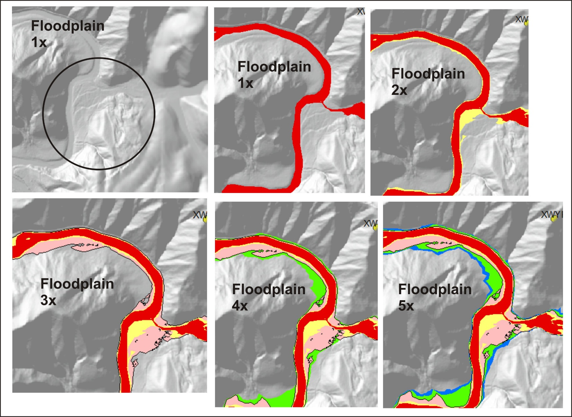
Consider floodplains
NetMap’s floodplain mapping tool
Notes:
Floodplains are an important constituent of coho habitats and can be targeted for restoration. NetMap’s advanced floodplain mapping tool calculates floodplains based on multiples of bankfull depths above the channel. This graphic (right panel) illustrates this using a 2.5 m LiDAR DEM in the Nehalem. Floodplains at 1x bankfull depth defines the active channels; floodplain at 2x defines the current active floodplain; floodplain at 3x defines the higher current floodplain and or the historically active floodplain in channels that have incised; floodplains above 3x are likely terraces that do not get inundated.

Slide 38

Potentially historical
active floodplains, channel
now incised
Notes:
NetMap’s floodplain mapping tool can be used to identify current floodplains and abandoned floodplains, those that were once active but currently are non functioning because of dikes and other land uses.

Slide 39

Notes:
Using LiDAR DEMs, the floodplain mapping tool can be used to detect the effects of dikes in isolating floodplains from their river systems, as illustrated above.

Slide 40

See how floodplains are distributed across a watershed
Notes:
This map shows how floodplains and terraces are distributed across the Nehalem watershed. There are pockets of larger floodplains shown in red and yellow on the map.

Slide 41

Notes:
Here we see the locations of the largest (widest) 10% of floodplains in the Nehalem watershed. For example, only 10% of the upper Nehalem existing restoration locations are located in the widest floodplains. See next slide for a more detailed comparison.

Slide 42

Notes:
The figure shows the cumulative frequency plots of the lower and upper Nehalem that reveal that current restoration sites are not targeting the areas of the widest floodplains. This is probably due to the fact that the largest floodplains in the Nehalem are under agriculture land use. However, this finding might also point to an opportunity to extend restoration activities to wide floodplains, if land use issues can be overcome.

Slide 43



Add in-stream wood recruitment
Use digital data on vegetation characteristics
NetMap’s in-stream wood model
Notes:
Another important fish habitat component is in-stream wood recruitment

Slide 44


Notes:
Remote sensing data from LEMMA is used in NetMap’s watershed scale wood recruitment tool. Here we can see the distribution of vegetation/tree sizes across the Nehalem watershed. The ownership map in the top right corner that shows the distribution of private and public (state) lands corresponds in large part to the distribution of tree sizes. The dominance of small trees and saplings is concentrated in the private lands. However, many streams, particularly fish bearing, do have vegetation buffers that include larger trees (not easily seen in the watershed scale map).

Slide 45

Estimated mean recruitment rate
for pieces > 50cm mean diameter
< 1 piece/yr/100m
> 1 piece/yr/100m
(all channels > 2m width)
Notes:
This map shows the distribution of areas along channels that have greater than and less than 1 piece of instream wood > 50 cm in diameter (e.g., large wood). The blue lines appear somewhat exaggerated since the higher wood loading can occur anywhere along the average 100 m reaches. Nevertheless, maps like this can be used to plan restoration by identifying areas of current low wood recruitment and when they overlap with areas of high IP scores (priority areas for restoration). Likewise, areas of high wood loading associated with high coho habitat potential could be identified for extra protection or even different types of restoration.

Slide 46
Notes:
The cumulative distributions of recruitment rates are derived from the previous wood recruitment map. Note that only about 4% of the network gets recruitment rates > 1pc/yr/100m, whereas it looks like a much greater proportion on the map in the previous slide (a type of optical illusion). However the cumulative distributions above provide a more accurate picture of watershed scale wood loading, including the obvious pattern that streams on private lands have less recruitment potential for large wood (> 50 cm) compared to public (state) lands. This pattern can also be seen in two slides above that show the distribution of tree sizes.

Slide 47

Add Shade/Thermal Loading
Notes:
Shade and thermal loading can be important considerations when planning restoration activities. In particular, shade and thermal loading can be added to the other habitat forming factors to identify the best or optimized areas for targeting riparian and instream restoration.

Slide 48
Vegetation Basal Area used as Proxy for Strea Shade
Unharvested
small streams 100 – 175 ft²/ac
medium streams 100 – 400 ft²/ac
large streams 100 – 275 ft²/ac
Notes:
Basal area is often used as an index of potential shade, as seen here in an Oregon Department of Forestry Report from 2001. The scanned plot on the right shows the range of basal area associated with streams of different sizes. We can keep that in mind as we examine the basal area along streams in the Nehalem watershed in the next couple slides.

Slide 49

Basal Area (conifers & hardwoods), 60 m each side of channel – represented in stream channels
Notes:
Here is the LEMMA/GNN data on basal area, conifer and hardwoods combined for the Nehalem watershed.

Slide 50

Many areas along mainstem
fish bearing reaches have low
shade
Notes:
Here is a map of coho bearing streams only revealing areas of high to low shade. Certain areas stand out as having low shade including the larger valley floors that are developed including for agriculture.

Slide 51

Many headwater areas, mostly on
private land, lack adequate shade
(e.g., black and blue lines)
Notes:
With headwaters included, the shade levels are much lower in many headwater streams, as shown in this slide in the eastern portion of the Nehalem basin, in large part on private forest lands (where no buffers are required).

Slide 52


Thermal Loading
Notes:
Vegetation shade is one important factor influencing stream temperature. Another is whether the stream is topographically situated to be sensitive to increased or decreased thermal loading. NetMap’s thermal loading tool provides an estimate of bare earth loading in watt hours. Topographic patterns on thermal loading are apparent – south facing streams are sensitive as are wide channels located in wide floodplains. Less thermal loading occurs in north facing channels and channels located in deep valleys (southwestern portion of the basin). We can combine estimates of shade (basal area) with thermal loading to produce a new map.

Slide 53

Basal area conditioned by thermal loading
– coho habitat only
Notes:
We can divide basal area along streams by bare Earth thermal loading to produce a sensitivity index of current shade conditions on potential impacts on stream temperature. The smaller the shade (basal area) and the higher the bare Earth thermal load, the smaller the index value and the greater the channel sensitivity; the larger the shade and the lower the thermal load, the larger the index value and the smaller the channel sensitivity. The warmer colors in the map indicate those areas sensitive to increased thermal loading due to present day reductions in shade. This can be used to help prioritize locations for restoration.

Slide 54

Basal area -thermal loading
sensitivity index, or where
is increased shade needed most?
(the reaches with red and orange
colors)
Stream reaches of potential concern,
lower basal area, high natural thermal
loading

Slide 55
Basal area - thermal loading sensitivity index
Red and yellow areas most sensitive to solar energy and with the least shade
Notes:
Any NetMap attribute can be exported to Google Earth, as seen here in the lower Nehalem watershed where the shade-thermal loading sensitivity index is mapped onto the topography. The wide valley floors (likely former floodplains) are areas of greatest concern and identify areas where increased shade would be of highest priority. In addition, this index can be combined with coho intrinsic habitat potential to further optimize locations where enhanced shade would be highly desirable.

Slide 56
Decision Space: Spatially Explicit Maps
+
+
Coho fish habitat quality
Current wood recruitment
Floodplains
+
+
Gravel supply
Shade – basal area/thermal loading
Notes:
Recall one of the restoration planning decision spaces, involving overlaying maps of habitat forming processes. The issue of gravel supply has been omitted in the current presentation but see PPT addendum (at the end of this presentation) to review results from the sediment (gravel) supply analysis.

Slide 57


Combine coho intrinsic potential + wood recruitment (visual)
< 1 piece/yr/100m
> 1 piece/yr/100m
Where does the best coho habitat overlap with the best wood recruitment? – protect!
Where does the best coho habitat overlap with the worst wood recruitment? – restore!
Notes:
Decision Space: combine coho intrinsic potential scores with current, in-stream wood recruitment. Visually identify areas of overlap between the two. In areas of the highest IP scores and the highest wood recruitment, enhance protection. In areas of highest IP scores and lowest wood recruitment, prioritize for restoration activities (instream structures and or riparian restoration).

Slide 58
Decision Space: Automated search for thresholds and optimization of watershed attributes
Notes:
A second type of restoration planning decision space: using data distributions for all relevant habitat forming processes, select habitat condition thresholds for each of them and let NetMap quickly search for and locate spatial intersections between the various attributes. For example, where does the highest 10% of coho quality habitats (IP) intersect with the lowest wood recruitment potential and the widest floodplains? How many sites are there and where are they located. Use these data to prioritize restoration. Some examples follow.

Slide 59

NetMap Tool to Search for Optimizations
Notes:
NetMap contains a tool, that works with its virtual watershed like the Nehalem, to quickly locate intersections among habitat forming processes to help prioritize restoration site selection and monitoring. For more details on this tool, see: http://www.netmaptools.org/Pages/NetMapHelp/overlap_tool___reaches.htm

Slide 60

Application: Optimize Locations for Riparian Treatments or In-stream Structures
Notes:
Using NetMap’s tool, we quickly identified the locations where the highest 10% of coho habitat quality (IP) overlaps with the lowest 10% of wood recruitment. 281 sites were identified out of the total of 11,518 reaches in the virtual watershed (2.4% of the fish bearing network, with a total length of 32 km). Analysts, using the tool (previous slide), can change the threshold values (e.g., top 5%).

Slide 61

Application: Optimize Locations for Riparian Treatments to Enhance Shade (in consideration
with thermal sensitivity and coho habitat quality)
Notes:
Another example of restoration size optimization. Locate the areas with the highest 10% of coho habitat quality overlap with the lowest 10% of shade and thermal sensitivity. 347 sites were selected or about 3% of the fish bearing network.

Slide 62


Application: Optimization Plus – Sites overlap in some cases
Notes:
Sometimes, priority sites will overlap, yielding a bigger bang for your buck! Here there is commensurability among the best coho habitats (IP) and low wood recruitment and shade-thermal sensitivity. Use these types of maps to prioritize restoration actions.

Slide 63

Application: Impaired habitat hotspots as restoration targets
Notes:
In NetMap, you can search for five levels of intersections or overlaps among habitat forming conditions (or lack thereof). This example shows how four factors were overlaid: highest 10% of coho habitat, highest 10% of floodplain width, lowest 10% of in-stream wood recruitment and the lowest 10% of shade, conditioned by thermal sensitivity. Only about 1% of the fish bearing network meets these criteria; use this type of information to inform restoration planning.

Slide 64

Add Ownership
Notes:
Ownership (federal, state, local, private) can be an important determinant in selecting restoration sites. See how ownership varies across the

Slide 65

Other attributes to consider: landslide potential
highest resolution DEMs + latest models
Notes:
Another important factor to consider in watershed restoration is landslide potential. Although not considered a restoration priority per se, information on landslide potential could be used in watershed management planning more generally, or restoration planning more specifically, about where erosion risk is the highest and what types of land uses can contribute to it, such as roads. The image above is from the Oregon Coast Range.

Slide 66

The key is to link landslide (and debris flow) risk to aquatic habitats, channel sedimentation issues etc.
Landslide risk
Fish habitat
Road analysis
Floodplains
Notes:
The slide shows several types of NetMap outputs including landslide risk, fish habitats (steelhead IP), floodplains and road erosion potential. The key is to link these to identify areas of concern, including for prioritizing watershed restoration.

Slide 67

Nehalem shallow landslide Potential
Notes:
Here is an example of how shallow landslide potential is mapped using either 10 m or LiDAR DEMs in the Nehalem watershed. The LiDAR DEM when used with shallow landslide models provide a much higher spatial resolution, although the 10 m does an adequate job.

Slide 68

Debris flows –
impact potential but also
upslope sources of large
wood to streams
Notes:
Landslides often transition into debris flows that move through steep and confined headwater streams. Debris flows can pose a risk to fisheries but they can also be sources of large woody debris to streams, that can enhance fish habitat. For example, restoration could target the leaving of buffer strips along certain headwater streams to ensure the long term supply of large wood to streams; in many areas of the Oregon Coast Range, debris flow related upslope sources of wood are the dominant wood supply.

Slide 69

ADD debris flows
Notes:
The Nehalem watershed has a low debris flow potential overall, since the relatively weak bedrock (mudstone) leads to lower relief and less steep hillsides. The main area of high debris flow risk located in the southwestern area of the basin in an area of mechanically stronger basalt rocks, that lead to higher relief hillsides that are steeper.

Slide 70

Debris flows –
close up
Notes:
Here is a close up view of debris flow potential in headwater streams in the Nehalem watershed. You can see the difference between the higher relief and steep basalt rocks (towards the southwest) and the lower relief and lower gradient hillsides (mudstone) to the northwest.

Slide 71

Debris flow risk to
coho streams
Notes:
A key aspect involving forest management, watershed management and restoration is whether debris flow impacts can overlap high quality fish (coho) habitats. In NetMap, this is a quick analysis and shown in this slide is debris flow risk to coho habitat streams. The source areas of this risk could be used to identify restoration opportunities or hillsides that require additional protections.

Slide 72

Application: Management of debris flow risk / upslope wood recruitment
Notes:
When considering the importance of debris flows, either as an impact or as a source of upslope large wood, to fish habitats, and specifically to coho habitats in the Nehalem, NetMap is used to quickly identify locations where the top 20% of coho quality habitats overlap with the top 10% of debris flow risk. Sites are shown in yellow. Only 0.5% of stream reaches are identified, indicating the relatively low susceptibility of fish habitat to debris flows in the Nehalem system.

Slide 73


The entire 5 step analysis can be done at larger spatial scales, for example HUC 12 digit (6th field)
Search for overlaps
Notes:
Throughout this pilot Nehalem restoration planning project and powerpoint presentation, analyses were conducted at the scale of individual stream reaches and floodplains (100 m reaches) and slices of hillsides (approx. 0.1 km²). However, in NetMap all watershed attributes including all those discussed in the PPT, can be summarized at the scale of subbasins, illustrated here using HUC 6th field (12 digit) hydrologic unit code basins. Thus, restoration activities could be evaluated at this scale (approximately 10,000 to 15,000 acres) and then other tools, as outlined above, could be used to drill down to the scale of individual channel reaches and hillsides.

Slide 74
Road Restoration
Roads drainage diversion
Roads erosion/
sediment delivery
Road failure/gully
Roads in
floodplains
Habitat length
above crossings
Notes:
Watershed restoration activities can include road upgrades, maintenance and abandonment, as well as new construction. In NetMap and as applied in the Nehalem, road restoration can address: 1) drainage diversion, 2) road erosion and sediment delivery to streams, 3) road failure and gully potential, 5) roads in floodplains and 6) habitat length above road-stream crossings.

Slide 75

Notes:
A similar analysis approach is used for roads in the Nehalem. Information on potential road related stressors can be considered individually or in combination, and compared to predicted habitat conditions, such as coho habitat quality (IP), as shown in this slide.

Slide 76

Notes:
A similar restoration decision space can be used for road related issues. Cumulative distributions of road related information can be used to help identify and prioritize restoration activities.

Slide 77



Nehalem: many roads
Notes:
There is no shortage of roads in the Nehalem. Road density (length per area) is often considered a proxy for cumulative impacts. Road density is generally calculated at the scale of entire watersheds or subbasins (upper right); values in the Nehalem extend to about 4.3 km/km². In NetMap, road density is also calculated at the scale of individual 100 m channel segments via their associated small drainage wings. Calculated this way, road density extends up to 70 km/km². Road density could be considered during watershed scale restoration planning.

Slide 78

Application: Upgrade Fish Passage based on greatest habitat length and quality to be opened
Notes:
One type of road restoration planning involves reducing fish migration barriers by upgrading culverts, installation of bridges etc. In NetMap there is a tool for quickly calculating the cumulative habitat length and quality above all road-stream crossings. Such information could be used to help inform site selection for improving fish migration and movement.

Slide 79

Application: Identify Roads that are compromising floodplain function
Notes:
Another type of road restoration is removing roads from floodplains or redesigning them to lessen impacts. Once floodplains are mapped using NetMap tools (see earlier), a quick click of the mouse identifies all locations in the watersheds where roads are located in floodplains.

Slide 80

Application: Identify Roads that are
potentially unstable and pose a risk
to downstream habitats
Notes:
Roads are divided into pixel scale segments and then each of those are classified according to the predicted underlying hillslope stability, as shown in this slide. This information could be used to inform field programs to check on road conditions and to plan restoration to reduce road failure potential, including side-cast pullback and drainage diversions.

Slide 81

Application: Identify
road segments
with the greatest
runoff and erosion
potential and
sediment delivery
to streams
(mapped to roads)
Notes:
An important consideration with regards to road restoration is road drainage diversion, road sediment production and sediment delivery to streams. NetMap contains tools to predict road drainage (including using analyst supplied GPS road drain locations), road sediment productions (using WEPP and GRAIP-lite) and sediment delivery to streams. The results shown above are mapped to individual, hydrologically connected road segments.

Slide 82


Road Drainage Diversion and Surface Erosion Potential, and Sediment Delivery to Streams
Results:
Coho IP – highest 10%
Road surface erosion – highest 10%
n = 195 sites, 0.8%
Notes:
Predicted delivery of road erosion to streams is shown on the left panel and shows point sources of road surface erosion to stream channels; note the discontinuous nature of the road sediment point sources. This information can be overlaid onto coho habitat quality, yielding the panel figure on the upper right. This shows the locations where the highest 10% of coho habitat quality (IP) overlaps with the predicted highest 10% of road surface erosion. Restoration related to roads could target those locations, once field surveys have validated model predictions.

Slide 83

Notes:
Field data on actual stream and road conditions are critical, and typically agencies and watershed councils have such information available. However, remote sensing analysis such as what is described in this PPT provides a much needed larger spatial perspective of conditions surrounding any particular field site. The best approach is to combine both types of data, integrating them together. All remote sensing information needs to be field verified as well.

Slide 84
Options include:
-maps, tables
-ArcGIS shapefiles
-NetMap tools & data
-online tools
Notes:
There are various options for data distribution to users in the course of watershed restoration planning including maps, tables and plots such as what is included in this PPT, ArcGIS shapefiles, NetMap tools and virtual watersheds (to continue to update and create new analyses) and online tools, such as the TerrainViewer (http://www.terrainworks.com/terrain-viewer).

Slide 85
Field measurements could include:
-current instream conditions
-in-stream wood availability
-gravel availability
-riparian stand conditions/veg/shade
-floodplain geometry
-road factors
-surfacing
-maintenance
-and others.
Iterative
Notes:
Validating model predictions in the field is critical. There are many types of field measurements that can be obtained, some of those are listed.

Slide 86

Notes:
Questions can be directed to www.terrainworks.com (contact us).

Slide 87



In-stream Structures Require Sediment to Function Properly (create pools)
Notes:
Here are a few examples of in-stream structures designed to capture sediment to create pools but because of naturally low gravel sediment supply, the structures are not functioning as designed. Thus sediment supply in the form of gravels need to be considered when placing and designing in-stream structures.

Slide 88

Addendum: Add Gravel Supply,
e.g., erosion driven by hillslope
gradient & convergence,
plus consider rock hardness that is related to ability to create gravels
Notes:
NetMap converts topography, defined by hillside gradient and convergence into a measure of annual sediment yield, and as depicted in channels in this slide. The lower relief and less steep areas have lower predicted sediment supply, compared to steeper areas that have a higher predicted yield.

Slide 89

Notes:
Rock types in the Nehalem watershed can be converted to indices of rock hardness, a proxy for gravel supply.

Slide 90

Notes:
NetMap’s erosion and sediment supply index (described above) is combined with the index of rock hardness to derive predictions of gravel supply potential, as shown here. The dark blue channel segments are predicted to have low gravel supply while the warmer colors are predicted to have a higher potential for gravel sediment supply.

Slide 91

Combine coho IP + in-stream wood recruitment + gravel supply
For example, locate area with the
highest coho intrinsic potential (top 15%),
the highest in-stream wood recruitment
(top 15%) and the highest gravel supply
(top 50%).
This yields 226 sites or 1% of the channel
network
Notes:
Predicted gravel supply is combined with coho habitat quality to search for overlaps where in-stream structures would have adequate sediment to create pools.

