Slide 1
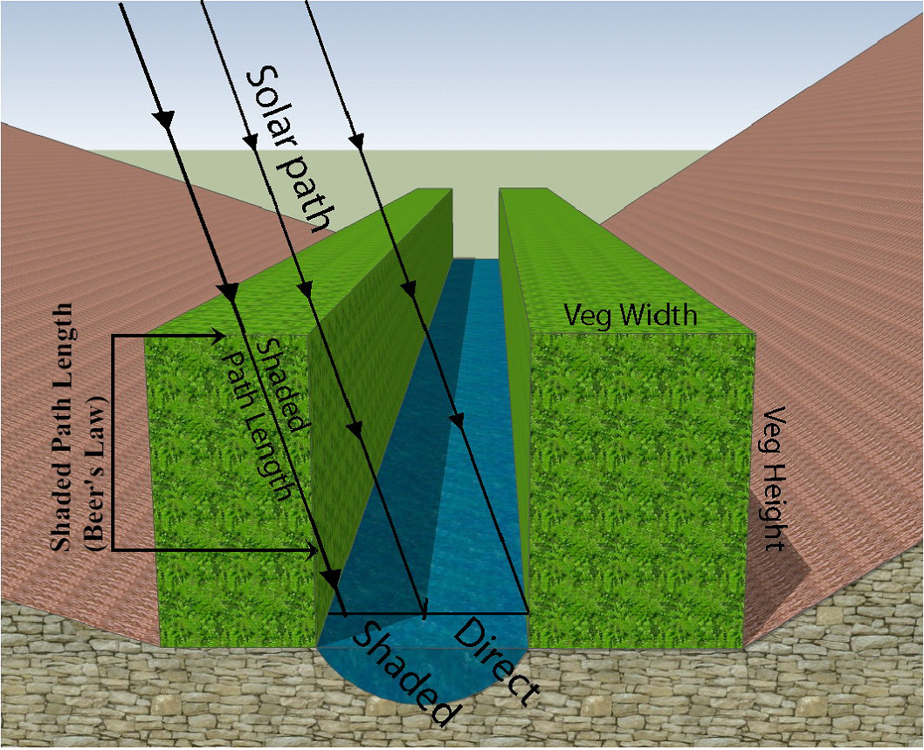
Optimizing Riparian Buffers for Thermal Protection
TerrainWorks (www.terrainworks.com)

Slide 2
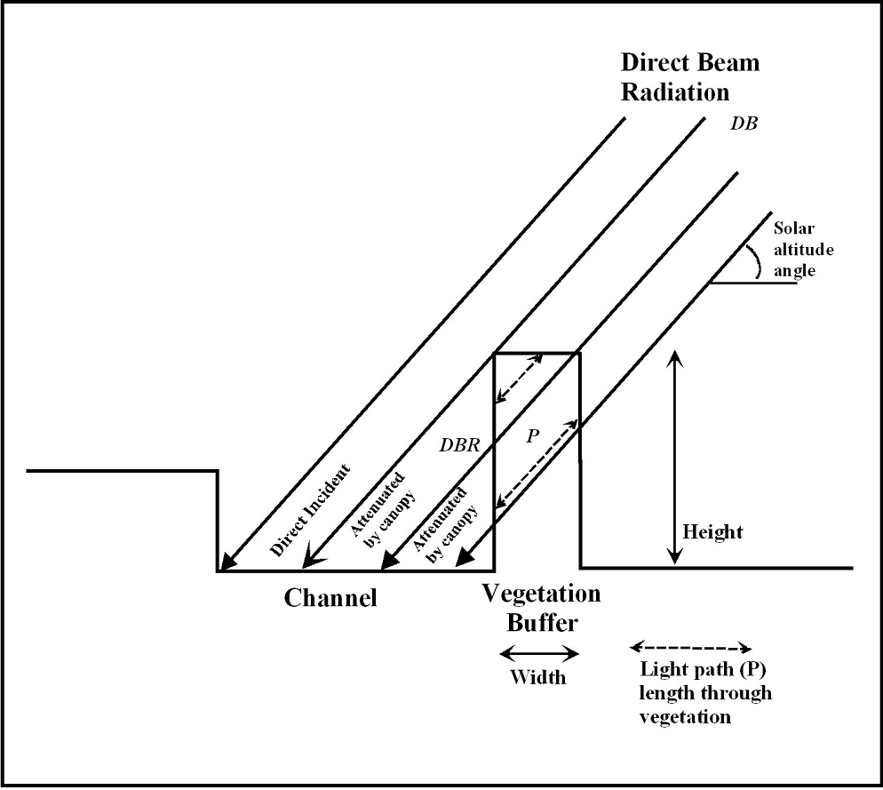
We ask the question:
What is the optimum design and width of riparian buffers to protect
against increases in thermal energy and how does that compare to fixed
with buffers in headwater streams?

Slide 3
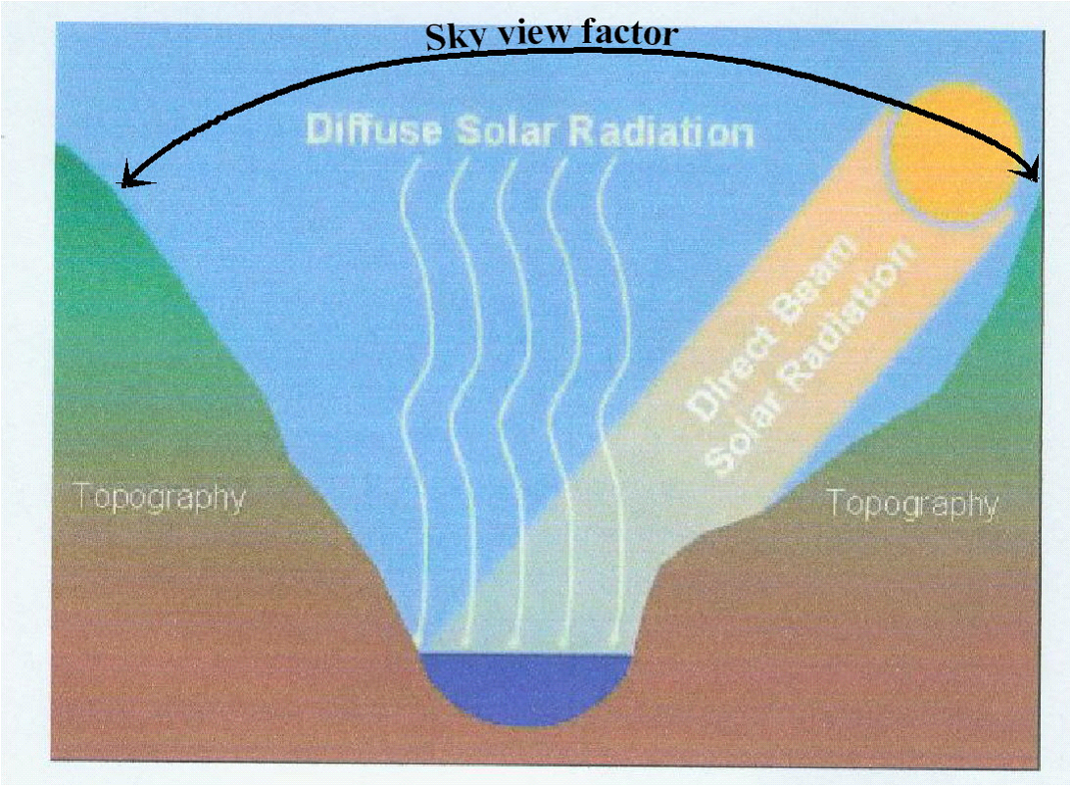
To answer that question, we employ NetMap’s “virtual watershed” that
evaluates thermal load that is sensitive to solar angle, latitude, topography,
channel width, channel orientation and streamside vegetation height
and density.

Slide 4
Background
Most thermal buffer rules are based on policy negotiations aimed at balancing thermal protection with forest economic values (timber harvest). Regardless of policy negotiations,
most buffer width dimensions are based on studies and literature that have identified
threshold buffer widths using stream temperature field measurements and or modeling.
The general rule of thumb is that buffers between 75 and 100 feet are necessary to ensure
thermal loading protection. In general, no consideration is given to stream orientation that
strongly influences thermal energy to streams, including left and right side of the channel.
Field studies that identify buffer width thresholds cannot, for practical reasons, consider
the full variability of channel characteristics.
Here, we use a thermal energy calculation to help understand the design of optimized buffer
widths.

Slide 5
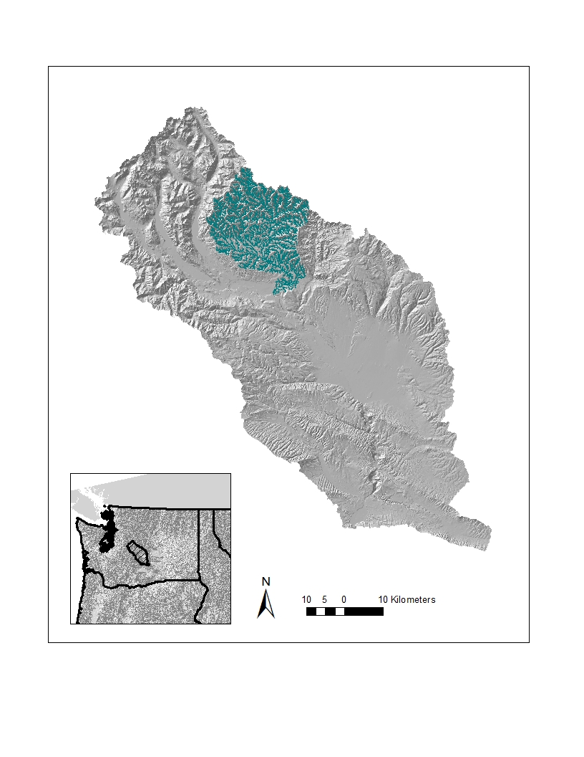
Project area: Teanaway River watershed
in the Yakima River basin, eastern
Washington; analysis limited to
non fish bearing streams less than
10 km² (2470 acres) in area.
Study Area

Slide 6
In the Teanaway River watershed in eastern Washington, we compare a few different riparian
buffer designs on headwater, non fish bearing streams (approx. 14,370, 100 m reach segments):
Optimized buffer widths that maximizes thermal energy reductions and that differentiates
right and left sides of channels (looking downstream) and accounts for varying azimuth,
Fixed with buffers at widths of 25 ft, 50 ft, 75 ft and 100 ft (same on both sides of the
channel);
We use a density of riparian forests of 70% (can be varied) to calculate light
transmission using a physically based model of thermal loading; the model incorporates
“Beers Law”, a common approach in thermal loading models
(density is a function of leaf area index, DeWalle 2010).
DeWalle, D. 2010. Modeling stream shade: riparian buffer height and density as important as buffer width. Journal of American Water Resources Association. 1-11:1752-1688.

Slide 7
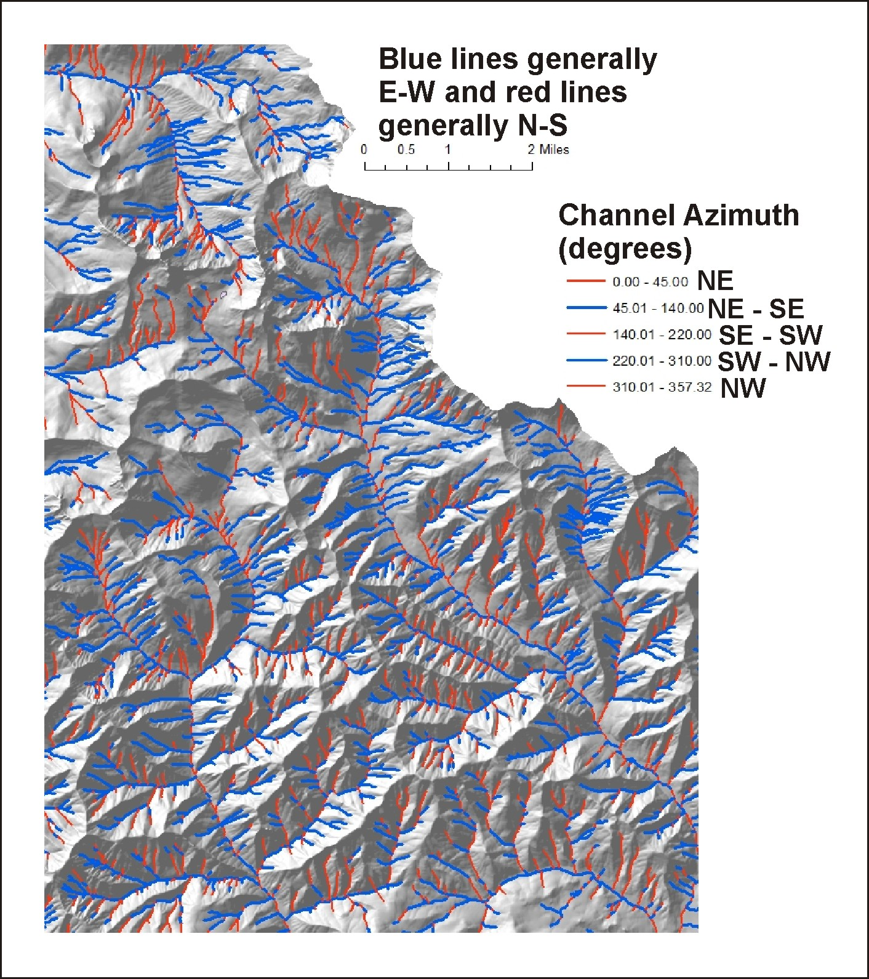
Channel direction or azimuth
(0 – 360 deg) matters:
N-S oriented streams require similar
buffer widths on both sides of the
stream;
whereas, E-W oriented streams have
less buffer width on the north side
of the channel.

Slide 8
The attenuation of solar
radiation with buffer
width is governed by
a power law (Beers Law)
less and less light radiation
comes into the stream
with increasing distance
from the stream within
a buffer

Slide 9
There is a rapidly diminishing
effectiveness of increasing
buffer width on radiation
protection (sketch)

Slide 10
Optimized buffers - analysis approach
1) calculate bare Earth radiation (maximum),
2) calculate maximum possible radiation reduction or protection (500 m forest width, density = 0.7),
3) specify a percent reduction in radiation (25%, 50%, 75%, 90%, 95%, 99%) between bare Earth and the maximum reduction.
Bare Earth
Maximum
reduction
Example – 90%
X ft
Specify % protection

Slide 11
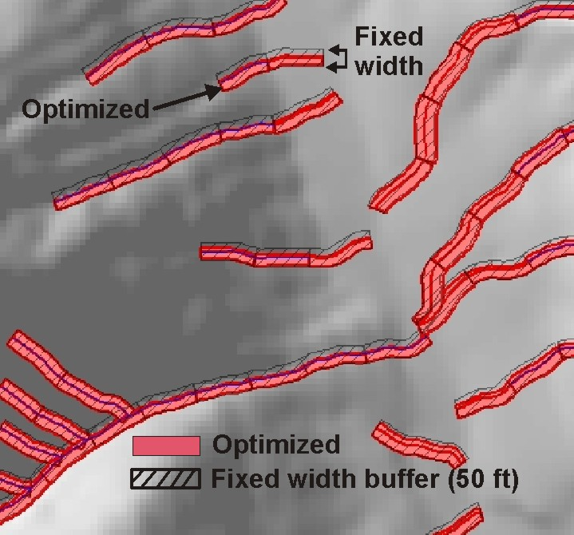
Here is a mapped example of
model outputs:
Optimized buffers are less
wide on the north sides of streams
along east – west flowing channels
little difference in north – sound
trending streams

Slide 12
The next three slides illustrate the effects of stream orientation (azimuth) on
left and right buffers at three levels of thermal loading protection:
80%, 90% and 99%; observe the y axis differences in left-right buffer widths

Slide 13
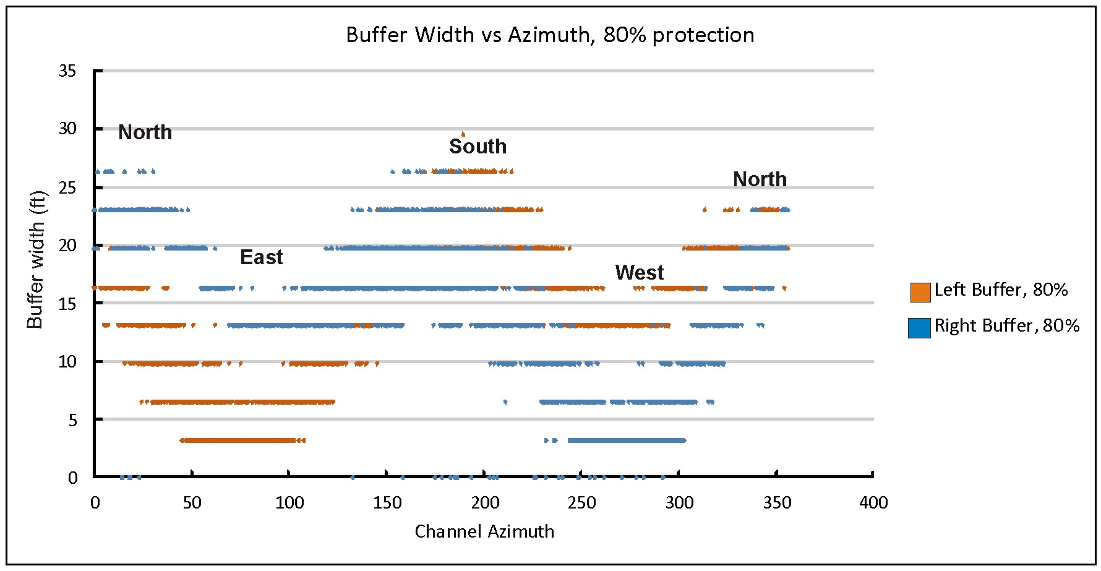
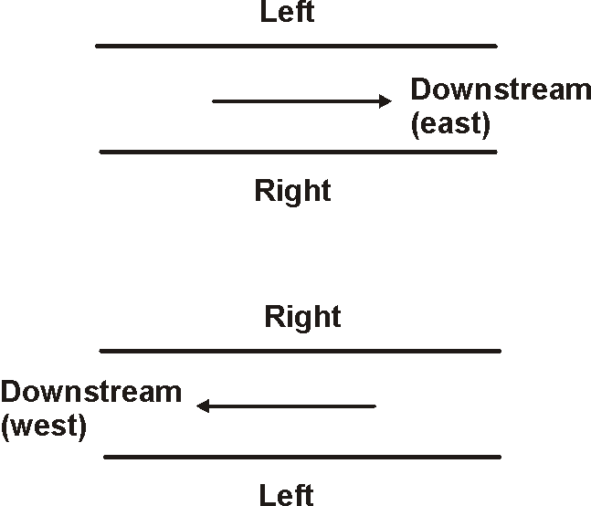
Optimized Buffer width (left-right) versus channel azimuth (80% protection)
Average tree ht = 25 m (82 ft); density = 0.7

Slide 14
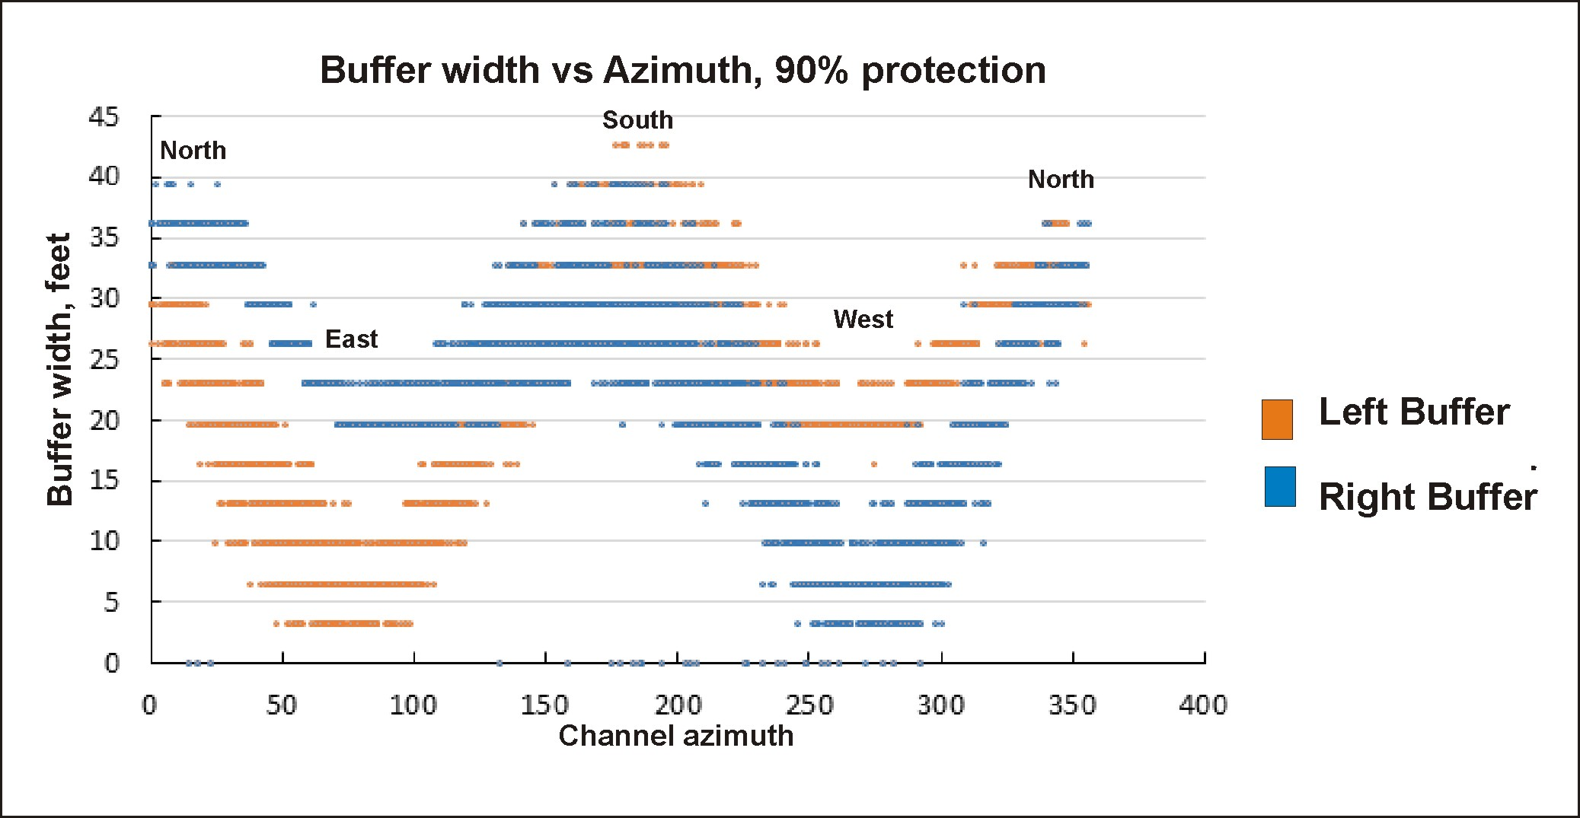
Optimized Buffer width (left-right) versus channel azimuth (90% protection)
Average tree ht = 25 m (82 ft); density = 0.7

Slide 15
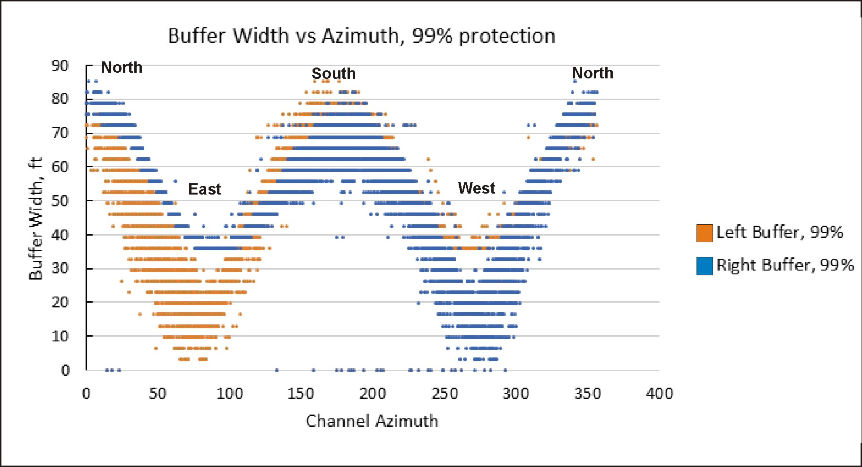
Optimized Buffer width (left-right) versus channel azimuth (99% protection)
Average tree ht = 25 m (82 ft); density = 0.7

Slide 16
Comparison of optimized versus fixed with buffers, percent protection
and area required
Prescription | Protection (%) | Area (acres) | Percent change of fixed width area to optimized buffer areas at 95%, 98% and 99%, respectively
Optimized, Left-right | 95% 98% 99% | 6,780 9,315 11,228 | +37% +65%
Fixed width 25 ft | 91% | 5,219 | -23%¹ -43% -53%
Fixed width 50 ft | 98% | 10, 428 | +54% +12% -7%
Fixed width 75 ft | 99.7% | 15,657 | +130% +68% +39%
Fixed width 100 ft | 99.9% | 20,874 | +207% +124% +86%
¹ ((5,219-6,780)/5,219)*100

Slide 17
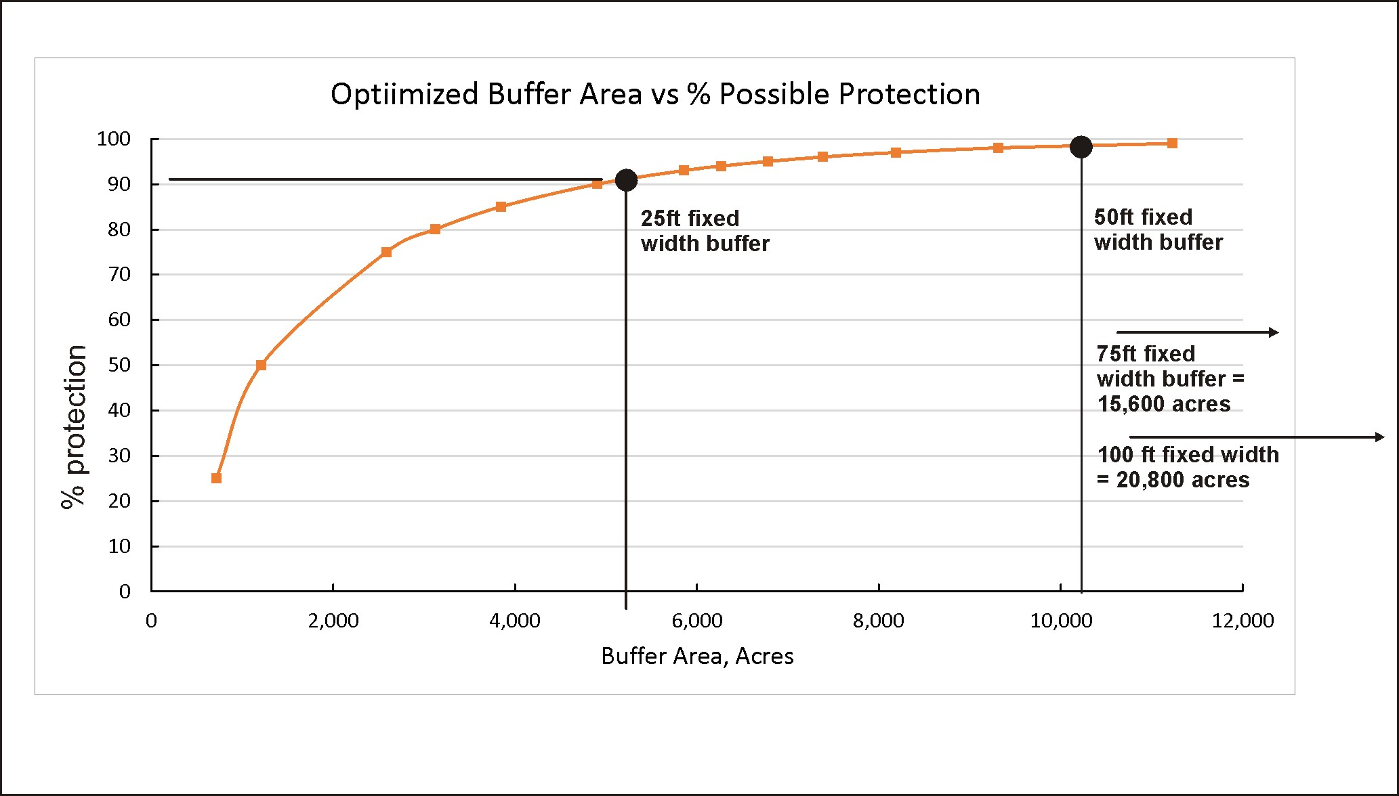

Slide 18
Comparing an optimized buffer to a fixed width 50 ft buffer
Prescription | Protection (%) | Area (acres) | Percent change of fixed width area to optimized buffer areas at 95%, 98% and 99%, respectively
Optimized, Left-right | 95% 98% 99% | 6,780 9,315 11,228 | +37% +65%
Fixed width 25 ft | 91% | 5,219 | -23% -43% -53%
Fixed width 50 ft | 98% | 10, 428 | +54% +12% -7%
Fixed width 75 ft | 99.7% | 15,657 | +130% +68% +39%
Fixed width 100 ft | 99.9% | 20,874 | +207% +124% +86%
1
Matching an optimized buffer design to a protection level equal to that of a fixed width 50 ft buffer decreases the
area under the buffer by 12% and ensures that 98% is the minimum protection – under the fixed 50ft, there
will be reaches that will not meet that minimum protection (e.g., protection improvement)
¹ ((10,428-9,315)/9,315)*100

Slide 19
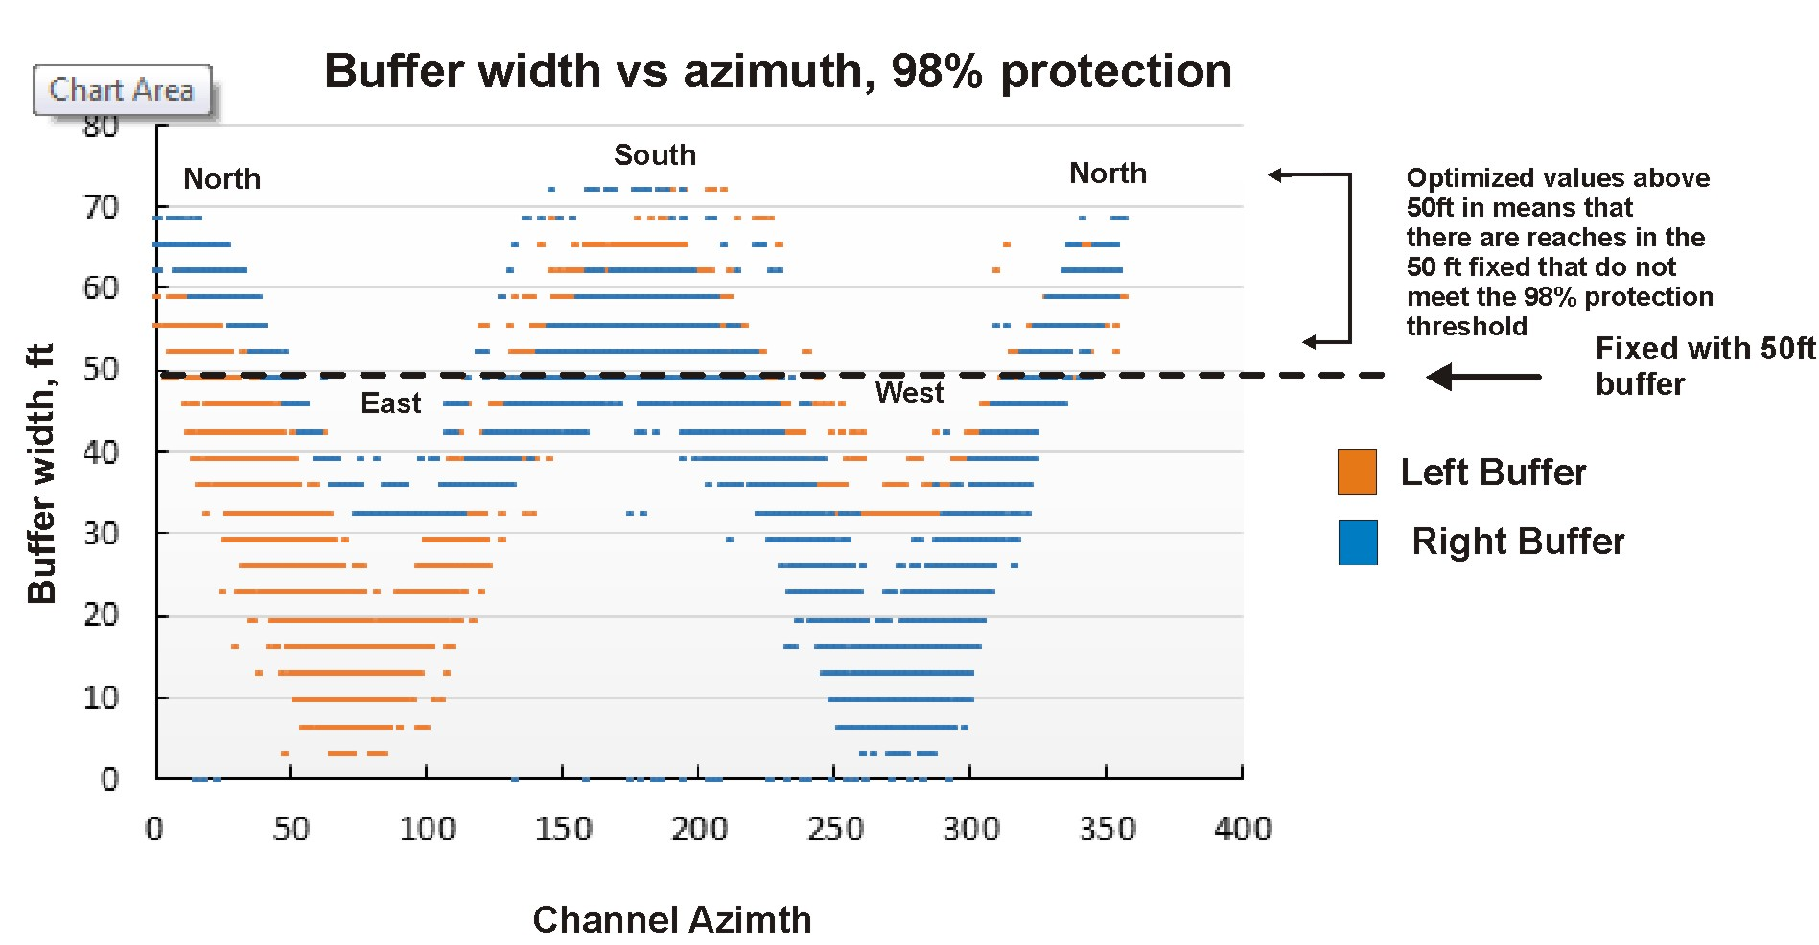
The optimized left-right buffer with a protection equivalent to a fixed 50 ft buffer

Slide 20
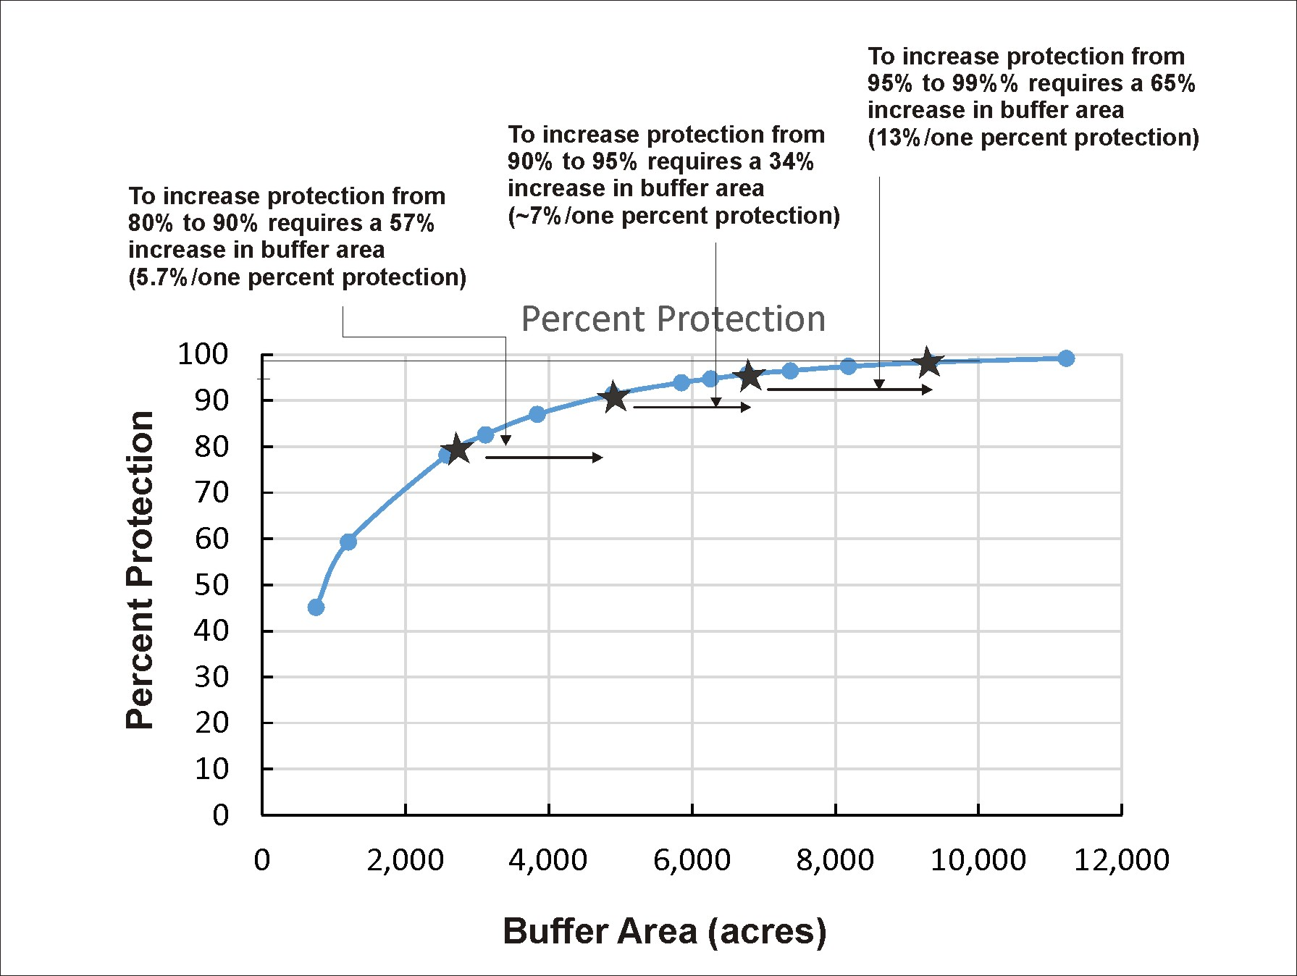
The amount of thermal protection
afforded by incrementally
increasing buffer
width rapidly diminishes
with increasing absolute buffer
width and the area
encompassed by the buffer.

Slide 21
Predicted buffer width vs % protection is very sensitive to vegetation density term; reducing vegetation
density to 0.50 yields 90% reduction for a 50ft buffer (rather than 98% with a 0.7 density) and a 75 ft and 100 ft buffer yields only 93.5% and 94% protection; the key here is to determine what the “natural” density of the riparian forest vegetation is and then use that as the baseline for all analyses and resulting buffer prescriptions (changing vegetation density will not change the results shown in this PPT).

Slide 22
Possible buffer strategies:
optimized (designer) buffers, select % protection, by tree height and density – left, right buffer dimensions vary
by channel segment azimuth etc. – create channel maps of optimized protection, apply reach by reach;
use optimized buffers to match some level of fixed with buffer protection (which will increase the effectiveness
above many fixed with buffers, for example, the 50 ft fixed with buffer shown in this PPT);
for headwater non fish streams, select % protection based on probability of being seasonal vs non seasonal;
GIS based analysis will never be truly accurate with regards to channel orientation, channel width and tree height –
thus build a field based approach using a Tablet and or collect field data and re-calculate in the office (see next).

Slide 23
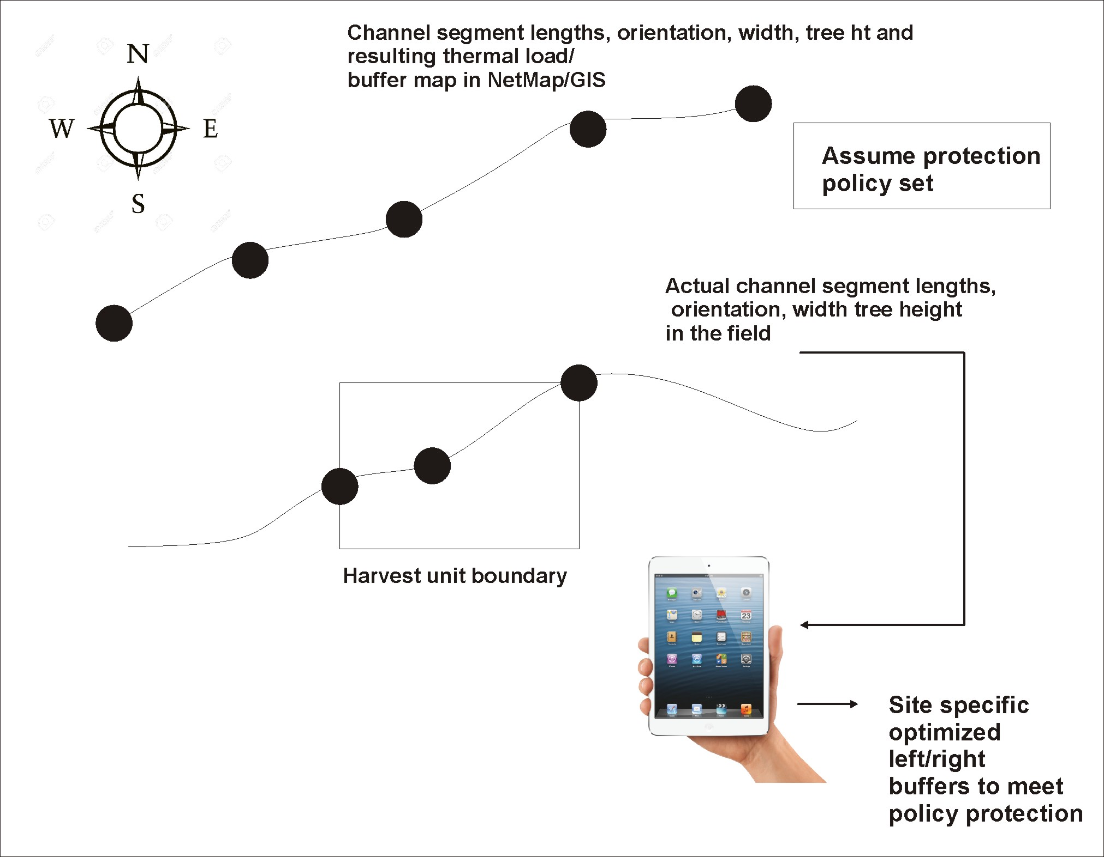
Improve accuracy
of optimized buffer
designs

Slide 24
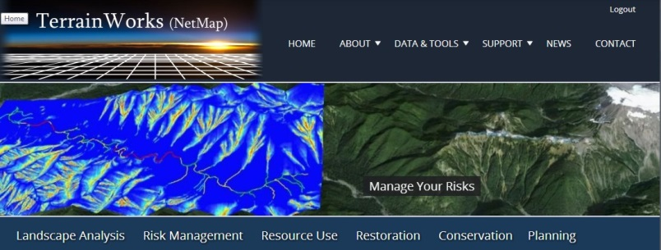
Contact us for further information (www.terrainworks.com)

