Slide 1
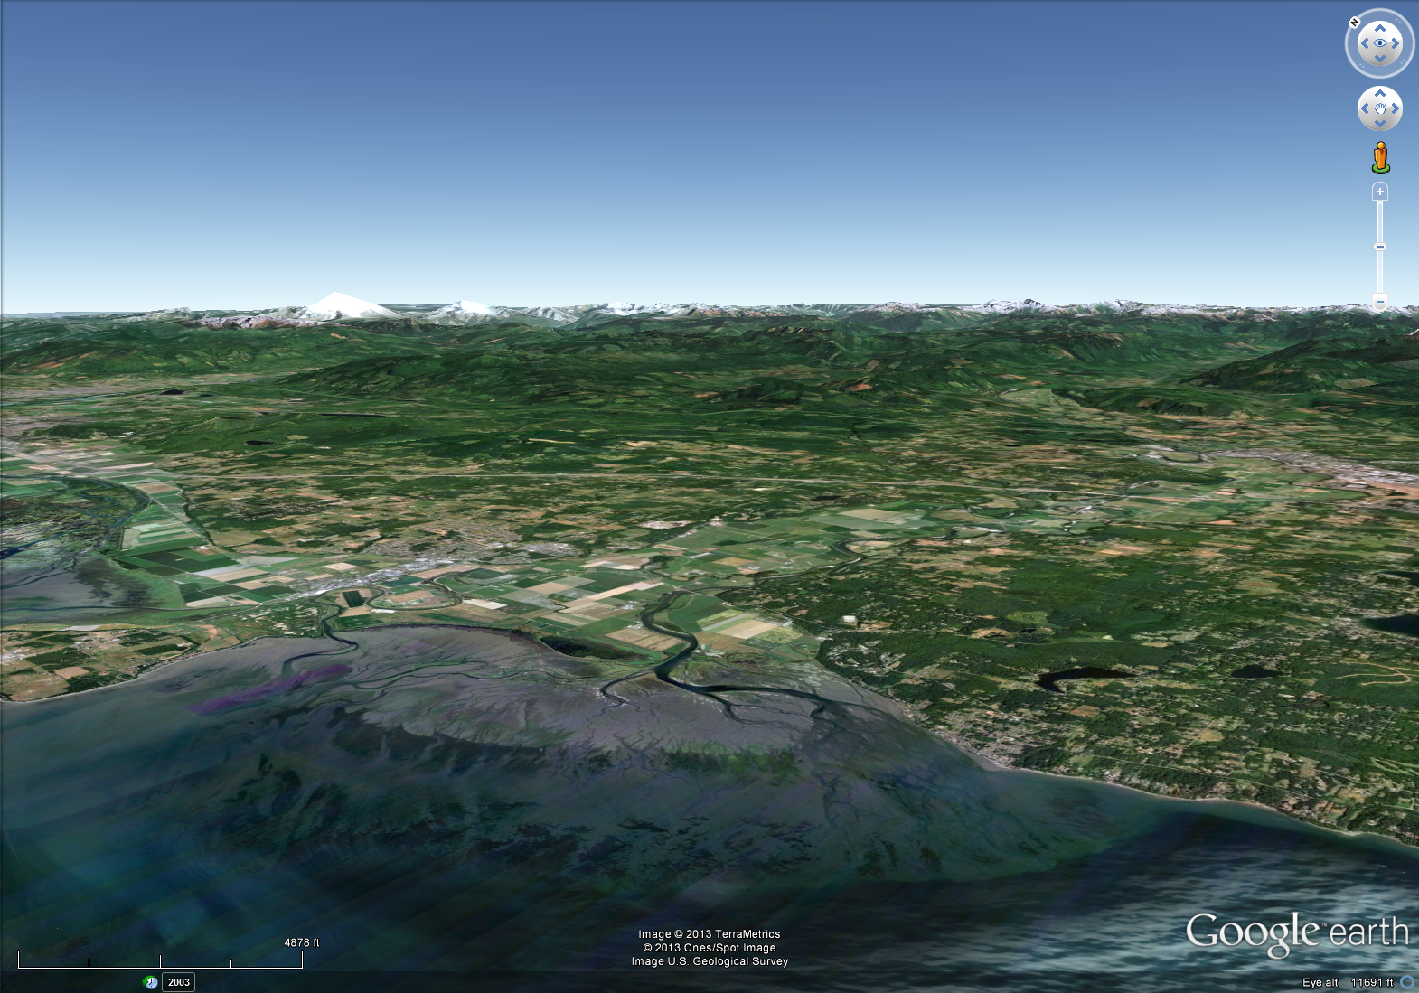
NetMap: Estuary Mapping (Puget Sound)

Slide 2
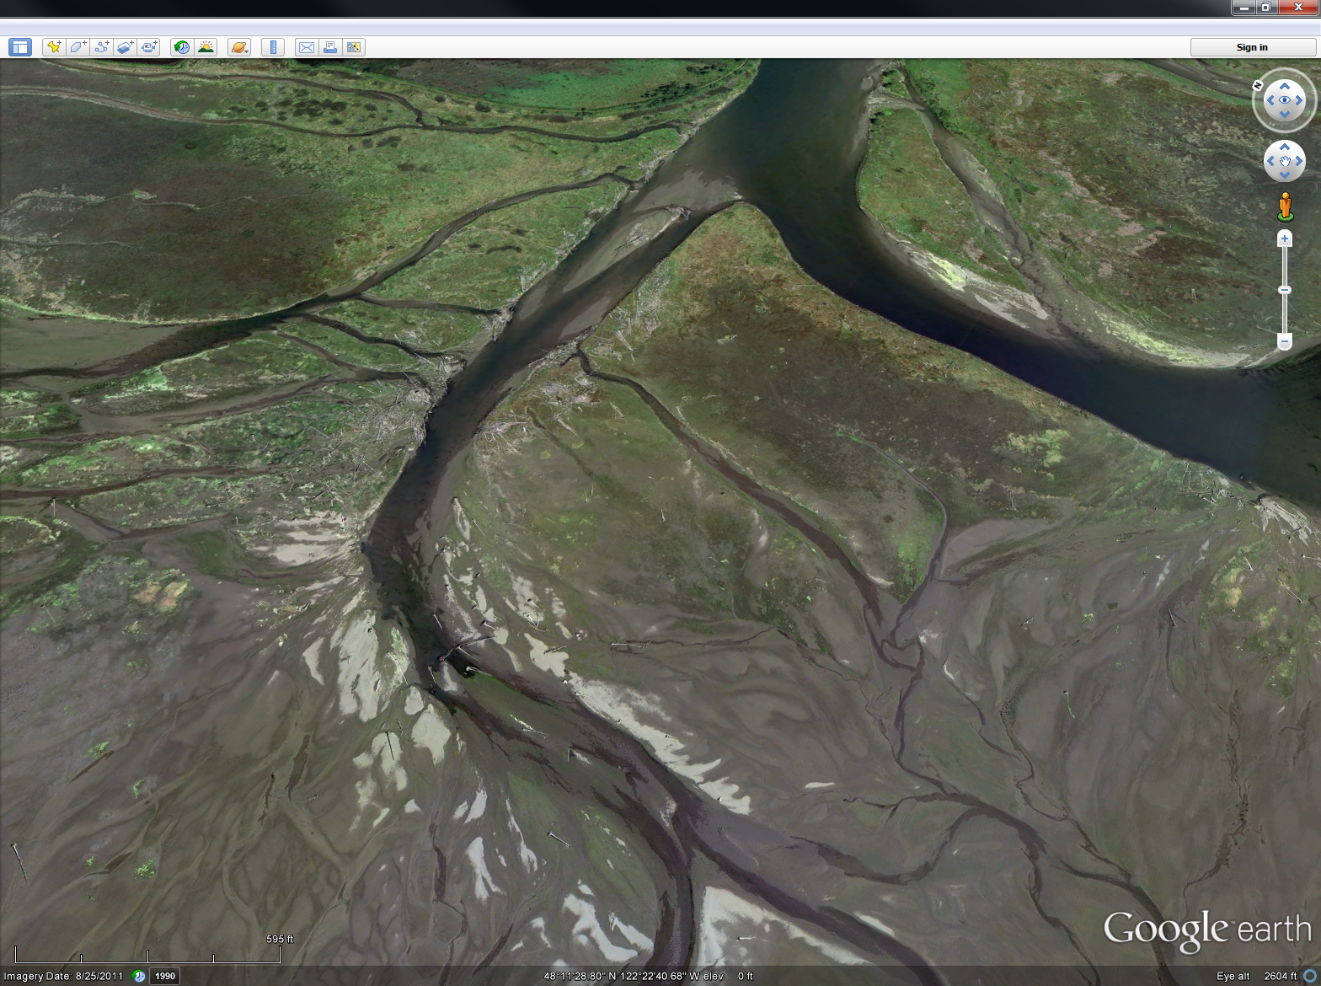
Salt marsh
Salt marsh
Salt marsh
Mudflat
Mudflat

Slide 3
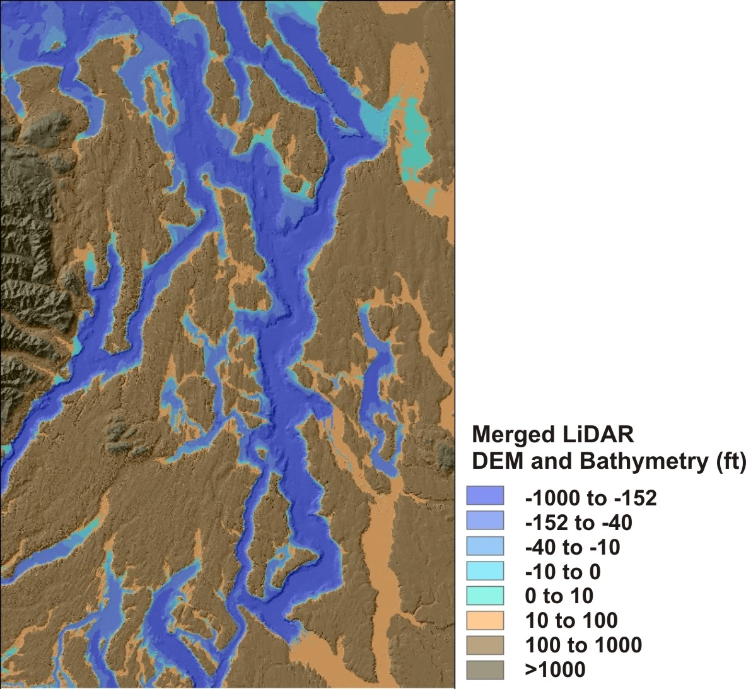
Model
-merged DEM (LiDAR)
-tidal gauge data
-proportion inundation
(0 – 100%)
-logistic regression model
(inundation vs estuary hab)

Slide 4
Model
-merged DEM (LiDAR)
-tidal gauge data
-proportion inundation
(0 – 100%)
-logistic regression model
(inundation vs estuary hab)

Slide 5
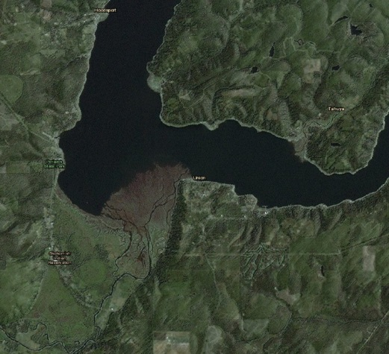
Results
Skokomish
River
estuary

Slide 6
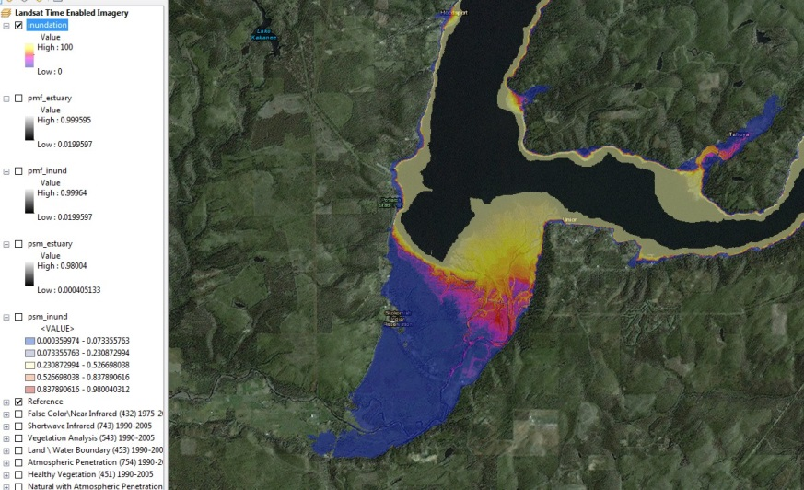
Percent Inundation
100%
1%

Slide 7
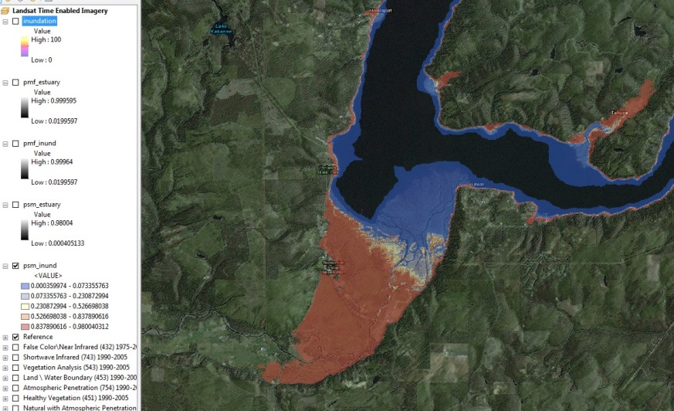
Probability salt marsh
mudflat
Salt marsh

Slide 8
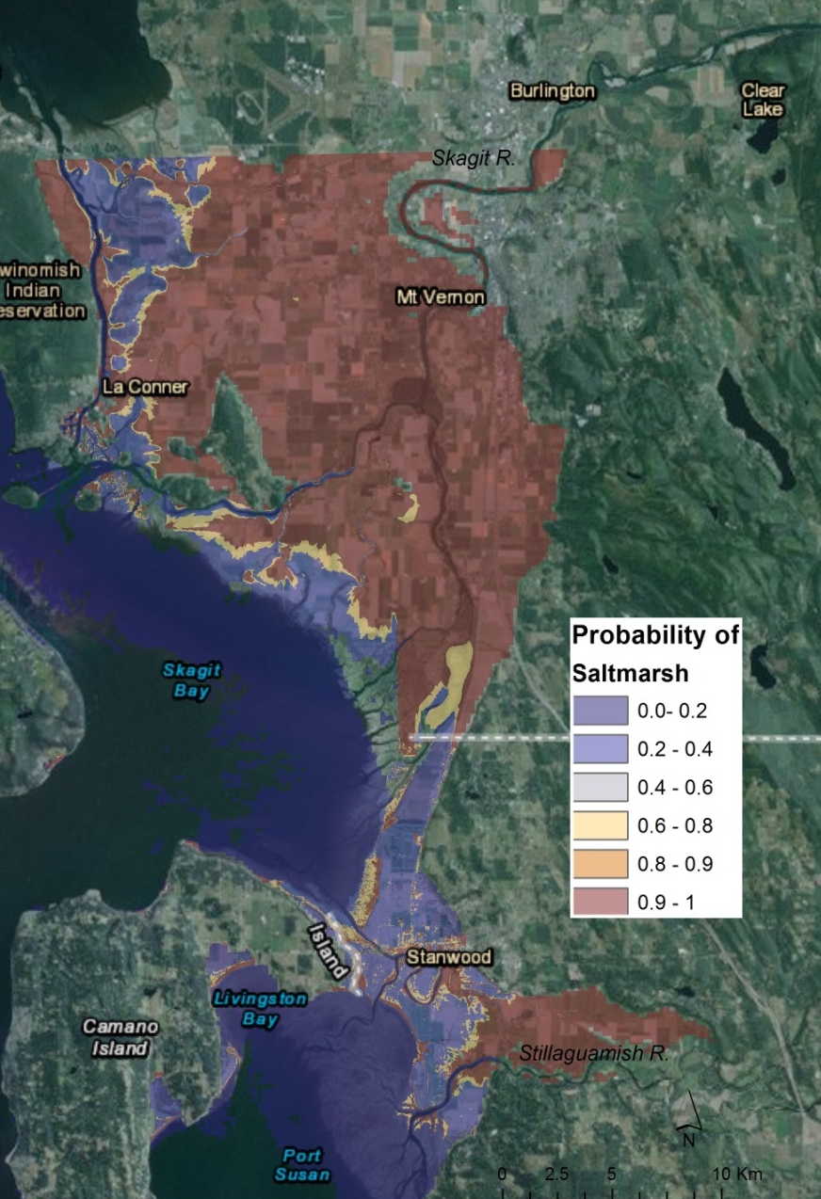
Skagit Delta
NetMap
Collins 2008

Slide 9
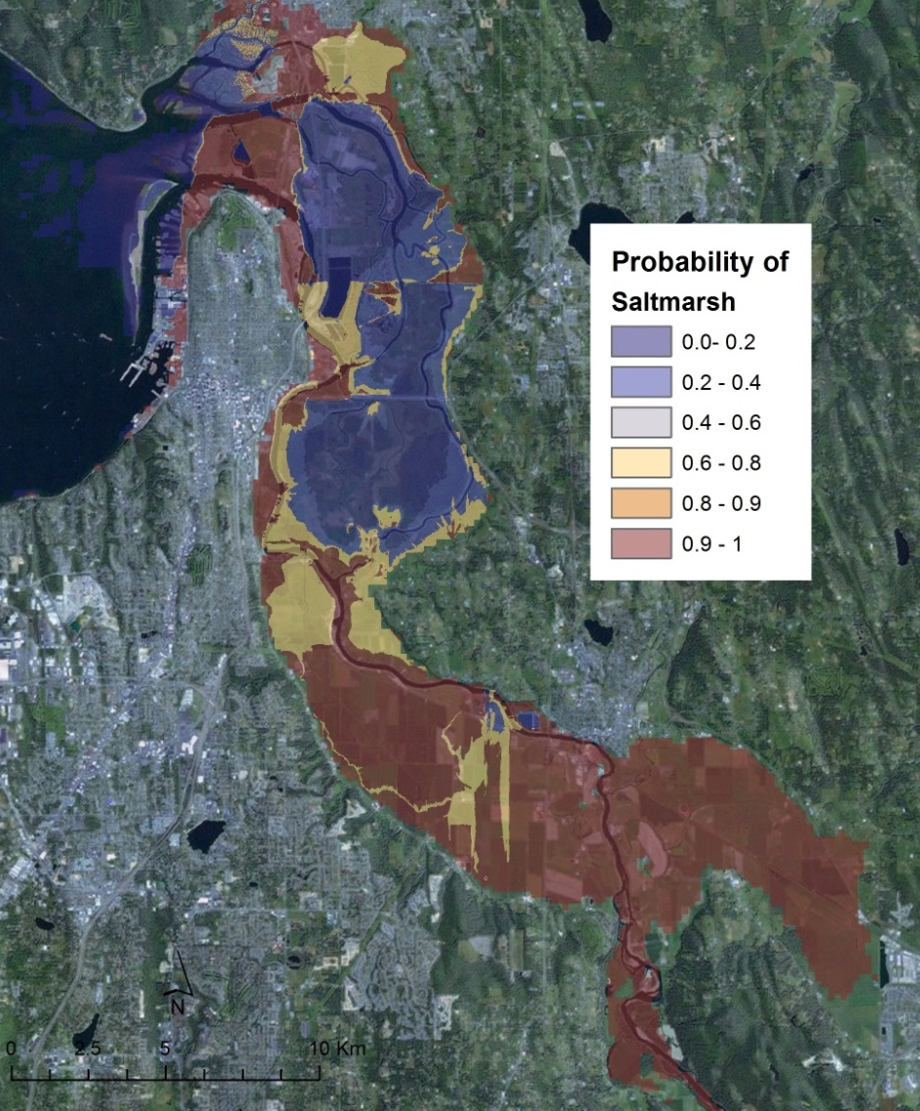
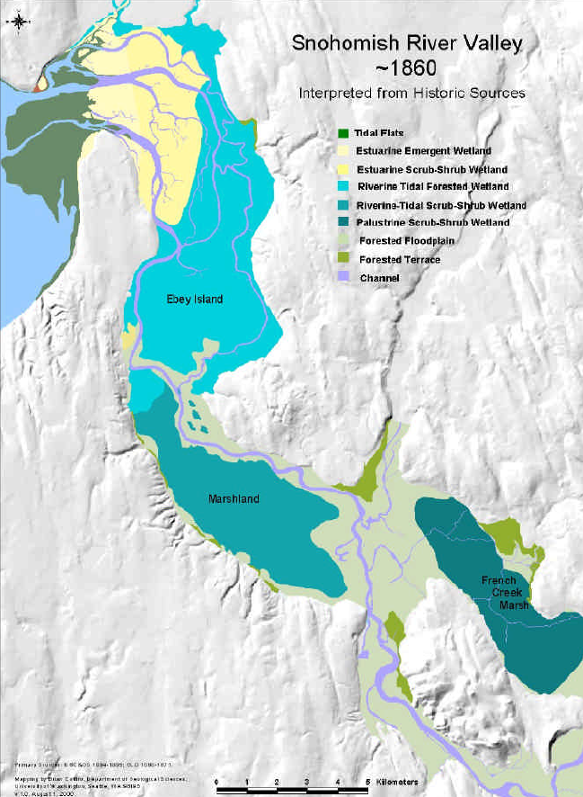
Snohomish Delta
Collins 2008

Slide 10
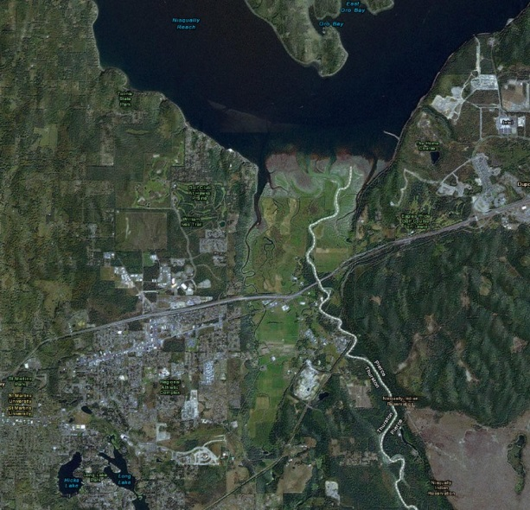
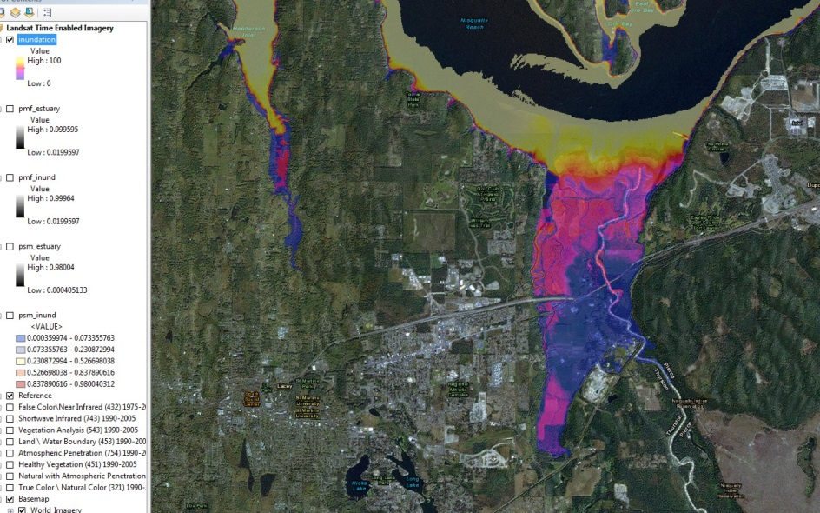
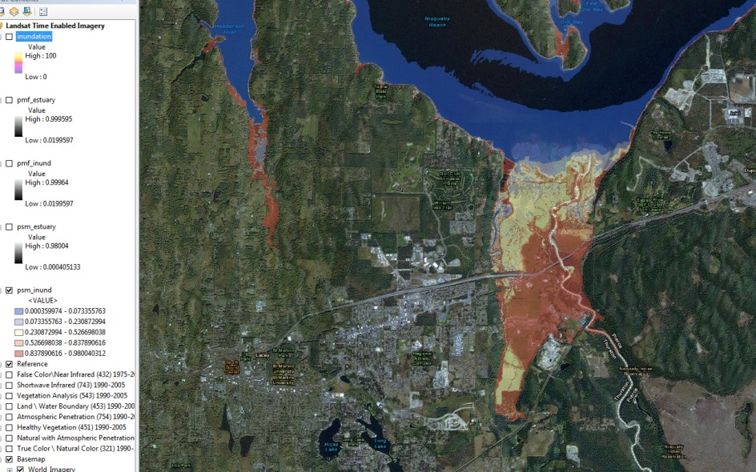
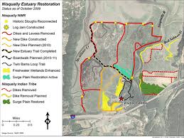
Nisqually Delta
Inundation
Probability of
salt marsh

Slide 11
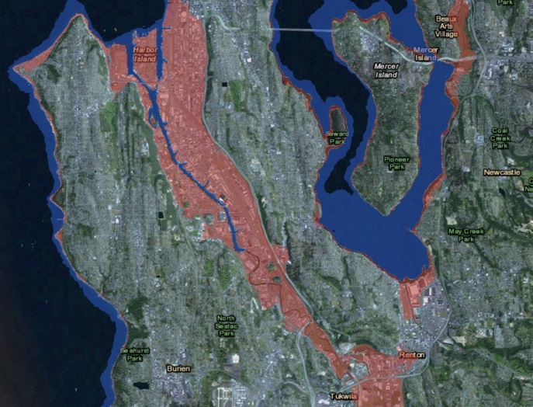
Duwamish River estuary/floodplain (RIP)

Slide 12
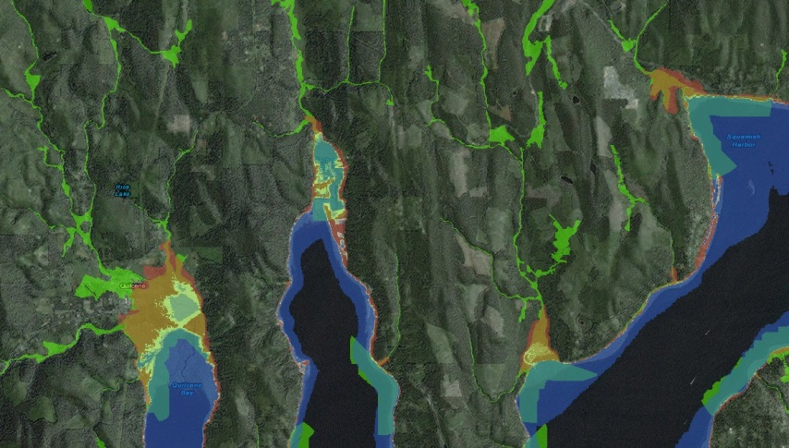
New classification schemes: estuary + floodplain

Slide 13
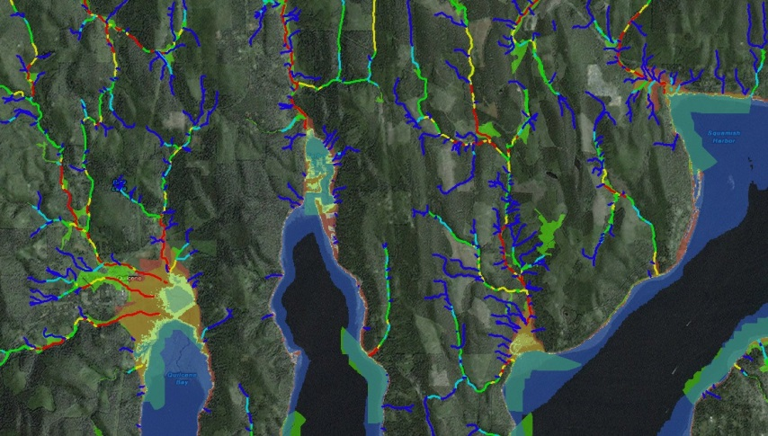
New classification schemes: estuary + floodplain + fish hab

Slide 14
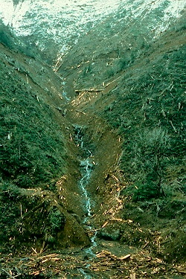
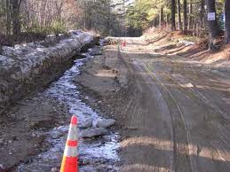
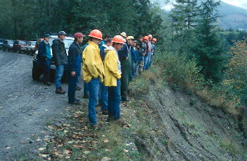
Applications: the rural, upstream domain
-forestry
-roads
-erosion
-wildfire

Slide 15
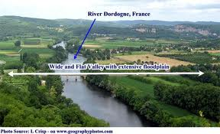
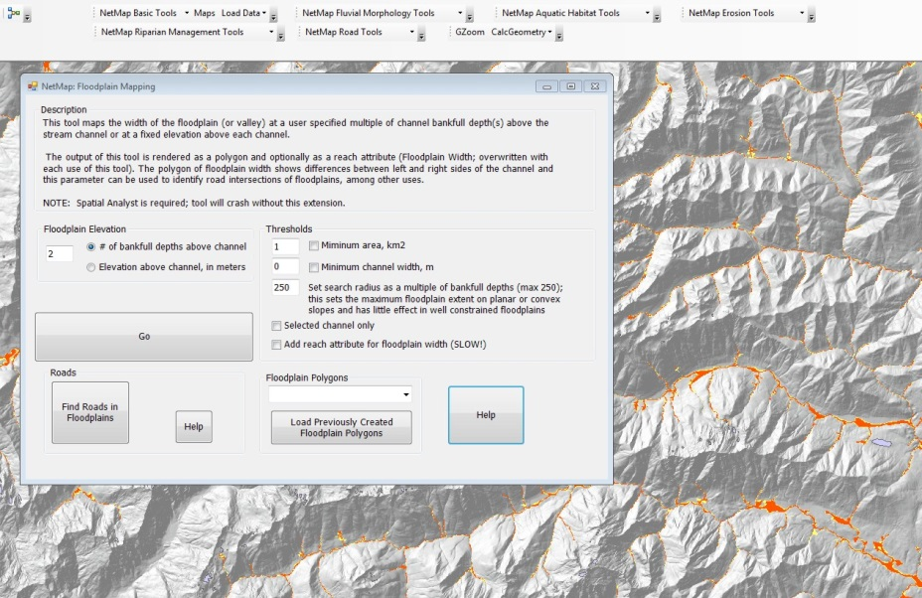
Flexible floodplain mapping

Slide 16
Flexible floodplain mapping

Slide 17
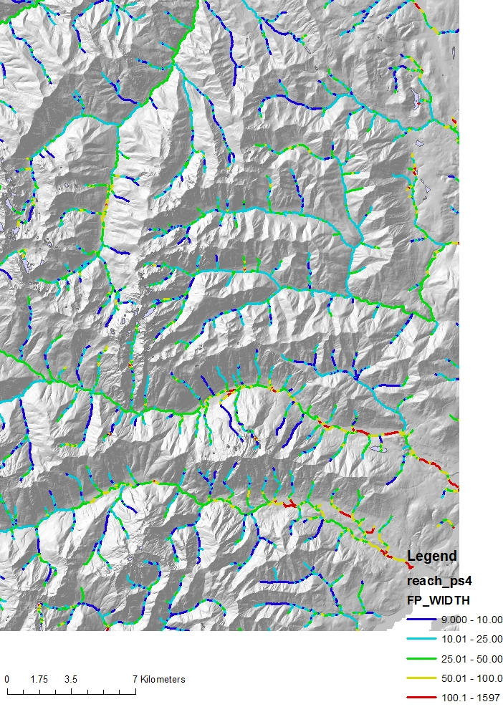
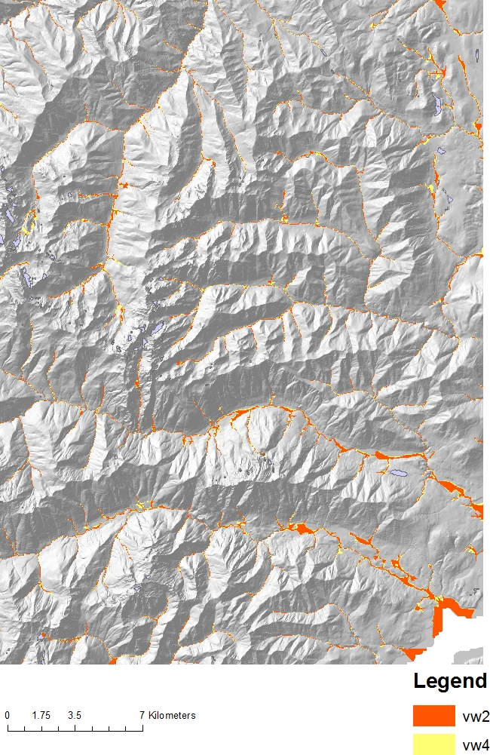
Mapping floodplains: regulatory or part of habitat mapping/prediction

Slide 18
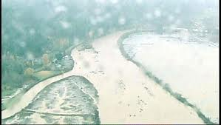
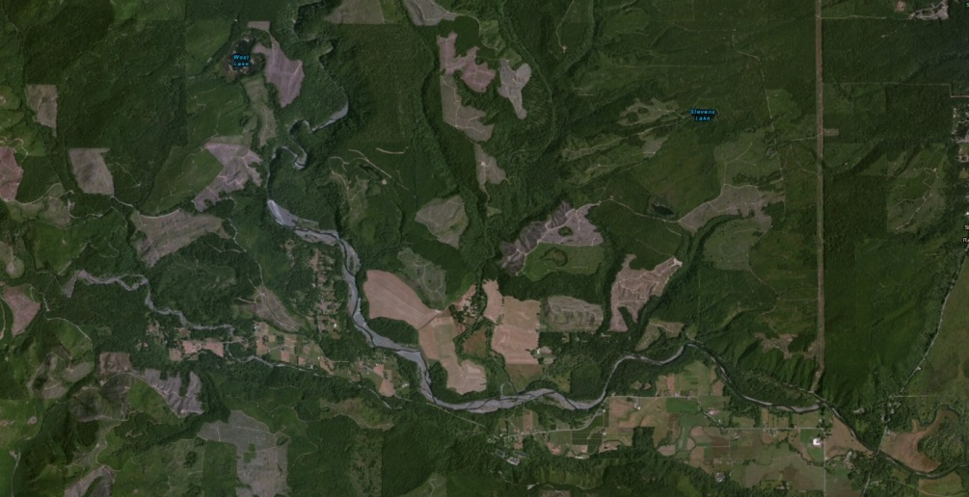
Mapping floodplains: identifying where obscured by land use
Skokomish River
Development

Slide 19
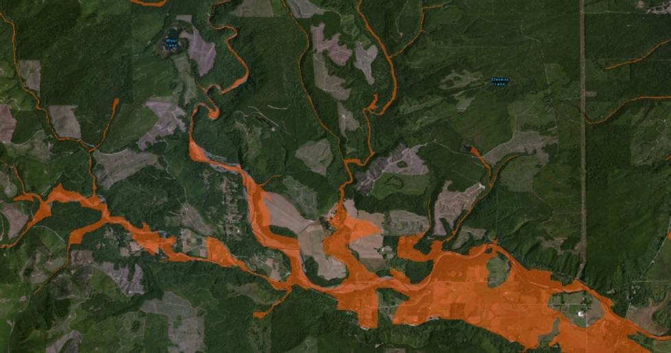
Mapping floodplains: identifying where obscured

Slide 20
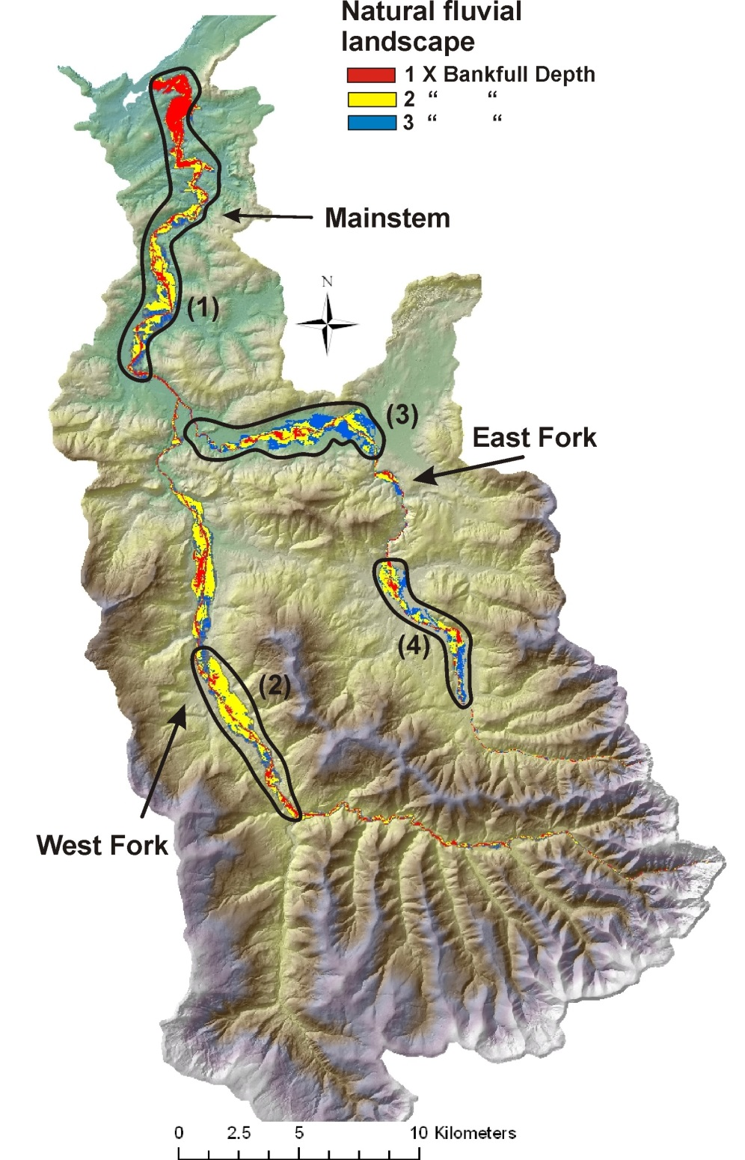
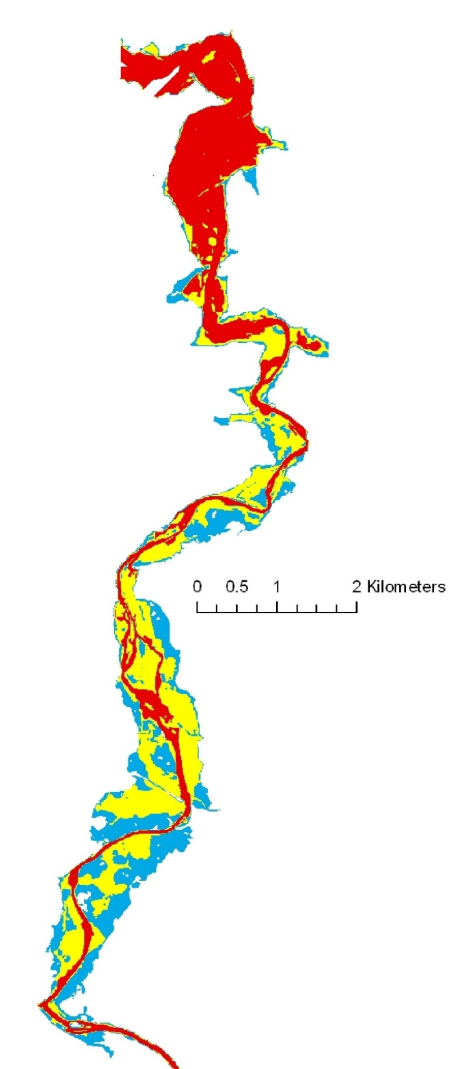
Floodplain
mapping for
restoration
planning

