Slide 1
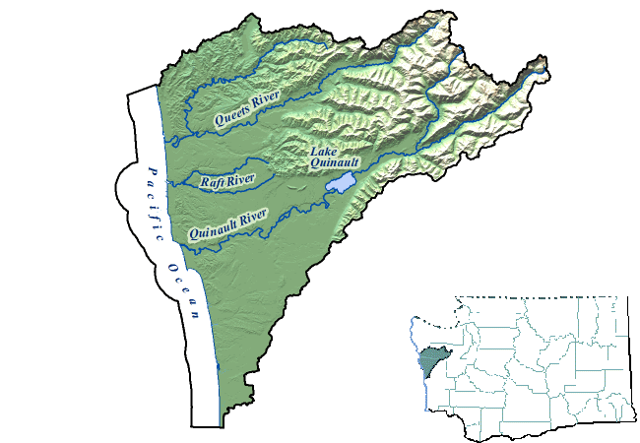
Project area covers the Quinault, Queets and the Raft Rivers

Slide 2
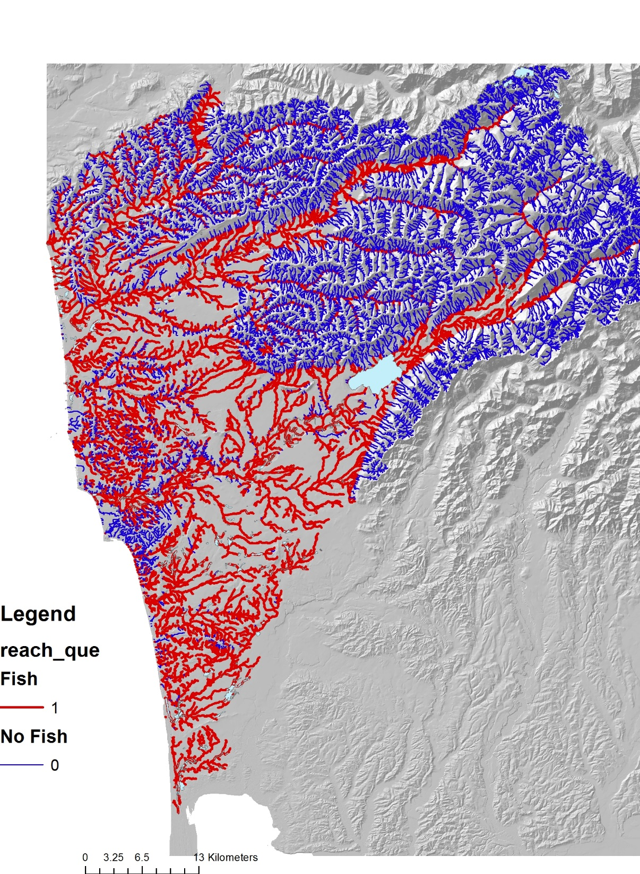
Fish bearing streams (anadromous), approximate

Slide 3
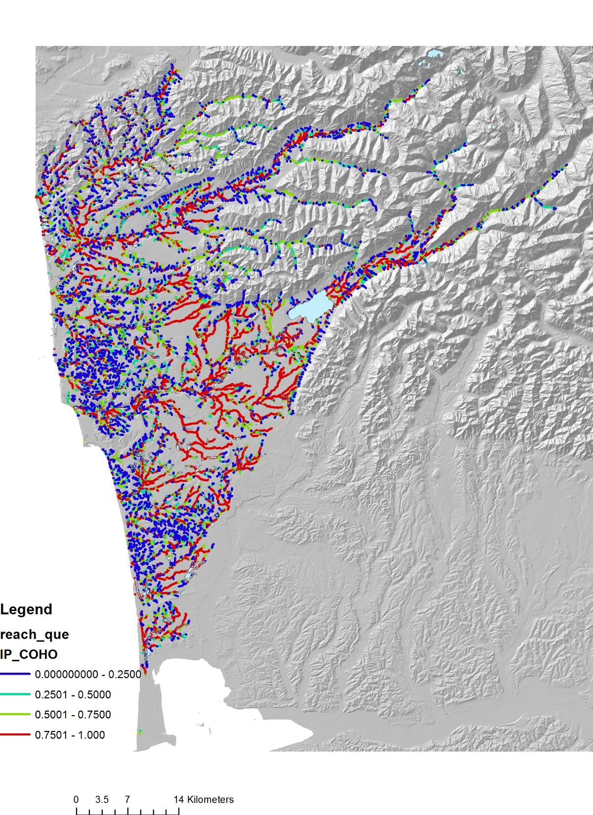
Coho, habitat intrinsic potential
(note legends same for all
three species)

Slide 4
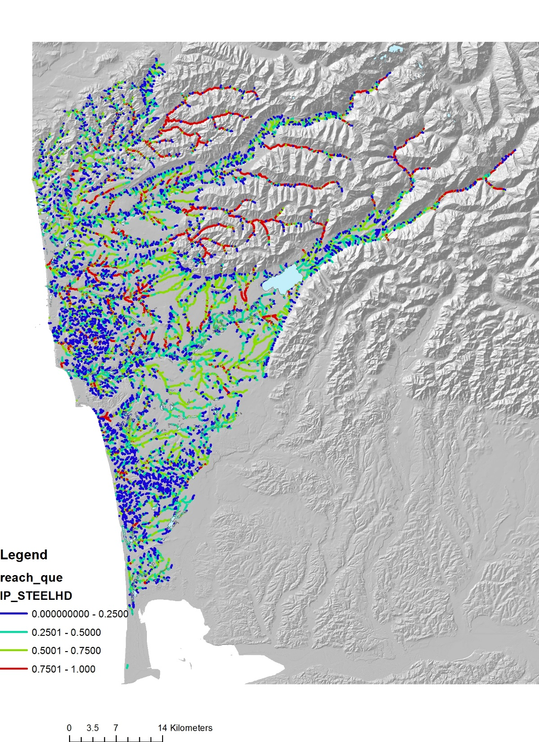
Steelhead, habitat intrinsic potential

Slide 5
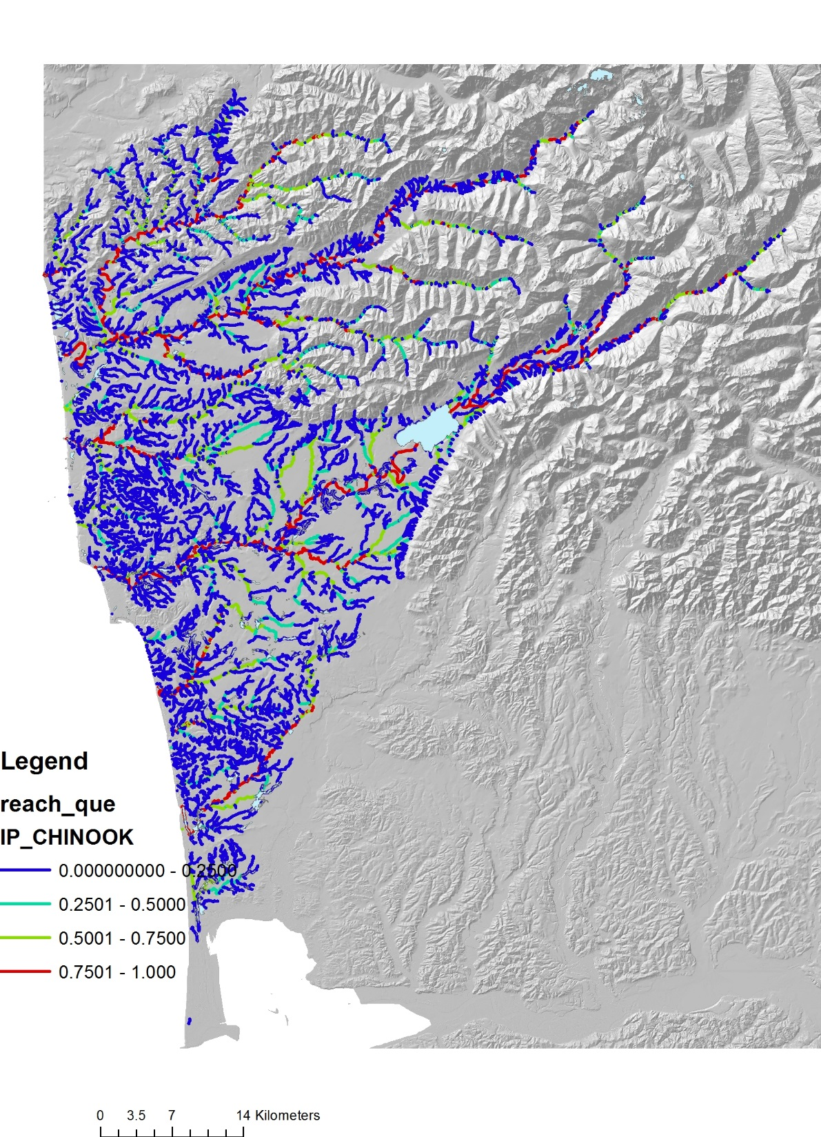
Chinook, habitat intrinsic potential

Slide 6
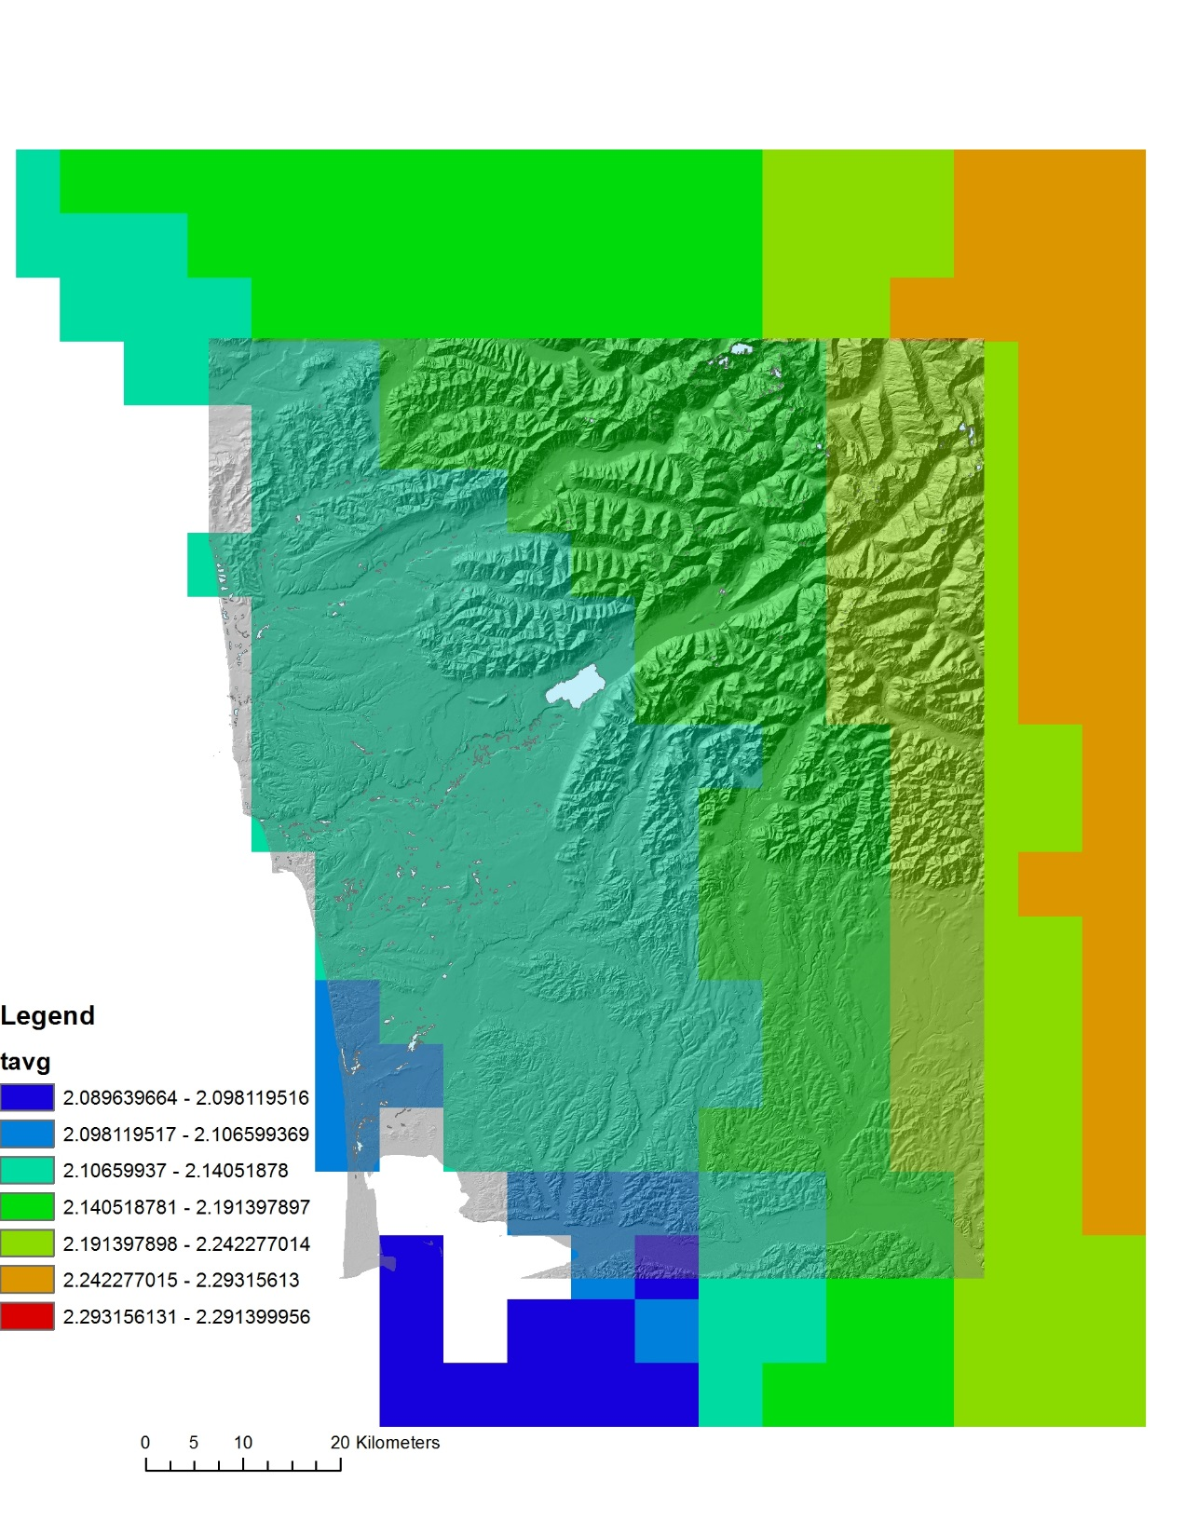
Climate Change - Temperature
UW-Climate Impact Group
Climate Change Forecasts, Downscaled
7x7 km grid cell
The scenarios represent a composite average of ten global
climate models (GCM) for the western US using four
bracketing scenarios based on four GCMs (ECHAM5,
MIROC_3.2, HADGEM1, and PCM1). Predictions are for
one greenhouse gas scenario (A1B, a middle of the road
scenario for future emissions). Results are in percent
change from historical (1916-2006) to forecasts in 2040.
Forecasts were obtained from University of Washington
Climate Impacts Group.
Predictions are in percent change from
historical [1916-2006] to forecasts in 2040, in deg C,
[all changes positive], and note relatively small change

Slide 7
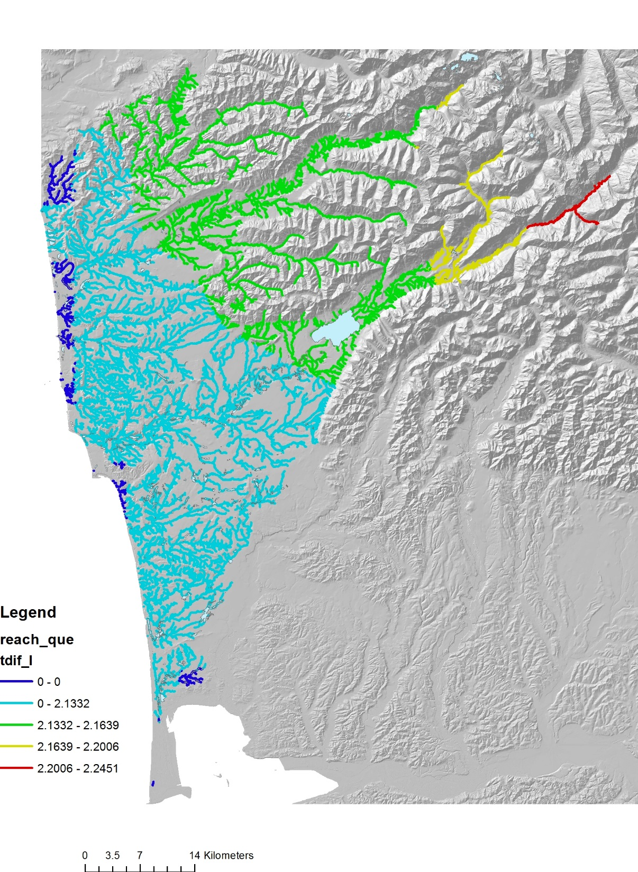
Climate Change –
Temperature
Percent change from
historical
(all values positive)
Change in temperature, stream segment scale
Change in temperature, averaged downstream

Slide 8
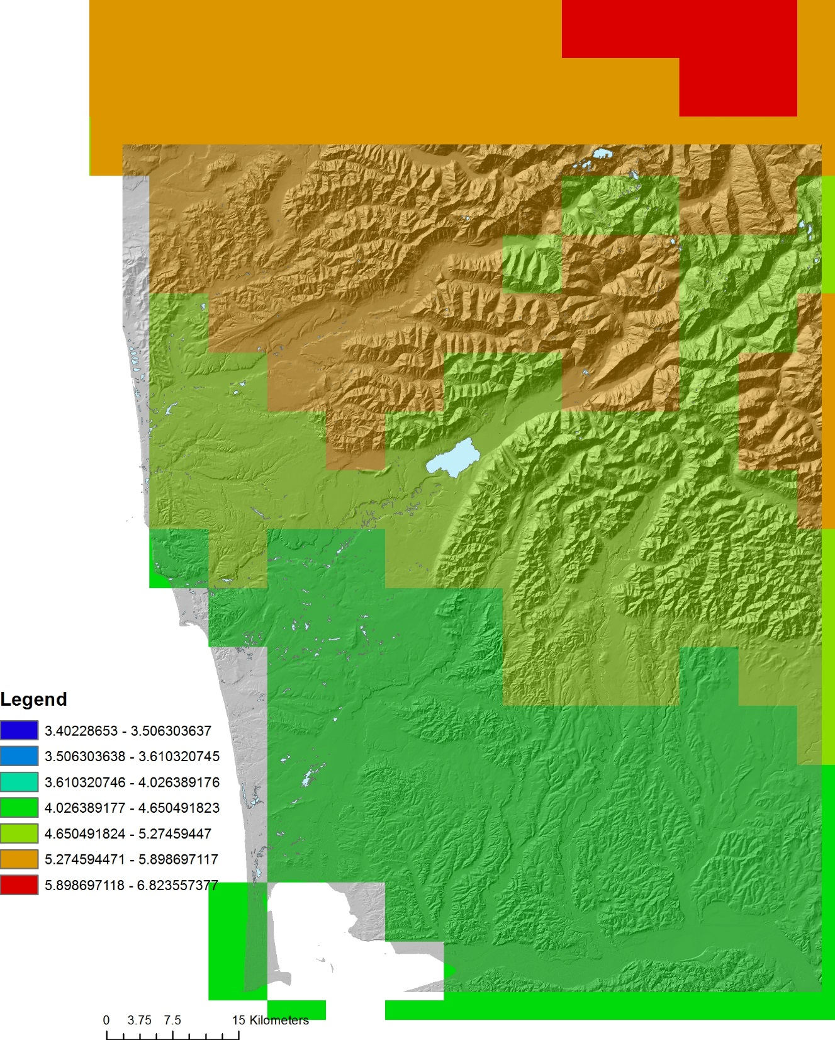
Climate Change – Precipitation
Percent change from historical
(all values positive)

Slide 9
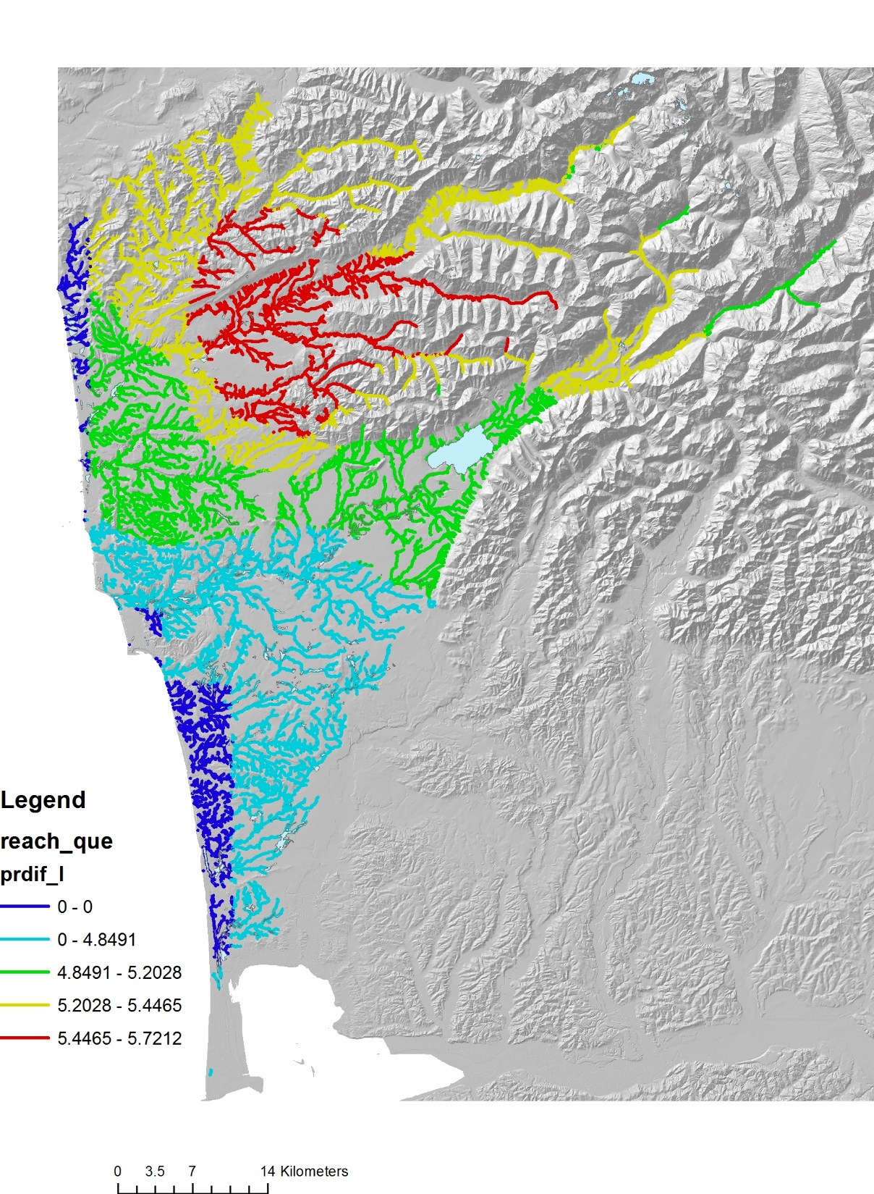
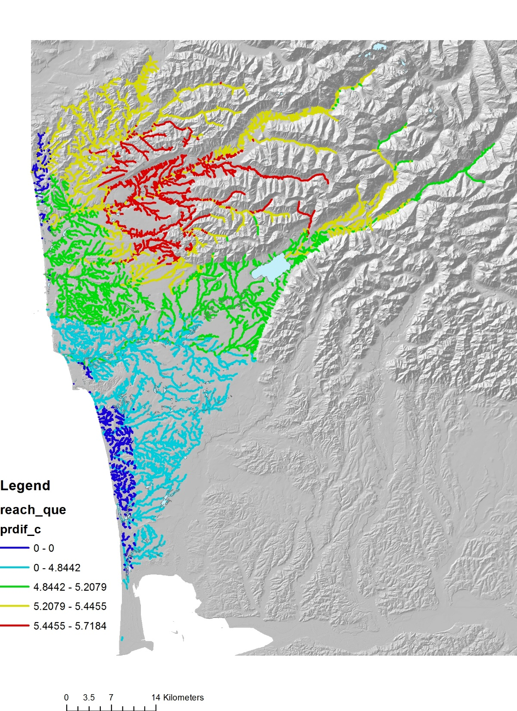
Climate Change –
Precipitation
Percent change
from historical
(all values positive)
Change in precipitation, stream segment scale
Change in temperature, averaged downstream

Slide 10
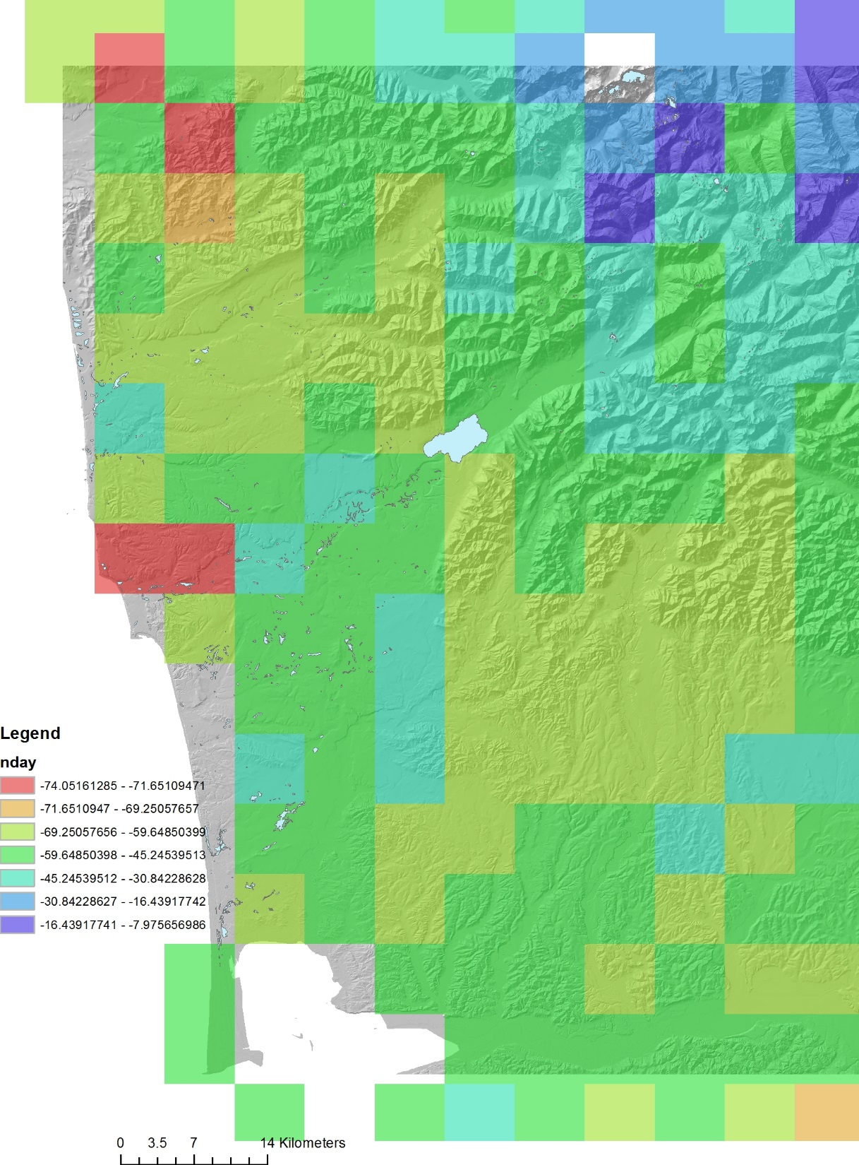
Climate Change – Snow accumulation days
Percent change from historical
(all values negative, e.g., reductions)

Slide 11
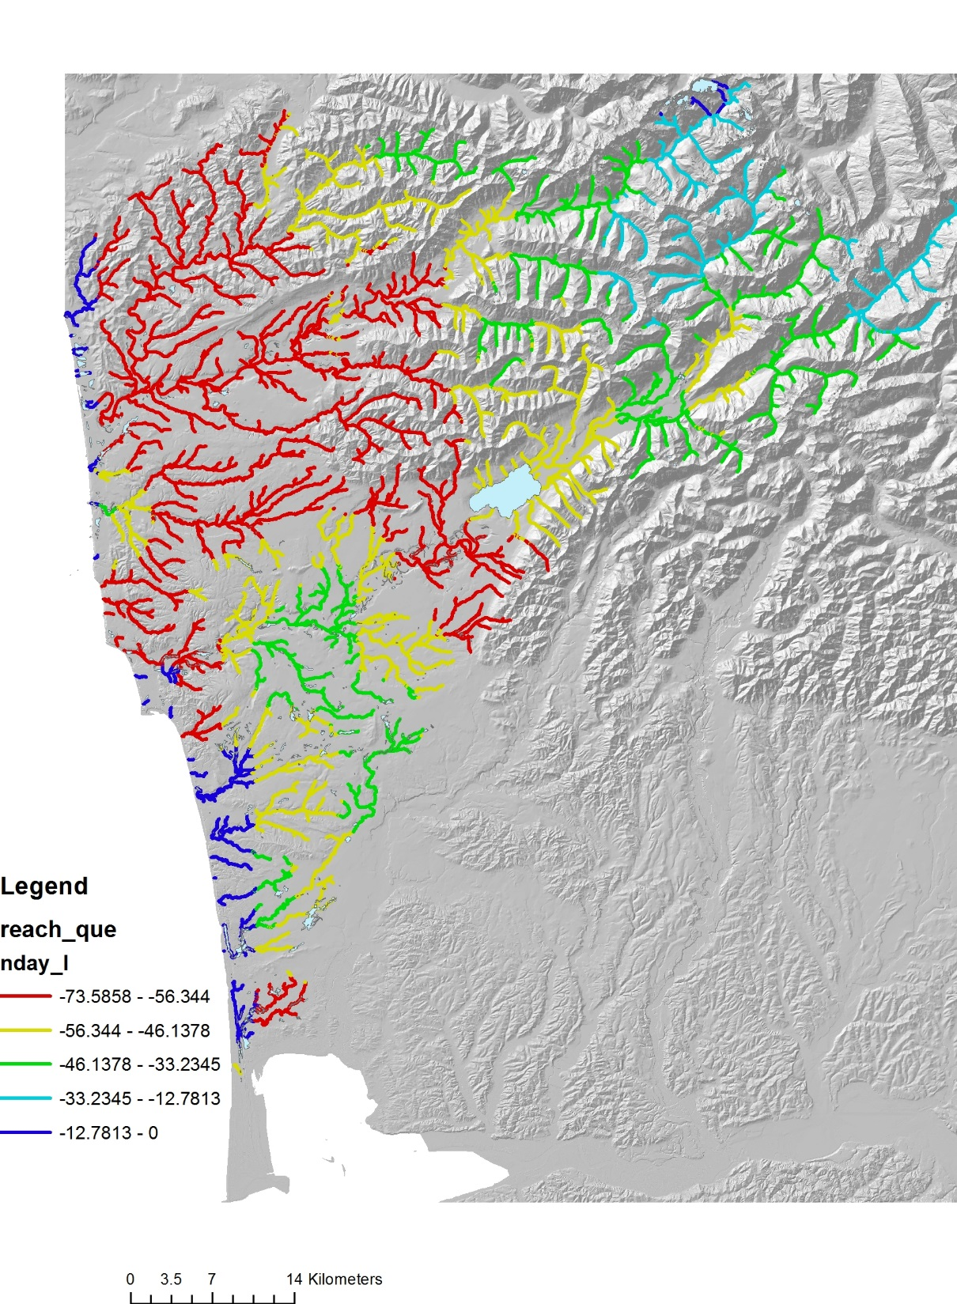
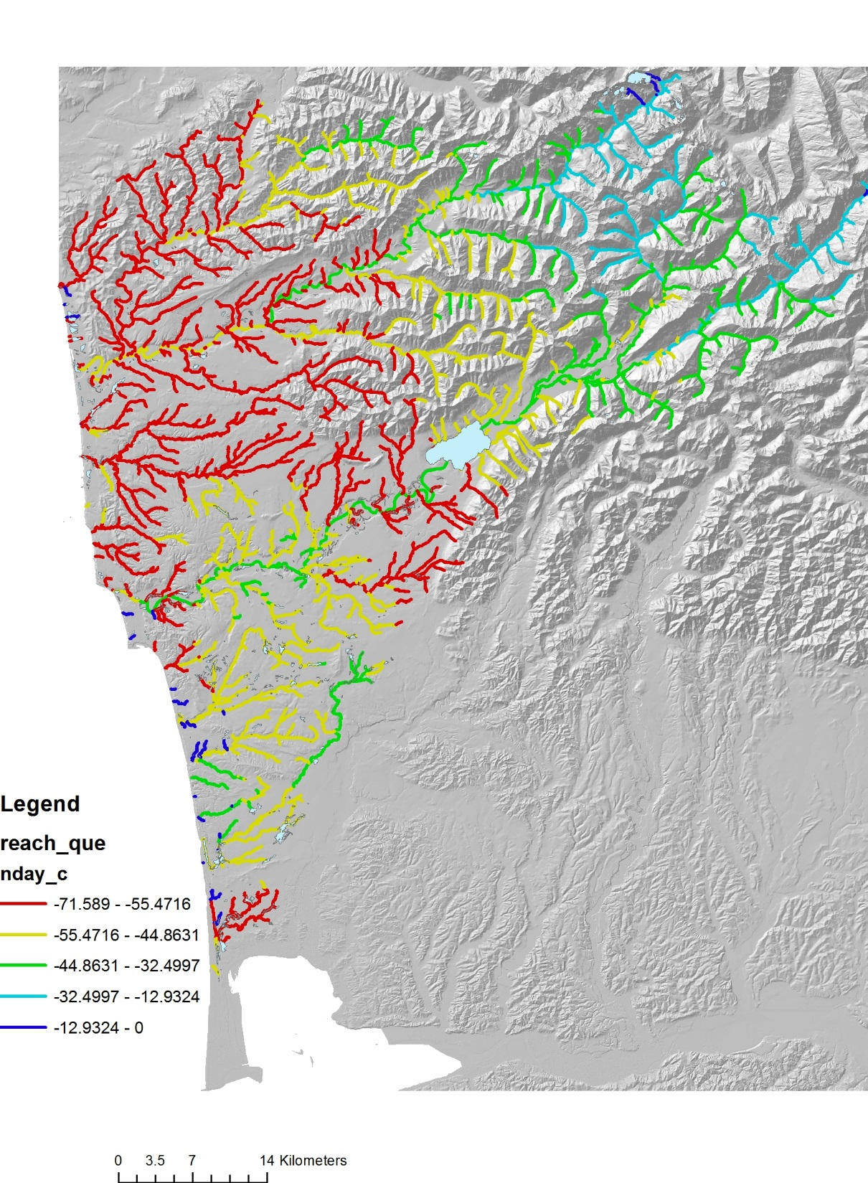
Change in snow accumulation, stream segment scale
Change in snow accumulation, averaged downstream
Climate Change –
Snow accumulation
days
Percent change from
historical
(all values negative,
e.g., reductions)

Slide 12
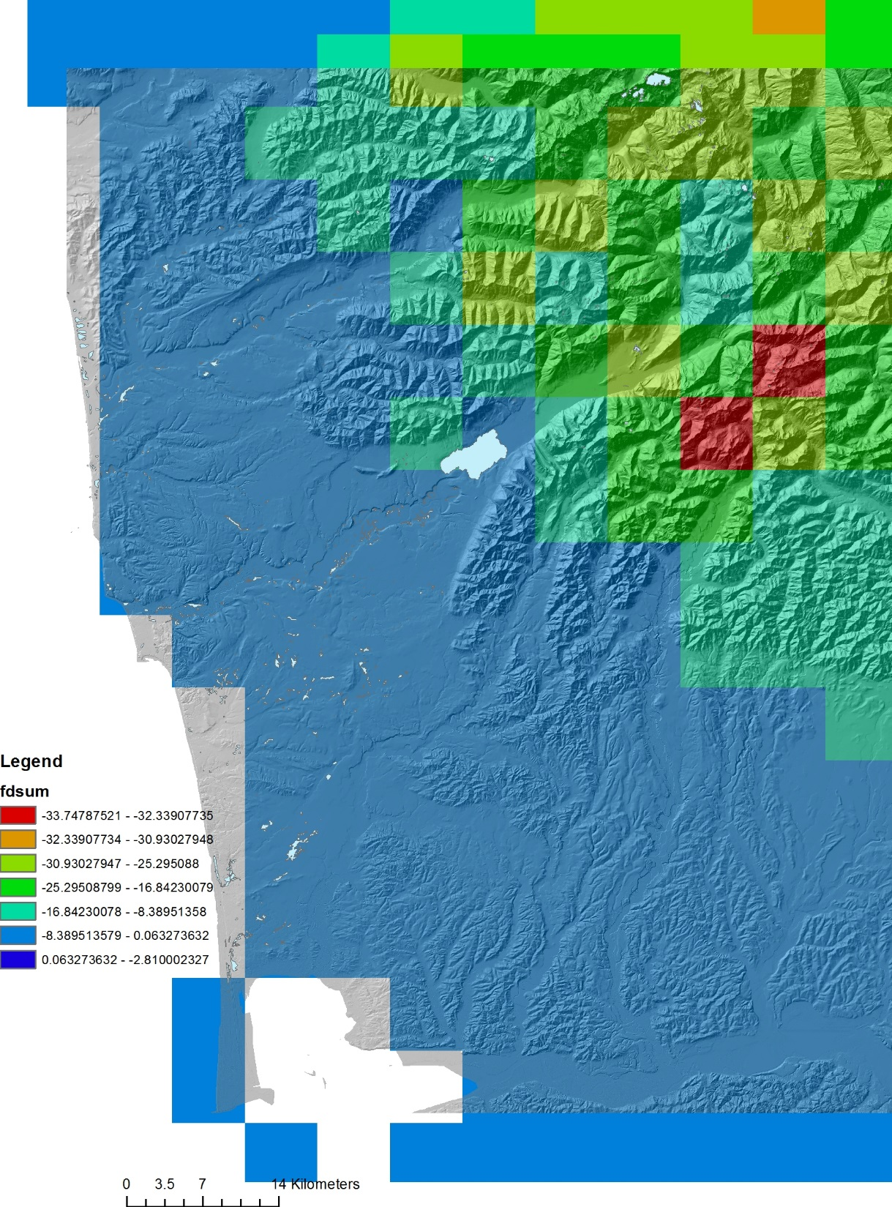
Climate Change – Summer flow
Percent change from historical
(most values negative, lower flows)

Slide 13
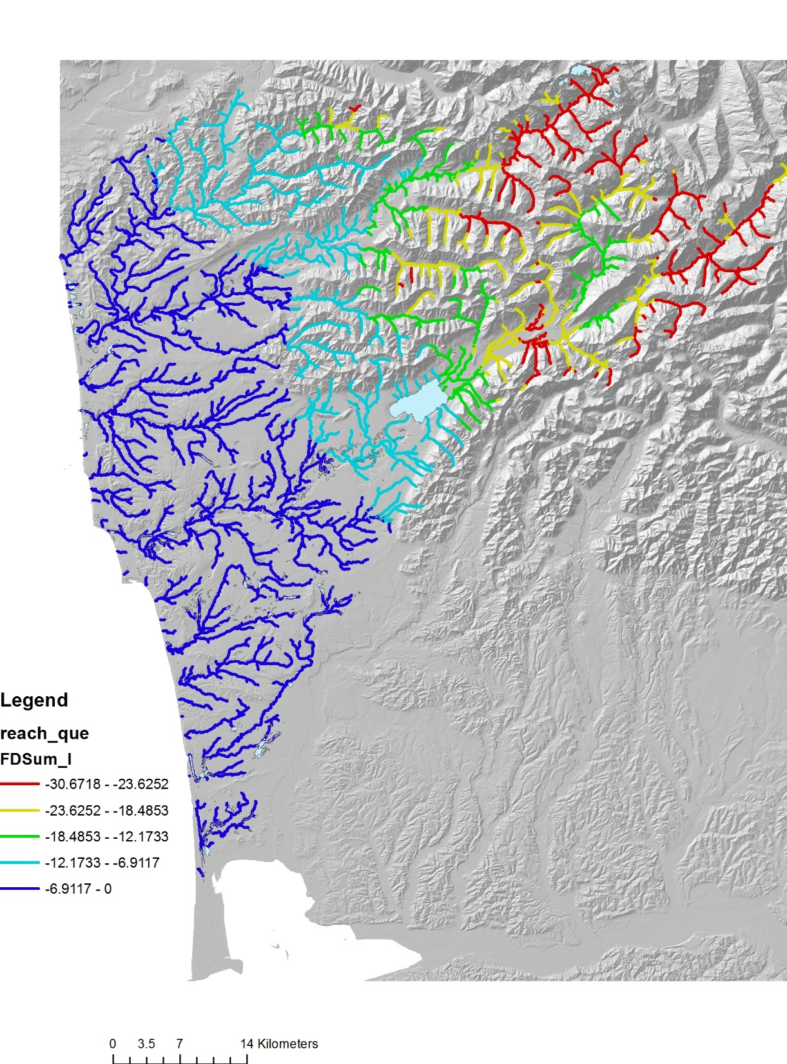
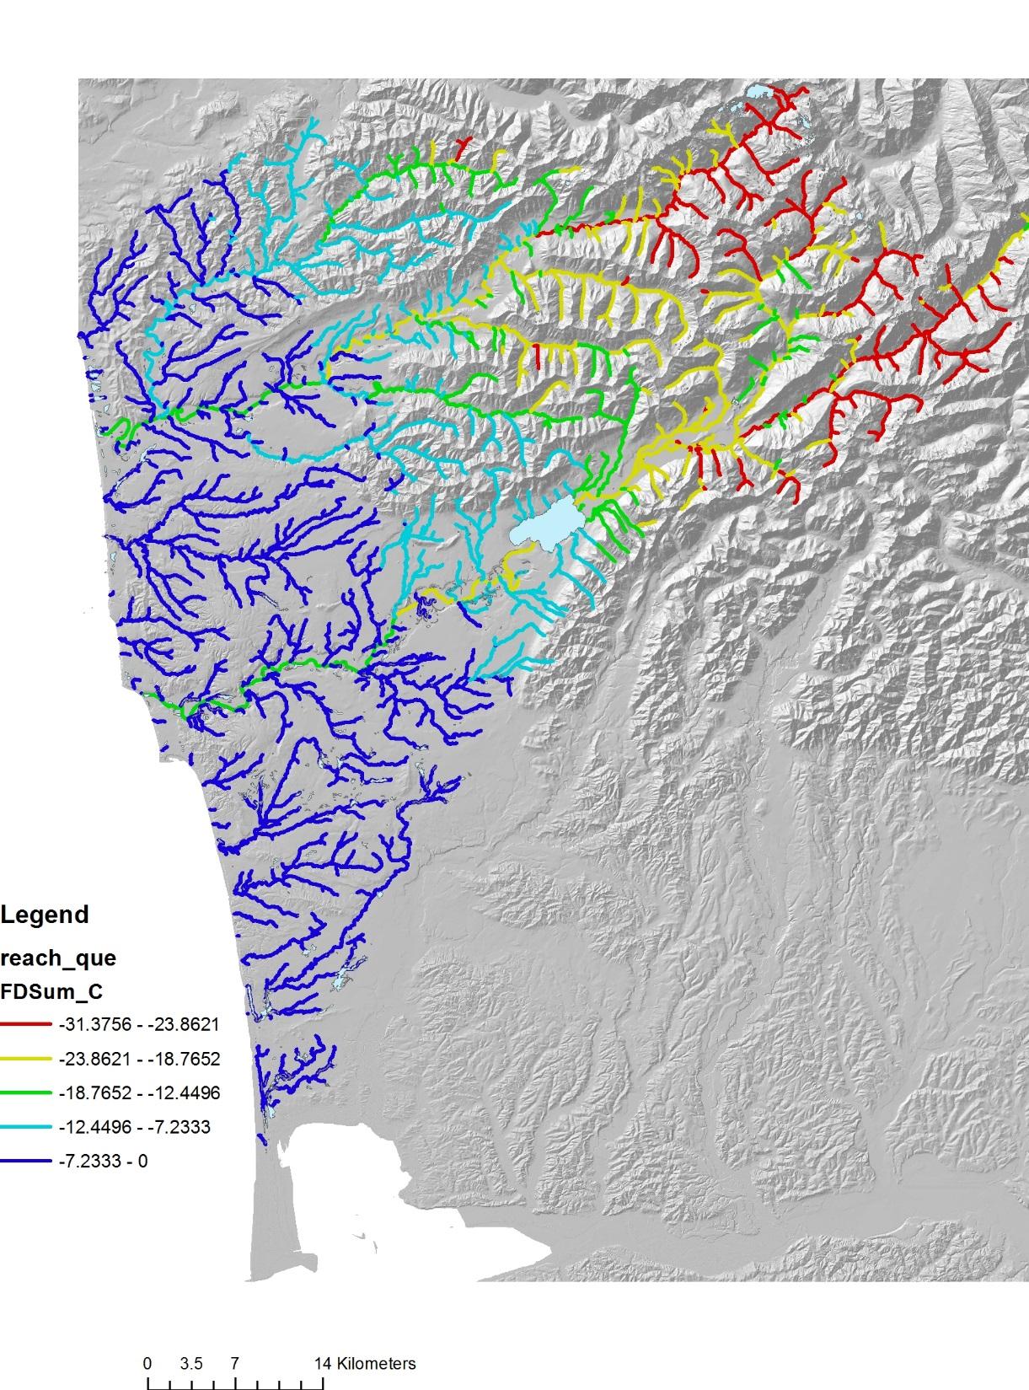
Climate Change
– Summer flow
Percent change
from historical
(most values
negative, lower
flows)
Change in summer flow, stream segment scale
Change in summer flow, averaged downstream

Slide 14
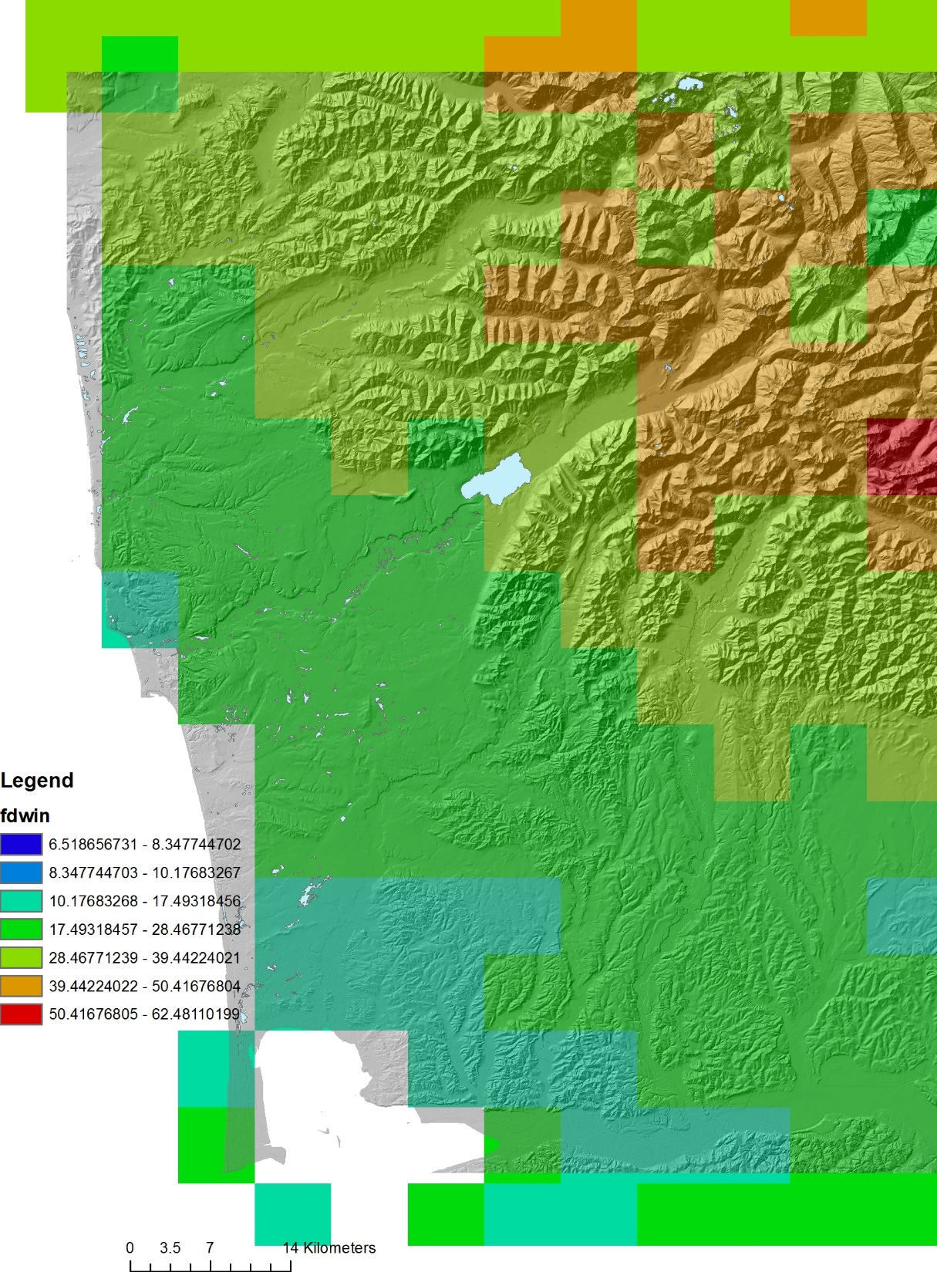
Climate Change – Winter flow (floods)
Percent change from historical
(most values positive, higher flows)

Slide 15
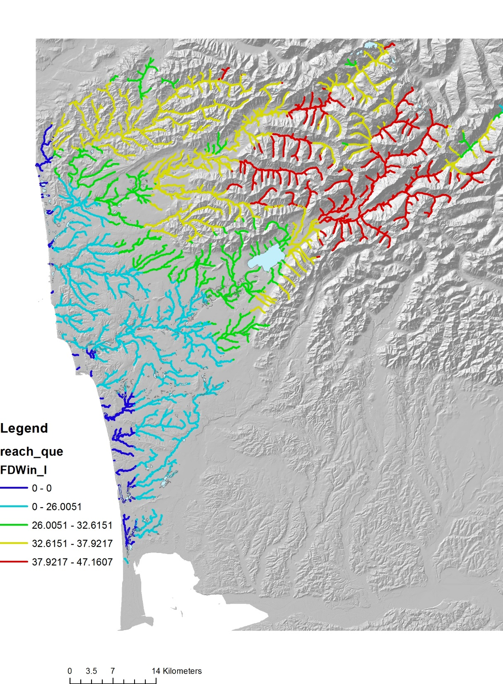
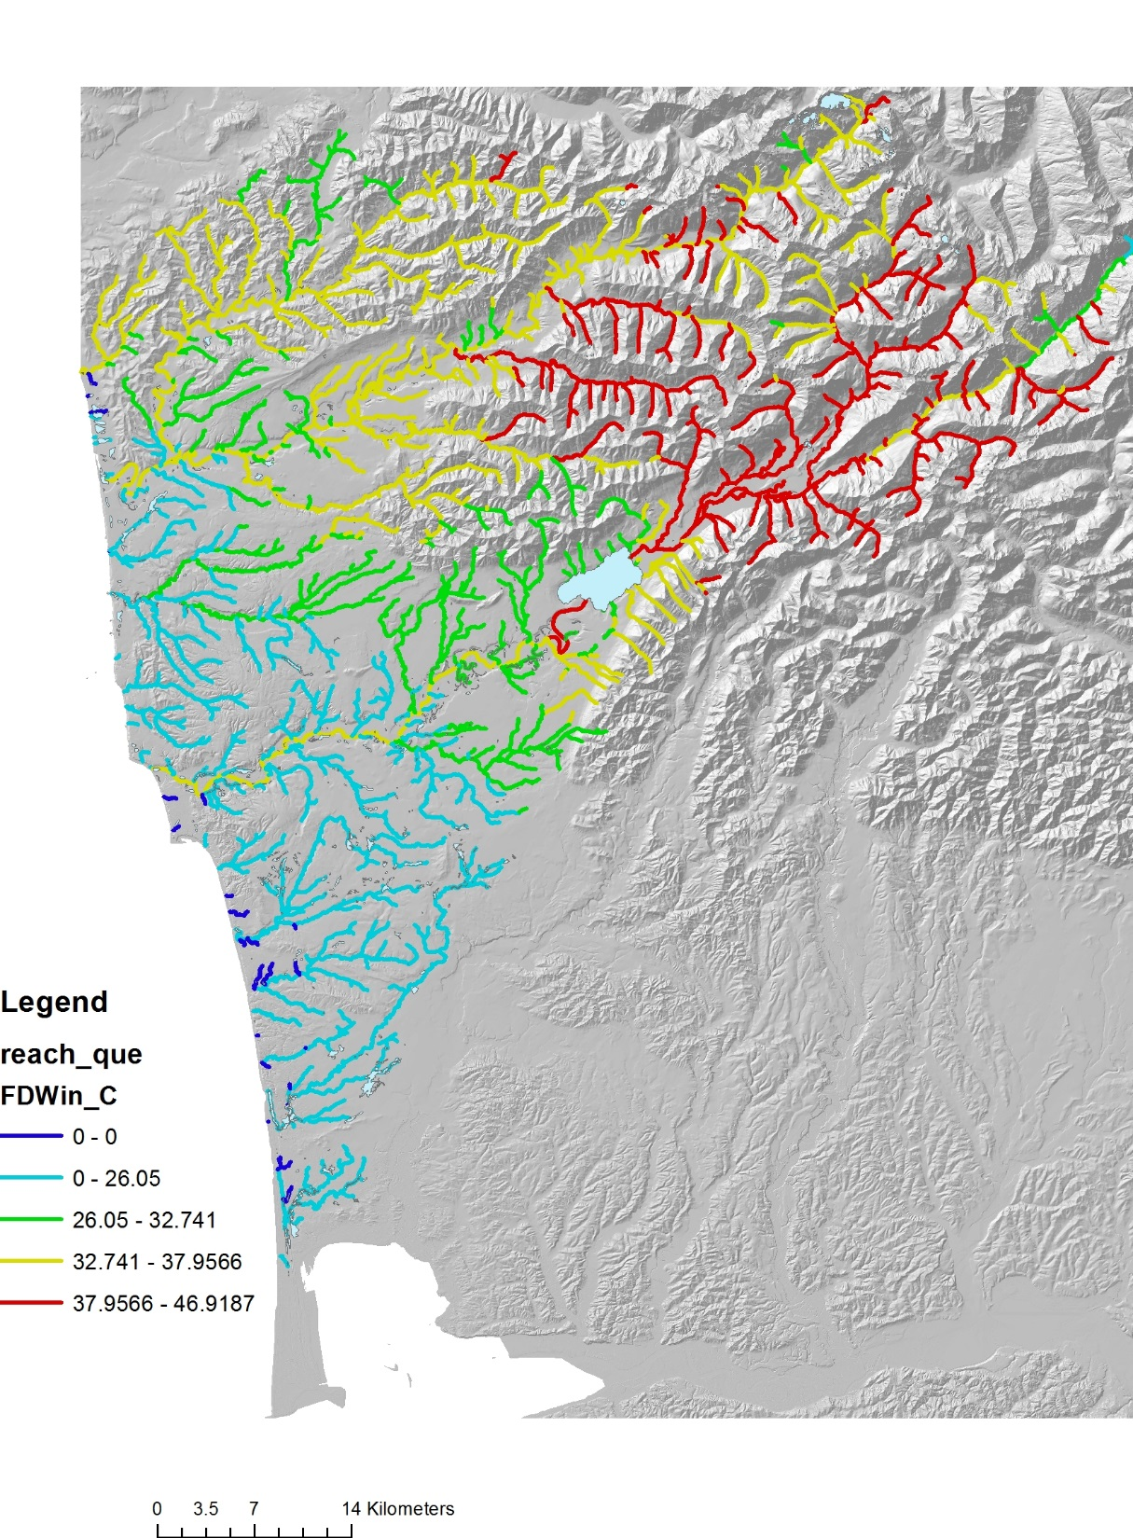
Climate Change –
Winter flow (floods)
Percent change from
historical
(most values positive,
higher flows)
Change in winter flow, stream segment scale
Change in winter flow, averaged downstream

Slide 16
In sum, looks like air temp increases (stream temp increases) in the summer (also considering predicted summer flow)
will be most important in the upper watersheds, where coho and steelhead might be at risk.
In addition, higher winter flows (floods) are predicted to be most pronounced, again in the upper basin, so the
upper to mid basin fisheries seem to be at risk, rather than the lower, coastal streams.

