Slide 1
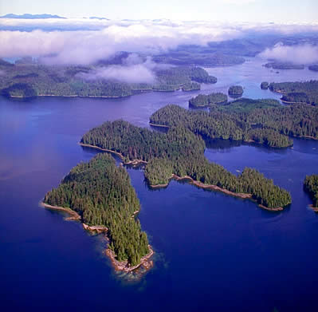
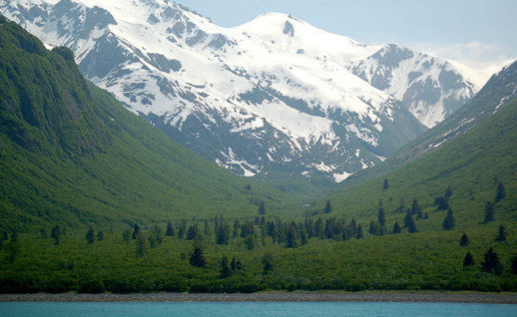
Climate Change & the Tongass NF:
Potential Impacts on Salmon Spawning Habitat
Matt Sloat, Gordie Reeves, Kelly Christiansen
US Forest Service
PNW Research Station

Slide 2


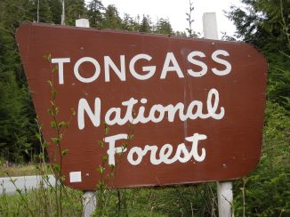
Funding provided by:
Additional assistance
provided by:
TNF, UCSB Marine Science Institute,
UC Davis, Oregon State University,
and USFS PNW RS.

Slide 3
Objectives:
Determine the vulnerability of watersheds on the Tongass National Forest to the potential impacts of climate change.
Focus on changes in flood disturbance in response to trends for a warmer, wetter climate.
Determine the impact of increases in mean annual flooding on spawning habitat for Pacific salmon.

Slide 4
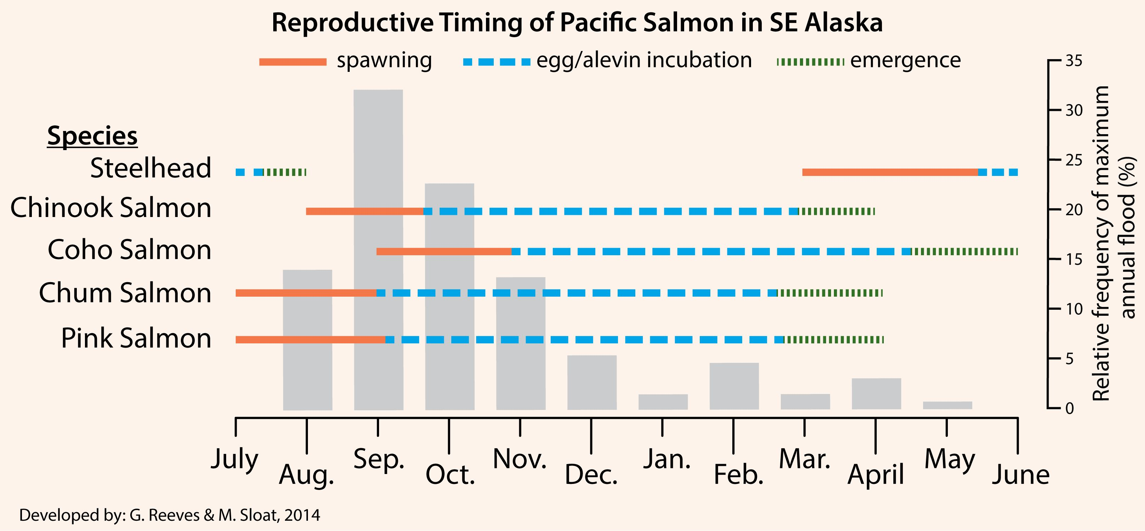
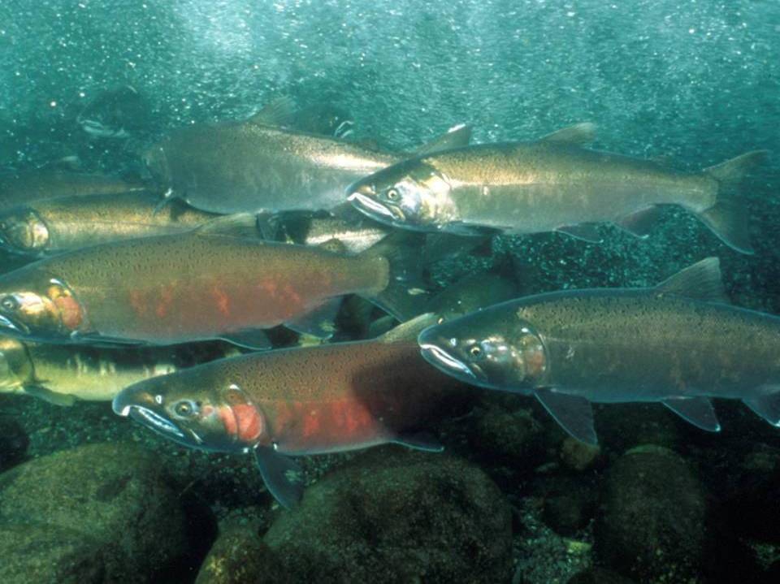
Notes:
4

Slide 5
Historic climate
Future climate models
Climate
Regional hydrologic model
Field measurements
and
digital elevation model (DEM)
Historic mean annual flood (Q₂)
Future mean annual flood (Q₂)
Hydrology
Morphologic predictions
h_{bf} , w_{bf} , S, D₅₀
static morphology
Geomorphology
dynamic adjustment
historic
morphology
Flow depth
h
Reach-averaged excess Shields stress
(τ*/ τ*_{c})
Habitat
Confined
valley
Unconfined
valley
Suitable spawning reaches
(D₅₀: 7 – 50 mm; h_{bf} ≥ 0.5 m; w_{bf} ≥ 2 m; Probability of scour mortality <0.50)
Critical scour probability

Slide 6
Historic climate
Future climate models
Regional hydrologic model
Notes:
Echam 5 A1B mid-range emissions scenario to project future climate data

Slide 7
Historic climate
Future climate models
Regional hydrologic model
Q₂ = 0.004119*A^{0.8361}*(ST+1) ^{-0.3590} *P ^{0.9110} *(J+32)^{1.635}
Q₂
A
ST
P
J
= Mean annual flood magnitude
= Drainage area
= Area of lakes
= Mean annual precipitation
= Mean January temperature
Curran et al. (2003) Estimating the magnitude and frequency
of peak streamflows for ungagged sites on stream in Alaska . . .
USGS Water Resources Investigations Report 03-4188.

Slide 8
Why focus on mean annual floods?
RIVERS ARE THE AUTHORS OF THEIR OWN GEOMETRY
Given enough time, rivers construct their own channels.
A river channel is characterized in terms of its bank-full geometry.
Bank-full geometry is defined in terms of river width and average depth at bank-full discharge.
Bank-full discharge (~Q₂) is the flow discharge when the river is just about to spill onto its floodplain.

Slide 9
Historic climate
Regional hydrologic model
Historic mean annual flood (Q₂)
Historic conditions characterized
from 1977 – 2000
Q₂ = 0.004119*A^{0.8361}*(ST+1) ^{-0.3590} *P ^{0.9110} *(J+32)^{1.635}
Q₂
A
ST
P
J
= Mean annual flood magnitude
= Drainage area
= Area of lakes
= Mean annual precipitation
= Mean January temperature
Curran et al. (2003) Estimating the magnitude and frequency
of peak streamflows for ungagged sites on stream in Alaska . . .
USGS Water Resources Investigations Report 03-4188.

Slide 10
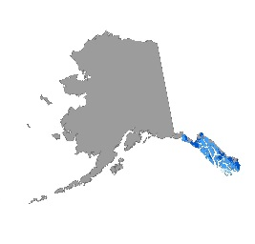
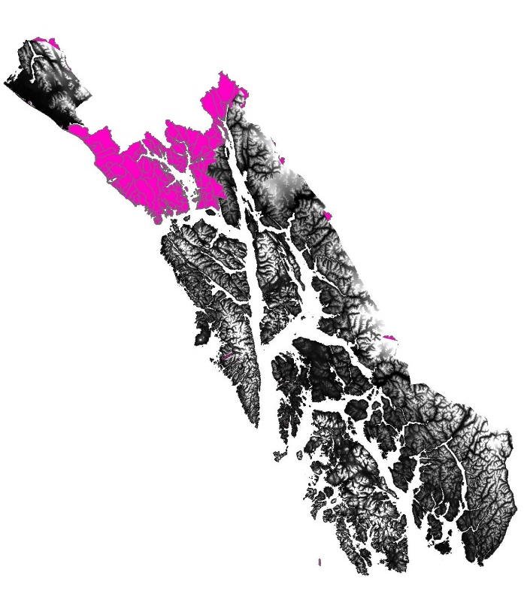
Historic climate
Regional hydrologic model
Field measurements
and
digital elevation model (DEM)
Historic mean annual flood (Q₂)
Morphologic predictions
h_{bf} , w_{bf} , S, D₅₀
NetMap’s attributed and routed stream
layer in southeast Alaska was used to
delineate fish habitats and to calculate
hydrographic and morphological
variables (www.terrainworks.com)

Slide 11
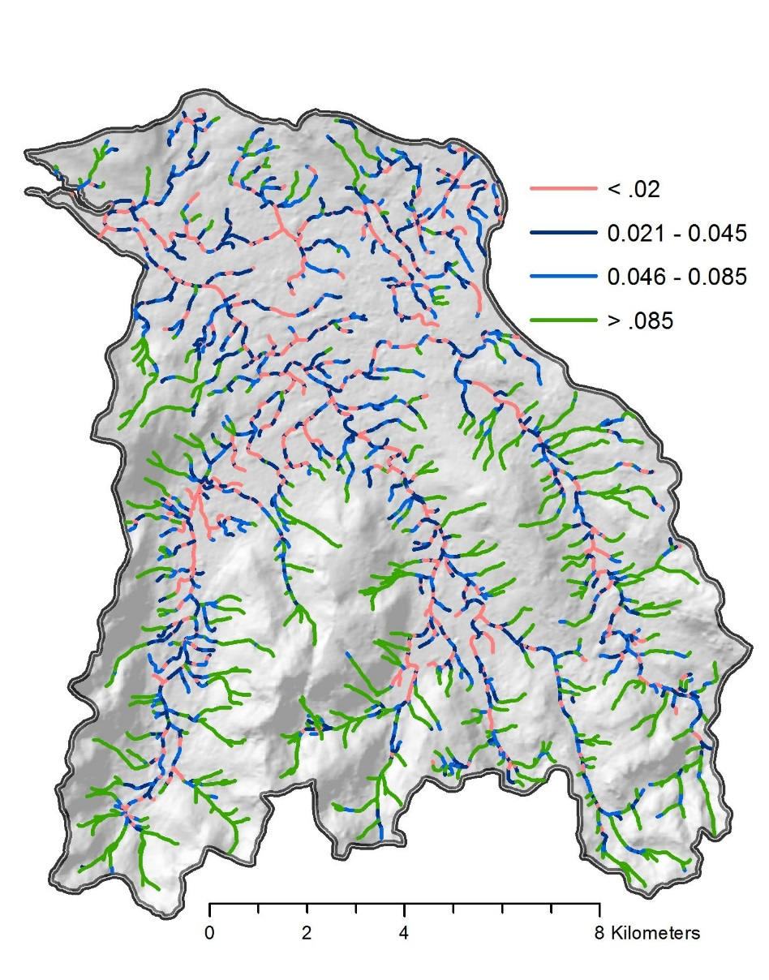
Historic climate
Regional hydrologic model
Field measurements
and
digital elevation model (DEM)
Historic mean annual flood (Q₂)
DEM-derived channel slope
Morphologic predictions
h_{bf} , w_{bf} , S, D₅₀

Slide 12
HC (>0.35)
HC (>0.08–0.35)
AF (>0.08)
Colluvial
HC (<0.08)
AF (<0.08)
Cascade
MM, MC
LC, FP, PA
ES
Step-pool
Plane-bed
Pool-riffle
High
Low
Gradient
Notes:
Some stream channels are more likely to respond to changes in flood magnitude than others. Channel typing schemes are useful for understanding the likely effects of increased flood magnitude on channel morphology. We reclassified R10’s channel typing system (Paustian et al. 1992) to correspond with the channel classification scheme of Montgomery and Buffington (1997). We used the revised R10 channel typing user guide to determine which R10 channel types corresponded with the Montgomery and Buffington system. In some cases (i.e, within HC and AF process groups), we used professional judgment and field photos to split R10 process groups into morphologies consistent with the Montgomery and Buffington system based on channel gradient. The reclassification of channel types was done in order to reduce the number of process groups considered in our coarse-scale analysis and to emphasize similarities in channel morphology, sediment transport, and hydrologic discharge, and also to facilitate reach-scale predictions of channel morphology as a function of channel gradient (Montgomery and Buffington 1997, 1998; Buffington et al. 2003).

Slide 13
CA
SP
PB
PR
ES
Notes:
This figures shows the distribution of channel slopes as a function of reach-scale channel morphology based on field measurements from 318 stream reaches on the Tongass NF. Although the observed gradient ranges of different channel types overlap, they have nonoverlapping central tendencies that allow first-order prediction of channel types based on reach-average channel gradient. Slope breaks dividing reach-scale channel morphology are 0.02, 0.045, and 0.085. These slope breaks differ slightly from those used in the Pacific Northwest (i.e., 0.015, 0.03, and 0.075), which likely reflects differences in regional sediment transport and hydrological processes (and could possibly be an artifact of translating R10 channel types to Montgomery Buffington morphologies). Overall, they are remarkably similar, however. The bottom line is that knowing the slope of a stream reach gives us a fairly good idea of its likely channel morphology. Channel slope can easily be obtained from DEMs.

Slide 14
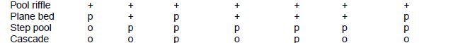
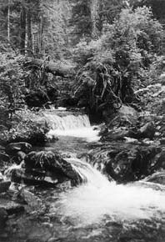
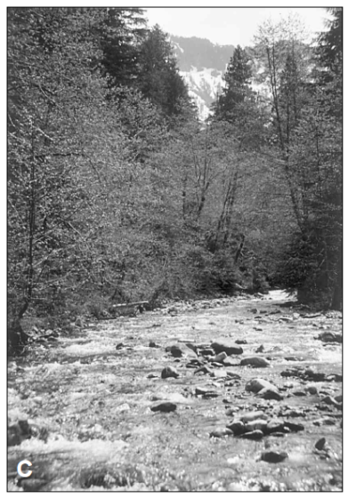
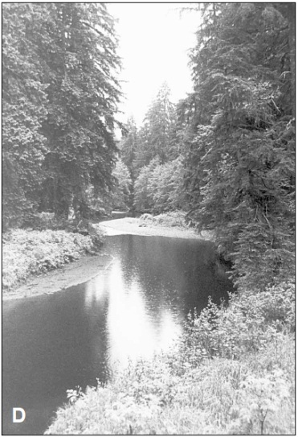
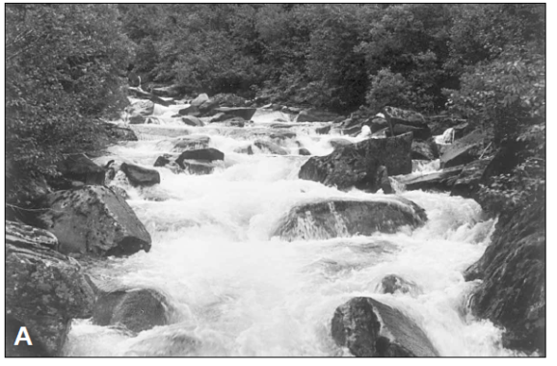
Reach-level channel response potential to changes in sediment
supply and discharge (modified from Montgomery and Buffington 1997)
Cascade
Step-pool
Plane-bed
Pool-riffle
Transport
Response
High
Low
Slope
Notes:
This table shows the expected reach-level channel response potential to changes in sediment supply and/or discharge. In general, moving from high-gradient headwaters (i.e., cascades) to low-gradient, low-elevation portions of the watershed (e.g., pool-riffle channels), channels become more responsive to altered sediment and hydrologic regimes. “+” indicates that a particular type of channel response is likely in a given channel type, “p” indicates the response is possible, and “o” indicates it is unlikely. Understanding the spatial arrangement of different channel types is a first step in understanding spatial variation in channel response potential.

Slide 15
Historic climate
Regional hydrologic model
Field measurements
and
digital elevation model (DEM)
Historic mean annual flood (Q₂)
Morphologic predictions
h_{bf} , w_{bf} , S, D₅₀
Zynda, T. (2005). Development of regional hydraulic geometry relationships and stream basin equations for the Tongass National Forest, Southeast Alaska. Unpublished Master’s Thesis, Michigan State University, Lansing MI.

Slide 16
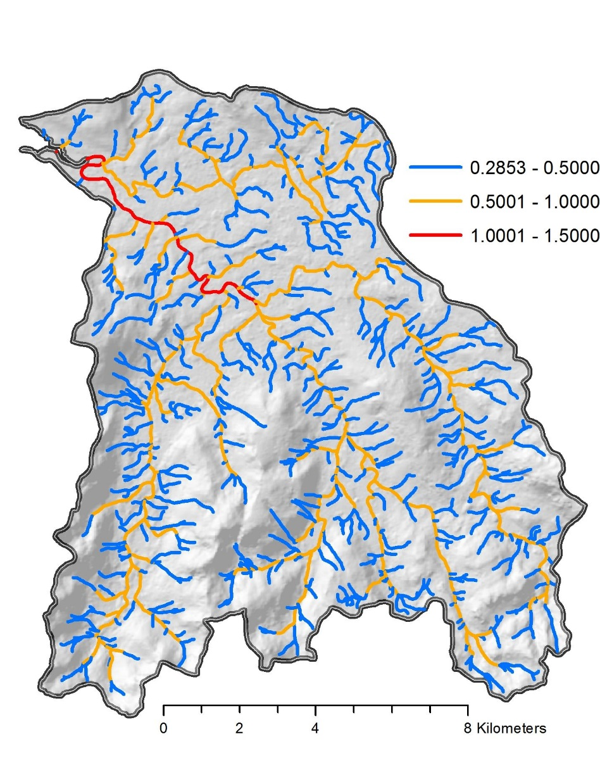
Historic climate
Regional hydrologic model
Field measurements
and
digital elevation model (DEM)
Historic mean annual flood (Q₂)
Bank-full channel depth (h_{bf} )
Morphologic predictions
h_{bf} , w_{bf} , S, D₅₀

Slide 17
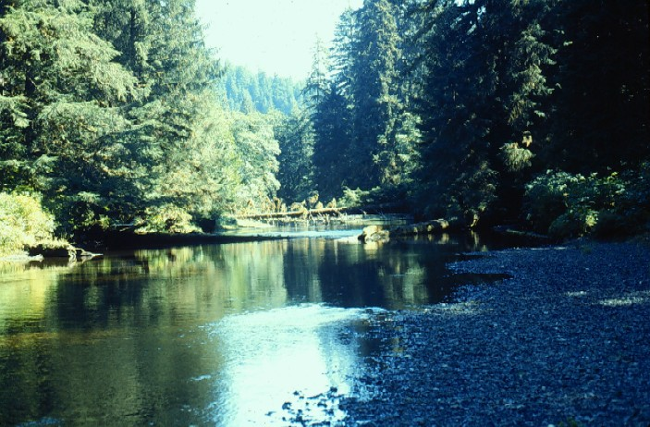
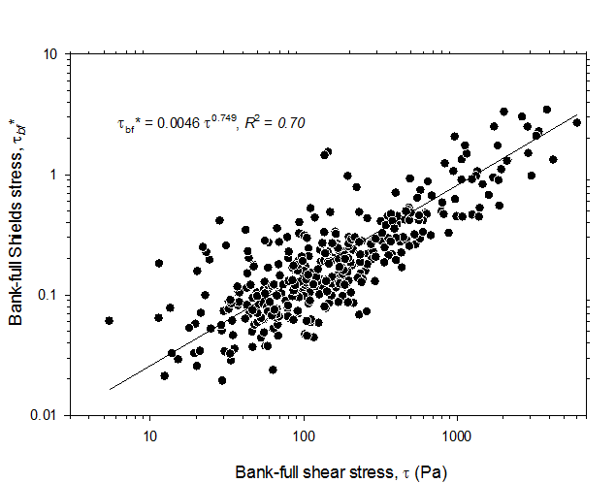
Historic climate
Regional hydrologic model
Field measurements
and
digital elevation model (DEM)
Historic mean annual flood (Q₂)
Morphologic predictions
h_{bf} , w_{bf} , S, D₅₀
Surface substrate size characterized by median grain size (D₅₀) and predicted by :
D₅₀ = (ρhS)^{1-n}/(ρ_{s}-ρ)kg^{n}
(Buffington et al. 2004)
where k and n are empirical constants relating bank-full Shields stress and total bank-full shear stress in southeast AK streams.
Notes:
Surface grain size was characterized by estimated median grain size (D₅₀) according to methods of Buffington et al. (2004) using empirical relationships between bank-full Shields stress (τ_{bf}*) and total bank-full shear stress (τ) (Figure ##). The relationship shown in Figure ## can be mathematically represented as:
τ_{bf}* = k(ρghS)^{n} = k τ^{n}
where ρ is water density (typically 1000 kg·m⁻³·s⁻¹), g is gravitational acceleration, h is bank-full depth, S is channel slope, and k and n are empirical values relating τ_{bf}* and τ for streams in southeastern Alaska. Following this relationship, reach-average median particle size (D₅₀) can be predicted from the following equation (Buffington et al. 2004):
D₅₀ = (ρhS)^{1-n}/(ρ_{s}-ρ)kg^{n}

Slide 18
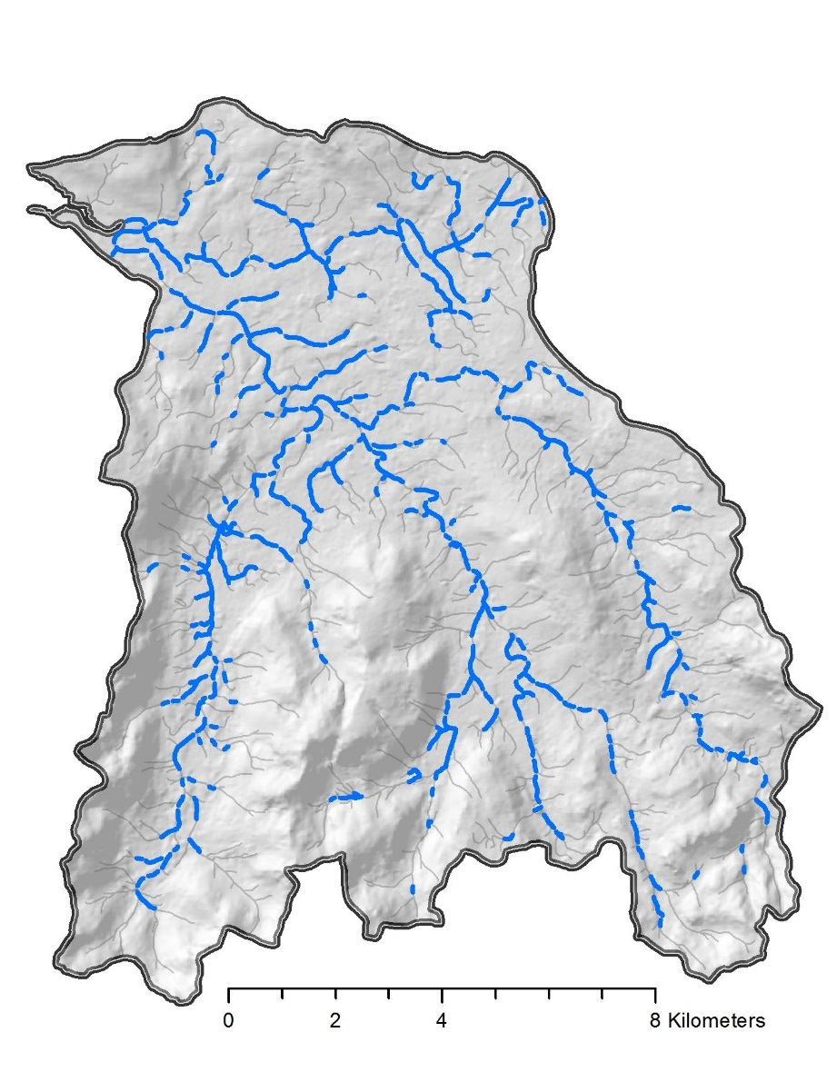
Historic climate
Regional hydrologic model
Spatially explicit prediction of median gravel size is used to assess the extent of reaches with suitable size gravel for salmon spawning
Field measurements
and
digital elevation model (DEM)
Historic mean annual flood (Q₂)
Morphologic predictions
h_{bf} , w_{bf} , S, D₅₀
D₅₀ range
7 – 50 mm
Notes:
Surface grain size was characterized by estimated median grain size (D₅₀) according to methods of Buffington et al. (2004) using empirical relationships between bank-full Shields stress (τ_{bf}*) and total bank-full shear stress (τ) (Figure ##). The relationship shown in Figure ## can be mathematically represented as:
τ_{bf}* = k(ρghS)^{n} = k τ^{n}
where ρ is water density (typically 1000 kg·m⁻³·s⁻¹), g is gravitational acceleration, h is bank-full depth, S is channel slope, and k and n are empirical values relating τ_{bf}* and τ for streams in southeastern Alaska. Following this relationship, reach-average median particle size (D₅₀) can be predicted from the following equation (Buffington et al. 2004):
D₅₀ = (ρhS)^{1-n}/(ρ_{s}-ρ)kg^{n}

Slide 19
Historic climate
Regional hydrologic model
Field measurements
and
digital elevation model (DEM)
Historic mean annual flood (Q₂)
Morphologic predictions
h_{bf} , w_{bf} , S, D₅₀
historic
morphology
Reach-averaged excess Shields stress
(τ*/ τ*_{c})
τ* = ρghS/(ρ_{s} – ρ)gD₅₀
τ*_{c} =0.15 S^{0.25} (Lamb et al. 2008)
Critical scour probability
Pscour(≥ 30 cm) = e^{(-30 (3.33e(-1.52 τ*/τ*c))}
(Haschenburger 1999; Goode et al. 2013)

Slide 20
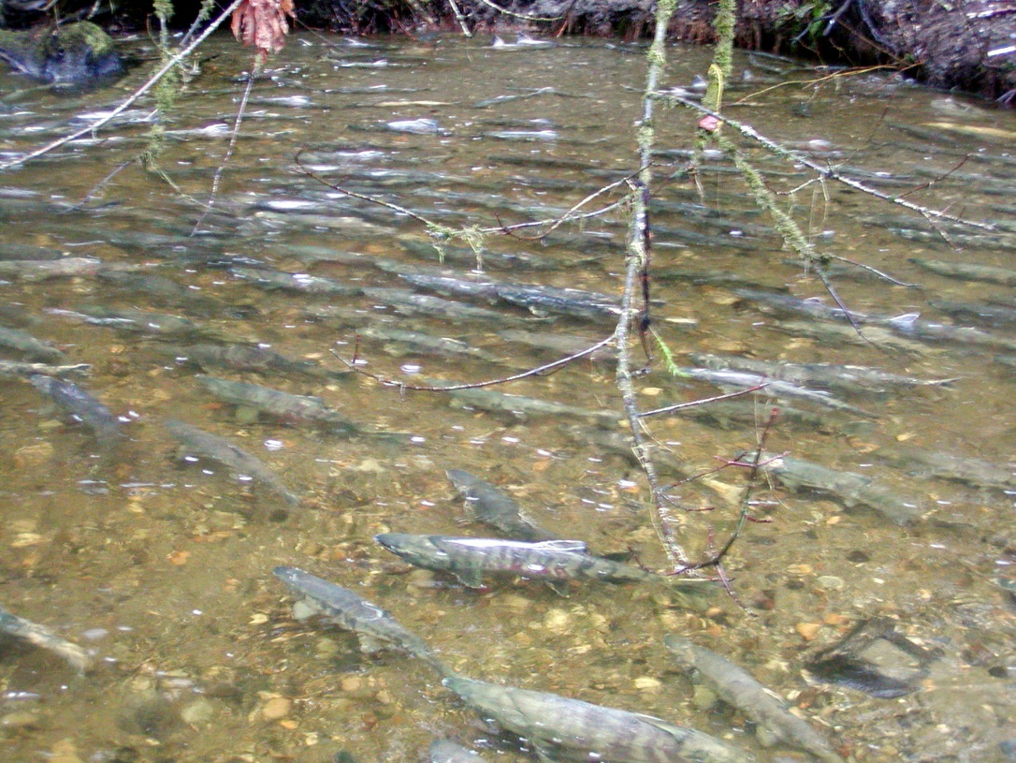
Historic climate
Regional hydrologic model
Field measurements
and
digital elevation model (DEM)
Historic mean annual flood (Q₂)
Morphologic predictions
h_{bf} , w_{bf} , S, D₅₀
historic
morphology
Reach-averaged excess Shields stress
(τ*/ τ*_{c})
Suitable spawning reaches
(D₅₀: 7 – 50 mm; h_{bf} ≥ 0.5 m; w_{bf} ≥ 2 m; Probability of scour mortality <0.50)
Critical scour probability

Slide 21
Historic climate
Future climate models
Regional hydrologic model
Notes:
Echam 5 A1B mid-range emissions scenario to project future climate data

Slide 22
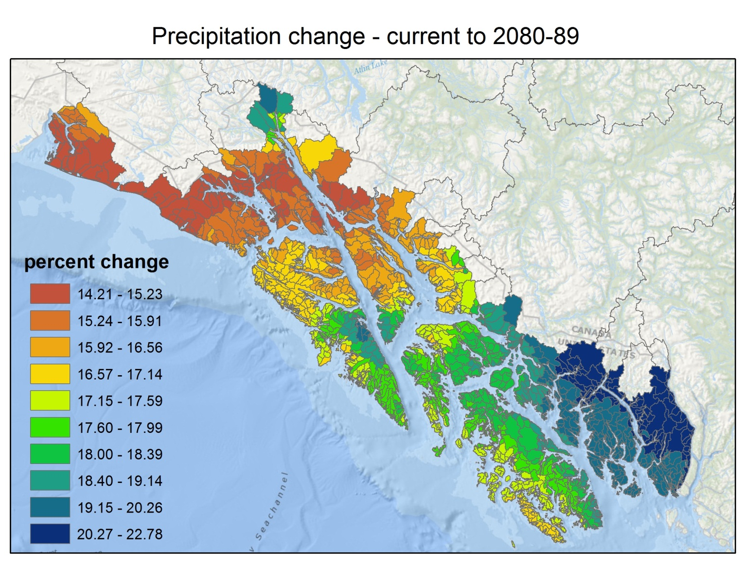
Notes:
The climate in southeast alaska is predicted to become warmer and wetter over the next century. These two factors are expected to significantly increase flooding in streams draining the Tongass National Forest.

Slide 23
Future climate models
Regional hydrologic model
Future mean annual flood (Q₂)
Future conditions were
considered at 2 time-steps:
2040 – 2049
2080 – 2089

Slide 24
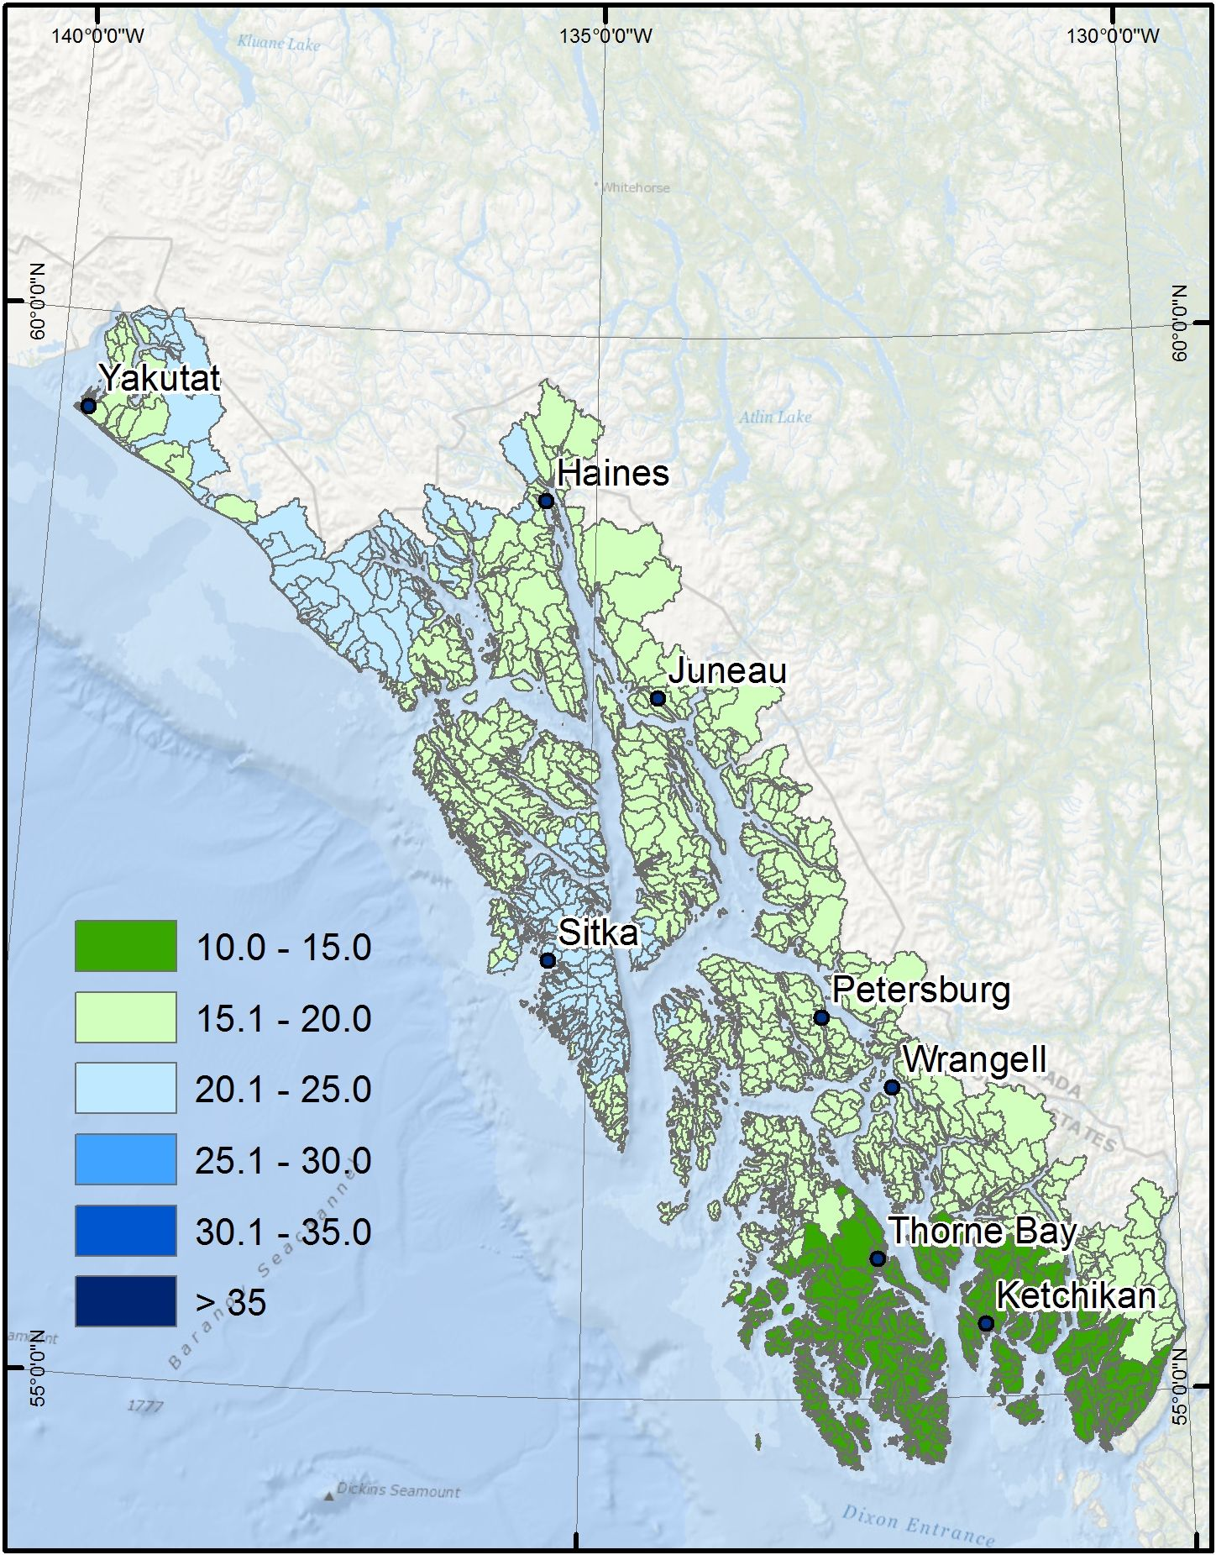
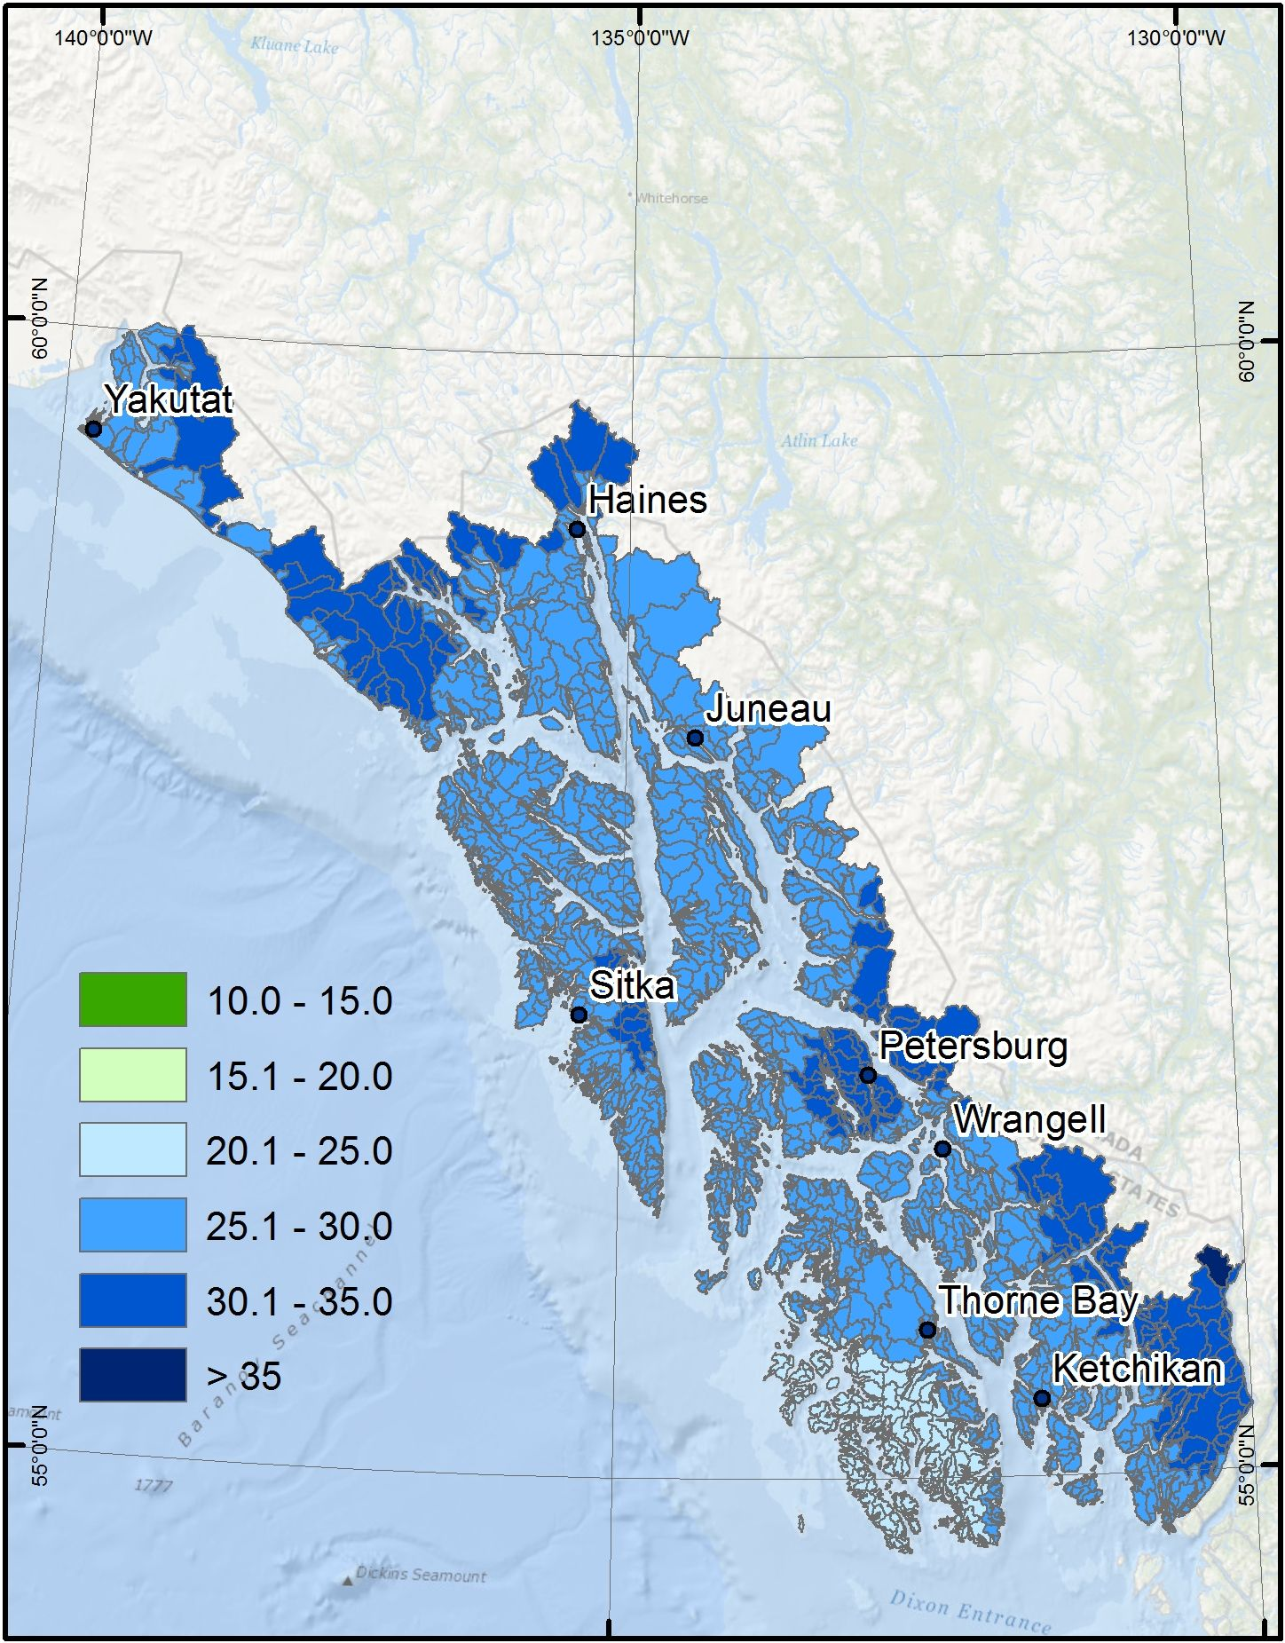
A warmer, wetter future for SE AK will produce larger mean annual floods (Q₂)
2040
2080
Percent increase
Percent increase

Slide 25
A warmer, wetter future for SE AK will produce larger mean annual floods
Predicted increase in southeast AK flood magnitude
Median: 18%
28%
Notes:
This figure shows the frequency distributions of the estimated percent increase in mean annual flood magnitude (Q2) for >2,000 watersheds in the Tongass National Forest in 2040 and 2080 relative to historical values. By 2040, there is a median predicted increase in mean annual flood magnitude of 18%, and by 2080, that increase is predicted to be 28%.

Slide 26
Future climate models
Regional hydrologic model
Field measurements
and
digital elevation model (DEM)
Future mean annual flood (Q₂)
Morphologic predictions
h_{bf} , w_{bf} , S, D₅₀
static morphology
Flow depth
h
Reach-averaged excess Shields stress
(τ*/ τ*_{c})
Confined
valley
Unconfined
valley
Suitable spawning reaches
(D₅₀: 7 – 50 mm; h_{bf} ≥ 0.5 m; w_{bf} ≥ 2 m; Probability of scour mortality <0.50)
Critical scour probability

Slide 27
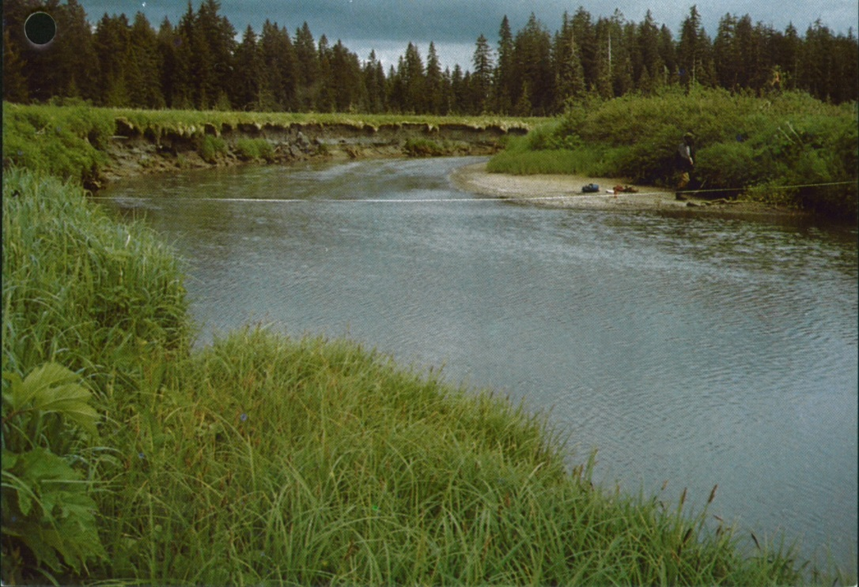
Static channel morphology
Unconfined channels
h_{new} ≈ h_{bf}
(McKean and Tonina 2013)
New h
Depth (h)
h_{bf}
Q₂
New Q₂
Flood magnitude (Q)

Slide 28
Static channel morphology
Confined channels
Q_{bf} = 3.732*w_{bf}*h_{new}*
√(g*h_{new}*S)*(h_{new}/D₅₀)^{0.2645}
(Parker et al. 2007)
New h
Depth (h)
h_{bf}
Q₂
New Q₂
Flood magnitude (Q)
Notes:
Predict new Qbf, hold wbf constant and solve for h new. In other words, the channel will have to accommodate the increase flow by getting deeper not wider.

Slide 29
Future climate models
Regional hydrologic model
Field measurements
and
digital elevation model (DEM)
Future mean annual flood (Q₂)
Morphologic predictions
h_{bf} , w_{bf} , S, D₅₀
static morphology
Flow depth
h
Reach-averaged excess Shields stress
(τ*/ τ*_{c})
Confined
valley
Unconfined
valley
Suitable spawning reaches
(D₅₀: 7 – 50 mm; h_{bf} ≥ 0.5 m; w_{bf} ≥ 2 m; Probability of scour mortality <0.50)
Critical scour probability

Slide 30
Future climate models
Regional hydrologic model
Field measurements
and
digital elevation model (DEM)
Future mean annual flood (Q₂)
Morphologic predictions
h_{bf} , w_{bf} , S, D₅₀
static morphology
dynamic adjustment
Flow depth
h
Reach-averaged excess Shields stress
(τ*/ τ*_{c})
Confined
valley
Unconfined
valley
Suitable spawning reaches
(D₅₀: 7 – 50 mm; h_{bf} ≥ 0.5 m; w_{bf} ≥ 2 m; Probability of scour mortality <0.50)
Critical scour probability

Slide 31
Mutual adjustment of stream channel
parameters to changing discharge
Slope does not change. Readjusting river valley slope involves moving large amounts of sediment over long reaches, and typically requires long geomorphic time (thousands of years or more).
Bank-full width and depth change. Rivers can readjust their bank-full depths and widths over relatively short geomorphic time (decades to centuries).
D₅₀ changes. Rivers can readjust surface grain size over short geomorphic time (years to decades).

Slide 32
Dynamic channel morphology
Unconfined channels
Depth (h)
h_{bf}
Q₂
Flood magnitude (Q)

Slide 33
Dynamic channel morphology
Unconfined channels
h_{new} = Q_{bf}^{2/5}/g^{1/5}
(Parker et al. 2007)
New h_{bf}
Depth (h)
New Q₂
Flood magnitude (Q)

Slide 34
Dynamic channel morphology
Confined channels
h_{bf}
Depth (h)
Q₂
Flood magnitude (Q)

Slide 35
Dynamic channel morphology
Confined channels
h_{new} = Q_{bf}^{2/5}/g^{1/5}
(Parker et al. 2007)
New h_{bf}
Depth (h)
New Q₂
Flood magnitude (Q)

Slide 36
Historic climate
Future climate models
Regional hydrologic model
Field measurements
and
digital elevation model (DEM)
Historic mean annual flood (Q₂)
Future mean annual flood (Q₂)
Morphologic predictions
h_{bf} , w_{bf} , S, D₅₀
static morphology
dynamic adjustment
historic
morphology
Flow depth
h
Reach-averaged excess Shields stress
(τ*/ τ*_{c})
Confined
valley
Unconfined
valley
Suitable spawning reaches
(D₅₀: 7 – 50 mm; h_{bf} ≥ 0.5 m; w_{bf} ≥ 2 m; Probability of scour mortality <0.50)
Critical scour probability

Slide 37
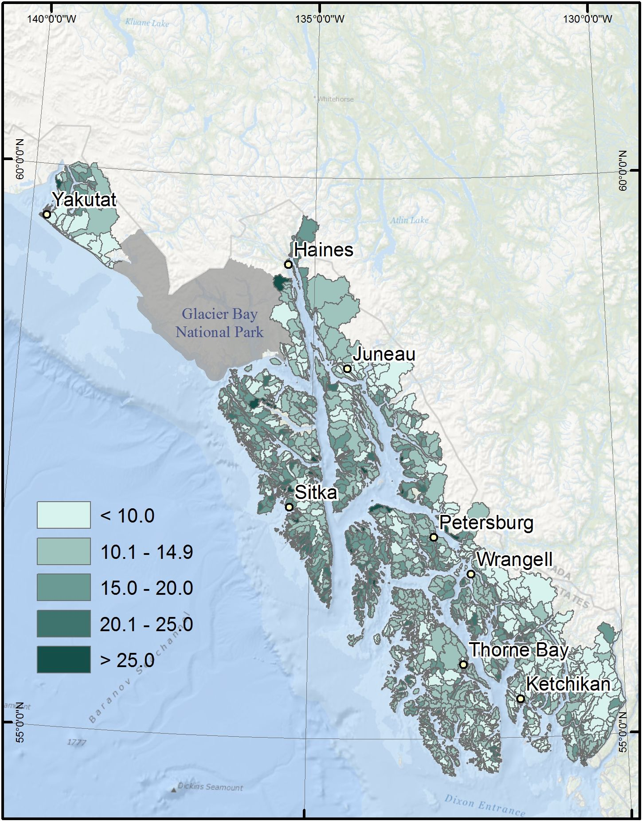
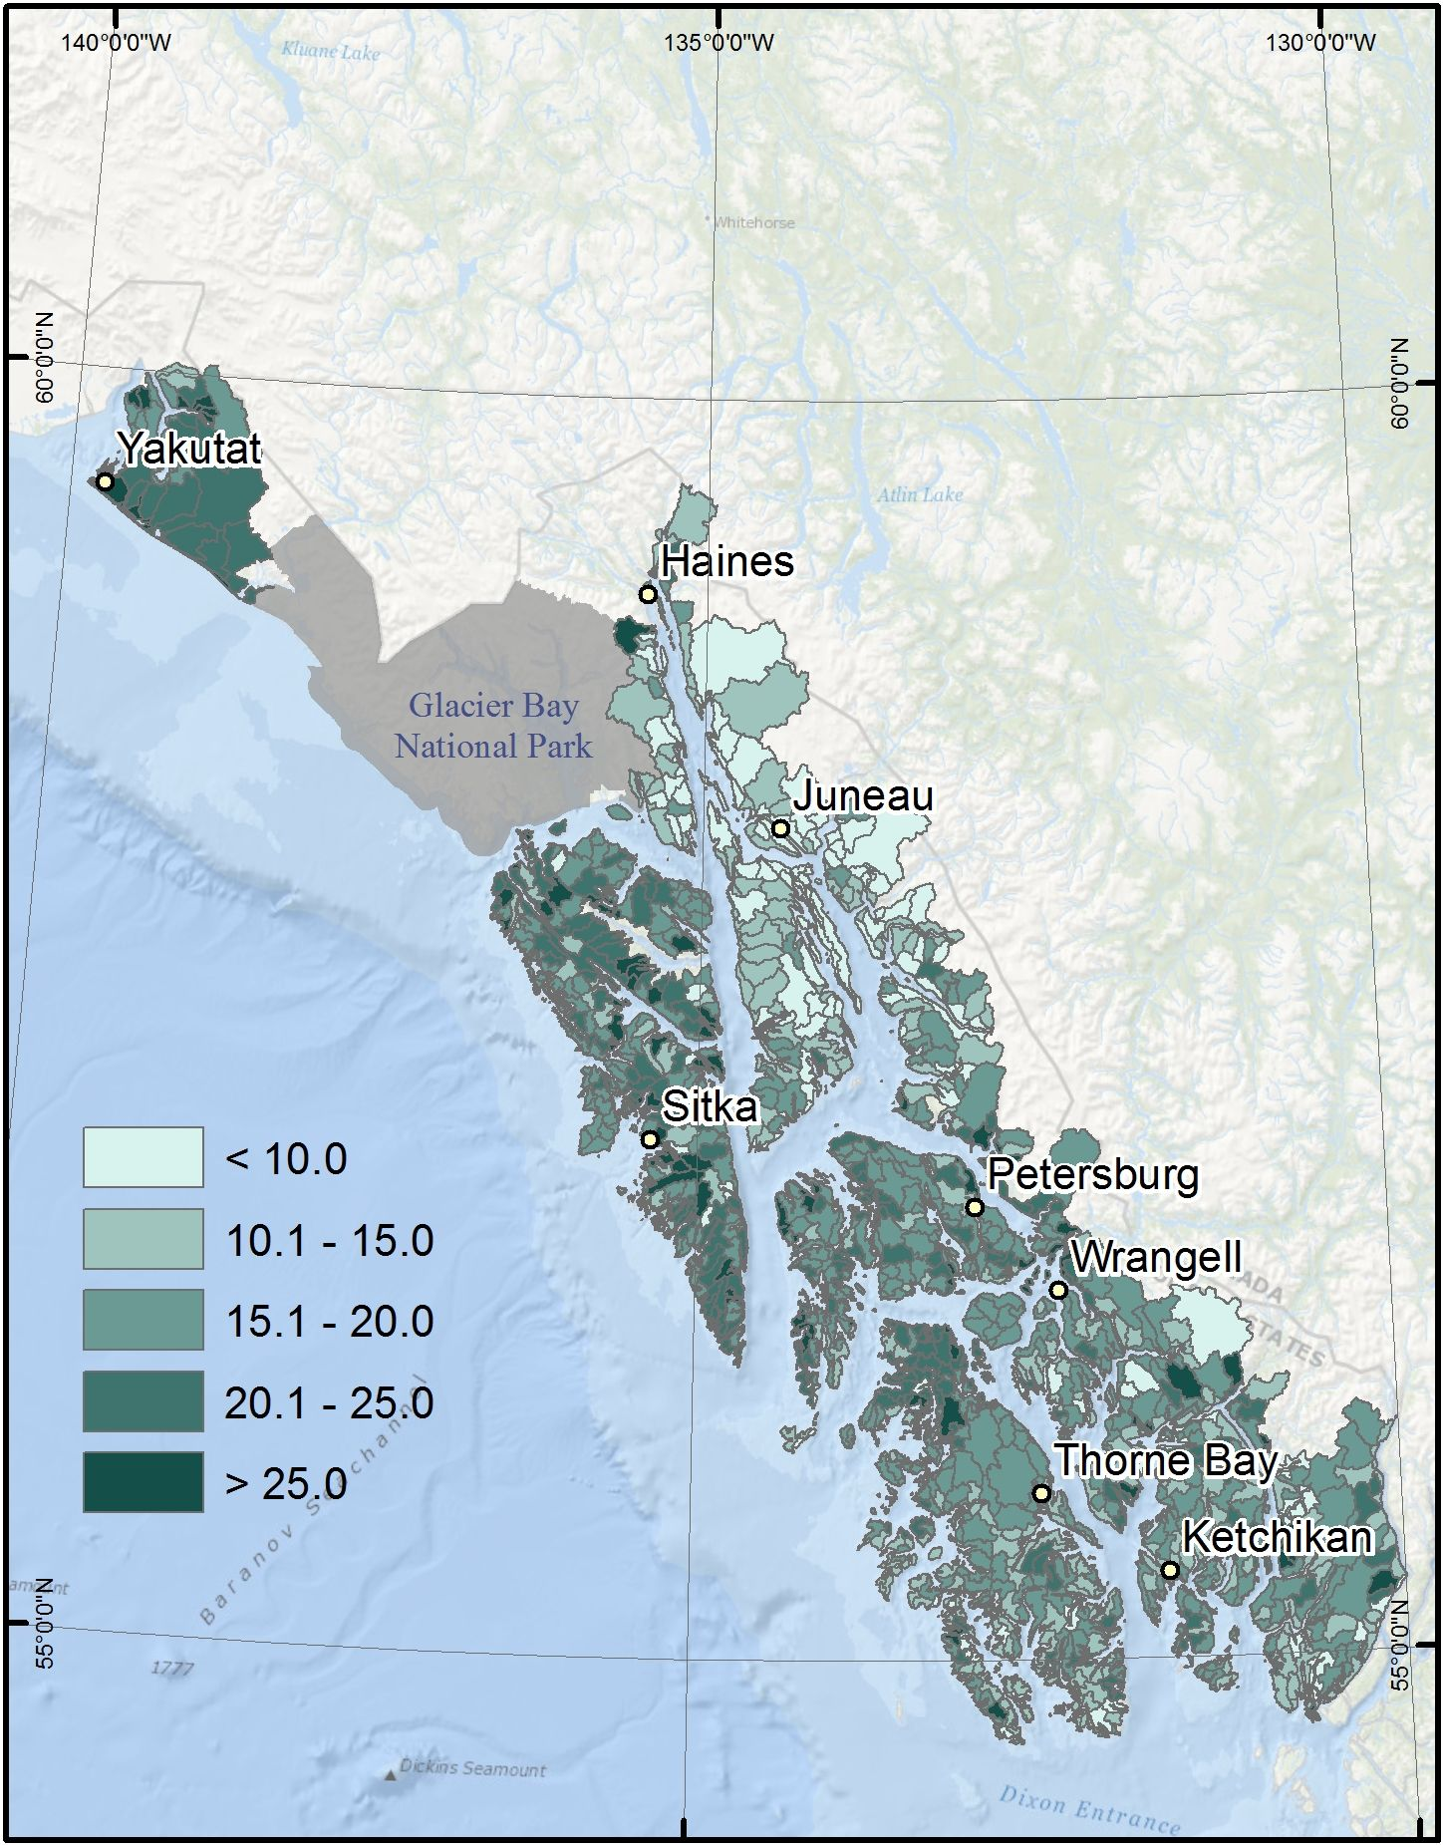
Spawning habitat response to
increased flood magnitude: 2040
2040 static morphology
2040 dynamic morphology
Percent change
Percent change

Slide 38
Spawning habitat response to
increased flood magnitude: 2040
Static median: 12%
Dynamic median: 17%
Loss is greater if
morphological adjustment
keeps pace with increased
flood magnitude
Notes:
Median change 2040 stat = 12%; 2040 dynamic = 17%

Slide 39
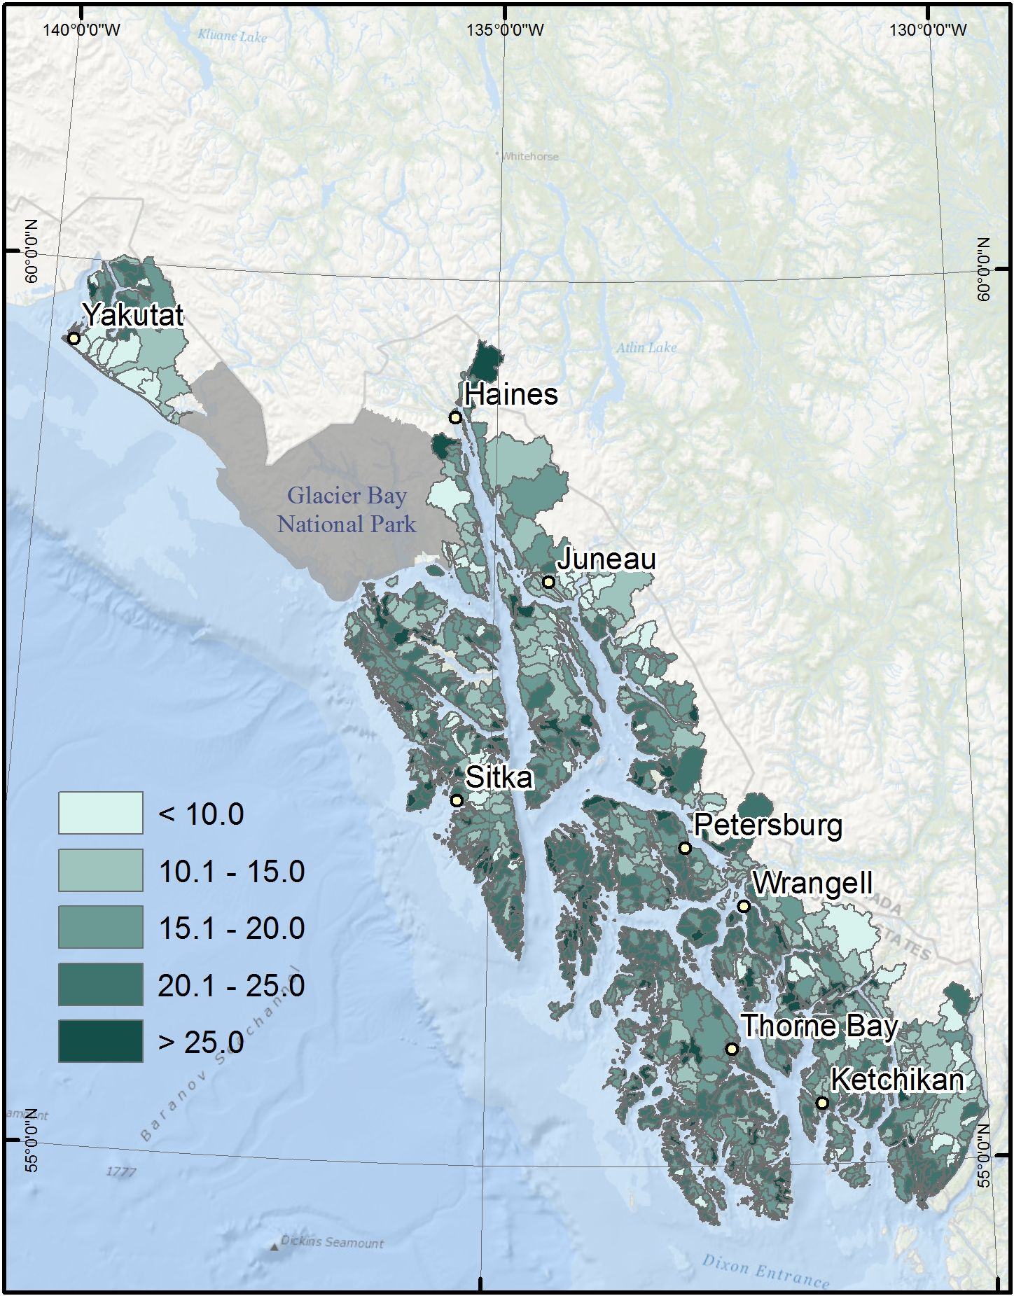
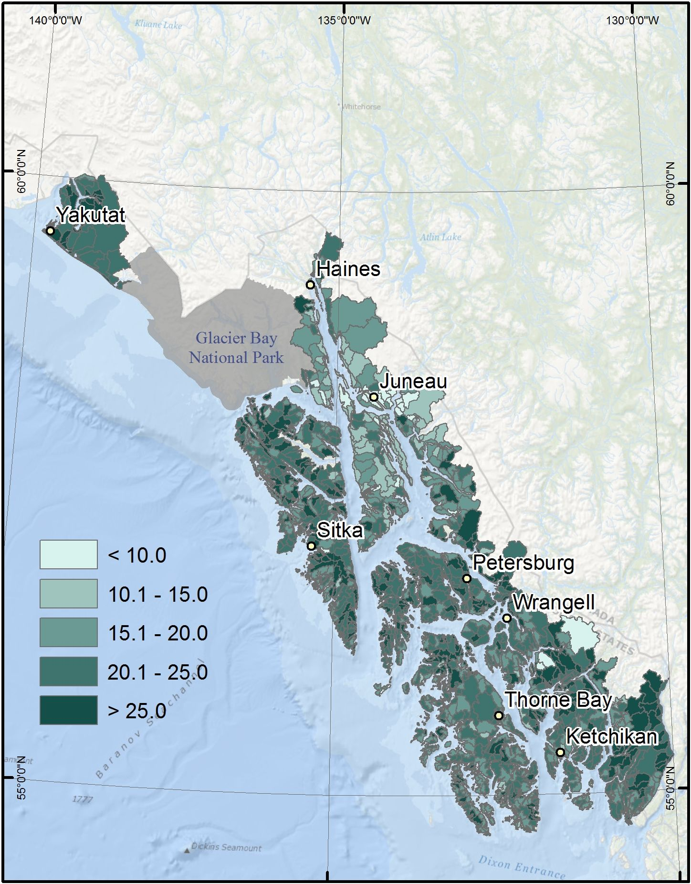
Spawning habitat response to
increased flood magnitude: 2080
2080 static morphology
2080 dynamic morphology
Percent change
Percent change

Slide 40
A warmer, wetter future for SE AK will produce larger mean annual floods
Static median: 18%
Dynamic median: 22%
Loss is greater if
morphological adjustment
keeps pace with increased
flood magnitude
Notes:
Median change 2080 stat = 18%; 2080 dynamic = 22%

Slide 41

Historic (1977- 2000)
D₅₀: 78 km
Scour > .50: 19 km
59 km
Probability of egg mortality from scour
< 50%
> 50%

Slide 42

2040 static
D₅₀: 78 km
Scour > .50: 26 km
52 km
Probability of egg mortality from scour
< 50%
> 50%

Slide 43

2080 static
D₅₀: 78 km
Scour > .50: 30 km
48 km
Probability of egg mortality from scour
< 50%
> 50%

Slide 44

2040 dynamic
D₅₀: 76 km
Scour > .50: 24 km
52 km
Probability of egg mortality from scour
< 50%
> 50%

Slide 45

2080 dynamic
D₅₀: 73 km
Scour > .50: 26 km
47 km
Probability of egg mortality from scour
< 50%
> 50%

Slide 46
This framework provides tools for:
Identifying watersheds, streams,
and reaches with high resilience to
impacts of climate change.
Monitoring trends in salmon
spawning habitat.
Prioritizing areas for habitat
improvement (e.g., lwd placement,
flood plain connectivity).
Guiding more detailed watershed
assessments and salmon population
models.
Probability of egg mortality from scour
< 50%
> 50%

Slide 47
Conclusions:
Mean annual flood magnitudes may increase ~ 28% by 2080 (high spatial variability).

Slide 48
Conclusions:
Mean annual flood magnitudes may increase ~ 28% by 2080 (high spatial variability).
Larger floods will potentially reduce salmon spawning habitat by ~ 18 – 22%, but there is high spatial variability due to geomorphic context.

Slide 49
Conclusions:
Mean annual flood magnitudes may increase ~ 28% by 2080 (high spatial variability).
Larger floods will potentially reduce salmon spawning habitat by ~ 18 – 22%, but there is high spatial variability due to geomorphic context.
The spatially-explicit framework we describe provides tools that can help managers reduce or avoid habitat loss through climate adaptation strategies.

Slide 50
Conclusions:
Mean annual flood magnitudes may increase ~ 28% by 2080 (high spatial variability).
Larger floods will potentially reduce salmon spawning habitat by ~ 18 – 22%, but there is high spatial variability due to geomorphic context.
The spatially-explicit framework we describe provides tools that can help managers reduce or avoid habitat loss through climate adaptation strategies.
Salmon population responses to changes in spawning habitat will vary among the species considered (e.g., differences in phenology, spatial distribution, life history).

Slide 51
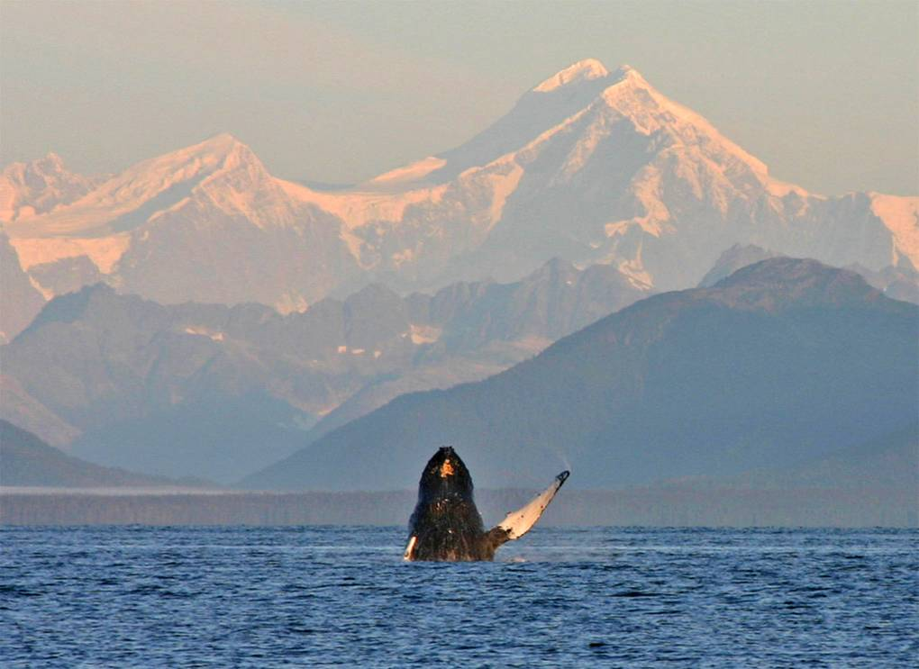
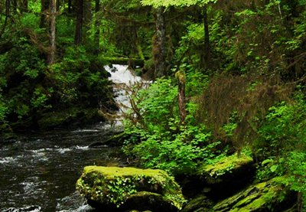
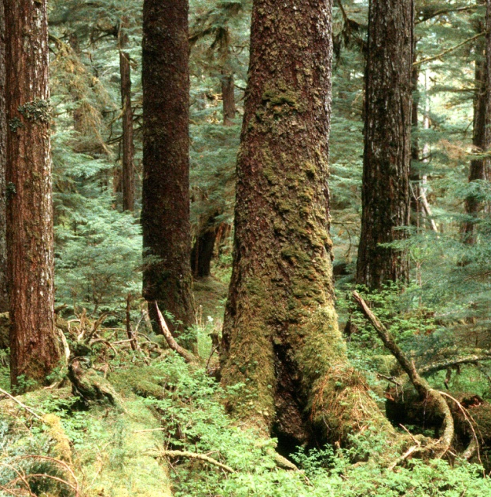
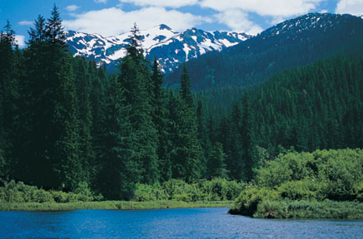

Slide 53
Pool-riffle
Plane-bed
Step-pool

Slide 55
Historic climate
Future climate models
Climate
Regional hydrologic model
Field measurements
and
digital elevation model (DEM)
Historic mean annual flood (Q₂)
Future mean annual flood (Q₂)
Hydrology
Morphologic predictions
h_{bf} , w_{bf} , S, D₅₀
static morphology
Geomorphology
dynamic adjustment
historic
morphology
Flow depth
h
Reach-averaged excess Shields stress
(τ*/ τ*_{c})
Habitat
Confined
valley
Unconfined
valley
Suitable spawning reaches
(D₅₀: 7 – 50 mm; h_{bf} ≥ 0.5 m; w_{bf} ≥ 2 m; Probability of scour mortality <0.50)
Critical scour probability

Slide 56
River bankfull discharge is a key parameter for estimating channel geometry. A knowledge of bankfull discharge is necessary for the evaluation and implementation of many river restoration projects.
The best way to measure bankfull discharge is from a stage-discharge relation. Bankfull discharge is often estimated in terms of a flood of a given recurrence frequency (e.g. 2-year flood, or a flood with a peak flow that has a 50% probability of occurring in a given year; Williams, 1978).
In some cases, however, the information necessary to estimate bankfull discharge from a stage-discharge relation or from flood hydrology may not be available.

