Slide 1
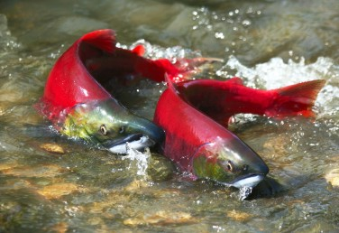
Salmonidae Geographica: How Can You Protect Salmon
If You Don’t Know Where They Are?
A Potential Crowdfunding Solution

Slide 2
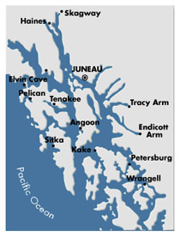
Project Pilot Area, approximately 1,000 km² with
1 m LiDAR digital elevation model (DEM)
We can map salmon habitats using digital elevation models (DEMs) by identifying
channel gradient thresholds and by applying salmon models. The extent and accuracy
of predicting salmon habitats are strongly influenced by the resolution of DEMs. Here we examine the ability of four DEM resolutions: in southeast Alaska (20m, IfSAR
5m and 1m LiDAR) and in British Columbia (17m). We compare those salmon maps to
salmon extent in existing cartographic map products including SEAK-Hydro, ADF&G
Anadromous Waters Catalog and B.C. Provincial stream layer.

Slide 3
We can start with available maps that show where salmon habitats are located
U.S.F.S – Tongass NF
Note the use of densities (km km⁻²) that allow us
to compare stream networks and salmon stream
length across the different data products

Slide 4
Next, we can
derive entire
river networks
and salmon habitats
using the highest
resolution DEMs
available in
Southeast Alaska and B.C.

Slide 5
Southeast Alaska also has newly available 5m DEMs called
IfSAR provided by the U.S.G.S., because LiDAR DEMs are
considered too expensive and unaffordable in Alaska;
However, in southeast Alaska, the new IfSAR 5 m, that is
a surface radar product (as compared to laser altimetry [LiDAR]
that uses lasers to “see” under forest canopy), cannot be used
to derive accurate stream networks and salmon habitats (DEM
is too noisy because of variable vegetation heights); the IfSAR
product might be better in northern regions where there is less
vegetation.
The IfSAR 5m DEM is effected by
variation in vegetation heights

Slide 6
LiDAR (1m DEM) is the gold
standard and can “see” under
vegetation (using the latest
sensors) as viewed in
this shaded relief imagery.
All channels can be seen
and thus accurate river
networks can be derived from
the LiDAR DEM (from headwaters
to mainstems, and valley side
channels).
Imagery is from the pilot analysis
area in northern Chichigof Island,
southeast Alaska (Hoonah
Community Forest Project).
North Chichigof Island
Southeast Alaska

Slide 7
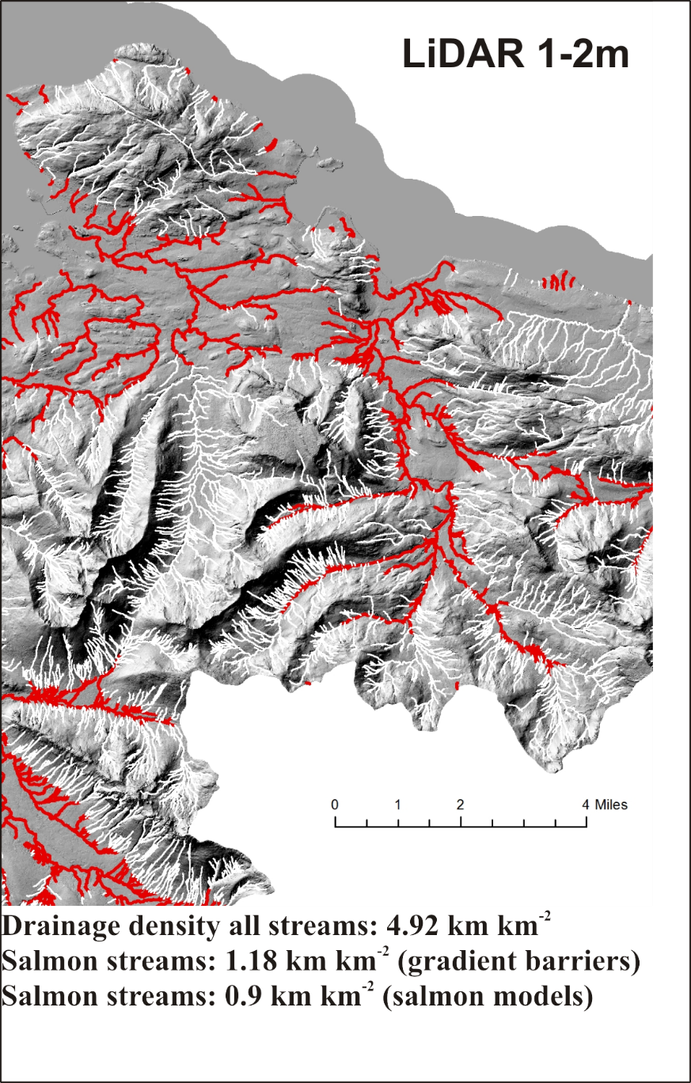
Salmon streams
This image shows how the various DEM resolutions support, or not, the delineation of stream and river networks
and salmon habitats. Note the differences in the densities of all streams and salmon streams; LiDAR produces
the best river networks with the highest densities, including for potential salmon streams.

Slide 8
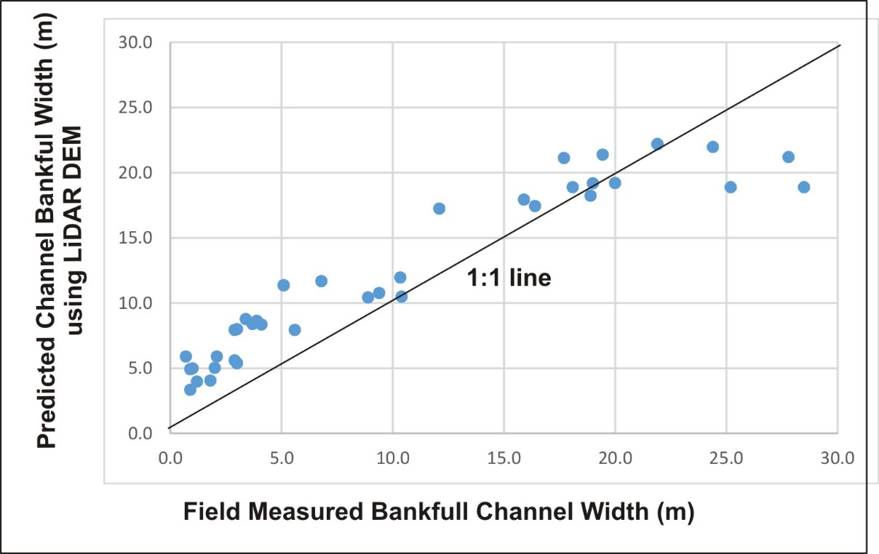
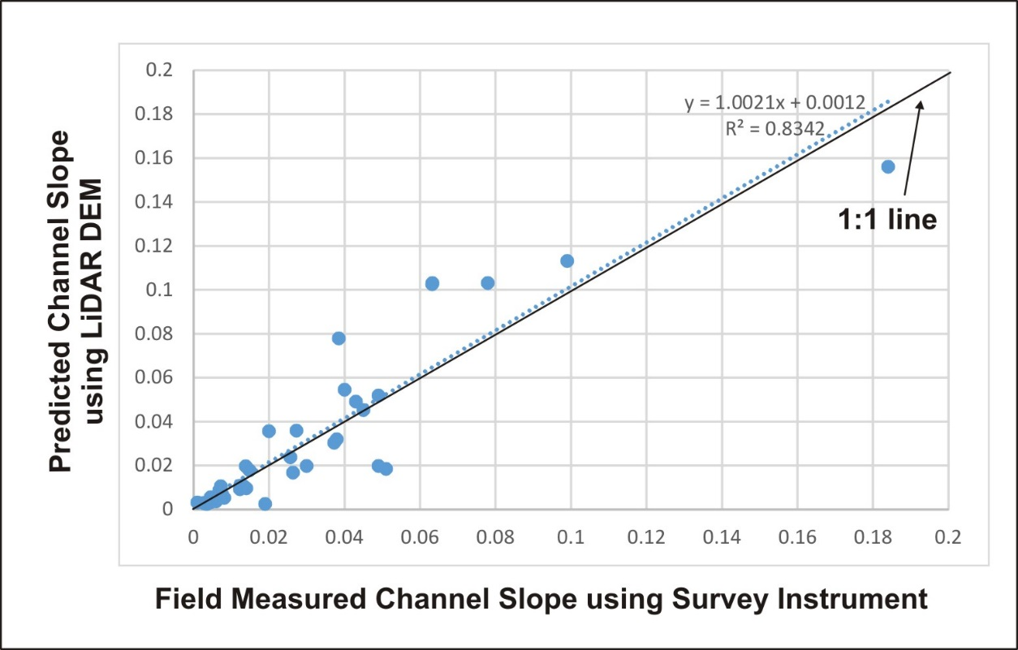
How Accurate is LiDAR for Predicting Channel Attributes Relevant to Gradient Barriers
and Salmon Habitat Modeling?
Field data were collected in the Hoonah study area (at 43 sites) including channel gradient (using a survey equipment), channel bankfull width, bankfull depth and floodplain width.
Bankfull channel width is an important component of
salmon habitat models and it is used in calculating
channel confinement, as floodplain width divided
by channel width. Channel width is predicted using
a regression equation based on 1,000 data points
across SE AK. The model preformed very well.
Channel gradient, the principle variable in predicting salmon gradient barriers and in salmon intrinsic habitat potential
modeling, was very accurately predicted using LiDAR.

Slide 9
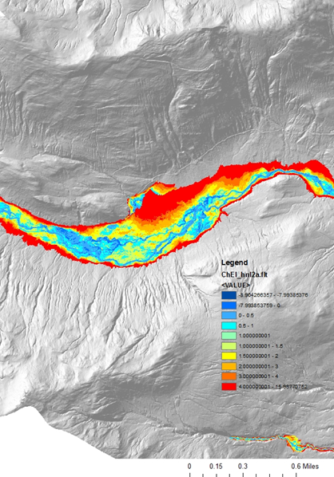
How Accurate is LiDAR for Predicting Channel Attributes Relevant to Gradient Barriers
and Salmon Habitat Modeling?
Field data were collected in the Hoonah study area (at 43 sites) including channel gradient (using a survey station), channel
bankfull width, bankfull depth and floodplain width.
LiDAR
LiDAR
Mapping valley floor elevations and floodplains
using LiDAR is highly accurate, thus predictions of channel confinement (valley width/channel width) in the salmon models is also considered accurate.

Slide 10
Compare the ADF&G AWC salmon extent with that predicted using the LIDAR DEM: AWC has 400% fewer
potential salmon streams (based on length)
Salmon streams

Slide 11
Compare the SEAK-hydro (Tongass NF) salmon extent with that predicted using the LIDAR DEM: SEAK has about 200% fewer
potential salmon streams (based on length)
Salmon streams

Slide 12
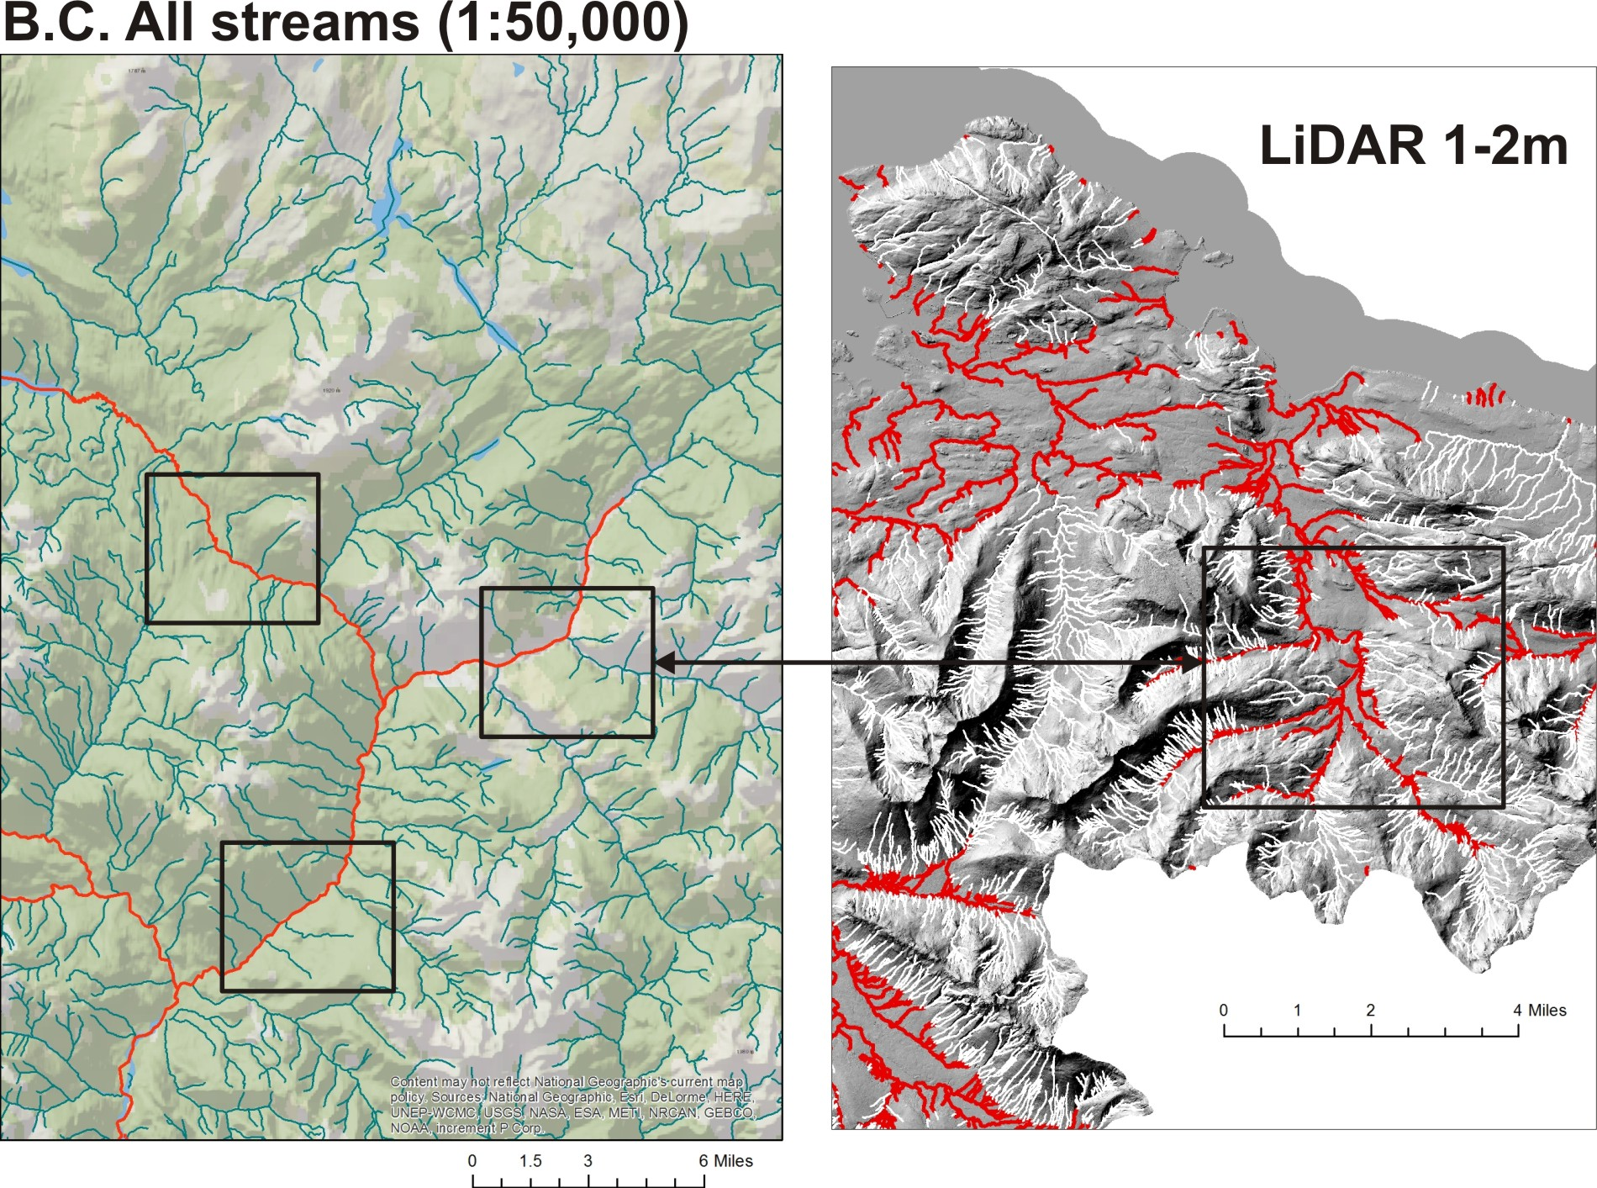
Let’s check out what is
available in B. C. coastal
watersheds.
Note that the boxes in the
two images are of the
same scale; the streams
in the box on the right
indicates how many
streams are missing
in the B.C. trans-boundary
area; the B.C. streams
(Provincial hydrography)
have about 350% less
stream length compared
to the LiDAR).
Drainage density all streams: 1.37 km km⁻²
Drainage density all streams: 4.92 km km⁻² Fish streams: 1.18 km km⁻²

Slide 13
Note that the B.C. fish streams
(includes salmon)
on the left has a density
of 0.22 km km⁻², compared
to the potential salmon
stream density using
LiDAR (1.18 km km⁻²); this strongly suggests that
salmon streams in B.C.
might be underestimated
(in length) by as much as
500%!

Slide 14
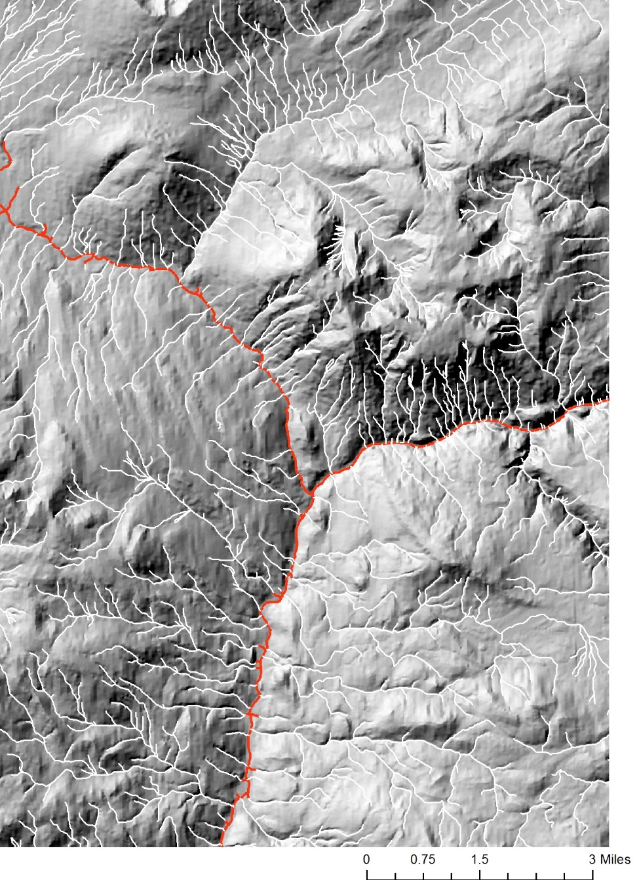
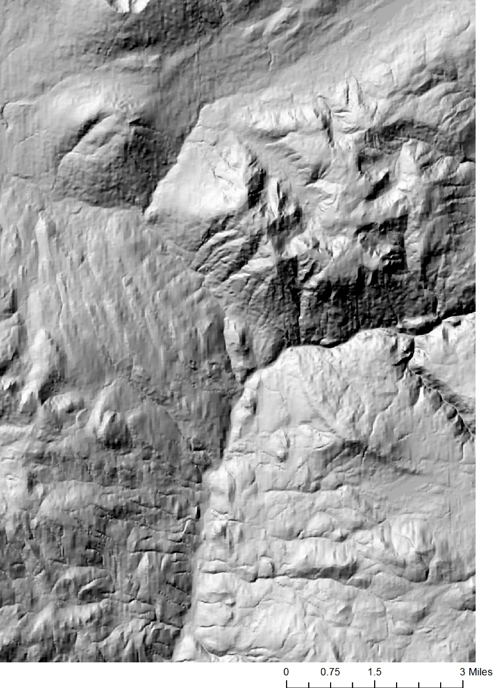
Can we delineates more complete stream networks and salmon habitat in B.C. using the available 17m DEM
across the coastal watersheds?
B.C. 17 m DEM
(low resolution)
Derived stream
network and
salmon streams
using the B.C.
17m DEM
Salmon streams
Drainage density all streams: 2.85 km km⁻²
Fish streams: 0.29 km km⁻²

Slide 15
Compare the derived stream network using B.C. 17m DEM with streams using a 1-2m LiDAR DEM
Salmon streams
Drainage density all streams: 2.85 km km⁻²
Fish streams: 0.29 km km⁻²

Slide 16
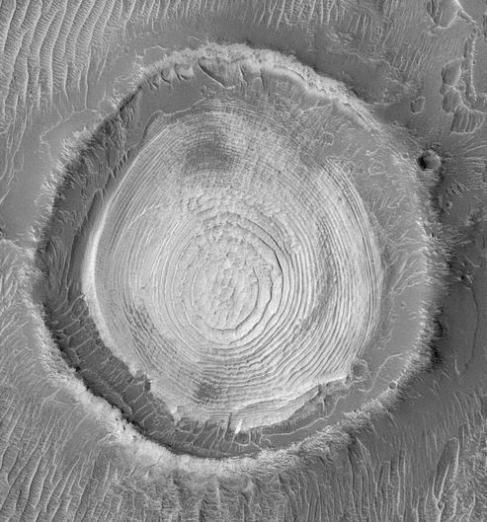
Why does Mars have better digital elevation models and maps than the U.S.–Canadian Trans Boundary Region?
Best in B.C. Trans-Boundary:
18m (surface radar product)
Mars
Best in SE AK: IfSAR 5m
(surface radar product)
Remember the “Schiaparelli Crater”
in “The Martian”

Slide 17
Answer: Because the U.S. and Canadian Governments consider LiDAR in remote areas like
Alaska and northern British Columbia too expensive and thus unaffordable.
Best in B.C. Trans-Boundary:
18m (surface radar product)
Mars
Best in SE AK: IfSAR 5m
(surface radar product)
Remember the “Schiaparelli Crater”
in “The Martian”

Slide 18
Data Analysis: Contrast the abundance of all streams and salmon streams only across existing data products and DEMs
Abundance of all streams by density (km km⁻²)
Salmon stream abundance by density (km km⁻²)
*
*
Salmon gradient barriers
Salmon models
*
*
x
*
x
x
*
*
x
x
*
na
1
2
1
2
*
Stream networks derived from DEMs
Cartographic stream layers (existing map products)
Potential salmon streams, predicted using synthetic river networks derived from DEMs and by gradient barriers and models
*
x
Histograms showing the relative differences in
mapped streams (all) and salmon habitats only.
B.C. = British Columbia (Stikine, Taku, & Unuk Rivers) B.C.¹ = B.C. 1:50,000 Provincial stream layer B.C.² = Streams derived from B.C. 18m DEM

Slide 19
Table 1. Comparison (numeric differences) of existing and modeled streams and salmon habitats (based on existing
data products and DEMs) with LiDAR (1-2m) derived streams and salmon habitats using gradient barriers and salmon
habitat modeling.
Locations and Data Layers | All streams (km km⁻²) | All streams difference from LiDAR (km km⁻²) | Salmon Streams-gradient barrier | Salmon streams barrier difference from LiDAR (km km⁻²) | Salmon stream modeling | Salmon stream modeling difference from LiDAR (km km⁻²)
Southeast Alaska
ADF&G AWC | -- | -- | 0.26 (field valid) | 0.92 | -- | 0.64
USFS 20m | 1.5 | 3.4 | 0.35 | 0.83 | 0.3 | 0.6
SEAK-Hydro | 1.4 | 3.5 | 0.44 | 0.74 | --
IfSAR 5 m | 2.6 | 2.3 | 0.35 | 0.83 | .26 | 0.64
LiDAR | 4.9 | -- | 1.18 | -- | 0.9 | --
B.C.
Provincial Stream Layer | 1.4 | 3.5 | 0.2 (attribute in fish layer) | 5.4 | -- | --
17m BC DEM | 2.85 | 1.7 | 0.3 | 3.9 | 0.11 | 0.79

Slide 20
Table 2. Comparison (percent differences) of existing and modeled streams and salmon habitats (based on existing data
products and DEMs) with LiDAR (1-2m) derived streams and salmon habitats using gradient barriers and salmon habitat
modeling.
Locations and Data Layers | All streams (km km-2) | Difference percent from LiDAR (km km⁻²) | Salmon Streams-gradient barrier | Salmon barrier difference percent from LiDAR (km km⁻²) | Salmon, modeling | Salmon modeling difference percent from LiDAR (km km⁻²)
Southeast Alaska
ADF&G AWC | -- | -- | 0.26 (field valid) | -450% | -- | -350%
USFS 20m | 1.5 | -340% | 0.35 | -340% | 0.3 | -300%
SEAK-Hydro | 1.4 | -350% | 0.44 | -270% | --
IfSAR 5 m | 2.6 | -230% | 0.35 | -330% | .26 | -350%
LiDAR | 4.9 | -- | 1.18 | -- | 0.9 | --
B.C.
Provincial Stream Layer | 1.4 | -350% | 0.2 (attribute in fish layer) | -540% | -- | --
17m BC DEM | 2.85 | -170% | 0.3 | -390% | 0.11 | -800%

Slide 21
Table 3. Estimated missing stream length from current map products and from models using existing DEMs across
southeast Alaska (77,000 km², 30,000 mi²) and in coastal B.C. watersheds (100,000 km², 39,000 mi²), and
combined (177,000 km², 68,000 mi²).
Location | All Streams – Current maps/data products | All Streams – Modeled Existing DEMs (not done) | Salmon Streams – Current data products | Salmon Streams – Modeled using Existing DEMs (not done)
Southeast Alaska | 270,000 km (165,000 miles) | 177,000 km (110,000 miles) | 57,000 km (35,000 miles) | 49,000 km (30,000 miles)
B. C. | 350,000 km (217,000 miles) | 170,000 km (106,000 miles) | 98,000 km (61,000 miles) | 79,000 km (49,000 miles)
Entire US-Canada Trans-Boundary | 620,000 km (384,000 miles) | 347,000 km (215,000 miles) | 155,000 km (96,000 miles) | 128,000 km (79,000 miles)
Using the entire values, some perspective | 1.6 x the distance to the moon | almost to the moon | stretch around the earth 4 times | stretch around the earth 3 times
Of course there is
uncertainty around
these estimates.
But one thing is for
sure: there is a very
large length of
stream channels overall,
and salmon habitats
specifically, that
are not identified
on existing maps or that
can be derived from
existing DEMs

Slide 22
In the trans-boundary region, the predicted length of all missing streams could
be as high as 300,000 miles (distance to the moon is 240,000 miles).
The predicted length of missing salmon streams could be as high as 100,000
miles (about 4 times around the world).

Slide 23
Implications
How can federal, state and provincial agencies evaluate potential environmental impacts associated
with timber harvest, road building, hydro-development and mining, if they don’t even know
the accurate locations and abundances of salmon habitats, or river networks in general.
The majority of salmon streams remain undetected, unmapped and thus unprotected in much of
the Trans-Boundary area.
This represents the most basic limitation on science, resource management and conservation.
The delineation of complete river networks and accurate salmon habitat identification will not
be achieved in the U.S.-Trans Boundary region until LiDAR DEMs become available.

Slide 24
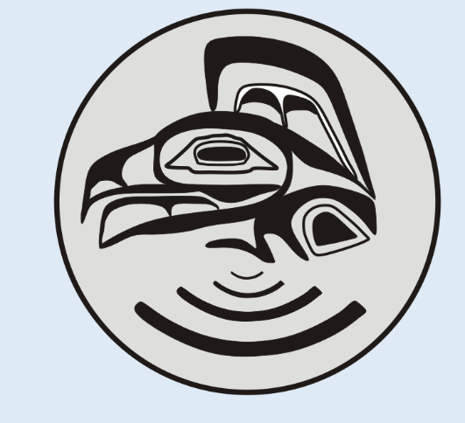
TerrainWorks is launching a crowdfunding campaign to raise 5 million dollars to acquire LiDAR DEMs and to create as complete-as-possible river networks
and to identify all potential salmon habitats across the 80,000 mi² southeast Alaska and coastal B.C. Trans-Boundary landscape. Launch date is June 1, 2016.
The LiDAR topographic database will be utilized by, and underpin, research, resource management and conservation by all stakeholders for many decades. Its uses will be extensive.
Add data products will be freely accessible and housed at the GIS Library at University of Alaska, Juneau.

Slide 25
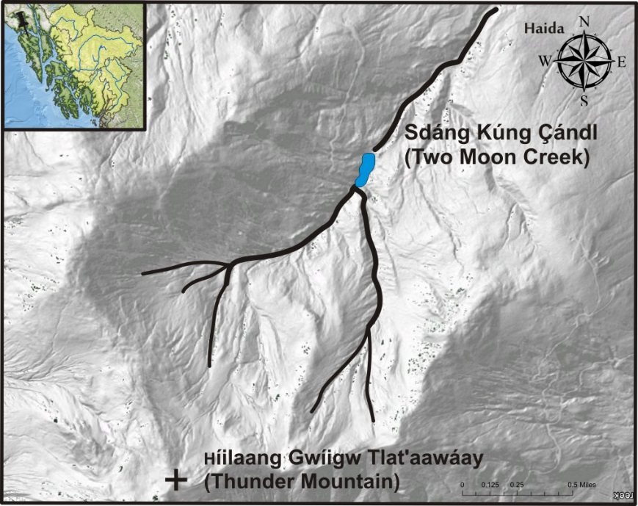
Successful crowdfunding requires supporters to receive rewards.
One unique reward is that supporters would nominate names for the newly discovered and
mapped streams (and possibly other currently unnamed geographic features) in the languages
of the Native Peoples in SE AK and B.C (Eyak, Haida, Tlingit, Tsimshian, Nisqaa, Gitsan,
Tahltan and Tagish).
Place names will be viewable in the online Map Atlas “Salmonidae Geographica” that will
also house all of the open source LiDAR products, complete river networks, salmon habitats
and other key topographic featues (floodplains etc.) at the University of Alaska, Southeast
GIS Library (freely available to all).

Slide 26
A journal paper is currently in development that described the analysis, results and interpretations. It
will be submitted to Plos One in May 2016.
The Challenge of Mapping Complete River Networks and Potential Salmon Habitats in Southeast Alaska and in
Adjoining Canadian Trans-Boundary Watersheds. Benda et al. in prep.
Abstract The Southeast Alaska region, inclusive of the Alexander Archipelago and the large rivers that extend into British Columbia (Stikine, Taku and Unuk watersheds), constitutes one of the last environmental strongholds of five species of wild Pacific Salmon. To manage resource development and to protect salmon in this trans-boundary region, federal, state and provincial agencies need to know the locations and abundance of salmon habitats accurately. We investigated the feasibility of identifying and mapping complete stream networks, including locations and abundance of salmon habitats in southeast Alaska and northern British Columbia (180,000 km²). We delineated complete river networks using a range of digital elevation models (DEMs) including 1m LiDAR available in a 1,000 km² pilot area in southeast Alaska, the newly available 5m IfSAR DEM across southeast Alaska and a 17m DEM available in British Columbia. We applied thresholds of channel steepness, including waterfalls, and salmon habitat models to identify potential salmon habitats in the virtual watersheds. The predicted density (km km⁻²) of all streams, and of potential salmon streams, were compared to those within existing map products including the Alaska Department of Fish and Game Anadromous Salmon stream catalogue, the U.S. Forest Service’s (Tongass National Forest) 1:100,000 stream layer, and British Columbia’s 1:50,000 hydrography, including its mapped salmon streams. In the U.S., the predicted LiDAR-derived salmon stream extent is 400% greater than the State of Alaska’s salmon stream catalogue, 200% greater than the Tongass National Forest salmon distribution, and 350% greater than the derived salmon streams using the newly available IfSAR 5m river networks. In B.C., we infer that LiDAR derived stream networks, and salmon streams specifically, would be respectively 350% and 550% greater in length compared to what is contained within existing B.C. map products. In addition, predicted salmon streams that are delineated using B.C.’s 20m DEM would be 400% less than LiDAR derived salmon stream extent. Based on this analysis we estimate that as much as 400,000 km of all streams, and 100,000 km of salmon streams, remain unidentified and unmapped across the north Pacific trans-boundary ecosystem. How can salmon habitats be protected, including within watersheds exposed to proposed timber harvest, road building, hydro-development and mining projects if agencies do not know the locations of the majority of salmon habitats? We conclude that delineation of complete river networks and accurate salmon habitat identification will not be achieved in the U.S. – Canadian trans-boundary region until LiDAR DEMs become available.

Slide 27
A Crowdfunding campaign is a solution to acquire LiDAR across the U.S. – Canada Trans Boundary
ecosystem; refer to the crowdfunding poster for additional information.
For additional information, contact Dr. Lee Benda @ TerrainWorks
leebenda@terrainworks.com
530 926-1066

